Slide 1
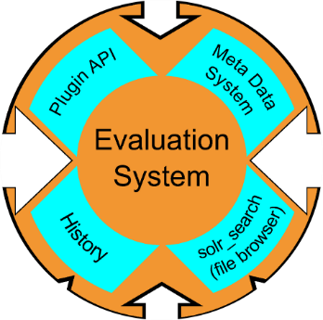
+
- Freie Univ Evaluation System Framework for
Scientific Infrastructures in Earth System Modeling
www-miklip.dkrz.de | freva.met.fu-berlin.de
∑
Usability & Flexibility
Plugin
Data Access
Transparency & Reproducibility
Christopher Kadow, S. Illing,
O. Kunst, T. Schartner, I. Kirchner, H.W. Rust, U. Cubasch, U. Ulbrich

Slide 2
+
- Freie Univ Evaluation System Framework for
Scientific Infrastructures in Earth System Modeling
www-miklip.dkrz.de | freva.met.fu-berlin.de
∑
HPC running at “German Climate Computing Centre“ with access to ESGF
around 5 million datasets
Usability & Flexibility
NEW
Feature
Shell
and
Web
Plugin
Data Access
ssh USER@miklip.dkrz.de
module load miklip-ces
freva --plugin
freva --history
freva --databrowser
www-miklip.dkrz.de
Plugins
History
Data-Browser
Transparency & Reproducibility
Christopher Kadow, S. Illing,
O. Kunst, T. Schartner, I. Kirchner, H.W. Rust, U. Cubasch, U. Ulbrich

Slide 3
+
- Freie Univ Evaluation System Framework for
Scientific Infrastructures in Earth System Modeling
www-miklip.dkrz.de | freva.met.fu-berlin.de
∑
MiKlip uses CMOR & access several ESGF standards
Usability & Flexibility
SOLR Apache
Indexing the different standards
Plugin
Data Access
Host a search tool using CMOR options
Transparency & Reproducibility
Support developers in process this data
Christopher Kadow, S. Illing,
O. Kunst, T. Schartner, I. Kirchner, H.W. Rust, U. Cubasch, U. Ulbrich

Slide 4
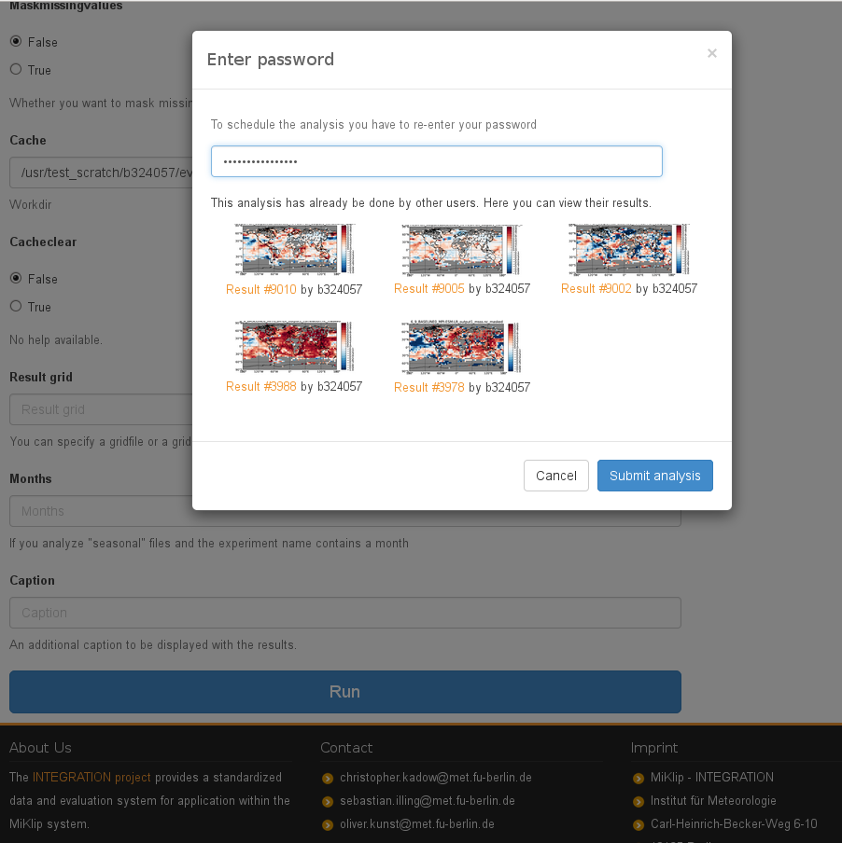
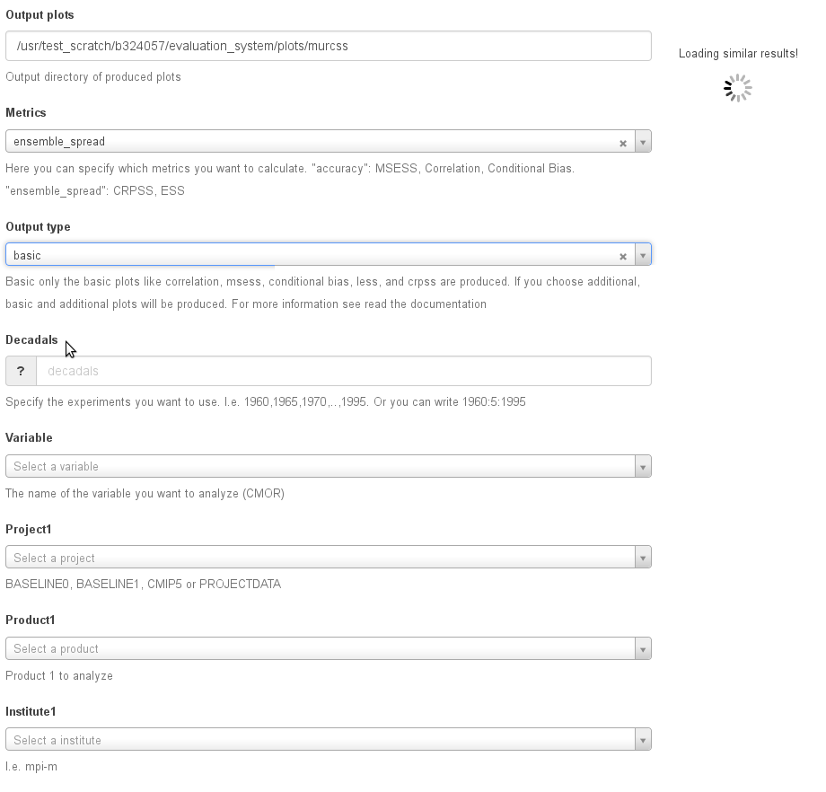
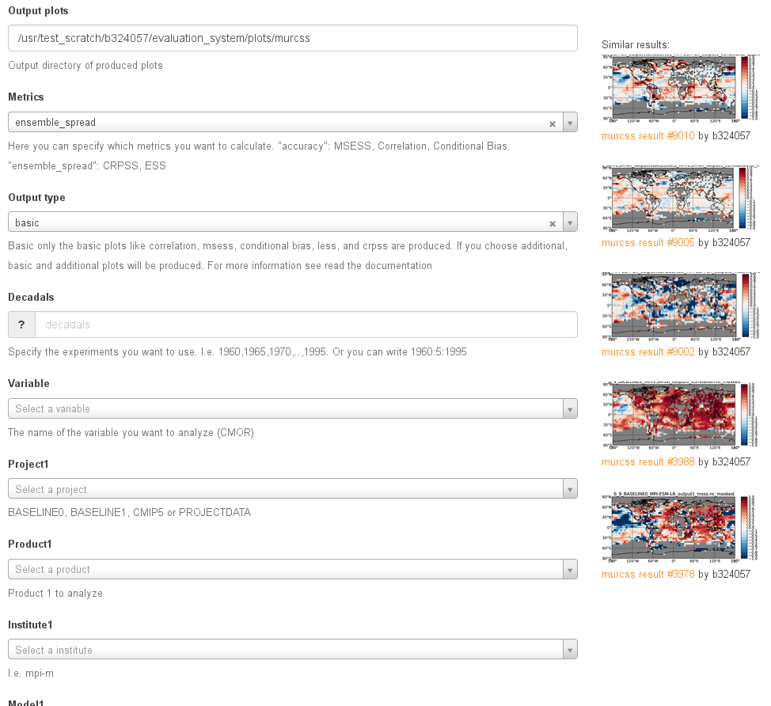
+
- Freie Univ Evaluation System Framework for
Scientific Infrastructures in Earth System Modeling
www-miklip.dkrz.de | freva.met.fu-berlin.de
∑
Featured Recommendations
Inspired by your
browsing history
MySQL Database
Every analysis is saved and can be rerun
Can be shared among scienists
GIT Versioning
Every tool and system version is saved to the analysis!
Saving CPU time,
I/O and disk space!
Usability & Flexibility
Plugin
Data Access
Transparency & Reproducibility
Christopher Kadow, S. Illing,
O. Kunst, T. Schartner, I. Kirchner, H.W. Rust, U. Cubasch, U. Ulbrich

Slide 5
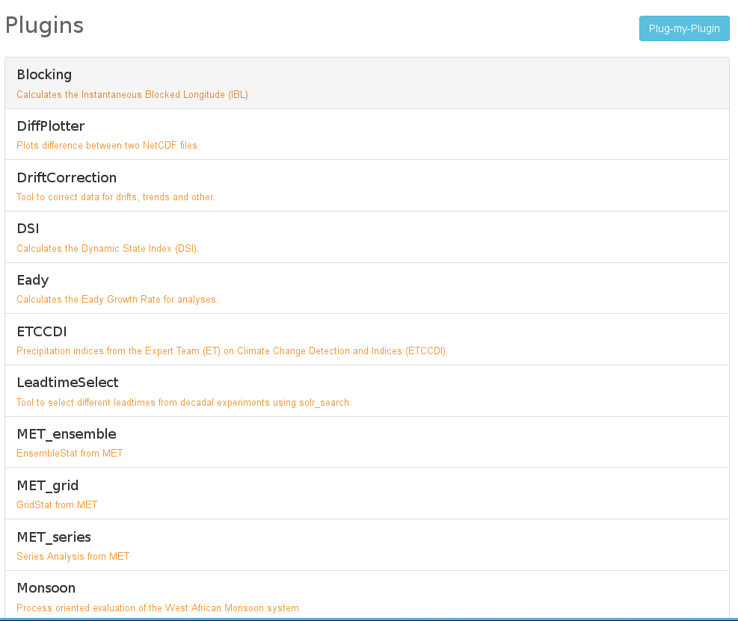
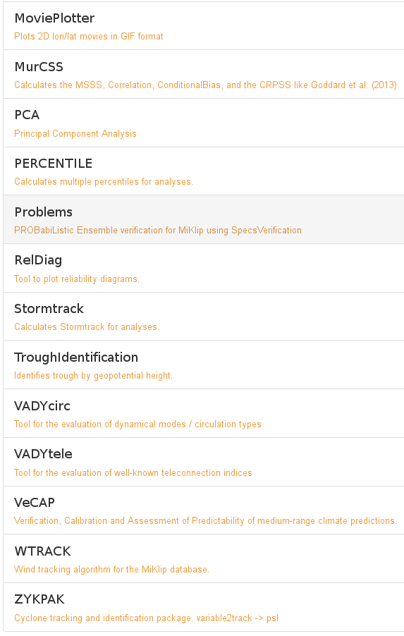
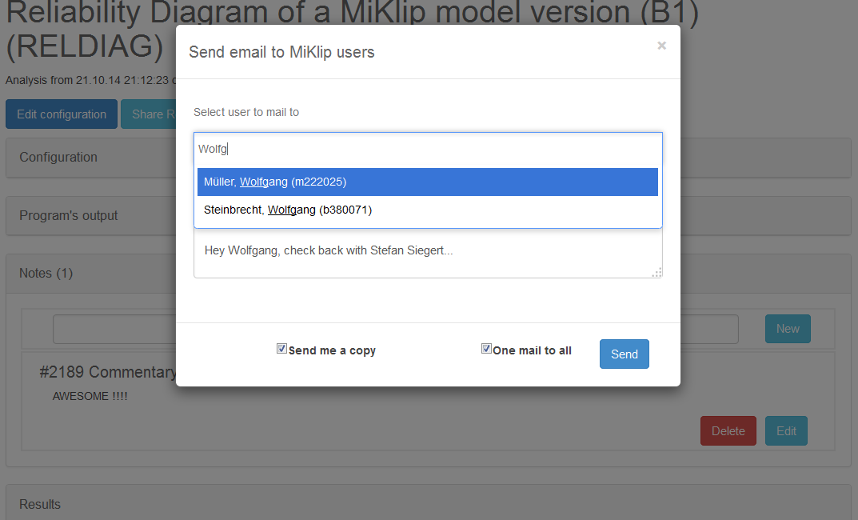
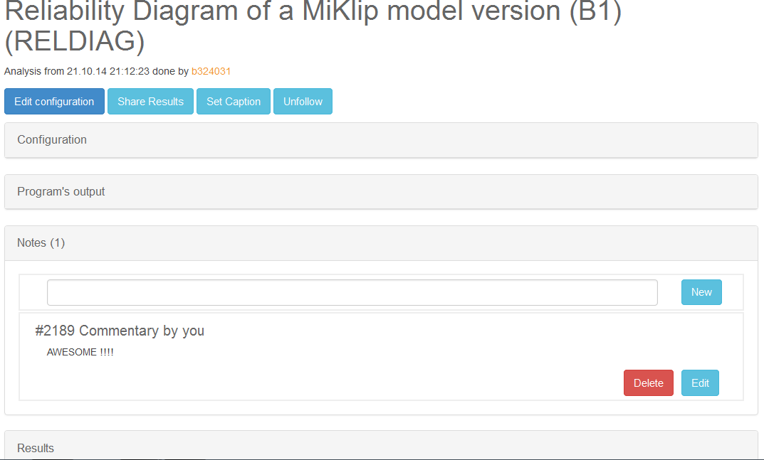
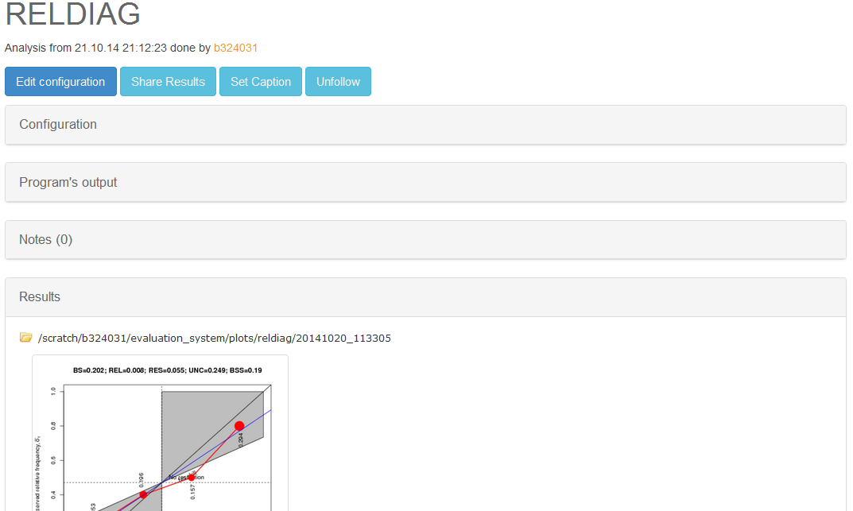
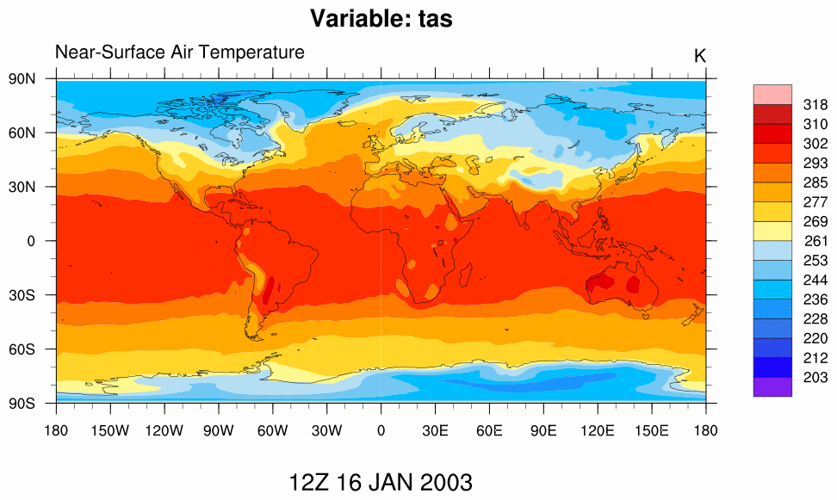
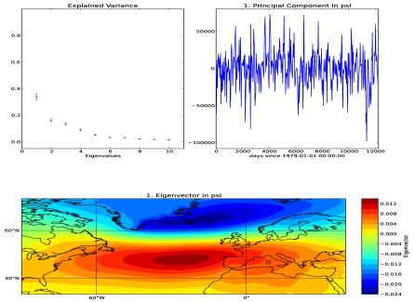
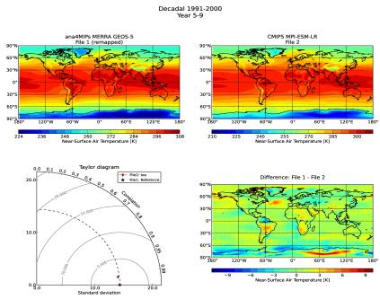
+
- Freie Univ Evaluation System Framework for
Scientific Infrastructures in Earth System Modeling
www-miklip.dkrz.de | freva.met.fu-berlin.de
∑
See PICO 2.7 Illing et al. EGU2016-14013
Set up some example tools to show
Developers
how2plugin via different scripts
Users
how2use the evaluation system
ADVANTAGES:
No specific programming language requested
No need to know all the code environments
Usability & Flexibility
freva --plugin MoviePlotter input=/path/2/tas_Amon_MPI-ESM-LR_decadal2000_r1i1p1_2003.nc outputdir=./
from evaluation_system.api import plugin
class MoviePlotter(plugin.PluginAbstract):
__short_description__ = "Plots 2D lon/lat movies in GIF format"
__version__ = (0,0,1)
__config_metadict__ = plugin.metadict(compact_creation=True,
input =(None, dict(type=str, mandatory=True, help=' File to be plotted')),
outputdir =(None, dict(type=str, mandatory=True, help='default output dir')))
def runTool(self, config_dict=None):
input = config_dict['input']
outputdir=config_dict[‘outputdir’]
result= self.call('%s/movie_plotter.sh %s %s' % (self.getClassBaseDir(),input,outputdir))
MoviePlotter
Plugin
PCA
Data Access
DiffPlotter
Transparency & Reproducibility
NCL
./movie_plotter.sh /path/2/INPUT /path/2/OUTPUT
C++
Christopher Kadow, S. Illing,
O. Kunst, T. Schartner, I. Kirchner, H.W. Rust, U. Cubasch, U. Ulbrich
Python

Slide 6
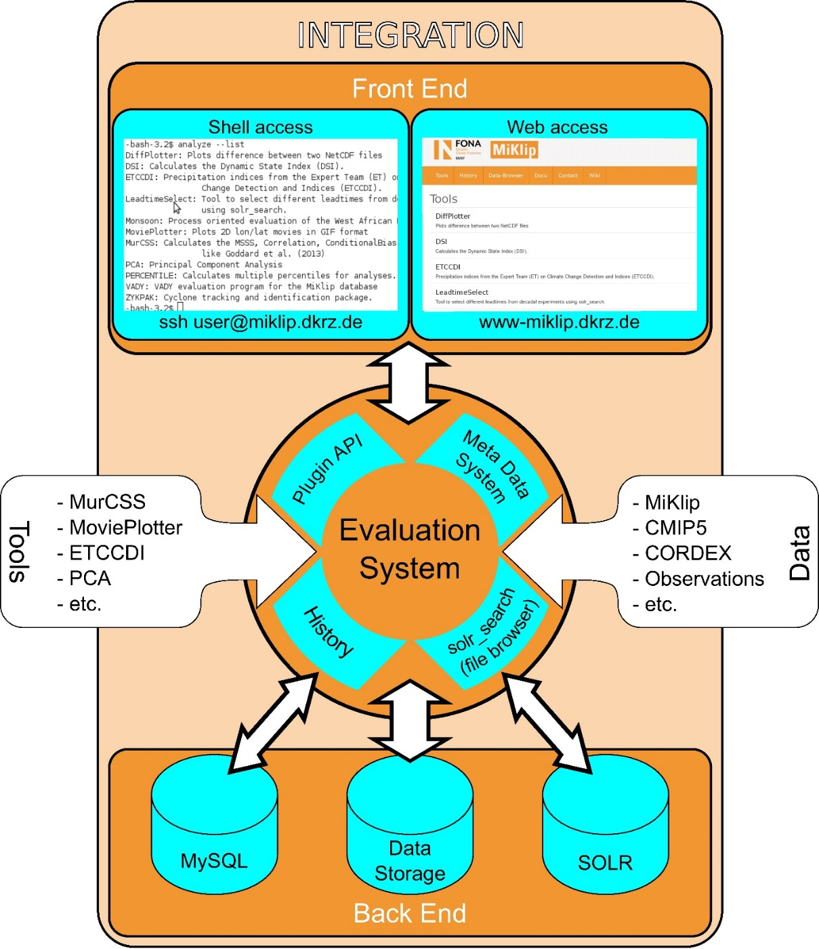
Summary
+
∑
Freva Evaluation System Framework
Central Scientific Infrastructure
Standardized data & applications
Usability & Flexibility
Transparency & Reproducibility
Big Data Analyses & Resource Management
Application Potential
Major Projects & Big Institutions
More Informations
MiKlip Decadal Prediction Project: www-miklip.dkrz.de
Webtour, ‘Guest?‘ Account, Contact informations: freva.met.fu-berlin.de
Christopher Kadow, S. Illing,
O. Kunst, T. Schartner, I. Kirchner, H.W. Rust, U. Cubasch, U. Ulbrich

Slide 7
+
- Freie Univ Evaluation System Framework for
Scientific Infrastructures in Earth System Modeling
www-miklip.dkrz.de | freva.met.fu-berlin.de
∑
Usability & Flexibility
Plugin
Data Access
Transparency & Reproducibility
Christopher Kadow, S. Illing,
O. Kunst, T. Schartner, I. Kirchner, H.W. Rust, U. Cubasch, U. Ulbrich

Slide 8
+
- Freie Univ Evaluation System Framework for
Scientific Infrastructures in Earth System Modeling
www-miklip.dkrz.de | freva.met.fu-berlin.de
∑
Plug
my
Plugin
Usability & Flexibility
Link
2
DB
Plugin
Data Access
Docu
ESGF
Transparency & Reproducibility
Christopher Kadow, S. Illing,
O. Kunst, T. Schartner, I. Kirchner, H.W. Rust, U. Cubasch, U. Ulbrich

Slide 9
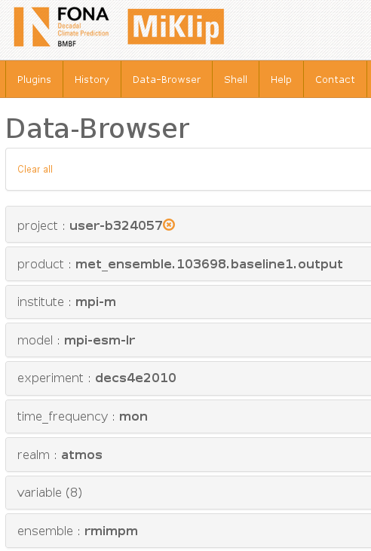
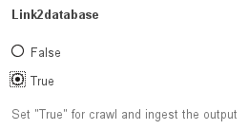
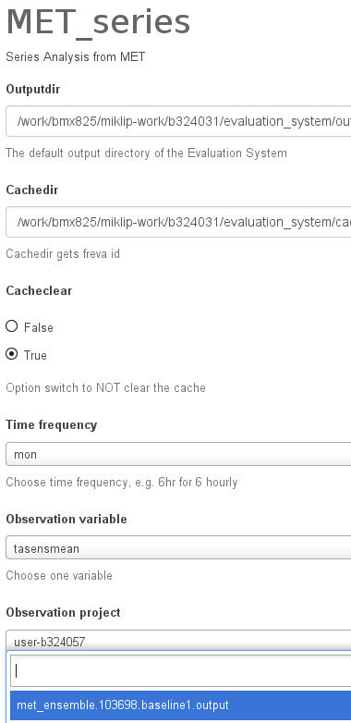
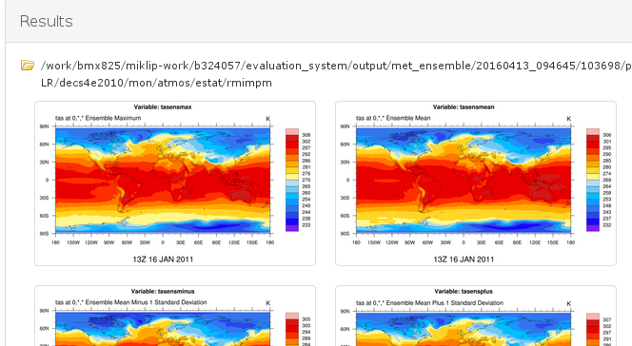
+
- Freie Univ Evaluation System Framework for
Scientific Infrastructures in Earth System Modeling
www-miklip.dkrz.de | freva.met.fu-berlin.de
∑
If the output of a plugin is a post-processed variable, it can be automatically part of the data base
Developers get a function from Freva for the plugin
Plug
my
Plugin
Usability & Flexibility
Link
2
DB
if link2database: self.linkmydata(os.path.join
(outputdir_org,'CMOR'))
Result of the plugin now part of the users database
… and can be choosen as input for next plugin
Option in plugin:
Plugin
Data Access
Preview output of the MET_ENSEMBLE plugin:
Docu
ESGF
Transparency & Reproducibility
Christopher Kadow, S. Illing,
O. Kunst, T. Schartner, I. Kirchner, H.W. Rust, U. Cubasch, U. Ulbrich

Slide 10
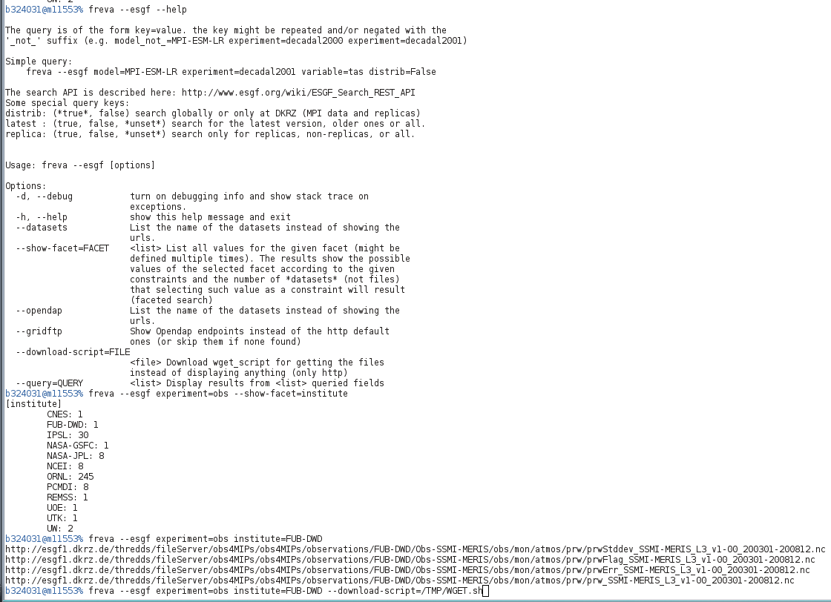
+
- Freie Univ Evaluation System Framework for
Scientific Infrastructures in Earth System Modeling
www-miklip.dkrz.de | freva.met.fu-berlin.de
∑
In the shell freva has a ESGF tool which finds data and builds download script
Plug
my
Plugin
Usability & Flexibility
Link
2
DB
Plugin
Data Access
BETA:
A virtual file system (FUSE) which extends the local data base with the full ESGF
Users can access (ls, cp, ncdump,etc …) all files, which are automatically downloaded in the moment of touching it.
A flexible cache can be used by all user, can be hold for a specific time or it will be overwritten
Plugins can directly use ESGF data without the need of downloading before using it
… in the web as well!
Docu
ESGF
Transparency & Reproducibility
Christopher Kadow, S. Illing,
O. Kunst, T. Schartner, I. Kirchner, H.W. Rust, U. Cubasch, U. Ulbrich

Slide 11
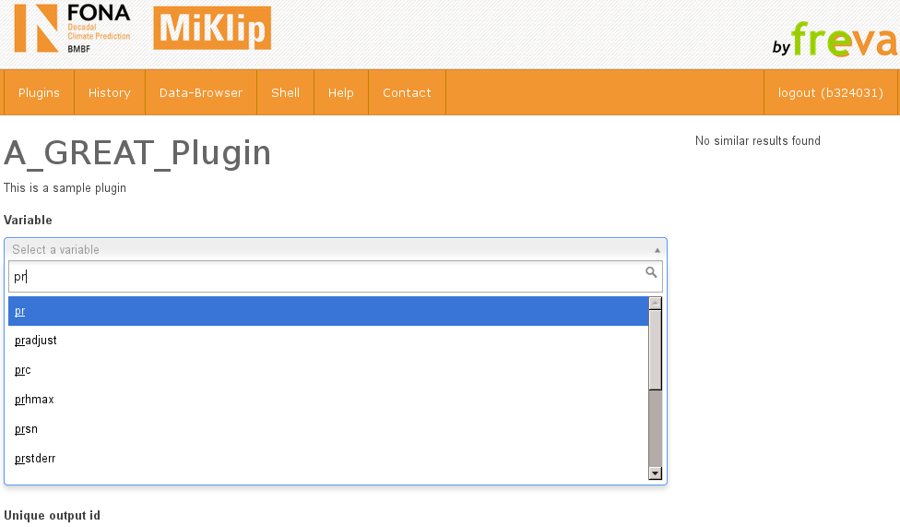
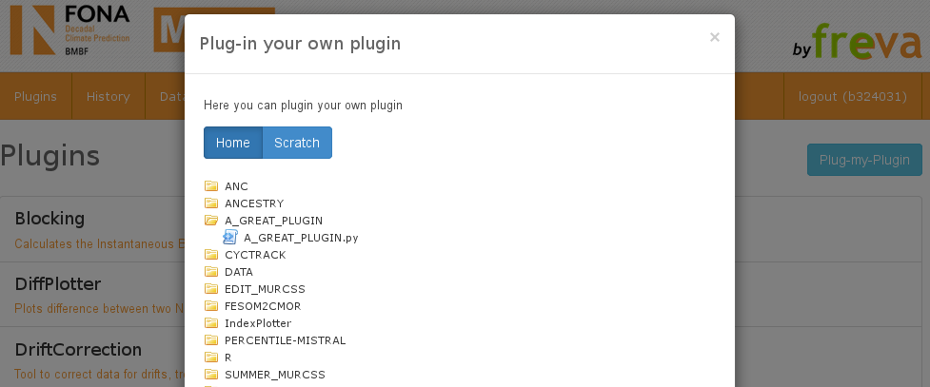
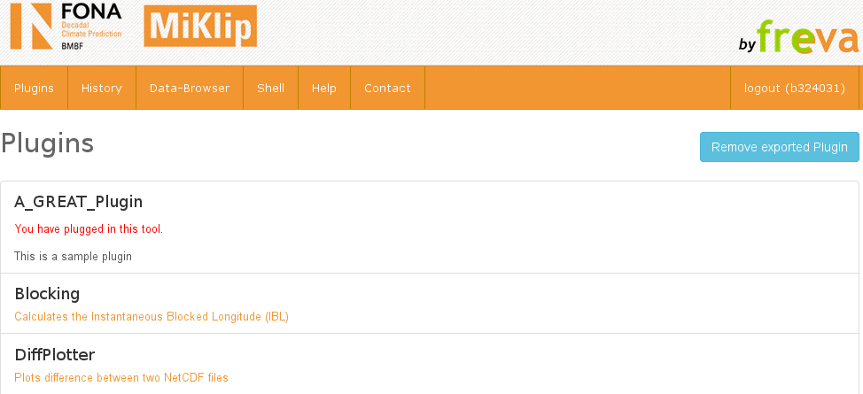
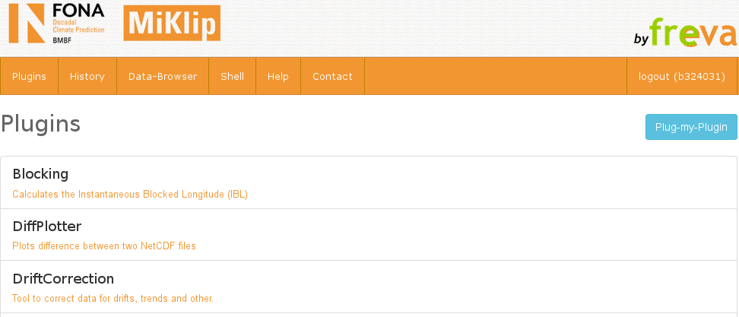
+
- Freie Univ Evaluation System Framework for
Scientific Infrastructures in Earth System Modeling
www-miklip.dkrz.de | freva.met.fu-berlin.de
∑
Developers can test new plugins in the shell and web
Plug
my
Plugin
Usability & Flexibility
WEB:
Link
2
DB
Plugin
Data Access
Docu
ESGF
Transparency & Reproducibility
Christopher Kadow, S. Illing,
O. Kunst, T. Schartner, I. Kirchner, H.W. Rust, U. Cubasch, U. Ulbrich

Slide 12
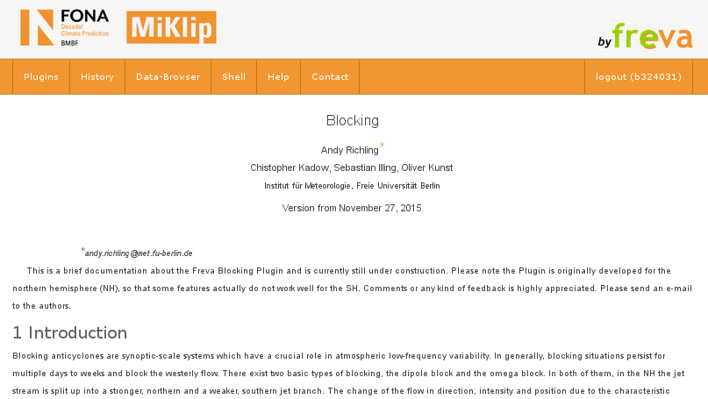
+
- Freie Univ Evaluation System Framework for
Scientific Infrastructures in Earth System Modeling
www-miklip.dkrz.de | freva.met.fu-berlin.de
∑
Basic documentation of the plugin is given by Freva, detailed docu in Latex for PDFs and web interface
Long Description
Short Description
Latex DOCU - PDF and Web
Options Description
WEB:
Plug
my
Plugin
Usability & Flexibility
Link
2
DB
Plugin
Data Access
SHELL:
Freva Plugin.py:
Docu
ESGF
Transparency & Reproducibility
Shell: ls blocking/doc/doc_Blocking_FrevaPlugin.pdf
Christopher Kadow, S. Illing,
O. Kunst, T. Schartner, I. Kirchner, H.W. Rust, U. Cubasch, U. Ulbrich

