Slide 1





Changing Temporal Structures in Scenario-Neutral
Runoff Response Surfaces
K. Vormoor¹, O. Rössler², G. Bürger¹, A. Bronstert¹, R. Weingartner²
¹ Institute for Earth- and Environmental Science, University of Potsdam (kvormoor@uni-potsdam.de)
² Oeschger Centre for Climate Change Research, University of Bern
H o m e
Background & Motivation
Data & Study Area
Methods
Results & Conclusions
Navigation
Home Button
Previous-/Next
Slide
Start
EGU General Assembly 2016

Slide 2
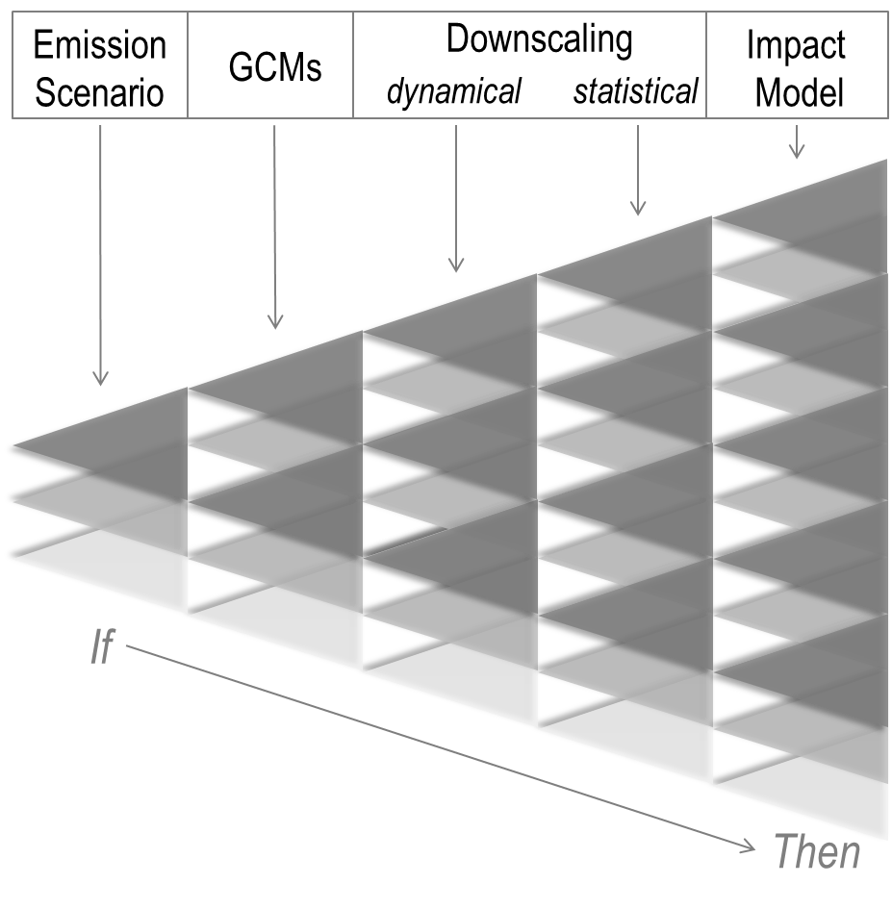
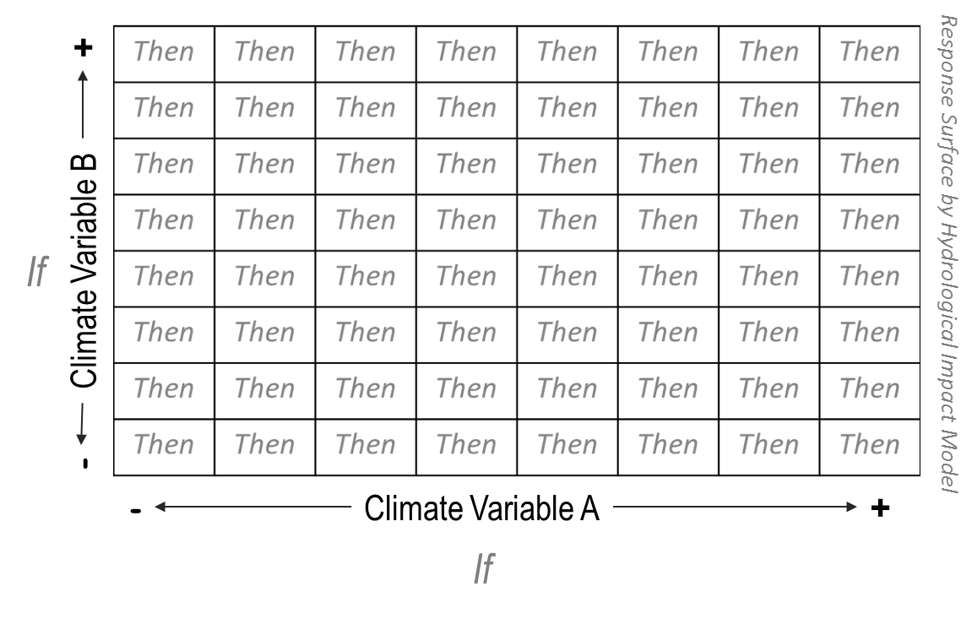
Changing Temporal Structures in Scenario-Neutral
Runoff Response Surfaces
K. Vormoor¹, O. Rössler², G. Bürger¹, A. Bronstert¹, R. Weingartner²
¹ Institute for Earth- and Environmental Science, University of Potsdam (kvormoor@uni-potsdam.de)
² Oeschger Centre for Climate Change Research, University of Bern
Runoff Response Surfaces??
traditional: “top-down“
alternative: “bottom-up“
Multi-model/multi-parameter cascade
Physically sound projections; large uncertainties
Impact model is run with systematically perturbed climate input data
Each realization is one pixel in 2D-matrix → Response Surface

Slide 3
Changing Temporal Structures in Scenario-Neutral
Runoff Response Surfaces
K. Vormoor¹, O. Rössler², G. Bürger¹, A. Bronstert¹, R. Weingartner²
¹ Institute for Earth- and Environmental Science, University of Potsdam (kvormoor@uni-potsdam.de)
² Oeschger Centre for Climate Change Research, University of Bern
Changing Temporal Structures??
Previous studies:
Perturbation of climate input data:
  various methods of different complexity
  usually linear scaling
  → Temporal structure remains the same
  (i.e. annual-, seasoanal, day-to-variablity)
alternative: “bottom-up“
In this study:
Linear scaling of observed and projected climate data from 8 GCM-RCMs
2 statistical downscaling methods
Visualisation at a common domain
Considers changing temporal structures
Allows quantification of their effect on Response Surfaces
Mean annual discharge
Low flows
Floods (magnitude, seasonality)

Slide 4
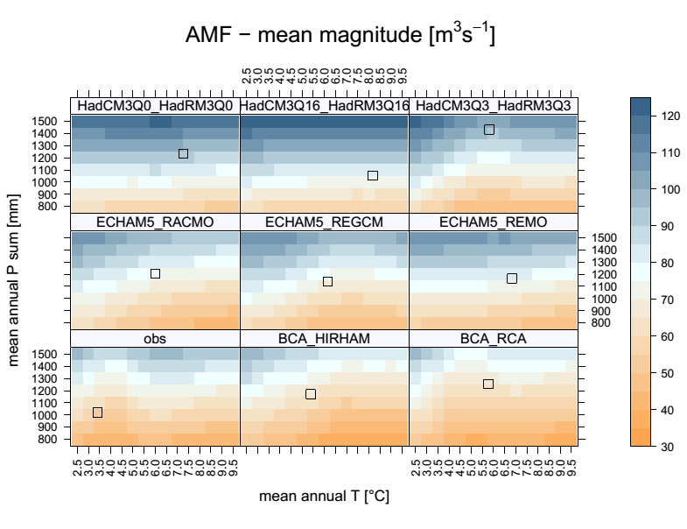
Changing Temporal Structures in Scenario-Neutral
Runoff Response Surfaces
K. Vormoor¹, O. Rössler², G. Bürger¹, A. Bronstert¹, R. Weingartner²
¹ Institute for Earth- and Environmental Science, University of Potsdam (kvormoor@uni-potsdam.de)
² Oeschger Centre for Climate Change Research, University of Bern
Example...
More details at:
PICO3.15
kvormoor@uni-potsdam.de

Slide 5
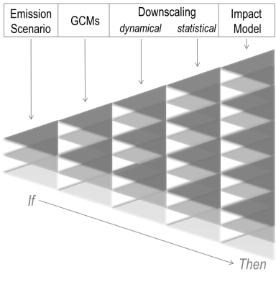
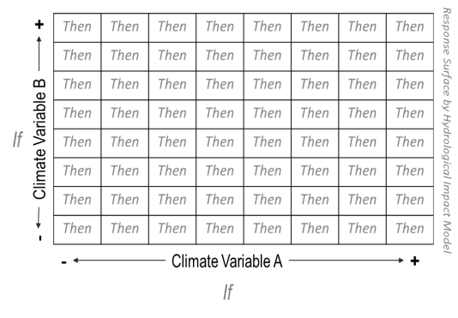

Changing Temporal Structures in Scenario-Neutral
Runoff Response Surfaces
Background & Motivation
Data & Study Area
K. Vormoor¹, O. Rössler², G. Bürger¹, A. Bronstert¹, R. Weingartner²
Methods
Results & Conclusions
¹ Institute for Earth- and Environmental Science, University of Potsdam (kvormoor@uni-potsdam.de)
² Oeschger Centre for Climate Change Research, University of Bern
Navigate directly to chapter
Background & Motivation
Climate Change Impact Assessment
Scenario-based modelling
Traditionally: Scenario-based multi-model ensembles
Alternatively: Response Surfaces:
  Impact model is driven with systematically perturbed climate input data (usually T and P)
  Sensitivity study of an impact model towards changes in climate system; response in 2D-matrix
  Critical: Methods used for perturbation; usually some kind of linear scaling
  → temporal structures (i.e. annual-, seasonal-, day-to-day variability) of climate input data remain unchanged
1|2
Scenario-neutral response surface

Slide 6
Changing Temporal Structures in Scenario-Neutral
Runoff Response Surfaces
Background & Motivation
Data & Study Area
K. Vormoor¹, O. Rössler², G. Bürger¹, A. Bronstert¹, R. Weingartner²
Methods
Results & Conclusions
¹ Institute for Earth- and Environmental Science, University of Potsdam (kvormoor@uni-potsdam.de)
² Oeschger Centre for Climate Change Research, University of Bern
Navigate directly to chapter
Background & Motivation
Climate Change Impact Assessment
We introduce Standardized Runoff Response Surfaces (SRRS):
Linear scaling of both observed and projected climate data from 8 GCM-RCM combinations, statistically downscaled by two different approaches
Climate projections are assumed to represent changes in the temporal structure
Visualization at a common domain: the standardized response surface
This study presents:
SRRS for different aspects of runoff response in one test catchment
The quantified effects of considering changes in the temporal structure of climate data in SRRS
Standardized Runoff Response Surface for the following target variables:
2|2
Mean annual discharge
Low flows
Floods (magnitude, seasonality)

Slide 7
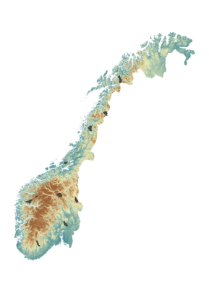
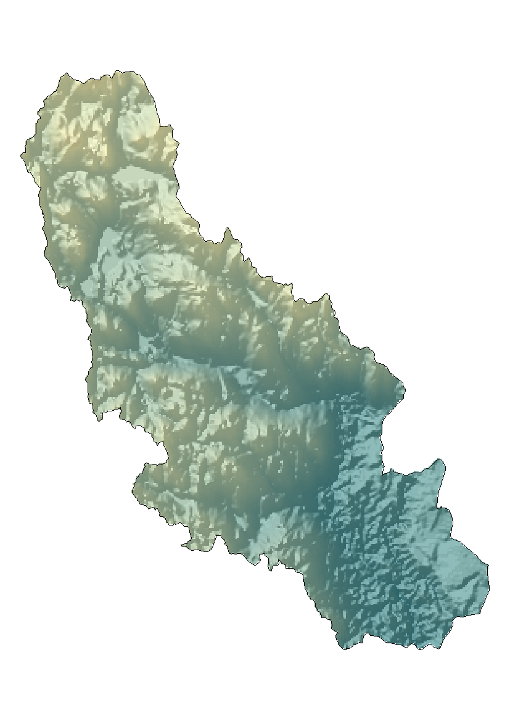
Changing Temporal Structures in Scenario-Neutral
Runoff Response Surfaces
Background & Motivation
Data & Study Area
K. Vormoor¹, O. Rössler², G. Bürger¹, A. Bronstert¹, R. Weingartner²
Methods
Results & Conclusions
¹ Institute for Earth- and Environmental Science, University of Potsdam (kvormoor@uni-potsdam.de)
² Oeschger Centre for Climate Change Research, University of Bern
Navigate directly to chapter
Data & Study Area
Study catchment
Mesoscale catchment in SE-Norway
Constrasting flood seasonality (spring vs. autumn)
1|1
Kråkfoss
433km²
Median Elevation [m.a.s.l] | Elevation Range [m.a.s.l.] | Average Annual Q [mm] | Dominant Land Cover, % forest | Anthropo-genic Land Use [%]
445 | 105-803 | 910 | 76 | 11
Data
Observed T-, P-, and Q-data for the period 1966-2012
Climate projections for T and P (2071-2099) generated by 8 GCM-RCM-combinations from ENSEMBLES

Slide 8





Changing Temporal Structures in Scenario-Neutral
Runoff Response Surfaces
Background & Motivation
Data & Study Area
K. Vormoor¹, O. Rössler², G. Bürger¹, A. Bronstert¹, R. Weingartner²
Methods
Results & Conclusions
¹ Institute for Earth- and Environmental Science, University of Potsdam (kvormoor@uni-potsdam.de)
² Oeschger Centre for Climate Change Research, University of Bern
Navigate directly to chapter
Methods
Local adjustment of climate projections
Necessary due to biases in the projections and insufficient spatial resolution
Two different methods have been applied:
  Empirical Quantile Mapping (QM) – bias correction
  Expanded Downscaling (XDS) – statistical downscaling
1|3
Perturbation of climate input data (T and P)
Climate observations - linear scaling:
Climate projections - linear scaling and correction for comparability:
T_{o,} P_{o} observations
T´, P´ projections
X_{t} perturbation addend for T_{o} and T´
X_{p}; X´_{p} perturabtion factor for P_{o} ; P´
S_{j} desired scaling level (e.g. 900 mm)
$$T\left(i\right)=T_{o}\left(i\right)+X_{t}$$
$$P\left(i\right)=P_{o}\left(i\right)X_{p}$$
$$T\left(i\right)=(T^{′}(i)−\left(\overline{T^{′}\left(i\right)}− \overline{T_{0}}\right))+X_{t}$$
$P\left(i\right)=P^{′}\left(i\right){X^{′}}_{p},$ where:
$${X^{′}}_{p}=\frac{S_{j}}{\overline{P^{′}\left(i\right)}}$$

Slide 9
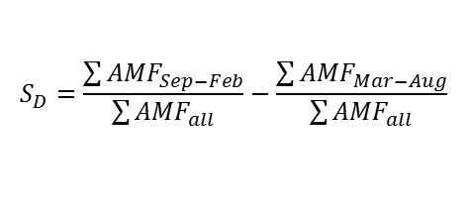
Changing Temporal Structures in Scenario-Neutral
Runoff Response Surfaces
Background & Motivation
Data & Study Area
K. Vormoor¹, O. Rössler², G. Bürger¹, A. Bronstert¹, R. Weingartner²
Methods
Results & Conclusions
¹ Institute for Earth- and Environmental Science, University of Potsdam (kvormoor@uni-potsdam.de)
² Oeschger Centre for Climate Change Research, University of Bern
Navigate directly to chapter
Methods
Hydrological model - HBV
All perturbed climate input data series (each 30 years) are used as input into the HBV model (i.e. a conceptually, lumped rainfall-runoff model for discharge simulation at the catchment scale)
4 runoff target variables:
  Mean daily discharge MQ
  Mean magnitude of annual maximum floods AMF
  Flood seasonality index S_{D}
  Low-flow index LF7 (i.e. annual 7-day minimum discharge; May-Nov)
  → For each variable: 17 SRRS! (1 obs; 8 GCM-RCM-QM; 8 GCM-RCM-XDS)
2|3
$$S_{D}=\frac{\sum{{AMF}_{Sep−Feb}}}{\sum{{AMF}_{all}}}−\frac{\sum{{AMF}_{Mar−Aug}}}{\sum{{AMF}_{all}}}$$
S_{D} < 0 : dominant spring/summer floods
S_{D} > 0 : dominant autumn/winter floods

Slide 10


Changing Temporal Structures in Scenario-Neutral
Runoff Response Surfaces
Background & Motivation
Data & Study Area
K. Vormoor¹, O. Rössler², G. Bürger¹, A. Bronstert¹, R. Weingartner²
Methods
Results & Conclusions
¹ Institute for Earth- and Environmental Science, University of Potsdam (kvormoor@uni-potsdam.de)
² Oeschger Centre for Climate Change Research, University of Bern
Navigate directly to chapter
Methods
The influence of changing temporal structures on overall variance
Linear regression and a series of linear mixed-effect models are applied to analyze the relative influence of perturbed parameters (T and P) and their temporal structure (V)
3|3
Baseline model – normal linear regression
$$Q_{j,k}^{i}={a+bT}_{j}+{cP}_{k}+ε$$
Full linear mixed-effect model also accounts the random realizations of V
$$Q_{j,k,l}^{i}=a+ {bT}_{j}+{cP}_{k}+\left(1 | V_{l}\right)+ε$$
a, b, c : regression coefficients
Q^{i} : runoff variable i = 1,…, 4 that is MQ, AMF, S_{D}, LF7
T_{j} : temperature levels T_{j} of the SRRS
P_{k} : precipitation levels P_{k} of the SRRS
V_{l} : temporal structure with i=1,…,17 (8 QM proj., 8 XDS proj., 1 observation)
ε : unexplained variance

Slide 11
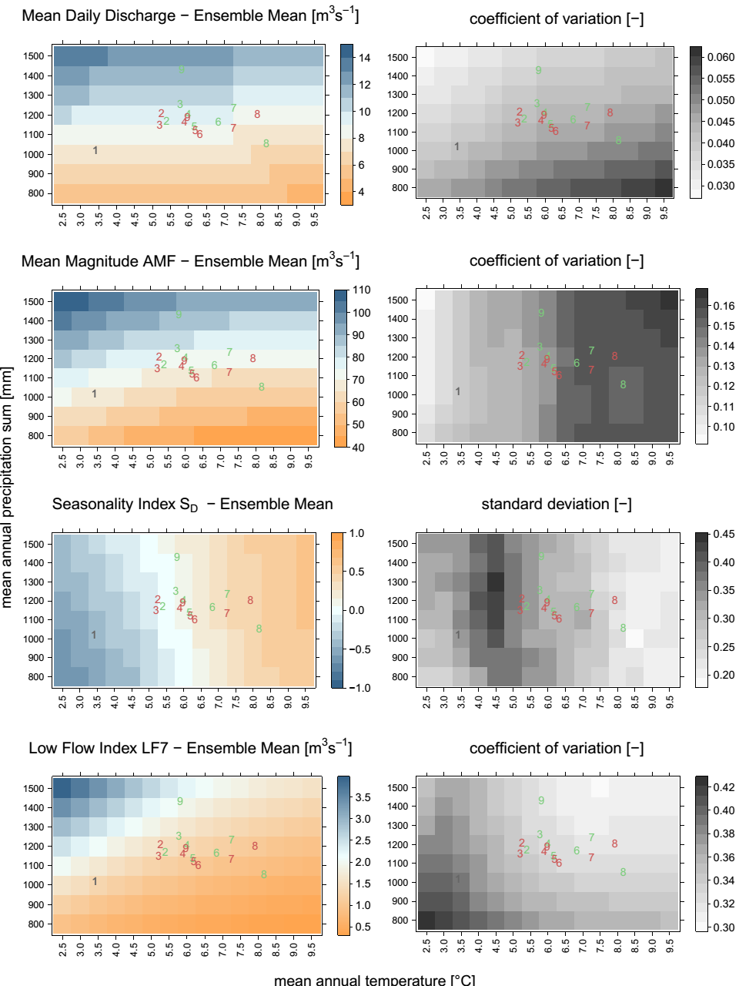
Changing Temporal Structures in Scenario-Neutral
Runoff Response Surfaces
Background & Motivation
Data & Study Area
K. Vormoor¹, O. Rössler², G. Bürger¹, A. Bronstert¹, R. Weingartner²
Methods
Results & Conclusions
¹ Institute for Earth- and Environmental Science, University of Potsdam (kvormoor@uni-potsdam.de)
² Oeschger Centre for Climate Change Research, University of Bern
Navigate directly to chapter
Results & Conclusions
Summarized Results of the SRRS for the 4 target variable
SRRSs showing the ensemble mean for the four hydrological target variables, and coefficient of variation (standard deviation for S_{D}) obtained from the entire ensemble of linearly scaled input data. The numbers in each plot indicate the origins of the data series used for scaling to generate the SRRS:
1. observed time series
2. BCA_HIRHAM
3. BCA_RCA
4. ECHAM5_RACMO
5. ECHAM5_REGCM
6. ECHMA5_REMO,
7. HadCM3Q0_HadRM3Q0,
8. HadCM3Q16_HadRM3Q16,
9. HadCM3Q0_HadRM3Q0.
Colors represent the method applied for the local adjustment of the RCM climate projections: XDS (green); QM (red).
Click on figure to enlarge!
1|3
MQ
AMF
Click for detailed results:
SD
LF7

Slide 12
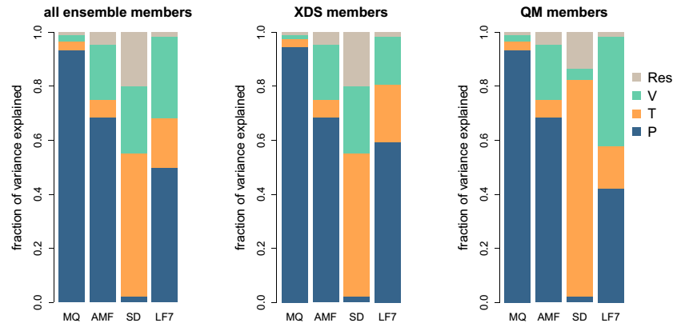
Changing Temporal Structures in Scenario-Neutral
Runoff Response Surfaces
Background & Motivation
Data & Study Area
K. Vormoor¹, O. Rössler², G. Bürger¹, A. Bronstert¹, R. Weingartner²
Methods
Results & Conclusions
¹ Institute for Earth- and Environmental Science, University of Potsdam (kvormoor@uni-potsdam.de)
² Oeschger Centre for Climate Change Research, University of Bern
Navigate directly to chapter
Results & Conclusions
Influence of perturbation and temporal structures
2|3
Detailed results:
Temporal structures of data-sets
Fraction of explained variance of the perturbed variables (T and P) and the different temporal structures (V) to the total variance as described by linear and linear mixed-effect models for the four runoff target variables MQ, AMF, S_{D}, LF7.
T: temperature
P: precipitation
V: climate variability (i.e. the temporal structure).
Proportion missing to 1 is unexplained variance (Resid).

Slide 13
Changing Temporal Structures in Scenario-Neutral
Runoff Response Surfaces
Background & Motivation
Data & Study Area
K. Vormoor¹, O. Rössler², G. Bürger¹, A. Bronstert¹, R. Weingartner²
Methods
Results & Conclusions
¹ Institute for Earth- and Environmental Science, University of Potsdam (kvormoor@uni-potsdam.de)
² Oeschger Centre for Climate Change Research, University of Bern
Navigate directly to chapter
Results & Conclusions
Conclusions
Standardized Runoff Response Surfaces (SRRS) a valuable option for climate change impact assessments (CCIA)
However: changing temporal structures can have strong effects in the estimation of floods and low flows (up to 21 % of the explained variance)
Crucial for SRRS: choice of the perturbation method; appropriate setup depends on target variable
Similarities: discussion on suitability of change-factor approaches in scenario-based CCIA
3|3
Future challenges
Larger sets of climate realizations with differring temporal structures
More hydrological model structures in differing geographical settings
Considering hydrological model uncertainty in „bottom-up“ approaches

Slide 14
X
Changing Temporal Structures in Scenario-Neutral
Runoff Response Surfaces
Background & Motivation
Data & Study Area
K. Vormoor¹, O. Rössler², G. Bürger¹, A. Bronstert¹, R. Weingartner²
Methods
Results & Conclusions
¹ Institute for Earth- and Environmental Science, University of Potsdam (kvormoor@uni-potsdam.de)
² Oeschger Centre for Climate Change Research, University of Bern
Navigate directly to chapter
Results & Conclusions
Summarized Results of the SRRS for the 4 target variable
SRRSs showing the ensemble mean for the four hydrological target variables, and coefficient of variation (standard deviation for S_{D}) obtained from the entire ensemble of linearly scaled input data. The numbers in each plot indicate the origins of the data series used for scaling to generate the SRRS:
1. observed time series
2. BCA_HIRHAM
3. BCA_RCA
4. ECHAM5_RACMO
5. ECHAM5_REGCM
6. ECHMA5_REMO,
7. HadCM3Q0_HadRM3Q0,
8. HadCM3Q16_HadRM3Q16,
9. HadCM3Q0_HadRM3Q0.
Colors represent the method applied for the local adjustment of the RCM climate projections: XDS (green); QM (red).
Click on figure to enlarge!
1|3
Detailed results:
MQ
AMF
SD
LF7

Slide 15
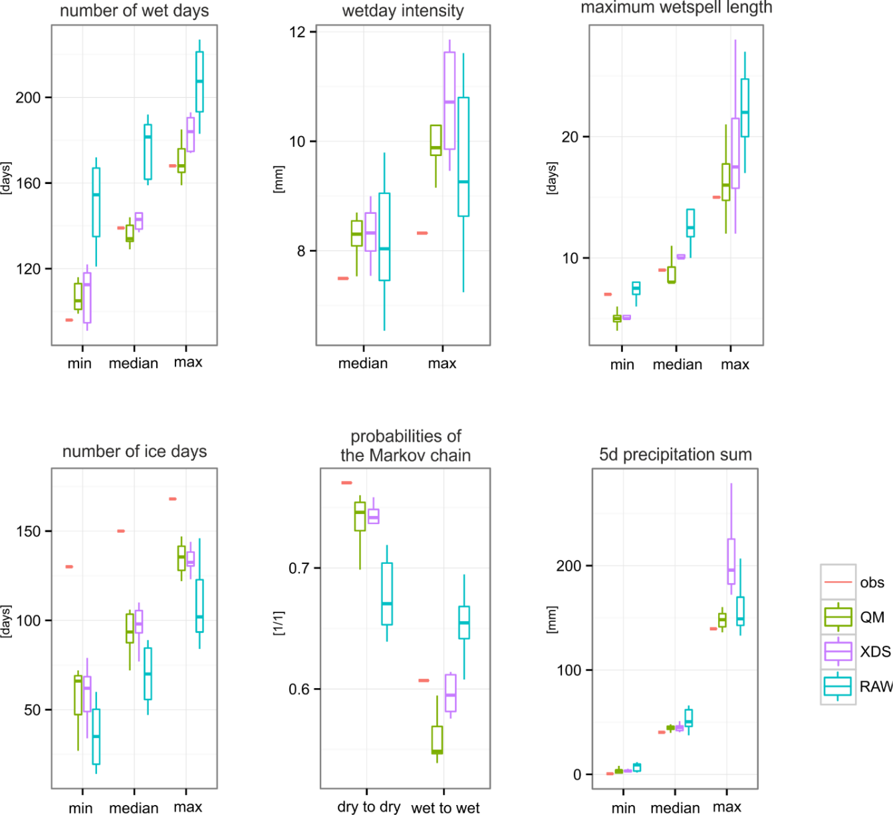
Changing Temporal Structures in Scenario-Neutral
Runoff Response Surfaces
Background & Motivation
Data & Study Area
K. Vormoor¹, O. Rössler², G. Bürger¹, A. Bronstert¹, R. Weingartner²
Methods
Results & Conclusions
¹ Institute for Earth- and Environmental Science, University of Potsdam (kvormoor@uni-potsdam.de)
² Oeschger Centre for Climate Change Research, University of Bern
Navigate directly to chapter
Results & Conclusions
Changes in the temporal structure of applied data-sets
Changes in the temporal structure of the applied data sets – a comparison of climate indices related to liquid and solid precipitation of the observed time series (=current climate; orange bars), the raw GCM-RCM outputs for the future time period 2071-2099 (RAW, lightblue boxes), and the GCM-RCM outputs locally adjusted by quantile mapping (QM, green boxes) and expanded downscaling (XDS, velvet boxes).
Detailed results:
Temporal structures of data-sets

Slide 16
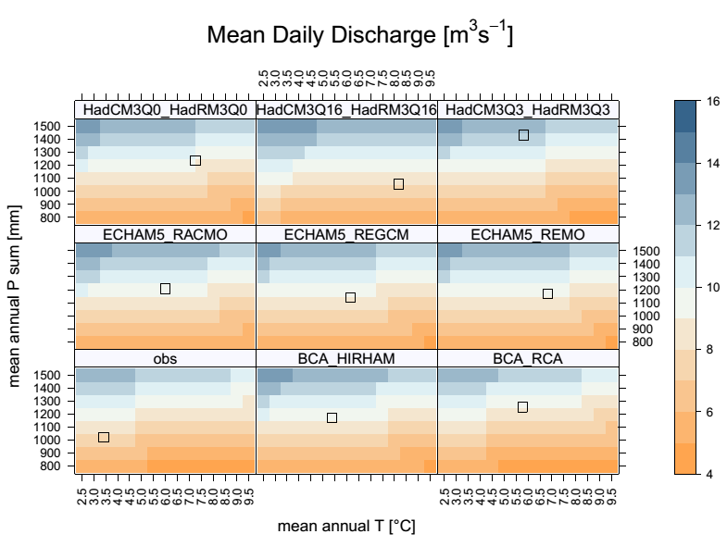
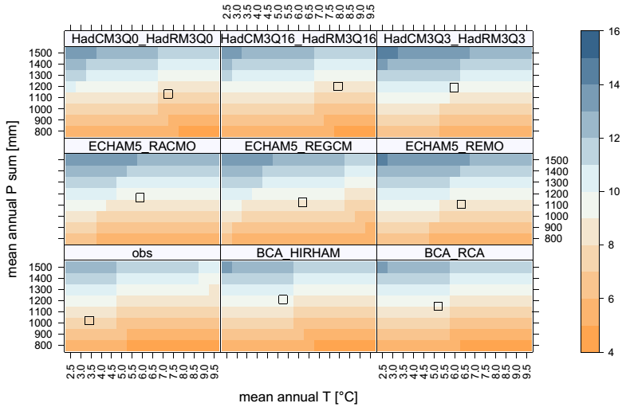
Changing Temporal Structures in Scenario-Neutral
Runoff Response Surfaces
Background & Motivation
Data & Study Area
K. Vormoor¹, O. Rössler², G. Bürger¹, A. Bronstert¹, R. Weingartner²
Methods
Results & Conclusions
¹ Institute for Earth- and Environmental Science, University of Potsdam (kvormoor@uni-potsdam.de)
² Oeschger Centre for Climate Change Research, University of Bern
Navigate directly to chapter
Results & Conclusions
XDS
Click on figure to enlarge!
Detailed results:
MQ
AMF
QM
SD
LF7

Slide 17
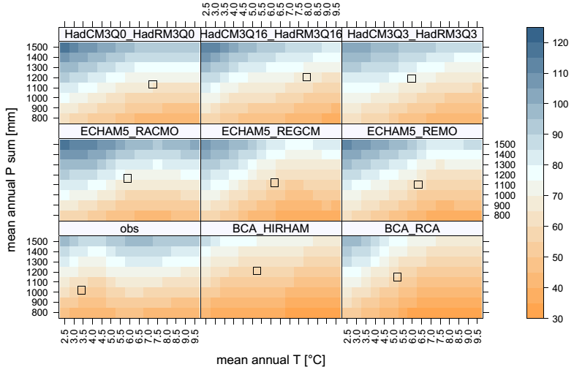
Changing Temporal Structures in Scenario-Neutral
Runoff Response Surfaces
Background & Motivation
Data & Study Area
K. Vormoor¹, O. Rössler², G. Bürger¹, A. Bronstert¹, R. Weingartner²
Methods
Results & Conclusions
¹ Institute for Earth- and Environmental Science, University of Potsdam (kvormoor@uni-potsdam.de)
² Oeschger Centre for Climate Change Research, University of Bern
Navigate directly to chapter
Results & Conclusions
XDS
Click on figure to enlarge!
Detailed results:
MQ
AMF
QM
SD
LF7

Slide 18
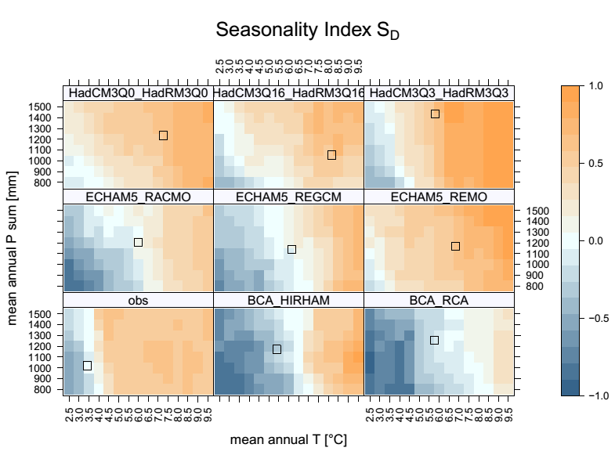
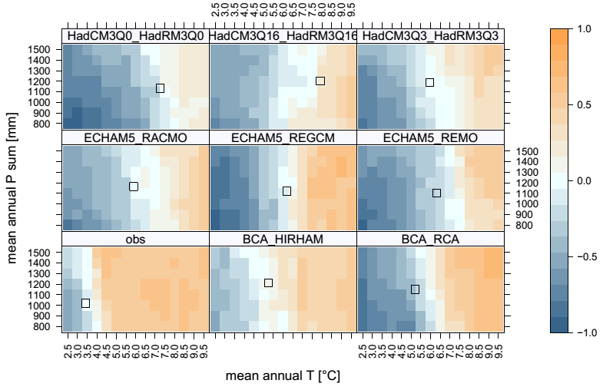
Changing Temporal Structures in Scenario-Neutral
Runoff Response Surfaces
Background & Motivation
Data & Study Area
K. Vormoor¹, O. Rössler², G. Bürger¹, A. Bronstert¹, R. Weingartner²
Methods
Results & Conclusions
¹ Institute for Earth- and Environmental Science, University of Potsdam (kvormoor@uni-potsdam.de)
² Oeschger Centre for Climate Change Research, University of Bern
Navigate directly to chapter
Results & Conclusions
XDS
Click on figure to enlarge!
Detailed results:
MQ
AMF
QM
SD
LF7

Slide 19
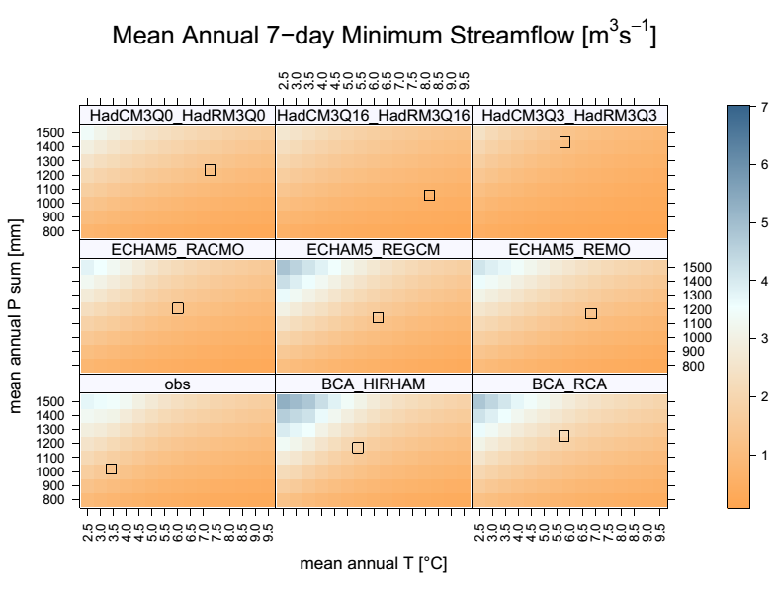
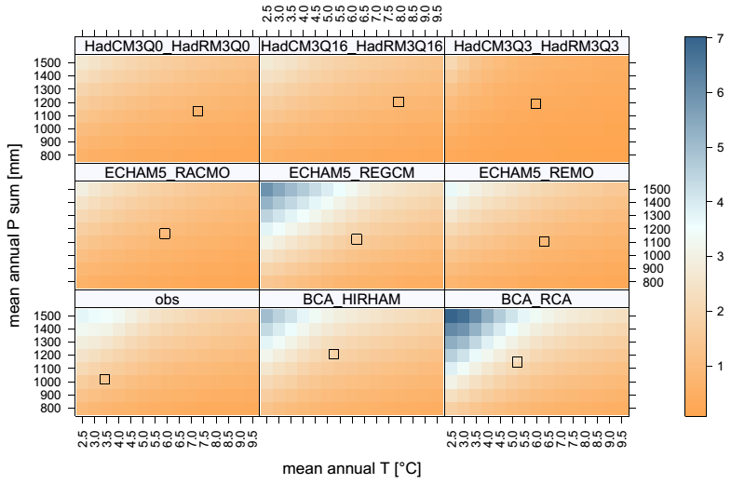
Changing Temporal Structures in Scenario-Neutral
Runoff Response Surfaces
Background & Motivation
Data & Study Area
K. Vormoor¹, O. Rössler², G. Bürger¹, A. Bronstert¹, R. Weingartner²
Methods
Results & Conclusions
¹ Institute for Earth- and Environmental Science, University of Potsdam (kvormoor@uni-potsdam.de)
² Oeschger Centre for Climate Change Research, University of Bern
Navigate directly to chapter
Results & Conclusions
XDS
Click on figure to enlarge!
Detailed results:
MQ
AMF
QM
SD
LF7

Slide 20
Changing Temporal Structures in Scenario-Neutral
Runoff Response Surfaces
Background & Motivation
Data & Study Area
X
K. Vormoor¹, O. Rössler², G. Bürger¹, A. Bronstert¹, R. Weingartner²
Methods
Results & Conclusions
¹ Institute for Earth- and Environmental Science, University of Potsdam (kvormoor@uni-potsdam.de)
² Oeschger Centre for Climate Change Research, University of Bern
Navigate directly to chapter
Results & Conclusions
XDS
Click on figure to enlarge!
Detailed results:
MQ
AMF
QM
SD
LF7

Slide 21
Changing Temporal Structures in Scenario-Neutral
Runoff Response Surfaces
Background & Motivation
Data & Study Area
X
K. Vormoor¹, O. Rössler², G. Bürger¹, A. Bronstert¹, R. Weingartner²
Methods
Results & Conclusions
¹ Institute for Earth- and Environmental Science, University of Potsdam (kvormoor@uni-potsdam.de)
² Oeschger Centre for Climate Change Research, University of Bern
Navigate directly to chapter
Results & Conclusions
XDS
Click on figure to enlarge!
Detailed results:
MQ
AMF
QM
SD
LF7

Slide 22
Changing Temporal Structures in Scenario-Neutral
Runoff Response Surfaces
Background & Motivation
Data & Study Area
X
K. Vormoor¹, O. Rössler², G. Bürger¹, A. Bronstert¹, R. Weingartner²
Methods
Results & Conclusions
¹ Institute for Earth- and Environmental Science, University of Potsdam (kvormoor@uni-potsdam.de)
² Oeschger Centre for Climate Change Research, University of Bern
Navigate directly to chapter
Results & Conclusions
XDS
Click on figure to enlarge!
Detailed results:
MQ
AMF
QM
SD
LF7

Slide 23
Changing Temporal Structures in Scenario-Neutral
Runoff Response Surfaces
Background & Motivation
Data & Study Area
X
K. Vormoor¹, O. Rössler², G. Bürger¹, A. Bronstert¹, R. Weingartner²
Methods
Results & Conclusions
¹ Institute for Earth- and Environmental Science, University of Potsdam (kvormoor@uni-potsdam.de)
² Oeschger Centre for Climate Change Research, University of Bern
Navigate directly to chapter
Results & Conclusions
XDS
Click on figure to enlarge!
Detailed results:
MQ
AMF
QM
SD
LF7

Slide 24
Changing Temporal Structures in Scenario-Neutral
Runoff Response Surfaces
Background & Motivation
Data & Study Area
X
K. Vormoor¹, O. Rössler², G. Bürger¹, A. Bronstert¹, R. Weingartner²
Methods
Results & Conclusions
¹ Institute for Earth- and Environmental Science, University of Potsdam (kvormoor@uni-potsdam.de)
² Oeschger Centre for Climate Change Research, University of Bern
Navigate directly to chapter
Results & Conclusions
XDS
Click on figure to enlarge!
Detailed results:
MQ
AMF
QM
SD
LF7

Slide 25
Changing Temporal Structures in Scenario-Neutral
Runoff Response Surfaces
Background & Motivation
Data & Study Area
X
K. Vormoor¹, O. Rössler², G. Bürger¹, A. Bronstert¹, R. Weingartner²
Methods
Results & Conclusions
¹ Institute for Earth- and Environmental Science, University of Potsdam (kvormoor@uni-potsdam.de)
² Oeschger Centre for Climate Change Research, University of Bern
Navigate directly to chapter
Results & Conclusions
XDS
Click on figure to enlarge!
Detailed results:
MQ
AMF
QM
SD
LF7

Slide 26
Changing Temporal Structures in Scenario-Neutral
Runoff Response Surfaces
Background & Motivation
Data & Study Area
X
K. Vormoor¹, O. Rössler², G. Bürger¹, A. Bronstert¹, R. Weingartner²
Methods
Results & Conclusions
¹ Institute for Earth- and Environmental Science, University of Potsdam (kvormoor@uni-potsdam.de)
² Oeschger Centre for Climate Change Research, University of Bern
Navigate directly to chapter
Results & Conclusions
XDS
Click on figure to enlarge!
Detailed results:
MQ
AMF
QM
SD
LF7

Slide 27
Changing Temporal Structures in Scenario-Neutral
Runoff Response Surfaces
Background & Motivation
Data & Study Area
X
K. Vormoor¹, O. Rössler², G. Bürger¹, A. Bronstert¹, R. Weingartner²
Methods
Results & Conclusions
¹ Institute for Earth- and Environmental Science, University of Potsdam (kvormoor@uni-potsdam.de)
² Oeschger Centre for Climate Change Research, University of Bern
Navigate directly to chapter
Results & Conclusions
XDS
Click on figure to enlarge!
Detailed results:
MQ
AMF
QM
SD
LF7

