Slide 1



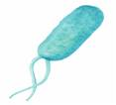
Visualizing carbon and nitrogen transfer in the tripartite symbiosis of Fagus sylvatica, ectomycorrhizal fungi and soil microorganisms using NanoSIMS
Werner Mayerhofer (1), Marlies Dietrich (1), Arno Schintlmeister (1), Raphael Gabriel (1), Stefan Gorka (1),
Julia Wiesenbauer (1), Victoria Martin (1), Peter Schweiger (1), Siegfried Reipert (2), Marieluise Weidinger (2),
Andreas Richter (1), Dagmar Woebken (1), and Christina Kaiser (1)
(1) Department of Microbiology and Ecosystem Science, University of Vienna, Vienna, Austria (christina.kaiser@univie.ac.at)
(2) Core Facility of Cell Imaging and Ultrastructure Research, University of Vienna, Vienna, Austria
University of Vienna
Research Questions
& Summary
Experimental Design
Methods
Results
Tripartite Symbiosis

Slide 2
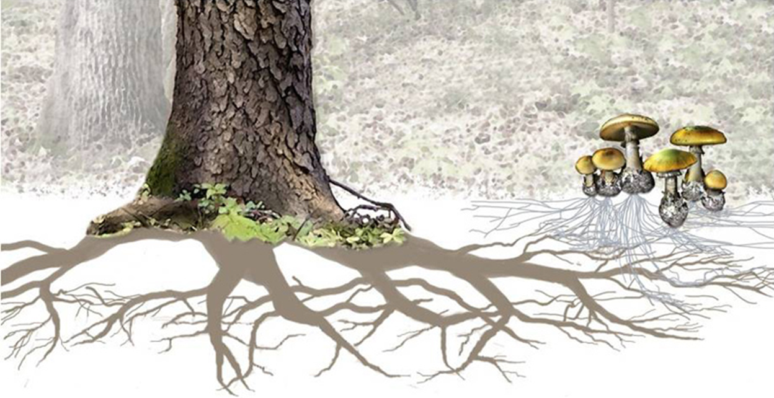
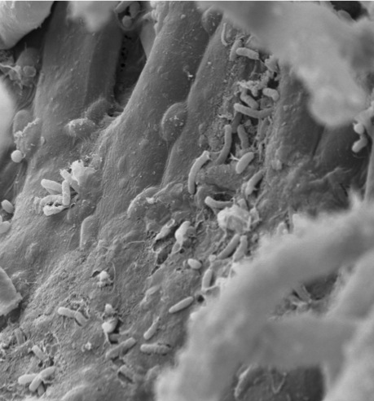
Tripartite Symbiosis
Research Questions
Experimental Design
Methods
Results
Mycorrhiza – Tripartite Symbiosis
Nitrogen
Carbon
SEM – Bacteria on Hyphae Surface
Notes:
Mycorrhiza is the world’s most ancient association between plants and fungi. and this coexistence has ever since facilitated the nutrient transfer between the two partners. A common feature of mycorrhiza is that the fungi interconnects plant roots with the surrounding soil and this soil area is densly colonized by soil microbes( that play crucial a role in the nutrient transfer)which are in fact considered to be the third component in this symbiosis. It has been shown that plants trade C in exchange for nutrients, such as Nitrogen from the fungus. However understanding the underlying mechanisms of this nutrient exchange id difficult as it takes place at the micrometer scale.
Zuerst: beide fotos, zeigen, aber ohne pfeile;
Rechts: SEM Bild Bakterien auf Hyphen von Raphi;

Slide 3
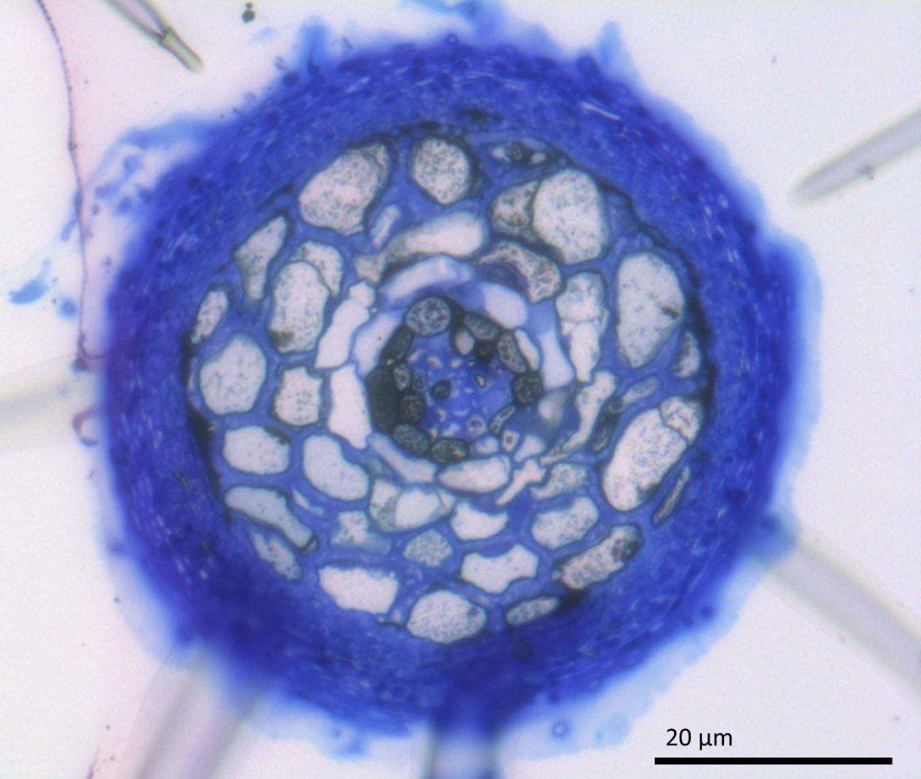
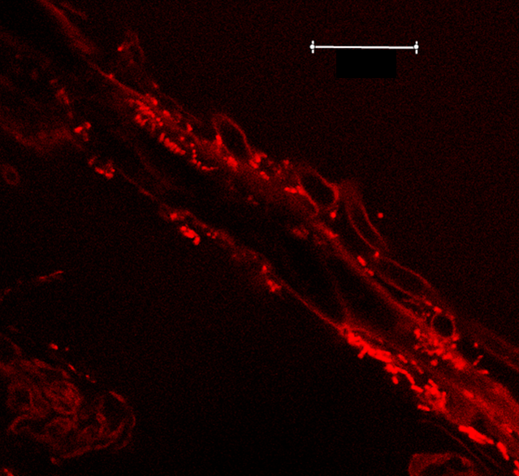
Investigating C and N flow at the subcellular scale
Tripartite Symbiosis
Research Questions
Experimental Design
Methods
Results
Interface Plant – Fungi
Interface Fungi - Microbes
Hyphae Mantle
20µm
Bacteria
Root Cell
Mycorrhizal Root Tip
Bacteria on hyphae (CARD-FISH)
Notes:
In order to visualize the highly sensitive nutrient exchange for the first time in living plants we used a double stable isotope labeling approach in combinations with NanoSIMS which allows to measure up to 7 elements in parallel on a single cell level.
We were able to trace the Carbon and Nitrogen transfers across two relevant interfaces:
Ectomycorrhizal hyphae; pfeil dazugeben;
Picoscreen4.5 hinschreiben!
Wo ist was hinschreiben: also hyphae pfeil

Slide 4
NanoSIMS
(Nanoscale secondary ion mass spectrometry)
Tripartite Symbiosis
Research Questions
Experimental Design
Methods
Results
Interface Plant - Fungi
Interface Fungi - Microbes
AT% ¹³C
1,03 AT %
7 AT %
Notes:
Our NanoSIMS images demonstrate a rapid transfer of photoassimliated C and a strongly controlled exchange of C an N between the 3 symbiotic partners which is a striking result and has never been shown before.
Unten: noch ein satz visulaise 15N and 13C exchange between plat fungi, hinzeigen, dass 13C dort ist
15N, 13C
Wir können es visualisieren, und wenn ihr mehr sehen wollt kommt zu unserem talk
Nummer von screen dazugeben.
Pfeile machen wo 15N und 13C ist.

Slide 5
Research Questions
Tripartite Symbiosis
Research Questions
Experimental Design
Methods
Results
Is there a mutual control of Carbon and Nitrogen transfer at the ectomycorrhizal interface?
Do mycorrhizal fungi directly allocate Carbon to hyphosphere bacteria?

Slide 6
Summary & Conclusion
Tripartite Symbiosis
Research Questions
Experimental Design
Methods
Results
Recently assimilated plant C is rapidly transferred across the ectomycorrhizal interface into soil bacteria.
The exchange of C and N between roots and ectomycorrhizal fungi is spatially correlated at the microscale.
NanoSIMS allows to visualize in situ fluxes of C and N at the plant – fungal and fungal – bacterial interface.

Slide 7
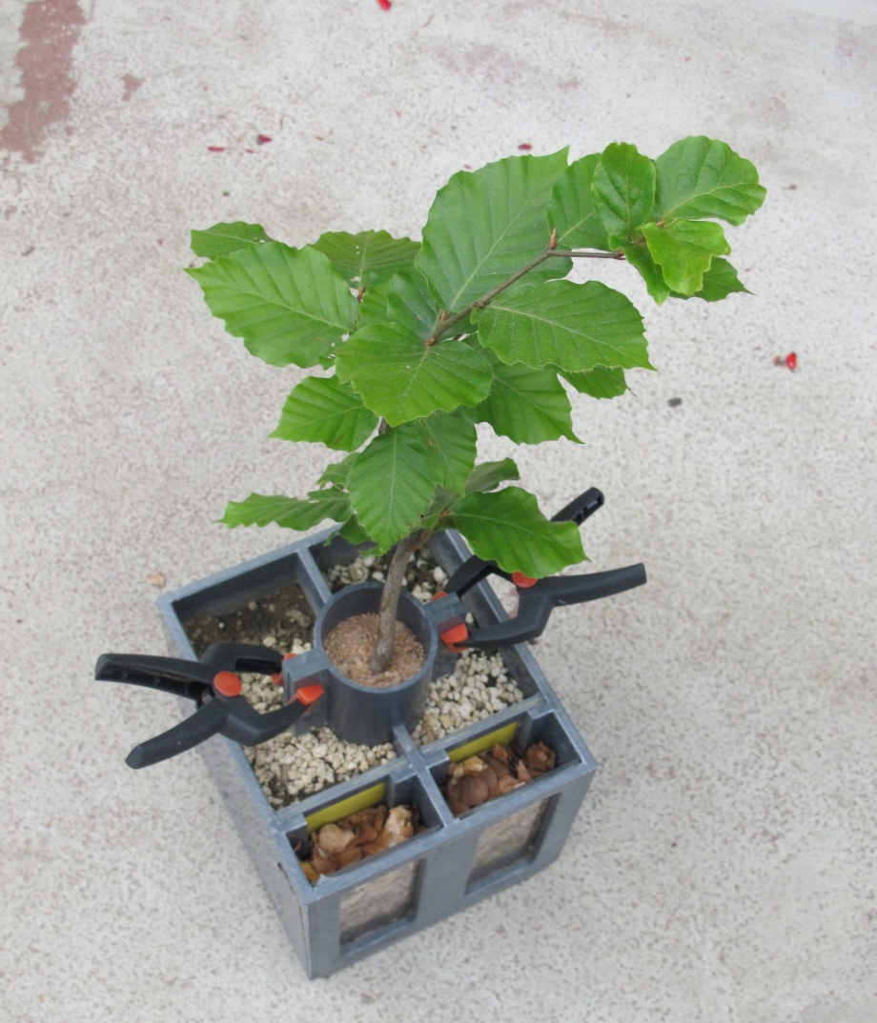
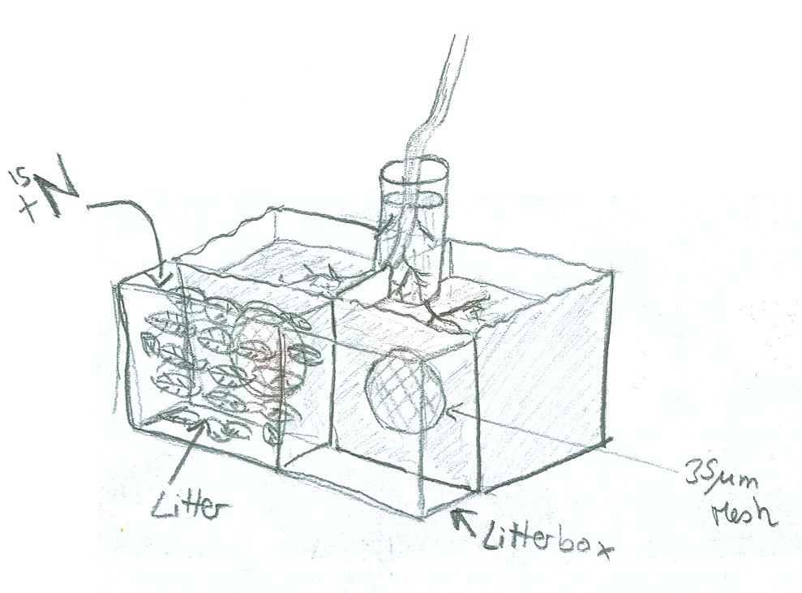
Experimental Design
Tripartite Symbiosis
Research Questions
Experimental Design
Methods
Results
¹³CO₂
Fagus sylvatica
¹⁵N
Split-root box (membrane 35 µm mesh size)

Slide 8
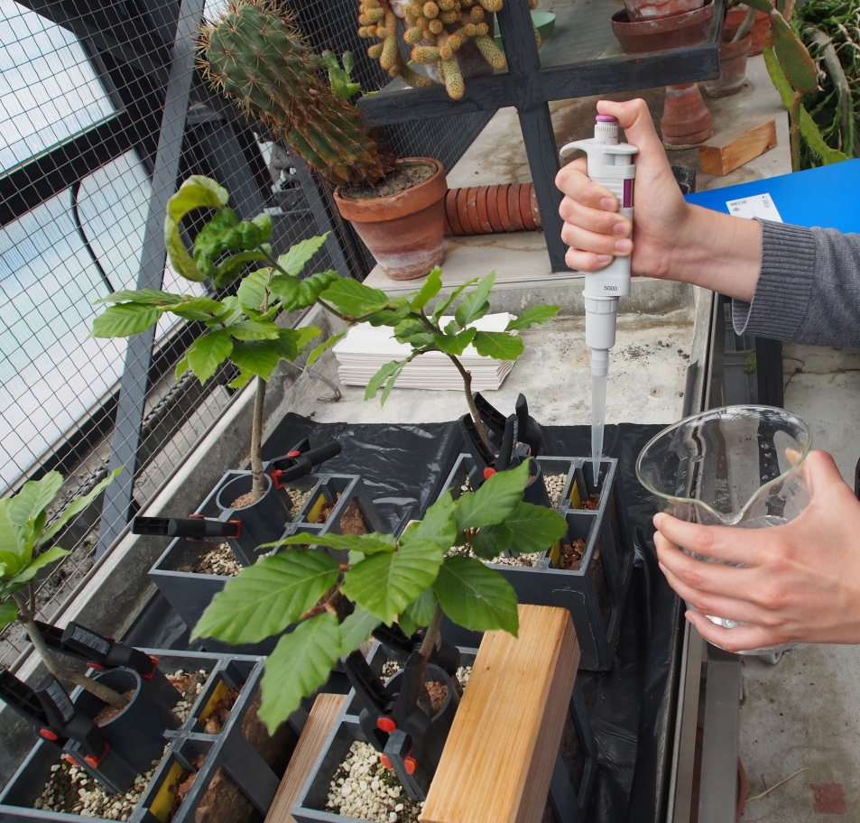
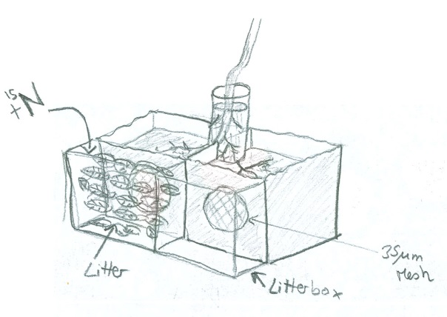
Experimental Design
Tripartite Symbiosis
Research Questions
Experimental Design
Methods
Results
¹⁵N-labeling
Left | Right
1mM¹⁵NH₄ + ¹⁵N - Amino Acids | H₂O
¹⁵N

Slide 9
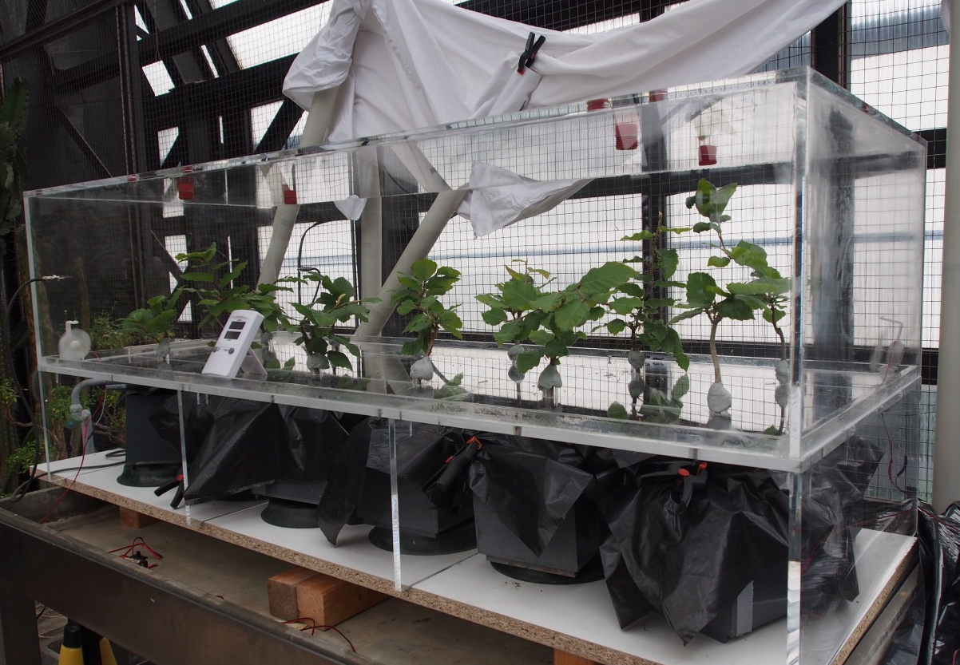
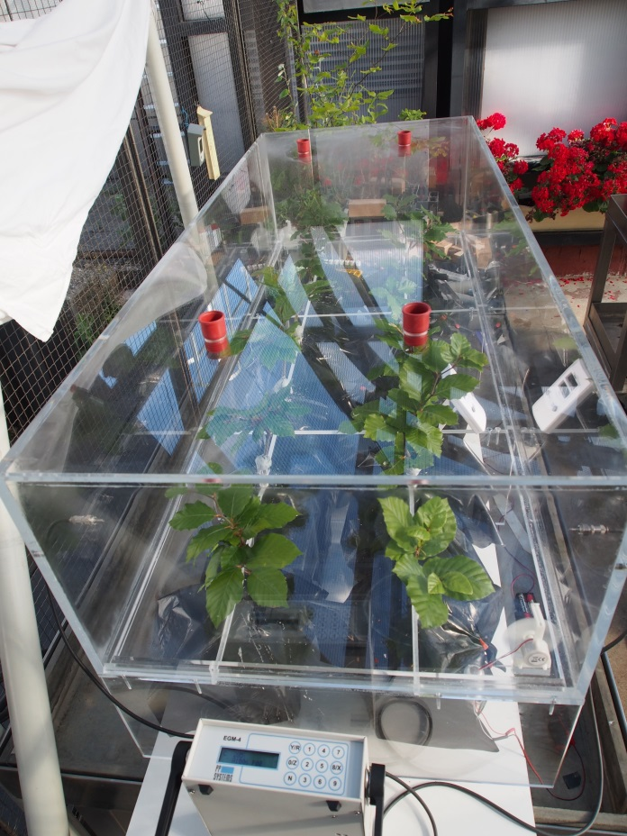
Experimental Design
Tripartite Symbiosis
Research Questions
Experimental Design
Methods
Results
¹³CO₂-labeling
8 hours
approx. 90 at% ¹³CO₂ (1500 ppm)
Labeling chamber

Slide 10
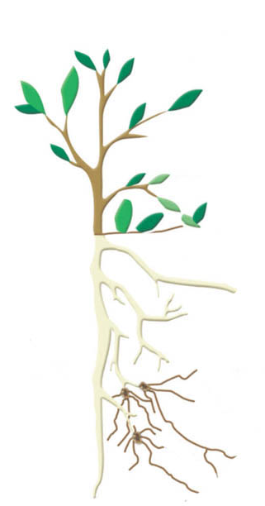
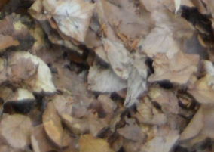
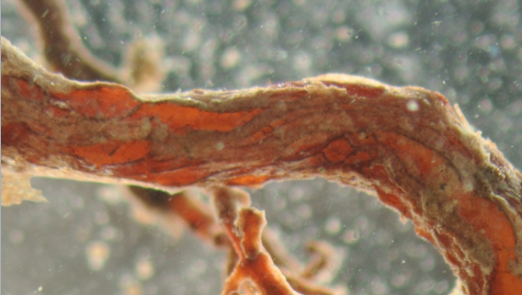
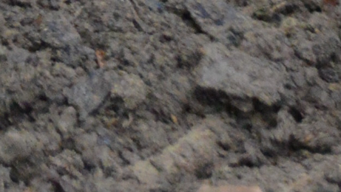
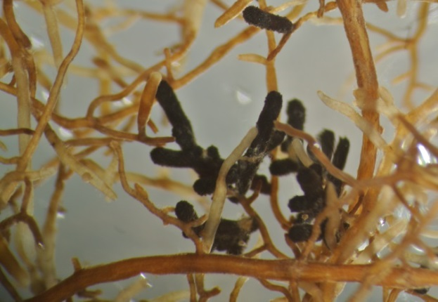
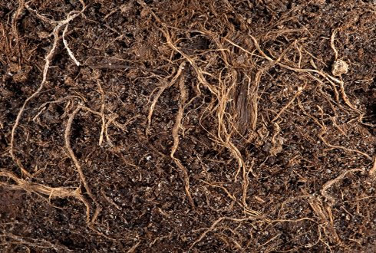
Soil habitats of Fagus sylvatica
Tripartite Symbiosis
Research Questions
Experimental Design
Methods
Results
litter
rhizoplane
bulk soil
mycorrhizal roottips
rhizosphere soil
http://mycor.nancy.inra.fr/IAM/?page_id=727

Slide 11
Methods
Tripartite Symbiosis
Research Questions
Experimental Design
Methods
Results
¹³CO₂ by Gasbench IRMS ¹³C in PLFAs by GC-IRMS Visualization of ¹³C and ¹⁵N by NanoSIMS | Light Microscopy CARD-FISH Scanning Electron Microscopy (SEM) NanoSIMS
Isotopic Analysis
Visualization
Microbial Communities: 16S rRNA gene amplicon sequencing (Illumina-Miseq; 806R/515F) Fungal Diversity: ITS Sanger Sequencing (ITS1F/ITS4)
Molecular Methods
Techniques

Slide 12
Tripartite Symbiosis
Research Questions
Experimental Design
Methods
Results
NanoSIMS
(Nanometer-Scale Secondary Ion Mass Spectrometry)
Nanometer resolution
High sensitivity
Multi collection: collection of 7 elements or isotopes in parallel
http://img.directindustry.de/images_di/photo-g/29082-2289895.jpg

Slide 13
Uses an energetic primary ion beam to produce and expel secondary particles under high vacuum from the samples surface
Small fraction of these ejected atoms or atom clusters are ionized, focused into a secondary ion beam and analyzed by mass spectrometry
Eichorst & Woebken, Molecular Methods and Applications in Microbiology, 2014

Slide 14
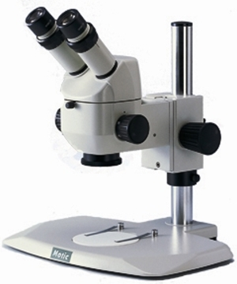
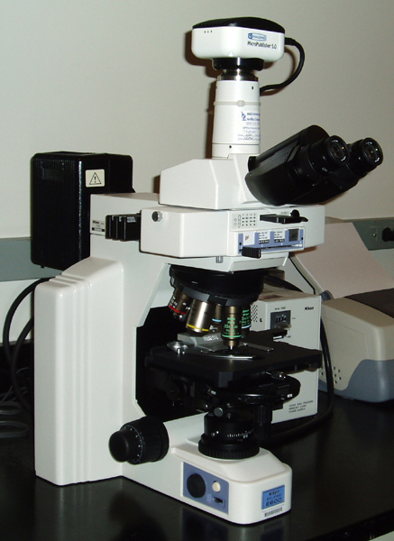
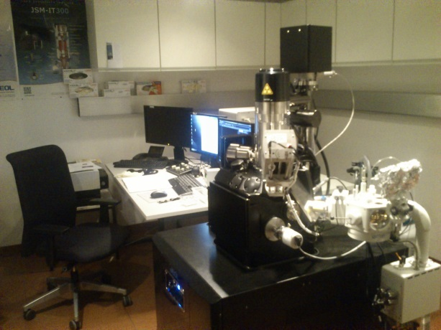
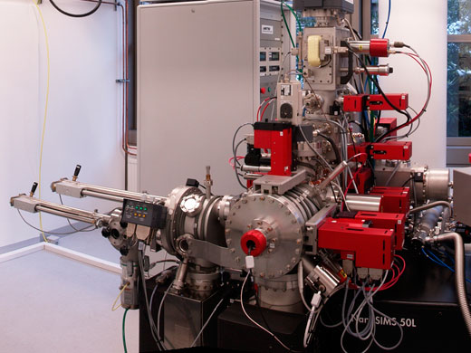
Correlative Microscopy
Tripartite Symbiosis
Research Questions
Experimental Design
Methods
Results
Stereoscope
Magnification 8-80x
Transmission Light Microscope
Magnification 40-1000x, Resolution 500 nm
Scanning Electron Microscope (SEM)
Resolution >10 nm
Image: http://www.spectra-shop.de
NanoSIMS
Resolution 100 nm
Image: http://dba.med.sc.edu
Image: http://cius.univie.ac.at
Image: Grogor Eder

Slide 15
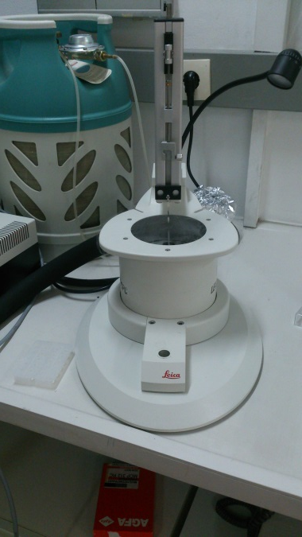
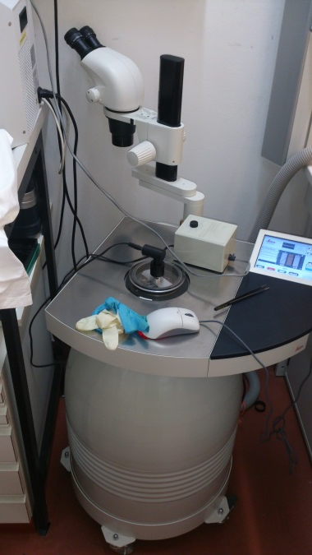
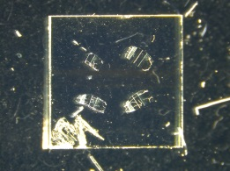
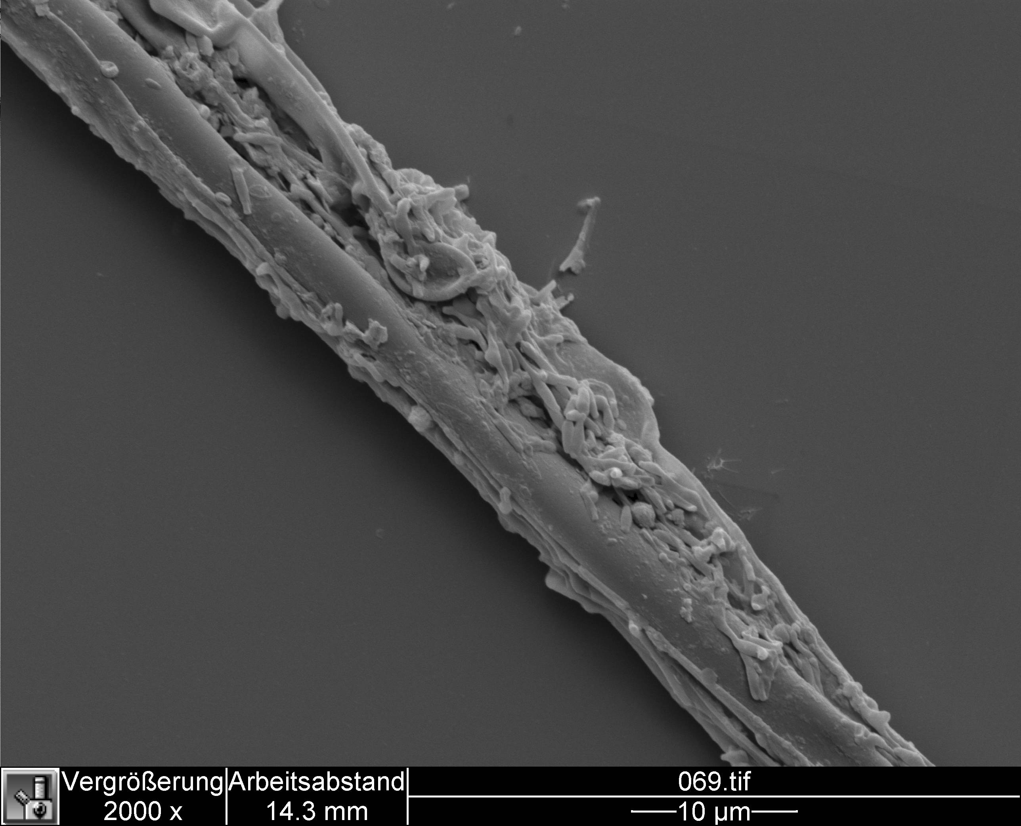
Sample Preparation
Tripartite Symbiosis
Research Questions
Experimental Design
Methods
Results
Mycorrhizal Root Tips Cross Sections:
Plunge Freezing (-183 °C)
Long Time Cryo Substitution: 3 weeks at -80°C, in Acrolein-Ether
Resin embedding in LR-White Acrylic Resin
External Hyphae:
Air dried hyphae on Silica-wafer
Cryo Techniques
Plunge freezing unit
Automatic freeze substitution unit
1 – Resin section on IT glass wafer
2 – SEM Hyphae on Si wafer
1
2

Slide 16
Results
Tripartite Symbiosis
Research Questions
Experimental Design
Methods
Results
Major Players
C and N transport across the system
Visualization
Plant - Fungi
Interface
Visualization
Fungi - Microbes
Interface

Slide 17
Who are the major Players?
Tripartite Symbiosis
Research Questions
Experimental Design
Methods
Results
Mycorrhizal Fungi
Soil Microbes

Slide 18
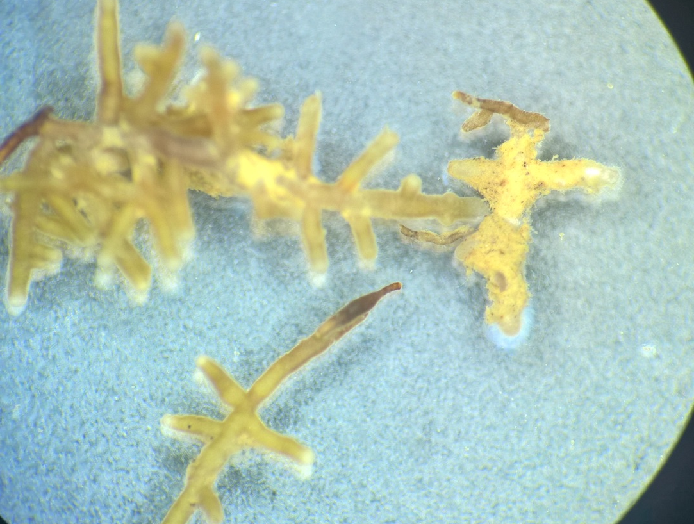
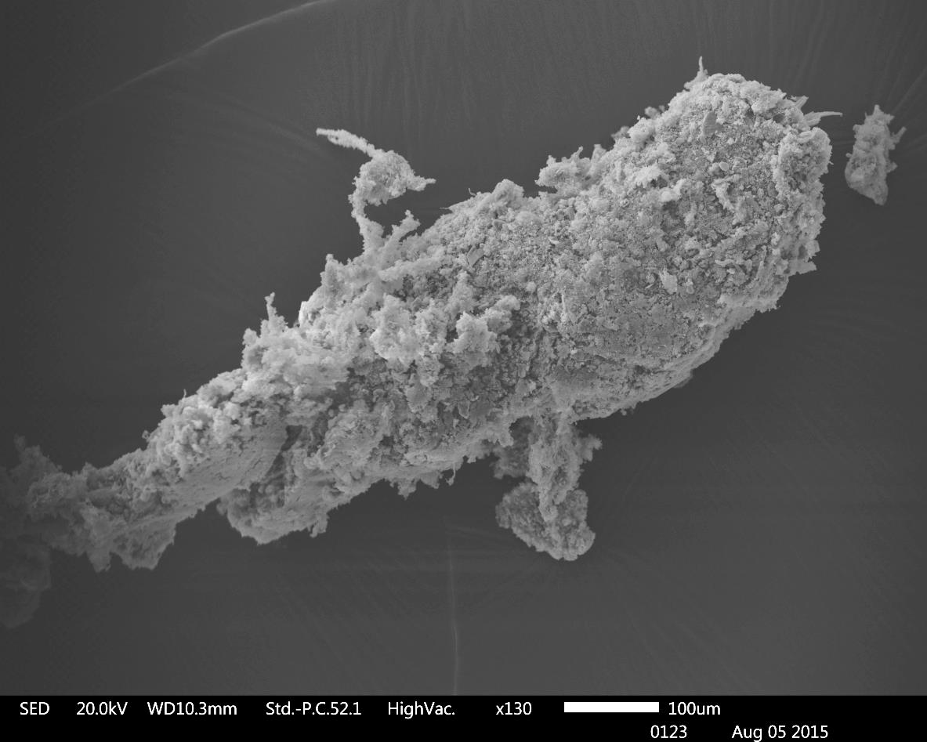
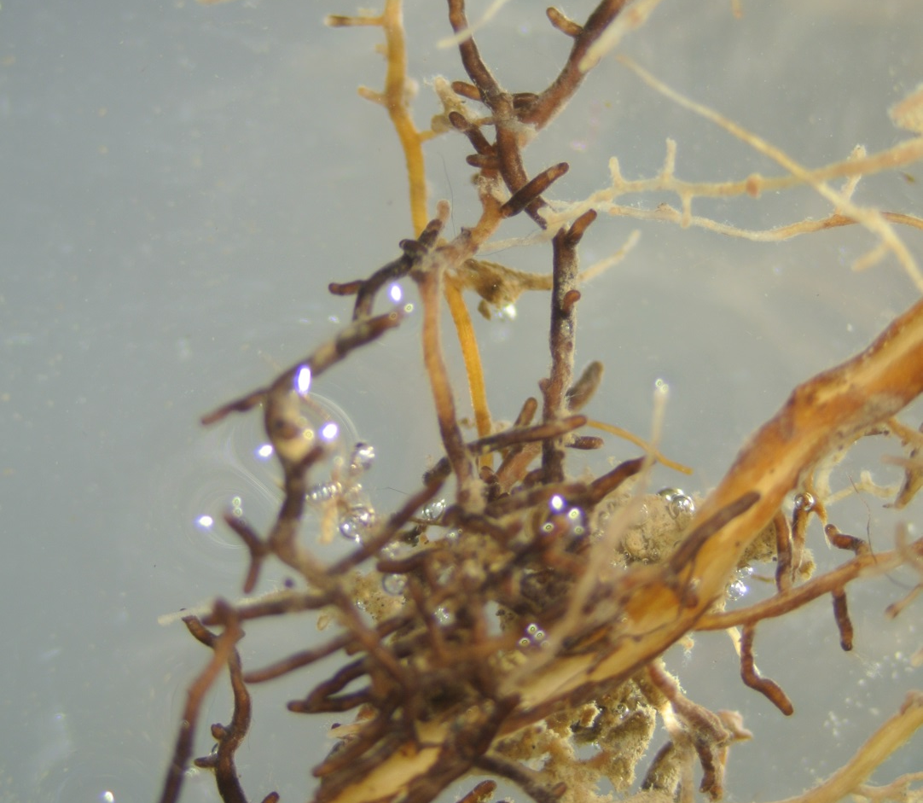
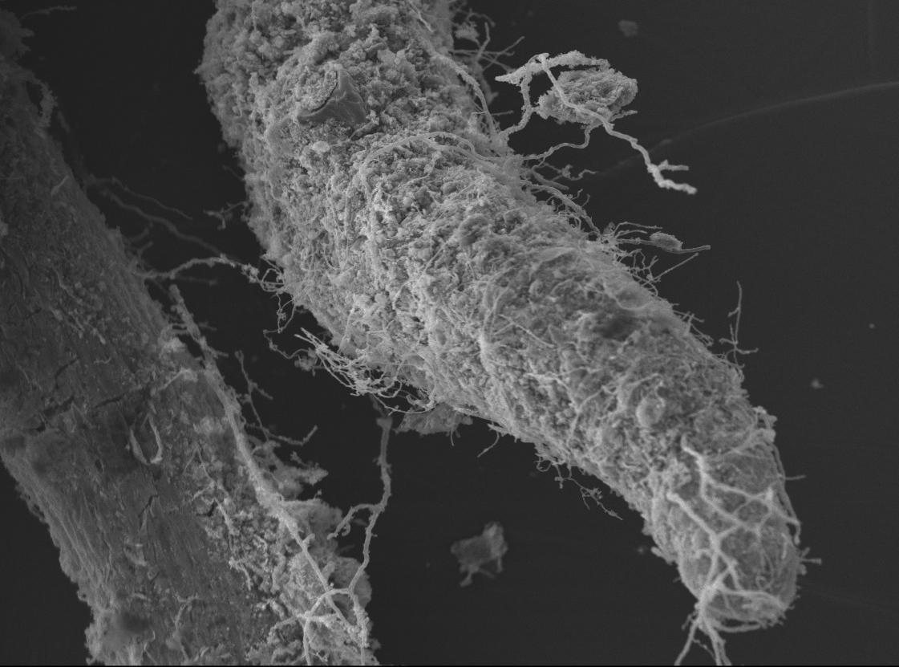
Fungal Morphotypes
M2
M2
5 mm
100 µm
M4
M4
100 µm

Slide 19
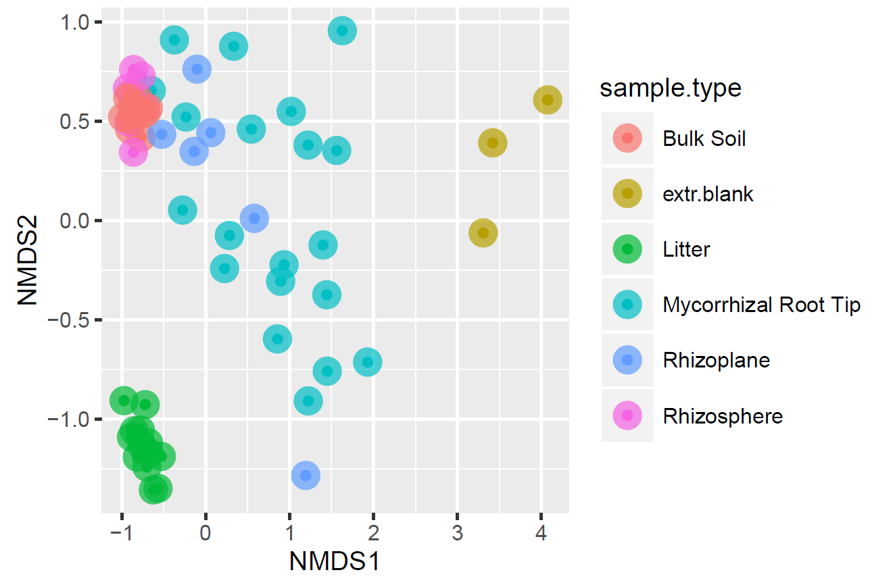
Beta Diversity Analysis
Tripartite Symbiosis
Research Questions
Experimental Design
Methods
Results
Soil Habitats

Slide 20
Microbial Community Composition
Tripartite Symbiosis
Research Questions
Experimental Design
Methods
Results
Litter
Soil Habitats
Methods
Litter
Bulk
Rhizosphere
Rhizoplane
Mycorrhizal Root Tip
Notes:
Litter, Bulk, RS, RP, MRT

Slide 21
Soil habitats of Fagus sylvatica
Tripartite Symbiosis
Research Questions
Experimental Design
Methods
Results
litter
rhizoplane
bulk soil
mycorrhizal roottips
rhizosphere soil
http://mycor.nancy.inra.fr/IAM/?page_id=727

Slide 22
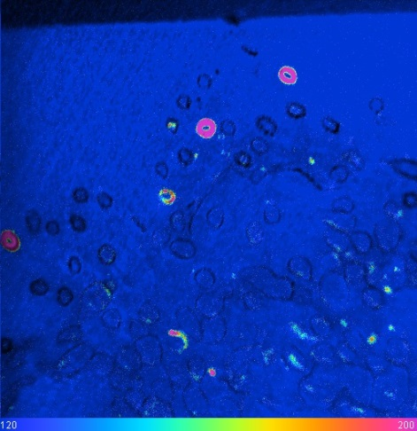
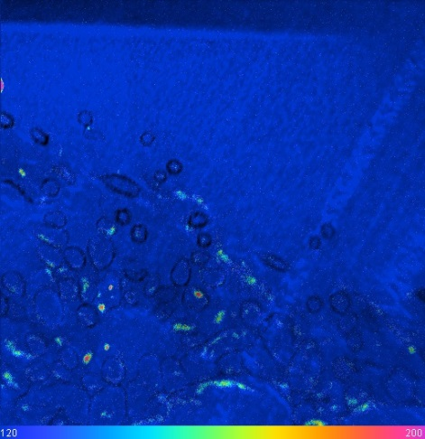
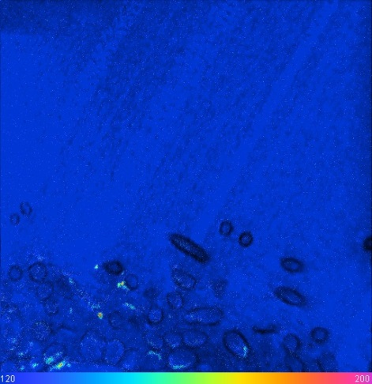
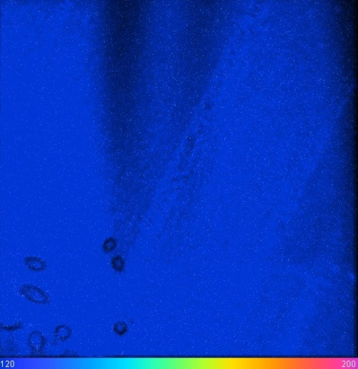
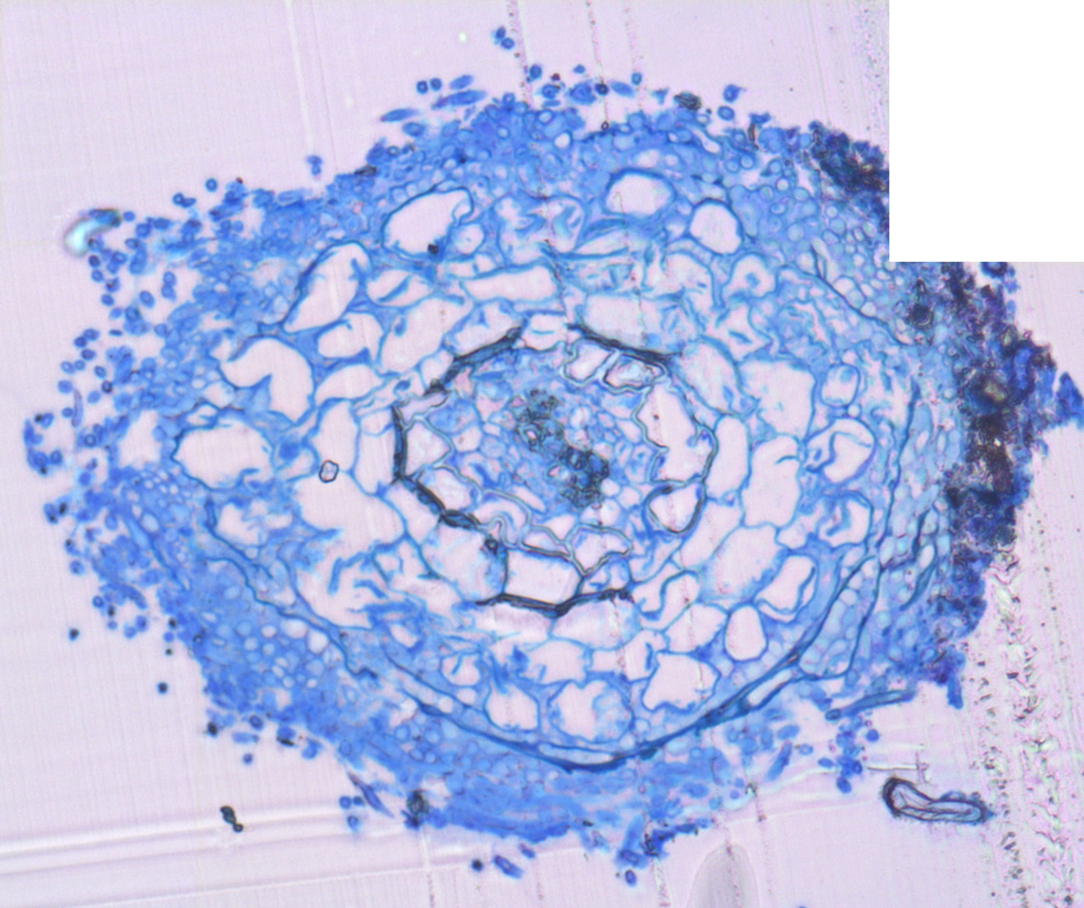
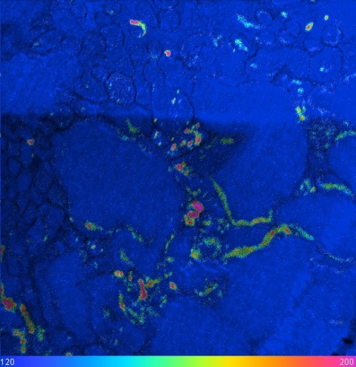
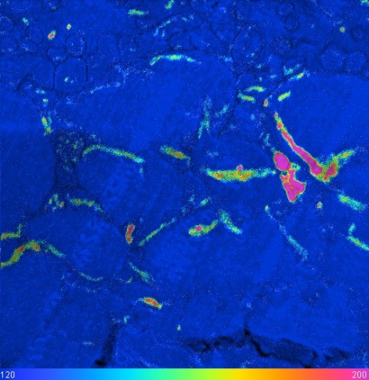
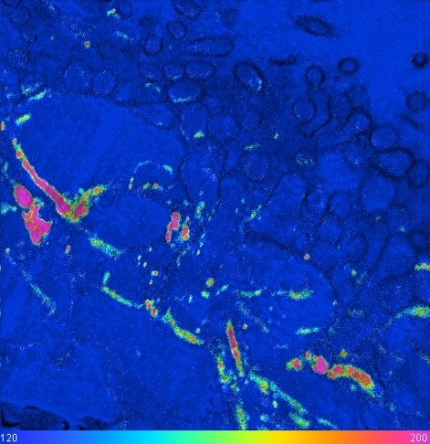
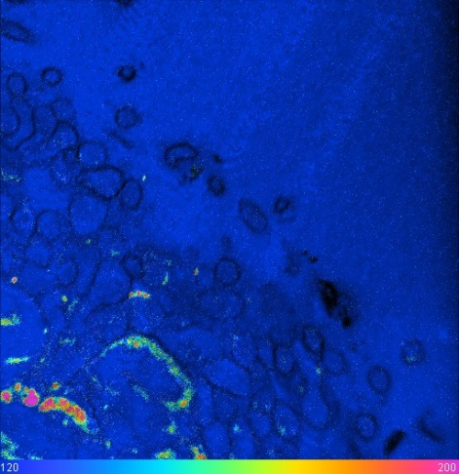
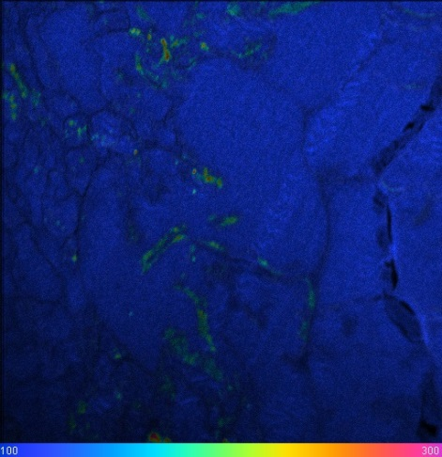
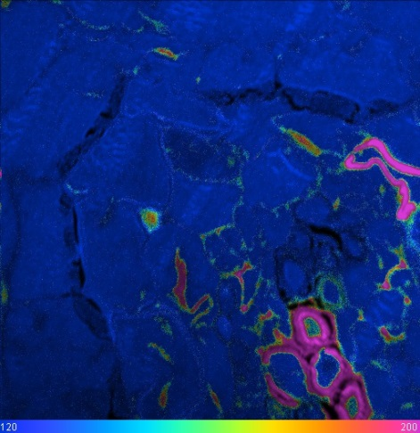
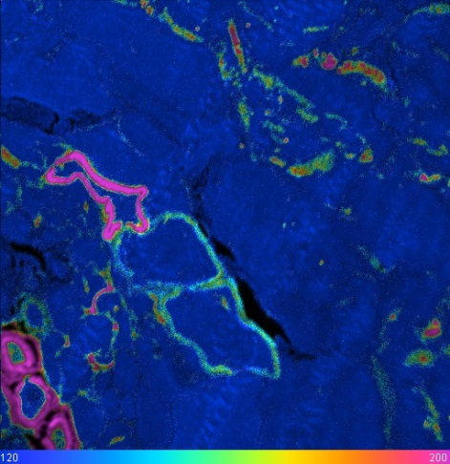
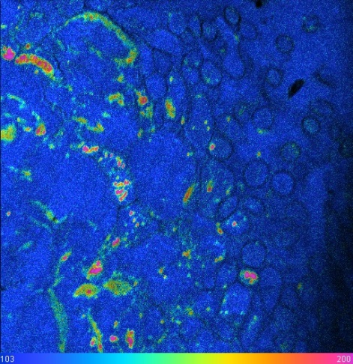

Interface Plant – Fungi ¹³C
Tripartite Symbiosis
Research Questions
Experimental Design
Methods
Results
Switch to
¹⁵N
11
12
9
10
Click to zoom in
7
6
5
8
Flow of recently assimilated plant C and N taken up from the soil is spatially correlated at the root-fungus interface
2
3
4
1
3
1,03 AT %
2 AT %

Slide 23
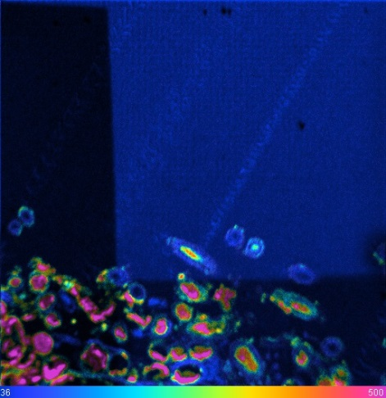
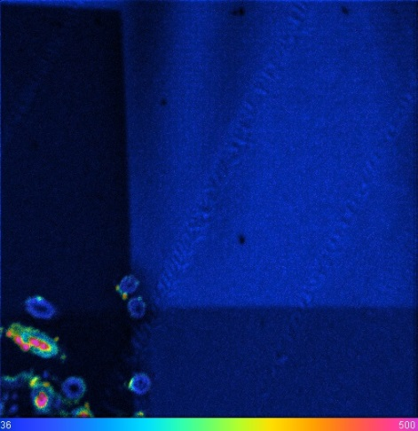
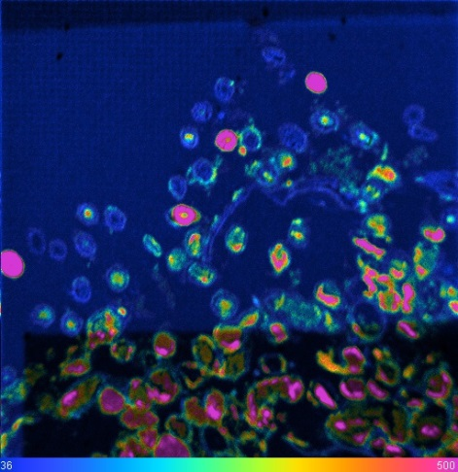
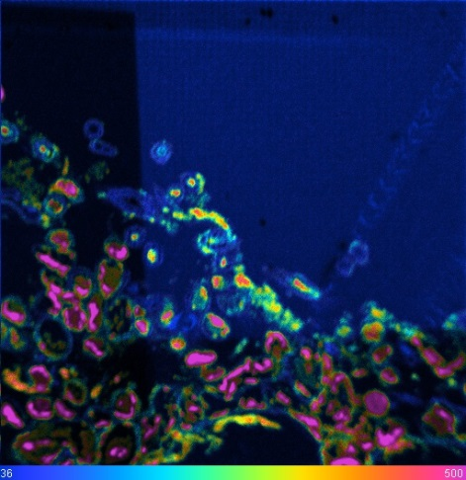
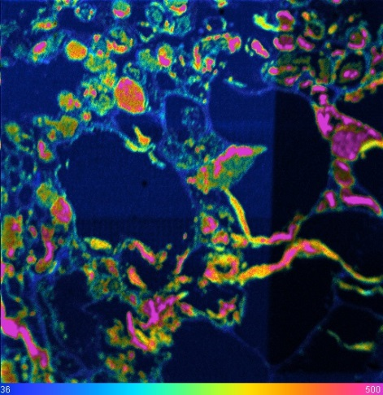
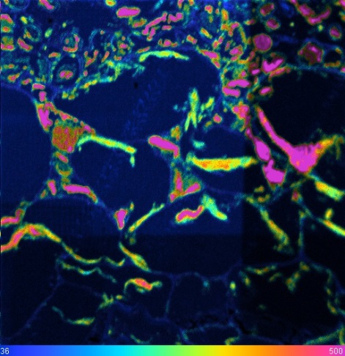
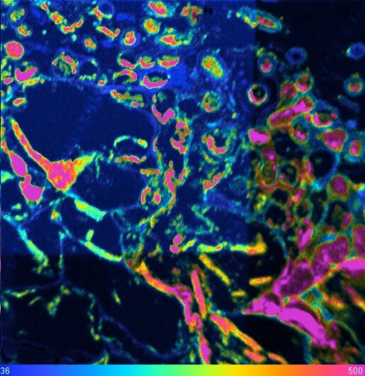



Interface Plant – Fungi ¹⁵N
Tripartite Symbiosis
Research Questions
Experimental Design
Methods
Results
Switch to
¹³C
11
12
9
10
Click to zoom in
7
6
5
8
Flow of recently assimilated plant C and N taken up from the soil is spatially correlated at the root-fungus interface
1
2
3
4
0,36 AT %
5 AT %

Slide 24
Interface Plant – Fungi
Tripartite Symbiosis
Research Questions
Experimental Design
Methods
Results
M2

Slide 25
Interface Plant – Fungi 1
Tripartite Symbiosis
Research Questions
Experimental Design
Methods
Results
1,03 AT %
2 AT %
0,36 AT %
5 AT %
AT% ¹³C
AT% ¹⁵N

Slide 26


Interface Plant – Fungi 2
Tripartite Symbiosis
Research Questions
Experimental Design
Methods
Results
1,03 AT %
2 AT %
0,36 AT %
5 AT %
AT% ¹³C
AT% ¹⁵N

Slide 27


Interface Plant – Fungi 3
Tripartite Symbiosis
Research Questions
Experimental Design
Methods
Results
1,03 AT %
2 AT %
0,36 AT %
5 AT %
AT% ¹³C
AT% ¹⁵N

Slide 28


Interface Plant – Fungi 4
Tripartite Symbiosis
Research Questions
Experimental Design
Methods
Results
1,03 AT %
2 AT %
0,36 AT %
5 AT %
AT% ¹³C
AT% ¹⁵N

Slide 29


Interface Plant – Fungi 5
Tripartite Symbiosis
Research Questions
Experimental Design
Methods
Results
1,03 AT %
2 AT %
0,36 AT %
5 AT %
AT% ¹³C
AT% ¹⁵N

Slide 30


Interface Plant – Fungi 6
Tripartite Symbiosis
Research Questions
Experimental Design
Methods
Results
AT% ¹³C
AT% ¹⁵N
1,03 AT %
2 AT %
0,36 AT %
5 AT %
AT% ¹³C
AT% ¹⁵N

Slide 31


Interface Plant – Fungi 7
Tripartite Symbiosis
Research Questions
Experimental Design
Methods
Results
1,03 AT %
2 AT %
0,36 AT %
5 AT %
AT% ¹³C
AT% ¹⁵N

Slide 32


Interface Plant – Fungi 8
Tripartite Symbiosis
Research Questions
Experimental Design
Methods
Results
1,03 AT %
2 AT %
0,36 AT %
5 AT %
AT% ¹³C
AT% ¹⁵N

Slide 33


Interface Plant – Fungi 9
Tripartite Symbiosis
Research Questions
Experimental Design
Methods
Results
1,03 AT %
2 AT %
0,36 AT %
5 AT %
AT% ¹³C
AT% ¹⁵N

Slide 34


Interface Plant – Fungi 10
Tripartite Symbiosis
Research Questions
Experimental Design
Methods
Results
1,03 AT %
2 AT %
0,36 AT %
5 AT %
AT% ¹³C
AT% ¹⁵N

Slide 35


Interface Plant – Fungi 11
Tripartite Symbiosis
Research Questions
Experimental Design
Methods
Results
1,03 AT %
2 AT %
0,36 AT %
5 AT %
AT% ¹³C
AT% ¹⁵N

Slide 36


Interface Plant – Fungi 12
Tripartite Symbiosis
Research Questions
Experimental Design
Methods
Results
1,03 AT %
2 AT %
0,36 AT %
5 AT %
AT% ¹³C
AT% ¹⁵N

Slide 37

Recently assimilated plant C and soil N transferred through plant-mycorrhiza-soil microbe experimental system
Tripartite Symbiosis
Research Questions
Experimental Design
Methods
Results
Significant Difference to Natural Abundance : * p < 0.05, ** p < 0.005, *** p < 0.0005

Slide 38



Interface Fungi – Microbes
Tripartite Symbiosis
Research Questions
Experimental Design
Methods
Results
C and N are transported within ectomycorrhizal hyphae

Slide 39


Interface Fungi – Microbes
Tripartite Symbiosis
Research Questions
Experimental Design
Methods
Results
Mycorrhizal hyphae transfer recently assimilated plant C to soil microbes

Slide 40

Hyphae – ¹³C Enrichment
Tripartite Symbiosis
Research Questions
Experimental Design
Methods
Results
NanoSIMS - Stacked images

Slide 41


Transfer of plant C from hyphae to bacteria shown by ¹³C-PLFA
Tripartite Symbiosis
Research Questions
Experimental Design
Methods
Results

Slide 42

and Bettina Mayerhofer

