Slide 1
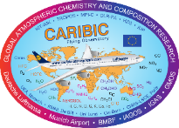
Spatio-temporal aerosol particle distributions in the
Upper Troposphere/Lowermost Stratosphere measured
by the IAGOS-CARIBIC Observatory
Denise Assmann, M. Hermann, A. Weigelt, B. Martinsson,
C. Brenninkmeijer, A. Rauthe-Schöch, P. van Velthoven,
H. Bönisch, and A. Zahn
assmann@tropos.de
1. IAGOS-CARIBIC
PICO Navigation
2. Spatio-temporal aerosol
particle distributions
→ Enlarge pictures by clicking on them
The orange ‘Home‘
button takes you to
the select menu
The blue left/right
arrows take you to
the previous/next page
3. Cross-tropopause exchange processes
of aerosol particles

Slide 2
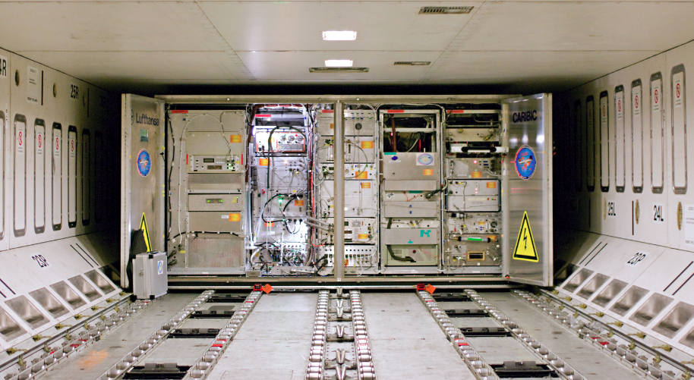
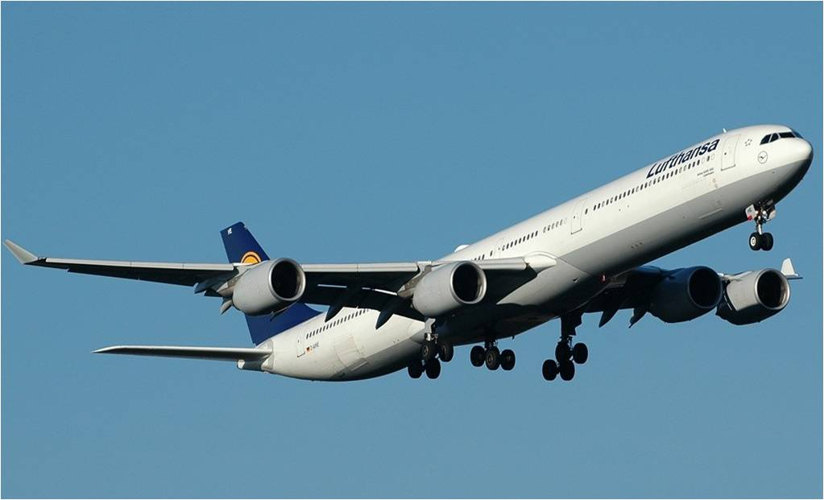
IAGOS-CARIBIC
In-service Aircraft for a Global Observing System
Civil Aircraft for Regular Investigation of the Atmosphere Based on an Instrument Container
Airbus A340-600 (since 2005)
2-MINUTE MADNESS
N₁₄₀
N₄, N₁₂, N₁₈
S, H, C, N, O, Fe, K, …, BC
GHG, NMHC, CFC,
CH₃CN, O₃, Hg, H₂O,
CO, CO_{2,} NO, NO_{y}, …
Aerosol
particles
Trace
gases
www.caribic-atmospheric.com
www.iagos.org

Slide 3
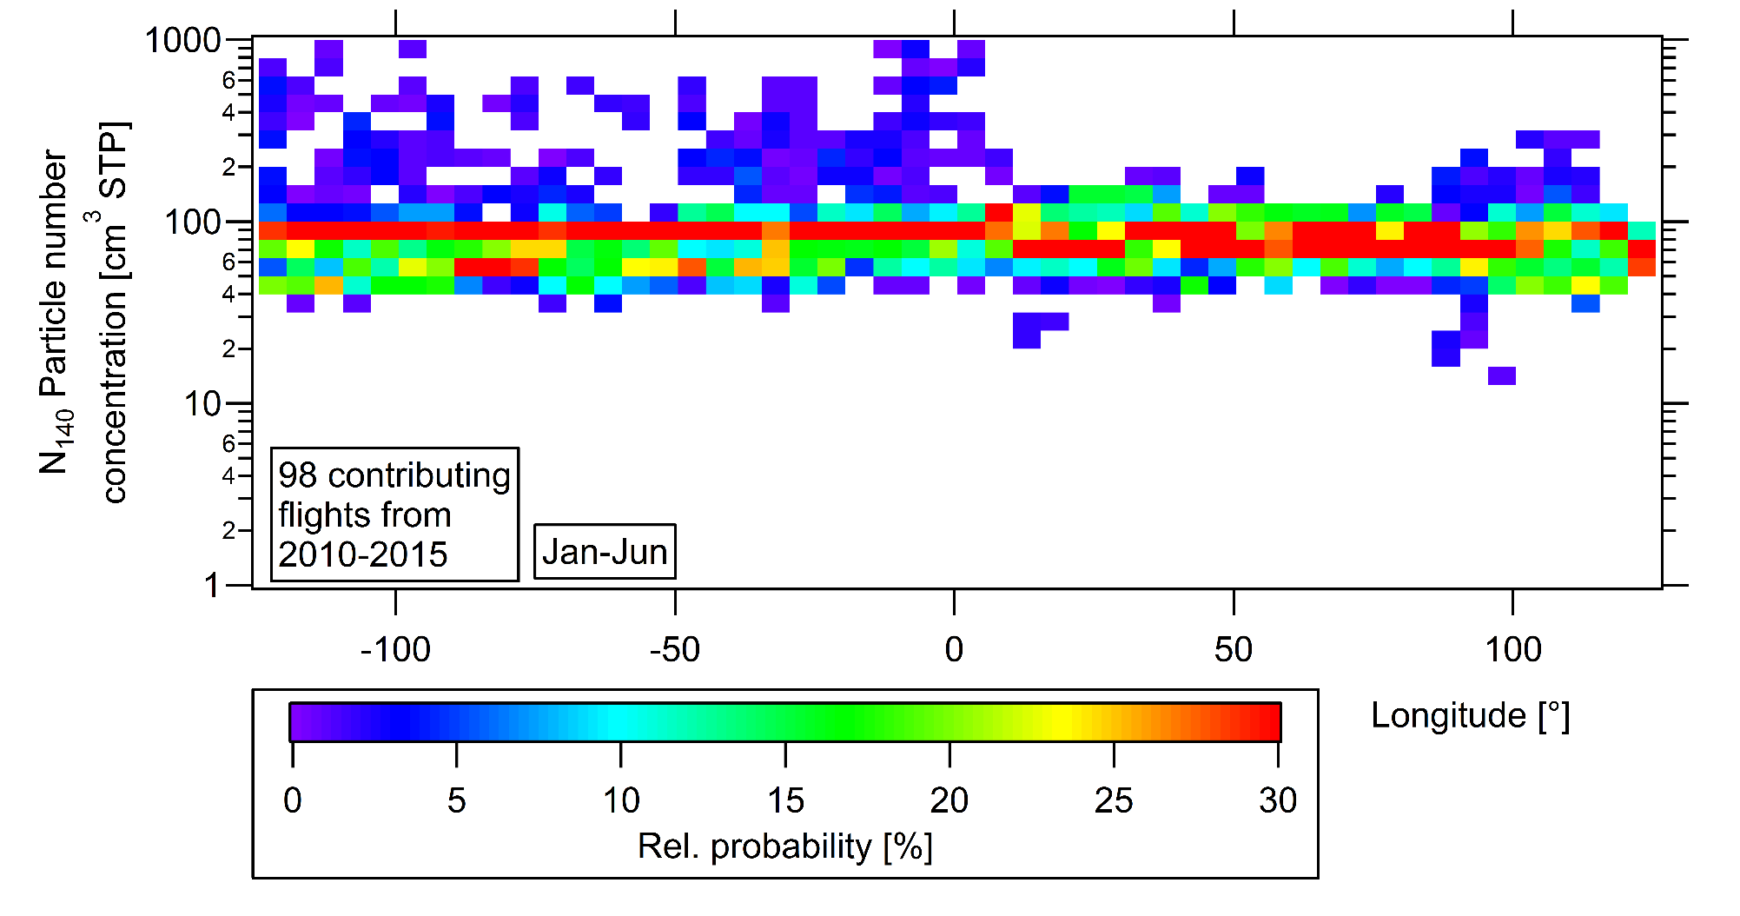
Spatio-temporal aerosol particle distributions
Probability density function (Latitude: 40-80 °N)
2-MINUTE MADNESS
Nearly constant concentration
over the Northern Hemisphere
≈ 80 particles/cm³

Slide 4
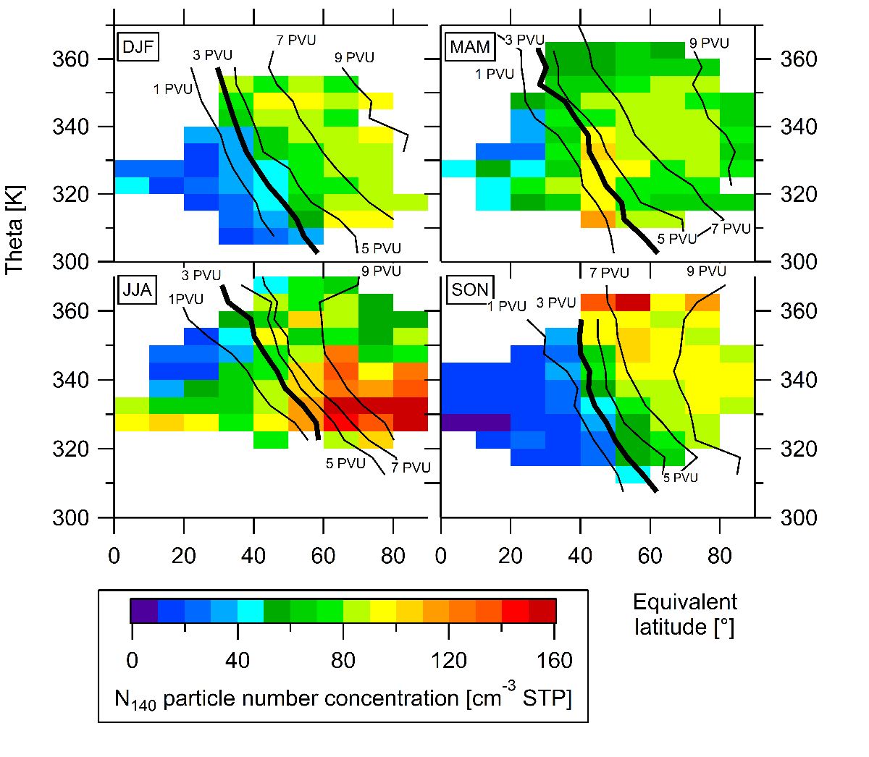
Exchange processes of aerosol particles
across the tropopause
Accumulation mode particles:
DJF: Clear separation of
troposphere and stratosphere
MAM: Effect of Brewer-
Dobson circulation
JJA: Minimum in the tropics
Maximum at higher latitudes
SON: Clear separation of
troposphere und stratosphere
2-MINUTE MADNESS

Slide 5
IAGOS-CARIBIC
In-service Aircraft for a Global Observing System
Civil Aircraft for Regular Investigation of the Atmosphere Based on an Instrument Container
Airbus A340-600 (since 2005)
IAGOS-CARIBIC
N₁₄₀
N₄, N₁₂, N₁₈
S, H, C, N, O, Fe, K, …, BC
GHG, NMHC, CFC,
CH₃CN, O₃, Hg, H₂O,
CO, CO_{2,} NO, NO_{y}, …
Aerosol
particles
Trace
gases
www.caribic-atmospheric.com
www.iagos.org

Slide 6
IAGOS-CARIBIC inlet
aircraft skin doubler
Flight direction →
DOAS telescopes
35 cm
trace gas probe
IAGOS-CARIBIC
water drain mast
gaseous water probe
total water probe
aerosol probe
50 cm

Slide 7
IAGOS-CARIBIC container
Cargo compartment
Once per month: loading & unloading for four intercontinental flights
GHG,
NMHC,
CFC
SO₂,NO₂
BrO,HONO
CH₄
OPSS
O₃
CO
Hg
CO₂
IAGOS-CARIBIC
CH₃CN
CPC
NO,
NO_{y}
S,H,C,
N,O
H₂O
O - isotope
+ BC since Aug 2014

Slide 8
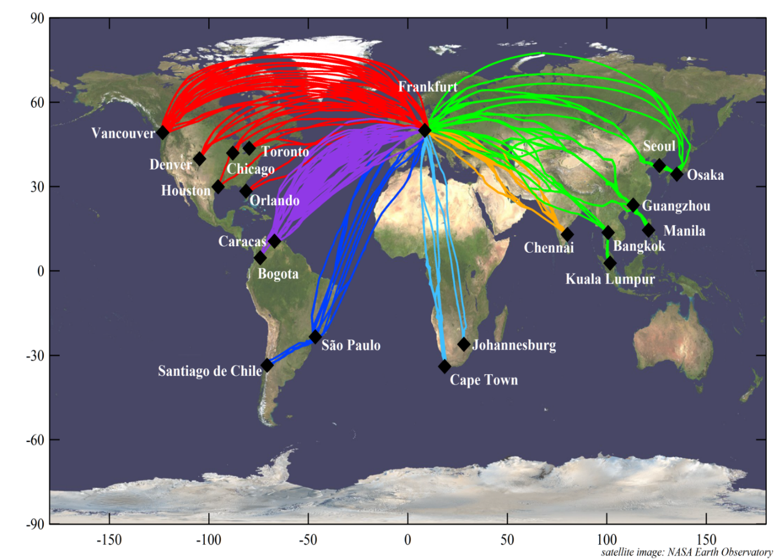
IAGOS-CARIBIC flights
In-service Aircraft for a Global Observing System
Civil Aircraft for Regular Investigation of the Atmosphere Based on an Instrument Container
Flight altitude:
8-12 km
Long-term measurements
(2005 – …)
> 1500 flight hours until summer 2015
IAGOS-CARIBIC

Slide 9
Aerosol measurements
Condensation Particle Counters (3 CPCs) - 4, 12, 18 nm < diameter < ~ 2000 nm (N₄, N₁₂, N₁₈) - N₁₂ ≈ Aitken mode particles
Optical Particle Size Spectrometer (OPSS) - 140 nm < diameter < ~ 1040 nm (N₁₄₀) - N₁₄₀ ≈ accumulation mode particles
Particle Sampler - 0.08 μm < d_{p} < 2.0 μm - Elemental particle composition by ion beam analysis
PIXE (Particle Induced X-ray Emission) PESA (Particle Elastic Scattering Analysis) (e.g. S, H, C, N, O, K, Fe, Ni)
Single Particle Soot Photometer (SP2) - 70 nm < diameter < 500 nm - Black carbon
IAGOS-CARIBIC

Slide 10
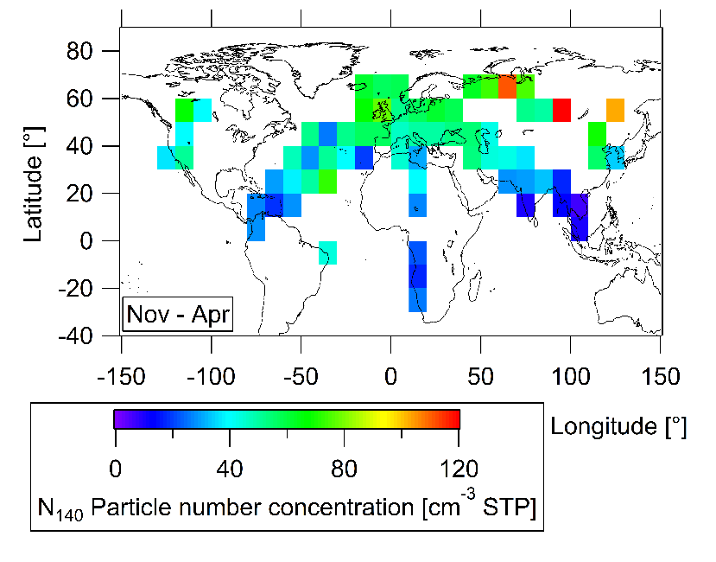
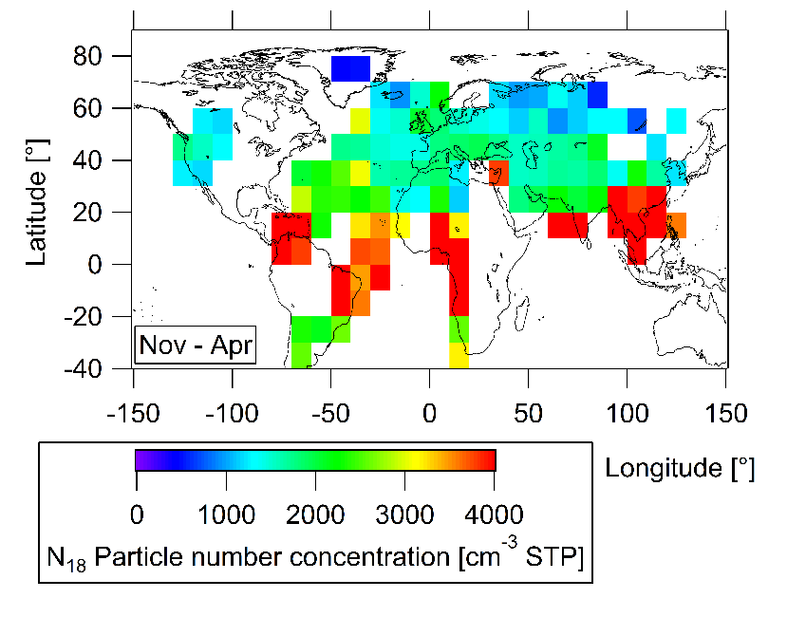
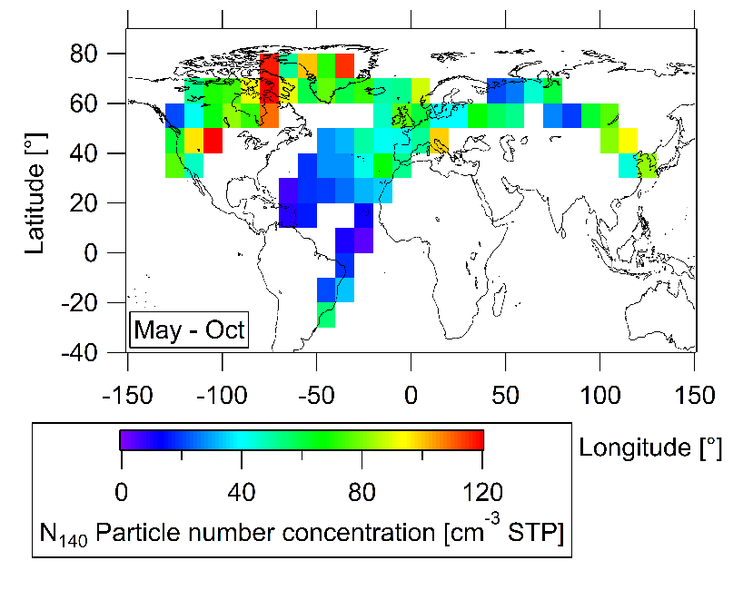
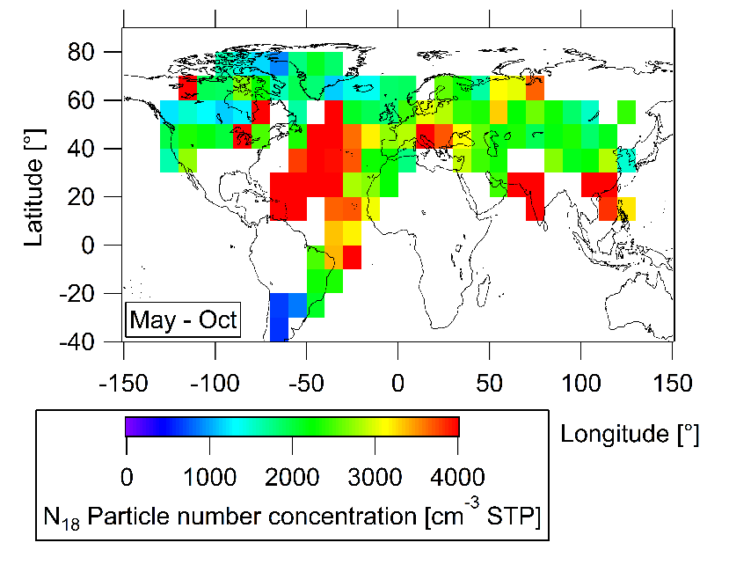
Spatio-temporal aerosol distribution: Troposphere
OPSS: N₁₄₀ - Median - CPC: N₁₈
Boreal
winter
ITCZ
ITCZ
Aerosol particle distributions
Boreal
summer
ITCZ
ITCZ
Opposite gradient from mid-latitudes into the tropics

Slide 11
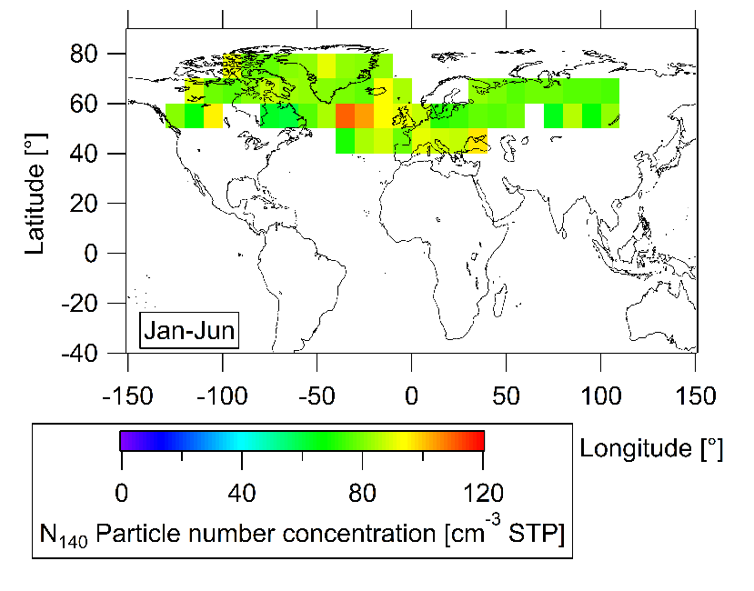
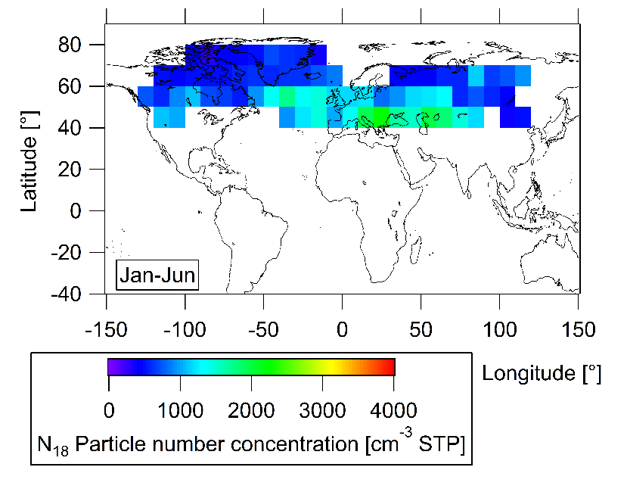
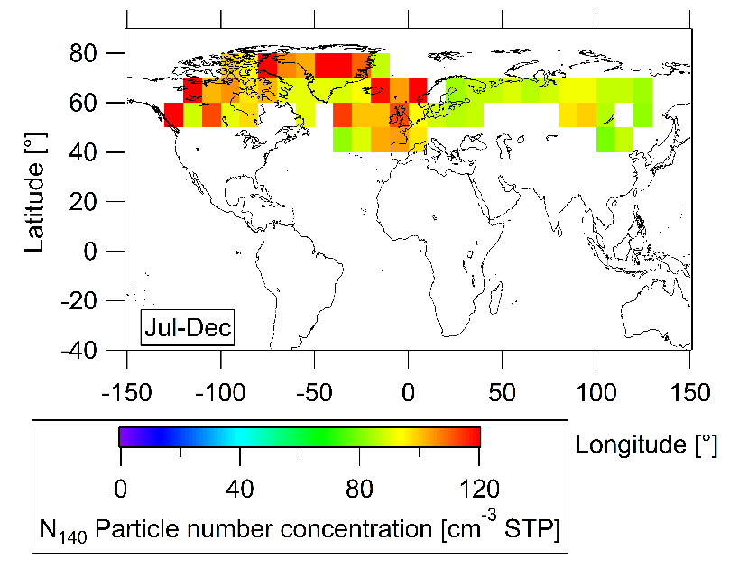
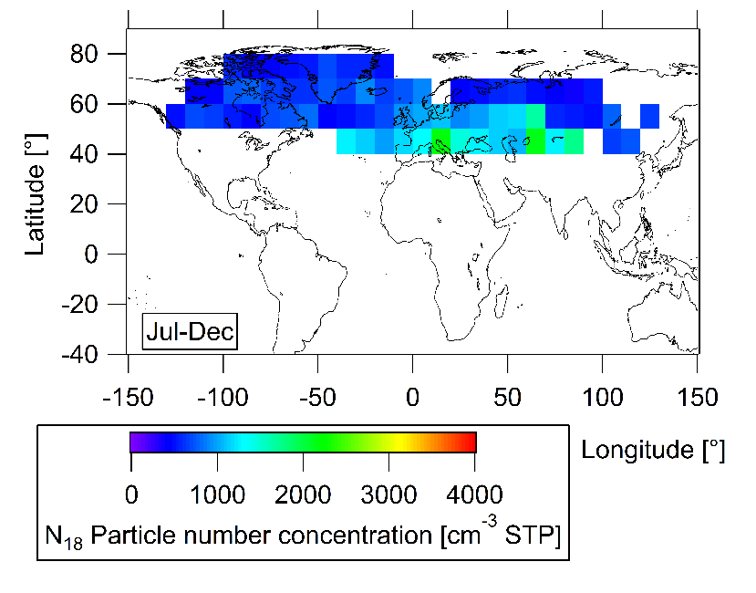
Spatio-temporal aerosol distribution: Stratosphere
OPSS: N₁₄₀ - Median - CPC: N₁₈
Boreal
winter
Aerosol particle distributions
Boreal
summer
N₁₄₀: mostly higher values than in the troposphere
N₁₈ : mostly lower values than in the troposphere;
more homogenous than in the troposphere

Slide 12
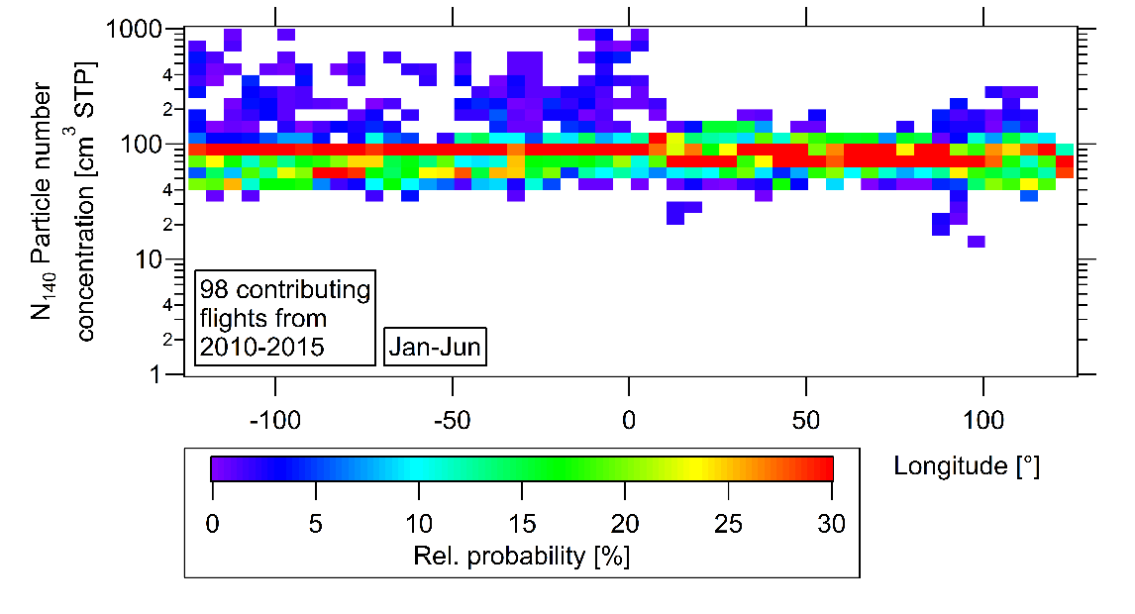
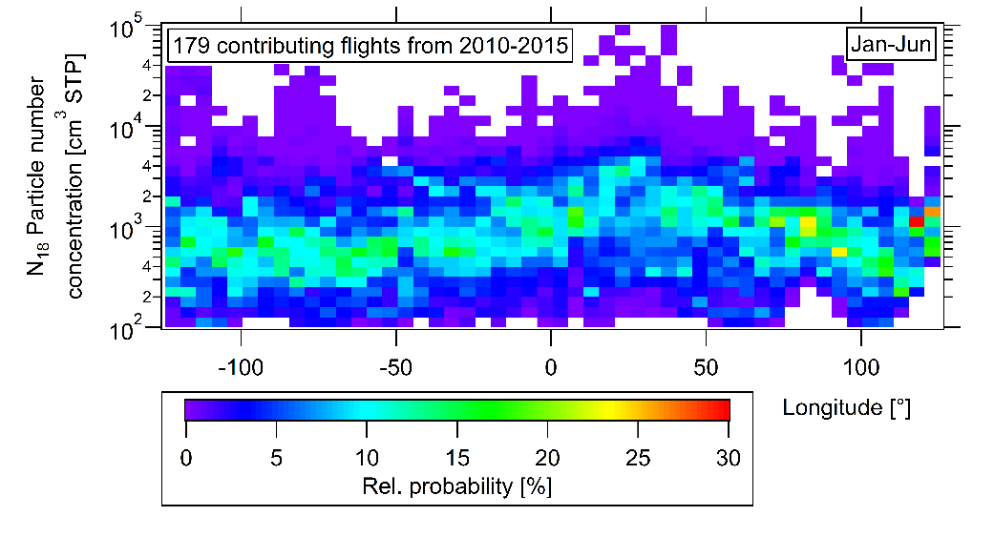
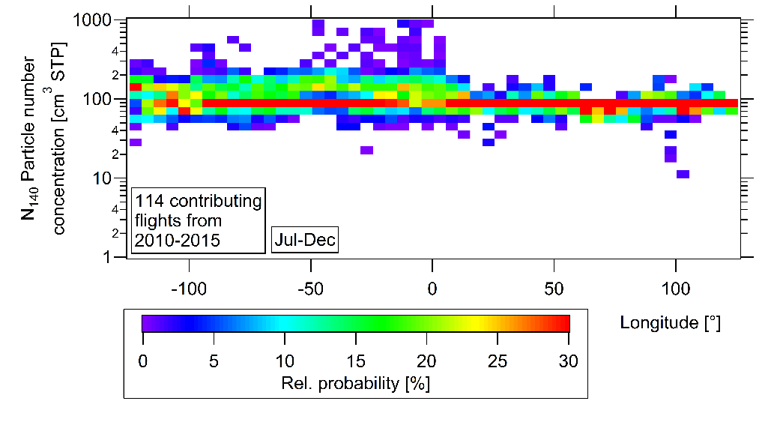
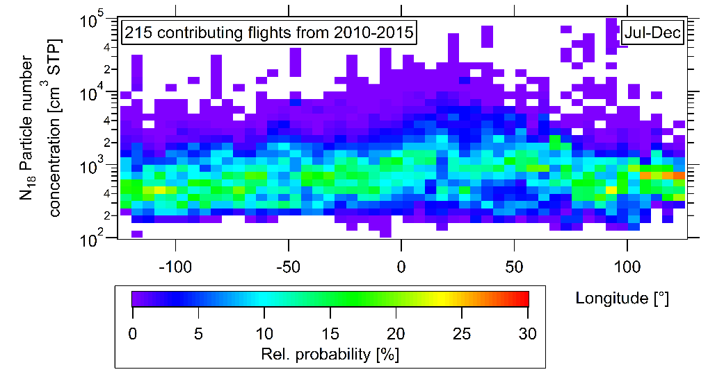
Northern Hemisphere (40 °N - 80 °N)
OPSS: N140 CPC: N18
Aerosol particle distributions
N₁₄₀: Narrow band of possible concentrations
N₁₈: Higher variability than N₁₄₀ but still relatively constant

Slide 13
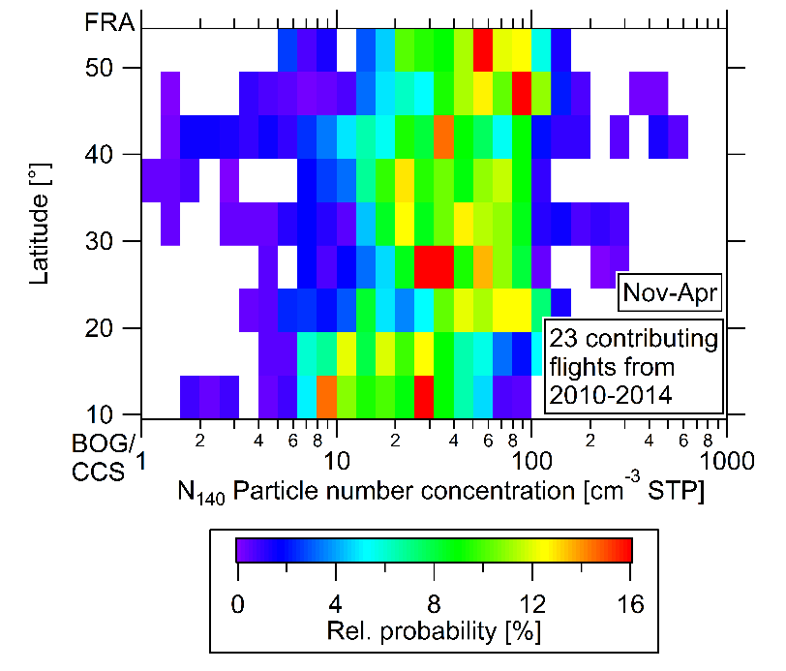
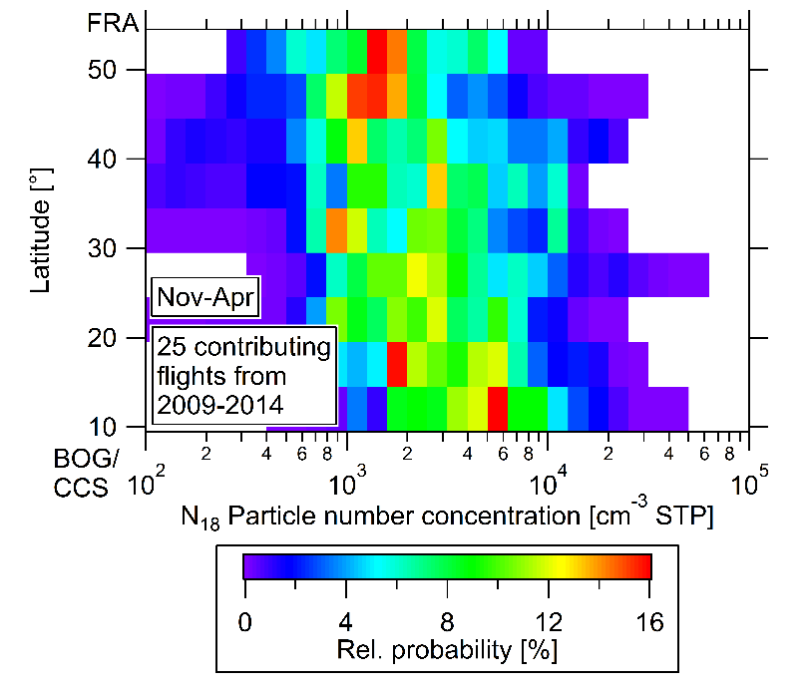
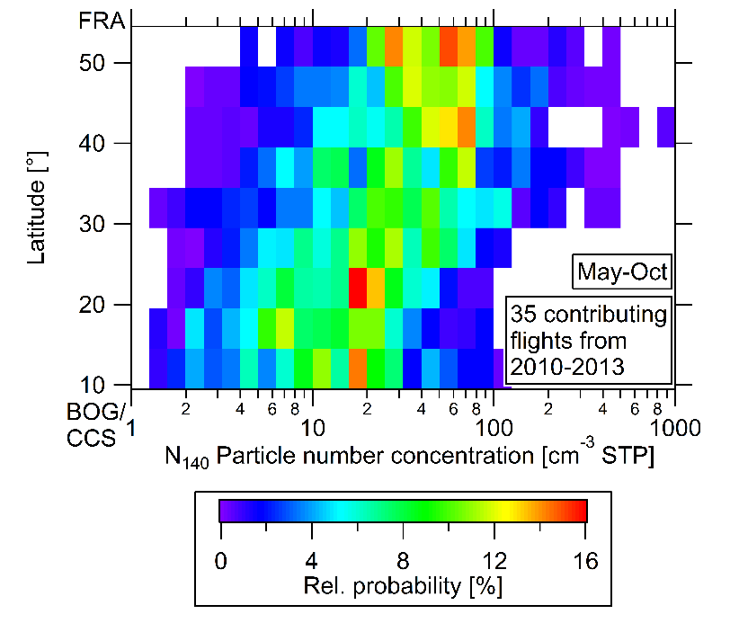
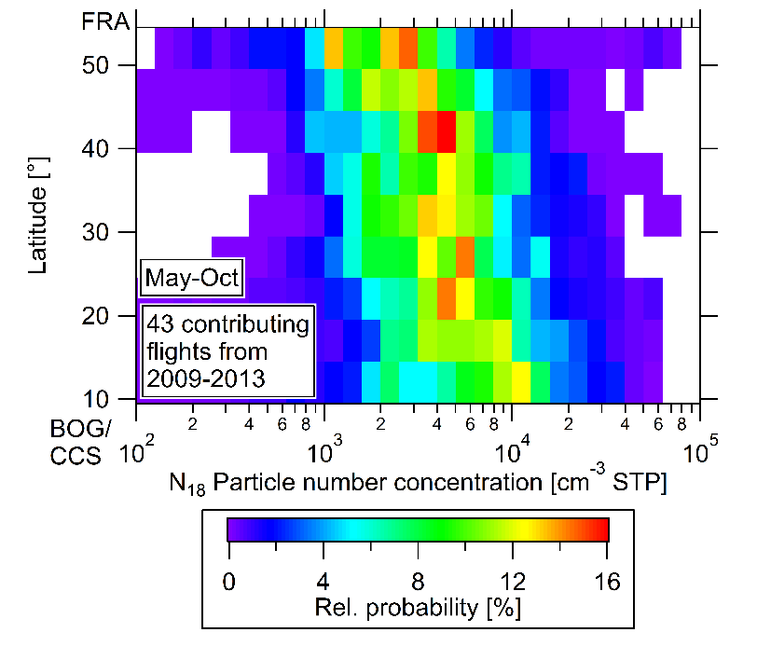
Flight route: South America
OPSS: N140 CPC: N18
Boreal
winter
Aerosol particle distributions
Boreal
summer
N140: Maximum of PDF is shifted to lower values into the tropics
N18: Maximum of PDF is shifted to higher values into the tropics

Slide 14
Microphysical scheme
ITCZ
H₂SO₄ / H₂O
.
.
.
.
.
.
.
.
.
.
.
.
.
SO₂
.
.
.
.
.
.
.
.
.
.
.
.
.
New particle formation
Cloud droplet activation
Aerosol particle distributions
trade winds
SO₂
subtropics
tropics
DMS

Slide 15
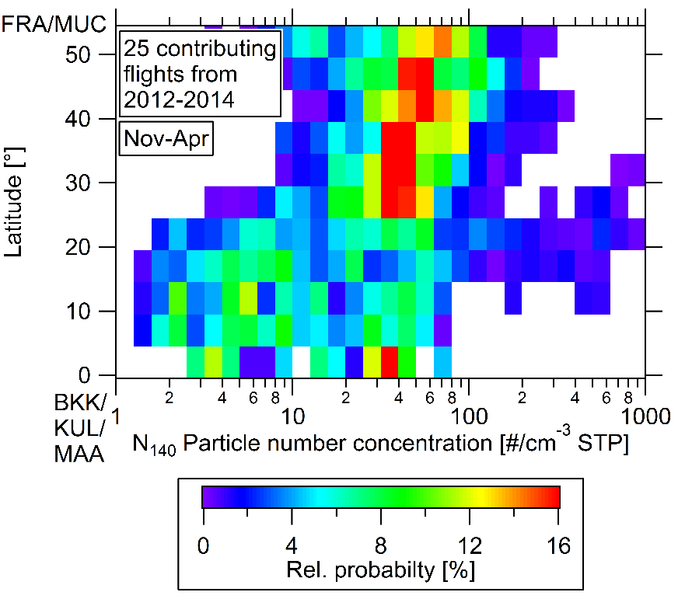
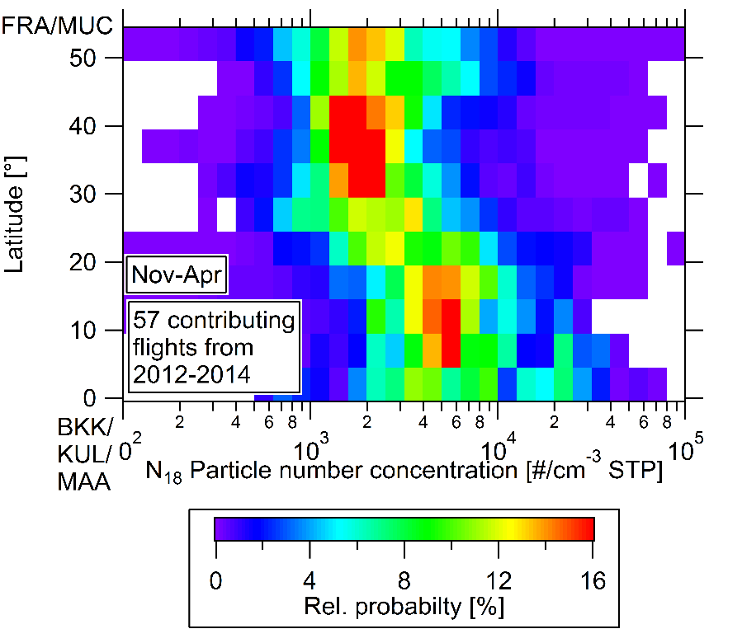
Flight route: South Asia
OPSS: N140 CPC: N18
Boreal
winter
Aerosol particle distributions
N140: Maximum of PDF is shifted to lower values into the tropics
N140: Special feature with high concentrations between 10-30 °N
N18: Maximum of PDF is shifted to higher values into the tropics

Slide 16
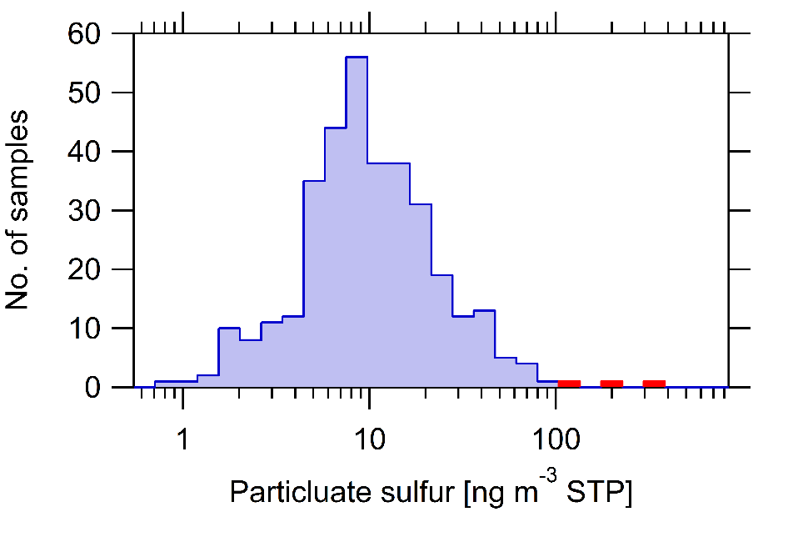
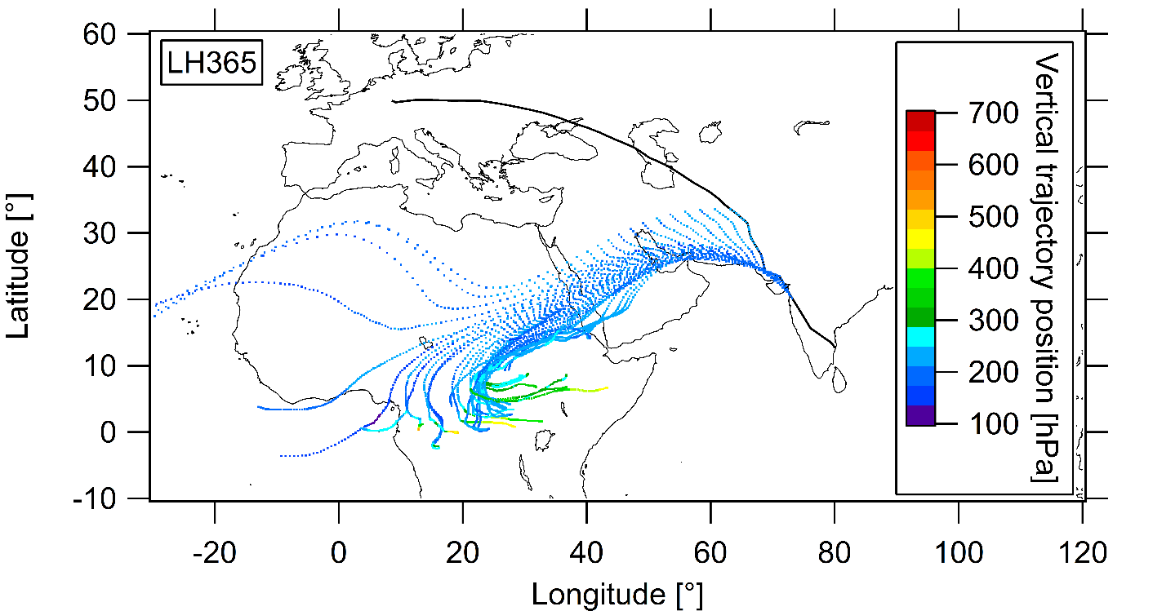
LH365 +
LH366
Nov 2011
LH365 +
LH366
Aerosol particle distributions
Break-up of smooth Gaussian distribution
Highest sulphur measurements ever within IAGOS-CARIBIC
Trajectories indicate volcanic eruption
Nyamuragira
Nov 2011

Slide 17
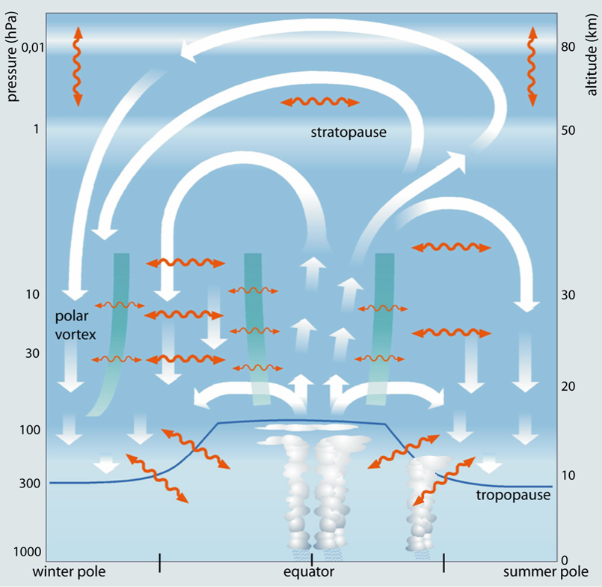
Exchange processes of aerosol particles
across the tropopause
Main transport pathways:
Deep convective clouds
Warm conveyor belt
Brewer-Dobson circulation
Isentropic transport
Exchange processes
Flight
altitude
www.uni-frankfurt.de

Slide 18
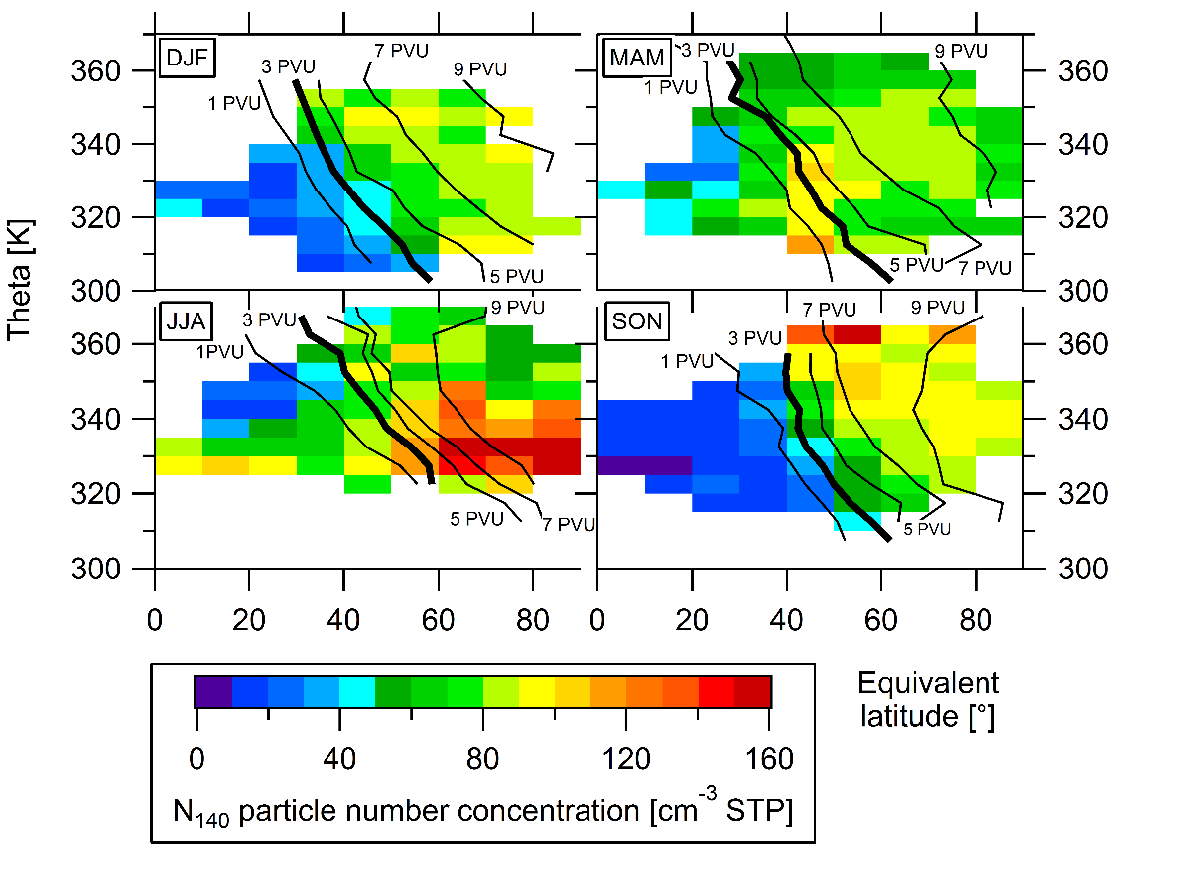
Exchange processes of aerosol particles
across the tropopause
Accumulation mode particles:
DJF: Clear separation of
troposphere and stratosphere
MAM: Effect of Brewer-
Dobson circulation
JJA: Minimum in the tropics
Maximum at higher latitudes
SON: Clear separation of
troposphere und stratosphere
Exchange processes

Slide 19
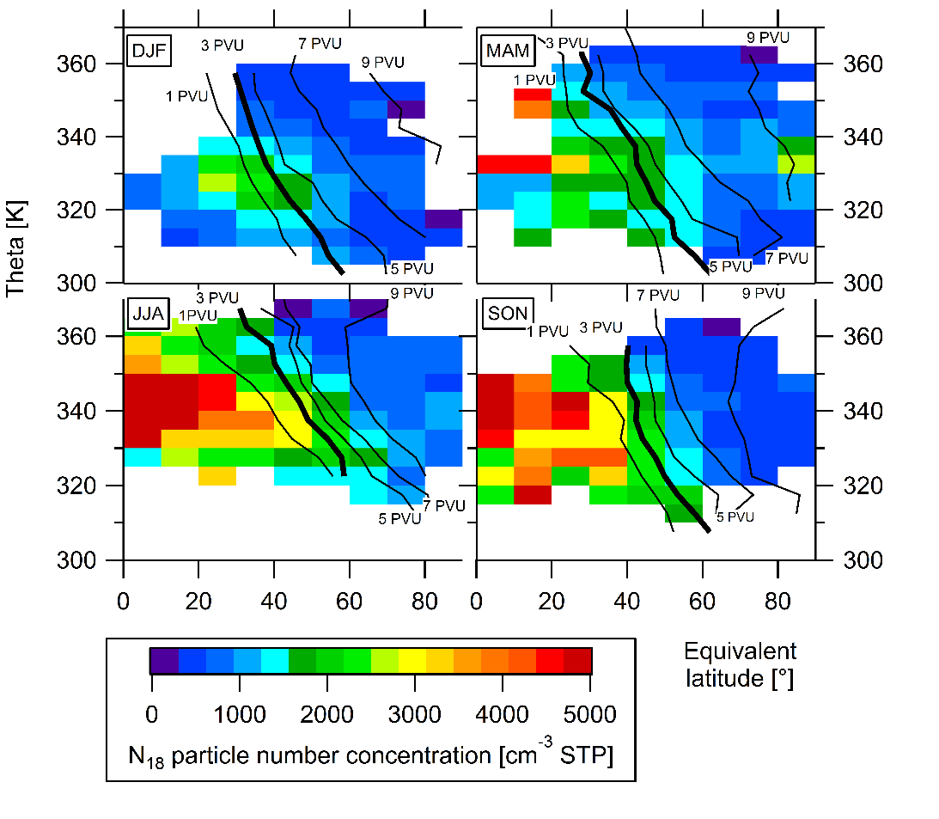
Exchange processes of aerosol particles
across the tropopause
Accumulation mode particles:
Aitken mode particles:
Exchange processes

Slide 20
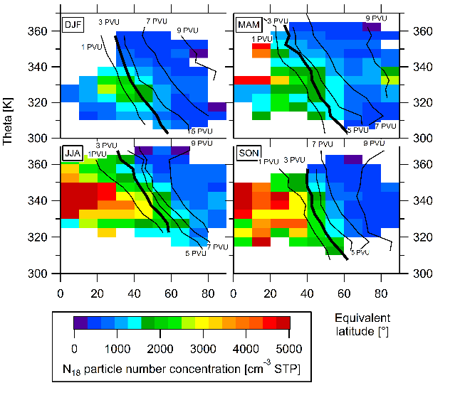
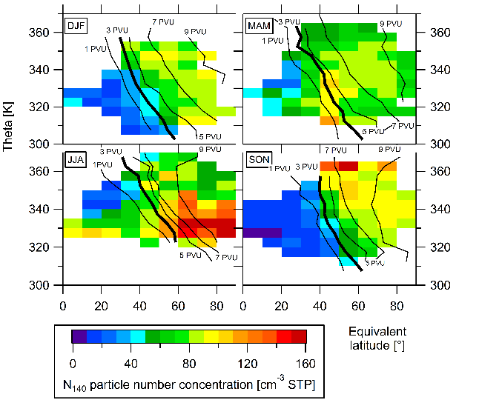
Microphysical scheme
ITCZ
H₂SO₄ / H₂O
.
.
.
.
.
.
.
.
.
.
.
.
.
SO₂
.
.
.
.
.
.
.
.
.
.
.
.
.
New particle formation
Cloud droplet activation
Exchange processes
SO₂
subtropics
trade winds
tropics
DMS

Slide 21
Thank you!

Slide 22
X
ITCZ

Slide 23
X
ITCZ

Slide 24
X
ITCZ

Slide 25
X
ITCZ

Slide 26
X

Slide 27
X

Slide 28
X

Slide 29
X

Slide 30
X

Slide 31
X

Slide 32
X

Slide 33
X

Slide 34
X

Slide 35
X

Slide 36
X

Slide 37
X

Slide 38
X

Slide 39
X

Slide 40
X

Slide 41
X

Slide 42
X

Slide 43
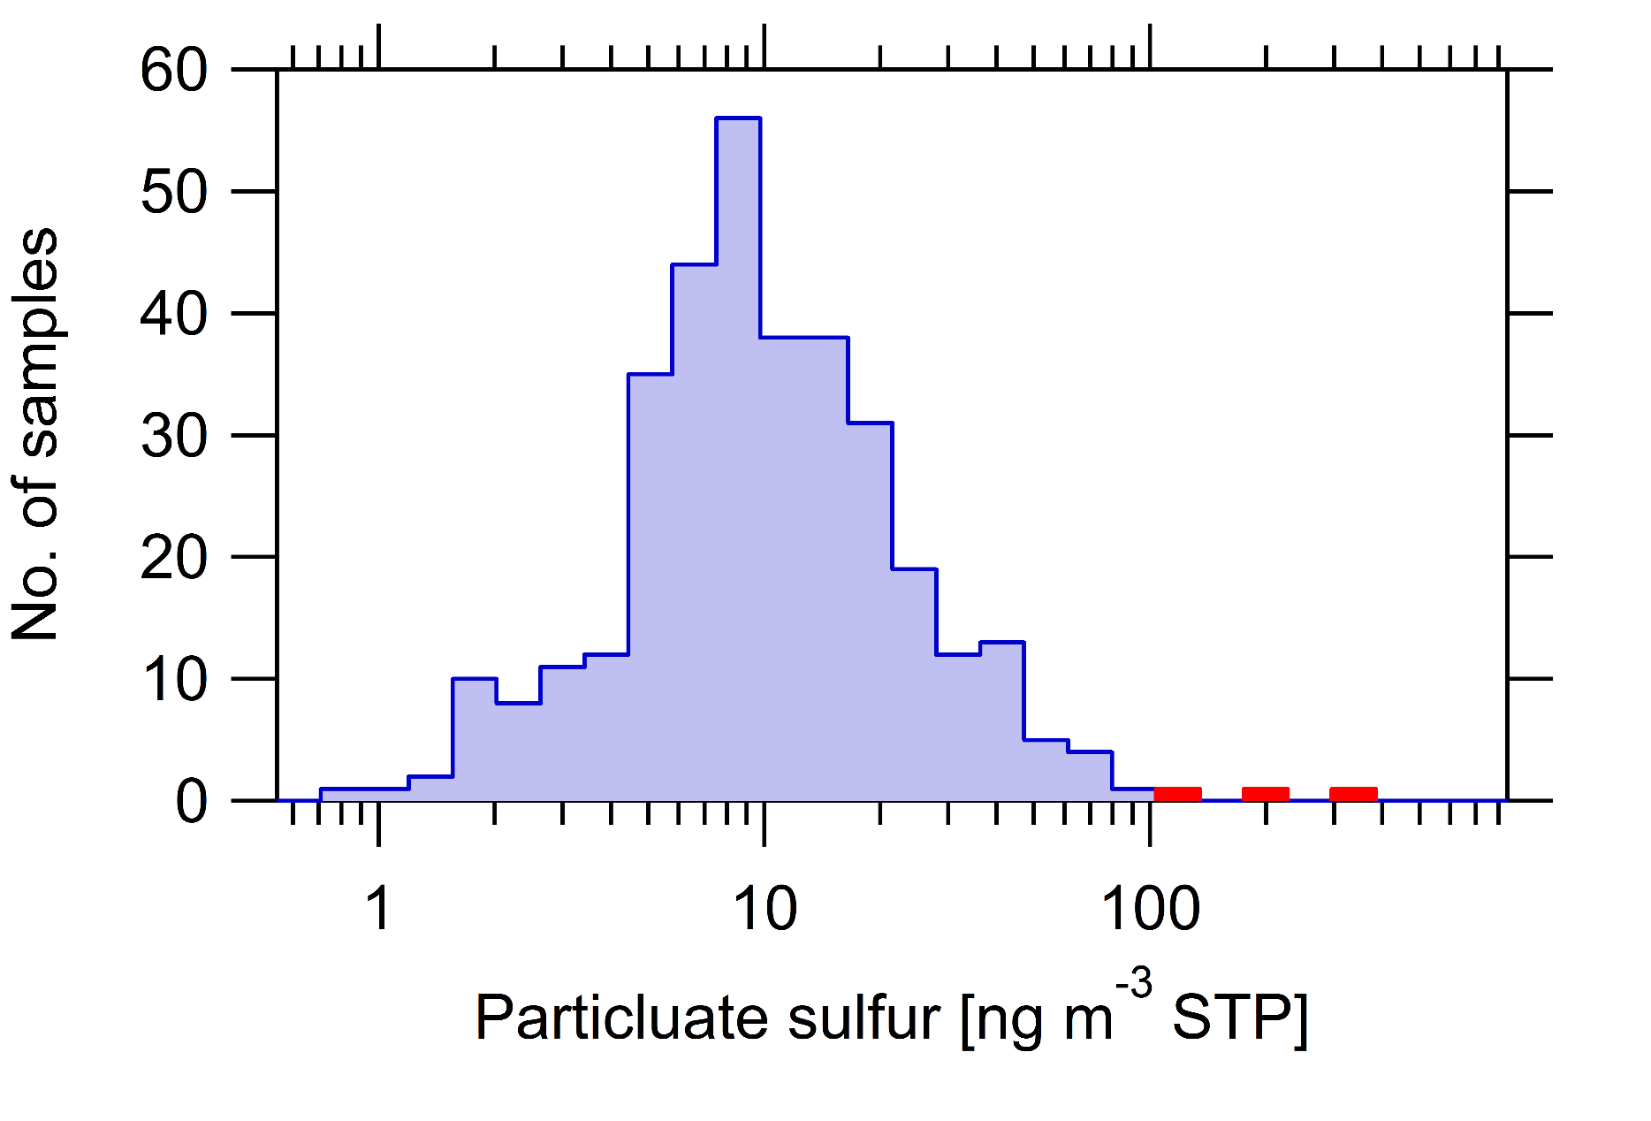
X

Slide 44
X
Nyamuragira
06.11.2011

Slide 45
X
Flight
altitude
www.uni-frankfurt.de

Slide 46
X

Slide 47
X

Slide 48
X

Slide 49
X

Slide 50
X

Slide 51
X

