Slide 1
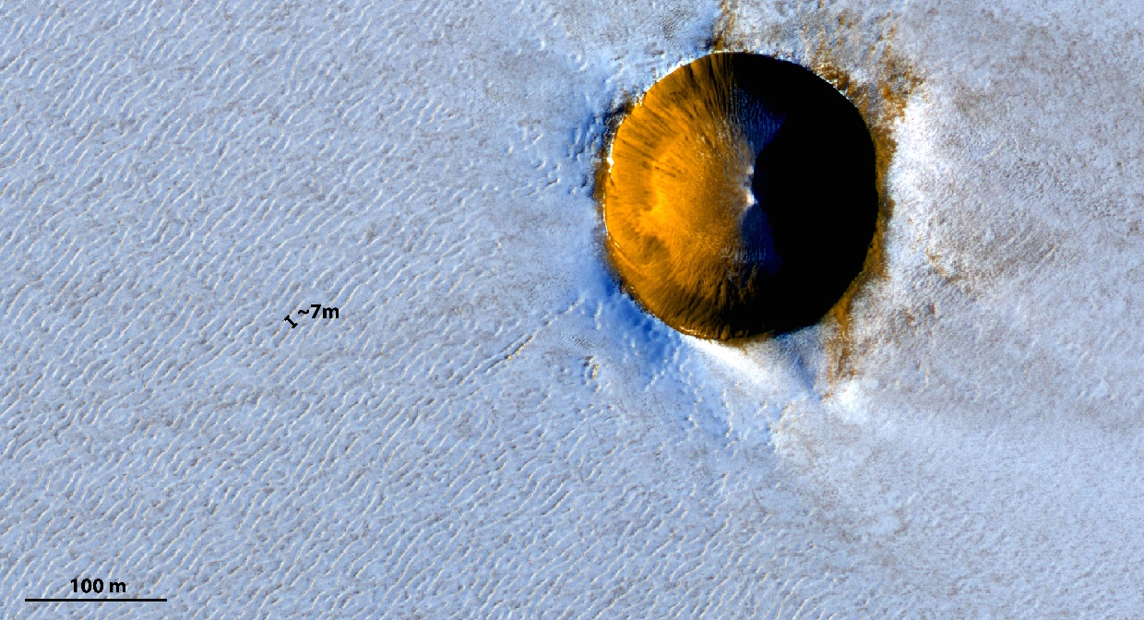
2-min presentation support
The redistribution of surface ice induced the wind flow may lead to the development and migration of periodic bedforms, or “ice ripples”, at the surface of ice sheets. In certain cold and dry environments, this redistribution need not involve solid particle transport but may be dominated by sublimation and condensation, inducing mass transfers between the ice surface and the overlying steady boundary layer turbulent flow. These mass transfers diffuse the water vapour sublimated from the ice into the atmosphere and become responsible for the amplification and propagation of ripples in a direction perpendicular to their crests. Such ice ripples, 24 cm in wavelength, have been described in the so-called Blue Ice Areas of Antarctica.
Click on arrows, buttons and figures to get more information on each subject. Click on the black crosses to close the windows.
Dynamics
&
Mass transfer
modelling
Motivation
&
Assumptions
Amplification
&
Propagation
Application
&
Observations

Slide 2
2-min presentation support
In order to understand the mechanisms that generate and develop these periodic bedforms on terrestrial glaciers and to evaluate the plausibility that similar bedforms may develop on Mars, we performed a linear stability analysis applied to a turbulent boundary layer flow perturbed by a wavy ice surface. The model is developed as follow. We first solve the flow dynamics using numerical methods analogous to those used in sand wave models assuming that the airflow is similar in both problems. We then add the transport/diffusion equation of water vapour following the same scheme. We use the Reynolds-averaged description of the equation with a Prandtl-like closure.
Click on arrows, buttons and figures to get more information on each subject. Click on the black crosses to close the windows.
Dynamics
&
Mass transfer
modelling
Motivation
&
Assumptions
Amplification
&
Propagation
Application
&
Observations

Slide 3
2-min presentation support
We insert a damping term in the exponential formula of the Van Driest mixing length, depending on the pressure gradient felt by the flow and related to the thickness of the viscous sublayer at the ice-atmosphere interface. This formulation is an efficient way
to properly represent the transitional regime under which the ripples grow. Once the mass flux of water vapour is solved, the phase shift between the ripples crests and the maximum of the flux can be deduced for different environments. The temporal evolution of the ice surface can be expressed from these quantities to infer the growth
rate, migration direction and velocity of the ripples. The present approach has been first used to model the atmospheric flow developing over wavy terrestrial ice bedforms in the Blue Ice Areas of Antarctica. Both the predicted preferential wavelength and propagation direction of the ice ripple have been found to be in agreement with the observations.
Click on arrows, buttons and figures to get more information on each subject. Click on the black crosses to close the windows.
Dynamics
&
Mass transfer
modelling
Motivation
&
Assumptions
Amplification
&
Propagation
Application
&
Observations

Slide 4
2-min presentation support
The present model has subsequently been applied to the same flow configuration but on Mars. Ice ripples are indeed likely to exist there, given that temperature and pressure conditions in the martian atmosphere favors sublimation/condensation as the dominant mass-transport process. The model has proved able to predict not only the development of ice-ripple on Mars (i.e it showed that some most amplified wavelength also exist under Martian atmospheric conditions) but also both their wavelength and propagation direction. The preferential wavelength of ices-ripples on the Martian polar caps appears to be much larger than on the Earth. Finally, a good match between the most likely ice-ripple wavelength predicted by the model and those deduced from recent available observations of the surface of Martian polar caps is shown.
Click on arrows, buttons and figures to get more information on each subject. Click on the black crosses to close the windows.
Dynamics
&
Mass transfer
modelling
Motivation
&
Assumptions
Amplification
&
Propagation
Application
&
Observations

Slide 5

«
« Ripples » on the Martian polar ice cap (7 meters in wavelength)
The redistribution of surface ice induced the wind flow may lead to the development and migration of periodic bedforms, or “ice ripples”, at the surface of ice sheets. In certain cold and dry environments, this redistribution need not involve solid particle transport but may be dominated by sublimation and condensation, inducing mass transfers between the ice surface and the overlying steady boundary layer turbulent flow. These mass transfers diffuse the water vapour sublimated from the ice into the atmosphere and become responsible for the amplification and propagation of ripples in a direction perpendicular to their crests. Such ice ripples, 24 cm in wavelength, have been described in the so-called Blue Ice Areas of Antarctica.
Dynamics
&
Mass transfer
modelling
Motivation
&
Assumptions
Amplification
&
Propagation
Application
&
Observations

Slide 6
« Ripples » on the Martian polar ice cap (7 meters in wavelength)
In order to understand the mechanisms that generate and develop these periodic bedforms on terrestrial glaciers and to evaluate the plausibility that similar bedforms may develop on Mars, we performed a linear stability analysis applied to a turbulent boundary layer flow perturbed by a wavy ice surface. The model is developed as follow. We first solve the flow dynamics using numerical methods analogous to those used in sand wave models assuming that the airflow is similar in both problems. We then add the transport/diffusion equation of water vapour following the same scheme. We use the Reynolds-averaged description of the equation with a Prandtl-like closure.
Dynamics
&
Mass transfer
modelling
Motivation
&
Assumptions
Amplification
&
Propagation
Application
&
Observations

Slide 7
« Ripples » on the Martian polar ice cap (7 meters in wavelength)
We insert a damping term in the exponential formula of the Van Driest mixing length, depending on the pressure gradient felt by the flow and related to the thickness of the viscous sublayer at the ice-atmosphere interface. This formulation is an efficient way
to properly represent the transitional regime under which the ripples grow. Once the mass flux of water vapour is solved, the phase shift between the ripples crests and the maximum of the flux can be deduced for different environments. The temporal evolution of the ice surface can be expressed from these quantities to infer the growth
rate, migration direction and velocity of the ripples. The present approach has been first used to model the atmospheric flow developing over wavy terrestrial ice bedforms in the Blue Ice Areas of Antarctica. Both the predicted preferential wavelength and propagation direction of the ice ripple have been found to be in agreement with the observations.
Dynamics
&
Mass transfer
modelling
Motivation
&
Assumptions
Amplification
&
Propagation
Application
&
Observations

Slide 8
« Ripples » on the Martian polar ice cap (7 meters in wavelength)
The present model has subsequently been applied to the same flow configuration but on Mars. Ice ripples are indeed likely to exist there, given that temperature and pressure conditions in the martian atmosphere favors sublimation/condensation as the dominant mass-transport process. The model has proved able to predict not only the development of ice-ripple on Mars (i.e it showed that some most amplified wavelength also exist under Martian atmospheric conditions) but also both their wavelength and propagation direction. The preferential wavelength of ices-ripples on the Martian polar caps appears to be much larger than on the Earth. Finally, a good match between the most likely ice-ripple wavelength predicted by the model and those deduced from recent available observations of the surface of Martian polar caps is shown.
Dynamics
&
Mass transfer
modelling
Motivation
&
Assumptions
Amplification
&
Propagation
Application
&
Observations

Slide 9
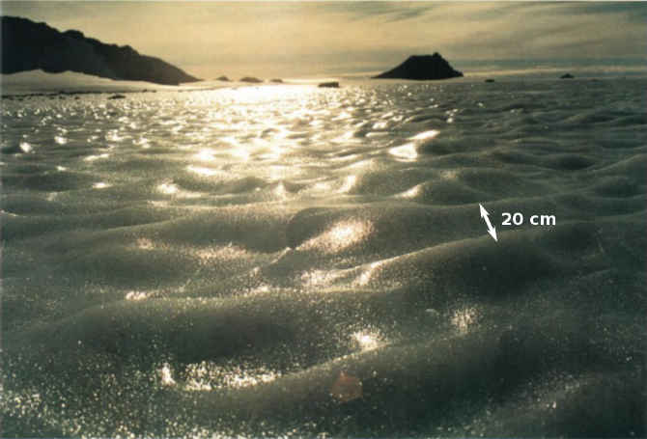
Motivation
Earth
Mars
Periodic bedforms of different sizes are observed on terrestrial glaciers. Their wavelength can range from the centimetre scale (figure c) to the kilometre one (figure a). Similar giant ice waves are also visible on the north polar cap of Mars (figure b). Assuming that the environmental conditions (dry and cold atmosphere, permanent and uniform wind regimes…) of the both planets are close, an analogy can be made that may lead to the following questions :
What are the relevant mechanisms controlling the generation of ice ripples on Earth ?
What would be the mechanisms controlling the plausible ice ripples on Mars ?
What would be their size and are they detectable from orbital observations ?
a
b
Giant
waves
The redistribution of surface ice induced the wind flow may lead to the development and migration of periodic bedforms, or “ice ripples”, at the surface of ice sheets. In certain cold and dry environments, this redistribution need not involve solid particle transport but may be dominated by sublimation and condensation, inducing mass transfers between the ice surface and the overlying steady boundary layer turbulent flow. These mass transfers diffuse the water vapour sublimated from the ice into the atmosphere and become responsible for the amplification and propagation of ripples in a direction perpendicular to their crests. Such ice ripples, 24 cm in wavelength, have been described in the so-called Blue Ice Areas of Antarctica.
c
Ripples on Mars ?
Ripples
Dynamics
&
Mass transfer
modelling
Motivation
&
Assumptions
Amplification
&
Propagation
Application
&
Observations

Slide 10

Motivation
Earth
Mars
Periodic bedforms of different sizes are observed on terrestrial glaciers. Their wavelength can range from the centimetre scale (figure c) to the kilometre one (figure a). Similar giant ice waves are also visible on the north polar cap of Mars (figure b). Assuming that the environmental conditions (dry and cold atmosphere, permanent and uniform wind regimes…) of the both planets are close, an analogy can be made that may lead to the following questions :
What are the relevant mechanisms controlling the generation of ice ripples on Earth ?
What would be the mechanisms controlling the plausible ice ripples on Mars ?
What would be their size and are they detectable from orbital observations ?
Ice ripples observed in Antarctica [Frezzotti et al., 2002]
Wavelenght $λ=2$ to $5$km
Amplitude $2ζ_{0}=2$ to $4$m
Velocity migration $V<20$ m/yr
a
b
Giant
waves
The redistribution of surface ice induced the wind flow may lead to the development and migration of periodic bedforms, or “ice ripples”, at the surface of ice sheets. In certain cold and dry environments, this redistribution need not involve solid particle transport but may be dominated by sublimation and condensation, inducing mass transfers between the ice surface and the overlying steady boundary layer turbulent flow. These mass transfers diffuse the water vapour sublimated from the ice into the atmosphere and become responsible for the amplification and propagation of ripples in a direction perpendicular to their crests. Such ice ripples, 24 cm in wavelength, have been described in the so-called Blue Ice Areas of Antarctica.
c
Ripples on Mars ?
Ripples
Dynamics
&
Mass transfer
modelling
Motivation
&
Assumptions
Amplification
&
Propagation
Application
&
Observations

Slide 11

Motivation
Earth
Mars
Periodic bedforms of different sizes are observed on terrestrial glaciers. Their wavelength can range from the centimetre scale (figure c) to the kilometre one (figure a). Similar giant ice waves are also visible on the north polar cap of Mars (figure b). Assuming that the environmental conditions (dry and cold atmosphere, permanent and uniform wind regimes…) of the both planets are close, an analogy can be made that may lead to the following questions :
What are the relevant mechanisms controlling the generation of ice ripples on Earth ?
What would be the mechanisms controlling the plausible ice ripples on Mars ?
What would be their size and are they detectable from orbital observations ?
Ice ripples observed in Antarctica [Bintanja et al., 1999]
Wavelenght $λ=20$ to $24$cm
Amplitude $2ζ_{0}=1$ to $2$cm
Velocity migration $V\sim 2$ cm/month
a
b
Giant
waves
The redistribution of surface ice induced the wind flow may lead to the development and migration of periodic bedforms, or “ice ripples”, at the surface of ice sheets. In certain cold and dry environments, this redistribution need not involve solid particle transport but may be dominated by sublimation and condensation, inducing mass transfers between the ice surface and the overlying steady boundary layer turbulent flow. These mass transfers diffuse the water vapour sublimated from the ice into the atmosphere and become responsible for the amplification and propagation of ripples in a direction perpendicular to their crests. Such ice ripples, 24 cm in wavelength, have been described in the so-called Blue Ice Areas of Antarctica.
c
Ripples on Mars ?
Ripples
Dynamics
&
Mass transfer
modelling
Motivation
&
Assumptions
Amplification
&
Propagation
Application
&
Observations

Slide 12
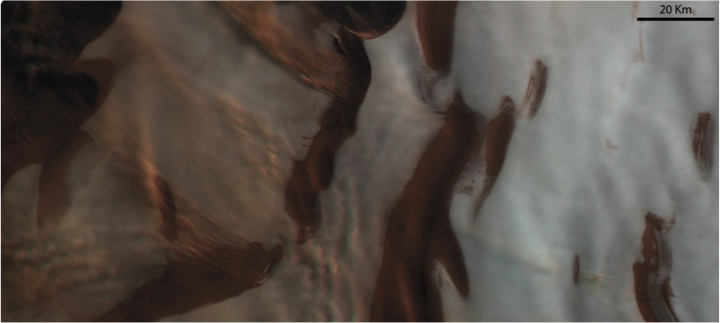

Motivation
Earth
Mars
Periodic bedforms of different sizes are observed on terrestrial glaciers. Their wavelength can range from the centimetre scale (figure c) to the kilometre one (figure a). Similar giant ice waves are also visible on the north polar cap of Mars (figure b). Assuming that the environmental conditions (dry and cold atmosphere, permanent and uniform wind regimes…) of the both planets are close, an analogy can be made that may lead to the following questions :
What are the relevant mechanisms controlling the generation of ice ripples on Earth ?
What would be the mechanisms controlling the plausible ice ripples on Mars ?
What would be their size and are they detectable from orbital observations ?
a
b
Giant ice waves observed on Mars [Herny et al., 2014]
Wavelenght $λ=8$ to $12$km
Amplitude $2ζ_{0}=8$ to $50$m
Giant
waves
The redistribution of surface ice induced the wind flow may lead to the development and migration of periodic bedforms, or “ice ripples”, at the surface of ice sheets. In certain cold and dry environments, this redistribution need not involve solid particle transport but may be dominated by sublimation and condensation, inducing mass transfers between the ice surface and the overlying steady boundary layer turbulent flow. These mass transfers diffuse the water vapour sublimated from the ice into the atmosphere and become responsible for the amplification and propagation of ripples in a direction perpendicular to their crests. Such ice ripples, 24 cm in wavelength, have been described in the so-called Blue Ice Areas of Antarctica.
c
Ripples on Mars ?
Ripples
Dynamics
&
Mass transfer
modelling
Motivation
&
Assumptions
Amplification
&
Propagation
Application
&
Observations

Slide 13
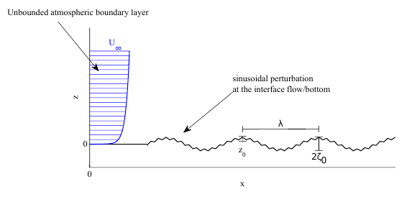
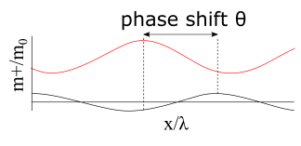
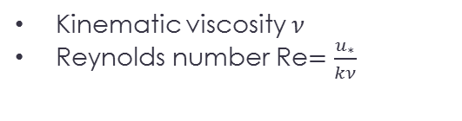
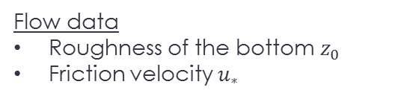

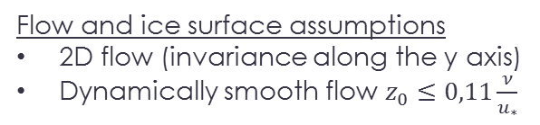
Assumptions
We make the assumption that the fluid dynamics is the same on Mars than on the Earth. While snow dunes are generated by solid particle transports, ices ripples may be generated by sublimation/condensation (diffusion of water vapour) mass transfers between the ice sheets and the wind. The position of the mass flux maximum above the bottom profile of the waves is responsible for the propagation or the amplification of the waves. The mass flux is linked to the speed flow and the dynamics have then to be solved first. Other assumptions on the flow are chosen in order to make a linear stability analysis possible.
The redistribution of surface ice induced the wind flow may lead to the development and migration of periodic bedforms, or “ice ripples”, at the surface of ice sheets. In certain cold and dry environments, this redistribution need not involve solid particle transport but may be dominated by sublimation and condensation, inducing mass transfers between the ice surface and the overlying steady boundary layer turbulent flow. These mass transfers diffuse the water vapour sublimated from the ice into the atmosphere and become responsible for the amplification and propagation of ripples in a direction perpendicular to their crests. Such ice ripples, 24 cm in wavelength, have been described in the so-called Blue Ice Areas of Antarctica.
Flow data
Roughness of the bottom $z_{0}$
Friction velocity $u_{∗}$
Kinematic viscosity $ν$
Reynolds number Re$=\frac{u_{∗}}{kν}$
Flow and ice surface assumptions
2D flow (invariance along the y axis)
Dynamically smooth flow $z_{0}≤0,11\frac{ν}{u_{∗}}$
Aspect ratio $r_{a}=\frac{2ζ_{0}}{λ}≤0,03$
Linear stability analysis (small amplitudes)
Dynamics
&
Mass transfer
modelling
Motivation
&
Assumptions
Amplification
&
Propagation
Application
&
Observations
Application
&
Observations

Slide 14
Assumptions
We make the assumption that the fluid dynamics is the same on Mars than on the Earth. While snow dunes are generated by solid particle transports, ices ripples may be generated by sublimation/condensation (diffusion of water vapour) mass transfers between the ice sheets and the wind. The position of the mass flux maximum above the bottom profile of the waves is responsible for the propagation or the amplification of the waves. The mass flux is linked to the speed flow and the dynamics have then to be solved first. Other assumptions on the flow are chosen in order to make a linear stability analysis possible.
The redistribution of surface ice induced the wind flow may lead to the development and migration of periodic bedforms, or “ice ripples”, at the surface of ice sheets. In certain cold and dry environments, this redistribution need not involve solid particle transport but may be dominated by sublimation and condensation, inducing mass transfers between the ice surface and the overlying steady boundary layer turbulent flow. These mass transfers diffuse the water vapour sublimated from the ice into the atmosphere and become responsible for the amplification and propagation of ripples in a direction perpendicular to their crests. Such ice ripples, 24 cm in wavelength, have been described in the so-called Blue Ice Areas of Antarctica.
Dimensionless mass flux profile above the ice sheets profile
Flow data
Roughness of the bottom $z_{0}$
Friction velocity $u_{∗}$
Kinematic viscosity $ν$
Reynolds number Re$=\frac{u_{∗}}{kν}$
Flow and ice surface assumptions
2D flow (invariance along the y axis)
Dynamically smooth flow $z_{0}≤0,11\frac{ν}{u_{∗}}$
Aspect ratio $r_{a}=\frac{2ζ_{0}}{λ}≤0,03$
Linear stability analysis (small amplitudes)
Dynamics
&
Mass transfer
modelling
Motivation
&
Assumptions
Amplification
&
Propagation
Application
&
Observations
Application
&
Observations

Slide 15
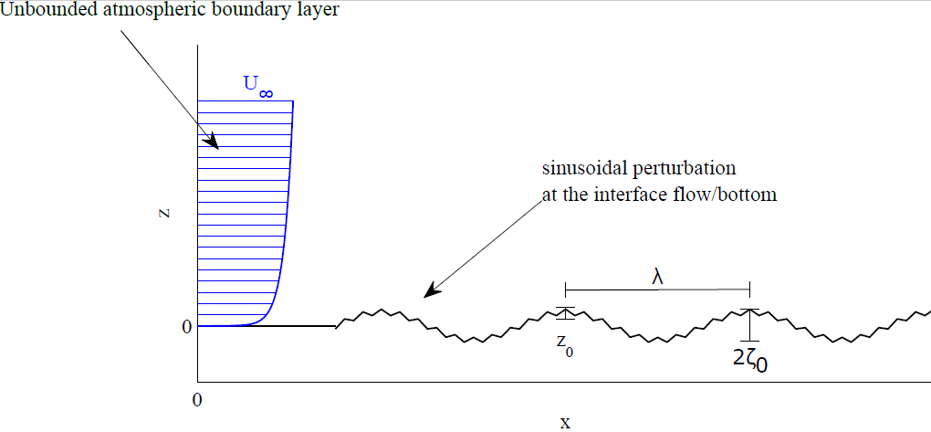
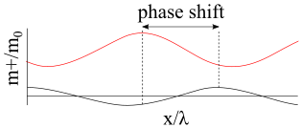
Assumptions
We make the assumption that the fluid dynamics is the same on Mars than on the Earth. While snow dunes are generated by solid particle transports, ices ripples may be generated by sublimation/condensation mass transfers between the ice sheets and the wind. The position of the mass flux maximum above the bottom profile of the waves is responsible for the propagation or the amplification of the waves (fig). The mass flux is linked to the speed flow and the dynamics have then to be solved first. Other assumptions on the flow are chosen in order to make a linear stability analysis.
Configuration of the flow over the wavy ice surface
The redistribution of surface ice induced the wind flow may lead to the development and migration of periodic bedforms, or “ice ripples”, at the surface of ice sheets. In certain cold and dry environments, this redistribution need not involve solid particle transport but may be dominated by sublimation and condensation, inducing mass transfers between the ice surface and the overlying steady boundary layer turbulent flow. These mass transfers diffuse the water vapour sublimated from the ice into the atmosphere and become responsible for the amplification and propagation of ripples in a direction perpendicular to their crests. Such ice ripples, 24 cm in wavelength, have been described in the so-called Blue Ice Areas of Antarctica.
Flow data
Roughness of the bottom $z_{0}$
Friction velocity $u_{∗}$
Kinematic viscosity $ν$
Reynolds number Re$=\frac{u_{∗}}{kν}$
Flow and ice surface assumptions
2D flow (invariance along the y axis)
Dynamically smooth flow $z_{0}≤0,11\frac{ν}{u_{∗}}$
Aspect ratio $r_{a}=\frac{2ζ_{0}}{λ}≤0,03$
Linear stability analysis (small amplitudes)
Dynamics
&
Mass transfer
modelling
Motivation
&
Assumptions
Amplification
&
Propagation
Application
&
Observations

Slide 16



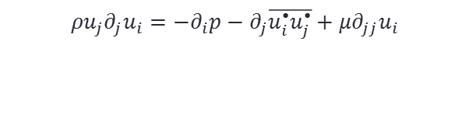







Linearized balance equations
Balance equations:
Turbulence modelling
Turbulence closure: Simple Gradient Diffusion Hypothesis
Linear stability analysis: first order expansion of all quantities decomposed under the form $g\left(x,z\right)=ℜ [G\left(kz\right)+\hat{g}\left(kz\right)kζ_{0}e^{ikx}]$
Dynamics
Mass transfer
Mass balance equation: $\frac{∂ρ}{∂t}+\vec{∇}.\left(ρ\vec{u}\right)=0$
Navier-Stokes equation:$\frac{∂\left(ρ\vec{u}\right)}{∂t}+\vec{∇}.\left(ρ\vec{u}⨂\vec{u}\right)=−\vec{∇}p+\vec{∇}.\overset{̿}{τ}+ρ\vec{f}$
Transport diffusion equation: $\frac{∂c}{∂t}+\vec{u}\vec{∇}c+\vec{∇.}\vec{j}=0$,
with $c$ the concentration of vapour in the air and $\vec{j}$ the mass diffusion flux
The redistribution of surface ice induced the wind flow may lead to the development and migration of periodic bedforms, or “ice ripples”, at the surface of ice sheets. In certain cold and dry environments, this redistribution need not involve solid particle transport but may be dominated by sublimation and condensation, inducing mass transfers between the ice surface and the overlying steady boundary layer turbulent flow. These mass transfers diffuse the water vapour sublimated from the ice into the atmosphere and become responsible for the amplification and propagation of ripples in a direction perpendicular to their crests. Such ice ripples, 24 cm in wavelength, have been described in the so-called Blue Ice Areas of Antarctica.
Reynolds decomposition
Reynolds Averaged equations (RANS)
$$x=\overline{x}+x^{•}$$
$$ρu_{j}∂_{j}u_{i}=−∂_{i}p−∂_{j}\overline{u_{i}^{•}u_{j}^{•}}+μ∂_{jj}u_{i}$$
$$u_{i}∂_{i}c+u_{j}∂_{j}c=−∂_{j}j_{j}−∂_{j}\overline{u_{j}^{•}c^{•}}$$
$${\frac{1}{ρ}∂}_{j}R_{ij}$$
$$∂_{j}m_{t}$$
Turbulent stress tensor $R_{ij}$
Turbulent mass flux $m_{t}$
$m_{t}=∂_{j}\overline{u_{j}^{•}c^{•}}=D_{t}∂_{j}c$, ${D_{t}=\frac{ν_{t}(l_{m}) }{Z_{t}}}_{}$
$R_{ij}=−ρ\overline{u_{i}^{•}u_{j}^{•}}=ρν_{t}∂_{j}u_{i}$, $ν_{t}\left(l_{m}\right)$
with${ ν}_{t}$ the turbulent viscosity, $l_{m}$ the semi-empirical length called « mixing length » and $Z_{t}$ the turbulent Schmidt number
Dynamics
&
Mass transfer
modelling
Motivation
&
Assumptions
Amplification
&
Propagation
Application
&
Observations

Slide 17
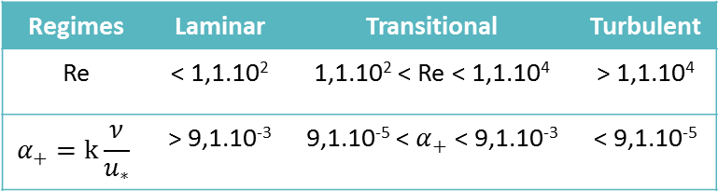
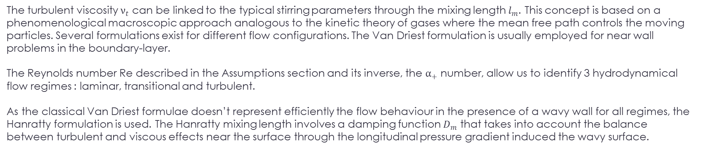
Specific mixing length
The turbulent viscosity $ν_{t}$ can be linked to the typical stirring parameters through the mixing length $l_{m}$. This concept is based on a phenomenological macroscopic approach analogous to the kinetic theory of gases where the mean free path controls the moving particles. Several formulations exist for different flow configurations. The Van Driest formulation is usually employed for near wall problems in the boundary-layer.
The Reynolds number Re described in the Assumptions section and its inverse, the $α_{+}$ number, allow us to identify 3 hydrodynamical flow regimes : laminar, transitional and turbulent.
As the classical Van Driest formulae doesn’t represent efficiently the flow behaviour in the presence of a wavy wall for all regimes, the Hanratty formulation is used. The Hanratty mixing length involves a damping function $D_{m}$ that takes into account the balance between turbulent and viscous effects near the surface through the longitudinal pressure gradient induced the wavy surface.
The redistribution of surface ice induced the wind flow may lead to the development and migration of periodic bedforms, or “ice ripples”, at the surface of ice sheets. In certain cold and dry environments, this redistribution need not involve solid particle transport but may be dominated by sublimation and condensation, inducing mass transfers between the ice surface and the overlying steady boundary layer turbulent flow. These mass transfers diffuse the water vapour sublimated from the ice into the atmosphere and become responsible for the amplification and propagation of ripples in a direction perpendicular to their crests. Such ice ripples, 24 cm in wavelength, have been described in the so-called Blue Ice Areas of Antarctica.
Regimes | Laminar | Transitional | Turbulent
Re | < 1,1.10² | 1,1.10² < Re < 1,1.10⁴ | > 1,1.10⁴
$$α_{+}=k\frac{ν}{u_{∗}}$$ | > 9,1.10⁻³ | 9,1.10⁻⁵ < $α_{+}$ < 9,1.10⁻³ | < 9,1.10⁻⁵
Van Driest : $l_{m}= κ(z − ζ)\left[1−\exp\left(−\frac{\sqrt{τ_{xz}}(z−ζ)}{νR_{t}}\right)\right]$ $R_{t}=25$
Hanratty : $l_{m}= κ(z − ζ)\left[1−\exp\left(D_{m}\right)\right]$ $D_{m}= D_{m}(τ_{xz},ν,z,\frac{dp}{dx})$
Dynamics
&
Mass transfer
modelling
Motivation
&
Assumptions
Amplification
&
Propagation
Application
&
Observations

Slide 18
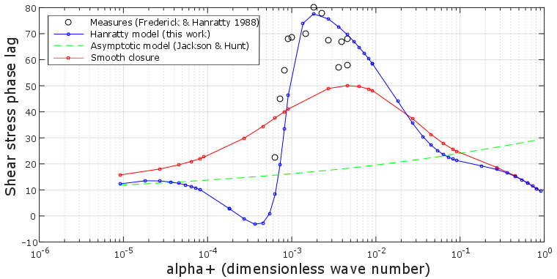
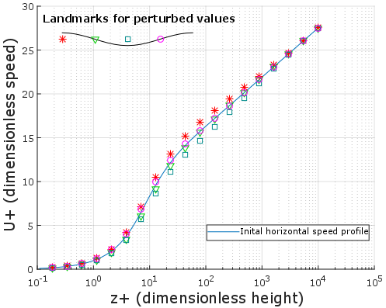
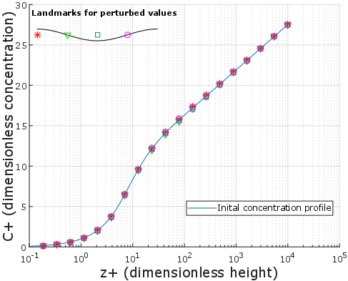
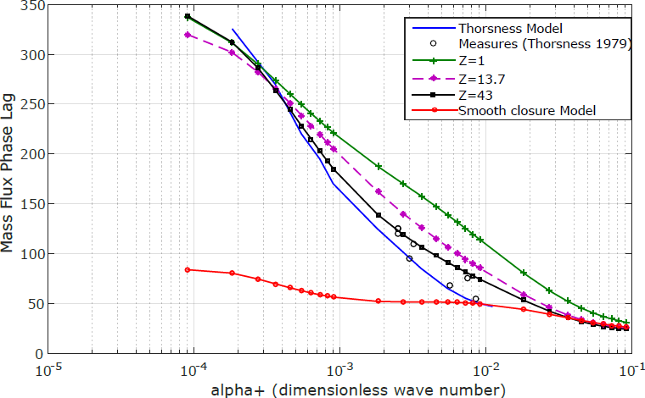
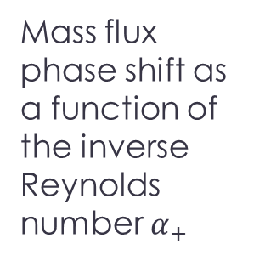
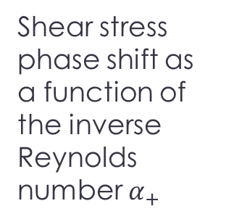
Speed and concentration profiles
Shear stress phase shift as a function of the inverse Reynolds number $α_{+}$
The linear stability analysis applied on the balance equations leads to a coupled differential system in terms of dynamics and mass transfer where both speed, shear stress, mass flux and concentration depending on the Reynolds number Re and the Schmidt number Z are obtained by solving it.
The redistribution of surface ice induced the wind flow may lead to the development and migration of periodic bedforms, or “ice ripples”, at the surface of ice sheets. In certain cold and dry environments, this redistribution need not involve solid particle transport but may be dominated by sublimation and condensation, inducing mass transfers between the ice surface and the overlying steady boundary layer turbulent flow. These mass transfers diffuse the water vapour sublimated from the ice into the atmosphere and become responsible for the amplification and propagation of ripples in a direction perpendicular to their crests. Such ice ripples, 24 cm in wavelength, have been described in the so-called Blue Ice Areas of Antarctica.
Horizontal speed profile
Concentration profile
Mass flux
phase shift as a function of the inverse Reynolds number $α_{+}$
Dynamics
&
Mass transfer
modelling
Motivation
&
Assumptions
Amplification
&
Propagation
Application
&
Observations

Slide 19
Speed and concentration profiles
Shear stress phase shift as a function of the inverse Reynolds number $α_{+}$
The linear stability analysis applied on the balance equations leads to a coupled differential system in terms of dynamics and mass transfer where both speed, shear stress, mass flux and concentration depending on the Reynolds number Re and the Schmidt number Z are obtained by solving it.
Horizontal speed profiles as functions of the dimensionless height z+ at various points along the wavy surface
A periodic variation around the basic speed state is observed under the position above the wavy surface.
The redistribution of surface ice induced the wind flow may lead to the development and migration of periodic bedforms, or “ice ripples”, at the surface of ice sheets. In certain cold and dry environments, this redistribution need not involve solid particle transport but may be dominated by sublimation and condensation, inducing mass transfers between the ice surface and the overlying steady boundary layer turbulent flow. These mass transfers diffuse the water vapour sublimated from the ice into the atmosphere and become responsible for the amplification and propagation of ripples in a direction perpendicular to their crests. Such ice ripples, 24 cm in wavelength, have been described in the so-called Blue Ice Areas of Antarctica.
Horizontal speed profile
Concentration profile
Mass flux
phase shift as a function of the inverse Reynolds number $α_{+}$
Dynamics
&
Mass transfer
modelling
Motivation
&
Assumptions
Amplification
&
Propagation
Application
&
Observations

Slide 20
Speed and concentration profiles
Shear stress phase shift as a function of the inverse Reynolds number $α_{+}$
The linear stability analysis applied on the balance equations leads to a coupled differential system in terms of dynamics and mass transfer where both speed, shear stress, mass flux and concentration depending on the Reynolds number Re and the Schmidt number Z are obtained by solving it.
Concentration profiles as functions of the dimensionless height z+ at various points along the wavy surface
A periodic variation around the basic concentration state is observed under the position above the wavy surface.
The redistribution of surface ice induced the wind flow may lead to the development and migration of periodic bedforms, or “ice ripples”, at the surface of ice sheets. In certain cold and dry environments, this redistribution need not involve solid particle transport but may be dominated by sublimation and condensation, inducing mass transfers between the ice surface and the overlying steady boundary layer turbulent flow. These mass transfers diffuse the water vapour sublimated from the ice into the atmosphere and become responsible for the amplification and propagation of ripples in a direction perpendicular to their crests. Such ice ripples, 24 cm in wavelength, have been described in the so-called Blue Ice Areas of Antarctica.
Horizontal speed profile
Concentration profile
Mass flux
phase shift as a function of the inverse Reynolds number $α_{+}$
Dynamics
&
Mass transfer
modelling
Motivation
&
Assumptions
Amplification
&
Propagation
Application
&
Observations

Slide 21

Speed and concentration profiles
Shear stress phase shift as a function of the inverse Reynolds number $α_{+}$
Shear stress phase shift as a function of the inverse Reynolds number $α_{+}$
The red curve (smooth closure) shows the results of the use of the Van Driest formulation. The blue curve represents the results of this work using the Hanratty formulation.
The linear stability analysis applied on the balance equations leads to a coupled differential system in terms of dynamics and mass transfer where both speed, shear stress, mass flux and concentration depending on the Reynolds number Re and the Schmidt number Z are obtained by solving it.
The redistribution of surface ice induced the wind flow may lead to the development and migration of periodic bedforms, or “ice ripples”, at the surface of ice sheets. In certain cold and dry environments, this redistribution need not involve solid particle transport but may be dominated by sublimation and condensation, inducing mass transfers between the ice surface and the overlying steady boundary layer turbulent flow. These mass transfers diffuse the water vapour sublimated from the ice into the atmosphere and become responsible for the amplification and propagation of ripples in a direction perpendicular to their crests. Such ice ripples, 24 cm in wavelength, have been described in the so-called Blue Ice Areas of Antarctica.
Horizontal speed profile
Concentration profile
Mass flux
phase shift as a function of the inverse Reynolds number $α_{+}$
Dynamics
&
Mass transfer
modelling
Motivation
&
Assumptions
Amplification
&
Propagation
Application
&
Observations

Slide 22

Speed and concentration profiles
Shear stress phase shift as a function of the inverse Reynolds number $α_{+}$
Mass flux phase shift as a function of the inverse Reynolds number $α_{+}$ for different Schmidt numbers Z
The red curve (smooth closure) shows the results of the use of the Van Driest formulation. The blue curve represents the results of this work using the Hanratty formulation for Z=729 (Schmidt number under which the presented measures were carried out).
The linear stability analysis applied on the balance equations leads to a coupled differential system in terms of dynamics and mass transfer where both speed, shear stress, mass flux and concentration depending on the Reynolds number Re and the Schmidt number Z are obtained by solving it.
The redistribution of surface ice induced the wind flow may lead to the development and migration of periodic bedforms, or “ice ripples”, at the surface of ice sheets. In certain cold and dry environments, this redistribution need not involve solid particle transport but may be dominated by sublimation and condensation, inducing mass transfers between the ice surface and the overlying steady boundary layer turbulent flow. These mass transfers diffuse the water vapour sublimated from the ice into the atmosphere and become responsible for the amplification and propagation of ripples in a direction perpendicular to their crests. Such ice ripples, 24 cm in wavelength, have been described in the so-called Blue Ice Areas of Antarctica.
Horizontal speed profile
Concentration profile
Mass flux
phase shift as a function of the inverse Reynolds number $α_{+}$
Dynamics
&
Mass transfer
modelling
Motivation
&
Assumptions
Amplification
&
Propagation
Application
&
Observations

Slide 23
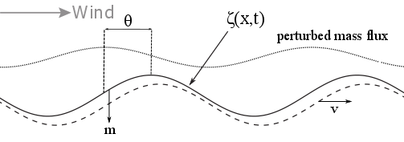
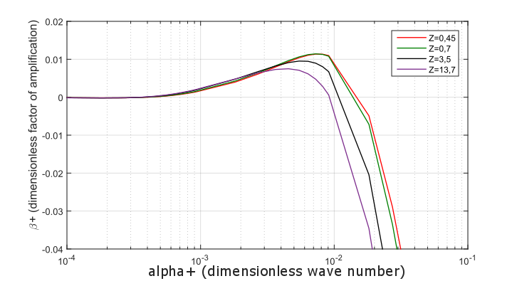
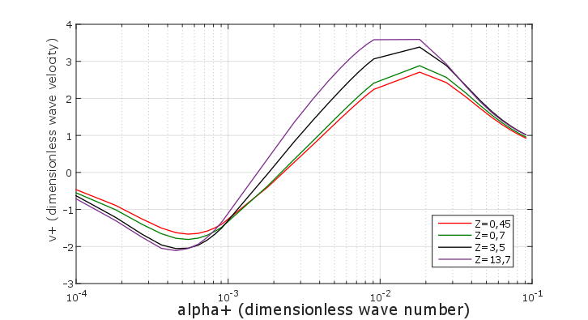




Amplification and propagation of the waves
The profile of the ice surface depends on the spatial dimension x and time. The profile evolution can then be written under the form:
$ζ\left(x,t\right)=\frac{1}{k}\left[\overline{ζ}\left(t\right)+kζ_{0}(t)\cos\left(kx−kvt\right)\right]$ , where $v$ is the migration velocity.
The mass conservation equation in a sublimation case is : $−ρ_{s}\frac{dζ}{dt}=m$,
where the mass flux m can also be decomposed under the form :
$m=M\left[1+\hat{m}kζ_{0}\left(t\right)\cos\left[\left(kx+θ\right)\right] −kvt\right]$,
where $θ$ is the phase shift between the crest and the maximum of the mass flux.
The redistribution of surface ice induced the wind flow may lead to the development and migration of periodic bedforms, or “ice ripples”, at the surface of ice sheets. In certain cold and dry environments, this redistribution need not involve solid particle transport but may be dominated by sublimation and condensation, inducing mass transfers between the ice surface and the overlying steady boundary layer turbulent flow. These mass transfers diffuse the water vapour sublimated from the ice into the atmosphere and become responsible for the amplification and propagation of ripples in a direction perpendicular to their crests. Such ice ripples, 24 cm in wavelength, have been described in the so-called Blue Ice Areas of Antarctica.
The redistribution of surface ice induced the wind flow may lead to the development and migration of periodic bedforms, or “ice ripples”, at the surface of ice sheets. In certain cold and dry environments, this redistribution need not involve solid particle transport but may be dominated by sublimation and condensation, inducing mass transfers between the ice surface and the overlying steady boundary layer turbulent flow. These mass transfers diffuse the water vapour sublimated from the ice into the atmosphere and become responsible for the amplification and propagation of ripples in a direction perpendicular to their crests. Such ice ripples, 24 cm in wavelength, have been described in the so-called Blue Ice Areas of Antarctica.
Combining these equations, a growth rate $β$ (such as $ζ_{0}\left(t\right)=Z_{0}e^{βt}$) and the migration velocity $v$ are found to depend on both the perturbation of the mass flux $\hat{m}$ and the phase shift $θ$. The $α_{+}$ number for which $β$ is maximum indicates the wave length that we should observe under the specified chosen conditions. The sign of $v$ corresponding to this $α_{+}$ gives the propagation direction of the waves.
Growth rate $β$
Migration velocity $v$
Dynamics
&
Mass transfer
modelling
Motivation
&
Assumptions
Amplification
&
Propagation
Application
&
Observations

Slide 24




Amplification and propagation of the waves
The profile of the ice surface depends on the spatial dimension x and time. The profile evolution can then be written under the form:
$ζ\left(x,t\right)=\frac{1}{k}\left[\overline{ζ}\left(t\right)+kζ_{0}(t)\cos\left(kx−kvt\right)\right]$ , where $v$ is the migration velocity.
The mass conservation equation in a sublimation case is : $−ρ_{s}\frac{dζ}{dt}=m$,
where the mass flux m can also be decomposed under the form :
$m=M\left[1+\hat{m}kζ_{0}\left(t\right)\cos\left[\left(kx+θ\right)\right] −kvt\right]$,
where $θ$ is the phase shift between the crest and the maximum of the mass flux.
The redistribution of surface ice induced the wind flow may lead to the development and migration of periodic bedforms, or “ice ripples”, at the surface of ice sheets. In certain cold and dry environments, this redistribution need not involve solid particle transport but may be dominated by sublimation and condensation, inducing mass transfers between the ice surface and the overlying steady boundary layer turbulent flow. These mass transfers diffuse the water vapour sublimated from the ice into the atmosphere and become responsible for the amplification and propagation of ripples in a direction perpendicular to their crests. Such ice ripples, 24 cm in wavelength, have been described in the so-called Blue Ice Areas of Antarctica.
The redistribution of surface ice induced the wind flow may lead to the development and migration of periodic bedforms, or “ice ripples”, at the surface of ice sheets. In certain cold and dry environments, this redistribution need not involve solid particle transport but may be dominated by sublimation and condensation, inducing mass transfers between the ice surface and the overlying steady boundary layer turbulent flow. These mass transfers diffuse the water vapour sublimated from the ice into the atmosphere and become responsible for the amplification and propagation of ripples in a direction perpendicular to their crests. Such ice ripples, 24 cm in wavelength, have been described in the so-called Blue Ice Areas of Antarctica.
Combining these equations, a growth rate $β$ (such as $ζ_{0}\left(t\right)=Z_{0}e^{βt}$) and the migration velocity $v$ are found to depend on both the perturbation of the mass flux $\hat{m}$ and the phase shift $θ$. The $α_{+}$ number for which $β$ is maximum indicates the wave length that we should observe under the specified chosen conditions. The sign of $v$ corresponding to this $α_{+}$ gives the propagation direction of the waves.
Growth rate $β$
Migration velocity $v$
Dynamics
&
Mass transfer
modelling
Motivation
&
Assumptions
Amplification
&
Propagation
Application
&
Observations

Slide 25


Amplification and propagation of the waves
Growth rate $β$as a function of the inverse Reynolds number $α_{+}$ for different Schmidt numbers Z
Earth case : Z=0,7
Mars case : Z=0,45
The profile of the ice surface depends on the spatial dimension x and time. The profile evolution can then be written under the form:
$ζ\left(x,t\right)=\frac{1}{k}\left[\overline{ζ}\left(t\right)+kζ_{0}(t)\cos\left(kx−kvt\right)\right]$ , where $v$ is the migration velocity.
The mass conservation equation in a sublimation case is : $−ρ_{s}\frac{dζ}{dt}=m$,
where the mass flux m can also be decomposed under the form :
$m=M\left[1+\hat{m}kζ_{0}\left(t\right)\cos\left[\left(kx+θ\right)\right] −kvt\right]$,
where $θ$ is the phase shift between the crest and the maximum of the mass flux.
Most amplified wavelenght for $α_{+}=7.{10}^{−3}$
Transitional regime
The redistribution of surface ice induced the wind flow may lead to the development and migration of periodic bedforms, or “ice ripples”, at the surface of ice sheets. In certain cold and dry environments, this redistribution need not involve solid particle transport but may be dominated by sublimation and condensation, inducing mass transfers between the ice surface and the overlying steady boundary layer turbulent flow. These mass transfers diffuse the water vapour sublimated from the ice into the atmosphere and become responsible for the amplification and propagation of ripples in a direction perpendicular to their crests. Such ice ripples, 24 cm in wavelength, have been described in the so-called Blue Ice Areas of Antarctica.
The redistribution of surface ice induced the wind flow may lead to the development and migration of periodic bedforms, or “ice ripples”, at the surface of ice sheets. In certain cold and dry environments, this redistribution need not involve solid particle transport but may be dominated by sublimation and condensation, inducing mass transfers between the ice surface and the overlying steady boundary layer turbulent flow. These mass transfers diffuse the water vapour sublimated from the ice into the atmosphere and become responsible for the amplification and propagation of ripples in a direction perpendicular to their crests. Such ice ripples, 24 cm in wavelength, have been described in the so-called Blue Ice Areas of Antarctica.
Combining these equations, a growth rate $β$ (such as $ζ_{0}\left(t\right)=Z_{0}e^{βt}$) and the migration velocity $v$ are found to depend on both the perturbation of the mass flux $\hat{m}$ and the phase shift $θ$. The $α_{+}$ number for which $β$ is maximum indicates the wave length that we should observe under the specified chosen conditions. The sign of $v$ corresponding to this $α_{+}$ gives the propagation direction of the waves.
Growth rate $β$
Migration velocity $v$
Dynamics
&
Mass transfer
modelling
Motivation
&
Assumptions
Amplification
&
Propagation
Application
&
Observations

Slide 26



Amplification and propagation of the waves
Migration velocity $v$as a function of the inverse Reynolds number $α_{+}$ for different Schmidt numbers Z
Earth case : Z=0,7
Mars case : Z=0,45
The profile of the ice surface depends on the spatial dimension x and time. The profile evolution can then be written under the form:
$ζ\left(x,t\right)=\frac{1}{k}\left[\overline{ζ}\left(t\right)+kζ_{0}(t)\cos\left(kx−kvt\right)\right]$ , where $v$ is the migration velocity.
The mass conservation equation in a sublimation case is : $−ρ_{s}\frac{dζ}{dt}=m$,
where the mass flux m can also be decomposed under the form :
$m=M\left[1+\hat{m}kζ_{0}\left(t\right)\cos\left[\left(kx+θ\right)\right] −kvt\right]$,
where $θ$ is the phase shift between the crest and the maximum of the mass flux.
$v+>0$ downwind migration
$v+<0$ upwind migration
The redistribution of surface ice induced the wind flow may lead to the development and migration of periodic bedforms, or “ice ripples”, at the surface of ice sheets. In certain cold and dry environments, this redistribution need not involve solid particle transport but may be dominated by sublimation and condensation, inducing mass transfers between the ice surface and the overlying steady boundary layer turbulent flow. These mass transfers diffuse the water vapour sublimated from the ice into the atmosphere and become responsible for the amplification and propagation of ripples in a direction perpendicular to their crests. Such ice ripples, 24 cm in wavelength, have been described in the so-called Blue Ice Areas of Antarctica.
The redistribution of surface ice induced the wind flow may lead to the development and migration of periodic bedforms, or “ice ripples”, at the surface of ice sheets. In certain cold and dry environments, this redistribution need not involve solid particle transport but may be dominated by sublimation and condensation, inducing mass transfers between the ice surface and the overlying steady boundary layer turbulent flow. These mass transfers diffuse the water vapour sublimated from the ice into the atmosphere and become responsible for the amplification and propagation of ripples in a direction perpendicular to their crests. Such ice ripples, 24 cm in wavelength, have been described in the so-called Blue Ice Areas of Antarctica.
Combining these equations, a growth rate $β$ (such as $ζ_{0}\left(t\right)=Z_{0}e^{βt}$) and the migration velocity $v$ are found to depend on both the perturbation of the mass flux $\hat{m}$ and the phase shift $θ$. The $α_{+}$ number for which $β$ is maximum indicates the wave length that we should observe under the specified chosen conditions. The sign of $v$ corresponding to this $α_{+}$ gives the propagation direction of the waves.
Growth rate $β$
Migration velocity $v$
Dynamics
&
Mass transfer
modelling
Motivation
&
Assumptions
Amplification
&
Propagation
Application
&
Observations

Slide 27
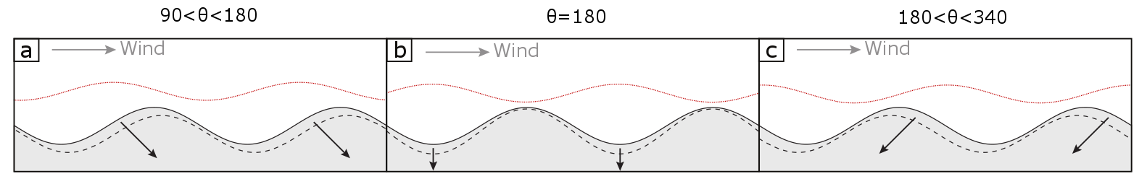

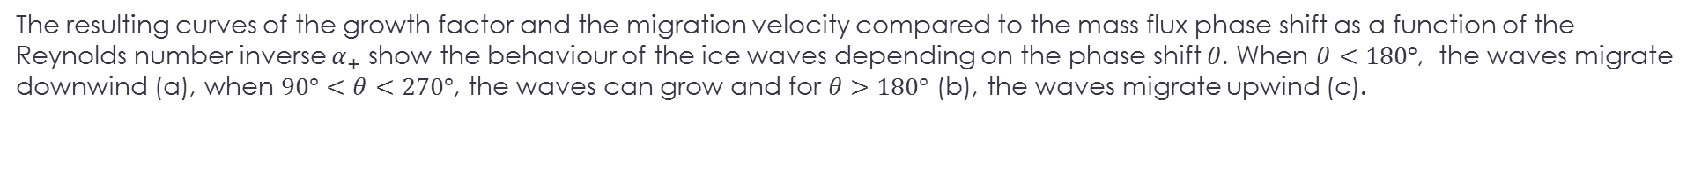
Application and observations
The resulting curves of the growth factor and the migration velocity compared to the mass flux phase shift as a function of the Reynolds number inverse $α_{+}$ show the behaviour of the ice waves depending on the phase shift $θ$. When $θ<180°$, the waves migrate downwind (a), when $90°<θ<270°$, the waves can grow and for $θ>180°$ (b), the waves migrate upwind (c).
The redistribution of surface ice induced the wind flow may lead to the development and migration of periodic bedforms, or “ice ripples”, at the surface of ice sheets. In certain cold and dry environments, this redistribution need not involve solid particle transport but may be dominated by sublimation and condensation, inducing mass transfers between the ice surface and the overlying steady boundary layer turbulent flow. These mass transfers diffuse the water vapour sublimated from the ice into the atmosphere and become responsible for the amplification and propagation of ripples in a direction perpendicular to their crests. Such ice ripples, 24 cm in wavelength, have been described in the so-called Blue Ice Areas of Antarctica.
The redistribution of surface ice induced the wind flow may lead to the development and migration of periodic bedforms, or “ice ripples”, at the surface of ice sheets. In certain cold and dry environments, this redistribution need not involve solid particle transport but may be dominated by sublimation and condensation, inducing mass transfers between the ice surface and the overlying steady boundary layer turbulent flow. These mass transfers diffuse the water vapour sublimated from the ice into the atmosphere and become responsible for the amplification and propagation of ripples in a direction perpendicular to their crests. Such ice ripples, 24 cm in wavelength, have been described in the so-called Blue Ice Areas of Antarctica.
The dimensionless curves of the growth factor and the migration velocity make it possible to access to the most amplified wavelength and the velocity of ripples for every environment since the characteristic parameters are known.
Then we try to apply these results first to the conditions of the blue ice area in Antarctica and then to those of the Martian polar cap as we know it.
The dimensionless $α_{+}$ number giving the most amplified wavelength is:${ α}_{+}=k\frac{ν}{u_{∗}}=\frac{2π}{λ}\frac{ν}{u_{∗}}=7.{10}^{−3}$ that leads to the following predictions:
Predictions: Blue ice area (Antarctica): $λ∼24 cm$ Martian polar cap: $λ∼6 m$
Dynamics
&
Mass transfer
modelling
Motivation
&
Assumptions
Amplification
&
Propagation
Application
&
Observations

Slide 28
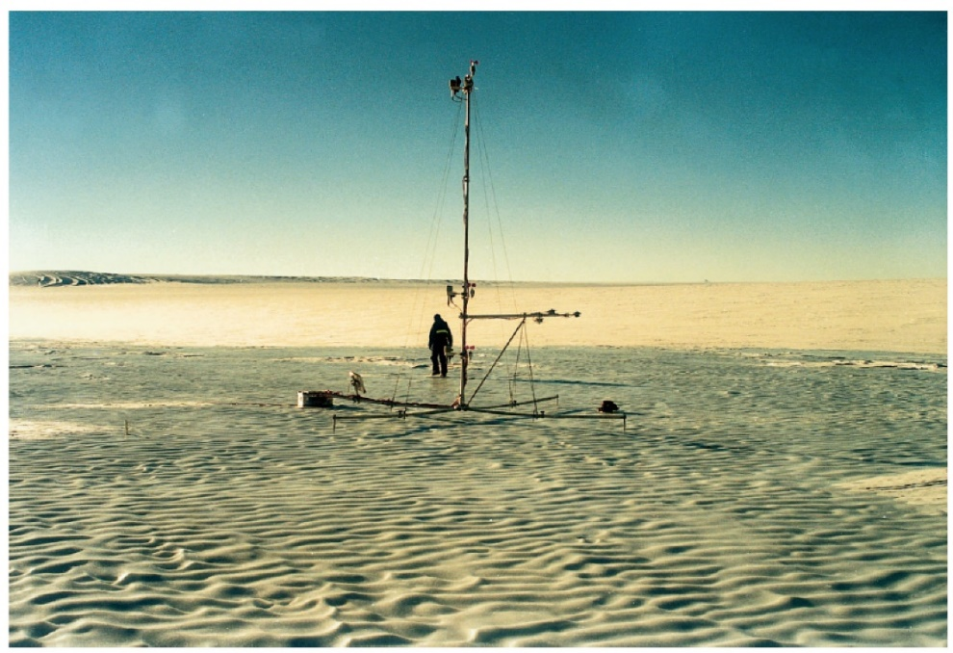

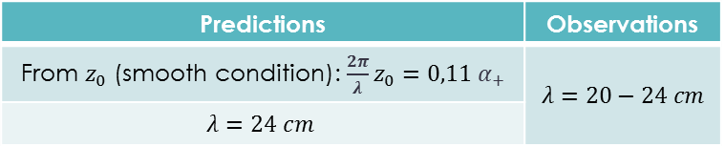
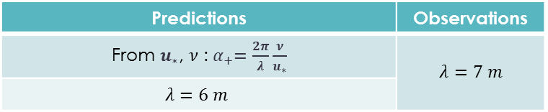
Application and observations
The predictions are compared to…
the observations in the blue ice area
Predictions | Observations
From $z_{0}$ (smooth condition): $\frac{2π}{λ}z_{0}=0,11{ α}_{+}$ | $$λ=20−24 cm$$
$$λ=24 cm$$
The redistribution of surface ice induced the wind flow may lead to the development and migration of periodic bedforms, or “ice ripples”, at the surface of ice sheets. In certain cold and dry environments, this redistribution need not involve solid particle transport but may be dominated by sublimation and condensation, inducing mass transfers between the ice surface and the overlying steady boundary layer turbulent flow. These mass transfers diffuse the water vapour sublimated from the ice into the atmosphere and become responsible for the amplification and propagation of ripples in a direction perpendicular to their crests. Such ice ripples, 24 cm in wavelength, have been described in the so-called Blue Ice Areas of Antarctica.
The redistribution of surface ice induced the wind flow may lead to the development and migration of periodic bedforms, or “ice ripples”, at the surface of ice sheets. In certain cold and dry environments, this redistribution need not involve solid particle transport but may be dominated by sublimation and condensation, inducing mass transfers between the ice surface and the overlying steady boundary layer turbulent flow. These mass transfers diffuse the water vapour sublimated from the ice into the atmosphere and become responsible for the amplification and propagation of ripples in a direction perpendicular to their crests. Such ice ripples, 24 cm in wavelength, have been described in the so-called Blue Ice Areas of Antarctica.
and to the detectable ripples on the Martian polar cap, discovered a posteriori
Predictions | Observations
From $u_{∗}$, $ν$ :${ α}_{+}=\frac{2π}{λ}\frac{ν}{u_{∗}}$ | $$λ=7 m$$
$$λ=6 m$$
Dynamics
&
Mass transfer
modelling
Motivation
&
Assumptions
Amplification
&
Propagation
Application
&
Observations

Slide 29
Application and observations
The predictions are compared to…
« Ripples » on the Martian polar ice cap (7 meters in wavelength) [Massé,2016]
the observations in the blue ice area
Predictions | Observations
From $z_{0}$ (smooth condition): $\frac{2π}{λ}z_{0}=0,11{ α}_{+}$ | $$λ=20−24 cm$$
$$λ=24 cm$$
The redistribution of surface ice induced the wind flow may lead to the development and migration of periodic bedforms, or “ice ripples”, at the surface of ice sheets. In certain cold and dry environments, this redistribution need not involve solid particle transport but may be dominated by sublimation and condensation, inducing mass transfers between the ice surface and the overlying steady boundary layer turbulent flow. These mass transfers diffuse the water vapour sublimated from the ice into the atmosphere and become responsible for the amplification and propagation of ripples in a direction perpendicular to their crests. Such ice ripples, 24 cm in wavelength, have been described in the so-called Blue Ice Areas of Antarctica.
The redistribution of surface ice induced the wind flow may lead to the development and migration of periodic bedforms, or “ice ripples”, at the surface of ice sheets. In certain cold and dry environments, this redistribution need not involve solid particle transport but may be dominated by sublimation and condensation, inducing mass transfers between the ice surface and the overlying steady boundary layer turbulent flow. These mass transfers diffuse the water vapour sublimated from the ice into the atmosphere and become responsible for the amplification and propagation of ripples in a direction perpendicular to their crests. Such ice ripples, 24 cm in wavelength, have been described in the so-called Blue Ice Areas of Antarctica.
and to the detectable ripples on the Martian polar cap, discovered a posteriori
Predictions | Observations
From $u_{∗}$, $ν$ :${ α}_{+}=\frac{2π}{λ}\frac{ν}{u_{∗}}$ | $$λ=7 m$$
$$λ=6 m$$
Dynamics
&
Mass transfer
modelling
Motivation
&
Assumptions
Amplification
&
Propagation
Application
&
Observations

Slide 30
Application and observations
The predictions are compared to…
« Ripples » on the blue ice area (Antarctica) (20-24 cm in wavelength) [Bintanja,2001]
the observations in the blue ice area
Predictions | Observations
From $z_{0}$ (smooth condition): $\frac{2π}{λ}z_{0}=0,11{ α}_{+}$ | $$λ=20−24 cm$$
$$λ=24 cm$$
The redistribution of surface ice induced the wind flow may lead to the development and migration of periodic bedforms, or “ice ripples”, at the surface of ice sheets. In certain cold and dry environments, this redistribution need not involve solid particle transport but may be dominated by sublimation and condensation, inducing mass transfers between the ice surface and the overlying steady boundary layer turbulent flow. These mass transfers diffuse the water vapour sublimated from the ice into the atmosphere and become responsible for the amplification and propagation of ripples in a direction perpendicular to their crests. Such ice ripples, 24 cm in wavelength, have been described in the so-called Blue Ice Areas of Antarctica.
The redistribution of surface ice induced the wind flow may lead to the development and migration of periodic bedforms, or “ice ripples”, at the surface of ice sheets. In certain cold and dry environments, this redistribution need not involve solid particle transport but may be dominated by sublimation and condensation, inducing mass transfers between the ice surface and the overlying steady boundary layer turbulent flow. These mass transfers diffuse the water vapour sublimated from the ice into the atmosphere and become responsible for the amplification and propagation of ripples in a direction perpendicular to their crests. Such ice ripples, 24 cm in wavelength, have been described in the so-called Blue Ice Areas of Antarctica.
and to the detectable ripples on the Martian polar cap, discovered a posteriori
Predictions | Observations
From $u_{∗}$, $ν$ :${ α}_{+}=\frac{2π}{λ}\frac{ν}{u_{∗}}$ | $$λ=7 m$$
$$λ=6 m$$
Dynamics
&
Mass transfer
modelling
Motivation
&
Assumptions
Amplification
&
Propagation
Application
&
Observations

Slide 31

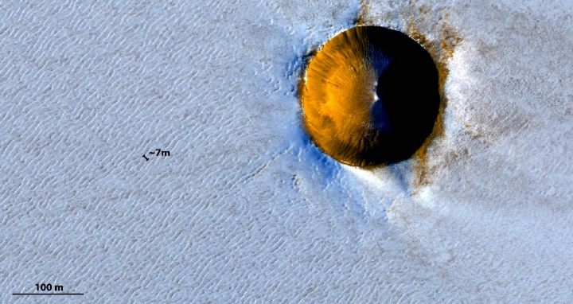


Mass flux (sublimation)
over a wavy ice surface
Ice ripples in Antarctica
Ripples on Mars ?
2-min presentation support
The redistribution of surface ice induced the wind flow may lead to the development and migration of periodic bedforms, or “ice ripples”, at the surface of ice sheets. In certain cold and dry environments, this redistribution need not involve solid particle transport but may be dominated by sublimation and condensation, inducing mass transfers between the ice surface and the overlying steady boundary layer turbulent flow. These mass transfers diffuse the water vapour sublimated from the ice into the atmosphere and become responsible for the amplification and propagation of ripples in a direction perpendicular to their crests. Such ice ripples, 24 cm in wavelength, have been described in the so-called Blue Ice Areas of Antarctica.
Linear stability analysis
Earth (Antarctica)
Model: $λ=24$ cm
Obs: $λ=20−24$ cm
Dimensionless growth rate and migration velocity
most amplified wavelength
Click on arrows, buttons and figures to get more information on each subject. Click on the black crosses to close the windows.
Dynamics
&
Mass transfer
modelling
Motivation
&
Assumptions
Amplification
&
Propagation
Application
&
Observations
Mars polar cap
Model: $λ=6$ m
Obs: $λ=7$ m

