Slide 1
Seismic slip on clay nano-foliation
STEFANO ARETUSINI
EGU
Vienna, 26th April 2017
OLIVER PLÜMPER
ELENA SPAGNUOLO
GIULIO DI TORO

Slide 2
Foliations can develop in 2.5 seconds!
BEFORE…
Fantastic clays and where to find them
500 nm

Slide 3
Foliations can develop in 2.5 seconds!
…AFTER
$$ε=\frac{3 m}{100 μm}=30000$$
$$\dot{ε}=\frac{1.3 {ms}^{−1}}{100 μm}=13000{ s}^{−1}$$
500 nm

Slide 4
SEISMIC SLIP ON CLAY NANO-FOLIATION
S. Aretusini, O. Plümper, E. Spagnuolo and G. Di Toro
INTRODUCTION
METHODS
RESULTS
DISCUSSION
CONCLUSIONS
DEFORMATION PROCESSES
EXPERIMENTS
ADVANCED MICROSCOPY
FRICTION COEFFICIENT
NANO-FOLIATION
SEISMOLOGY
This little, disordered clay will bring you back here

Slide 5
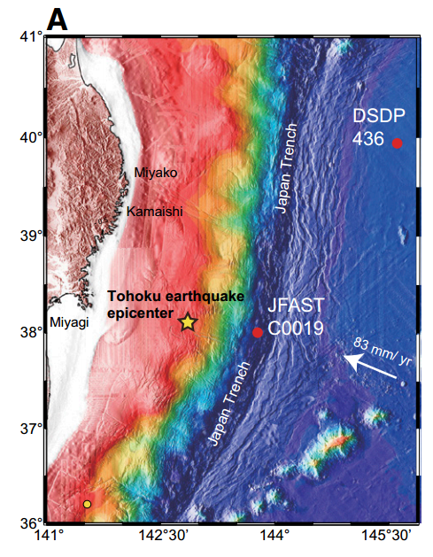
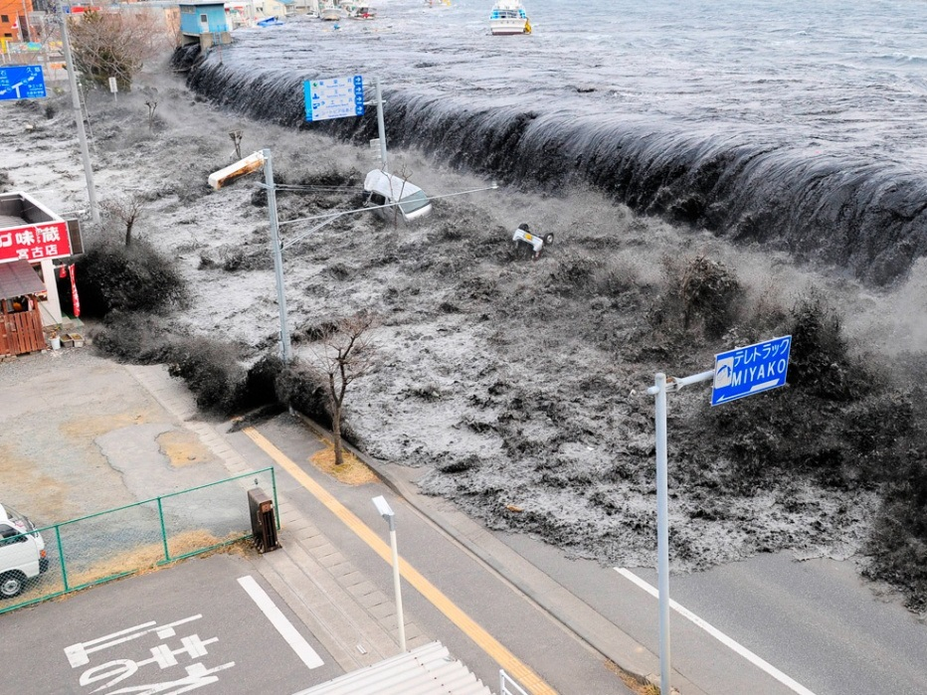
Seismic slip…
During 2011 Tohoku-Oki megathrust earthquake, seismic rupture propagated up to the trench, resulting in huge displacements up to 30 m at slip rates V=1 ms⁻¹, determining the seafloor rebound and the subsequent tsunami that stroke Honshu eastern coast.
Notes:
An example of seismic slip event: megathrust eqk
5

Slide 6
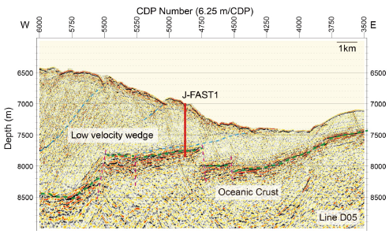
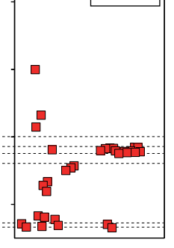
…in clay-rich fault core
Japan trench FAST drilling mission
In the area of maximum coseismic slip
limestone
limestone
56 wt% smectite clay!
Kameda et al., 2015
Chester et al., 2013; Ujiie et al., 2013; etc.
In 2012, JFAST expedition drilled through 850 m of the upper and lower plate sediments until reaching the megathrust fault: ca. 5 m of scaly clays with > 50 wt.% smectite clay mineral. Drilling stopped on chert-rich rocks (lower plate).
Chester et al 2013

Slide 7
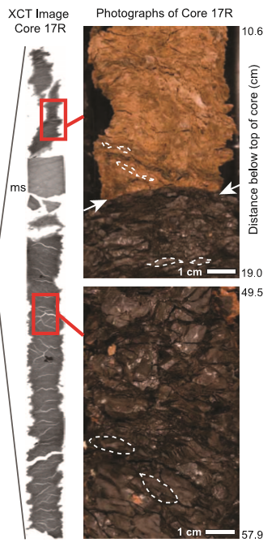
…in clay-rich fault core
Japan trench FAST drilling mission
In the area of maximum coseismic slip
limestone
limestone
Chester et al., 2013
Chester et al., 2013; Ujiie et al., 2013; etc.
During JFAST, the cm-scale scaly fabric of the fault core rocks was sampled and analysed.
Chester et al 2013

Slide 8
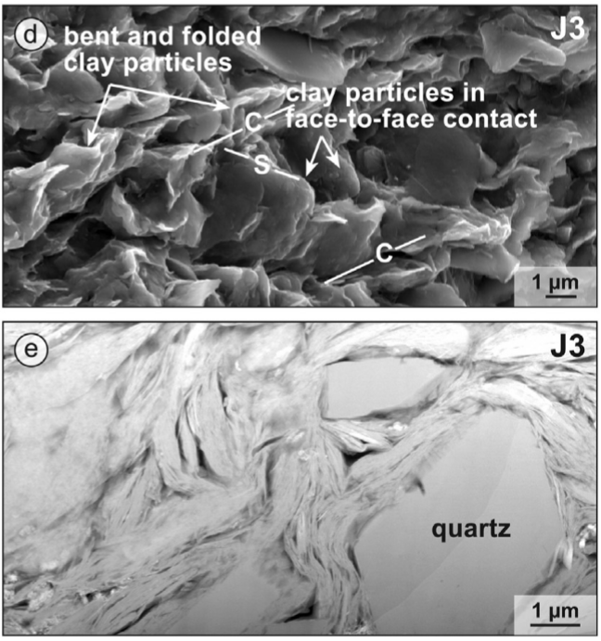
…in clay-rich fault core
limestone
Chester et al., 2013
Janssen et al., 2015
The scaly fabric of the fault core rocks as appears at the micrometer scale.
Smectite clay particles are oriented in S-C patterns and wrap quartz grains.
Chester et al 2013

Slide 9
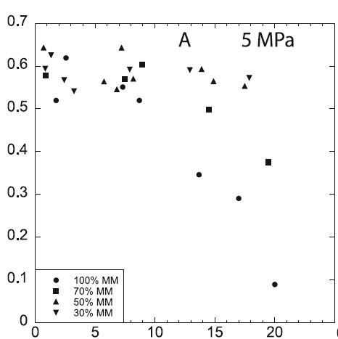
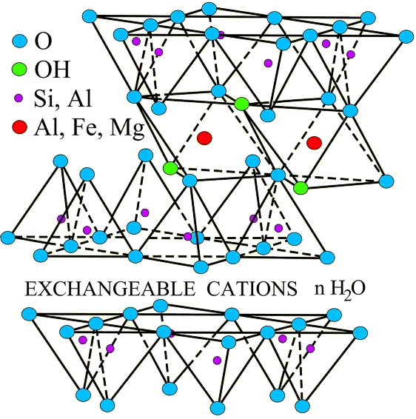
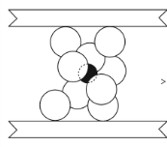
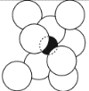
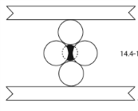
Smectite friction depends on interlayer hydration
Smectite is a TOT phyllosilicate with hydrated cations in the lattice (interlayer) because of the partial negative charge of the TOT layers.
Smectite friction was studied mainly at subseismic slip rates (V<10⁻³ ms⁻¹): experiments showed low friction coefficient (µ=0.1) in saturation conditions and increase of friction coefficient with decreasing water content.
$$μ=\frac{shear stress}{normal stress}$$
µ
Ikari et al., 2007; Moore et al., 2008
wt.% H₂O

Slide 10
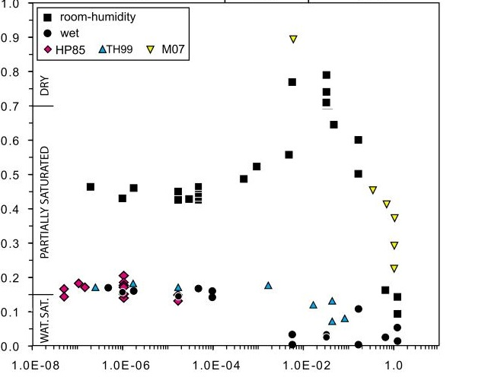
What happens at seismic slip rates and why?
At seismic slip rates (>10⁻⁴ ms⁻¹) friction coefficient of wet smectite is even lower. However, we don’t know the controlling deformation processes, yet.
Subseismic V
Seismic V
See also:
Faulkner et al., 2011
Ujiie et al., 2013
French et al., 2014
Sawai et al., 2014
Bullock et al., 2015
Remitti et al., 2015
?
Apparent friction µ
WEAK
EVEN WEAKER
why?
But none of them investigated the deformation processes at the nano-scale.
Velocity (m/s)
Ferri et al 2011

Slide 11
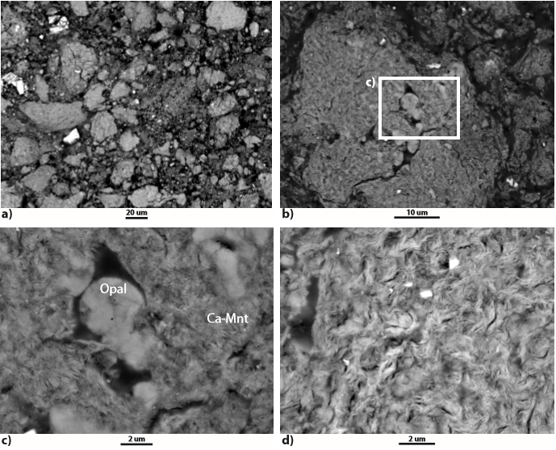
We tested a megathrust fault core analogue material with 70 wt.% smectite (Ca-Montmorillonite) and 30 wt.% opal-CT (STx-1b source clay).

Slide 12
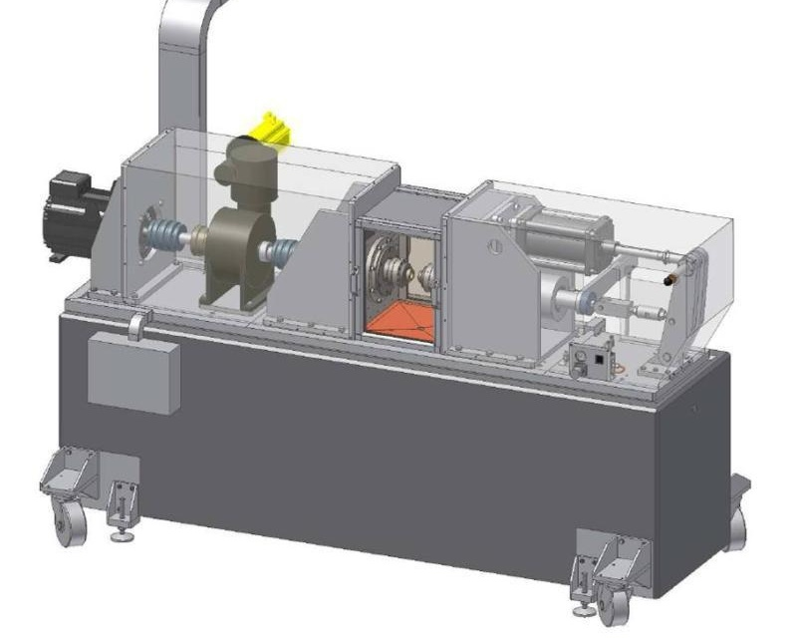
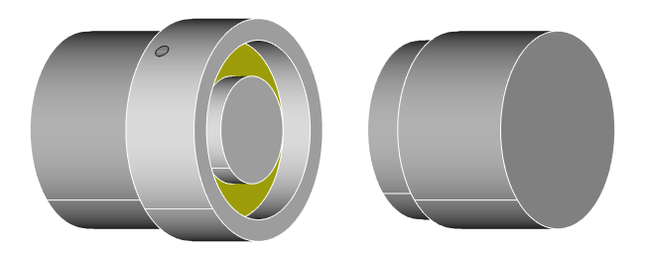
Rotary-Shear Experiments
SHIVA (Rome, INGV)
To achieve seismic slip rates, we used SHIVA, a rotary shear machine (INGV, Rome). It can apply slip rates up to 10 ms⁻¹.

Slide 13
At seismic slip rates, rocks typically heat up by frictional heating until they melt. What happens to wet clays?

Slide 14
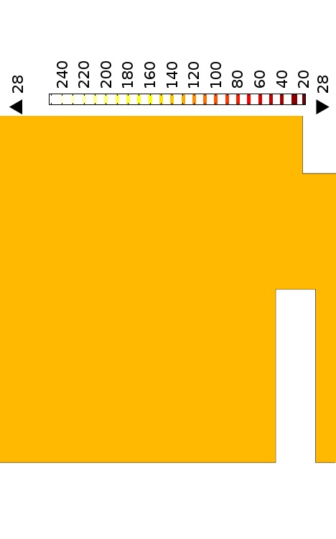
Sample holder and FE thermal model
50 mm
Gouge
Thermocouple
The clay gouge (yellow) is confined by teflon inside the sample holder. Temperature increase by frictional heating is measured with a thermocouple and used to calibrate a FEM numerical model (Comsol Multiphysics).
Notes:
New sample holder with SHIVA: reproduces the ROSA’s one

Slide 15
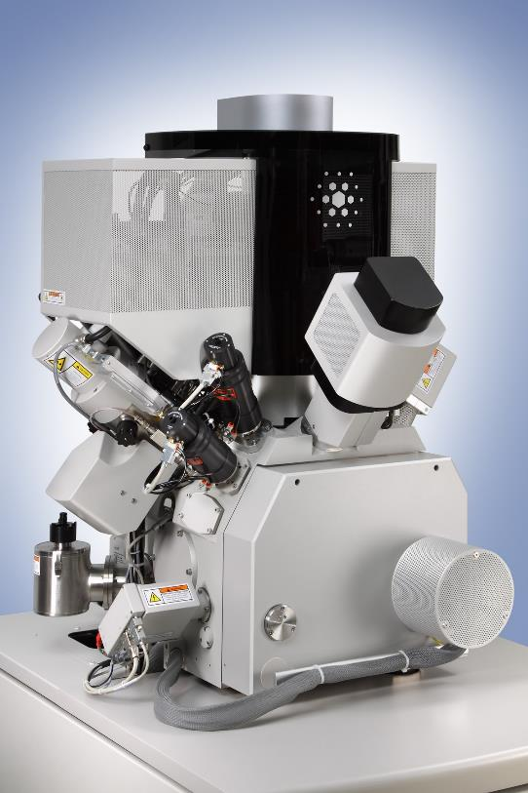
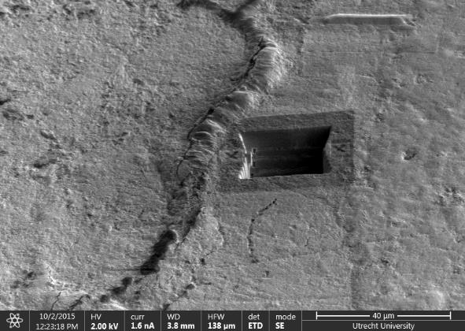
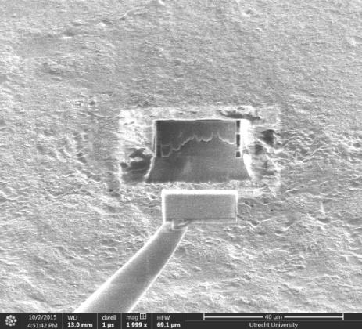
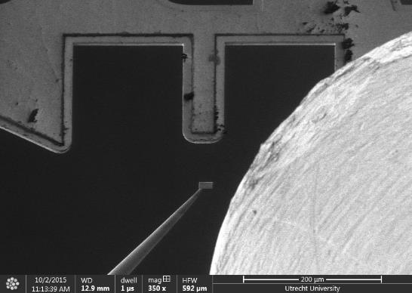
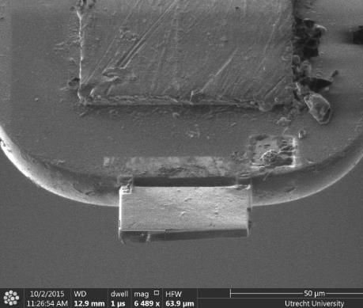
Focused Ion Beam SEM
Oliver Plümper
FEI Helios FIB-SEM-TSEM
1) DIG
2) PICK
3) DOCK
3) STICK & THIN
We prepared samples for Transmission Electron Microscope using a Focused Ion Beam Scanning Electron Microscope (Utrecht University).

Slide 16
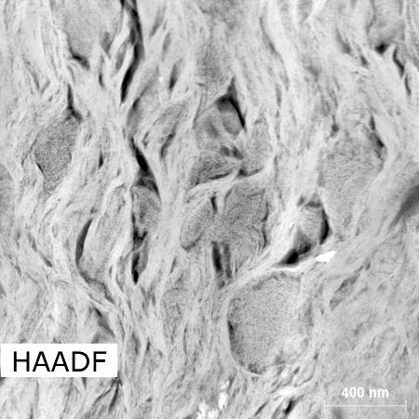
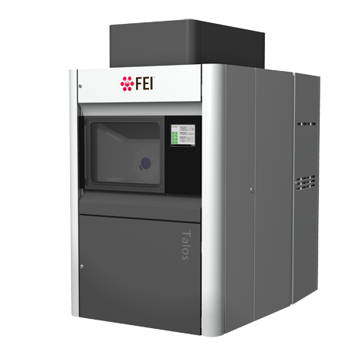
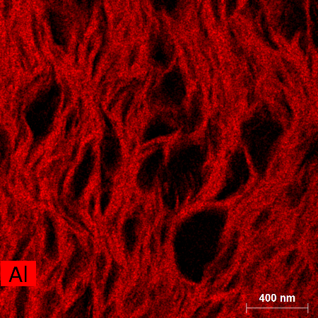
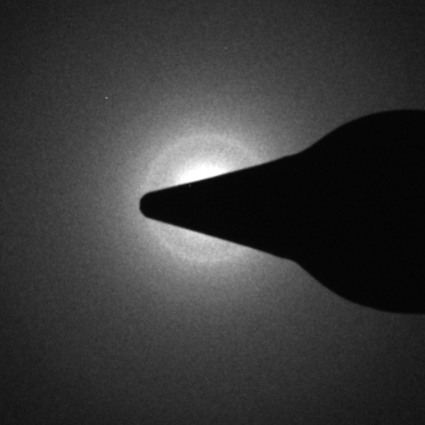
Transmission Electron Microscopy
Oliver Plümper
High Angle
Annular Dark Field
Bright Field
FEI Talos TEM
Electron Dispersive X-Ray
Spectroscopy
Selected Area
Electron Diffraction

Slide 17
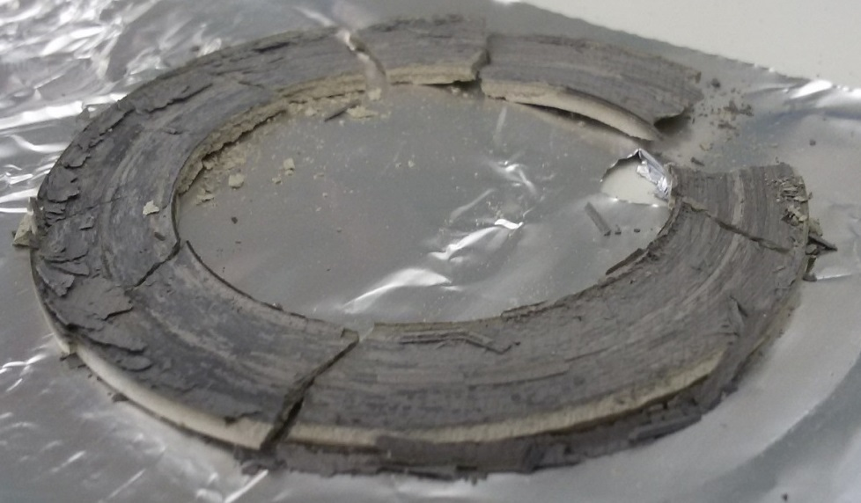
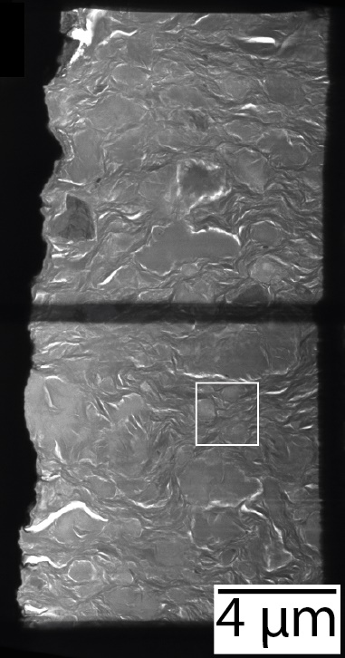
Microstructures: mm to nm scale
Oliver Plümper
Radial section: SEM – BSE image
Radial section
1 mm
10 mm
Position of FIB sampling
TEM - BF image
TEM - BF image
40 µm
Focused Ion Beam - Ion image
FIB cut
100 µm
SEM - BSE image

Slide 18
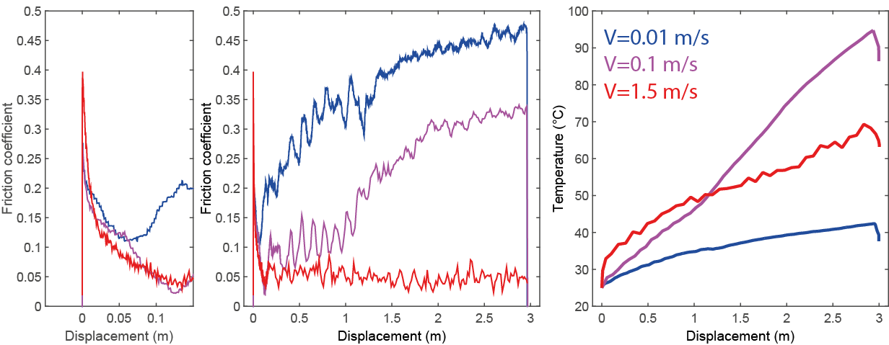
Friction coefficient and temperature
σ_{n} = 5 MPa; Displacement = 3 m; V=0.01, 0.1 and 1.3 m/s
Tohoku-Oki: σ_{n}‘ = 7 MPa (Fulton et al., 2013); Maximum slip = 30 m
1
2
3
V=0.01 m/s
V=0.1 m/s
V=0.1 m/s
V=1.3 m/s
V=1.3 m/s
V=0.01 m/s
Short term (d<0.1 m): weakening independent of slip rate;
Long term (0.1<d<3 m): time dependent strengthening
Temperature rise by frictional heating is limited at T<100 °C. No melting, limited dehydration.

Slide 19
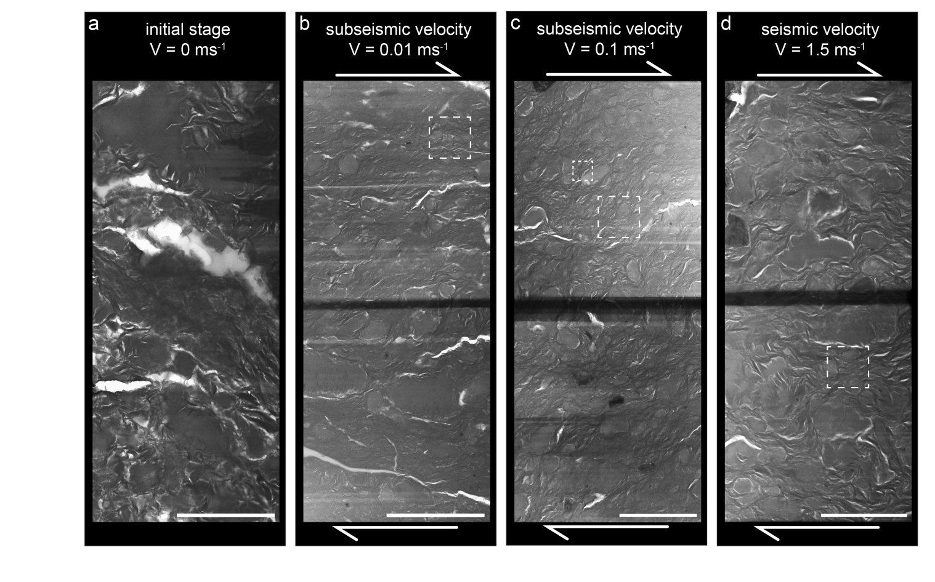
V = 1.3 ms⁻¹
At the micrometer scale, a similar nano-foliation developed at all imposed slip rates (scale = 4 µm).

Slide 20
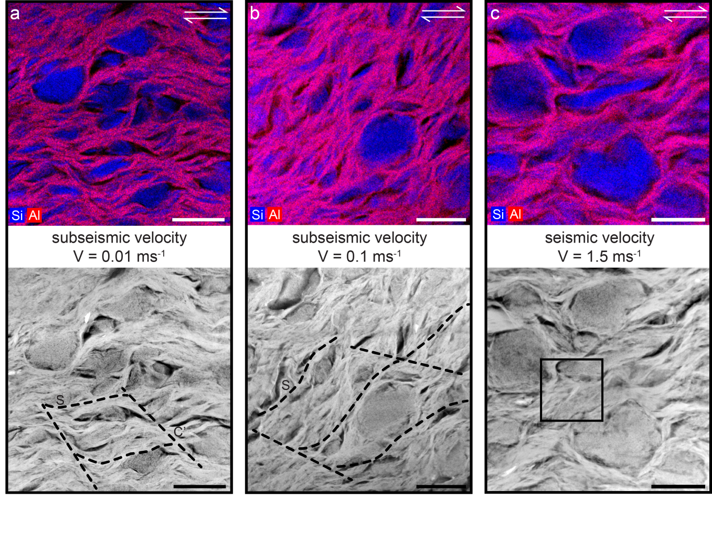
V = 1.3 ms⁻¹
At the nanoscale, the nano-foliation is well developed, with clear S-C’ patterns, at V≤0.1 ms⁻¹, while is anastomosing at V=1.5 ms⁻¹ (scale = 400 nm).

Slide 21
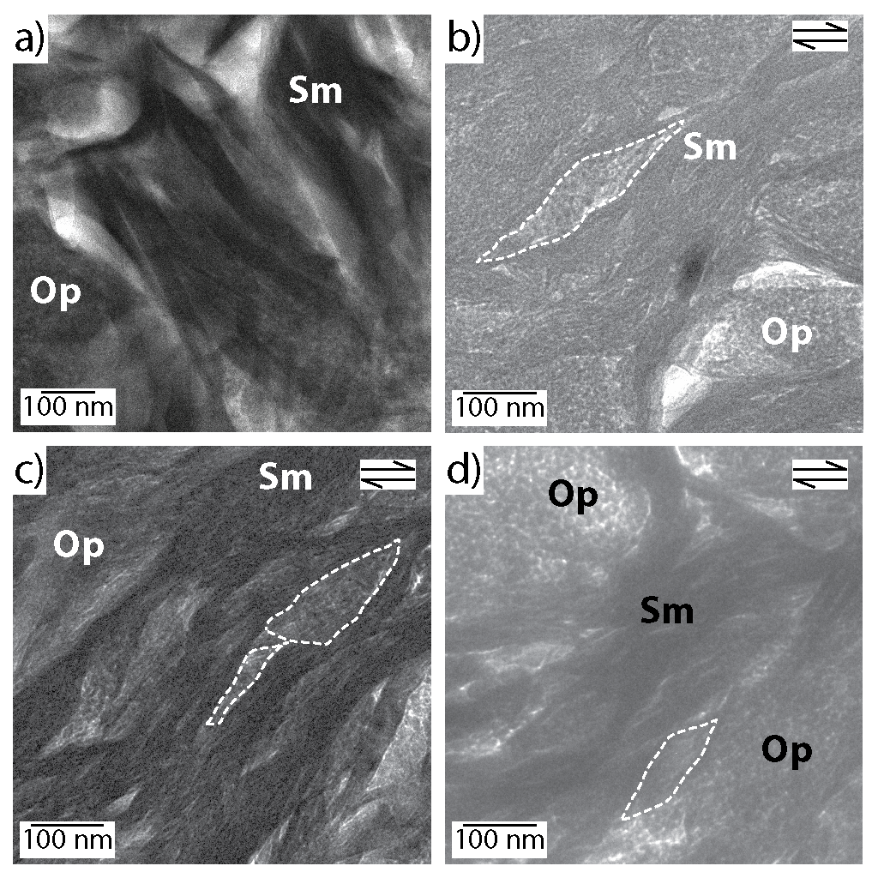
V=0 m/s
V=0.01 m/s
Tabular crystal (undeformed)
Sigmoidal crystal (deformed)
Progressive disappearence of crystal boundaries
V=0.1 m/s
V=1.3 m/s
Subrounded crystal (undeformed)
Angular crystal (deformed)

Slide 22
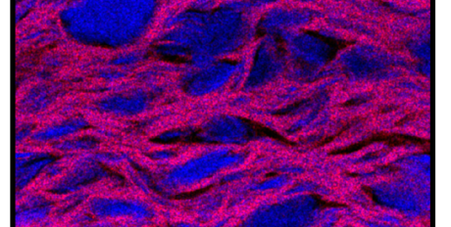
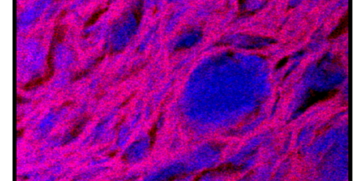
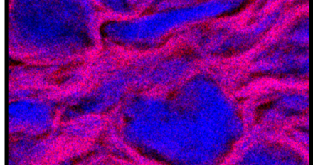
Nano-foliation at all V…
The smectite nano-foliation deforms by frictional sliding (FS). FS on hydrated interlayers accommodates intra-crystalline displacement and bending (sigmoidal shapes). FS on crystal boundaries accommodates inter-crystalline displacement thanks to water molecules bonded to smectite surfaces.
Apparent friction µ
Velocity (m/s)
Ferri et al 2011

Slide 23
Nano-foliation at all V…
Deformation of Opal-CT grains is cataclastic (fracturing, see angular shapes, and rigid rotation of clasts). Modelling (not discussed here) suggests that pressure solution is reaction limited and cannot accommodate the experimental strain rates. Opal-CT grains interaction with smectites results in anastomosing fabric (kinking of smectite crystals) and development of porosity.
Apparent friction µ
Velocity (m/s)
Ferri et al 2011

Slide 24
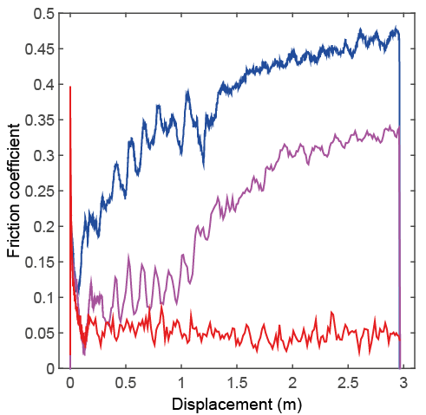
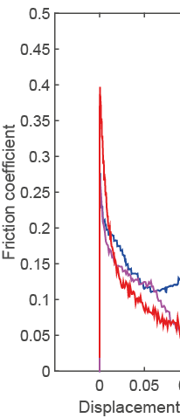
… but friction changes
In the short term (d<0.1 m), undrained - saturated conditions favour inter- and intra-crystalline FS, development of nano-foliation and slip weakening.
In the long term (0.1<d<3 m), water drainage and partially-saturated conditions inhibits inter- and intra-crystalline FS and promotes strengthening.
Apparent friction µ
Long term
Short term
Velocity (m/s)
Ferri et al 2011

Slide 25
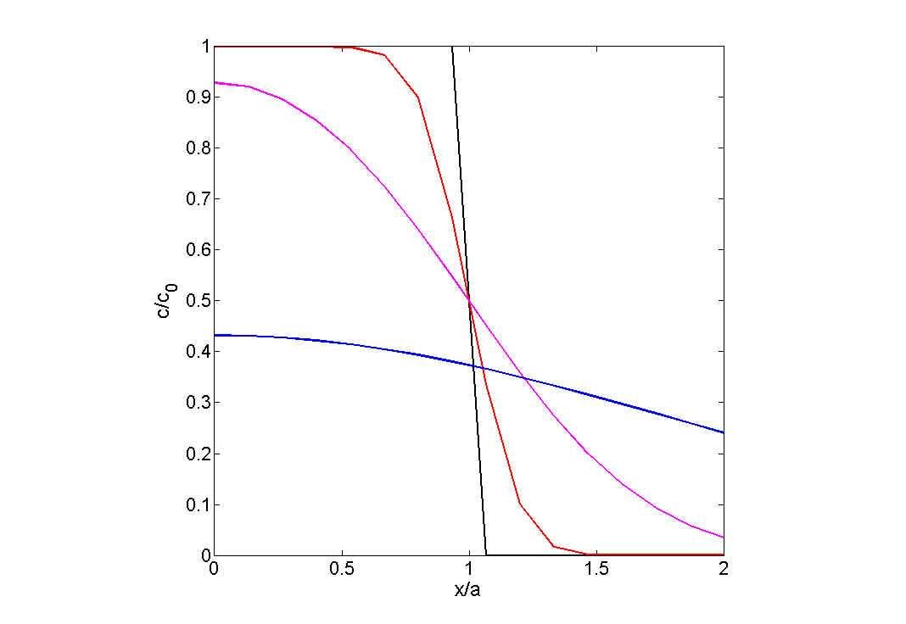
1D water diffusion
13 wt% H₂O
D_{p}~3.45*10⁻⁹ m²/s
1/100 of D_{p} in Gonzales Sanchez et al., 2008
$$\frac{∂C}{∂t}=Dp\frac{∂2C}{∂x2}$$
5.5 wt% H₂O
t=250 s; V=0.01 m/s
t=25 s; V=0.1 m/s
t=2 s; V=1.3 m/s
Gouge layer
With longer times, the whole gouge thickness becomes water-depleted

Slide 26
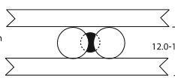
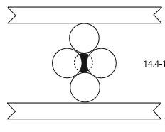
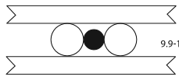
Time for drainage - strengthening V≤0.1m/s
µ
µ
LT
Partially saturated
ST
d(m)
Long term
LOW V
THERE IS TIME
FOR WATER DIFFUSION:
WATER LOSS
Short term
Saturated
Overpressured
Water wt.%
Modified after Ikari et al. 2007

Slide 27
No time for drainage @ V=1.5m/s
µ
µ
LT
Partially saturated
ST
d(m)
HIGH V
NO TIME
FOR WATER DIFFUSION:
WATER
PRESSURIZATION
Short=long term
Saturated
Overpressured
Water wt.%
Modified after Ikari et al. 2007

Slide 28
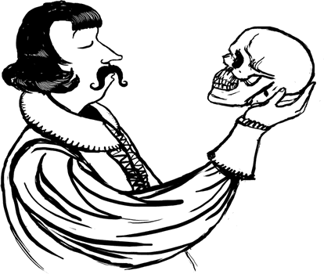
Seismologic implications: to slip or not to slip
V≤0.1 m/s
V=1.3 m/s
τ
τ
E_{g}
E_{hard}
E_{g}
E_{heat}
E_{heat}
d(m)
d(m)
Shear fracture energy E_{g} is dissipated in the rupture breakdown zone (Palmer and Rice, 1973; Wong, 1982; Faulkner et al., 2011). Larger E_{g}, more difficult is for a rupture to propagate.
Smectite-rich fault rocks have small Eg, favouring seismic slip propagation.
The E_{hard} additional energy sink is big and contributes to arrest of seismic slip. As E_{hard} is present only at V≤0.1 m/s, arrest of seismic slip has a strong, combined displacement and velocity dependence.

Slide 29
Conclusions
Smectite-rich fault rocks host megathrust faults and control their tsunamigenic potential.
Development of smectite nano-foliation is the main dynamic weakening mechanism at all seismic slip rates.
Friction coefficient of the nano-foliation is controlled by smectite interlayer hydration evolution with time.

Slide 30
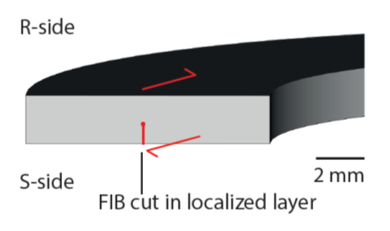
Position of FIB cuts
V=0.01 m/s
h=20 µm
1 mm
V=0.1 m/s
1 mm
V=1.3 m/s
1 mm

Slide 31
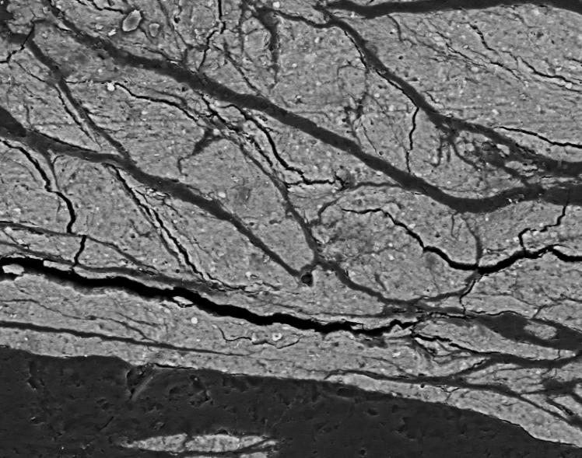
Position of FIB cuts
V=0.01 m/s
Microstructures – location of FIB cuts
V=0.1 m/s
100 µm
100 µm
V=1.3 m/s
Starting material
100 µm
100 µm

