Slide 1
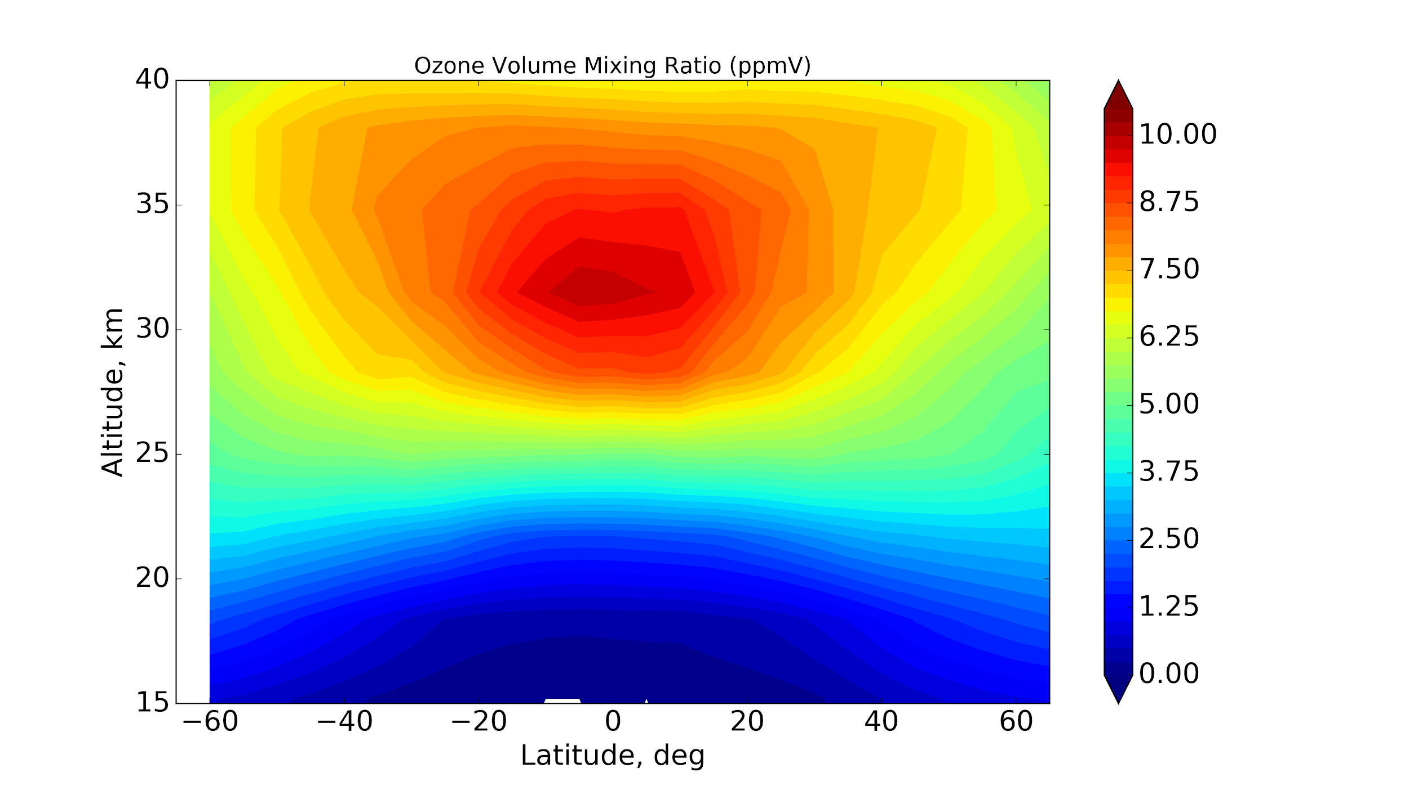
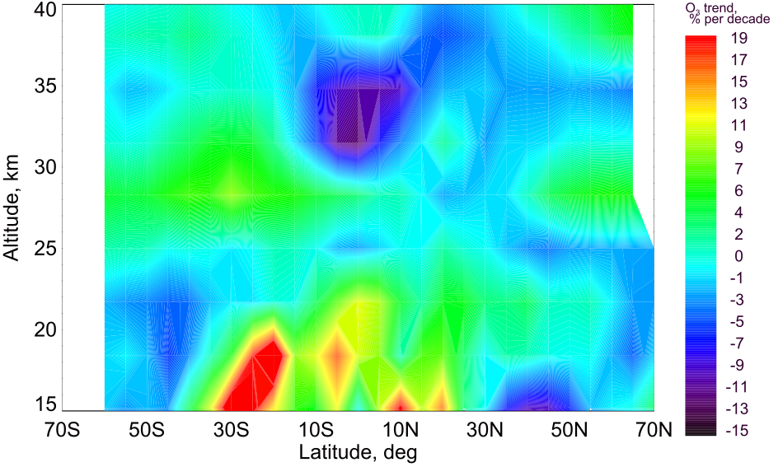
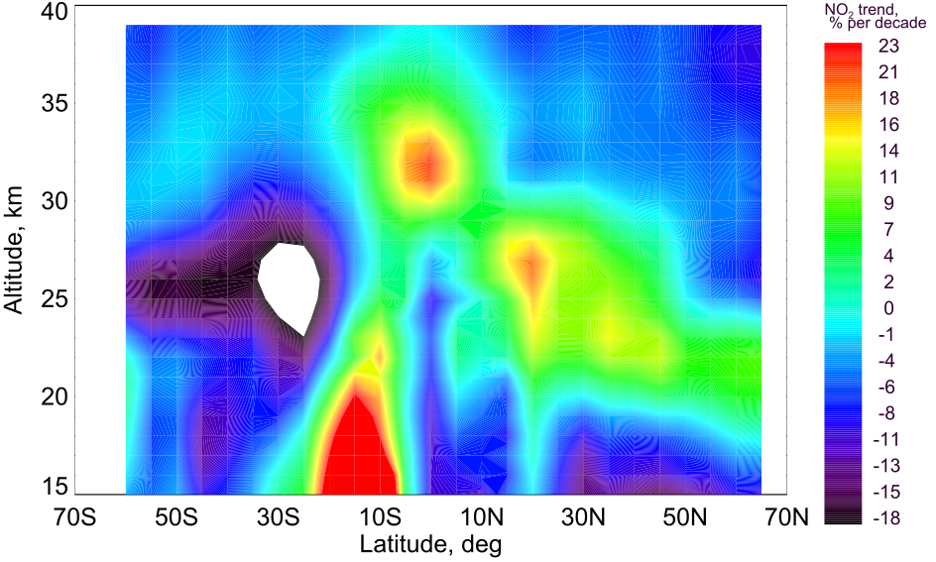
1
2
Correspondence:
egalytska@iup.physik.uni-bremen.de
NO₂ and O₃ changes in tropical mid-stratosphere during 2004-2012 by means of a chemistry-transport model
Evgenia Galytska¹ , A. Rozanov¹, M. P. Chipperfield², S. Dhomse², and J. P. Burrows¹
O₃ VMR (ppmV) from SCIAMACHY 2004-2012
Negative (~10%) O₃ changes (% per decade) from SCIAMACHY 2004-2012
Positive (~17%) NO₂ changes (% per decade) from SCIAMACHY 2004-2012
Reported negative O₃ trends:
Kyrölä et al., ACP, 2013. SAGE II-GOMOS, 1997-2011
Gebhardt et al., ACP, 2014. SCIAMACHY, 2002-2012
Nedoluha et al., ACP, 2015. MLS, 2004-2013
Sofieva et al., ACP, 2017. SAGE–CCI–OMPS,
2000-2016
Observed variations relate to changes in transport of N₂O
But what are these changes?
2-minute madness
1/2
Notes:
The topics is devoted to changes of stratospheric O3, in particular in tropics , which has been one of the most discussed issues of the past years.
This brings me to importance of this topic, as-->
O3 is formed in the tropical middle stratosphere from the photodissociation of molecular oxygen (and known as a Chapman mechanism because of the most intense sunlight). The high amount of O3 in middle and high latitudes is observed due to BDC.After O3 is formed via Chapman mechanism, it is afterward is meridionally transported via BDC.
Recently there have been several studies which showed O3 decrease in trop. mid-stratosphere. Nevertheless, a key limitation of previous studies is that the reasons of observed changes were not clearly stated or the reasons they provide are not yet confirmed by bservations.
In our research we associate negative O3 change with positive NO2 change/. Which is essential as mean O3 loss via NOx family coul reach upto 80%.

Slide 2
Seasonal changes of AoA, N₂O, and O₃ in the tropical middle stratosphere
AoA (years)
N₂O (ppbV)
O₃ (ppmV)
Key points are:
Seasonal changes of transport which affect N₂O
Winter months — speed up of transport
Autumn months — slow-down of transport
Non-linearity in relation AoA-N₂O
February
AoA (years)
N₂O (ppbV)
O₃ (ppmV)
Come to my PICO presentation to learn more about observed O₃ changes.
October
2-minute madness
2/2
Notes:
In particular we found that ….
AoA - Commonly used metrics of BDC

Slide 3
1
2
35
30
25
20
Ozone Volume Mixing Ratio (ppmV) from SCIAMACHY 2004-2012
I
Chemistry of O₃ and our motivation
II
NO₂ and O₃ changes in SCIAMACHY & TOMCAT model during 2004-2012
III
N₂O in tropical stratosphere and its changes
IV
What is our assumption?
V
Interesting features in N₂O-AoA (anti)correlation
NO₂ and O₃ changes in tropical mid-stratosphere
VI
Where the secret was hidden?
Evgenia Galytska¹ , A. Rozanov¹, M. P. Chipperfield²,
S. Dhomse², and J. P. Burrows¹
VII
Back-up slides
PICO navigation
active MENU button
change slide
egalytska@iup.physik.uni-bremen.de
Notes:
The topics is devoted to changes of stratospheric O3, in particular in tropics , which has been one of the most discussed issues of the past 40 years.

Slide 4
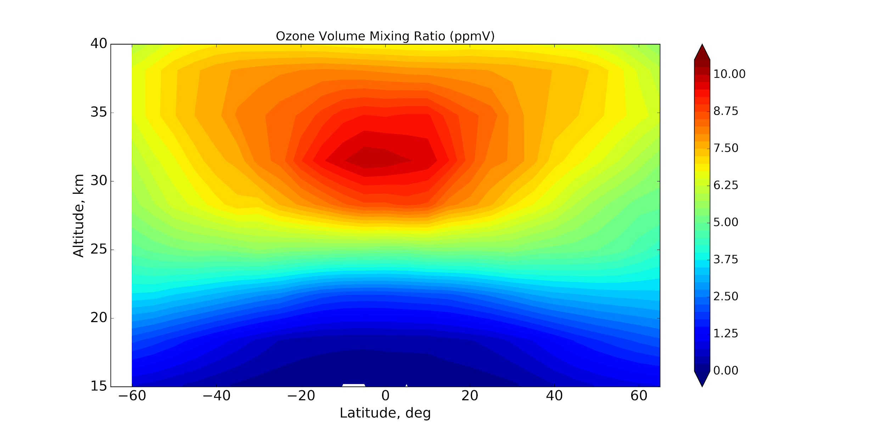
Ozone Volume Mixing Ratio (ppmV) from SCIAMACHY 2004-2012
O₃ VMR, ppmV
I
Summer Winter
2 BD circulation
4
Formation of NO_{y} from :
N₂O + O(¹D) 2 NO
1
O₃ formation via Chapman mechanism
5
O₃ destruction via NO_{x}:
NO + O₃ NO₂ +O₂
NO₂ + O₃ O₂ +NO₃
Altitude, km
3
Transport of N₂O
4
Notes:
Most of earth’s atmospheric O3 (about 90%) is found in the stratosphere.
Tropical stratosphere is an important area, in terms of O3 formation from the photodissociation of molecular oxygen (and known as a Chapman mechanism because of the most intense sunlight). The high amount of O3 in middle and high latitudes is observed due to BDC. This is how protecting O3 layer formed, which absorbs virtually all of the solar ultraviolet radiation of wavelengths between 240 and 290 nm (destroys unicellular organisms) and biologically active (UV-B), which causes skin cancer.
.
Thus, any changes in O3 in this tropical stratosphere can affect its distribution.
Although, O3 is not transported from the troposphere, as its lifetime is not long enough
After O3 is formed via Chapman mechanism, it is afterward is meridionally transported via BDC. BDC is …

Slide 5
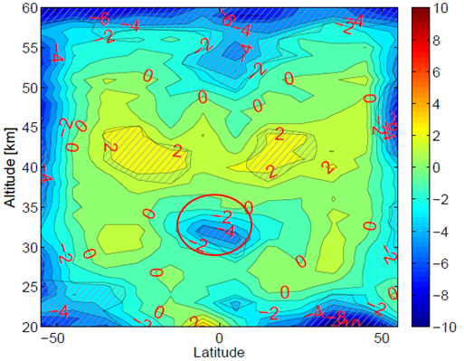
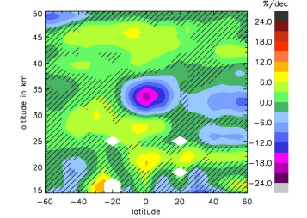
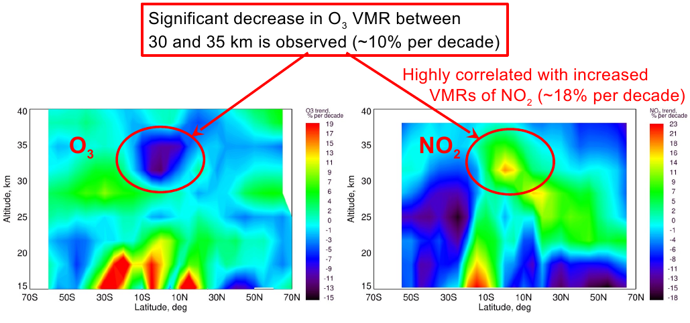
Recently reported negative O₃ trends in tropical mid-stratosphere
I
Kyrölä et al., ACP, 2013
SAGE II-GOMOS, 1997-2011
Gebhardt et al., ACP, 2014
SCIAMACHY, 2002-2012
Nedoluha et al., ACP, 2015
MLS, 2004-2013
Nedoluha et al. suggested that the slow-down of tropical upwelling increases the residence time of N₂O and produces more NO_{y}, which in turn causes O₃ decrease.
...and similar trends:
SAGE–CCI–OMPS, 1997(2000)-2016
Steinbrecht et al.,ACP, 2017
Sofieva et al., ACP, 2017
Nevertheless the reason of observed negative O₃ and positive NO₂ changes was not clarified.
Negative O₃ changes (2004-2012) observed by SCIAMACHY were associated with positive NO₂ changes.
Which brings us to the point of our research: What are the reasons of observed changes in O₃ and NO₂?
* From the presentation of Dr. A. Rozanov, 9th Workshop on Long Term Changes and Trends, Kuhlungsborn, Germany, September 2016
To learn more about our multivariate regression model, click here
5

Slide 6
SCIAMACHY
Performed 3 TOMCAT simulations:
II
~10%
Full chemistry
~60 species
~180 reactions
~constrained for SCIAMACHY measurements
Fixed surface concentrations of source gases (i.e. N₂O, CH₄, all bromine and chlorine source gases)
Fixed transport Meteorology is the same from year to year (i.e. ECMWF Era-Interim for 2004)
O₃
NO₂
~17%
To learn more about our multivariate regression model, click here
To learn more about SCIAMACHY - TOMCAT validation, click here
6

Slide 7
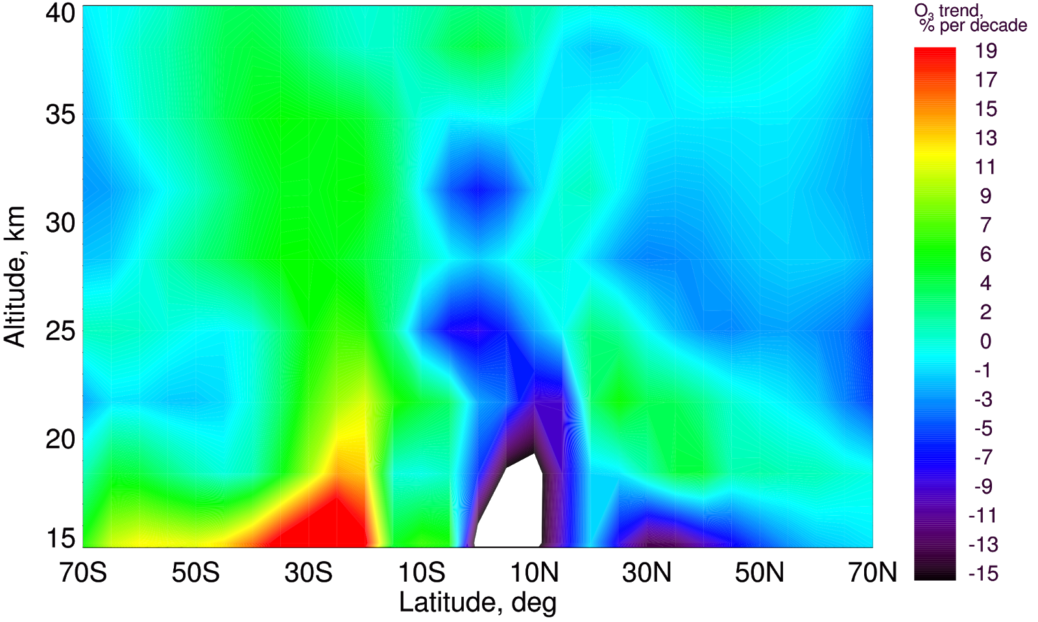
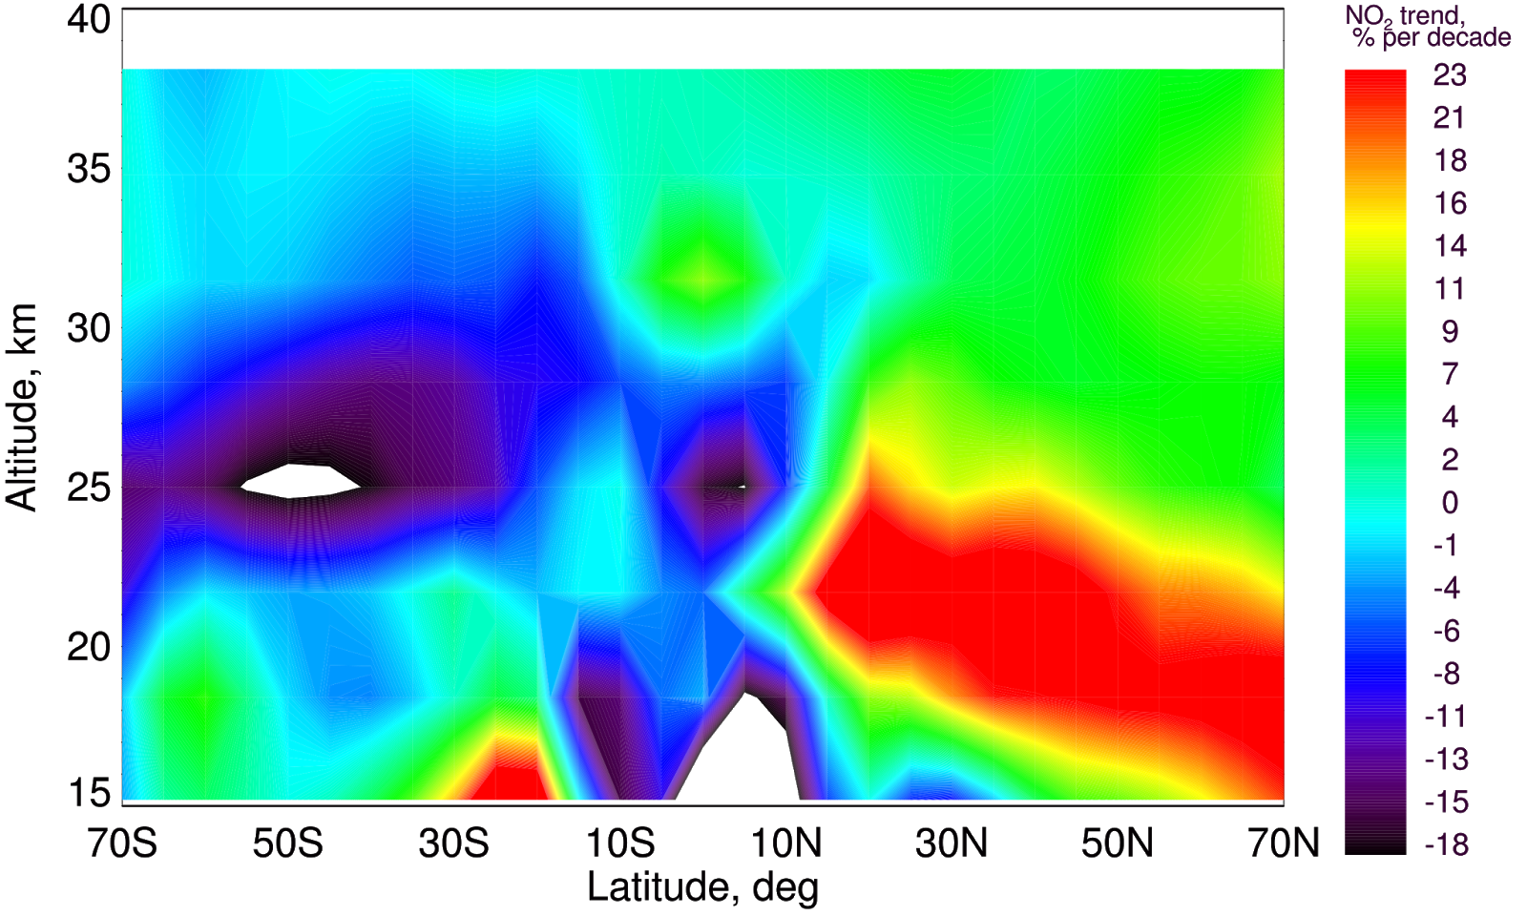
SCIAMACHY
TOMCAT
II
Full chemistry Fixed source gases Fixed transport
~10%
~7%
Fixed surface concentrations of source gases (i.e. N₂O, CH₄, all bromine and chlorine source gases)
Fixed transport Meteorology is the same from year to year (i.e. ECMWF Era-Interim for 2004)
O₃
NO₂
~17%
~10%
Observed O₃ and NO₂ changes are similar in both SCIAMACHY measurements and TOMCAT model
7

Slide 8
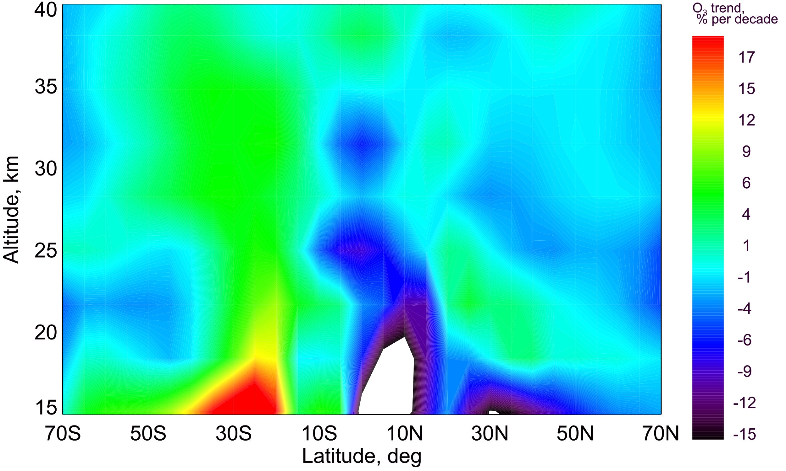
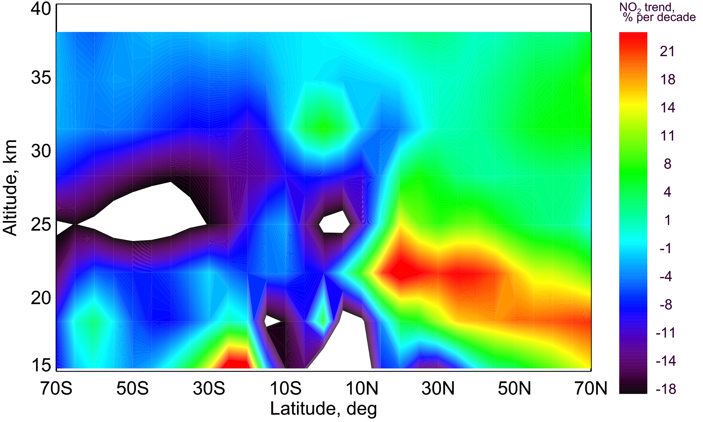
SCIAMACHY
TOMCAT
II
Full chemistry Fixed source gases Fixed transport
~10%
~7%
~6%
Fixed transport Meteorology is the same from year to year (i.e. ECMWF Era-Interim for 2004)
O₃
NO₂
~17%
~10%
~5-7%
Observed O₃ and NO₂ changes are similar in both SCIAMACHY measurements and TOMCAT model
Significant impact on observed changes is coming from the transport patterns
8

Slide 9
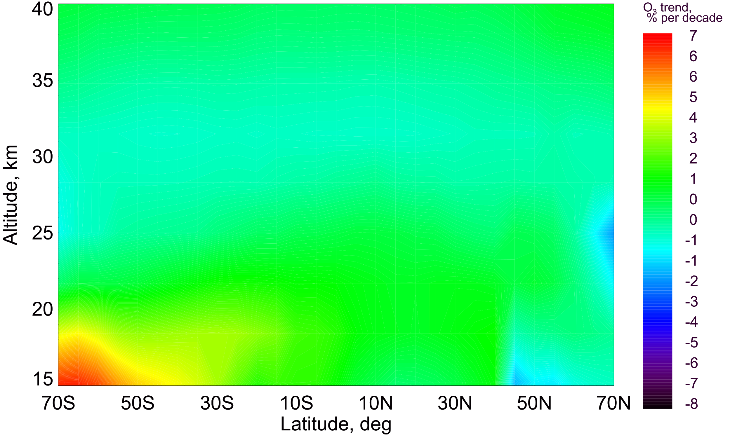
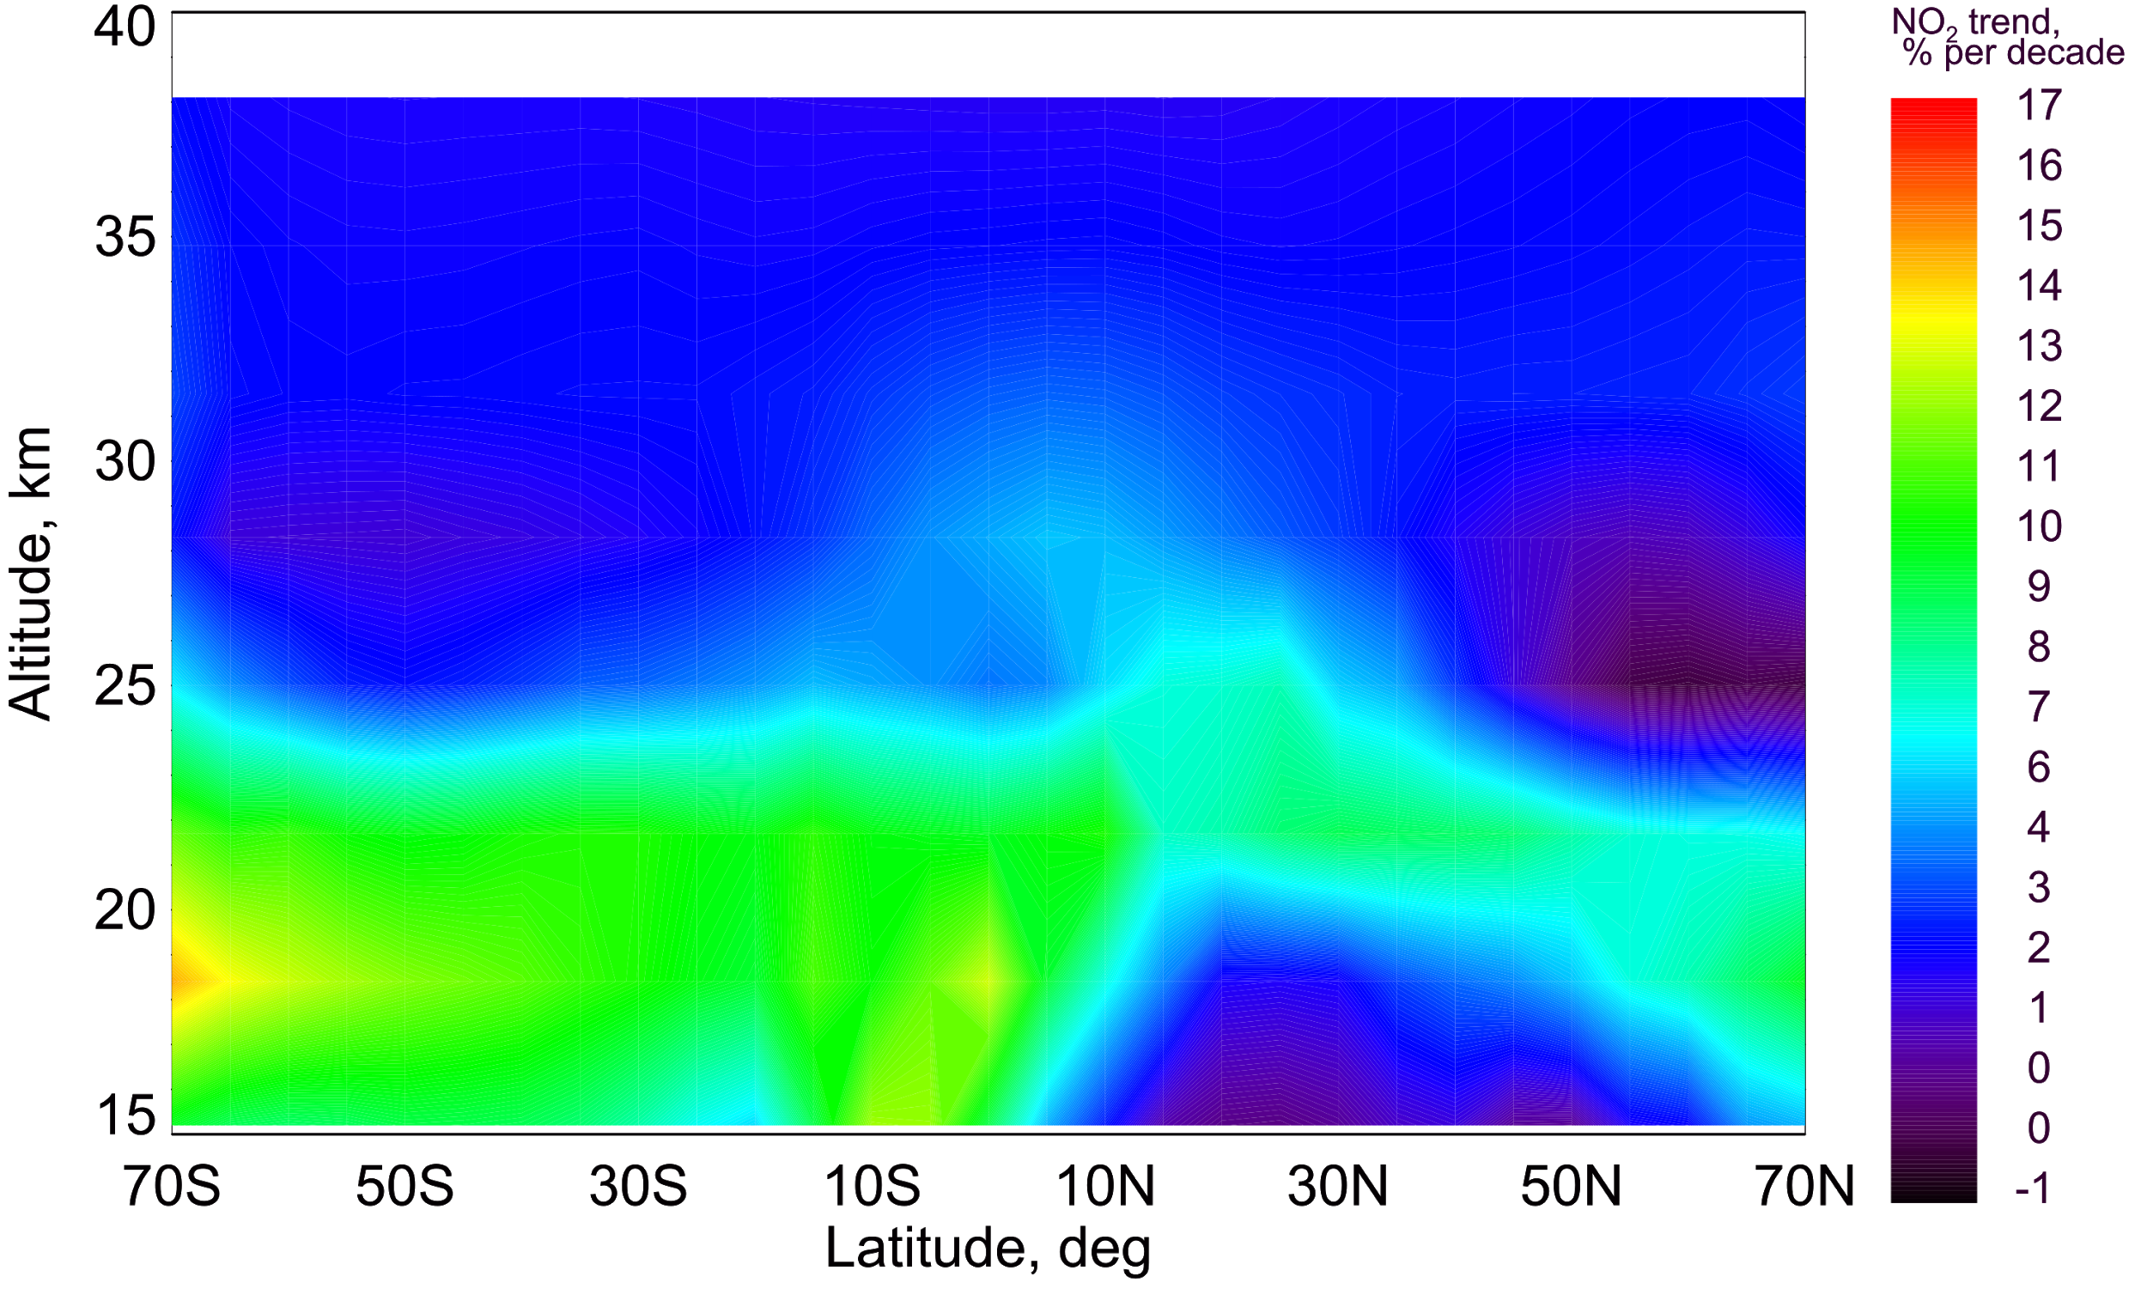
SCIAMACHY
TOMCAT
II
Full chemistry Fixed source gases Fixed transport
~10%
~7%
~6%
~1%
O₃
NO₂
~17%
~10%
~5-7%
~2-3%
Observed O₃ and NO₂ changes are similar in both SCIAMACHY measurements and TOMCAT model
Significant impact on observed changes is coming from the transport patterns
The impact of chemistry is not as significant
9

Slide 10
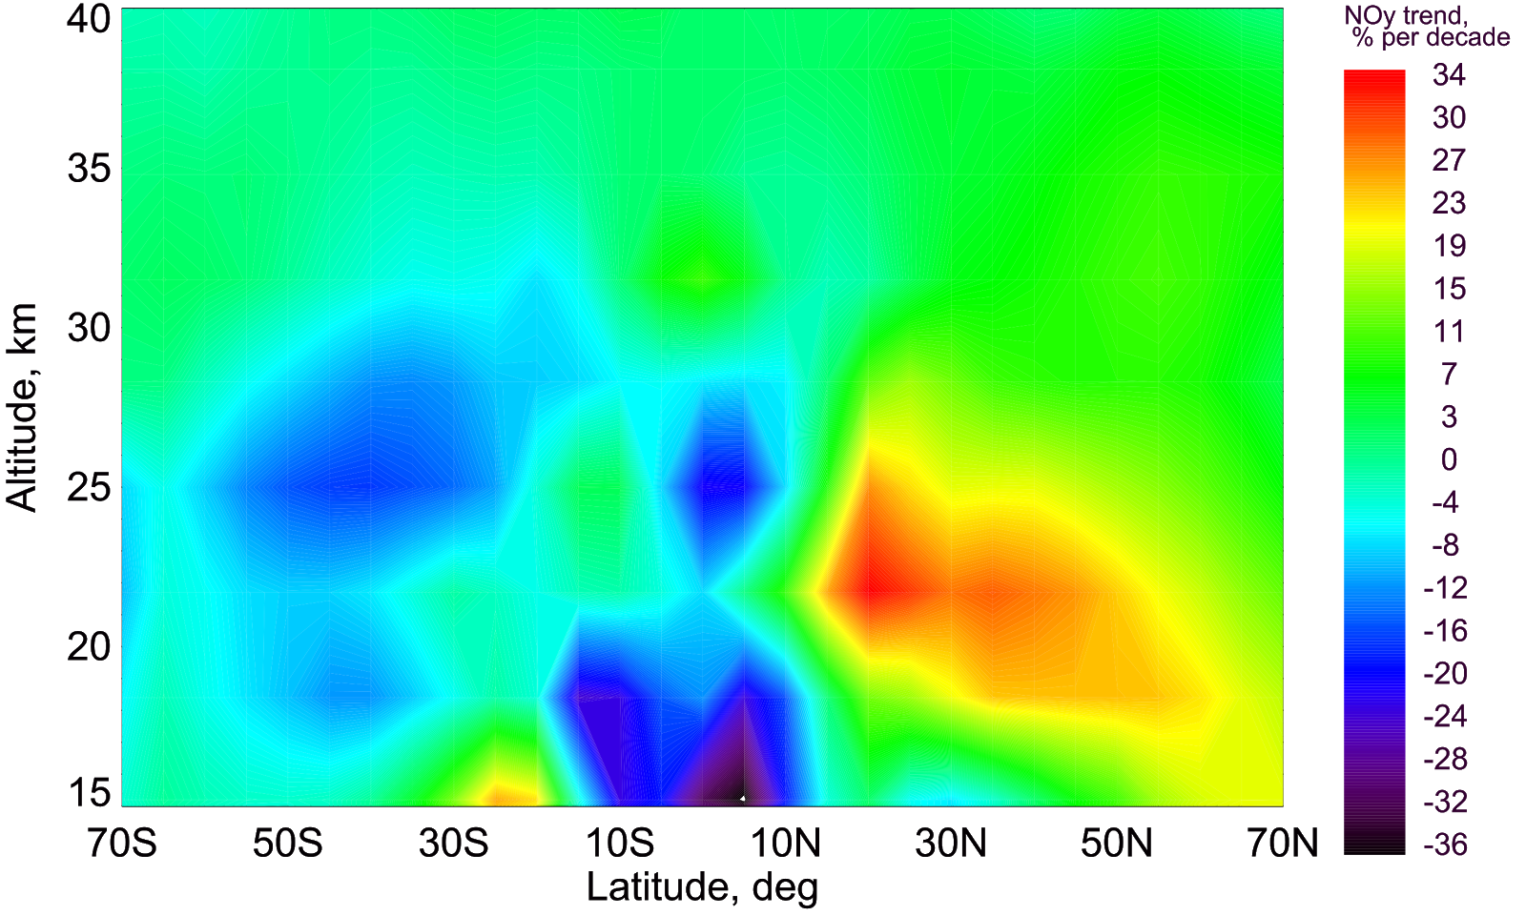
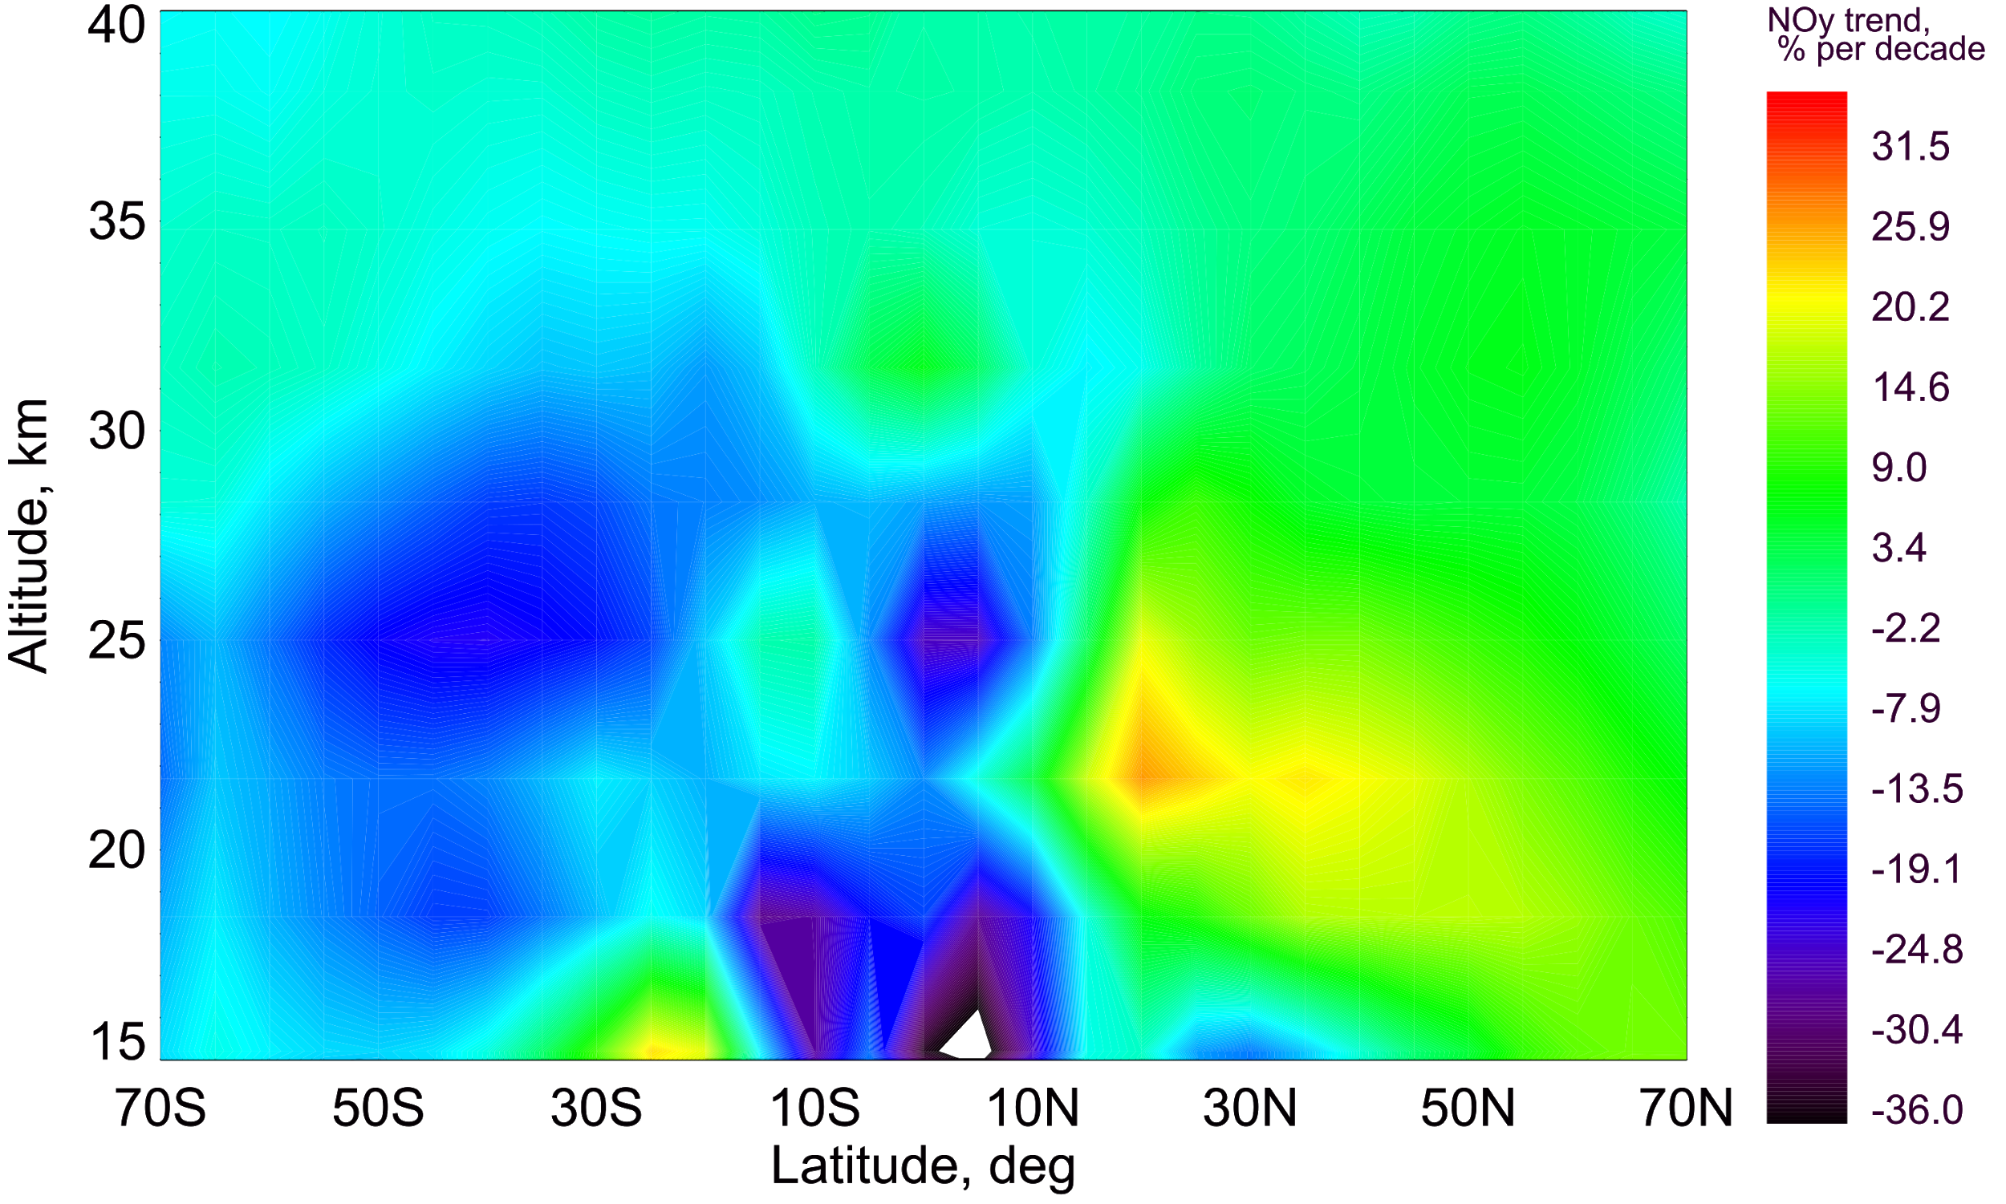
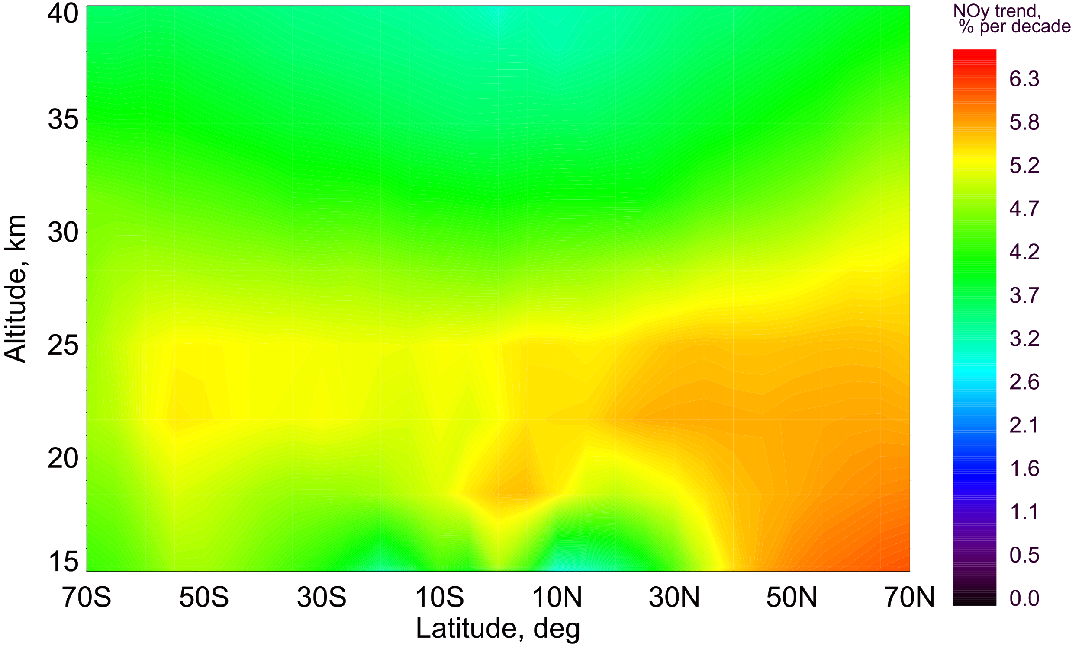
SCIAMACHY
TOMCAT
II
Full chemistry Fixed source gases Fixed transport
~10%
~7%
~6%
~1%
O₃
NO₂
NO_{y}
~17%
~10%
~5-7%
~2-3%
~8%
~5%
~3%
Positive NO_{y}
(NO+NO₂ + HNO₃ + 2xN₂O₅) changes are the reason of observed positive NO₂ changes
10

Slide 11
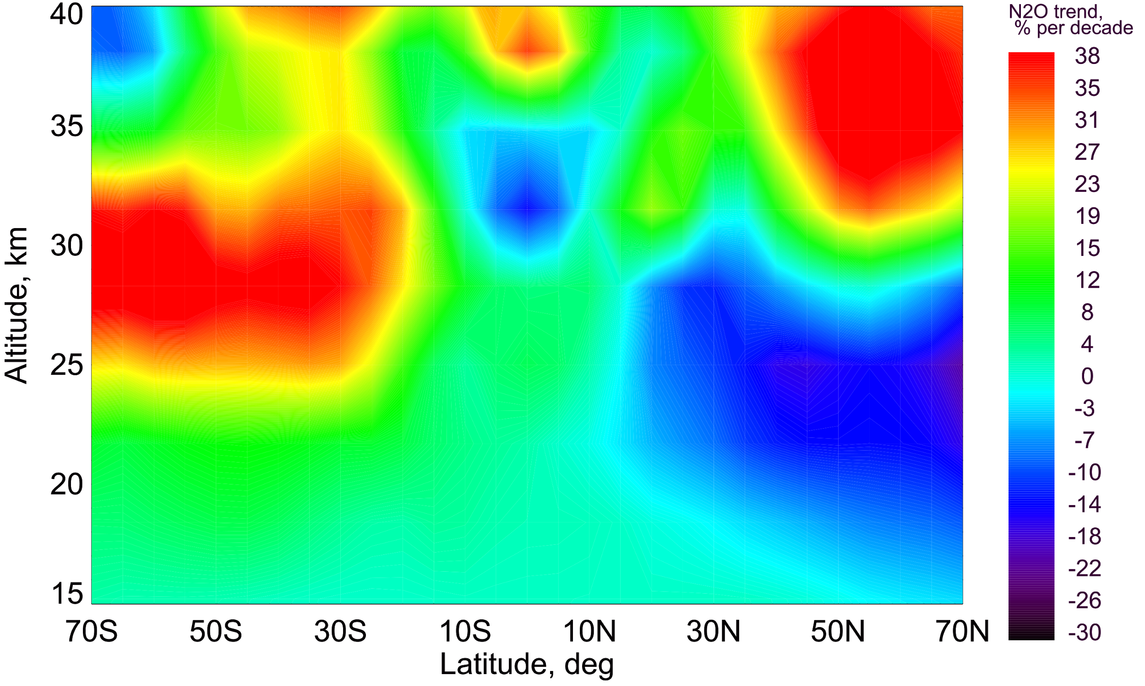
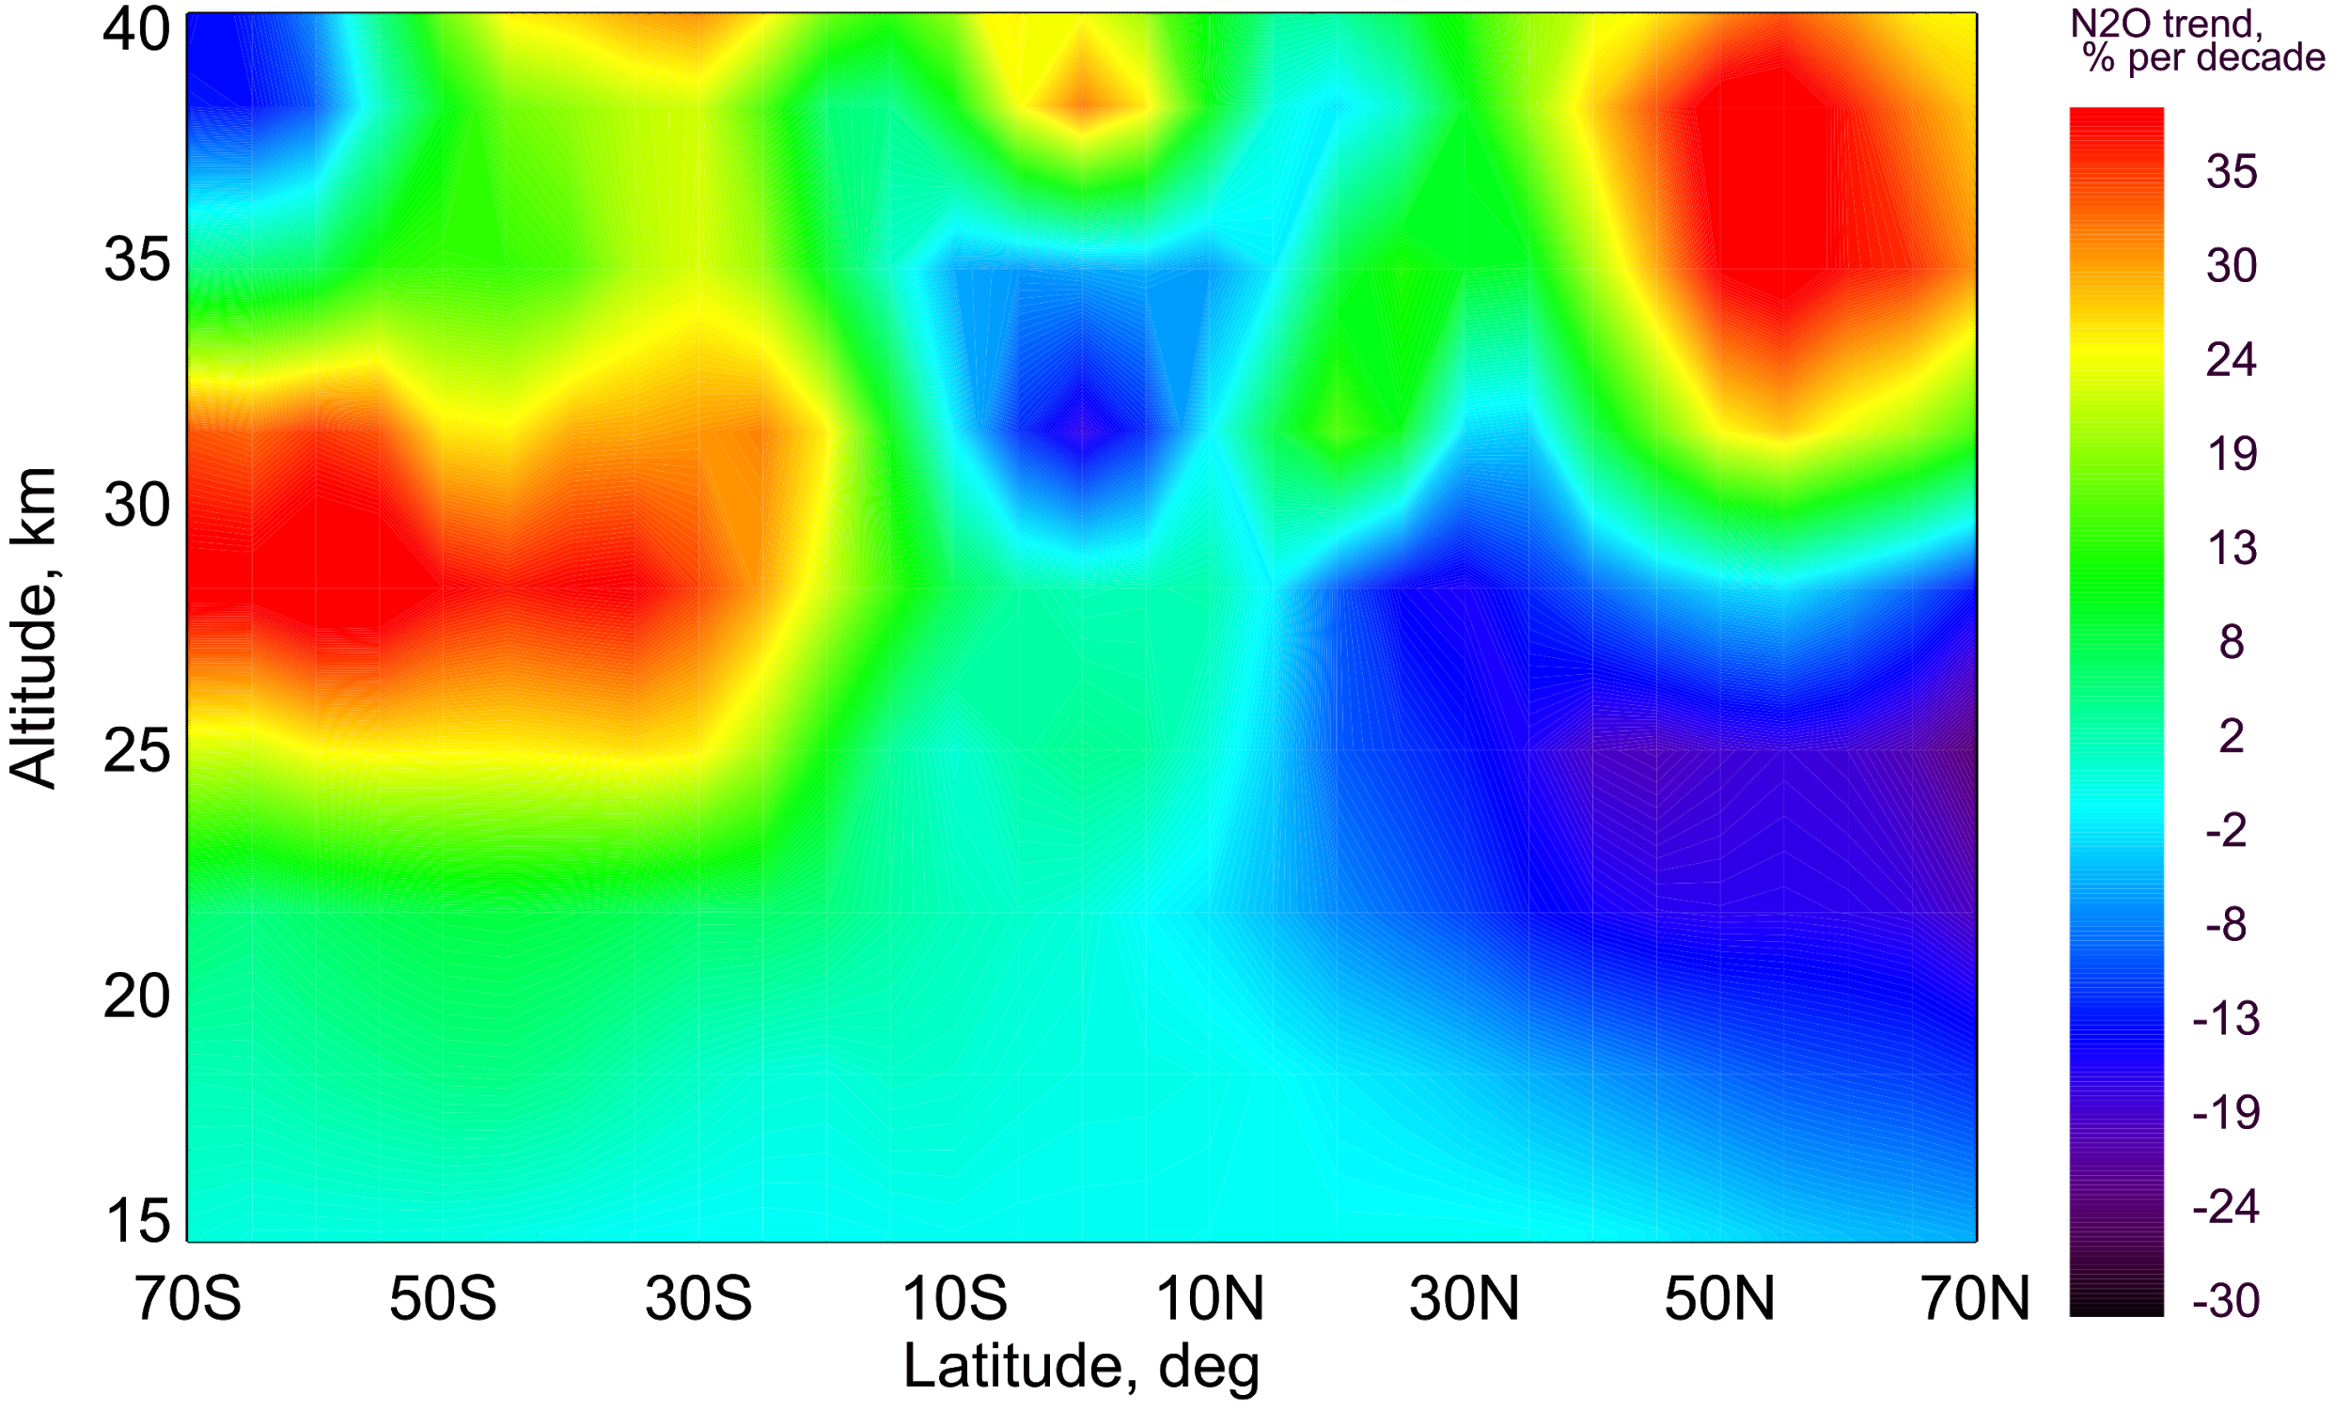
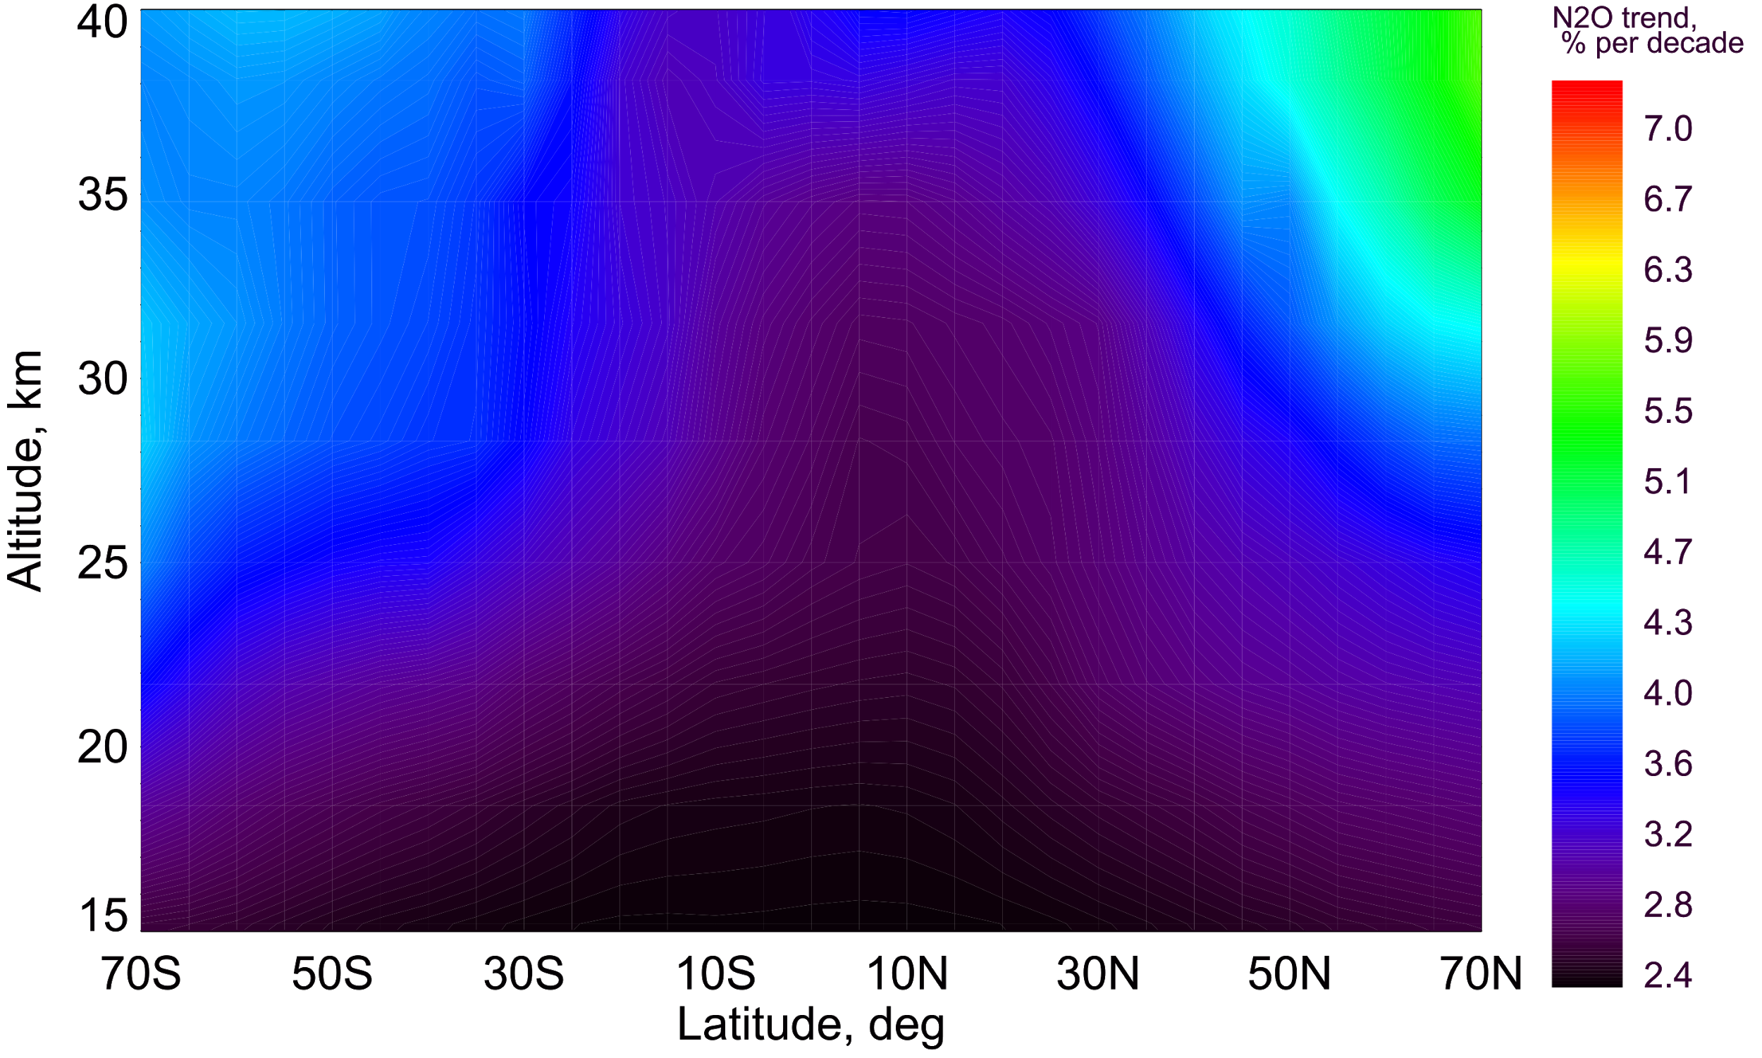
SCIAMACHY
TOMCAT
II
Full chemistry Fixed source gases Fixed transport
~10%
~7%
~6%
~1%
O₃
NO₂
N₂O
~17%
~10%
~5-7%
~2-3%
~14%
~11%
~3%
Negative N₂O changes might indicate to changes in transport. (N₂O global lifetime is ~115 years, Portmann et.al., 2012)
11

Slide 12
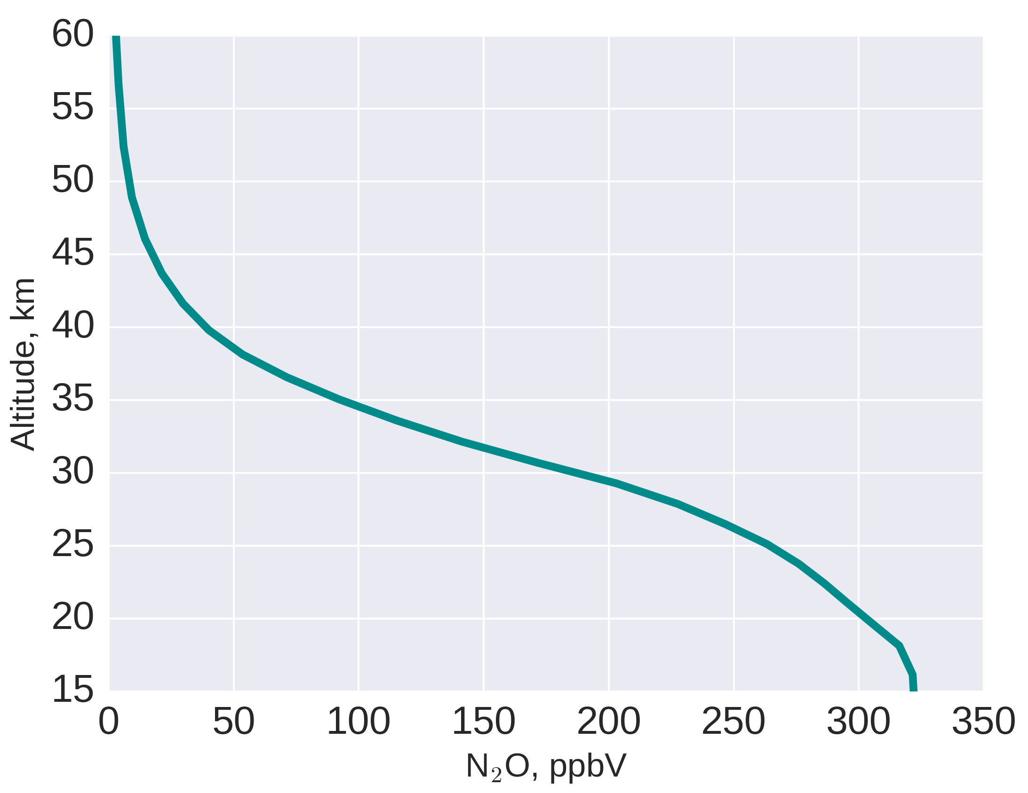
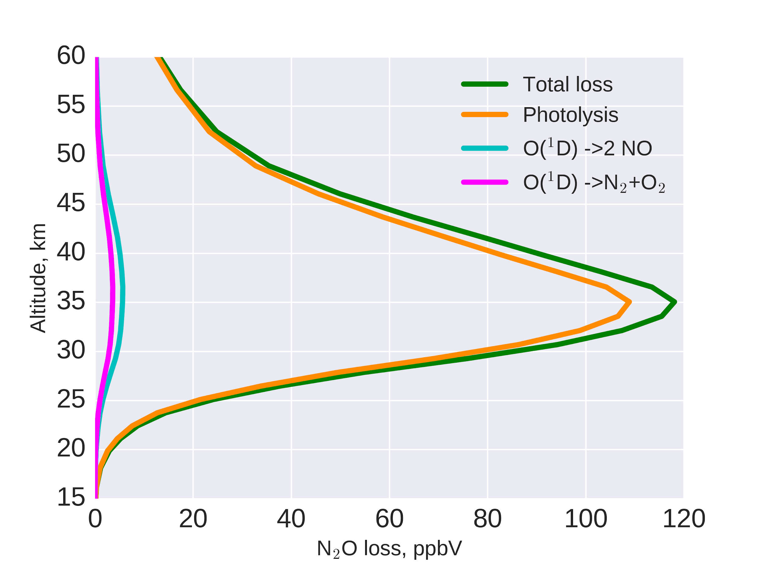
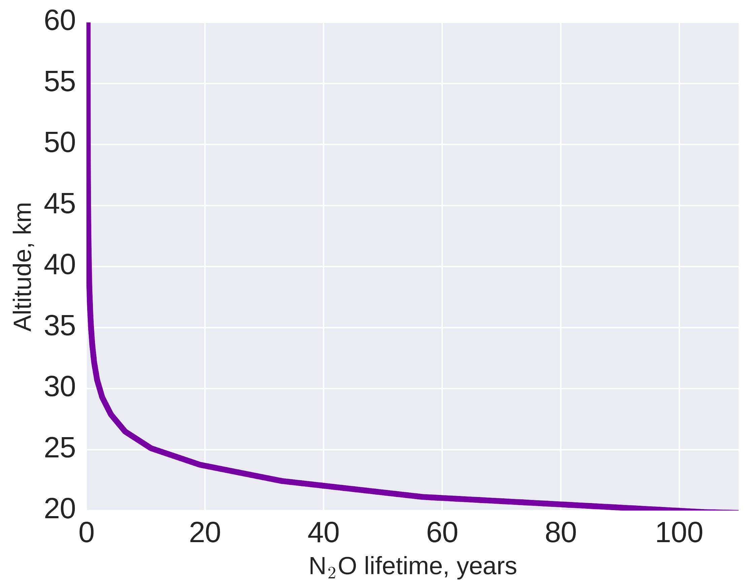
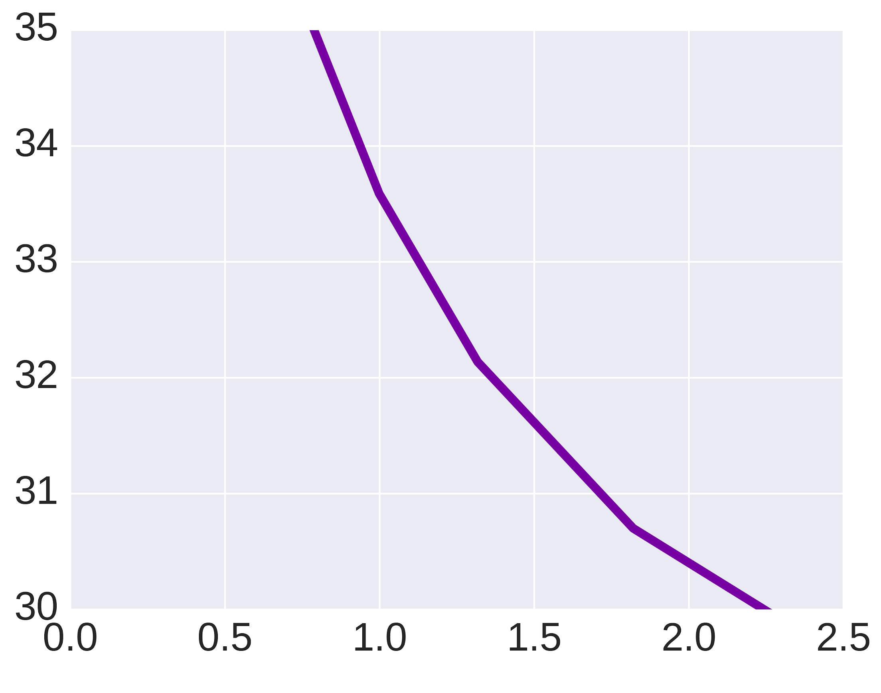
What do we know about tropical mid-stratospheric N₂O ?
III
N₂O seasonal loss in tropics
95 % N₂O +hV N₂ + O(¹D)
(major source of O(¹D) is O₃ + hv)
5 % N₂O + O(¹D) 2 NO (~60%)
N₂ + O₂ (~40%)
Total N₂O loss
N₂O photolysis
N₂O + O(¹D) -> 2 NO
N₂O + O(¹D) -> N₂+O₂
N₂O average profile
per year
per year
per year
per year
N₂O yearly loss
N₂O average lifetime
O(¹D)
hV
12
per year

Slide 13
SCIAMACHY
TOMCAT
Thus, with negative N₂O trends we would expect:
Increase of hV
N₂O +hV N₂ + O(¹D):
does not explain the increase of NO_{x}
or
Increase of O(¹D)
N₂O + O(¹D) 2 NO:
O(¹D) destroys only ~5% of all N₂O
O₃ as the main source on O(¹D) has a negative trend
modelled O(¹D) has negative trend
or
BDC slow-down (suggested by Nedoluha et al., 2015) or positive AoA trend
III
Full chemistry
~10%
~7%
~6%
~1%
O₃
NO₂
N₂O
~17%
~10%
~7-8%
~2-3%
~14%
~11%
~3%
13
13

Slide 14
SCIAMACHY
TOMCAT
Thus, with negative N₂O trends we would expect:
Increase of hV
N₂O +hV N₂ + O(¹D):
does not explain the increase of NO_{x}
or
Increase of O(¹D)
N₂O + O(¹D) 2 NO:
O(¹D) destroys only ~5% of all N₂O
O₃ as the main source on O(¹D) has a negative trend
modelled O(¹D) has negative trend
or
BDC slow-down (suggested by Nedoluha et al., 2015) or positive AoA trend
III
Full chemistry
~10%
~7%
~6%
~1%
O₃
NO₂
N₂O
~17%
~10%
~7-8%
~2-3%
~14%
~11%
~3%
14
14

Slide 15
SCIAMACHY
TOMCAT
Thus, with negative N₂O trends we would expect:
Increase of hV
N₂O +hV N₂ + O(¹D):
does not explain the increase of NO_{x}
or
Increase of O(¹D)
N₂O + O(¹D) 2 NO:
O(¹D) destroys only ~5% of all N₂O
O₃ as the main source on O(¹D) has a negative trend
modelled O(¹D) has negative trend
or
BDC slow-down (suggested by Nedoluha et al., 2015) or positive AoA trend
III
Full chemistry
~10%
~7%
~6%
~1%
O₃
NO₂
N₂O
~17%
~10%
~7-8%
~2-3%
~14%
~11%
~3%
15
15

Slide 16
What is our assumption ?
IV
Less O₃
33 km
More NO_{x}
More NO_{y} is produced
via N₂O + O(¹D)
Longer N₂O residence time
Less N₂O is transported
Slowdown of tropical upwelling
TROPICS
16

Slide 17
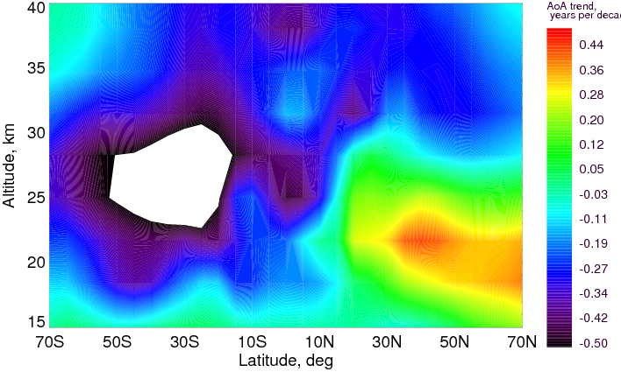
What is our assumption ?
AoA changes (years per decade)
IV
Less O₃
33 km
More NO_{x}
More NO_{y} is produced
via N₂O + O(¹D)
TOMCAT shows negative AoA changes (correspond to transport speed-up), which should cause positive N₂O changes, not negative.
Longer N₂O residence time
N₂O changes (% per decade)
Less N₂O is transported
Slowdown of tropical upwelling
TROPICS
17

Slide 18
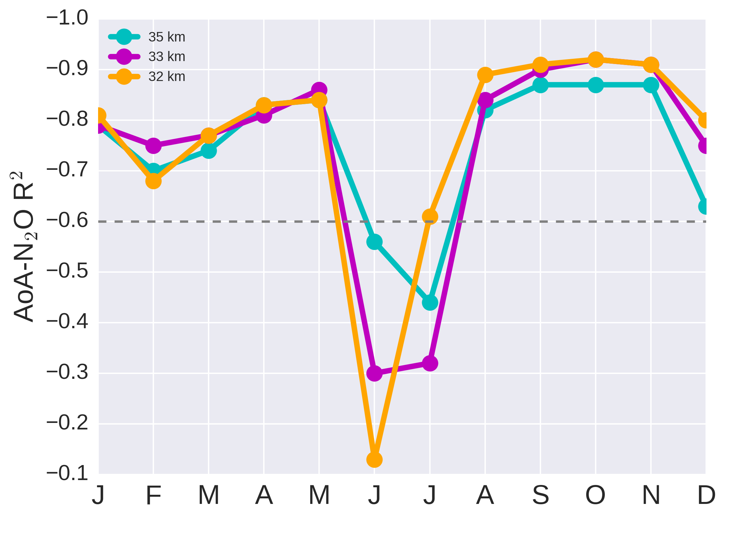
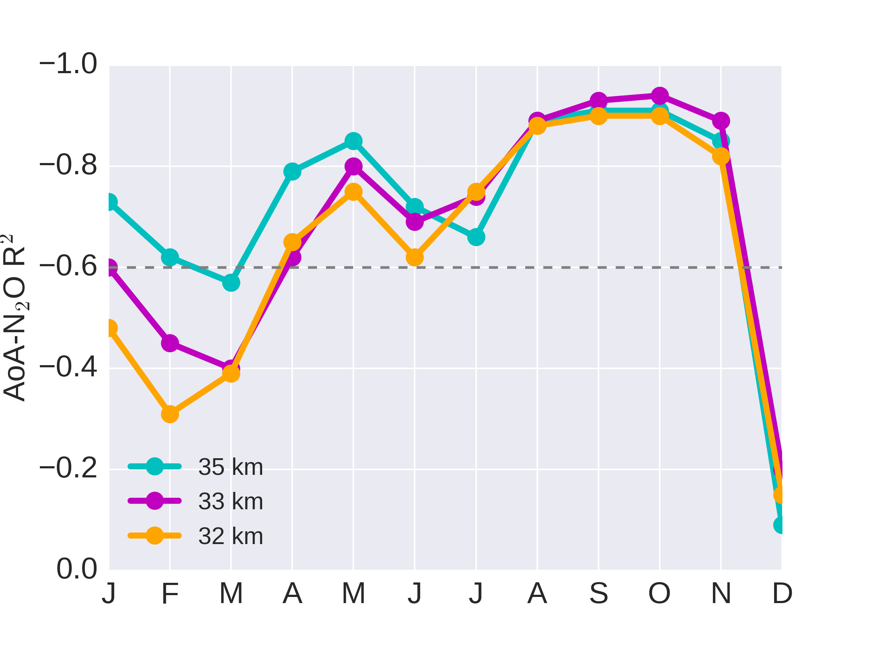
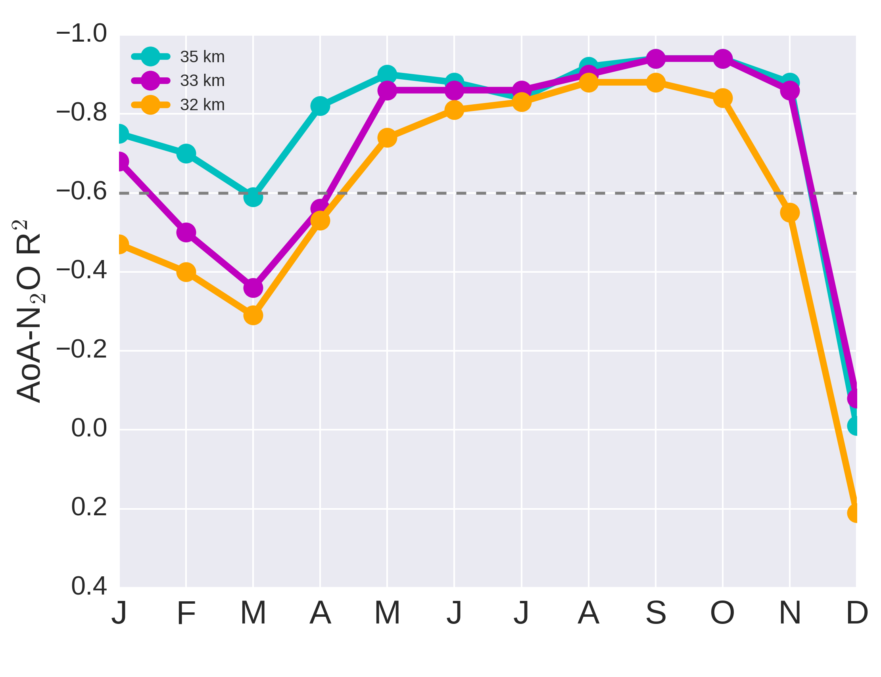
Interesting features in correlation (R²): AoA, N₂O, NO, NO₂, and O₃
V
N₂O, NO, NO₂, and O₃ are strongly correlated. Although, the (anti)correlation with AoA is only moderate.
0-10°N
We further analysed AoA - N₂O (anti)correlation as the function of time (month)
TROPICS
10°S-0
We calculated R² for Southern
(SH,10°S -0) and Northern
(NH, 0-10°N) hemispheres separately
- No changes in AoA and & N₂O = low/moderate correlation
- The first summer months (small wave activity) - low correlation
DJFM - low & moderate correlation, rest months -strong.
18

Slide 19
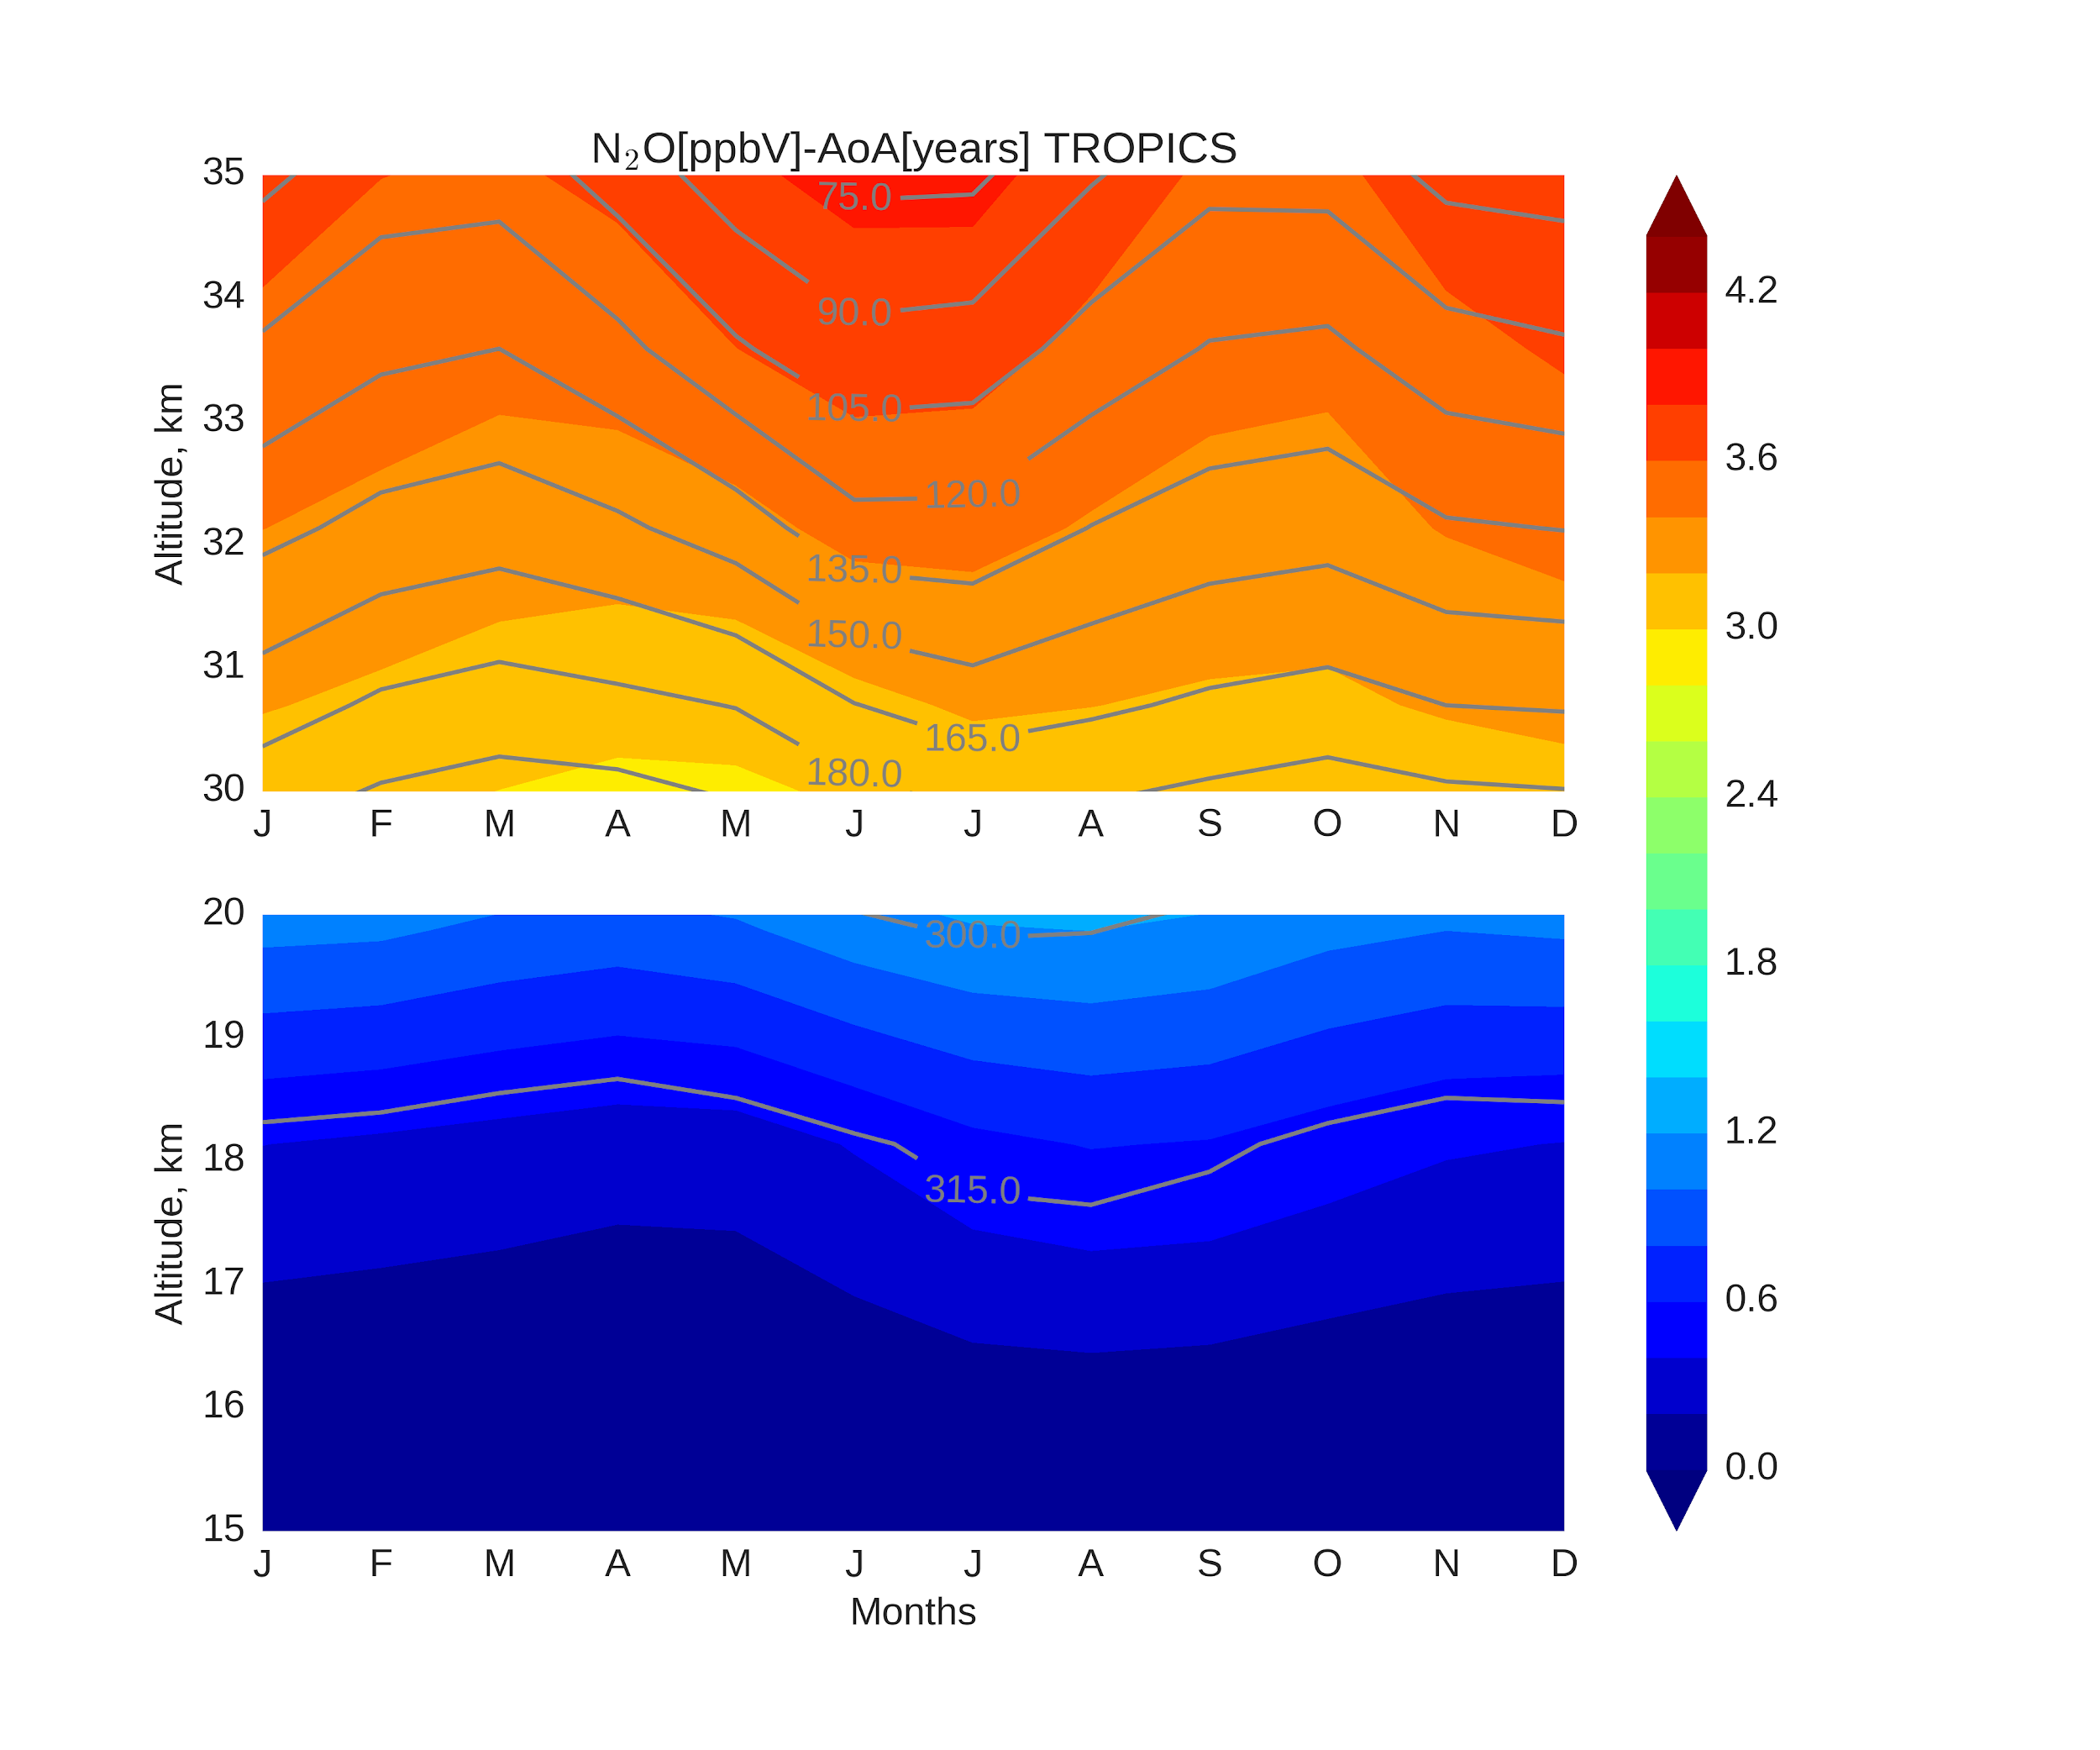
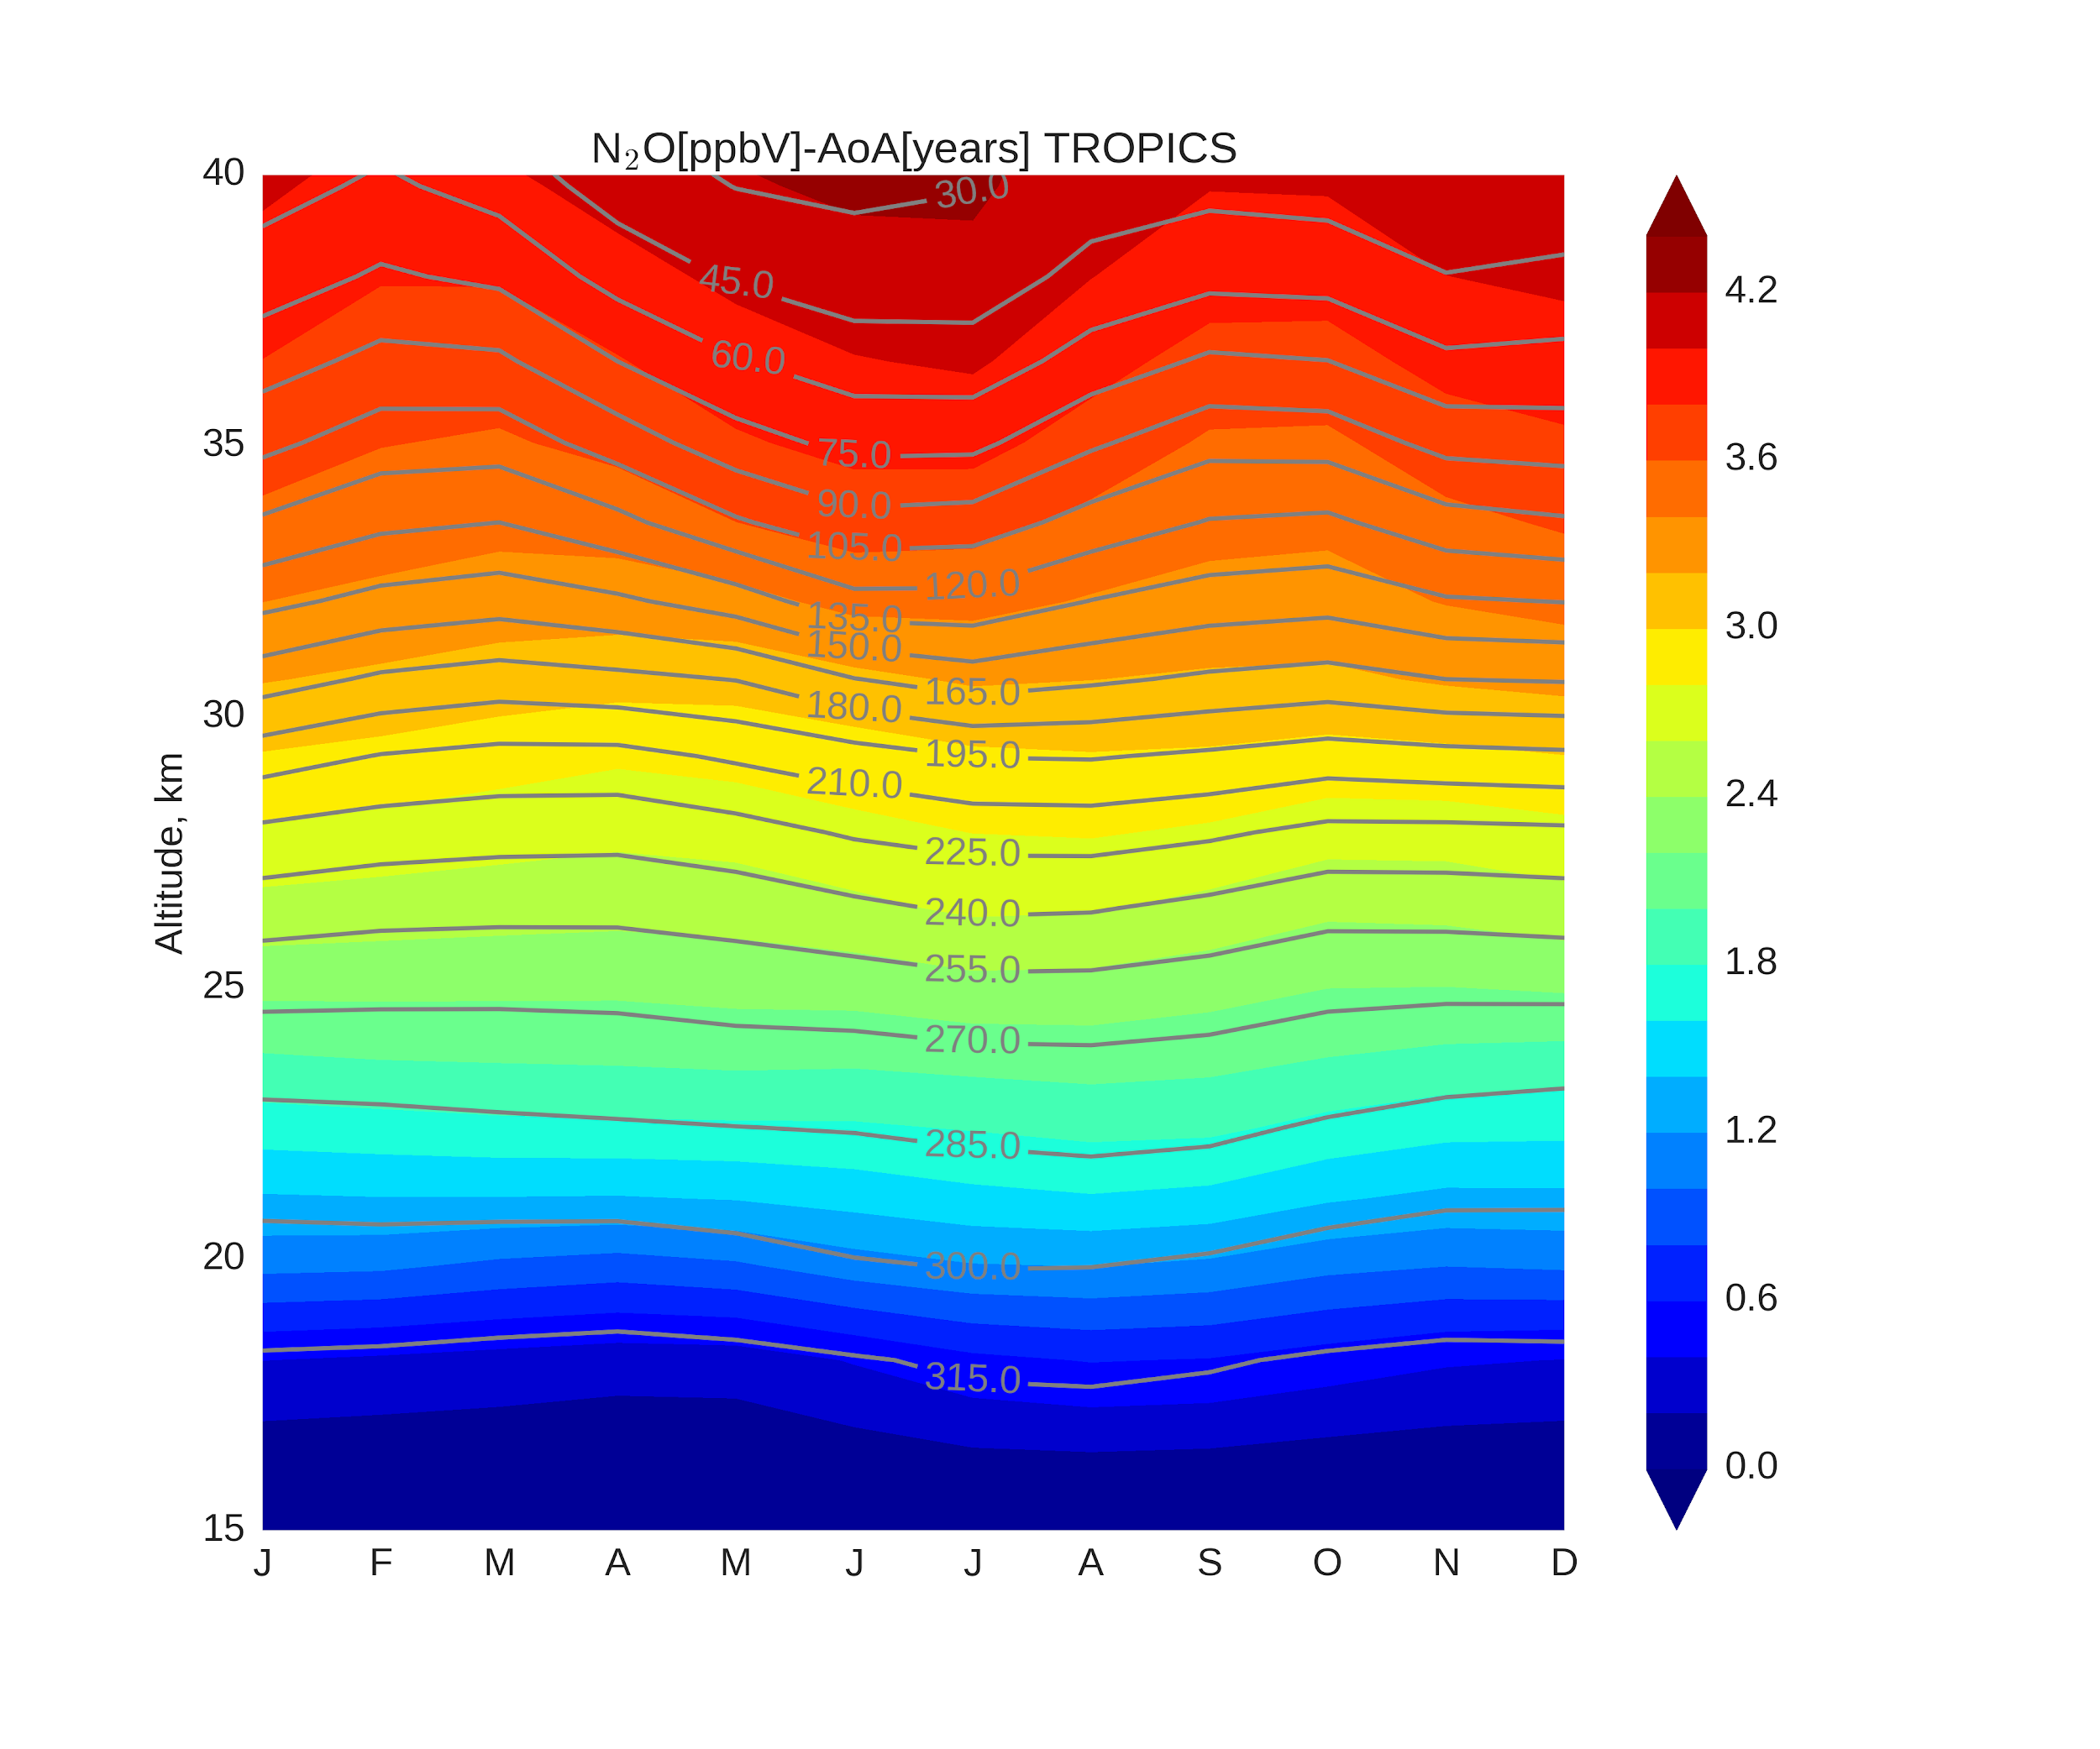
Where the secret was hidden: Combined N₂O - AoA plot
VI
N₂O(contour) step - 15 ppbV , AoA (color) step - 0.2 yrs
Seasonality in both AoA and N₂O distribution
At 30-35 km AoA is lower during FMA and SON.
AoA, years
AoA, years
The largest differences at 30-35 km between contours and colors are seen during DJFM
(also seen as low R² in previous slide).
At 15-20 km AoA is lower during DJF and MAM.
FMA & SON at 30-35 km → more N₂O is transported due to faster transport → less O₃ is destroyed
And what are the N₂O -AoA trends?
19

Slide 20
What do trends (2004-2012) in tropical stratosphere at 30-35 km say?
VI
AoA N₂O NO₂ O₃
Decrease in AoA causes an increase in N₂O with its smaller residence time. Less NO_{y} is produced then, thus there is more O_{3.}
Similar conditions are observed in January.
February
Increase in AoA causes a decrease in N₂O, while its residence time becomes longer. This way more NO_{y} is produced (via reaction with O(¹D)), thus more O₃ is destroyed. Similar conditions are observed in September.
AoA N₂O NO₂ O₃
October
20

Slide 21
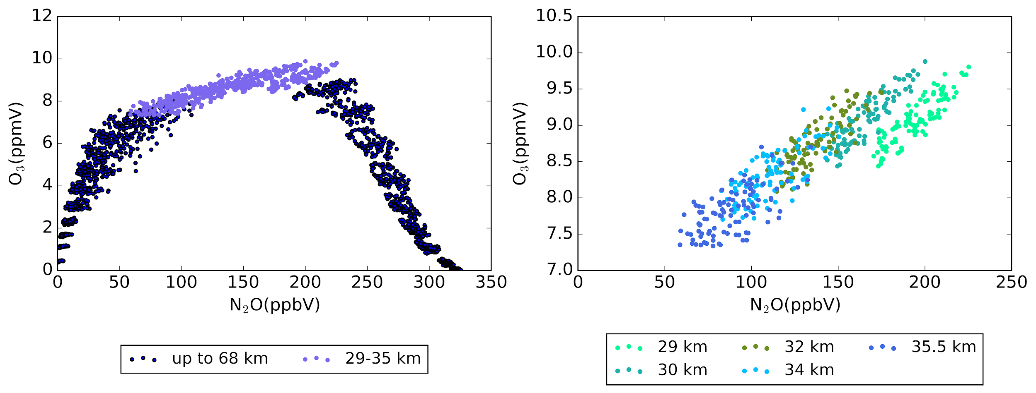
What are the reasons of O₃ negative trends in tropical mid-stratosphere during 2004-2012?
VI
The main driver of O₃ changes is seasonal variations of dynamics, which impact indirectly through chemistry.
Negative O₃ changes are the result of transport slowdown or additional air mixing (positive AoA changes) and thus longer residence time of N₂O during September, October, with more intense NO_{y} production which effectively destroys O₃.
Negative AoA trends during January, February, which show more intense N₂O transport, do not produce enough NO_{y} (via N₂O + O(¹D)) to further destroy O₃.
Negative AoA changes during winter and positive AoA changes during autumn on average show insignificant (negative) changes. But due to non-linearity between AoA and N₂O, N₂O on average decreases.
Regarding N₂O changes in the tropical mid-stratosphere:
N₂O and O₃ highly correlate: more transported N₂O with its shorter residence time produces less NO_{y} to further destroy O₃ and vice versa, less transported N₂O means less O₃.
Sep Oct
Jan Feb
21

Slide 22
Still have some questions?
There are some additional backup slides.
VII
More about SCIAMACHY and TOMCAT
Comparison of SLIMCAT and SCIAMACHY O₃ & NO₂
Multivariate linear regression
Why AoA-N₂O trends in tropical mid-stratosphere are not straightforward?
AoA seasonal distribution averaged for 2004-2012
N₂O seasonal distribution averaged for 2004-2012
N₂O-AoA seasonal distribution averaged for 2004-2012
N₂O-AoA time series
N₂O seasonal loss
N₂O-O₃ correlation plots from SLIMCAT
NO₂-O₃ correlation plots from SCIAMACHY and SLIMCAT
Click on the title of the topic you are additionally interested in.
22

Slide 23
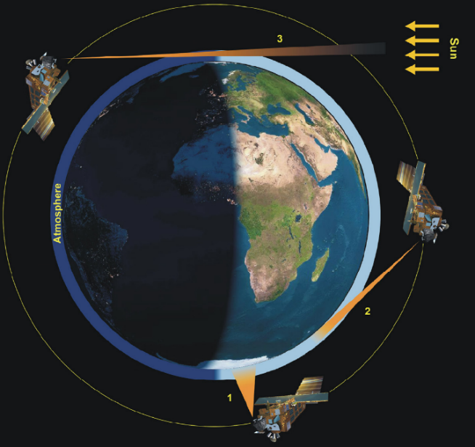
SCIAMACHY
TOMCAT
VII
SCanning Imaging Absorption spectroMeter for Atmospheric CHartographY
TOMCAT is a three-dimensional (3D) off-line chemical transport model (CTM; Chipperfield et al., 1999, 2006 ).
Model set-up
Period | 2004-2012
Vertical extent | Tropo + Stratosphere
Vertical coordinate | Pressure
Meteorological input | ECMWF, ERA-Interim
Orbit: sun-synchronous,~800 km
Operating time: 2002 –2012
Spectral range: 214 – 2386 nm
Measurement modes: limb, occultation, nadir.
We performed 3 model runs:
full chemistry run
run with fixed surface concentrations of source gases, and
run with fixed dynamics
(Era-Interim from 2004)

Slide 24
Comparison of SLIMCAT and SCIAMACHY O₃ & NO₂ (tropics)
VII
SCIAMACHY (ppmV) TOMCAT (ppmV) SCIAMACHY - TOMCAT (%)
O₃
NO₂
The agreement between TOMCAT and SCIAMACHY is within ~10 % in the area of O₃ and NO₂ maximum.
SCIAMACHY (ppbV) TOMCAT (ppbV) SCIAMACHY - TOMCAT (%)
Click here to go back to trends.
Click here to go back to the content of additional slides.
24

Slide 25
Multivariate linear regression
VII
Gebhardt et al., ACP, 2014
, , - fitting parameters
t - time of the months
j = 1-4 represent harmonics with 12-,6-,4,and 3-month period (and seasonal changes via sin & cos)
R(t) = QBO(t) +SC(t) + ENSO(t)
QBO(t) = aQBO_{10(t)}+bQBO_{30(t)},
a, b - fit coefficients
Mg II index
El Niño 3.4 index
Click here to go back to trends.
Click here to go back to the content of additional slides.
25
Notes:
\mu+ \omega t + \sum_{j=1}^{4} (\beta _{1j}sin(\frac{2\pi jt}{12})+ \beta _{2j}cos(\frac{2\pi jt}{12})) +R(t)

Slide 26
Why AoA-N₂O trends in tropical mid-stratosphere are not straightforward?
Because in our analysis we mix regimes of both hemispheres while analysing tropics (10°S-10°N)
Presented linear trends are averaged over 30-35 km (to avoid mess of plots)
The presence of negative AoA trend does not necessarily cause positive N₂O trend: the AoA negative trend does not play much role, if overall AoA values are too high (other words if upwelling is still slow).
Small positive trends of AoA (if transport is slow enough/AoA values are high enough) might cause noticeable negative trends in N₂O.
VII
Click here to go back to trends.
Click here to go back to the content of additional slides.
26

Slide 27
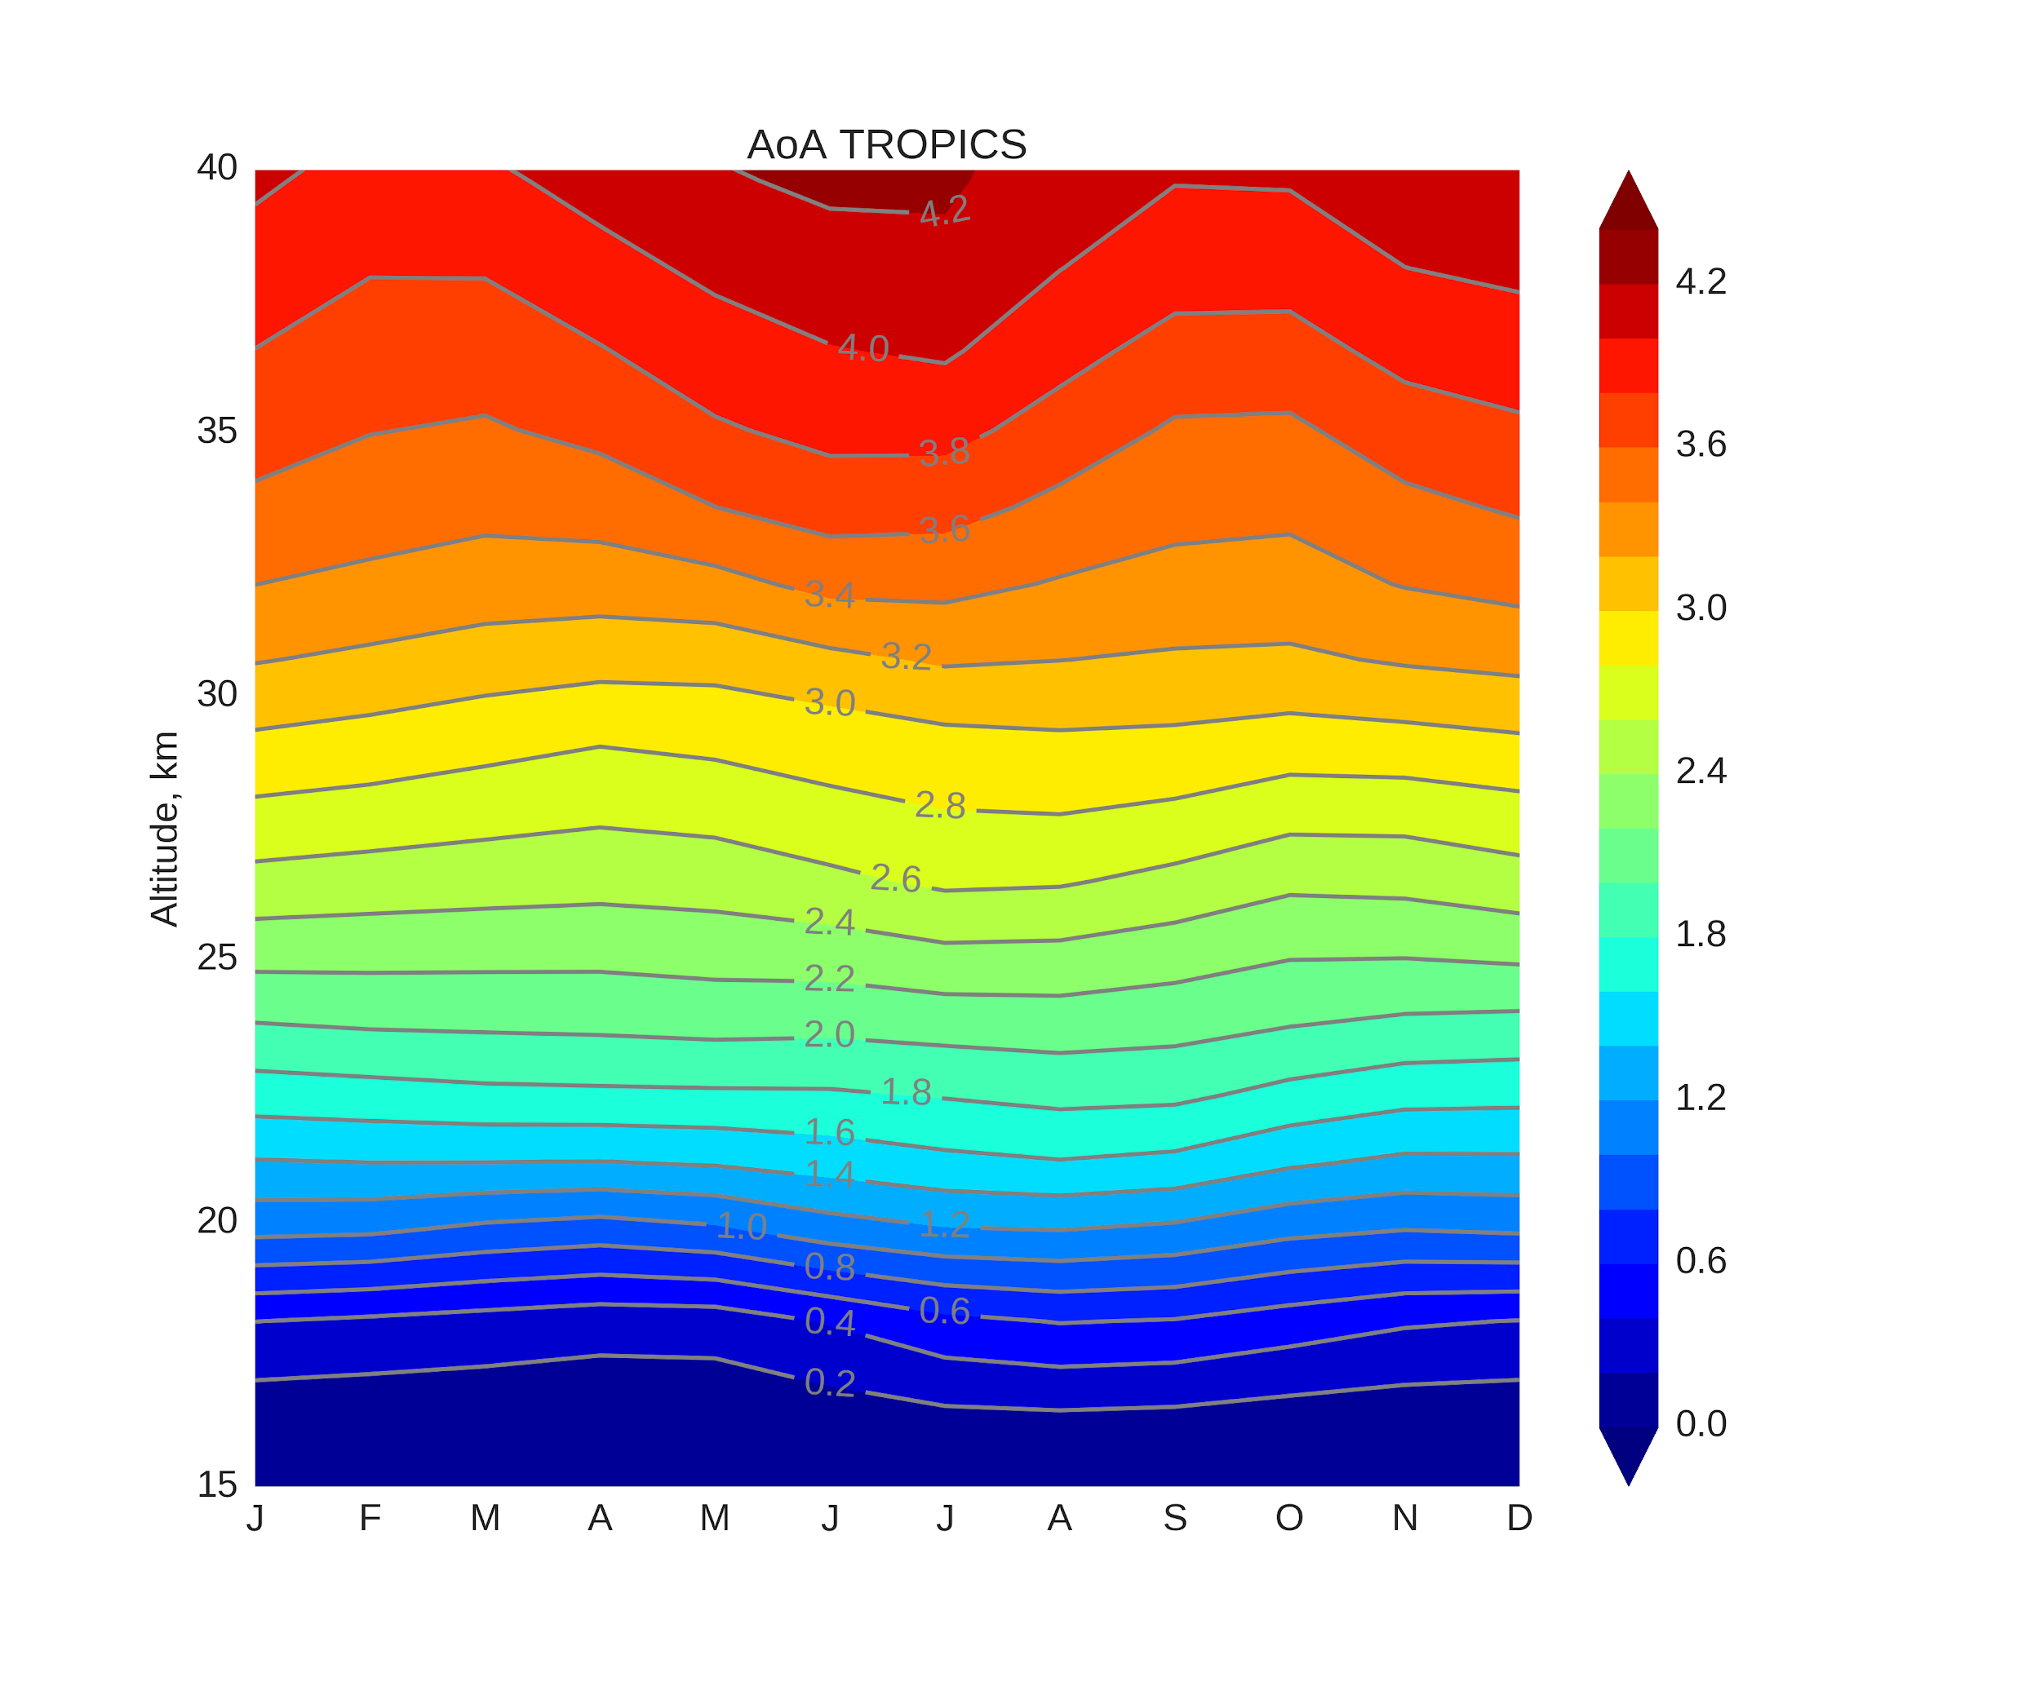
AoA, TROPICS
VII
AoA, years
AoA, years
At 30-35 km AoA is lower during FMA and SON.
At 15-20 km AoA is lower during DJF and MAM.
Lower AoA values at 30-35 km during FMA are coming from Southern Hemisphere (SH), see next Slide.
Lower AoA at 30-35 km during SON is coming from NH.
Click here to go back to the content of additional slides.
27

Slide 28
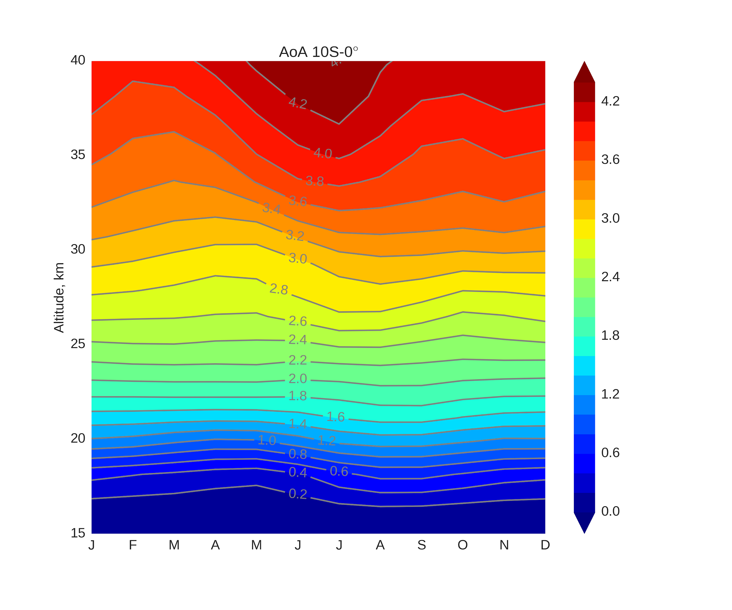
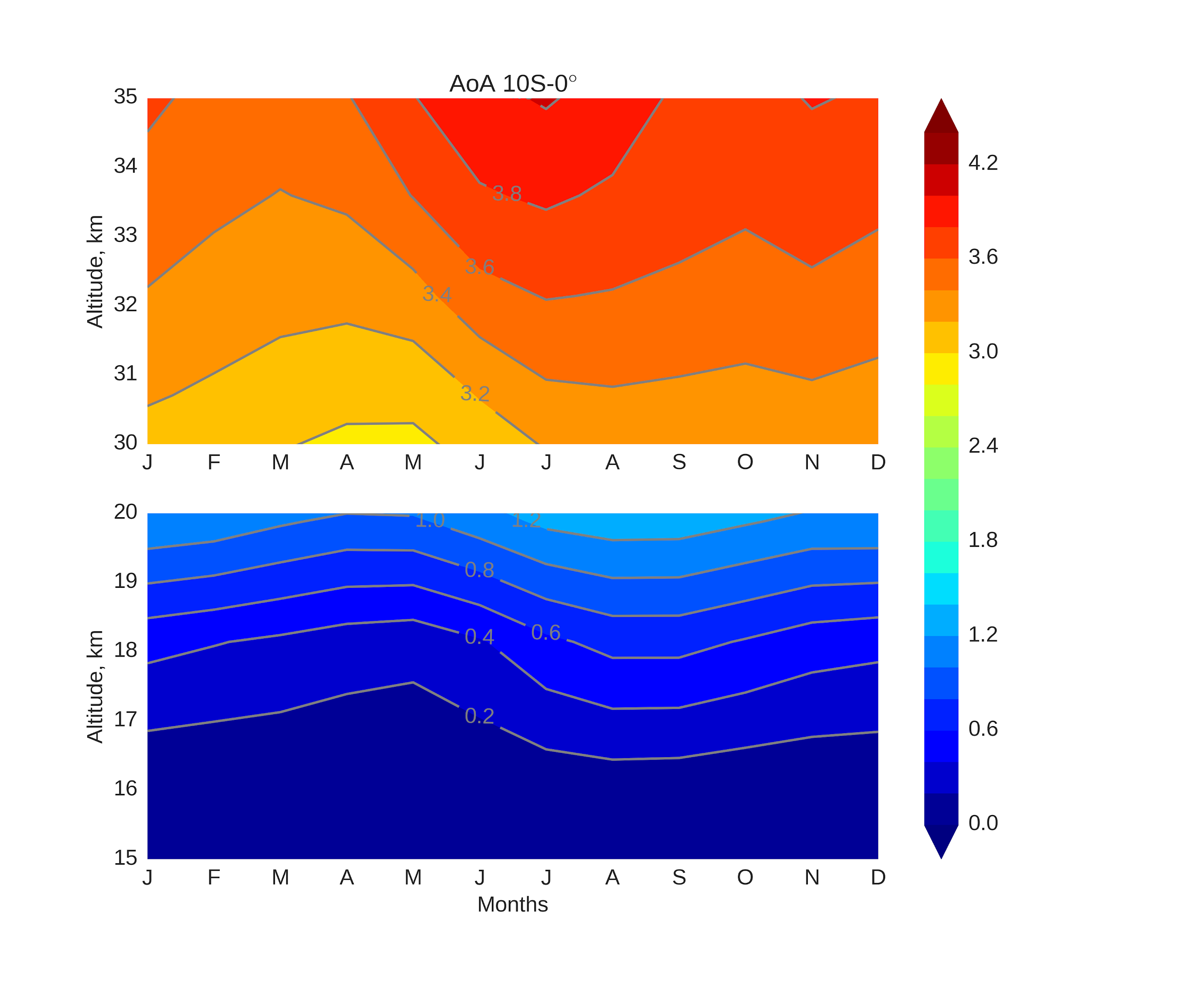
AoA, 10S-0°
VII
AoA, years
AoA, years
10S-0°
Upwelling is faster during FMA
Click here to go back to the content of additional slides.
28

Slide 29
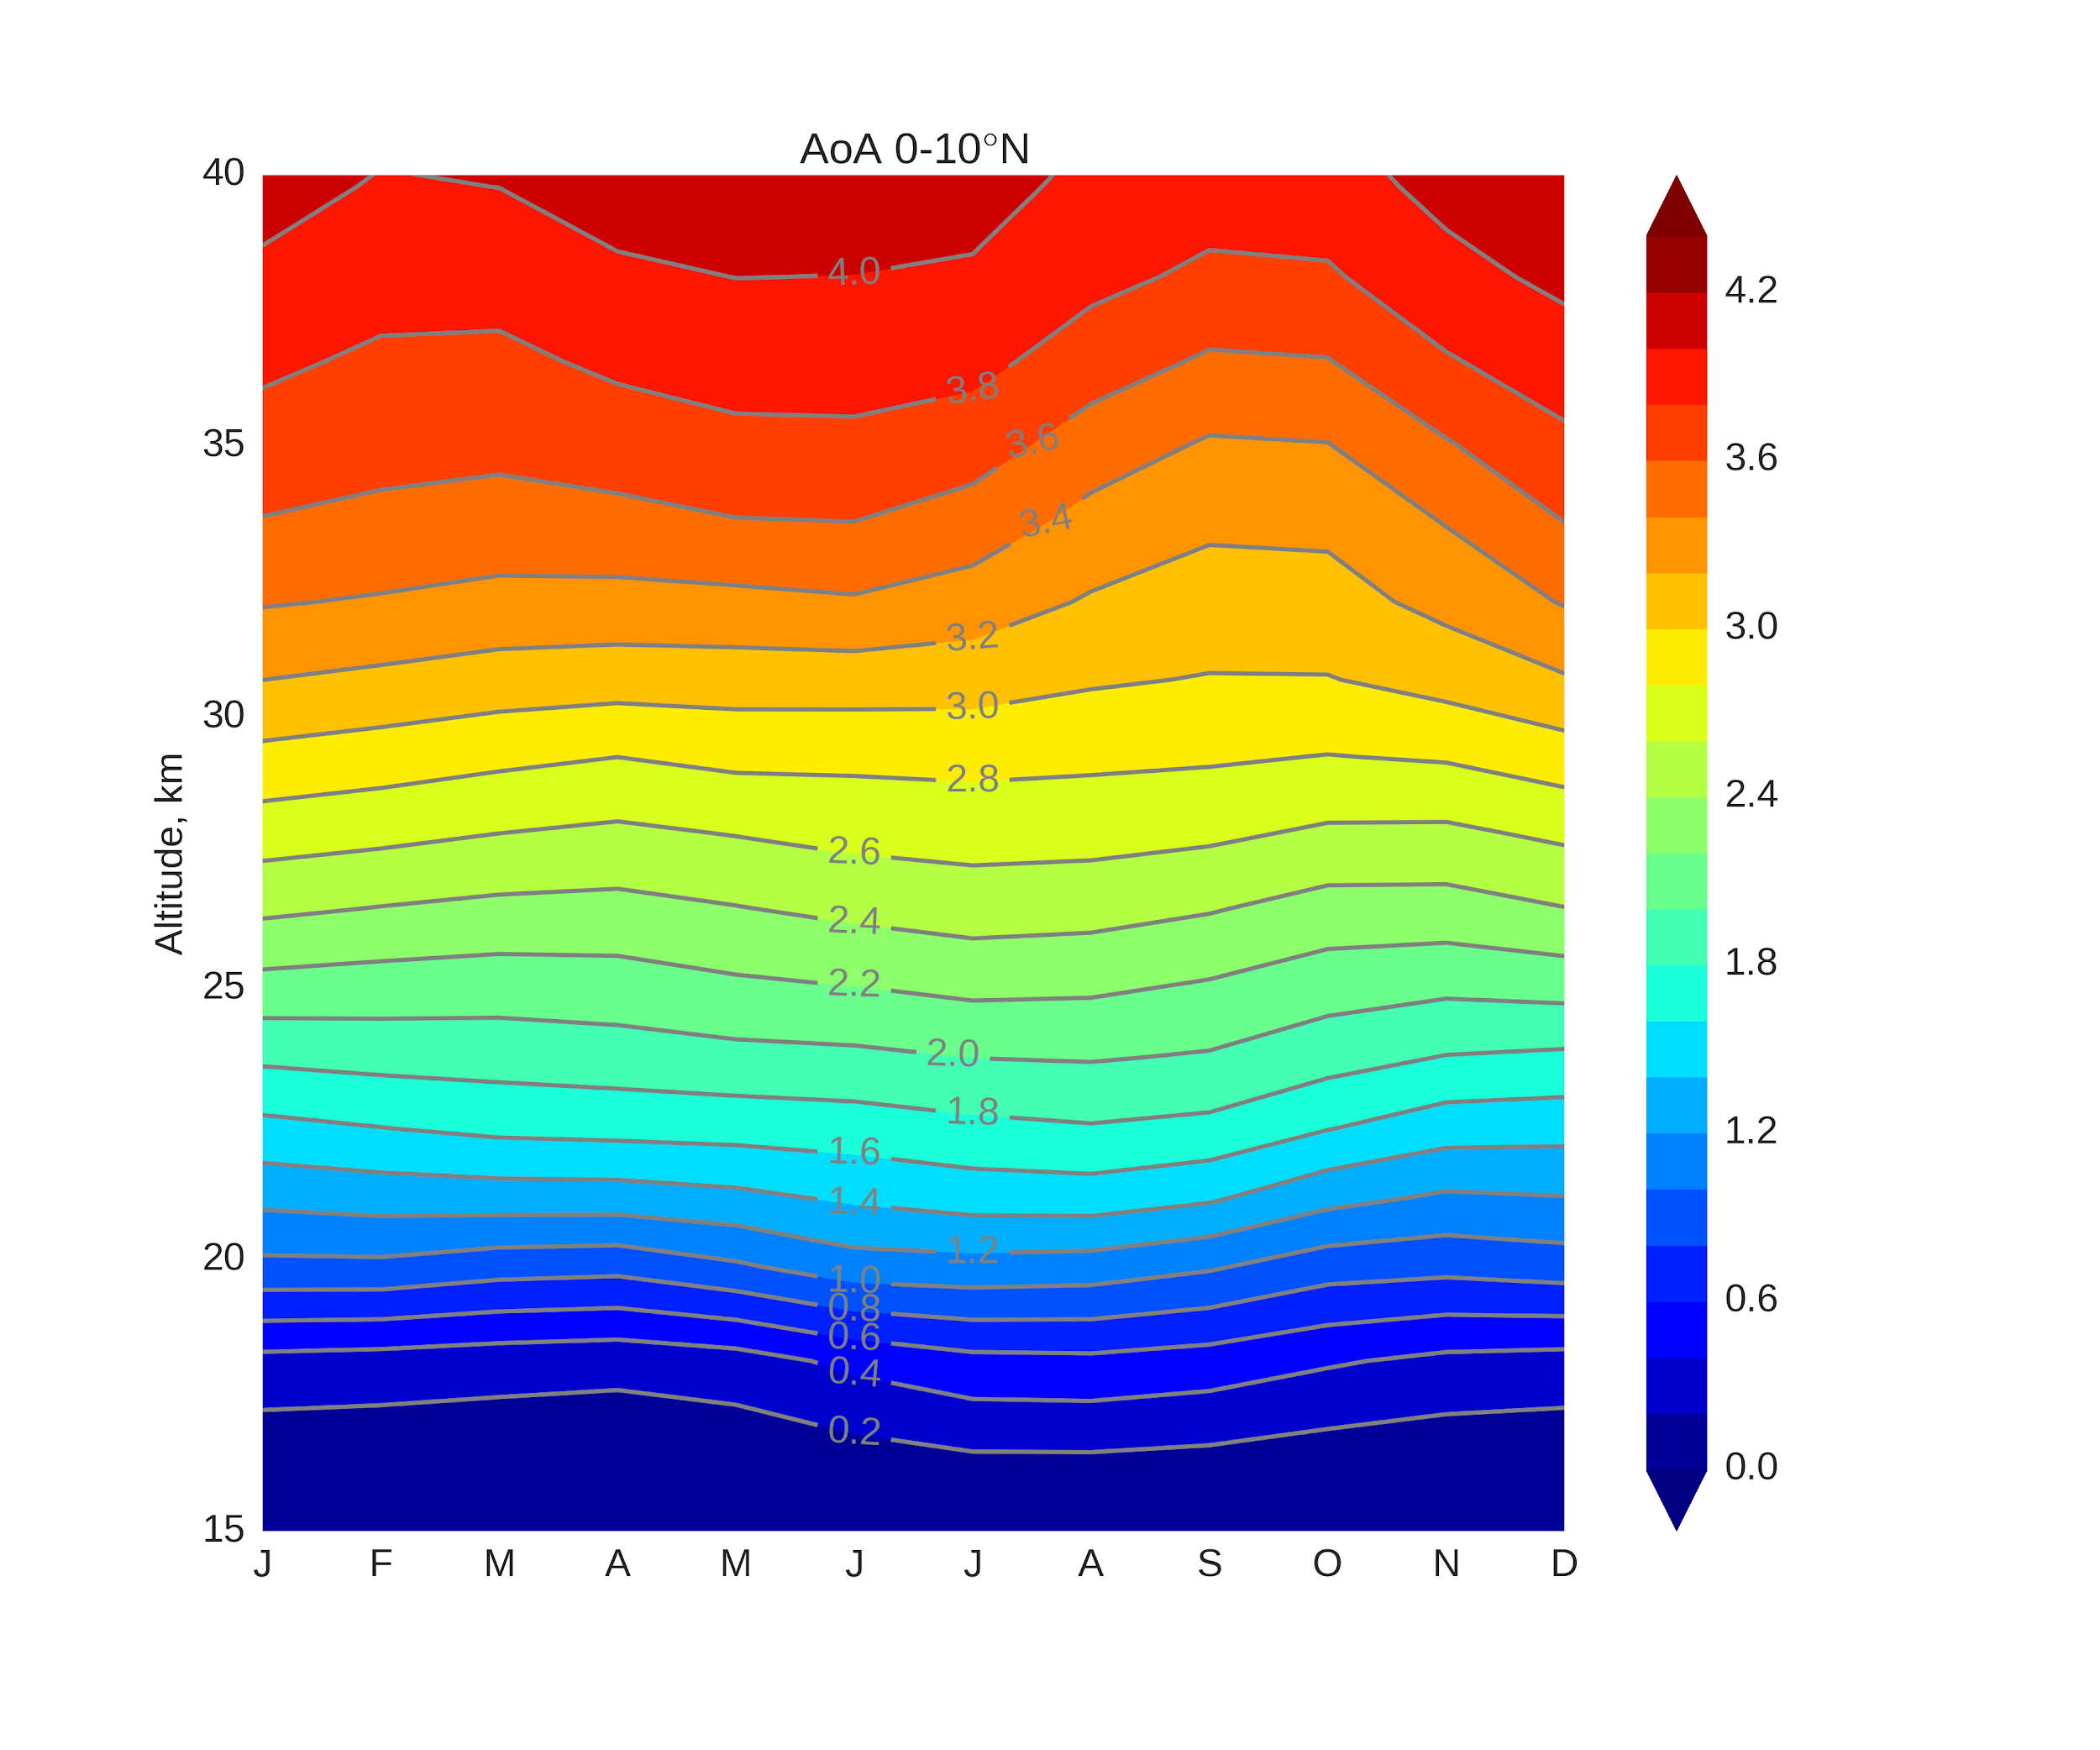
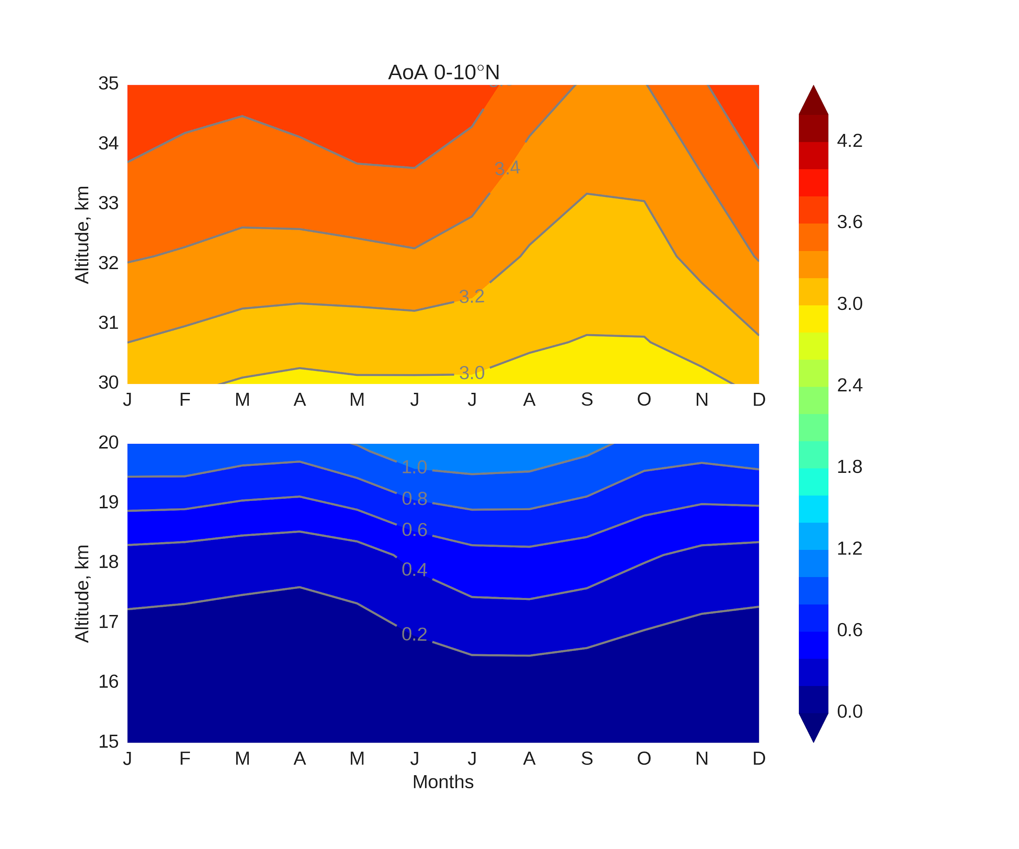
AoA, 0-10°N
VII
AoA, years
AoA, years
0-10°N
Upwelling is faster during SON
Click here to go back to the content of additional slides.
29

Slide 30
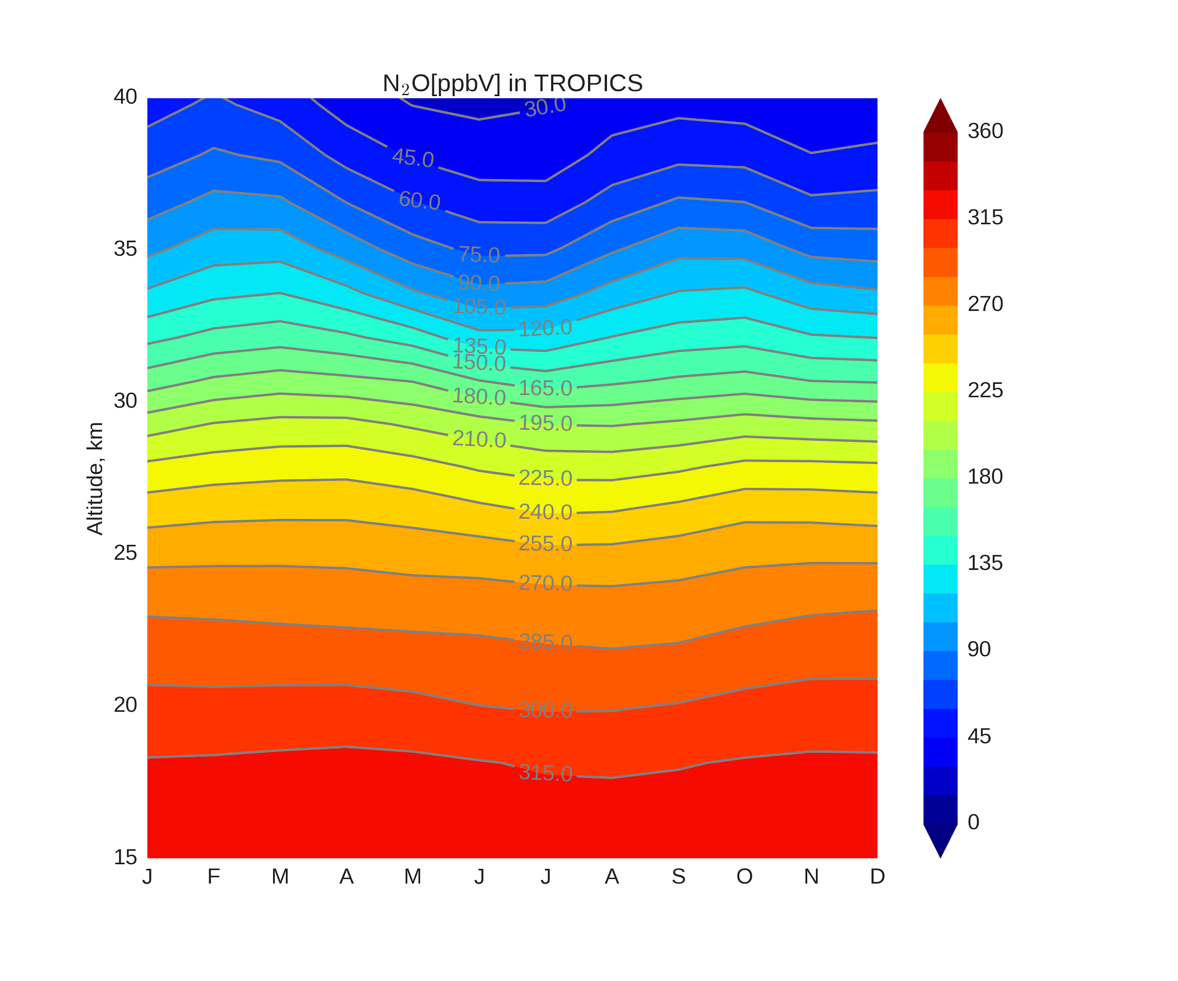
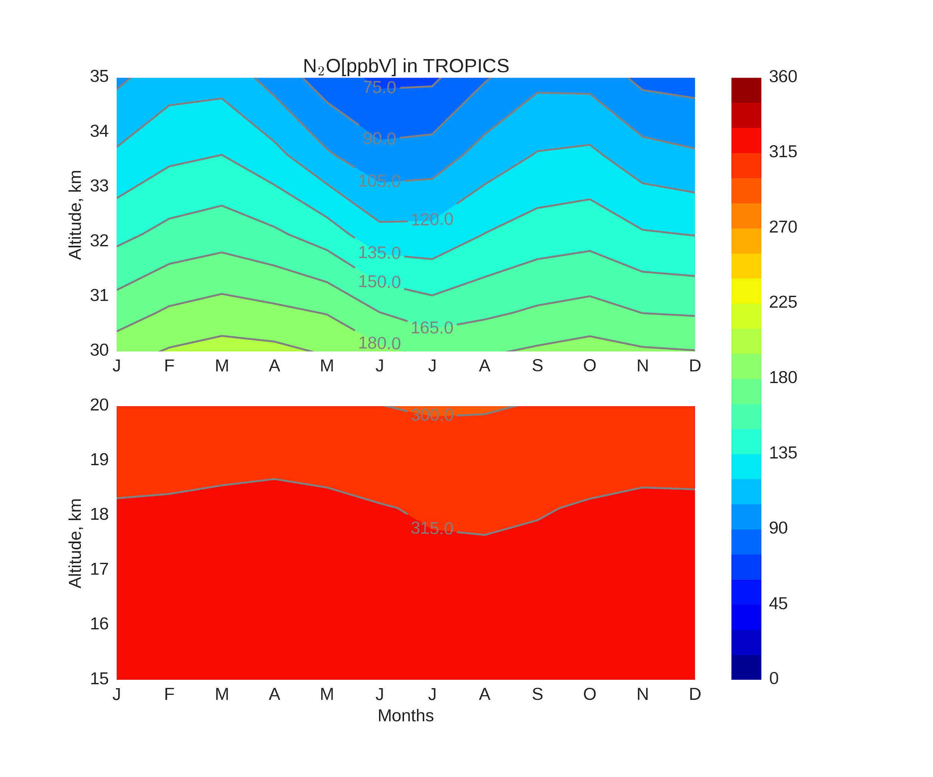
N₂O, TROPICS
VII
N₂O, ppbV
N₂O, ppbV
Similar patterns of N₂O as observed in AoA.
This corresponds the approach: faster transport - more N₂O is transported.
Click here to go back to the content of additional slides.
30

Slide 31
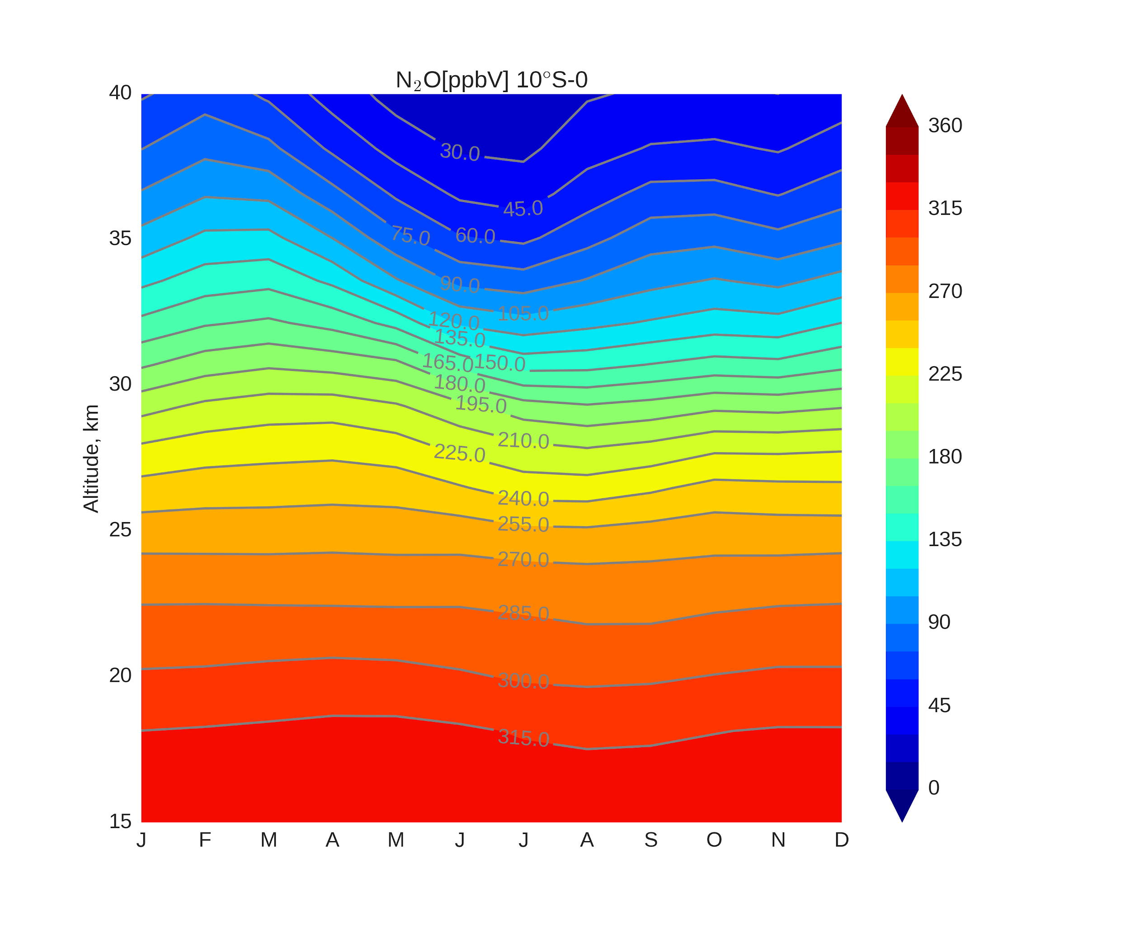
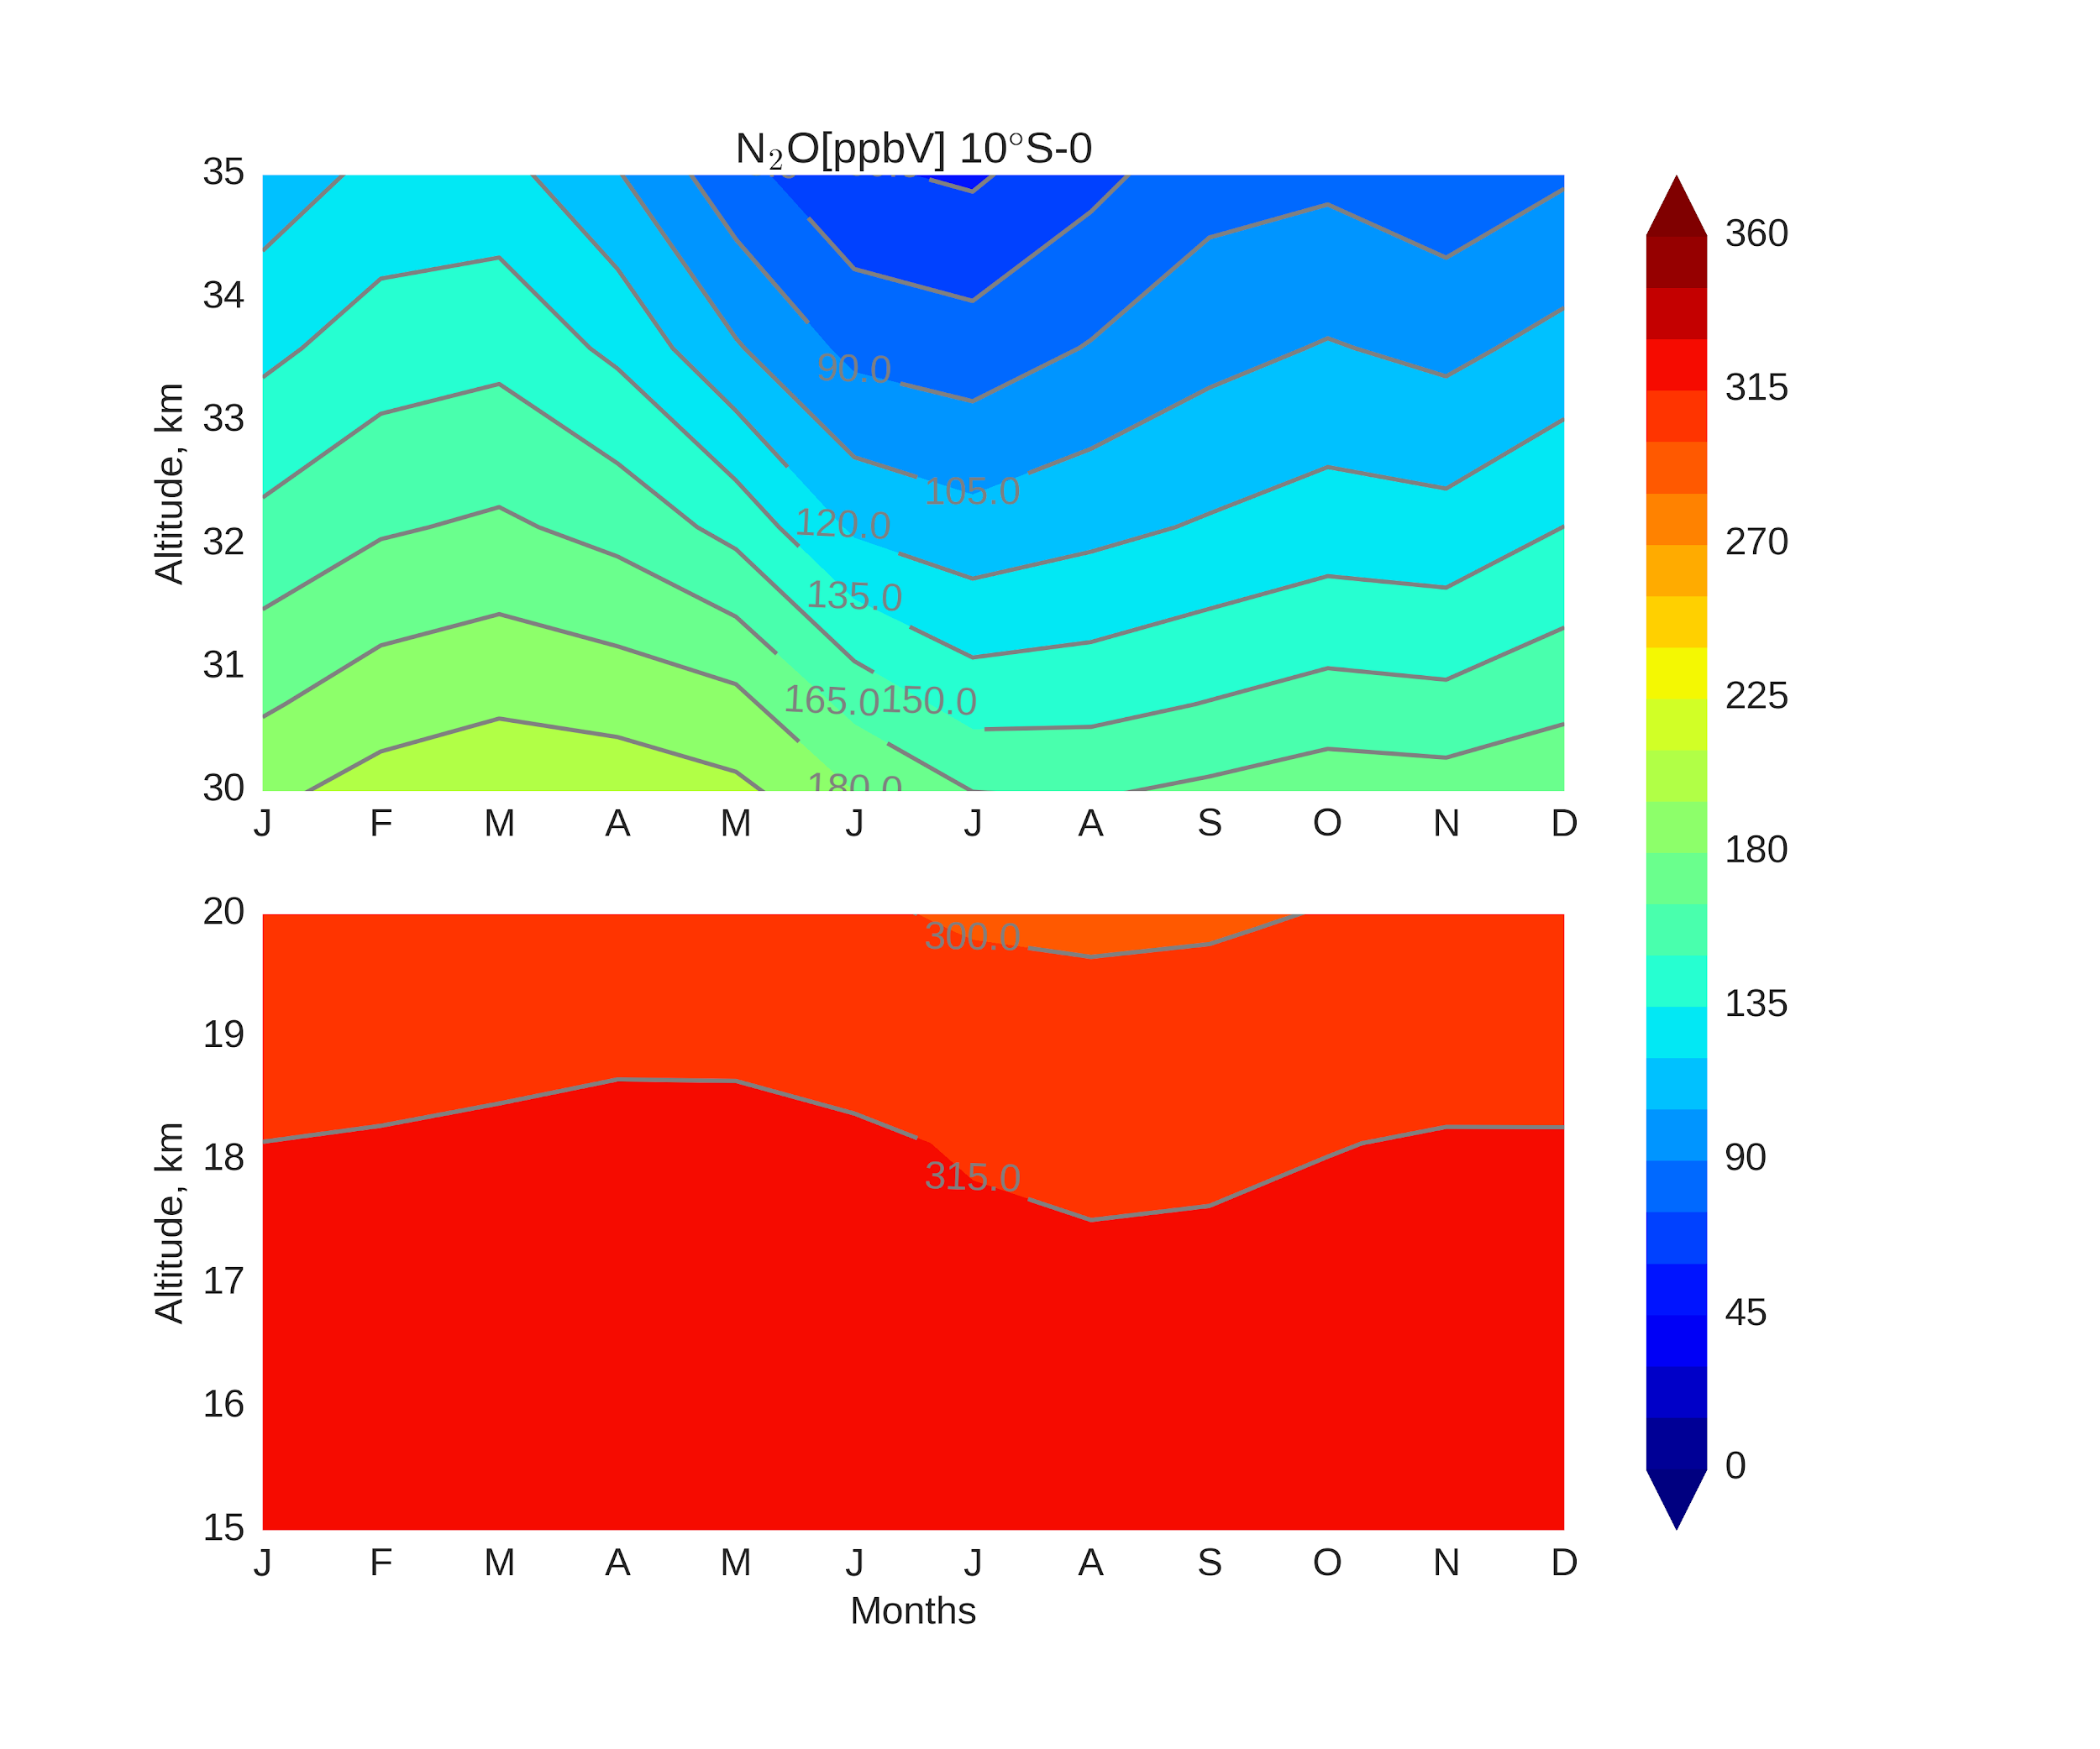
N₂O, 10S-0°
VII
N₂O, ppbV
N₂O, ppbV
Click here to go back to the content of additional slides.
31

Slide 32
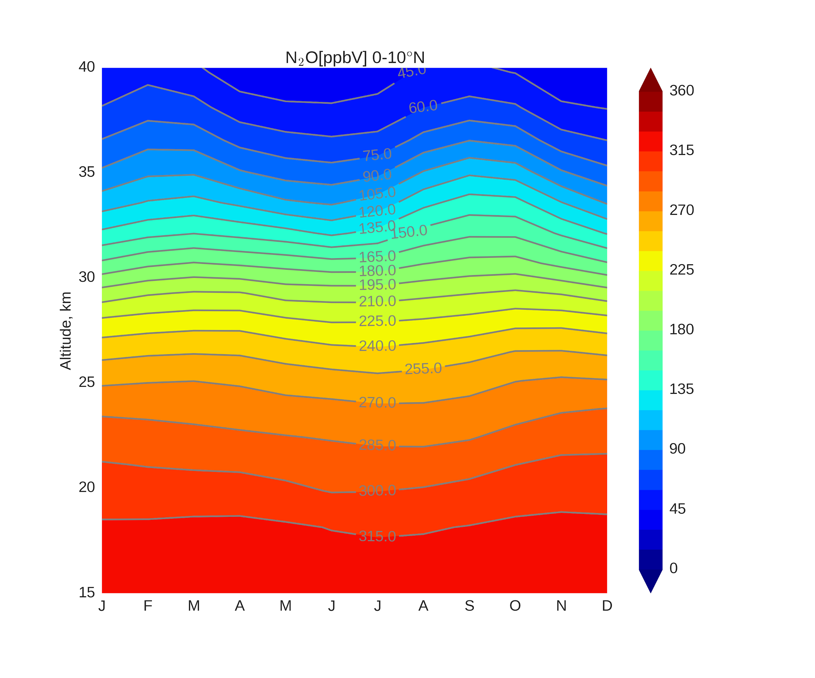
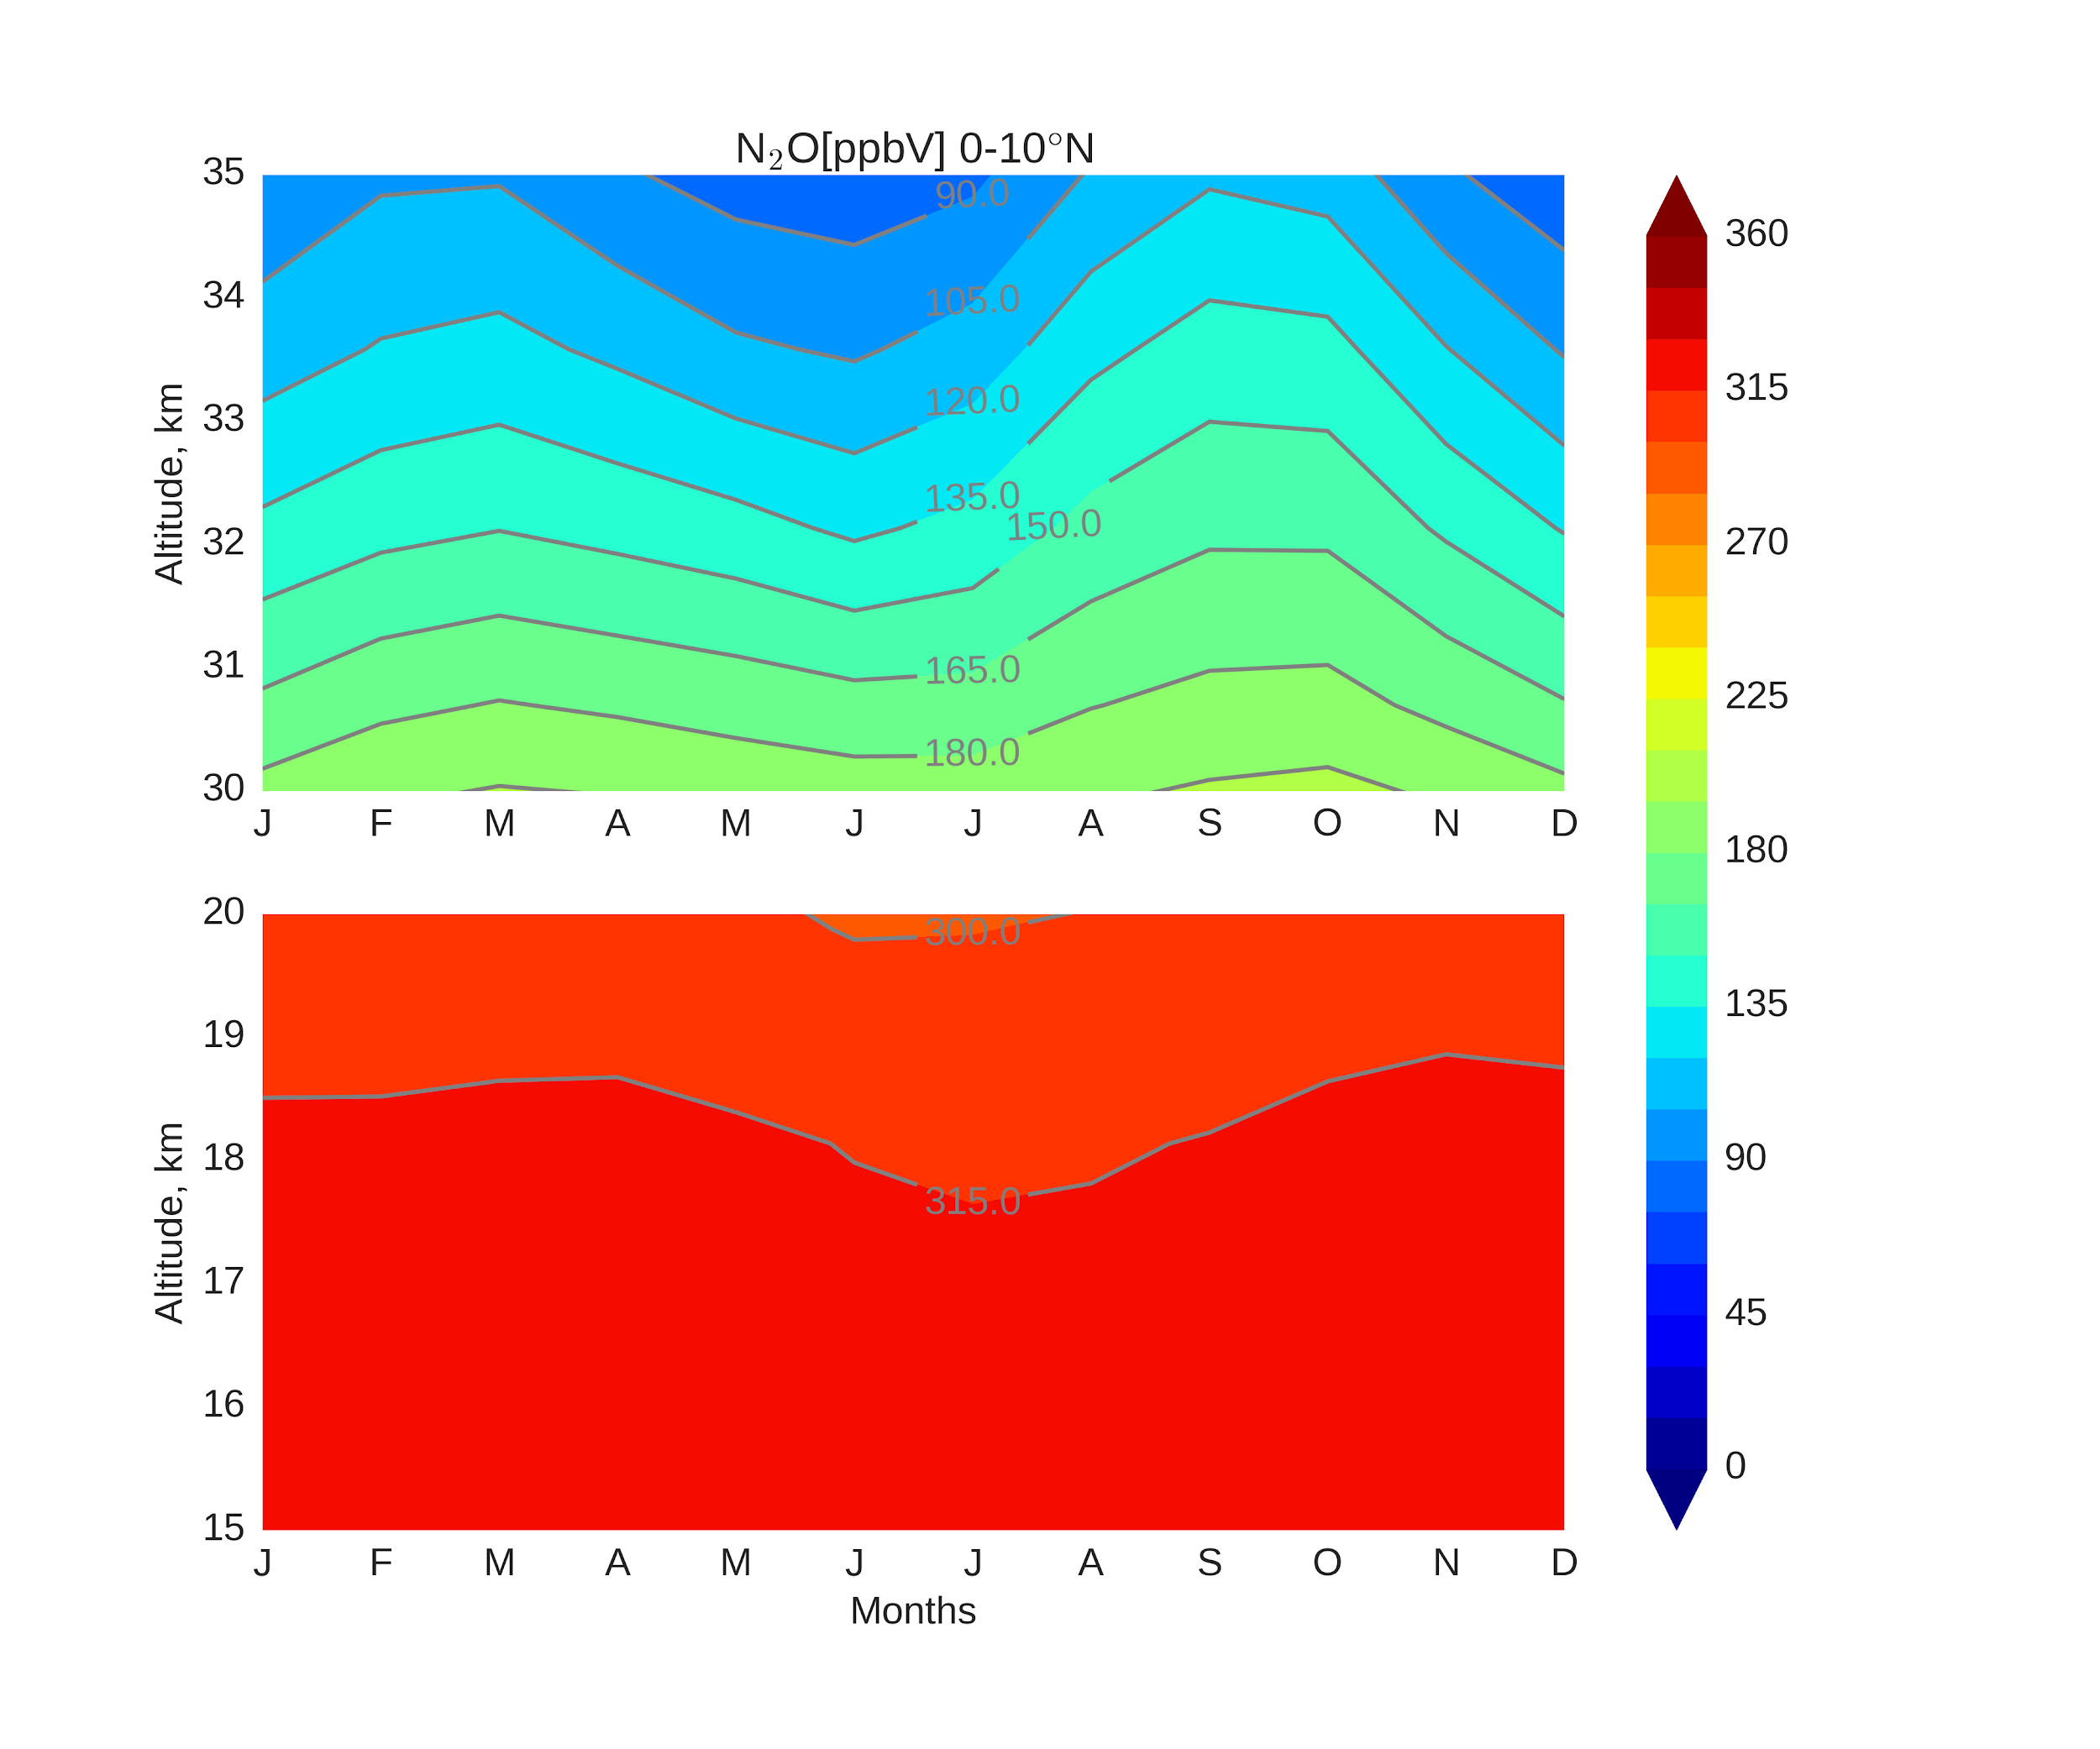
N₂O, 0-10°N
VII
N₂O, ppbV
N₂O, ppbV
Click here to go back to the content of additional slides.
32

Slide 33
VII
We are preparing the publication based on our results*.
*Recent update:
The manuscript is in open discussion in ACPD since 23 August 2018. https://doi.org/10.5194/acp-2018-746

Slide 34
N₂O-AoA, TROPICS
VII
AoA, years
AoA, years
Click here to go back to the content of additional slides.
34

Slide 35
N₂O-AoA, TROPICS
VII
AoA, years
AoA, years
The absence of strong R² between AoA and N₂O during DJFM we explain by:
Hemispheric differences
Absence of any N₂O or AoA changes
The largest difference at 30-35 km between contours and colors is seen during DJFM
This is exactly the time when the R² is the lowest.
AoA (color) step -
0.2 years
N₂O(contour) step -
15 ppbV
Click here to go back to the content of additional slides.
35

Slide 36
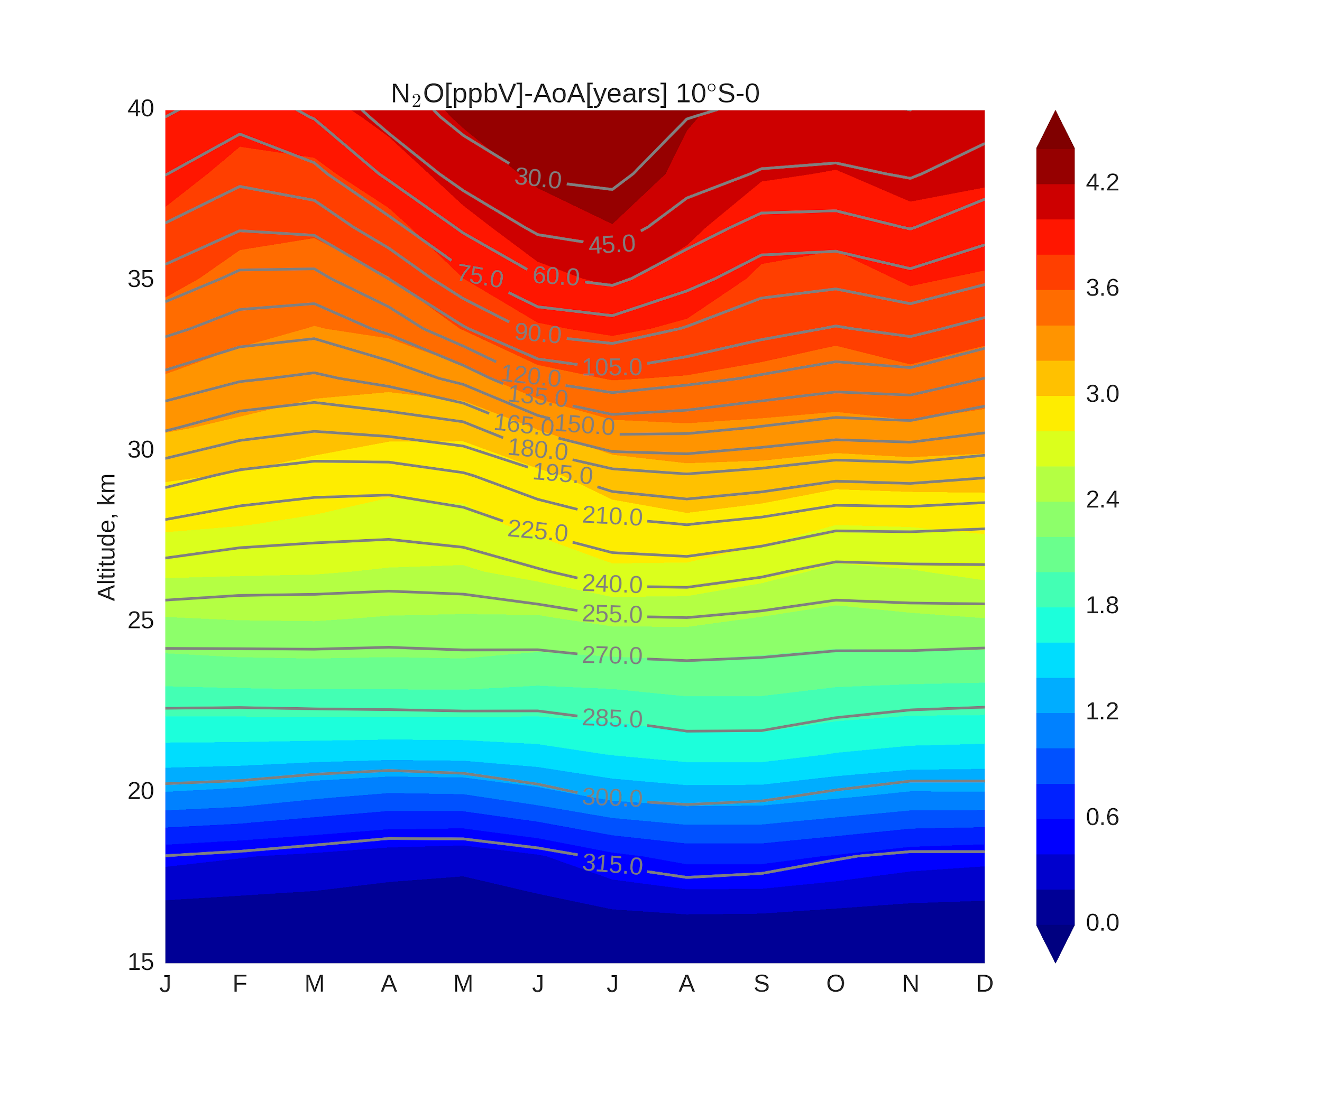
N₂O-AoA, 10S-0°
VII
AoA, years
AoA, years
AoA (color) step -
0.2 years
N₂O(contour) step -
15 ppbV
Click here to go back to the content of additional slides.
36

Slide 37
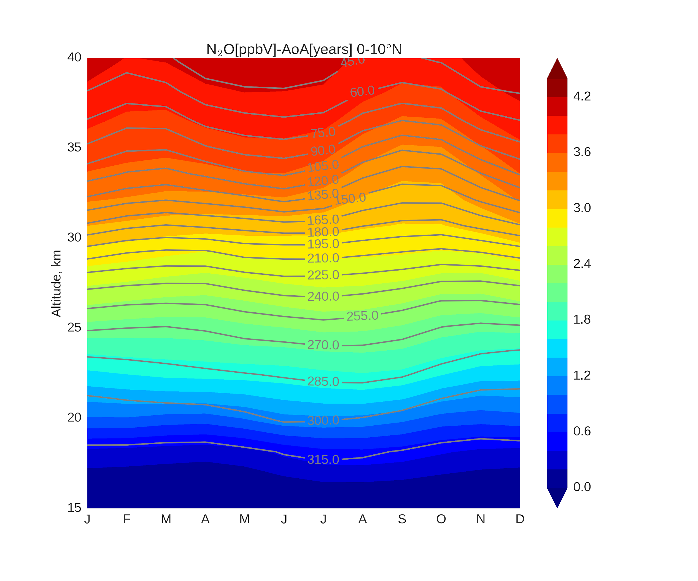
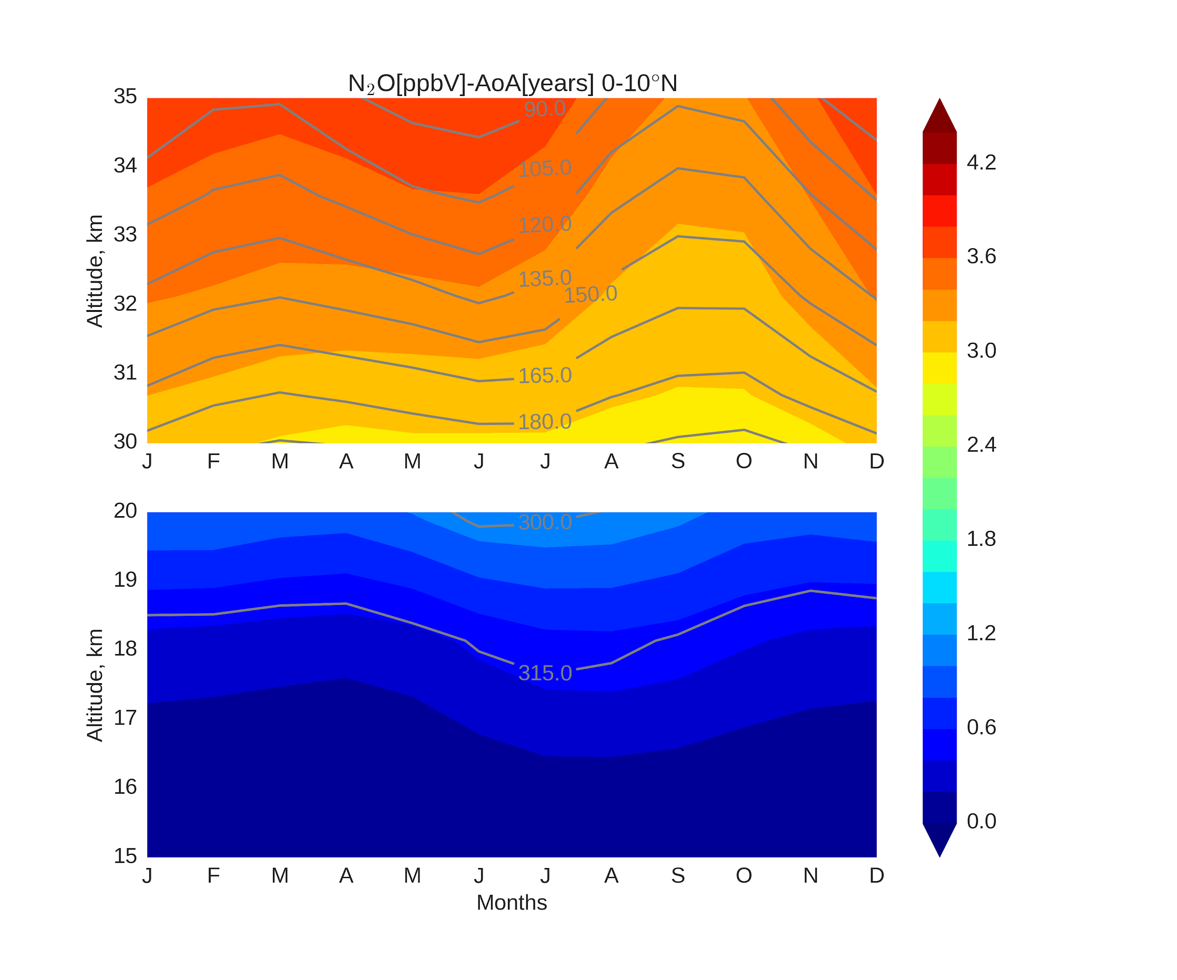
N₂O-AoA, 0-10°N
VII
AoA, years
AoA, years
AoA (color) step -
0.2 years
N₂O(contour) step -
15 ppbV
Click here to go back to the content of additional slides.
37

Slide 38
VII

Slide 39
VII
DJF MAM JJA SON
N₂O-AoA time series in tropics*
*N₂O is color coded
Click here to go back to the content of additional slides.
39

Slide 40
VII
DJF MAM JJA SON
N₂O-AoA time series,10°S-0*
*N₂O is color coded
Click here to go back to the content of additional slides.
40

Slide 41
VII
DJF MAM JJA SON
N₂O-AoA time series,0-10°N*
*N₂O is color coded
Click here to go back to the content of additional slides.
41

Slide 42
VII

Slide 43
VII
per year
per year
per year
per year
Click here to go back to the content of additional slides.
43

Slide 44
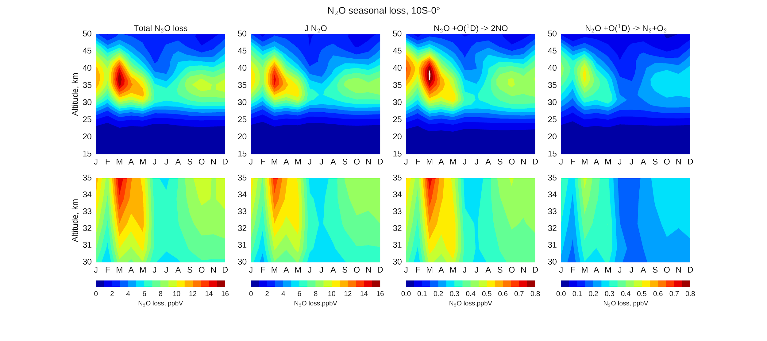
VII
per year
per year
per year
per year
Click here to go back to the content of additional slides.
44

Slide 45
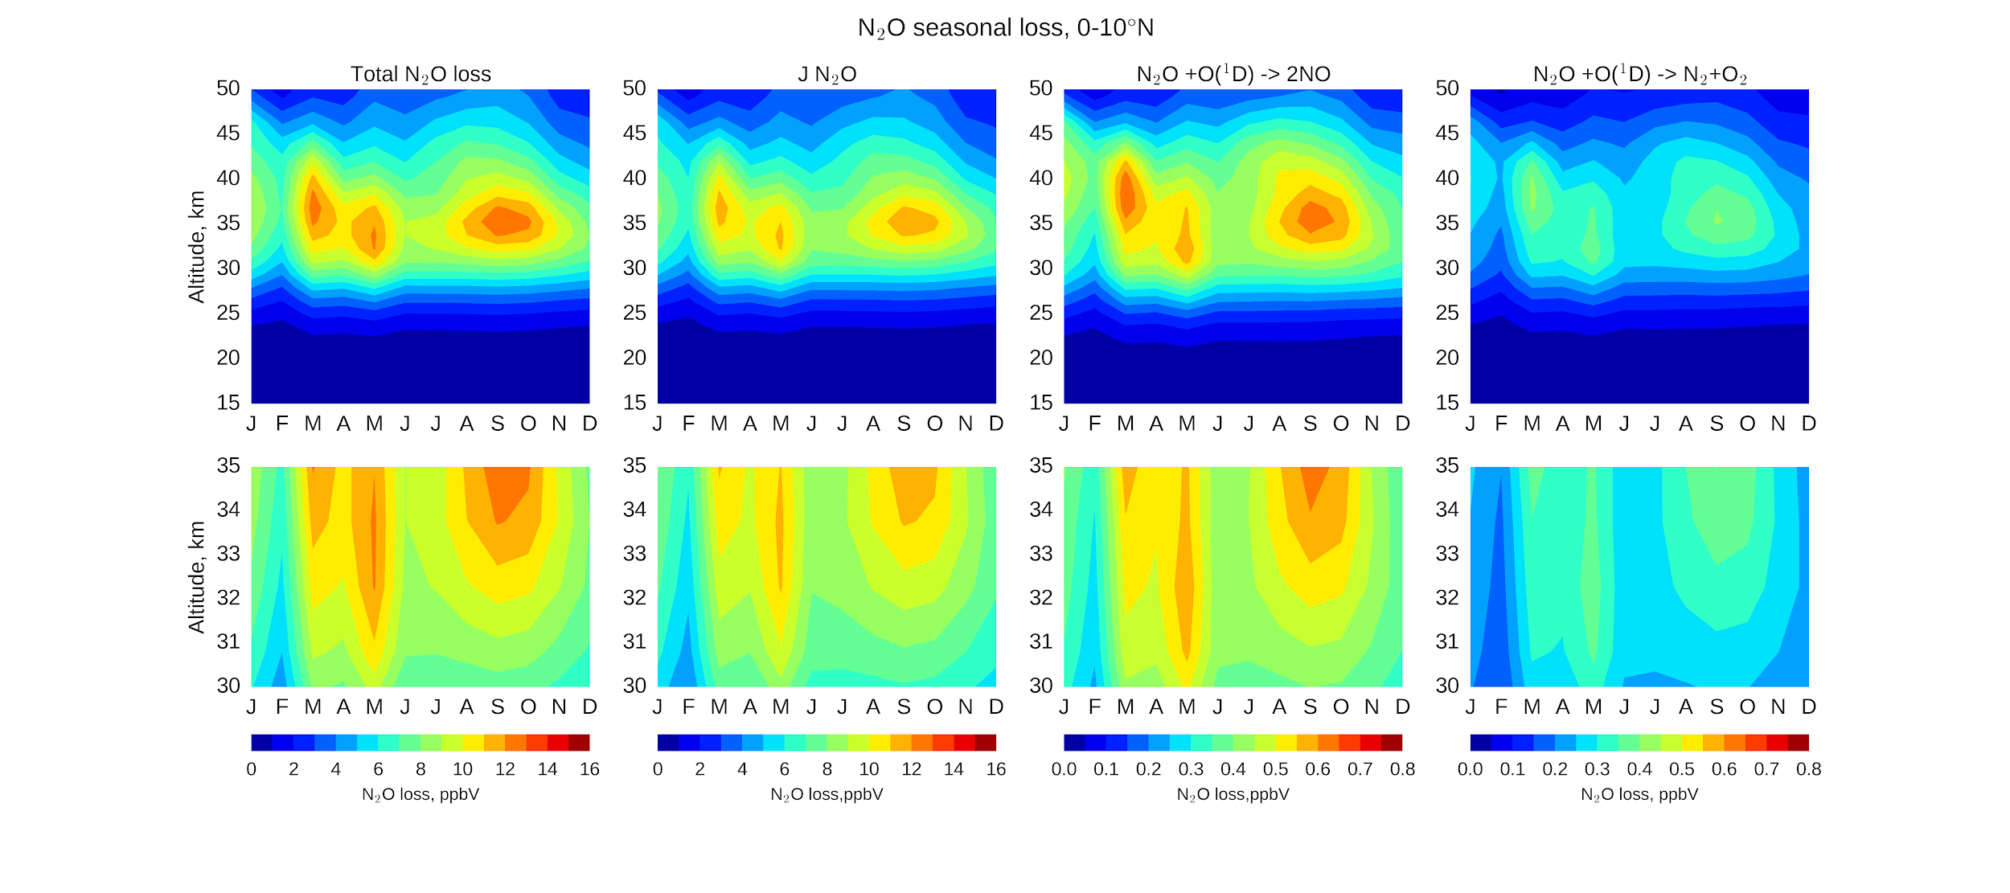
VII
per year
per year
per year
per year
Click here to go back to the content of additional slides.
45

Slide 46
VII

Slide 47
VII
sources
N₂O-O₃ correlation plots from TOMCAT
Click here to go back to the content of additional slides.
47

Slide 48
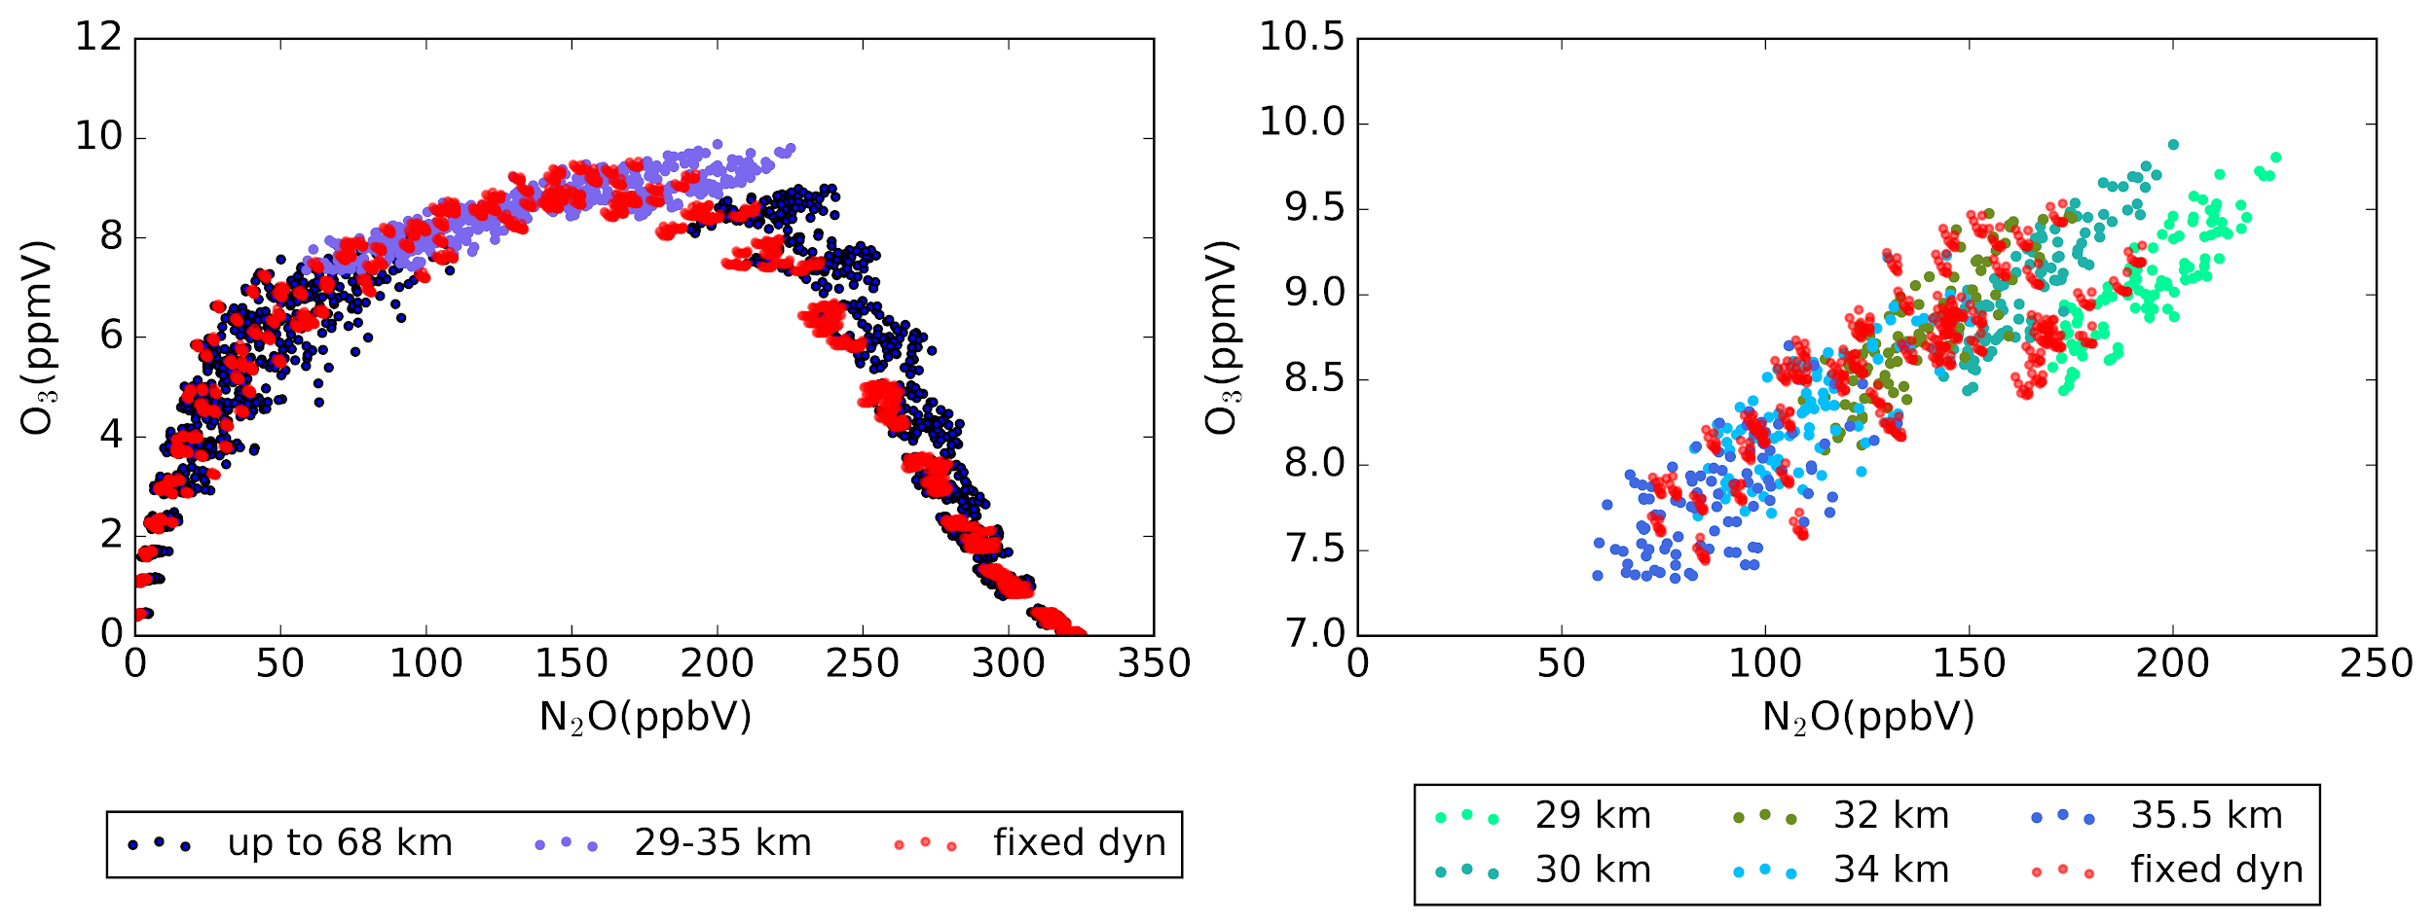
VII
sources
N₂O-O₃ correlation plots from TOMCAT
Click here to go back to the content of additional slides.
48

Slide 49
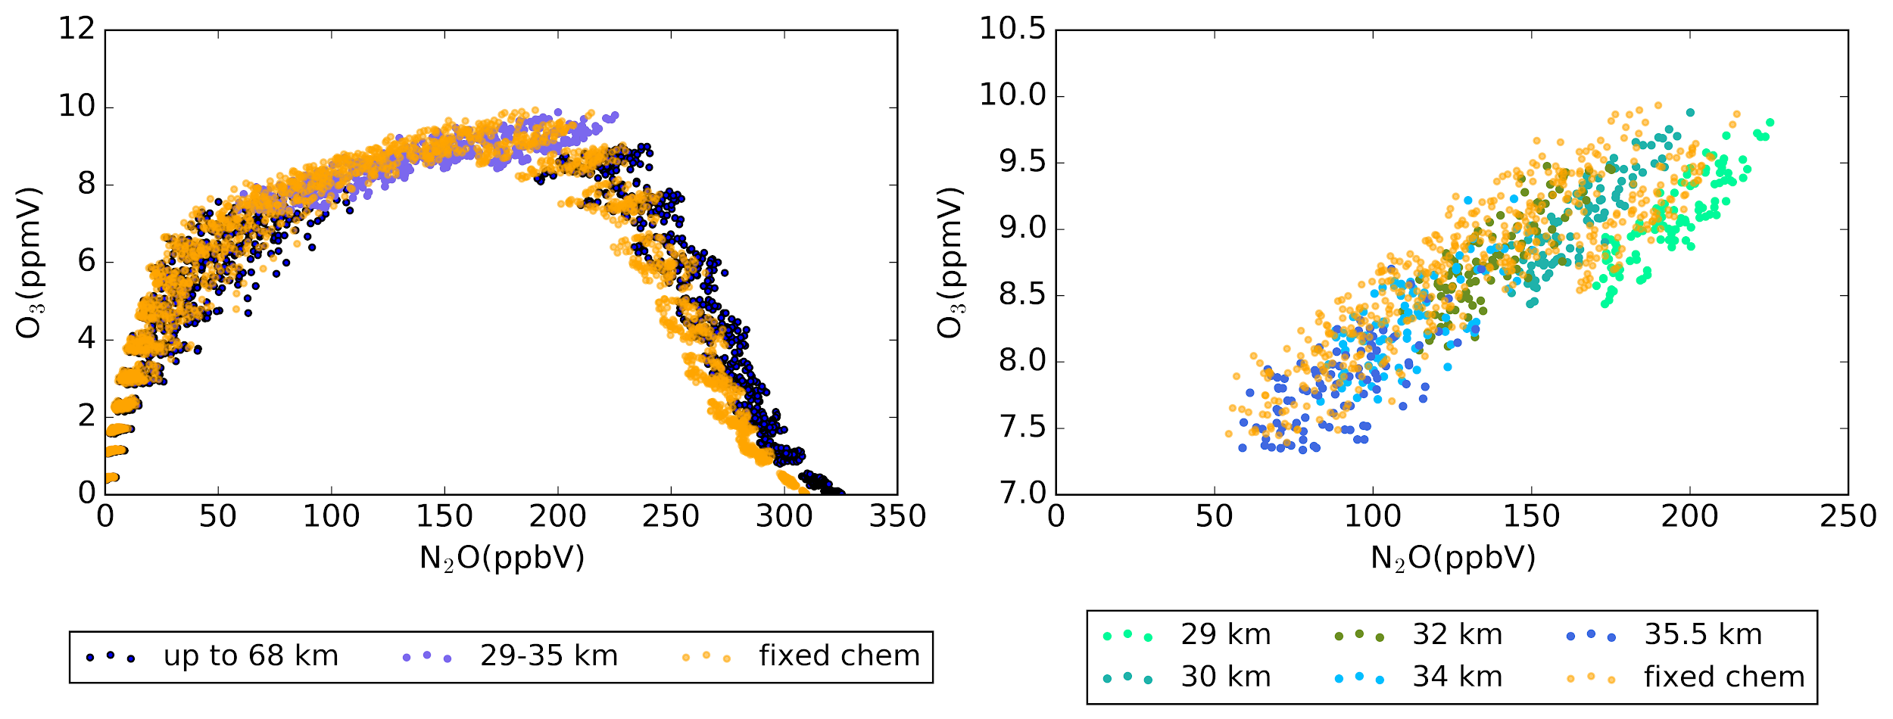
VII
sources
N₂O-O₃ correlation plots from TOMCAT
Click here to go back to the content of additional slides.
49

Slide 50
VII
sources
N₂O-O₃ correlation plots from TOMCAT
Click here to go back to the content of additional slides.
50

Slide 51
VII

Slide 52
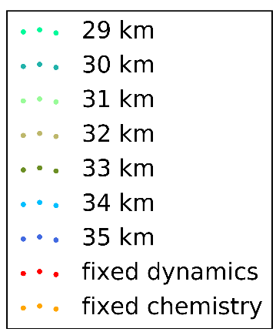
VII
TOMCAT
sources
NO₂-O₃ correlation plots from SCIAMACHY and TOMCAT
Click here to go back to the content of additional slides.
52

Slide 53
VII
TOMCAT
sources
NO₂-O₃ correlation plots from SCIAMACHY and TOMCAT
Click here to go back to the content of additional slides.
53

Slide 54
VII
TOMCAT
sources
NO₂-O₃ correlation plots from SCIAMACHY and TOMCAT
Click here to go back to the content of additional slides.
54

Slide 55
VII
TOMCAT
sources
NO₂-O₃ correlation plots from SCIAMACHY and TOMCAT
Click here to go back to the content of additional slides.
55

