Slide 1
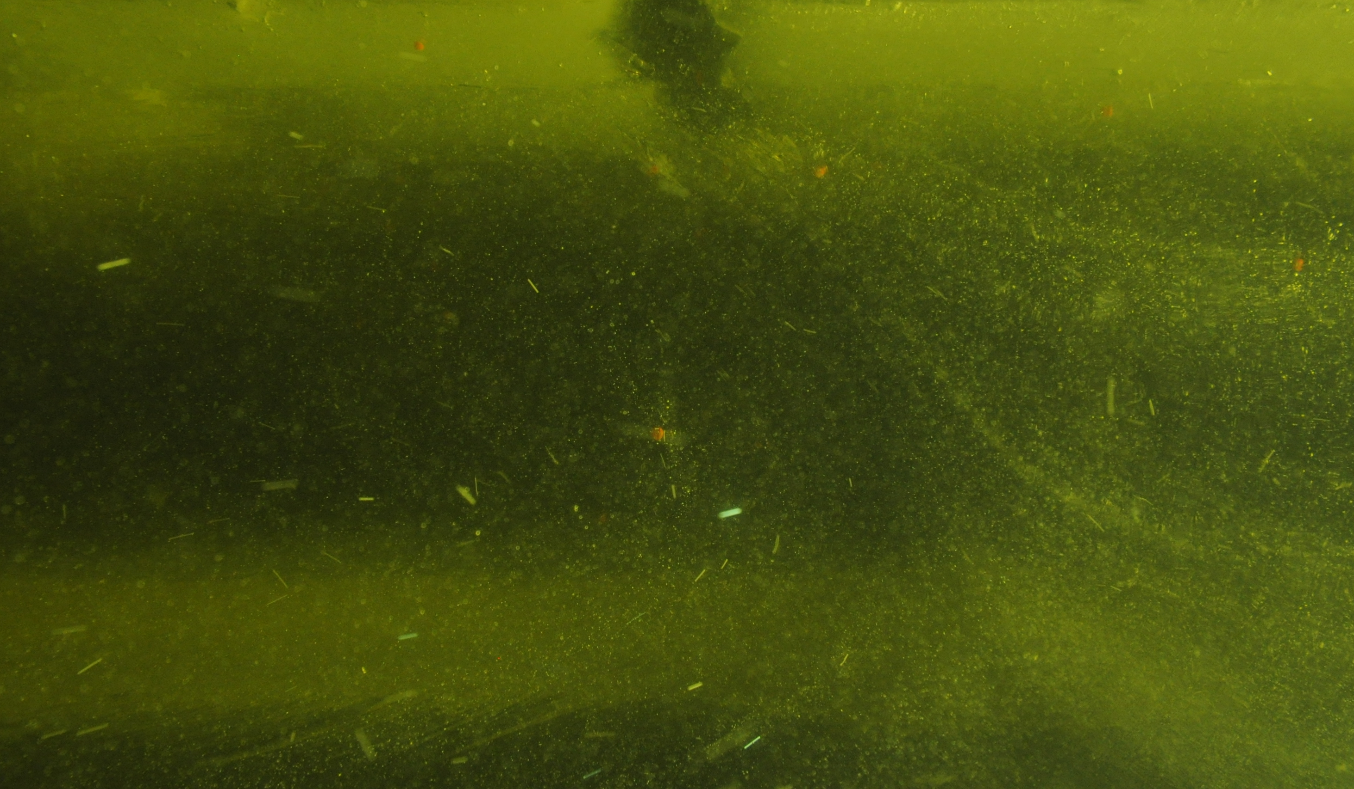
Mapping mantle complexity in 4-D geodynamical models of circulation beneath migrating mid-ocean ridges Loes van Dam, Christopher R. Kincaid, Robert A. Pockalny, R. Tucker Sylvia University of Rhode Island, Graduate School of Oceanography
Goal: better understand mantle source location for material erupted/emplaced at mid-ocean ridges
Method: Ridge Zone Replicator (RZR) laboratory experiments, incorporating realistic migration
Result: migration influences material pathlines in the mantle beneath ridges
Conclusion: mid-ocean ridges with high migration rates will draw material from shallower in the mantle
Tectonic Plates
Mantle
Depth

Slide 2
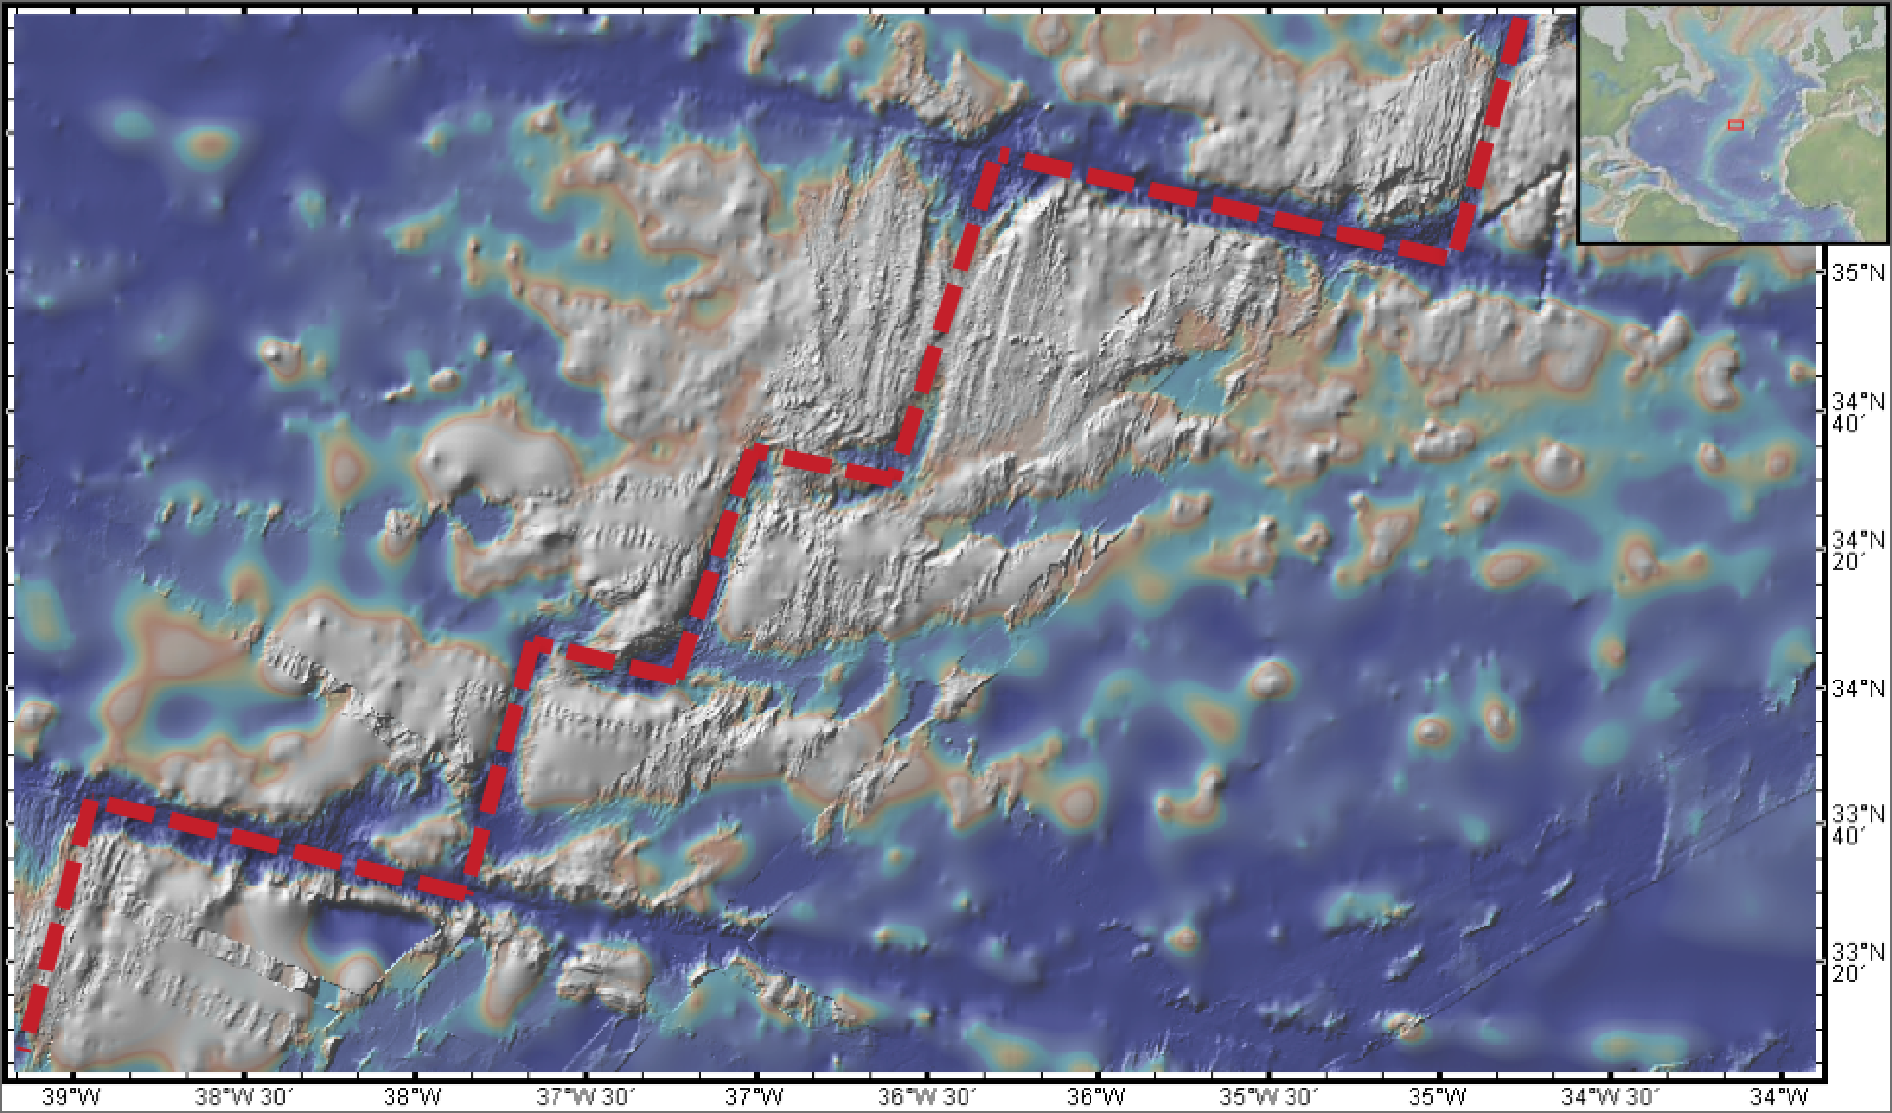
Mapping mantle complexity in 4-D geodynamical models of circulation beneath migrating mid-ocean ridges Loes van Dam, Christopher R. Kincaid, Robert A. Pockalny, R. Tucker Sylvia University of Rhode Island, Graduate School of Oceanography
Goal: better understand mantle source location for material erupted/emplaced at mid-ocean ridges
Method: Ridge Zone Replicator (RZR) laboratory experiments, incorporating realistic migration
Result: migration influences material pathlines in the mantle beneath ridges
Conclusion: mid-ocean ridges with high migration rates will draw material from shallower in the mantle
N
Bathymetry of a section of the Mid-Atlantic Ridge, generated with GeoMapApp (http://www.geomapapp.org).
Mantle flow at mid-ocean ridges is a highly three-dimensional (and time-evolving) fluid dynamics problem, where ridge migration makes modeling difficult.

Slide 3
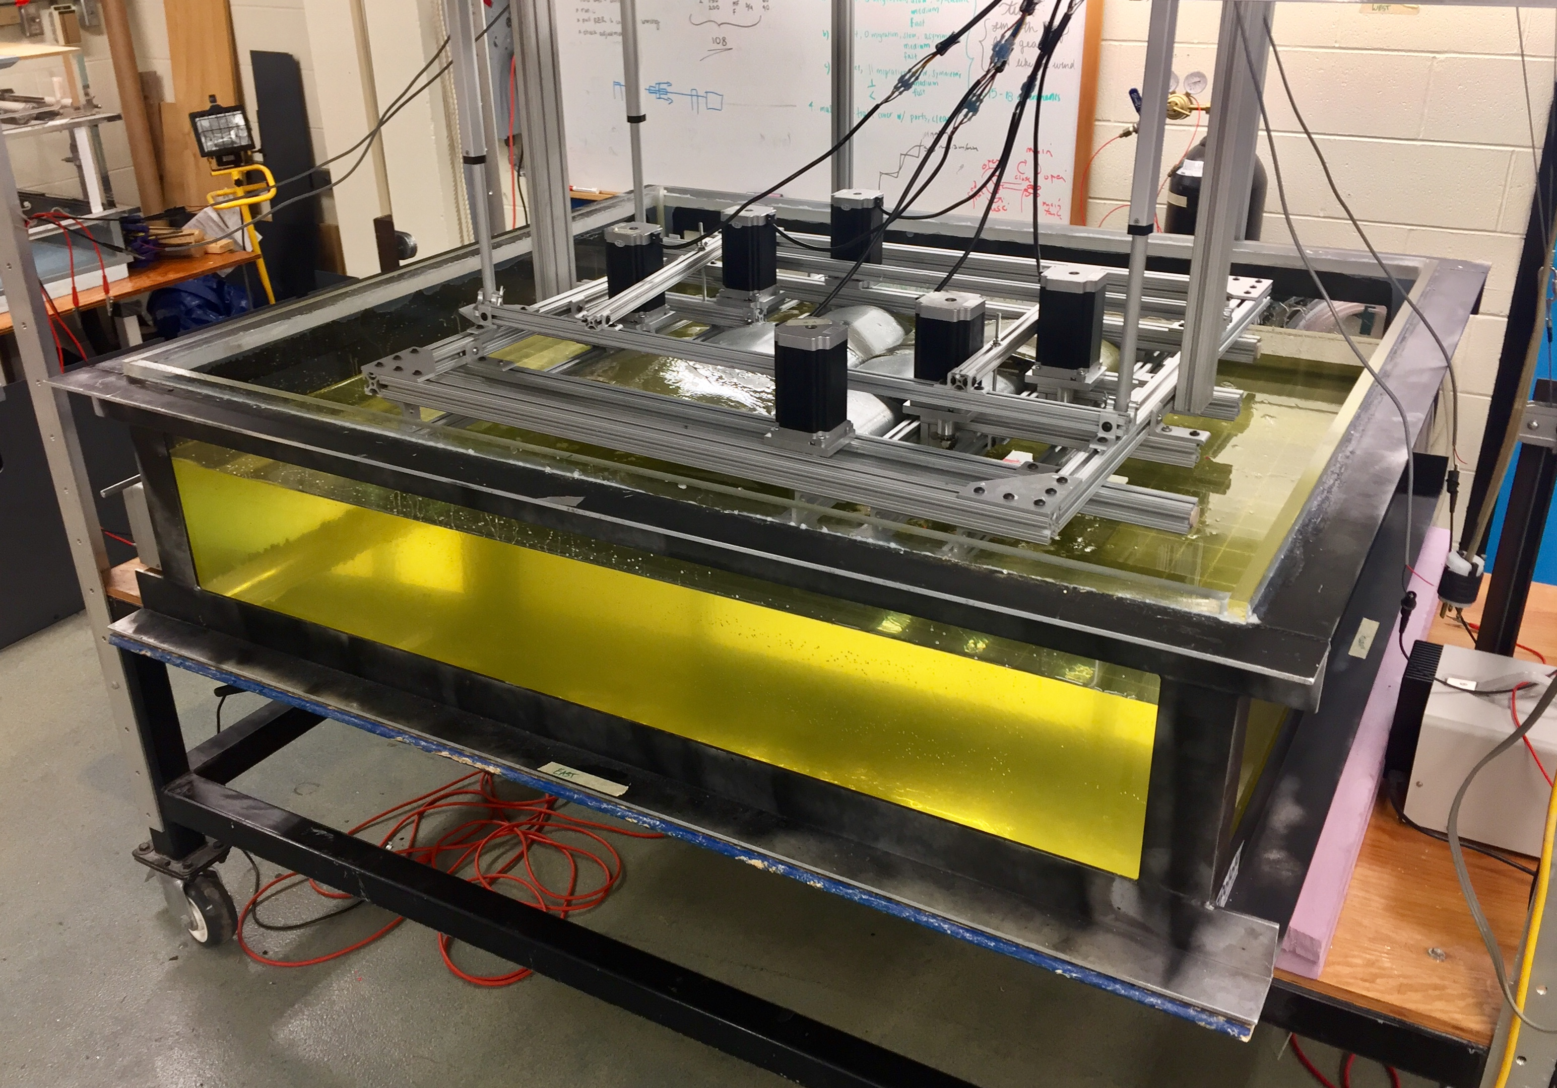
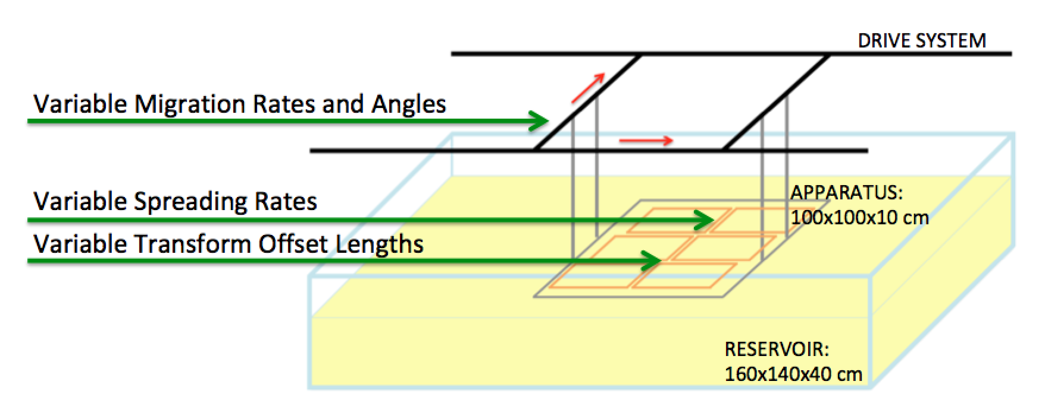
Mapping mantle complexity in 4-D geodynamical models of circulation beneath migrating mid-ocean ridges Loes van Dam, Christopher R. Kincaid, Robert A. Pockalny, R. Tucker Sylvia University of Rhode Island, Graduate School of Oceanography
Goal: better understand mantle source location for material erupted/emplaced at mid-ocean ridges
Method: Ridge Zone Replicator (RZR) laboratory experiments, incorporating realistic migration
Result: migration influences material pathlines in the mantle beneath ridges
Conclusion: mid-ocean ridges with high migration rates will draw material from shallower in the mantle

Slide 4
Mapping mantle complexity in 4-D geodynamical models of circulation beneath migrating mid-ocean ridges Loes van Dam, Christopher R. Kincaid, Robert A. Pockalny, R. Tucker Sylvia University of Rhode Island, Graduate School of Oceanography
Goal: better understand mantle source location for material erupted/emplaced at mid-ocean ridges
Method: Ridge Zone Replicator (RZR) laboratory experiments, incorporating realistic migration
Result: migration influences material pathlines in the mantle beneath ridges
Conclusion: mid-ocean ridges with high migration rates will draw material from shallower in the mantle
At our scaling, glucose syrup behaves similarly to mantle material.

Slide 5
Mapping mantle complexity in 4-D geodynamical models of circulation beneath migrating mid-ocean ridges Loes van Dam, Christopher R. Kincaid, Robert A. Pockalny, R. Tucker Sylvia University of Rhode Island, Graduate School of Oceanography
Tectonic Plates
Mantle
Depth
Time-lapse movie of an experiment, viewed from the side of the tank. The movie starts with a stationary ridge and symmetric spreading at 6 cm/yr equivalent. Ridge migration then starts at 4 seconds at 3 cm/yr equivalent, and ends at 10 seconds. The system then relaxes to stationary ridge conditions.

Slide 6
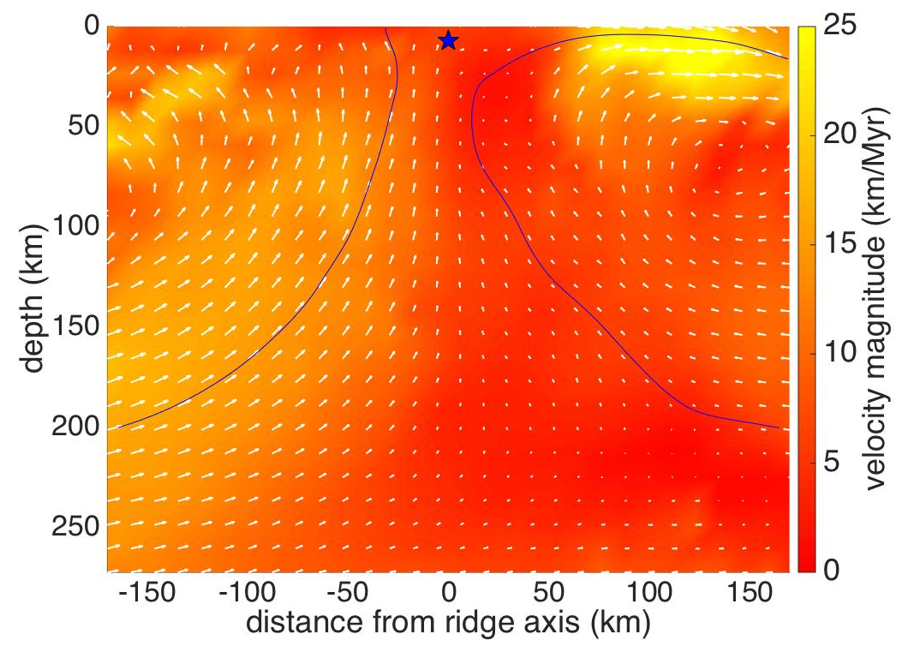
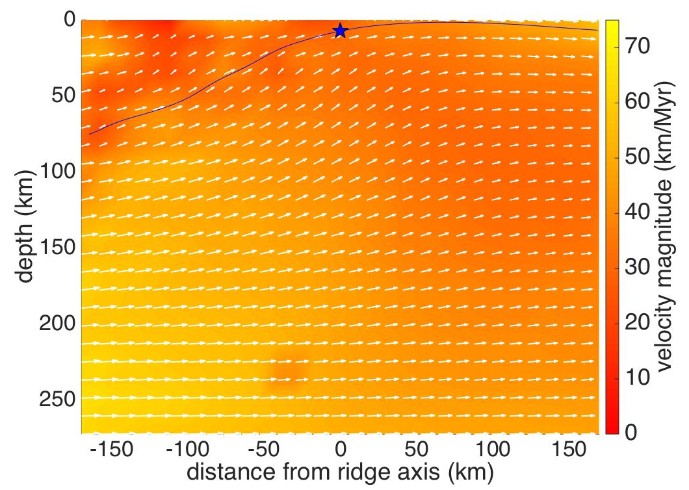
Mapping mantle complexity in 4-D geodynamical models of circulation beneath migrating mid-ocean ridges Loes van Dam, Christopher R. Kincaid, Robert A. Pockalny, R. Tucker Sylvia University of Rhode Island, Graduate School of Oceanography
Goal: better understand mantle source location for material erupted/emplaced at mid-ocean ridges
Method: Ridge Zone Replicator (RZR) laboratory experiments, incorporating realistic migration
Result: migration influences material pathlines in the mantle beneath ridges
Conclusion: mid-ocean ridges with high migration rates will draw material from shallower in the mantle
Particle image velocimetry (PIV) methods allow us to track beads, whiskers, and bubbles in the fluid. This gives us a sense of both the simulated mantle flow and particle pathlines.
Symmetric Spreading (6 cm/yr) Stationary Ridge
Symmetric Spreading (6 cm/yr)
Migrating Ridge (1.5 cm/yr)
Velocity fields generated with PIVlab (Thielicke and Stamhuis, 2014).

Slide 7
Mapping mantle complexity in 4-D geodynamical models of circulation beneath migrating mid-ocean ridges Loes van Dam, Christopher R. Kincaid, Robert A. Pockalny, R. Tucker Sylvia University of Rhode Island, Graduate School of Oceanography
Goal: better understand mantle source location for material erupted/emplaced at mid-ocean ridges
Method: Ridge Zone Replicator (RZR) laboratory experiments, incorporating realistic migration
Result: migration influences material pathlines in the mantle beneath ridges
Conclusion: mid-ocean ridges with high migration rates will draw material from shallower in the mantle
Stationary Ridge = Deep Upwelling
Migrating Ridge = Shallow Upwelling

Slide 8
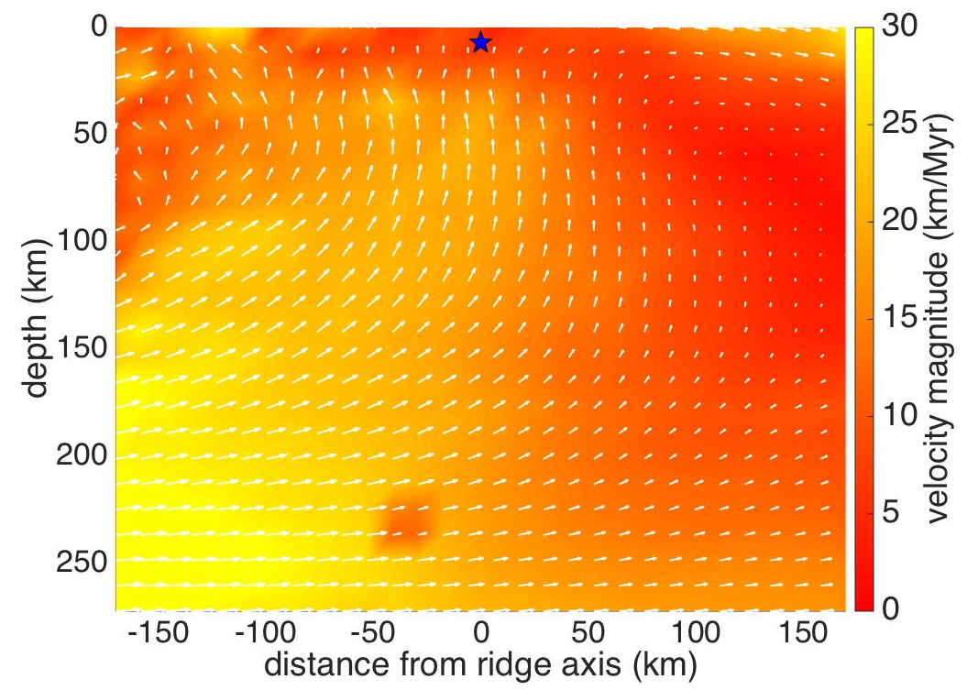
Mapping mantle complexity in 4-D geodynamical models of circulation beneath migrating mid-ocean ridges Loes van Dam, Christopher R. Kincaid, Robert A. Pockalny, R. Tucker Sylvia University of Rhode Island, Graduate School of Oceanography
Goal: better understand mantle source location for material erupted/emplaced at mid-ocean ridges
Method: Ridge Zone Replicator (RZR) laboratory experiments, incorporating realistic migration
Result: migration influences material pathlines in the mantle beneath ridges
Conclusion: mid-ocean ridges with high migration rates will draw material from shallower in the mantle
Cameras move along the side of the tank, with the RZR. This view gives us particle pathlines. Correcting for camera motion (i.e. reference frame) gives us mantle flow streamlines.
Symmetric Spreading (6 cm/yr)
Migrating Ridge (1.5 cm/yr)
Symmetric Spreading (6 cm/yr)
Migrating Ridge (1.5 cm/yr)
Reference Frame Corrected

Slide 9
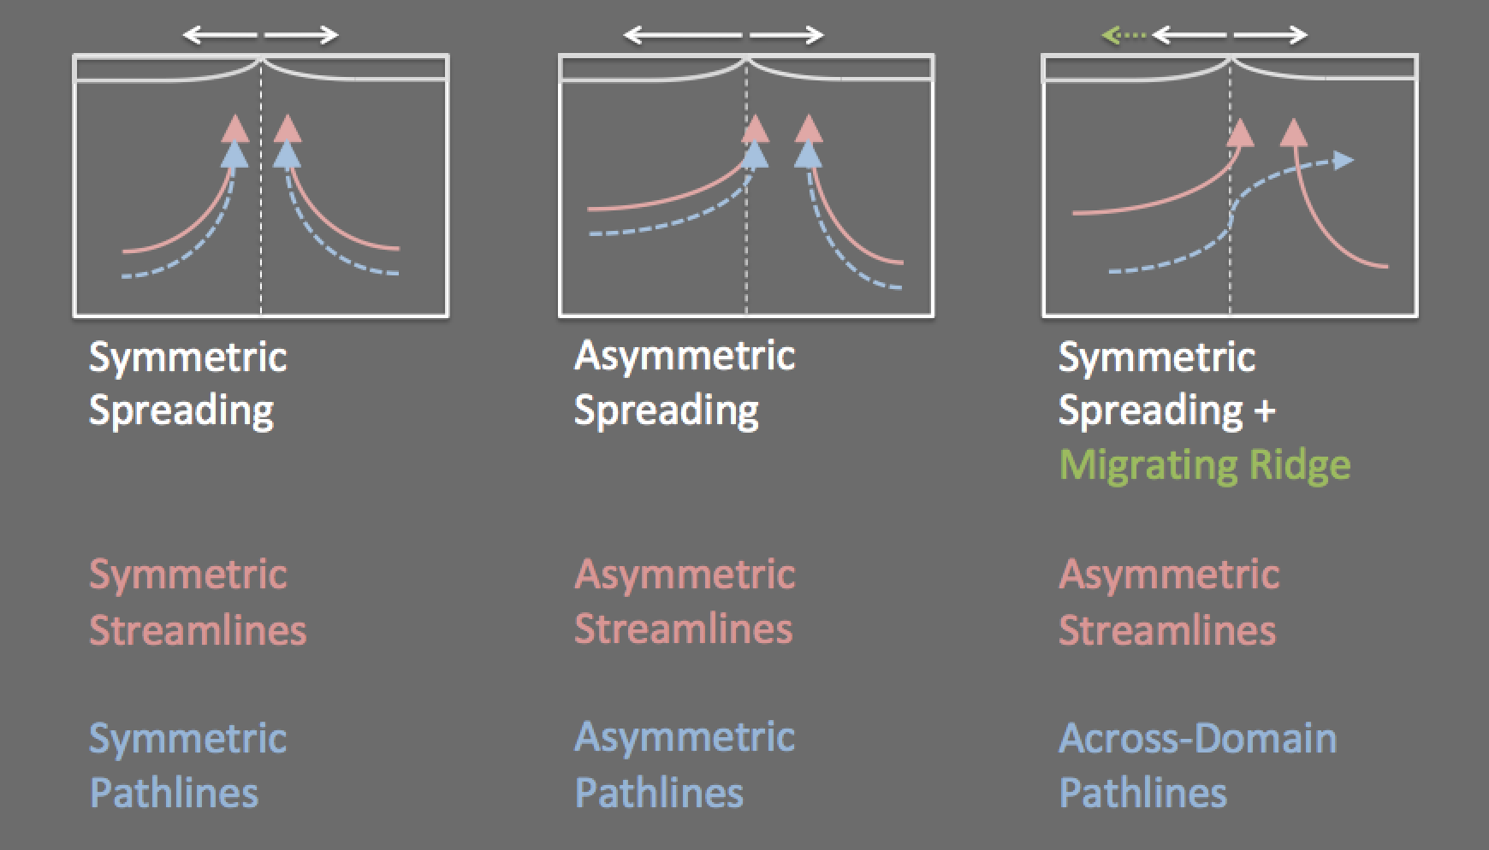
Mapping mantle complexity in 4-D geodynamical models of circulation beneath migrating mid-ocean ridges Loes van Dam, Christopher R. Kincaid, Robert A. Pockalny, R. Tucker Sylvia University of Rhode Island, Graduate School of Oceanography
Goal: better understand mantle source location for material erupted/emplaced at mid-ocean ridges
Method: Ridge Zone Replicator (RZR) laboratory experiments, incorporating realistic migration
Result: migration influences material pathlines in the mantle beneath ridges
Conclusion: mid-ocean ridges with high migration rates will draw material from shallower in the mantle
Simulated mantle flow streamlines agree with previous work in both numerical and analogue models. Pieces of the mantle do not necessarily follow streamlines in unsteady flows.

Slide 10
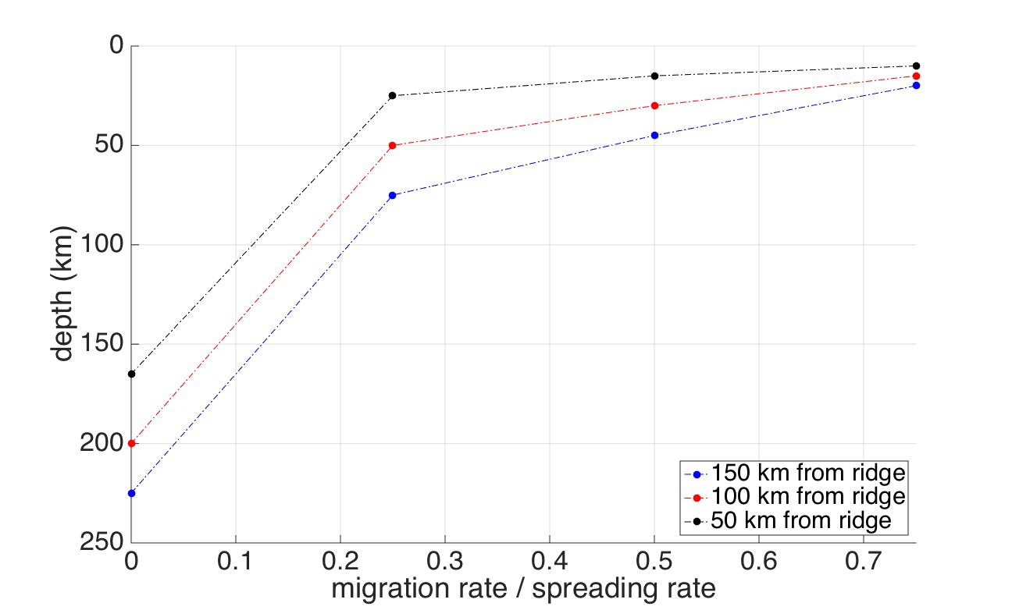
Mapping mantle complexity in 4-D geodynamical models of circulation beneath migrating mid-ocean ridges Loes van Dam, Christopher R. Kincaid, Robert A. Pockalny, R. Tucker Sylvia University of Rhode Island, Graduate School of Oceanography
Goal: better understand mantle source location for material erupted/emplaced at mid-ocean ridges
Method: Ridge Zone Replicator (RZR) laboratory experiments, incorporating realistic migration
Result: migration influences material pathlines in the mantle beneath ridges
Conclusion: mid-ocean ridges with high migration rates will draw material from shallower in the mantle
“parcel’s” lateral distance from axis
At high migration rates, material that reaches the ridge axis comes from shallower inside the mantle than for low migration rates or stationary ridges. Horizontal velocities are relatively high.

Slide 11
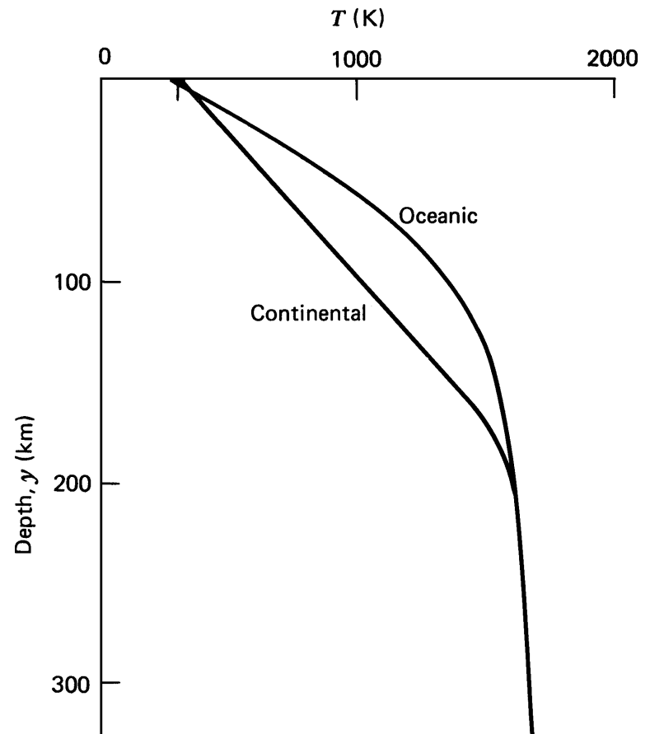
Mapping mantle complexity in 4-D geodynamical models of circulation beneath migrating mid-ocean ridges Loes van Dam, Christopher R. Kincaid, Robert A. Pockalny, R. Tucker Sylvia University of Rhode Island, Graduate School of Oceanography
Goal: better understand mantle source location for material erupted/emplaced at mid-ocean ridges
Method: Ridge Zone Replicator (RZR) laboratory experiments, incorporating realistic migration
Result: migration influences material pathlines in the mantle beneath ridges
Conclusion: mid-ocean ridges with high migration rates will draw material from shallower in the mantle
Implications for geochemical understanding of the mantle origin of mid-ocean ridge rocks. (Modified from Turcotte and Schubert, 1982.)
Migrating Ridge
Stationary Ridge

Slide 12
Mapping mantle complexity in 4-D geodynamical models of circulation beneath migrating mid-ocean ridges Loes van Dam, Christopher R. Kincaid, Robert A. Pockalny, R. Tucker Sylvia University of Rhode Island, Graduate School of Oceanography
Tectonic Plates
Mantle
Depth
SNEAK PREVIEW: Time-lapse movie of an experiment, viewed from the side of the tank. A sheet of light is focused on a transform offset. The ridge is stationary and the spreading rate is 6 cm/yr equivalent. Lateral flow is enhanced beneath the offset, such that material travels large distances before ascending.

