Slide 1
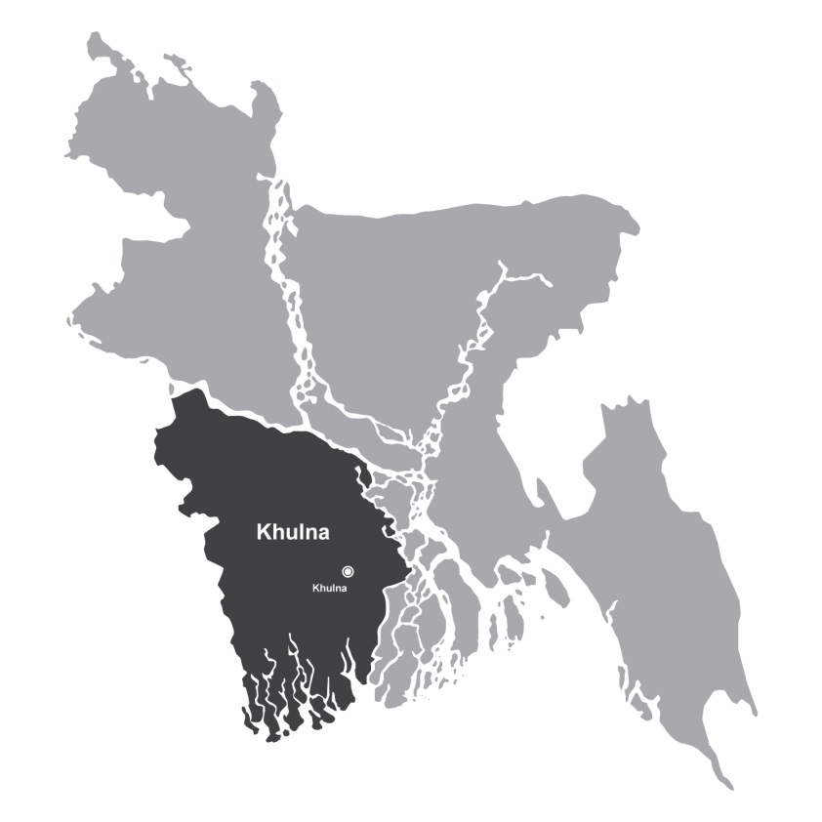
A TRANS-DISCPLINARY COMMUNITY BASED
APPROACH TO EXPLORE INSTITUTIONAL CHANGE IN
KHULNA’S PERI-URBAN
DRINKING WATER SERVICES
SHARLENE L. GOMES
PHD CANDIDATE
DELFT UNIVERSITY OF TECHNOLOGY

Slide 2
COLLABORATORS:
LEON M. HERMANS
DELFT UNIVERSITY OF TECHNOLOGY, NETHERLANDS
KAZI FAISAL ISLAM, NAZMUL HUDA & ATM ZAKIR HOSSAIN
JAGRATA JUBA SHANGHA, KHULNA
SHIFTING GROUNDS PROJECT:
FUNDED BY NWO
URBANISING DELTAS OF THE WORLD PROGRAM

Slide 3
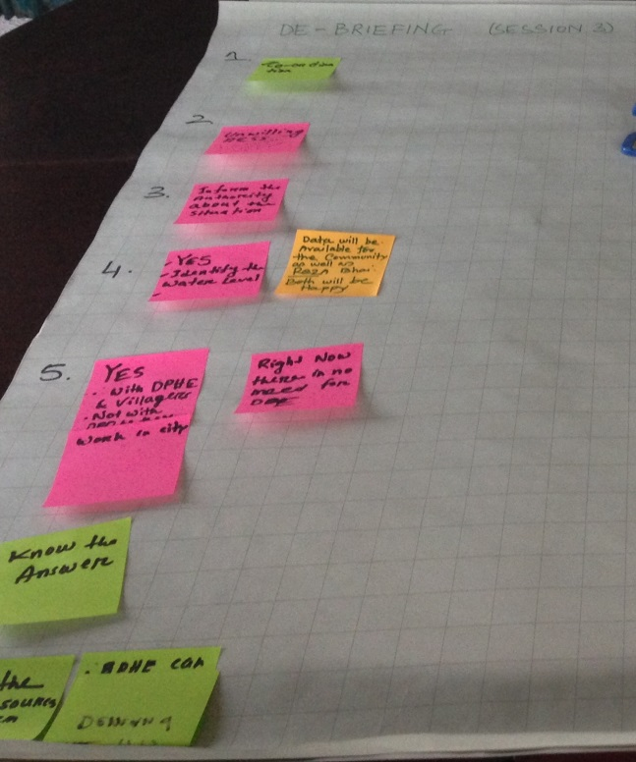
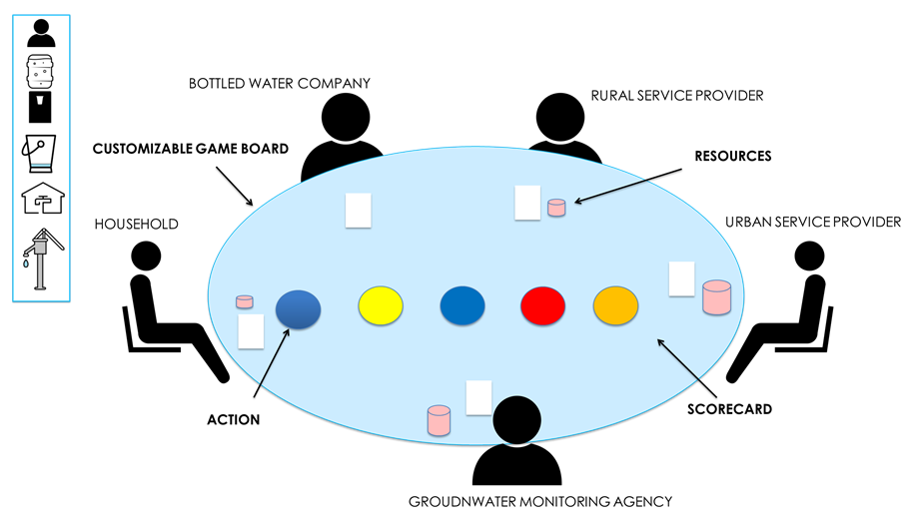
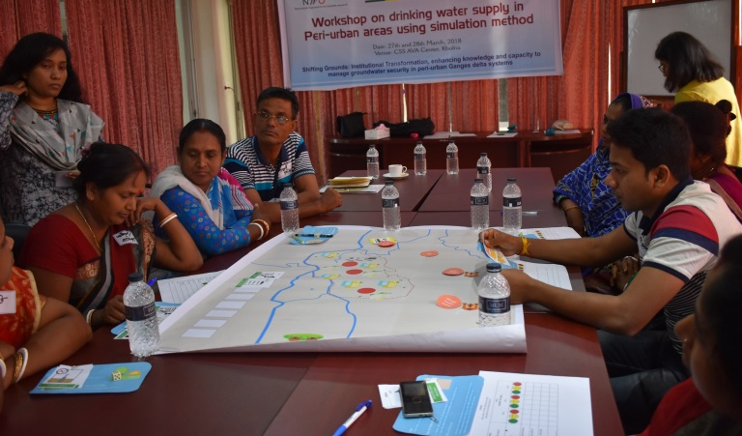
OVERVIEW
Context (4)
Problem (5-6)
Objectives (7)
Approach (9-15)
Khulna:
Rapid & uncontrolled urbanisation
Growing demand and competition over groundwater
Affecting drinking water services in peri-urban communities
Research Questions:
Design an approach that integrates institutional knowledge into problem solving efforts?
What is the role of trans-disciplinary research in this regard?
What effect does this have on the community’s problem solving process?
Design
Game-based simulation
Implementation
Community workshop (March 2018)
Evaluation
Learning, Method, Workshop
Institutions(rules):
Arranged along rural- urban boundaries
Unable to keep up with changing peri-urban needs
Peri-urban communities:
Lack insight into institutional context of the problem
Limits the solution space

Slide 4
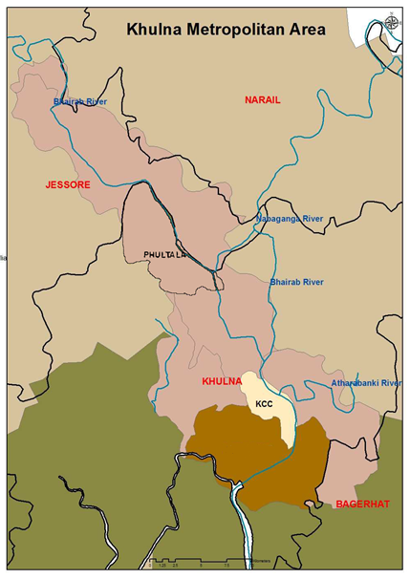
CONTEXT
Khulna city: 3rd largest city in Bangladesh
Indicated as KCC on map
Experiencing rapid & largely uncontrolled urban expansion
Groundwater is the primary source of water
However, growing competition for groundwater due to urbanisation is causing
Seasonal scarcity
Contamination (Salinity, Iron)
Affected peri-urban areas
Here, rural-urban transition is visible in changes in land use, economic activities, population
Eg. Hogladanga village (7km outside Khulna city boundaries)
HOGLADANGA VILLAGE

Slide 5
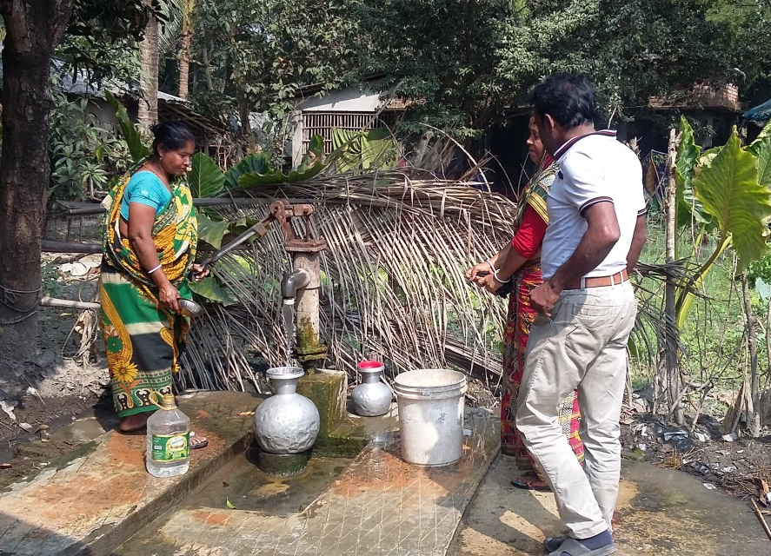
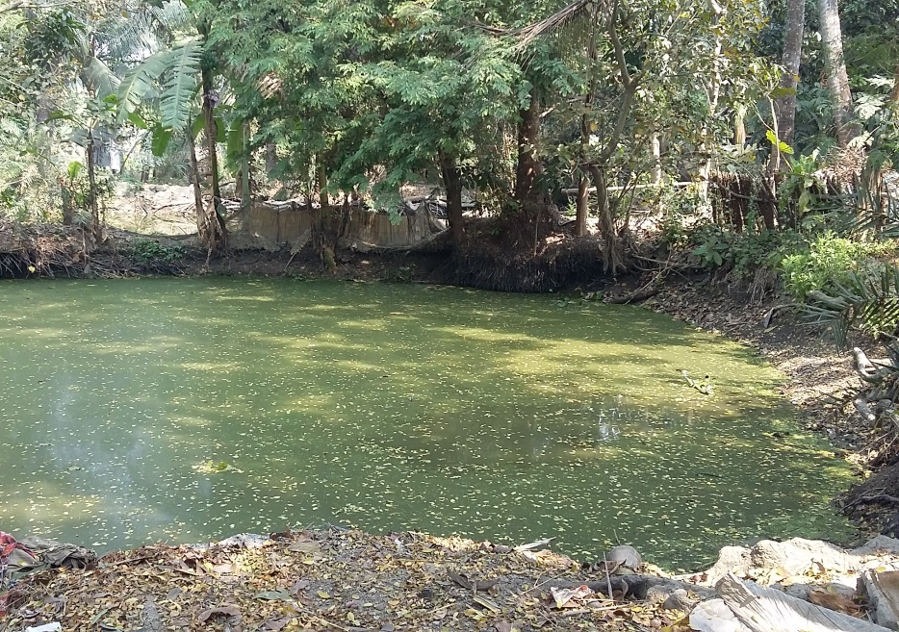
PERI-URBAN DRINKING WATER PROBLEM
Insufficient tube well infrastructure to meet village’s needs
Sharing 2-3 tube wells means significant time, distance, energy is spent collecting water (Fig. 1)
Need for safe drinking water (quality)
Depends on tube well depth
Poor data about groundwater conditions
Lack of alternatives
Local ponds and canals are not suitable for drinking (Fig. 2)
Investing in private tube wells is costly
Fig. 1
Fig. 2

Slide 6
INSTIUTIONAL CONTEXT OF DRINKING WATER PROBLEM
Institutions refer to ‘rules’ for decision making and interactions
Formal Rules- laws, policies
Informal Rules- norms, customs
What purpose do institutions serve?
Exist to help manage common pool resources like groundwater
Facilitate coordination between different actors
Peri-urban areas exist in an institutional void
Institutions arranged along rural- urban boundaries
Formally peri-urban areas fall within rural jurisdictions
Rural institutions unable to manage changing peri-urban needs
How does this affect problem solving?
Peri-urban communities are in need of solutions to drinking water problems
But they lack an understanding of the institutional context
This affects problem understanding &
Limits the solution space

Slide 7
RESEARCH OBJECTIVES
RQ 1. Design an approach that introduces institutional knowledge into community’s problem solving process
RQ2. What is the role of trans-disciplinary research in this regard?
RQ3. What effect does improved institutional understanding have on community’s problem solving process?

Slide 8
APPROACH
RQ 1. Participatory approach to introduce institutional knowledge into community’s problem solving process
1. Design
Game-based simulation based on trans-disciplinary research
2. Implementation
Community workshop in Khulna
(27th March 2018)
3. Evaluation
Learning, Workshop Facilitation, Gaming-Simulation method

Slide 9
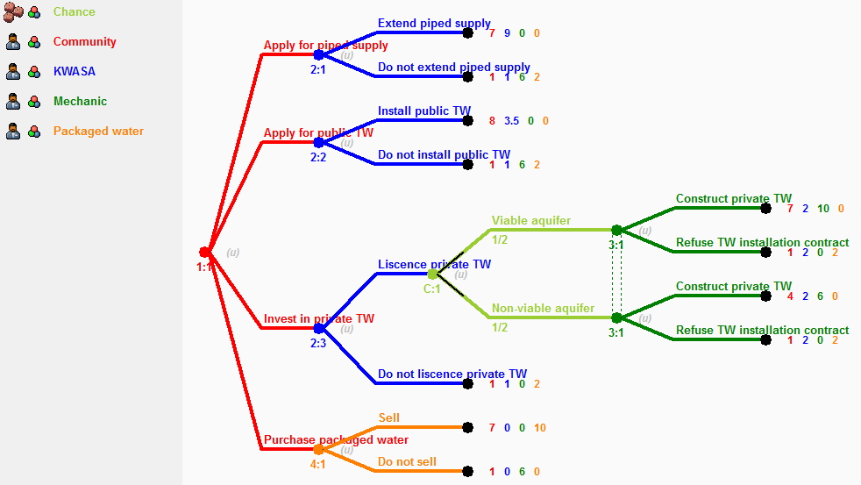
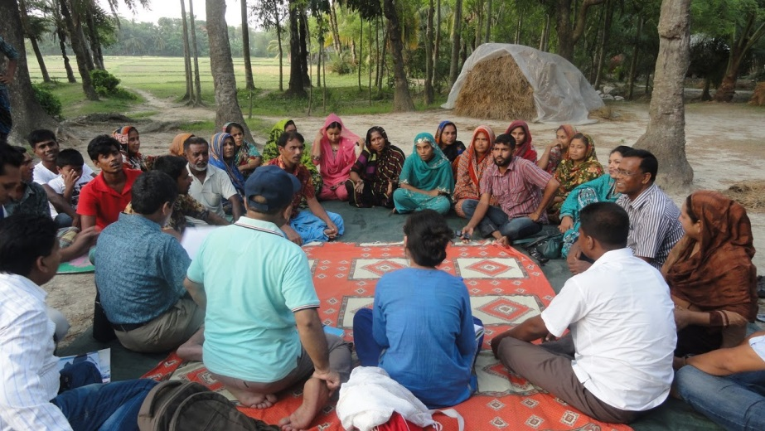
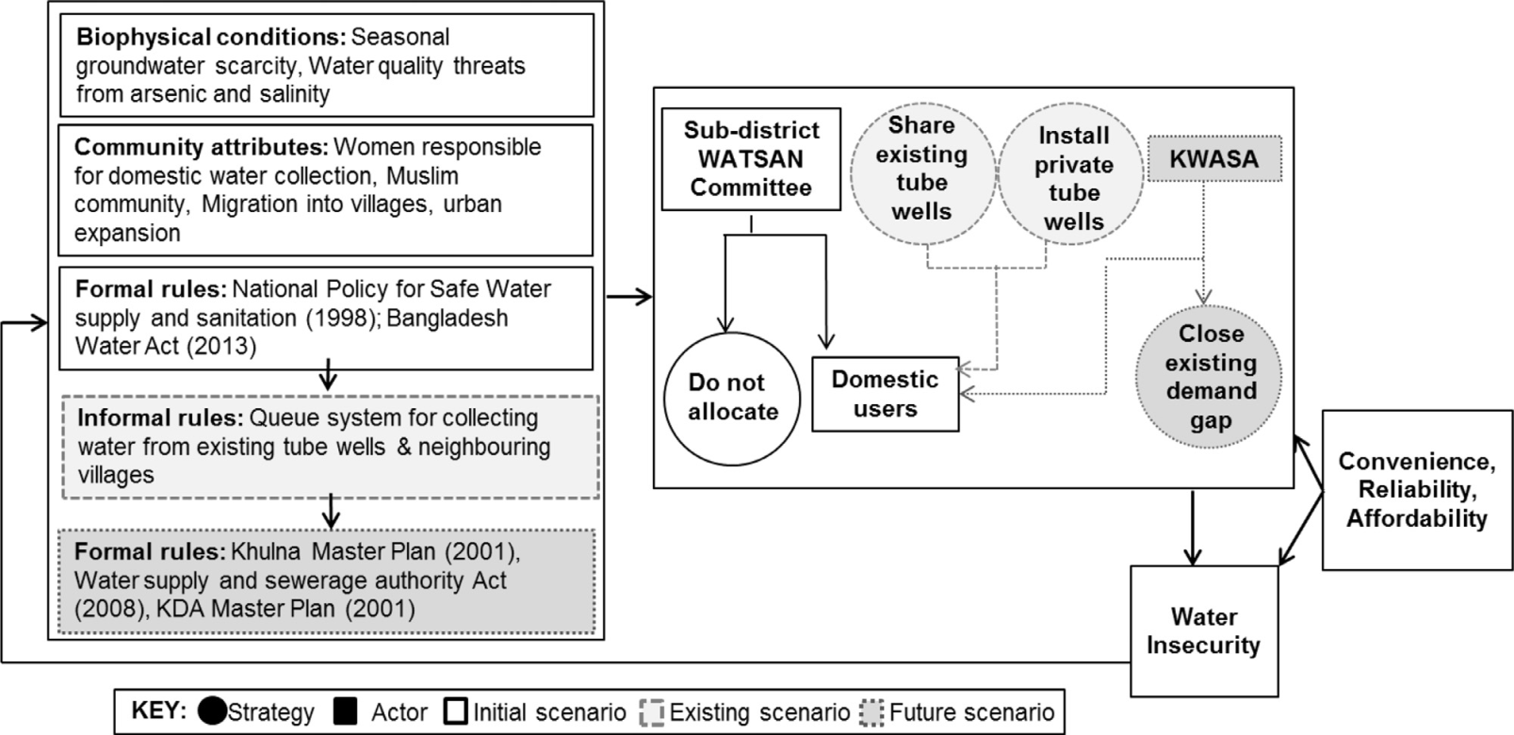
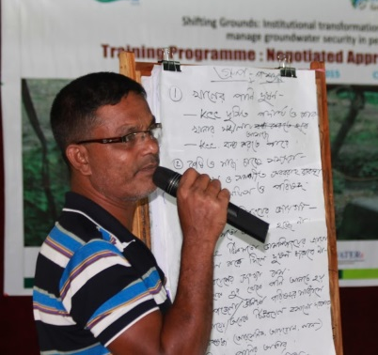
1. DESIGN (RQ2. ROLE OF TRANS-DISCIPLINARY RESEARCH)
STEP 2
Map institutional context
Action research
Field research(2015, 2017)- Fig. 1
Interviews and FGDs
Government, community, CSO’s
NGO-led community workshops- Fig. 2
Identified problem boundaries
Infrastructure access
Water quality
Community’s solution strategy
Request 4-5 additional deep tube wells from rural drinking water provider
3 separate models to explore specific aspects of drinking water problem
Non-cooperative game theory
Existing drinking water situation (baseline scenario)
Future drinking water situation (urban scenario)
Cooperative game theory
Coalitions to improve groundwater monitoring
Interviewed local stakeholders to calculate payoffs
Fig. 1
STEP 1
Identify problem boundary
Fig. 2
Using the IAD Framework (Ostrom 2005)
Important institutional aspects of the problem
Formal & informal institutions exist
Situation is dynamic (eg. Future changes following urban expansion)
Research verified with local stakeholders – Fig. 3
STEP 3
Model strategic behaviour of actors using game theory

Slide 10
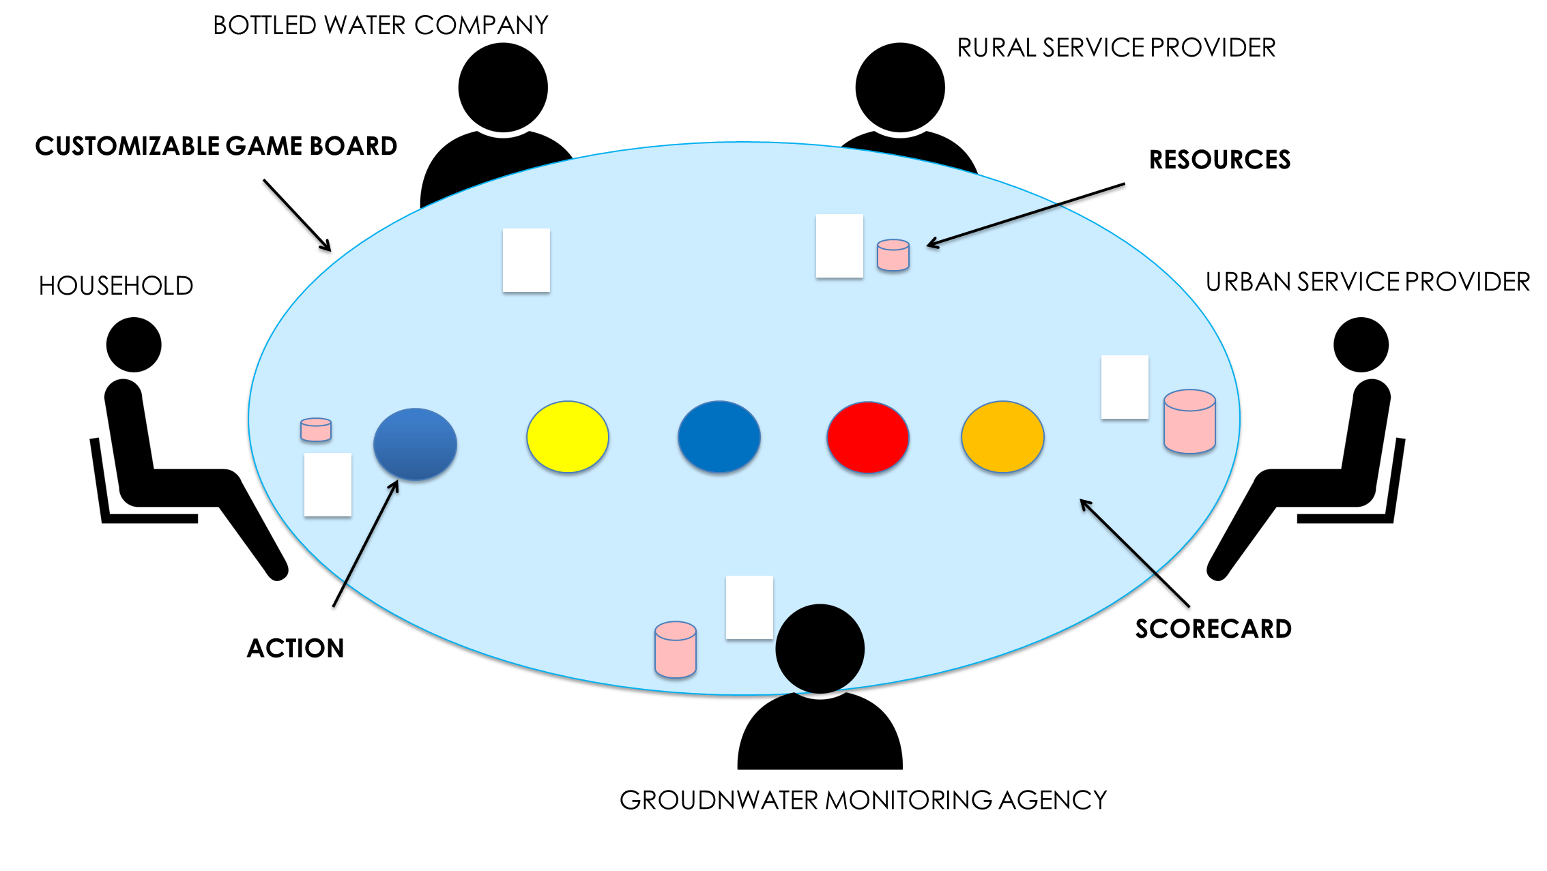
GAME BASED SIMULATION
STEP 4
Translate models into role-playing game

Slide 11
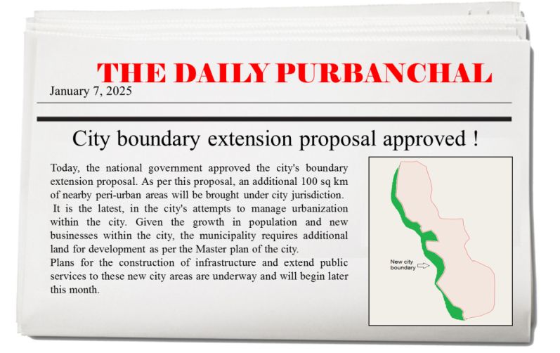
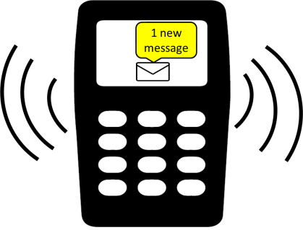
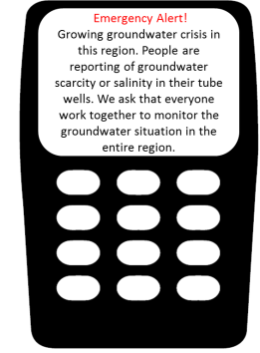
Session 1 Peri-urban drinking water supply
Round 1
Round 2
Session 2 Urban drinking water supply
Round 1
Round 2
Round 3
Round 3
Session 3 Groundwater monitoring
Individual monitoring
Joint monitoring
De-briefing
Introduction
2. IMPLEMENTATION
Participants play the role of one of the actors involved in peri-urban drinking water supply
Situation: peri-urban village residents explore strategies to improve drinking water access
Players evaluate the outcome of each round
Workshop Structure

Slide 12
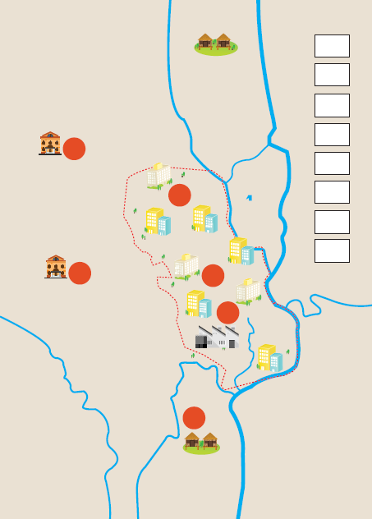
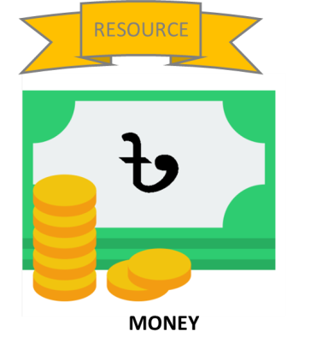
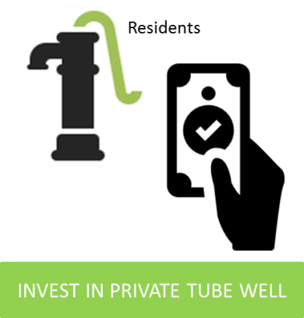
COMMUNITY WORKSHOP
March 27, 2018
One day workshop in Khulna city
9 participants (Male/ Female)
Residents from peri-urban village near Khulna
In collaboration with JJS, Khulna
Game translated by JJS into Bangla
Training of workshop facilitators
Facilitated by JJS project members
Sample game materials (below)

Slide 13
3. EVALUATION DESIGN
Learning
Post-session evaluation
Gaming-simulation method
Observations
Game structuring exercise
Real-world comparison & game materials (De-briefing)
Workshop
Post-workshop evaluation
Facilitation
Clarity & Process (De-briefing)
Pre-workshop evaluation

Slide 14
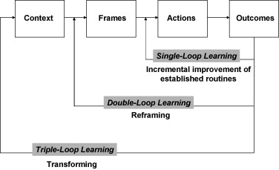
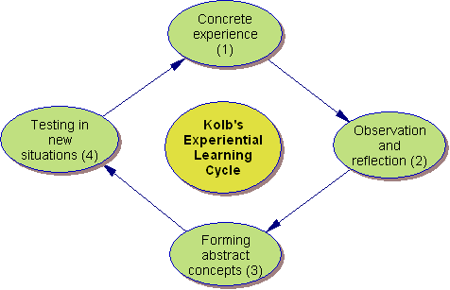
CURRENT WORK
Fig. 1
Identify the learning outcomes of this approach (RQ 2)
Several theories available for evaluating learning
Argyris & Schön (1974), Pahl- Wostl (2009) Fig. 1
Moser and Luers (2008) Fig. 2
Kolb (1984) Fig. 3
Fig. 3
Analysis
Awareness
Action
Fig. 2

Slide 15
PARTICIPANT EXPERIENCES
Play video to listen to participant feedback

Slide 16
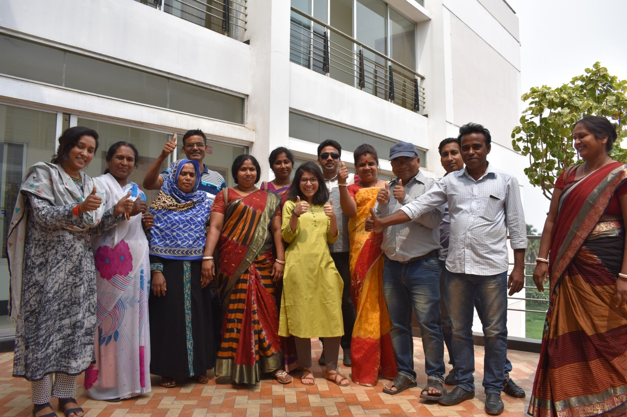
THANK YOU
To follow my research or learn more about this project please visit

Slide 17
PUBLICATIONS
1. Gomes, S. L., Hermans, L.M., Thissen, W.A.H. (2017). Extending community operational research to address institutional aspects of societal problems: Experiences from peri-urban Bangladesh. European Journal of Operational Research. Advance online publication. doi:10.1016/j.ejor.2017.11.007
2. Gomes, S. L., & Hermans, L. M. (2017). Institutional Function and Urbanization in Bangladesh: How Peri-urban Communities Respond to Changing Environments. Land Use Policy. Advance online publication. doi:10.1016/j.landusepol.2017.09.041
Online Link: https://www.sciencedirect.com/science/article/pii/S0264837717300571?via%3Dihub

