Slide 1
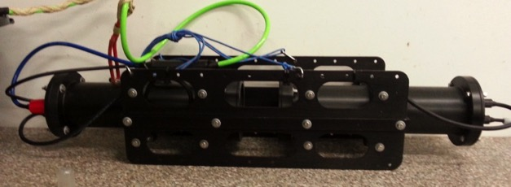
Background
Illuminating Lake Ecosystems project
Why
High resolution in situ measurements
Welcome to the menu
Please select which box you want to open
use the yellow previous or next buttons to navigate between boxes; or
return to this menu slide by pressing the red cross
Also, most slides are interactive or have animations, animations you can play and replay using the orange start animation button. Check them out!
How
Making high resolution in situ measurements
You like it?
Contacts & more
Results
The difference between old and new
Processing
Images to numbers and objects to classes
CNN
The computer classifying objects
Profile data
Differences between day and night

Slide 2
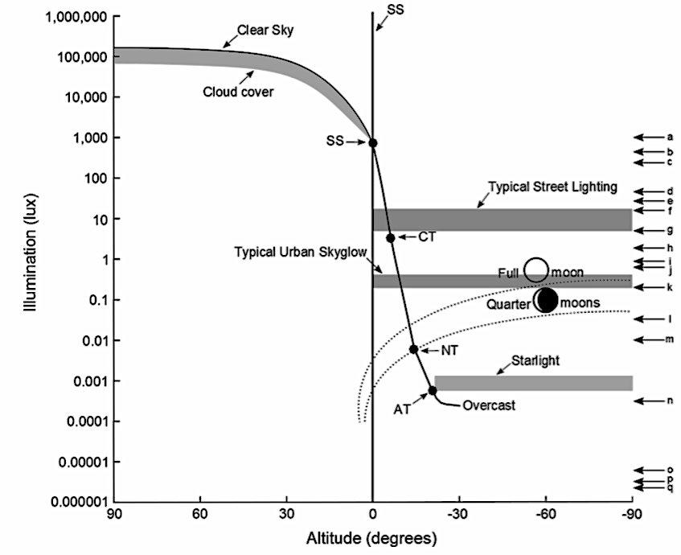
Background Illuminating Lake Ecosystems project
In lakes, natural light is essential for triggering diel rhythms, as well as rhythms on other times scales, such as lunar and seasonal cycles. In deep lakes, one such rhythm is the diel vertical migration of zooplankton (including water fleas) and fish. Under natural conditions, water fleas reside in deep water layers during the day to avoid predation by visual predators. At night, they migrate towards the water surface to feed on algae. Skyglow can dramatically reduce this diel vertical migration. However, the extent to which such behavioural changes of water fleas affect planktonic food web interactions and the productivity of freshwaters is completely unclear.
The project “Illuminating Lake Ecosystems” seeks to elucidate these phenomena. We will experimentally control the level of skyglow in the IGB LakeLab to assess complex responses of lake ecosystems to this perturbation. We expect that the new light conditions affecting the physiology and behaviour of key species will result in multiple indirect effects mediated by species interactions. Consequently, the lake food web and biogeochemical fluxes could be markedly altered. We expect our results to provide fundamentally new insights into lake ecosystems and at the same time important information for future lake management in the face of ongoing light pollution.
Bergman (1988)
European perch 0,02 lux
Daphnia 0,01 lux Flik et al. (1997)
Next

Slide 3
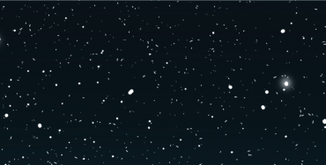
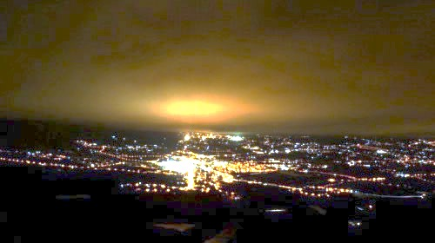
Why high resolution in situ measurements
Day
Night
Our aim:
Study migration response of zooplankton behaviour induced by low light levels
Method unable to reveal actual effects!
Why high resolution measurements:
With “normal” net sampling we can’t in situ measure a weak response variable
(see animation)
Previous
Run animation
Next

Slide 4
How Making high resolution in situ measurements
The Mine Deep Plankton Imager:
We use a Mini Deep Plankton Imager to image the depth profile as it’s being lowered (see animation)
Previous
Run animation
Next

Slide 5
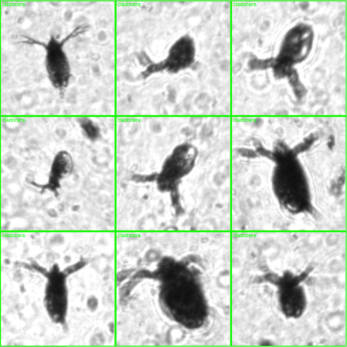
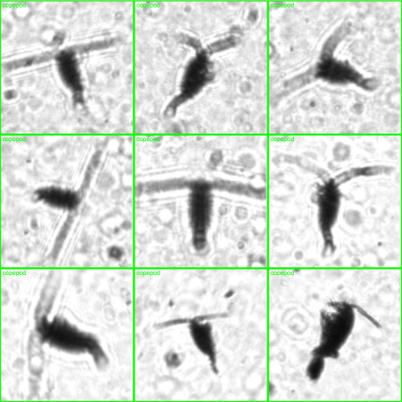
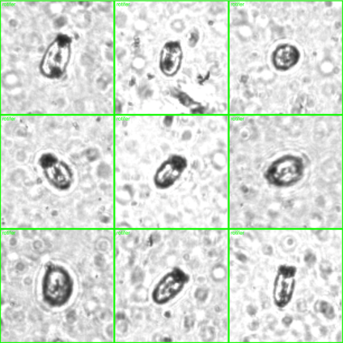
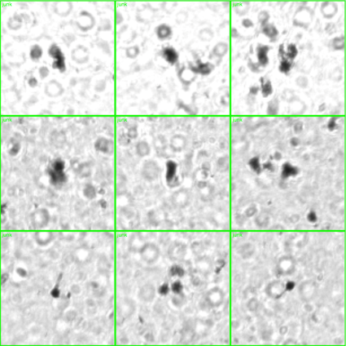
Cladocera
Processing Image to numbers and objects to classes
Copepod
Each image goes through a processing “pipeline”. (start animation)
First we have the RAW images
We increase objects to background contrast using flat-fielding
Detect objects within our set “region of interest” (size, pixel intensity, etc.)
Classify the detected objects using a convolutional neural network
Start animation
This video might cause migraines or motion sickness
Rotifer
Other
Previous
Next

Slide 6
Day
Profile data Differences between day and night
Depth
(m)
Night
0
5.0
7.5
10.0
12.5
PLAY
Previous
Next

Slide 7
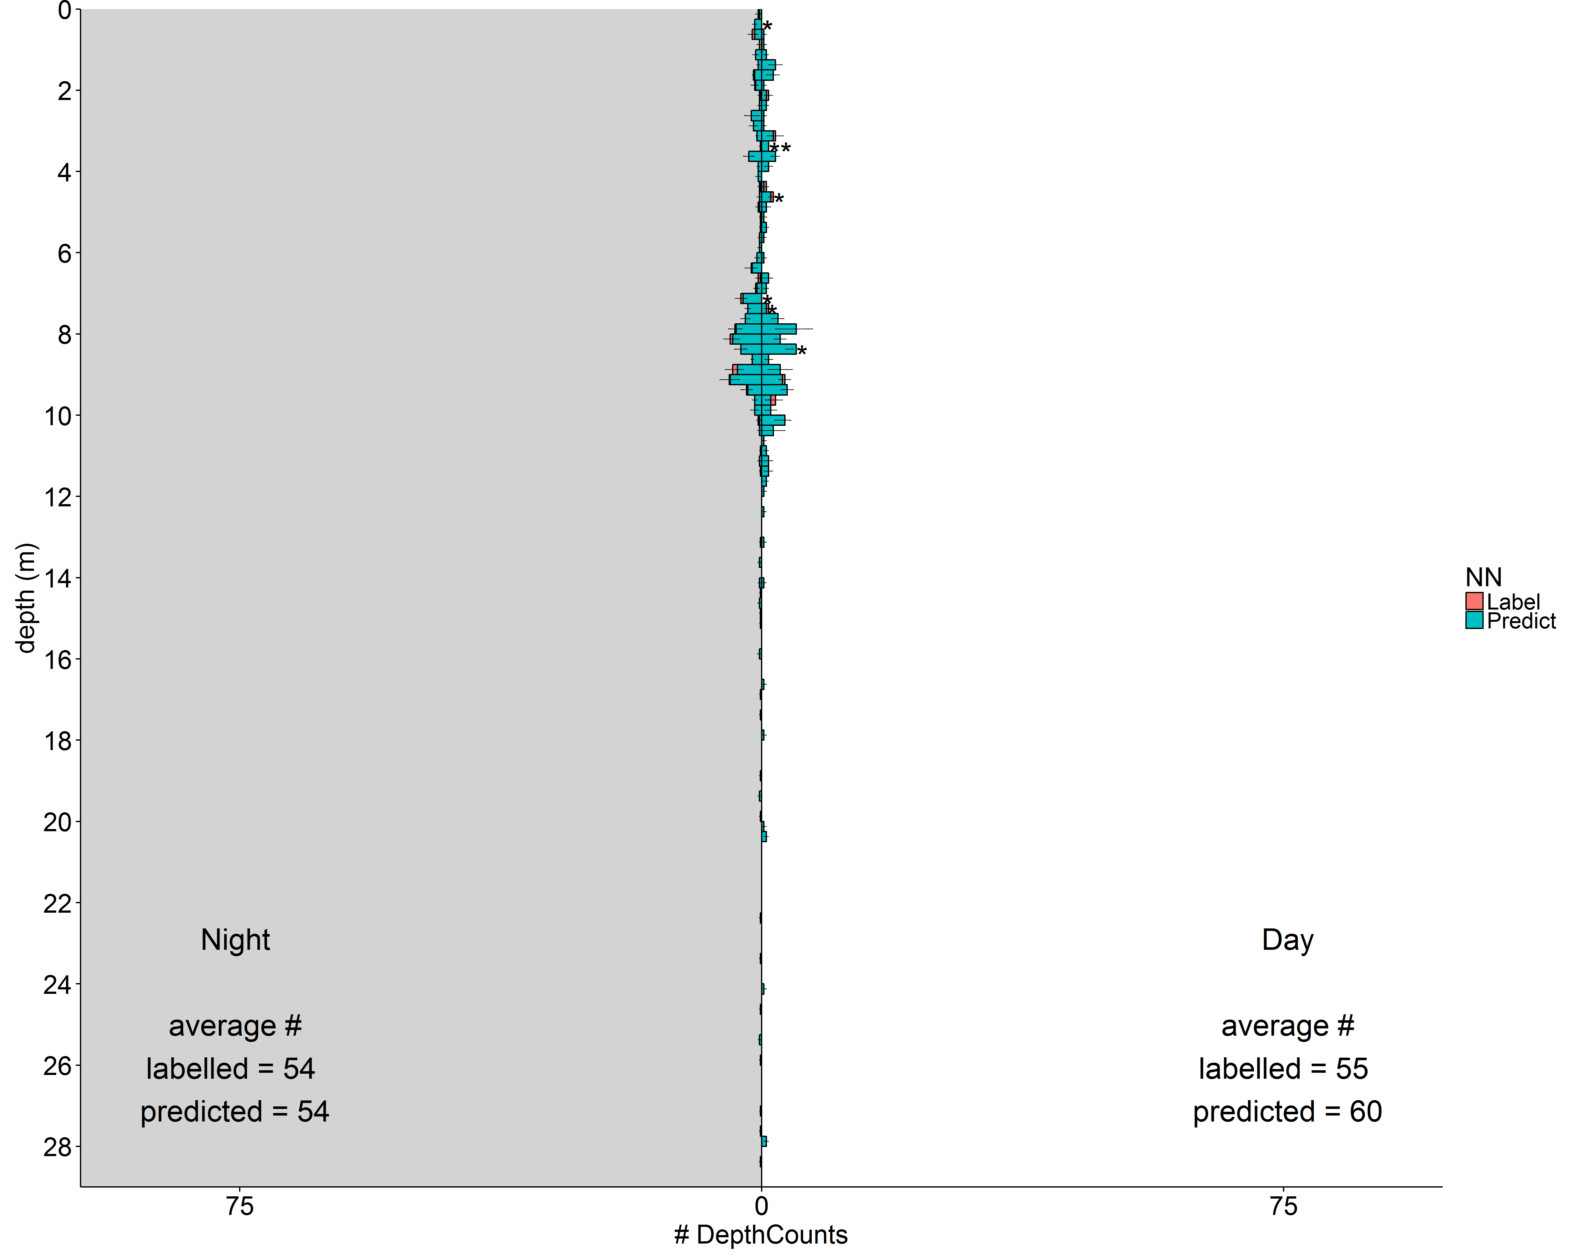
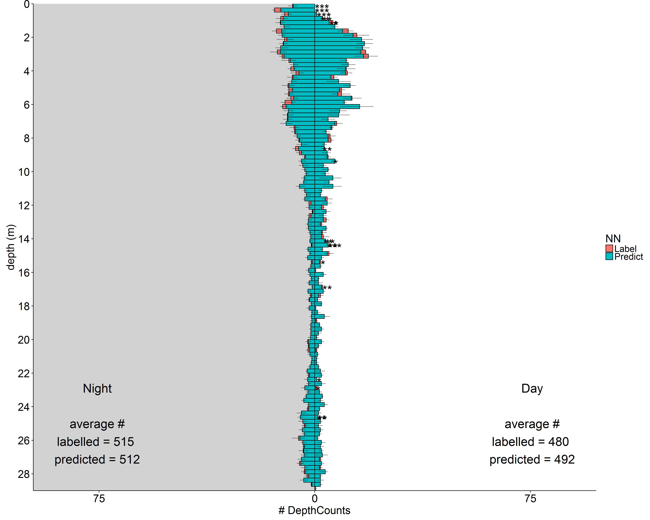
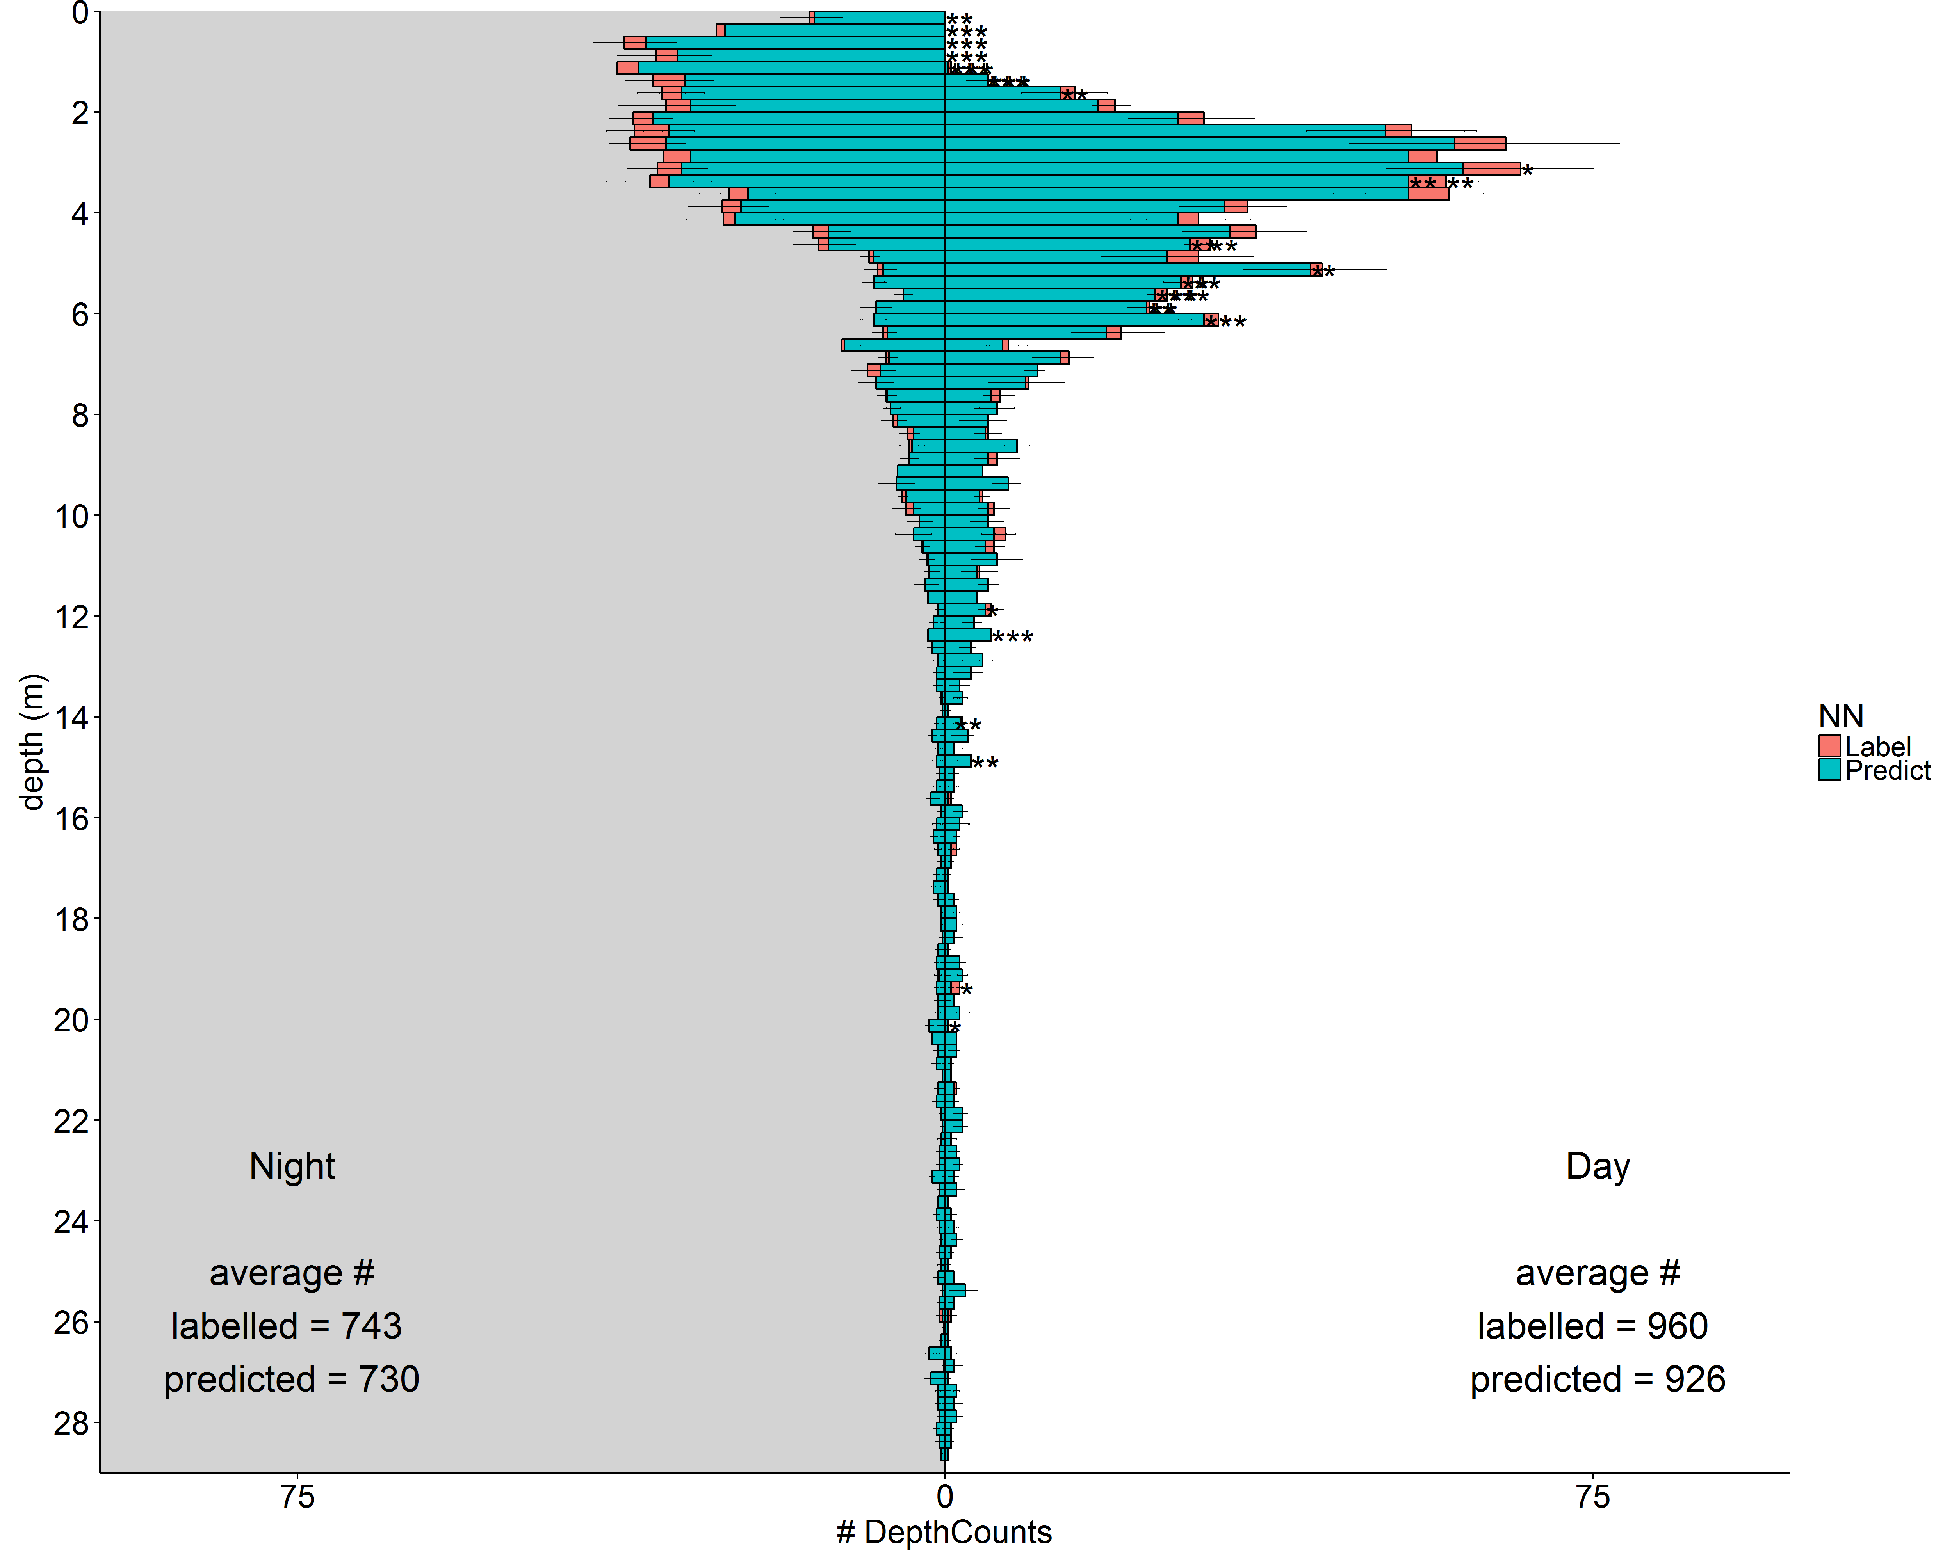
CNN The computer classifying objects
Accuracy:
The CNN classifies with 84% accuracy
Number of classes:
Our CNN classifies 4 classes:
Cladoceran
Copepod
Rotifer
Rest
Red = human labelled
Cyan = CNN predicted
Cladocera
Copepod
Rotifer
Previous
Next

Slide 8
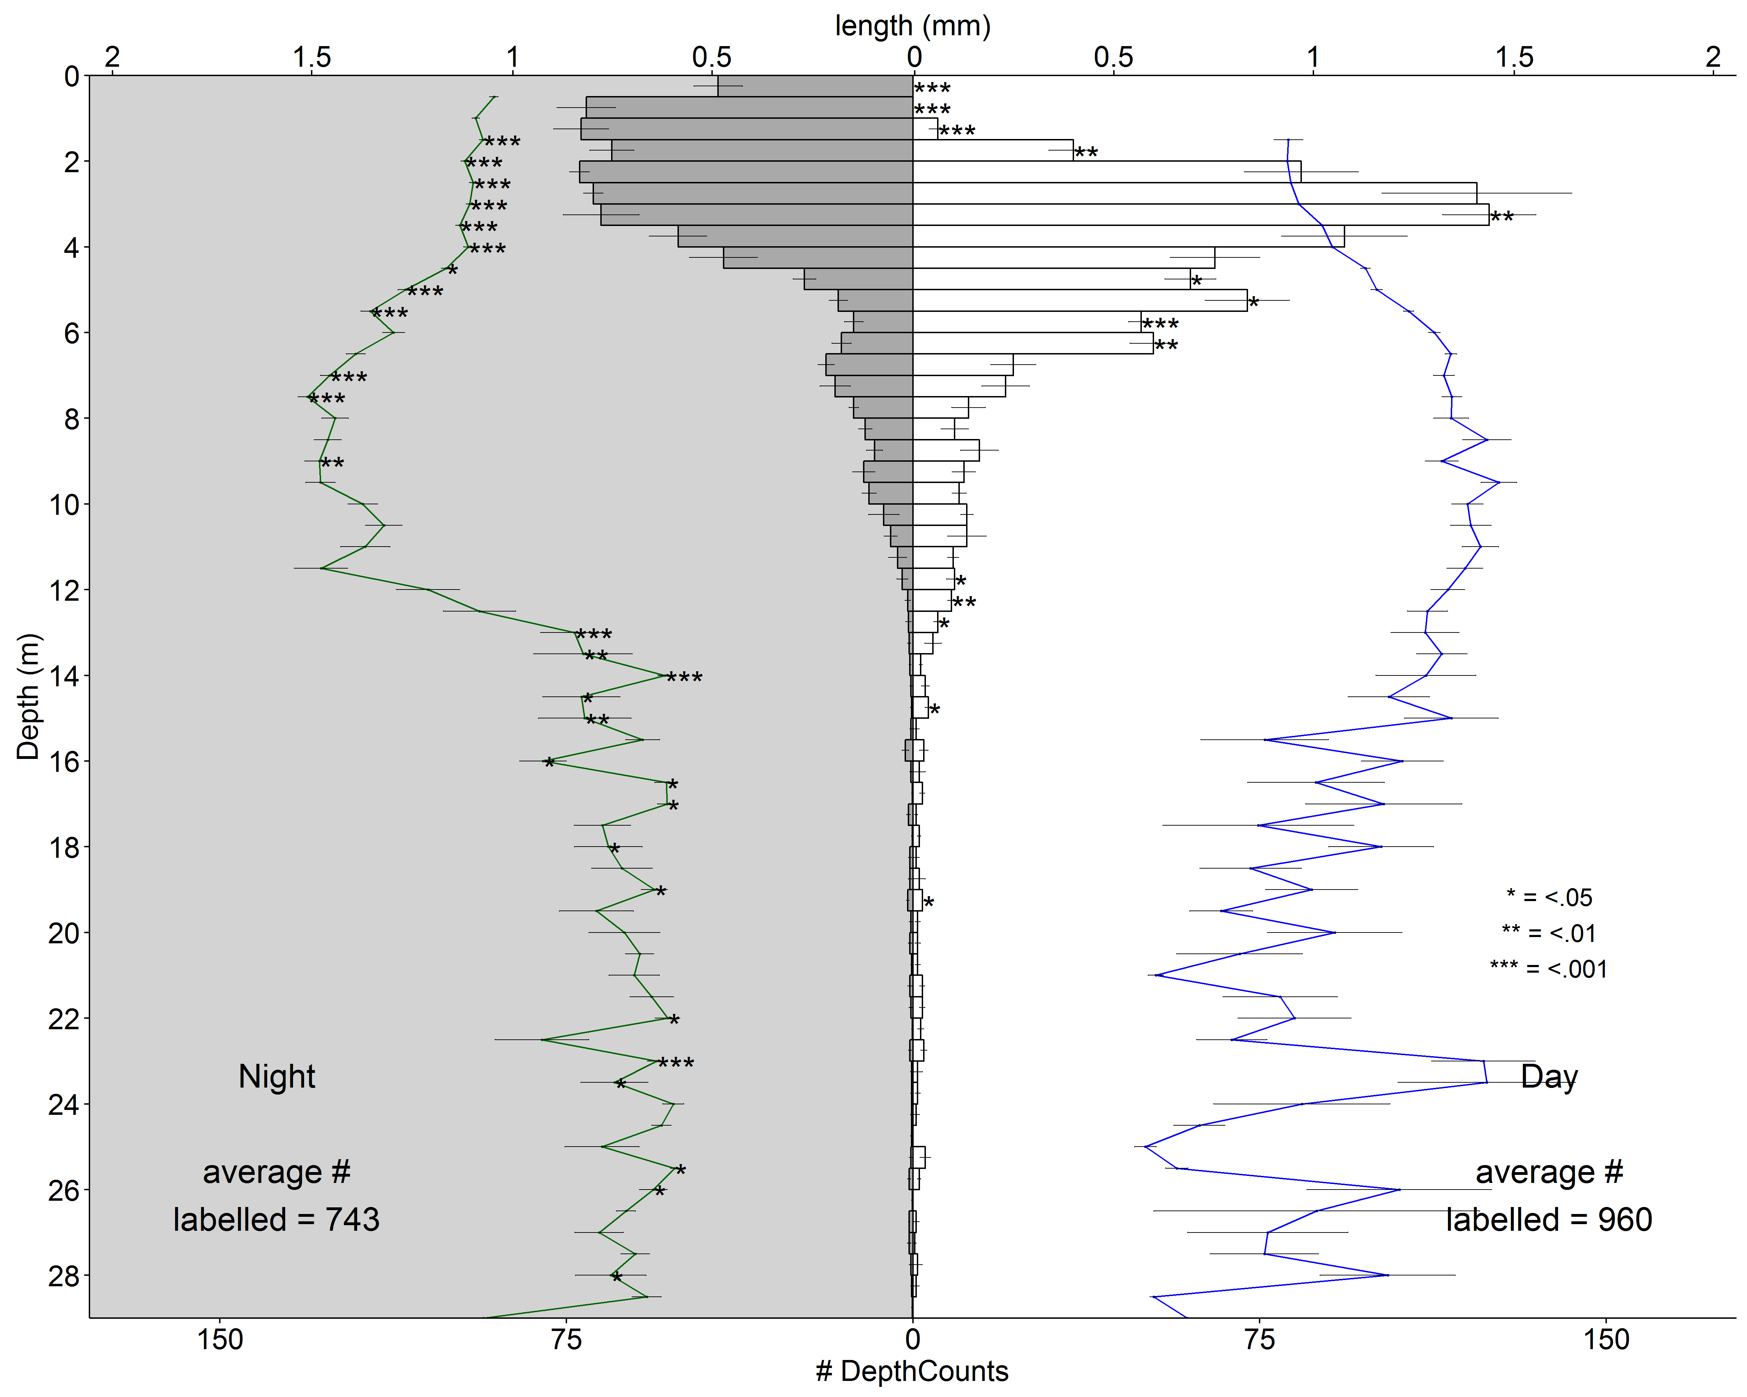
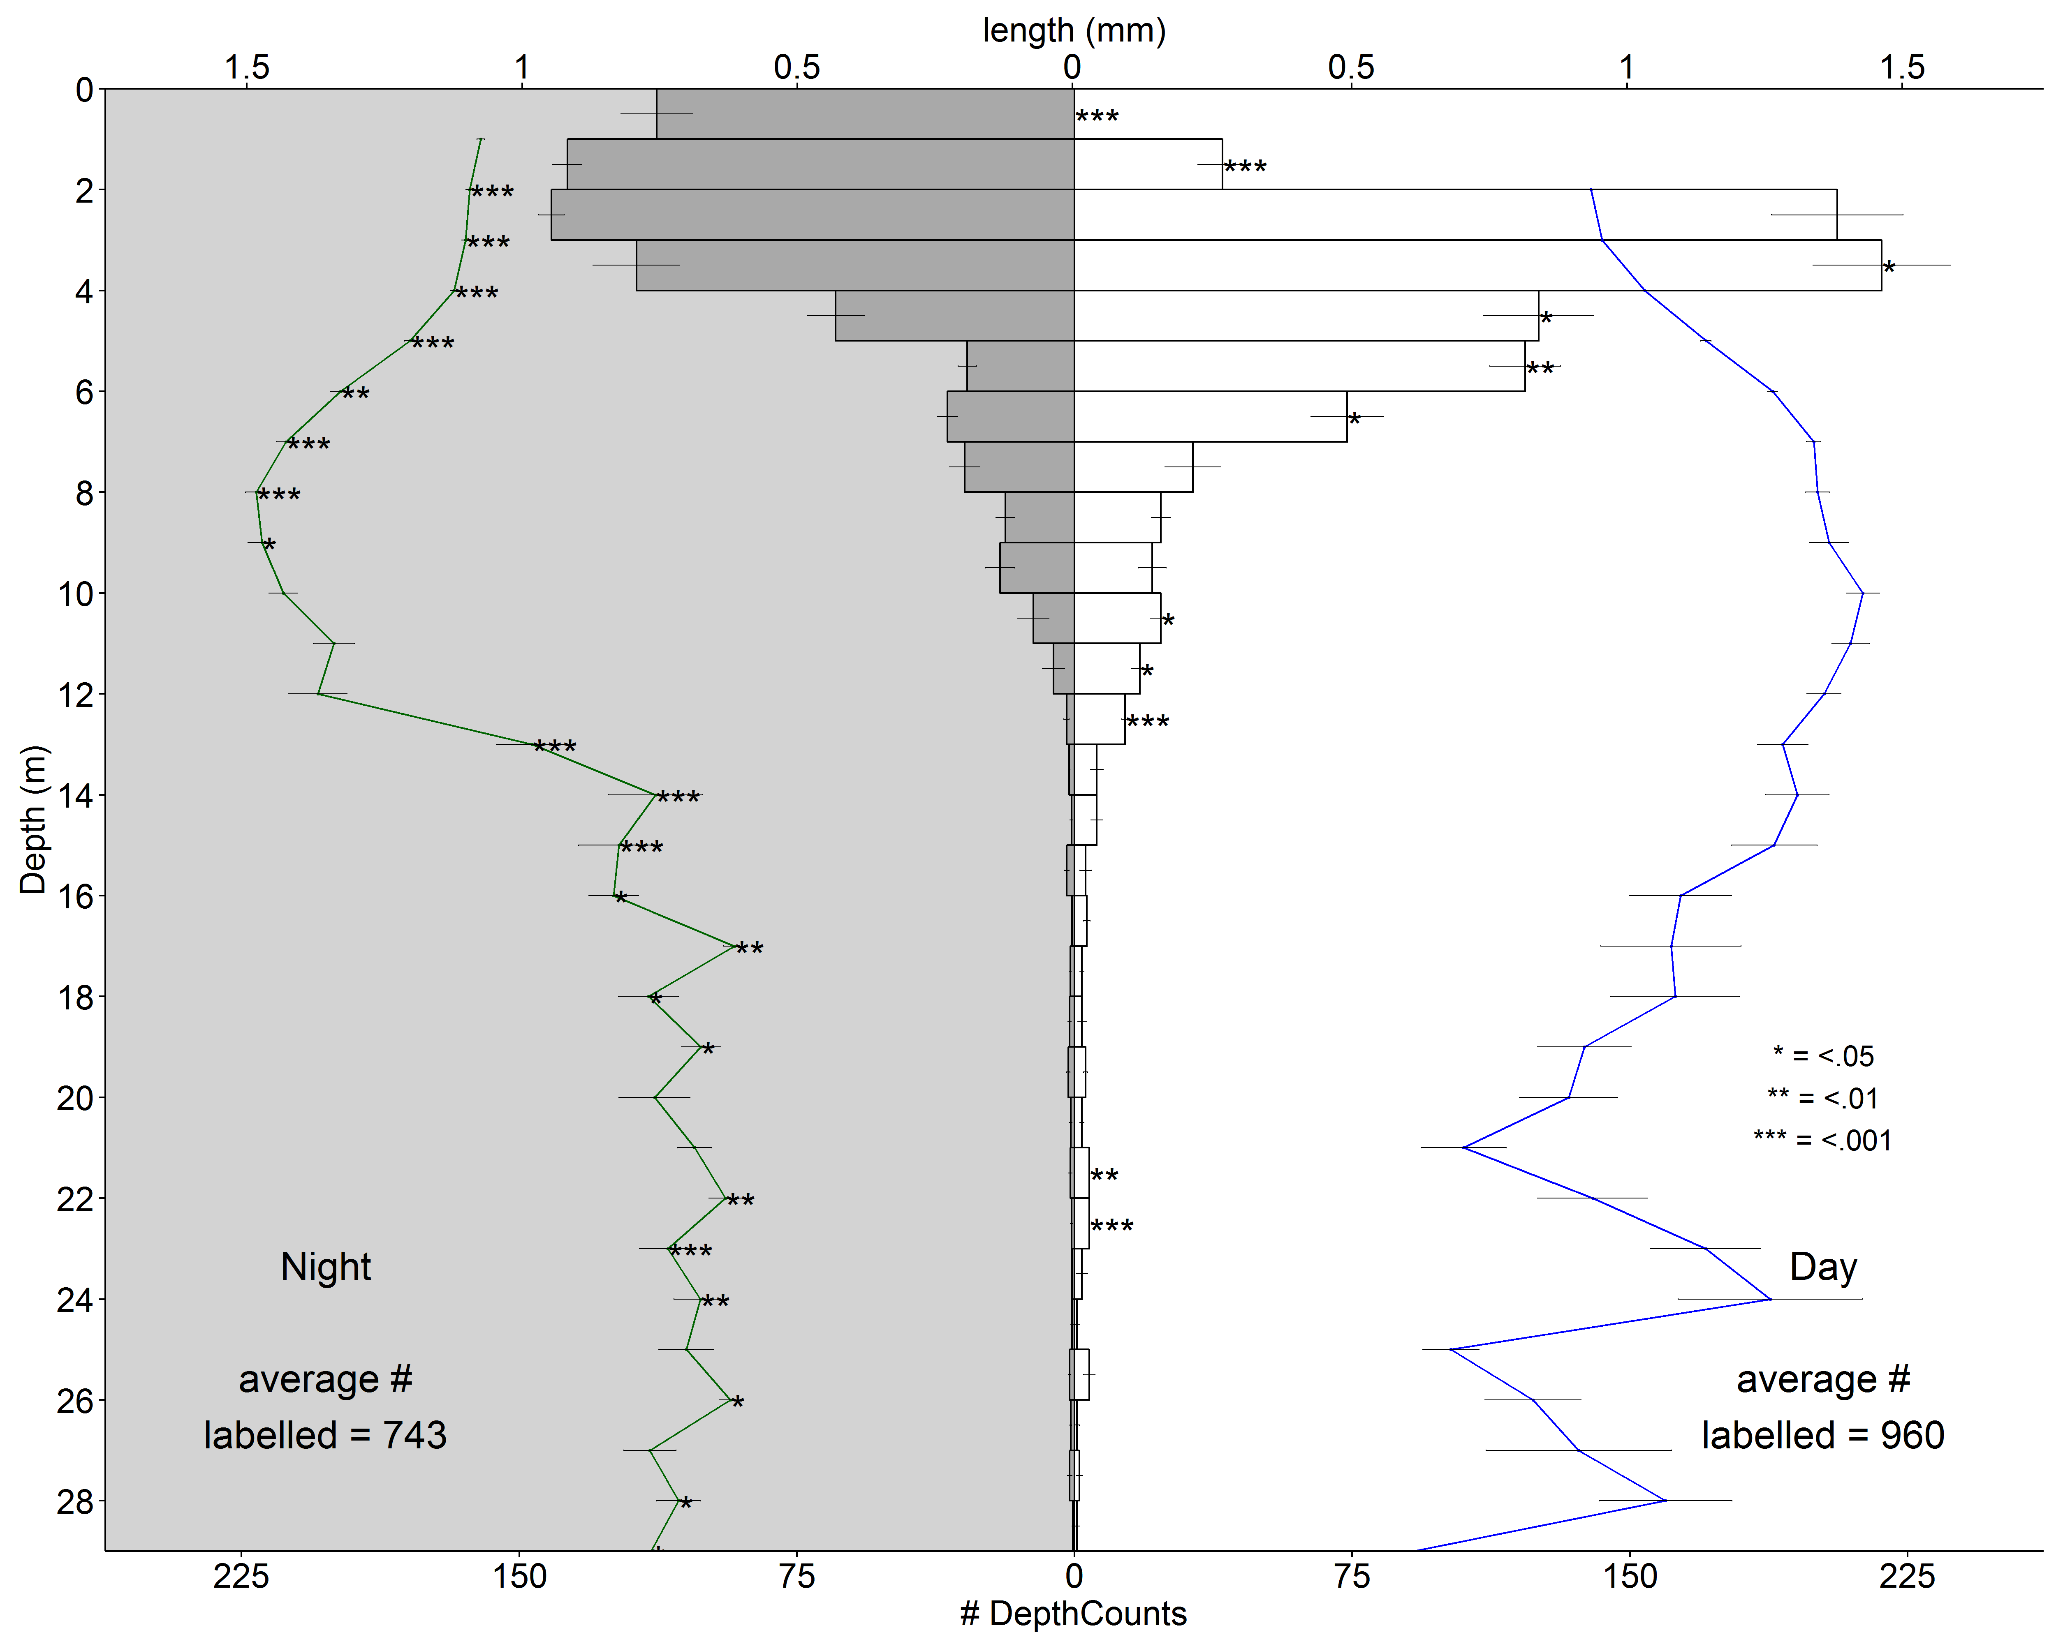
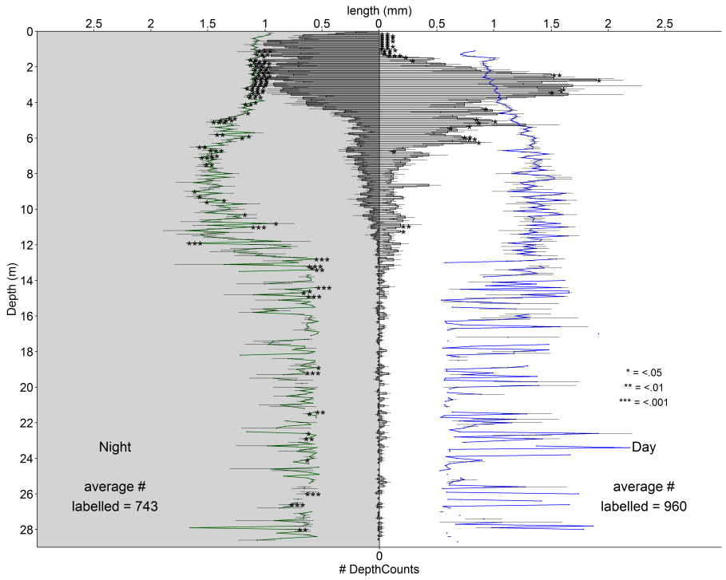
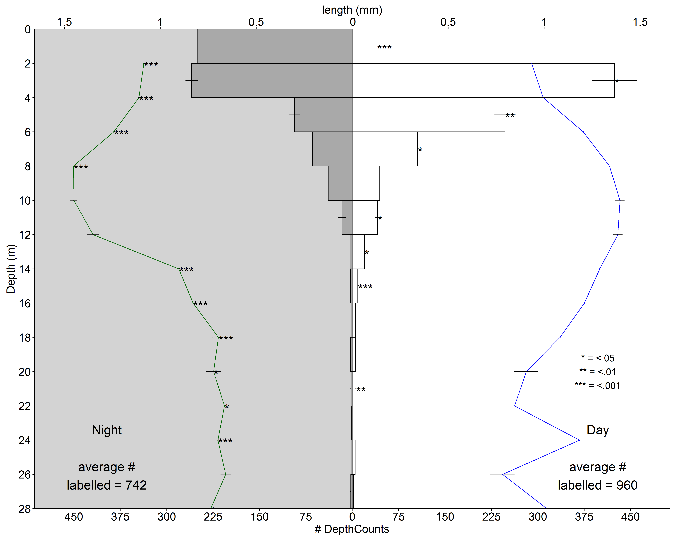
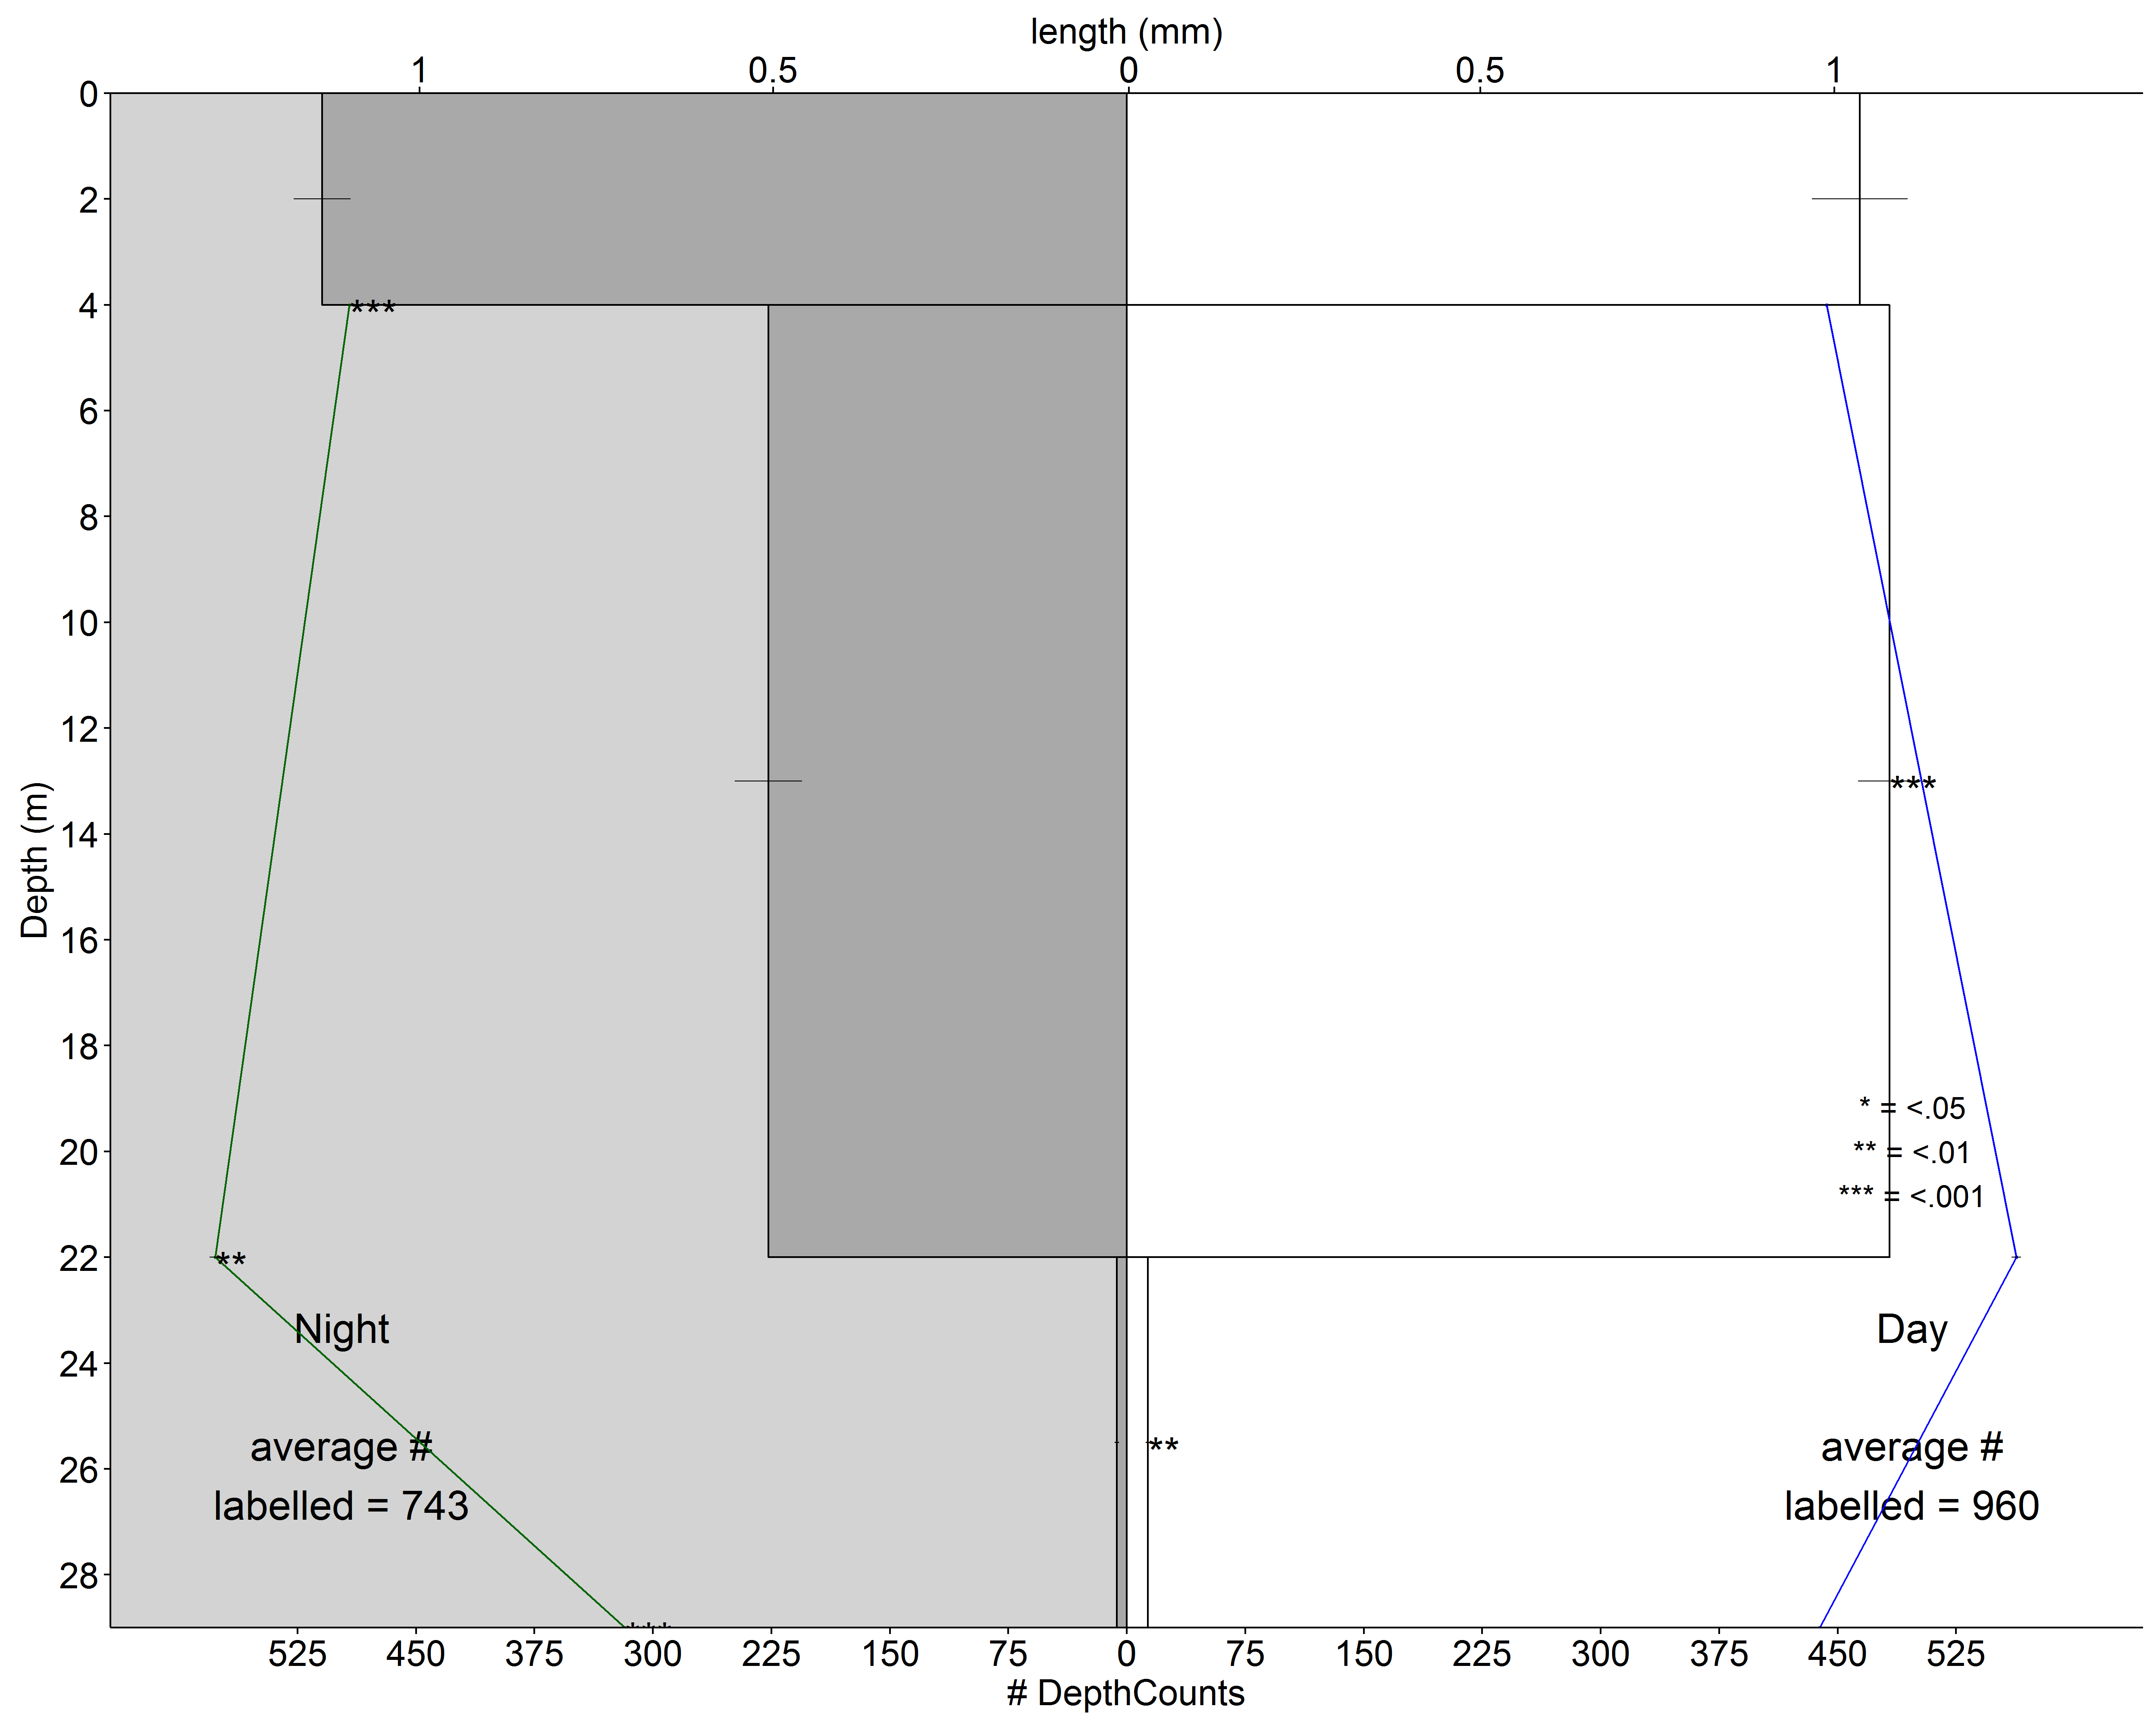
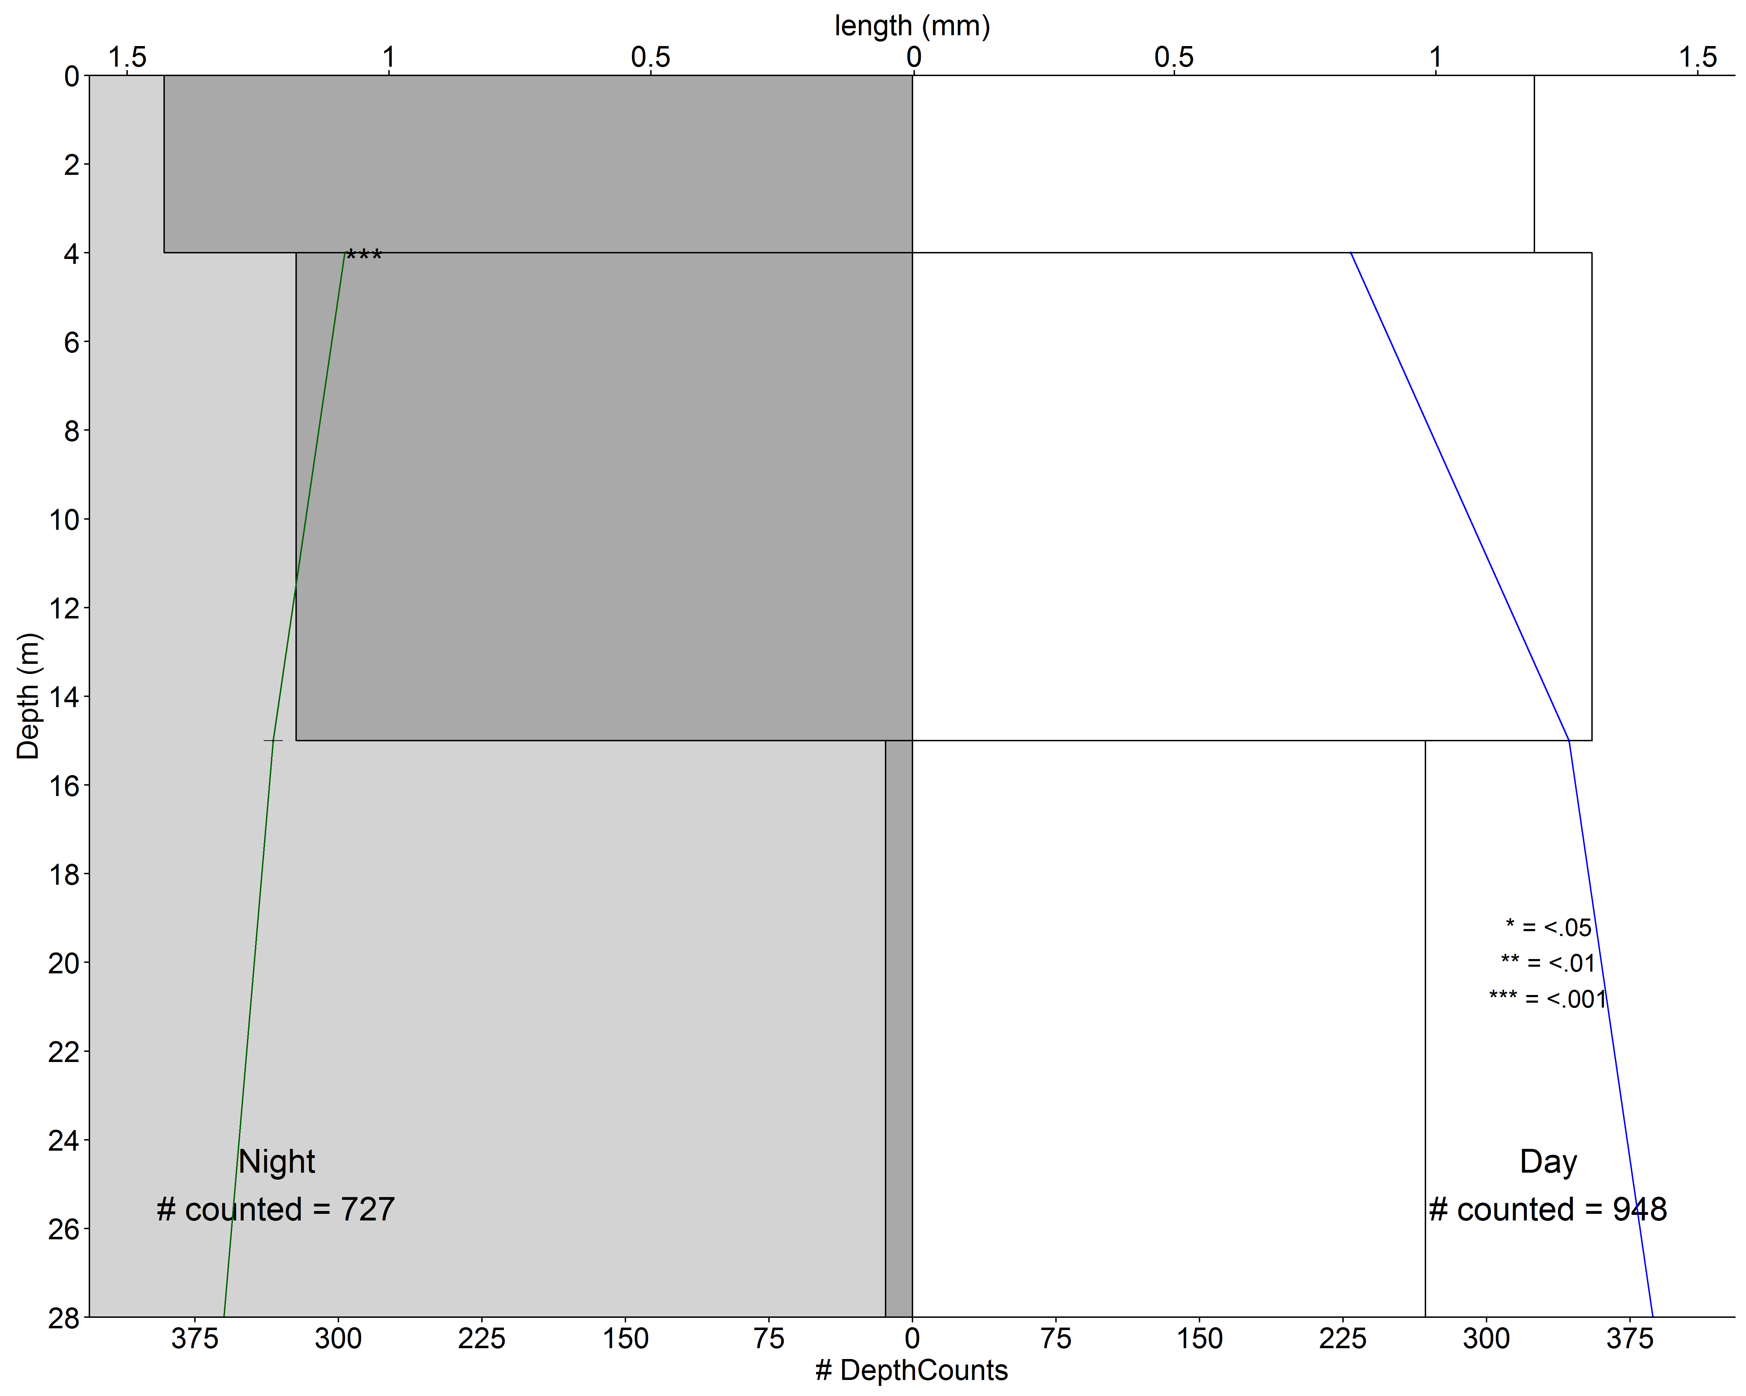
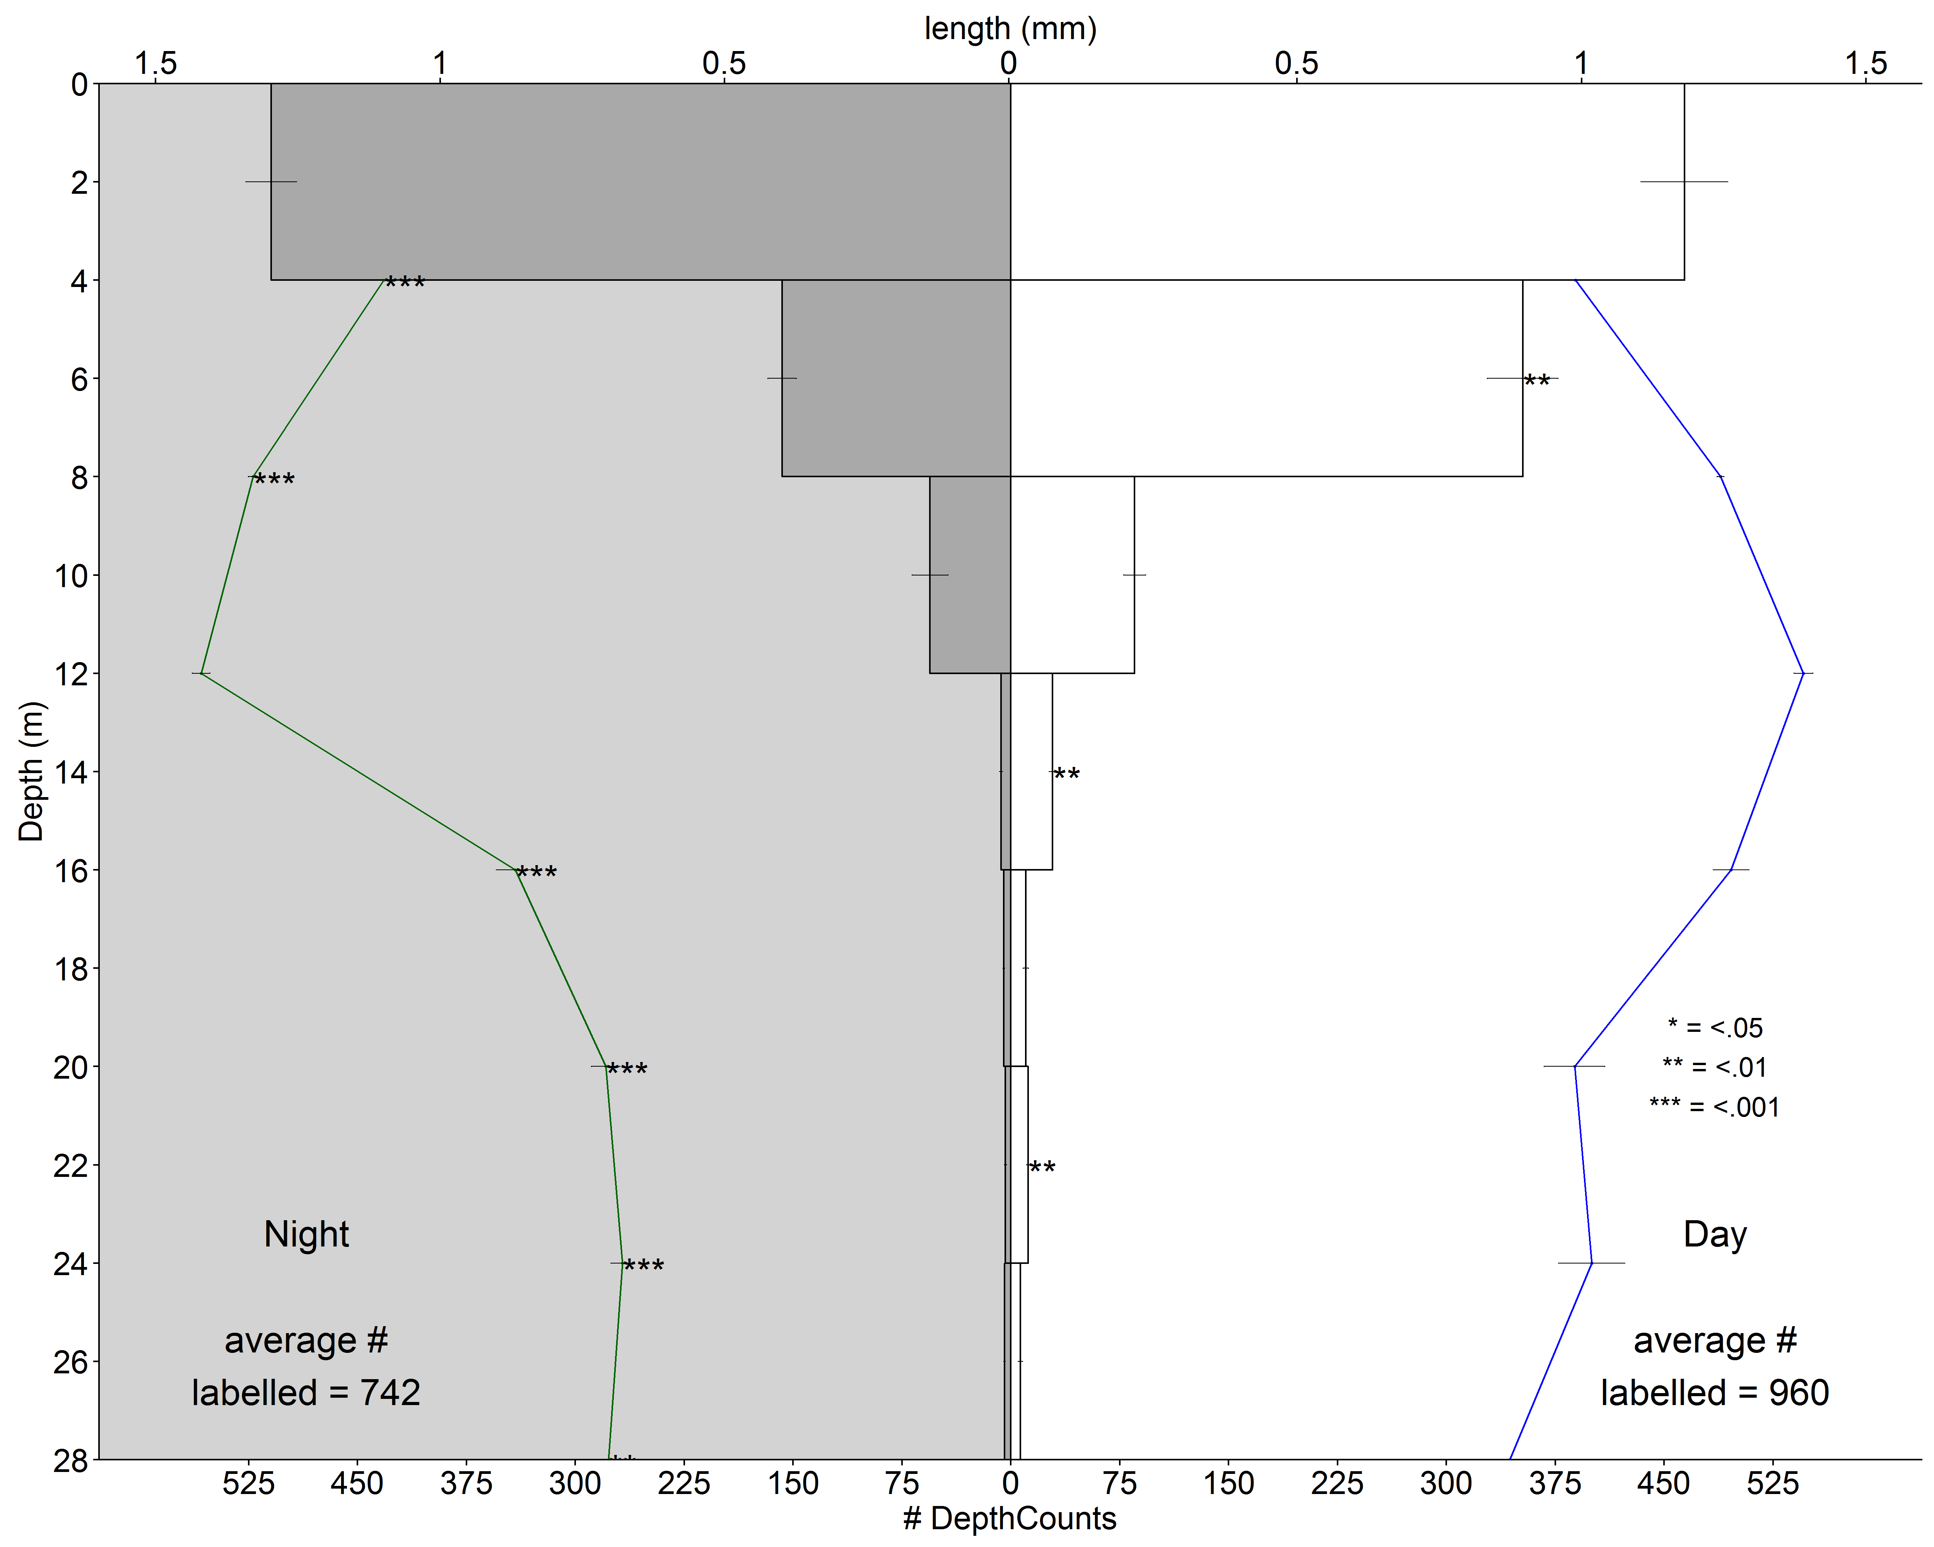
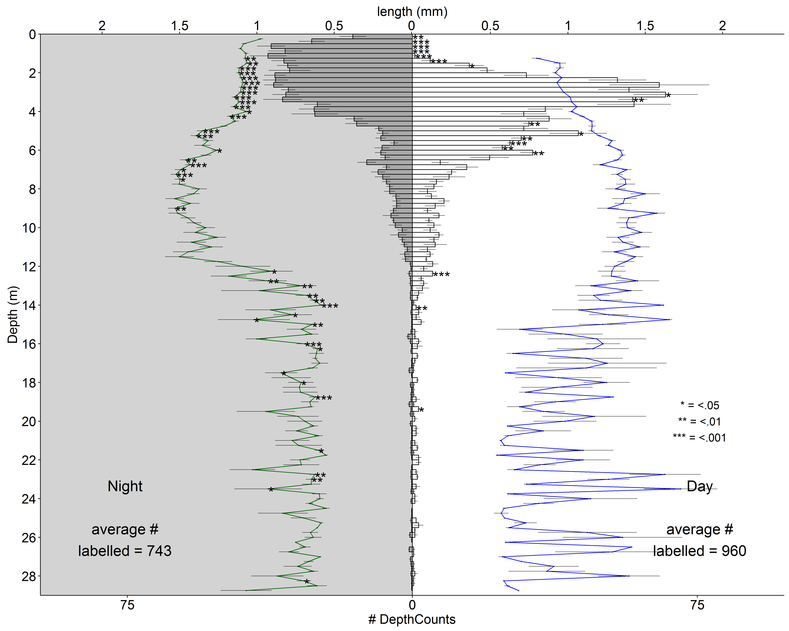
Net sample
Results - The difference between old and new
MDPI – depth bin = net
MDPI – depth bin = 4.00 m
MDPI – depth bin = 2.00 m
MDPI – depth bin = 1.00 m
MDPI – depth bin = 0.50 m
MDPI – depth bin = 0.25 m
MDPI – depth bin = 0.10 m
Bar = # Counts
Line = average size (mm)
Decrease resolution
Decrease resolution
Decrease resolution
Decrease resolution
Decrease resolution
Decrease resolution
Increase resolution
Increase resolution
Increase resolution
Increase resolution
Increase resolution
Increase resolution
Previous
Next

Slide 9
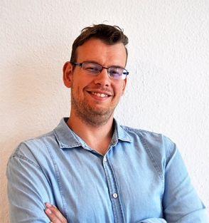
Leibniz-Institute of
Freshwater Ecology and inland Fisheries
Institute of Hydrobiology
Check out our blog on Research Gate and stay updated! Just search:
Automatic species identification using deep learning methods
(also check it when you’re curious about our backgrounds)
High-resolution automated approaches to study
in situ mesozooplankton abundance and migration
Back to menu
Tim Walles¹, Ghassen Bacha², Erik Bochinski², Volker Eiselein², Jens Nejstgaard¹
¹Leibniz-Institute of Freshwater Ecology and Inland Fisheries (walles@igb-berlin.de), Experimental Limnology IGB,
²Communication Systems Group, Technische Universität Berlin

