Slide 1
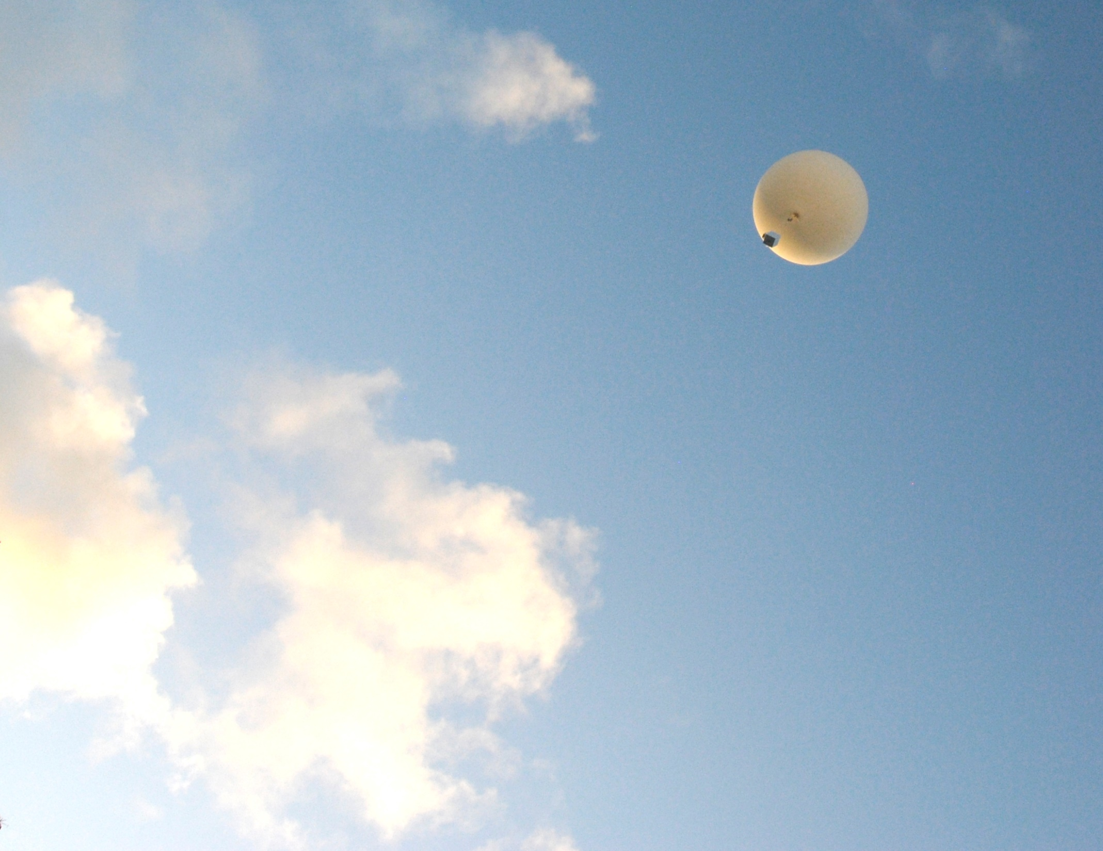
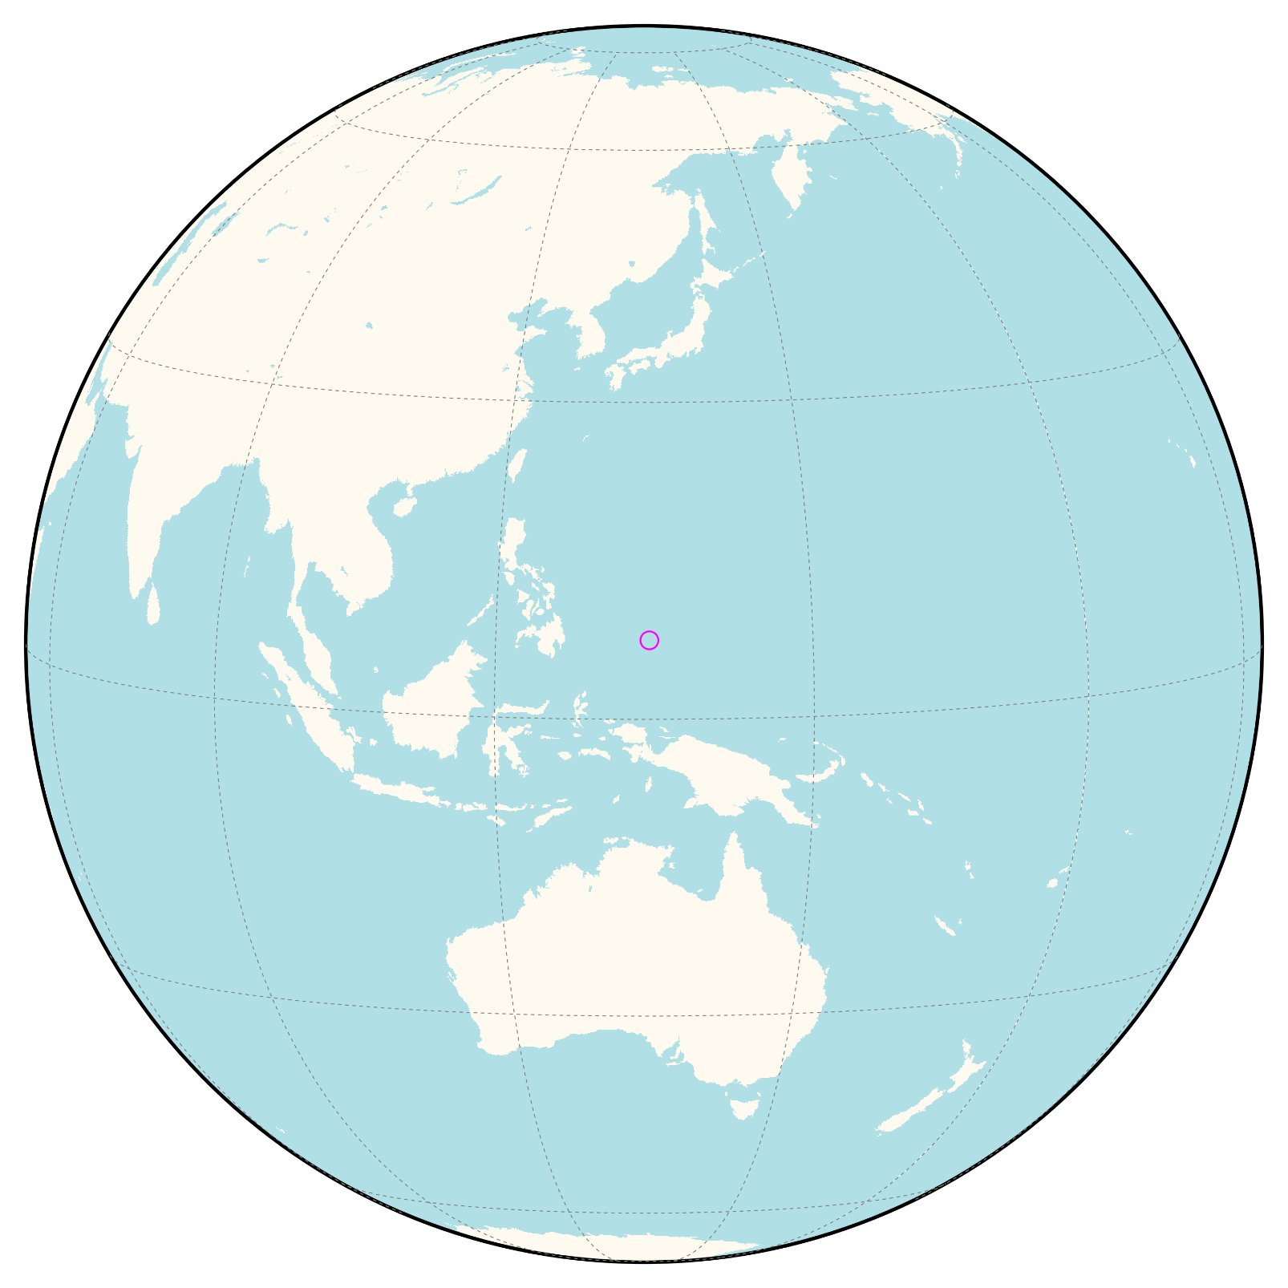






Balloon-borne Tropospheric Ozone Measurements from a New Station in Palau (Tropical West Pacific)
Why Palau?
Obvious reasons…
Katrin Müller, Peter von der Gathen,
Ingo Wohltmann, Ralph Lehmann
and Markus Rex
EGU GA AS3.19 10.04.2019
Contact: Katrin.Mueller@awi.de
Want to know the real reasons?
PICO 5a.12
Images by Katrin Müller(KM)
This project is
funded by the EU

Slide 2
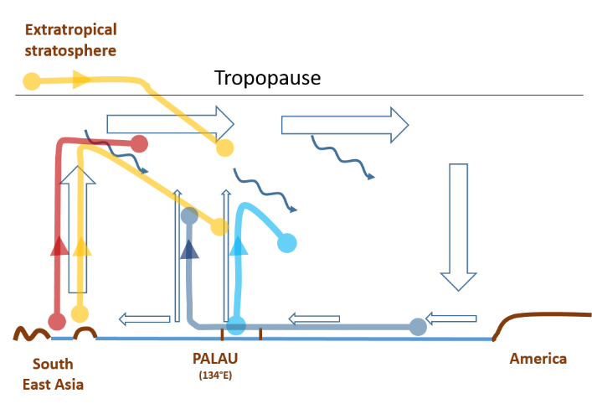
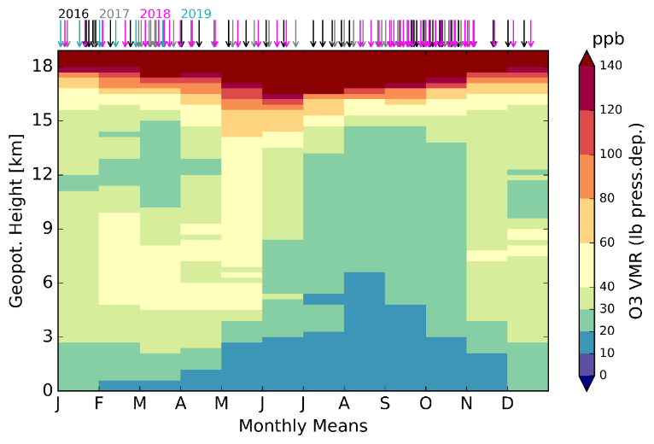
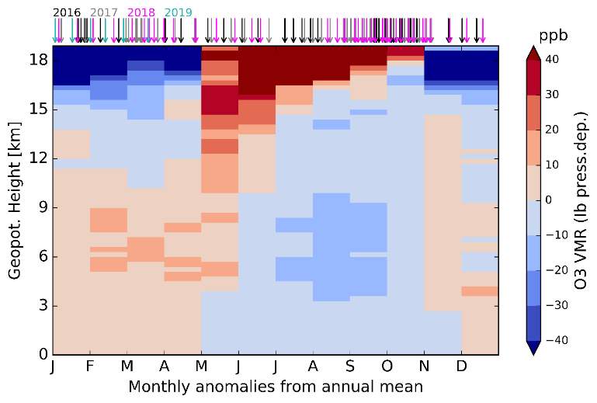
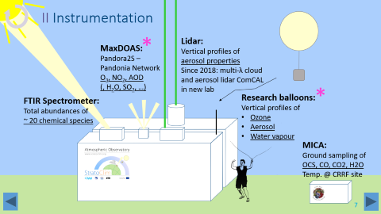
The Tropical West Pacific: Research Motivation
Palau
Atmospheric Observatory
Data Overview
Tropospheric O₃ Variability
Transport and Origin of Airmasses
PICO 5a.12
Contact: Katrin.Mueller@awi.de
This project is
funded by the EU

Slide 3
Balloon-borne Tropospheric Ozone Measurements from a New Station in Palau (Tropical West Pacific)
SUMMARY
The Tropical West Pacific: Research Motivation
Palau
Atmospheric Observatory
Data Overview
Tropospheric O₃ Variability
Transport and Origin of Airmasses
Katrin Müller, Peter von der Gathen, Ingo Wohltmann,
Ralph Lehmann and Markus Rex
I
V
Clockwise presentation
– or pick a „cloud“ of interest!
NAVIGATION
II
Main Menu
More Info / Back
Change Slides
IV
/ x
*
Contact: Katrin.Mueller@awi.de
Images by Katrin Müller(KM)
III
*
This project is
funded by the EU

Slide 4
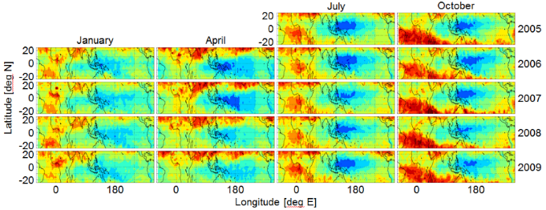

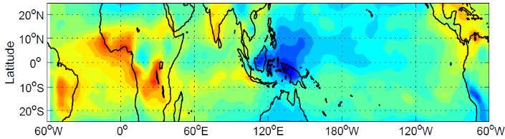
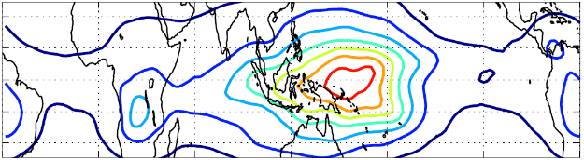
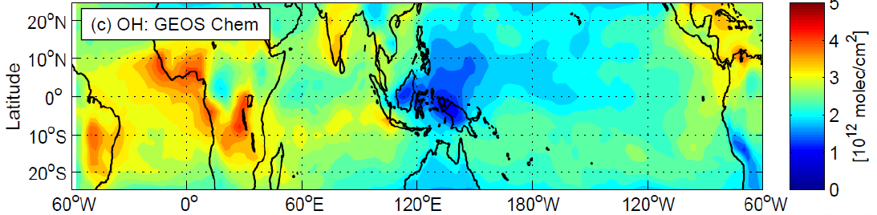
I The TWP: Research Motivation
Major source region* for stratospheric air in
boreal winter
(e.g. Fueglistaler et al. 2004)
Persistent tropospheric Ozone minimum*
(Rex et al. 2014)
Origin and transit region* of corresponding air masses in boundary layer and troposphere
(Rex et al. 2014)
Corresponding
OH minimum* and prolonged life times of various chemical species
(e.g. Kley et al. 1996)
Image: Markus Rex
$$O_{3}+hv→O({}_{}^{1}{D)+}O_{2}$$
$$O({}_{}^{1}{D)+H_{2}O→OH+OH}$$
SO₂ gas phase
lifetime [days]
25
7
GEOS Chem:
tropos. OH column

Slide 5
I The TWP: Research Motivation
Major source region* for stratospheric air in
boreal winter
(e.g. Fueglistaler et al. 2004)
Persistent tropospheric Ozone minimum*
(Rex et al. 2014)
Atmospheric Dynamics
Atmospheric Chemistry
Origin and transit region* of corresponding air masses in boundary layer and troposphere
(Rex et al. 2014)
Corresponding
OH minimum* and prolonged life times of various chemical species
(e.g. Kley et al. 1996)
Image: Markus Rex
$$O_{3}+hv→O({}_{}^{1}{D)+}O_{2}$$
Lack of (continuous) measurements: gap* in the observational network
$$O({}_{}^{1}{D)+H_{2}O→OH+OH}$$
SO₂ gas phase
lifetime [days]
Important region for supply
of chemical species
to the stratosphere*
25
7
GEOS Chem:
tropos. OH column

Slide 6



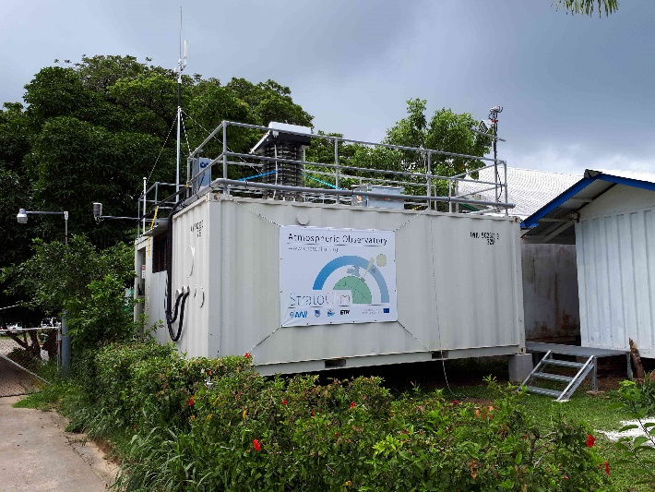




II Palau Atmospheric Observatory
Established in 01/2016 as part of the
EU-project StratoClim with several international and local partners (see below),
second container with ComCAL Lidar system added in fall 2018,
continuation until (at least) 2021
Located in the Tropical West Pacific warm pool, 7.34 N 134.47 E, 23 m a.s.l.
two 20 foot lab containers in downtown Koror, Palau, at the local community college
Stratospheric and upper tropospheric processes for better
Climate predictions
StratoClim is part of a European Research cluster on aerosols with funding from 2013 – 2019
Main research focus: dynamics and chemistry of pathways to the stratosphere, mainly in the Asian Monsoon region
*
More photo impressions
All data will be available after the completion of the project (~ mid 2019) - and any time upon request
Contribution to SHADOZ network avisioned
Image: Ingo Beninga

Slide 7


II Instrumentation
*
Lidar:
Vertical profiles of
aerosol properties
Since 2018: multi-λ cloud
and aerosol lidar ComCAL
in new lab
MaxDOAS:
Pandora2S –
Pandonia Network
O₃, NO₂, AOD
(, H₂O, SO₂, …)
*
FTIR Spectrometer:
Total abundances of
~ 20 chemical species
Research balloons:
Vertical profiles of
Ozone
Aerosol
Water vapour
MICA:
Ground sampling of
OCS, CO, CO2, H2O
Temp. @ CRRF site

Slide 8
III Data Overview
Temporal deployment of 5 different devices for measuring different atmospheric parameters
in numbers:
  3650 atmospheric profiles from lidar measurements in 2016
  90 hours of measurements with the new lidar system in 2018
  5 months of MAXDOAS observations (Oct 2016-Feb 2017)
  More than 4500 solar absorption spectra from FTIR measurements
  1 month of ground in situ gas measurements with MICA @ CRRF site
A total of 126 ECC ozone soundings was obtained in intensive
campaigns (spring and fall) and continuous, mostly bi-weekly measurements.
ECC sonde preparation are performed carefully according to WMO/GAW‘s Panel for the Assessment of Standard Operating Procedures for Ozonesondes (ASOPOS) (GAW Rep. No.201, Sept.2011) in awareness of the difficulties of ozone soundings in the tropics and the controversial measurements of very low VMR in the Tropical West Pacific in particular (see e.g. Voemel and Diaz 2010, Newton et al. 2016, Thompson et al. 2019)
Additional 8 measurements with CFH and COBALD sondes
First data publication in preparation
*

Slide 9
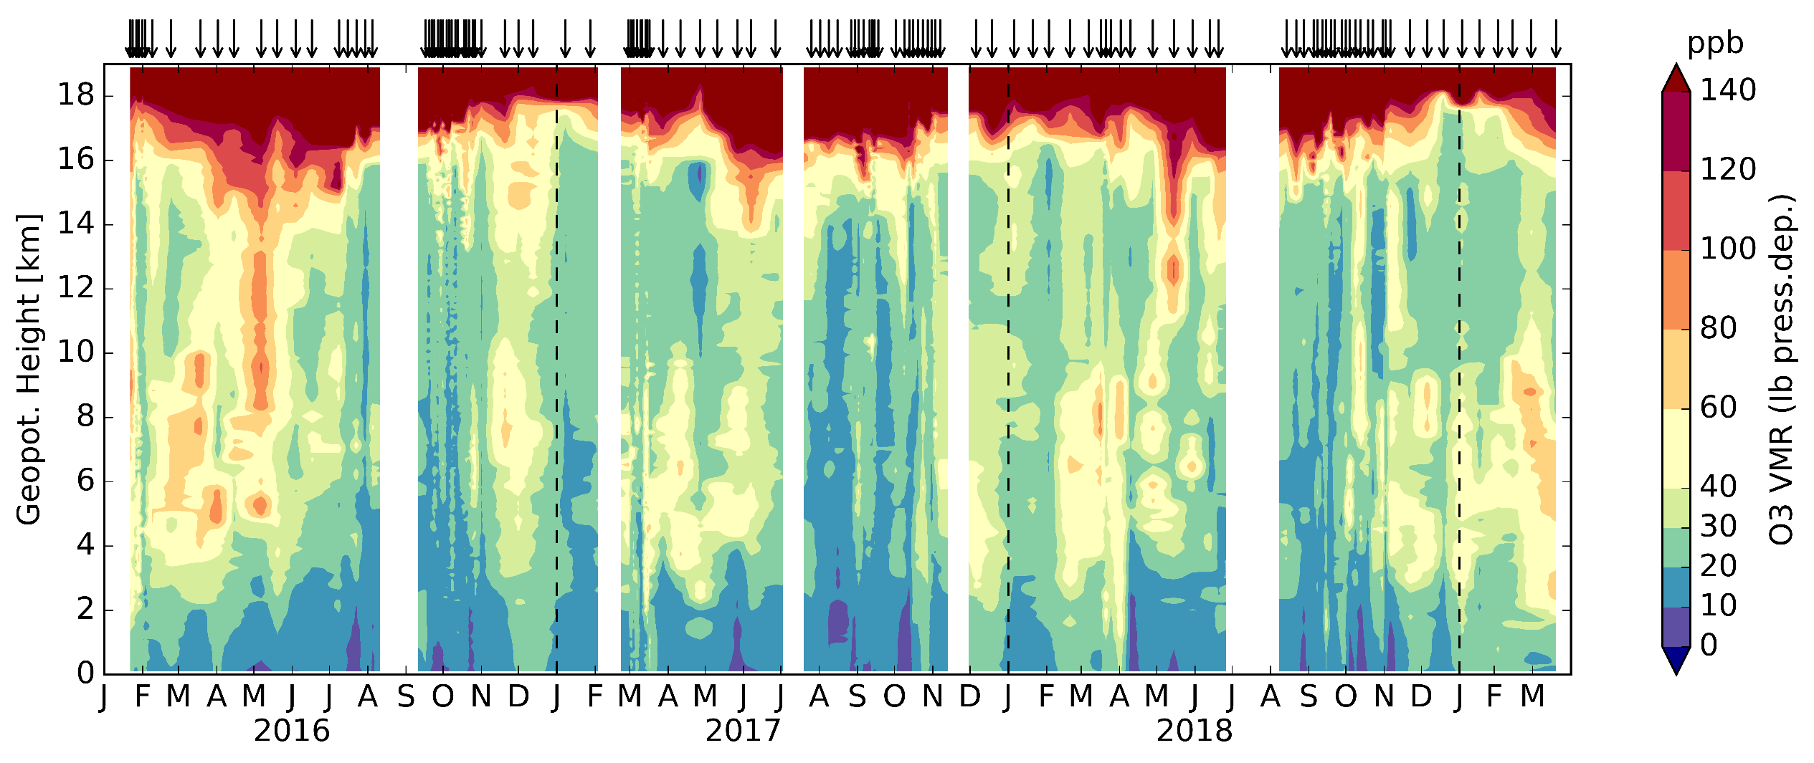
III Tropospheric O₃
Time-height-cross-section for O₃ Volume Mixing Ratios (VMR)
*
Arrows mark individual soundings, gaps are mostly due to personnel or logistical shortages
Data is linearly interpolated onto a daily-100 m grid (for RH and T see )
*

Slide 10
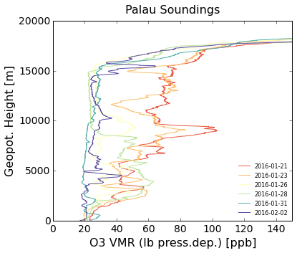
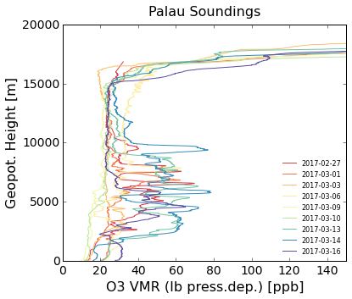
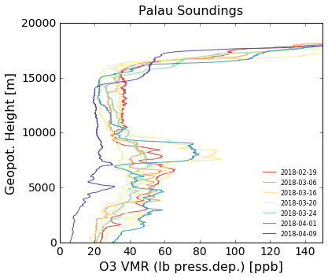
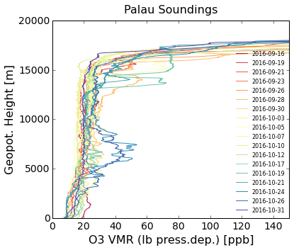
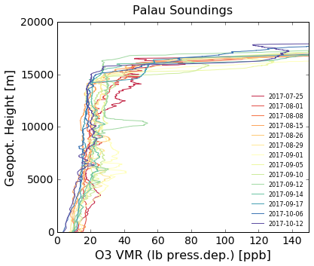
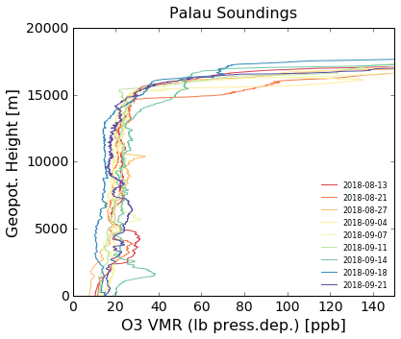
III Intensive Campaigns
O₃ Volume
Mixing Ratios
„spring“
20 ppb reference line
„fall“
2016
2017
2018

Slide 11
III Data Quality
*
In general within the uncertainty range for tropical ECC ozone sondes
(e.g. Smit et al. 2007, GAW report No.201, 2011, Thompson et al. 2019)
Comparison with satellite data and other ozone sounding (SHADOZ) stations in progress
Limitations of the dataset:
  too sparse sampling frequency to capture some (e.g. day-to-day) variabilities
  (see e.g. Liu et al. 2016 for discussion)
  comprised of only 3 years of data
  uneven distribution of measurements for different seasons
Strengths:
  EL Nino year included
  intensive campaigns during the regional tropospheric minimum ozone season
  (NH summer/fall): robust capture of the lowest VMRs
  high potential for case study analysis
  Coinciding with POSIDON campaign and local and regional WB57 measurements
*

Slide 12
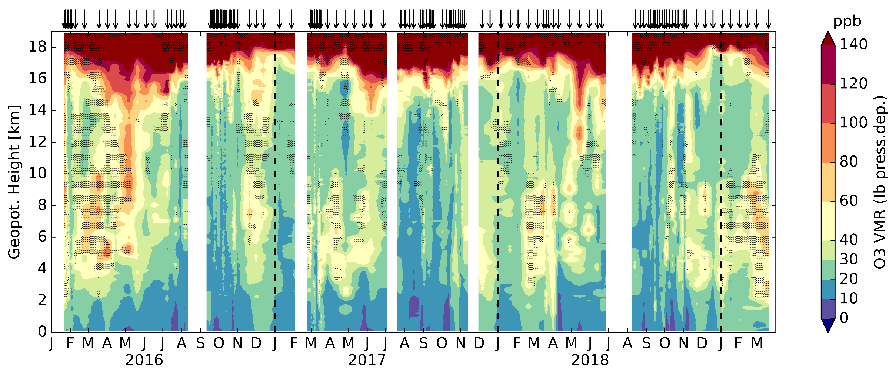
IV Tropospheric O₃ Variability
O3 Volume
Mixing Ratios (VMR)
with Relative Humidity (RH) below 30 % superimposed in grey shading
< 30 % RH
*
Dominant seasonal signals in the lower and mid-troposphere: expected O₃ Minimum in NH late summer/fall, layers of elevated O₃, often anti-correlated with RH from February until June
Interannual differences: very dry and ozone rich mid-troposphere in spring 2016 during El Nino 2016
*

Slide 13
IV Tropospheric O₃ Variability
O3 Volume
Mixing Ratios (VMR)
with Relative Humidity (RH) below 30 % superimposed in grey shading
< 30 % RH
*
Clear annual cycle in the TTL in accordance with tropopause height and temperature variations related to seasonality of Brewer Dobson circulation (e.g. Randel et al. 2007) and enhanced high altitude convective outflow (Folkins et al. 2006)
Transport to the stratosphere and the tropospheric O3 minimum occur
in boreal late summer/fall

Slide 14
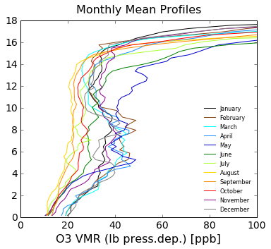
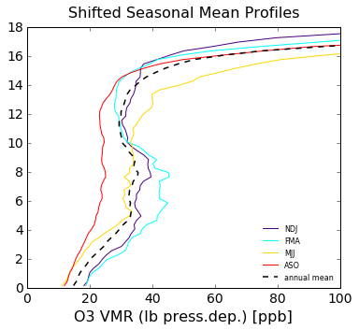
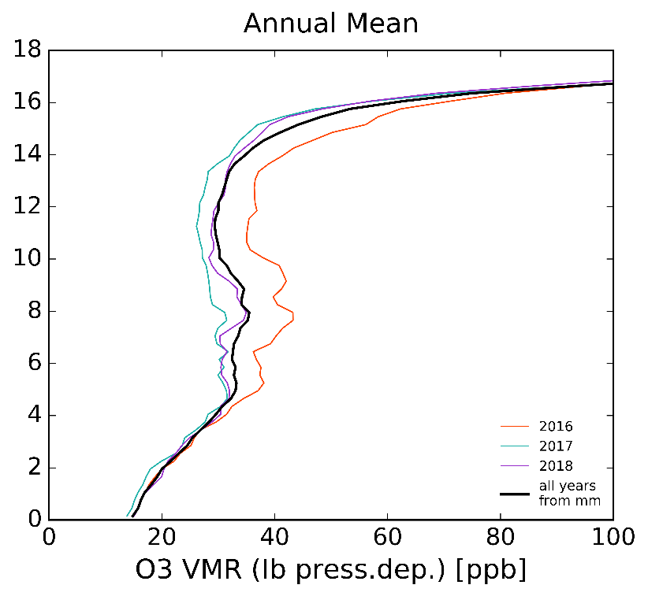
IV Mean O₃ Profiles
*
Monthly mean profile shapes suggest a grouping into shifted seasons
(i.e. NDJ, FMA, MJJ, ASO) possibly underlying differing meteorological conditions
Large interannual differences between the El Nino year 2016 and 2017/2018 are clearly visible in the annual profiles and suggest a separation of the years for further statistical analysis

Slide 15
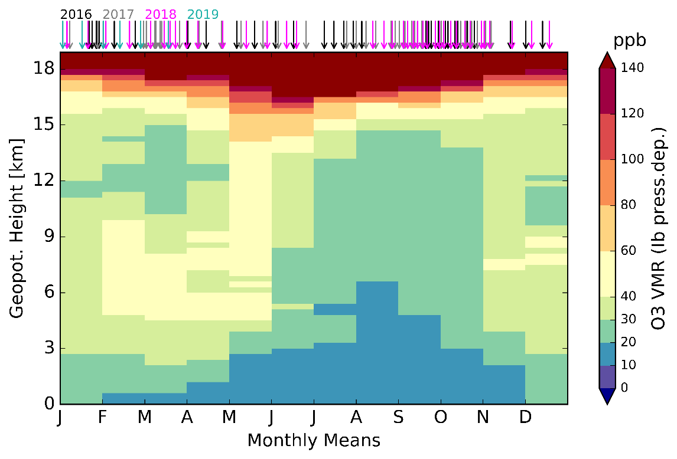

IV „Longterm“ Monthly Mean O₃
Seasonality shows well in „longterm“ statistics from monthly means for 01/2016 - 03/2019
Anomalies from the annual mean emphasis the annual cycles in the TTL (early NH summer maximum) and mid-troposphere (late NH summer/fall minimum)
The temporal displacement of the higher O₃ VMR from the mid-troposphere in spring to the lower stratosphere in summer seem typical for the wider region
(compare for Hanoi SHADOZ station, Ogino et al. 2013)
*

Slide 16
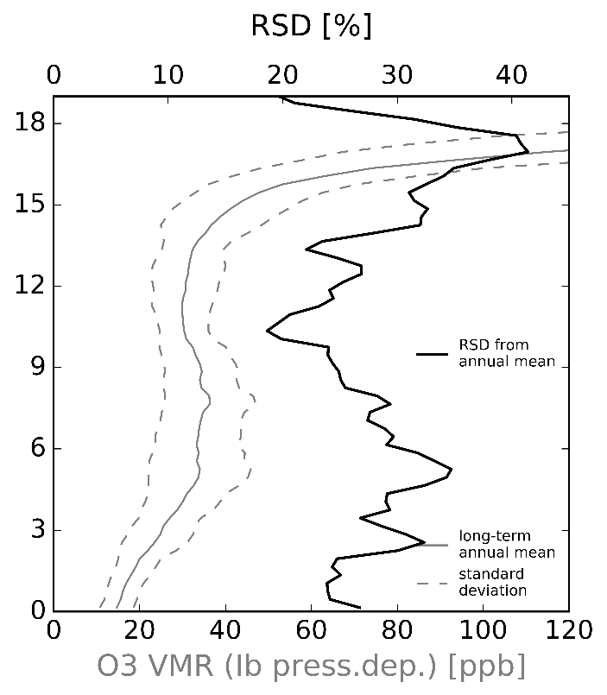
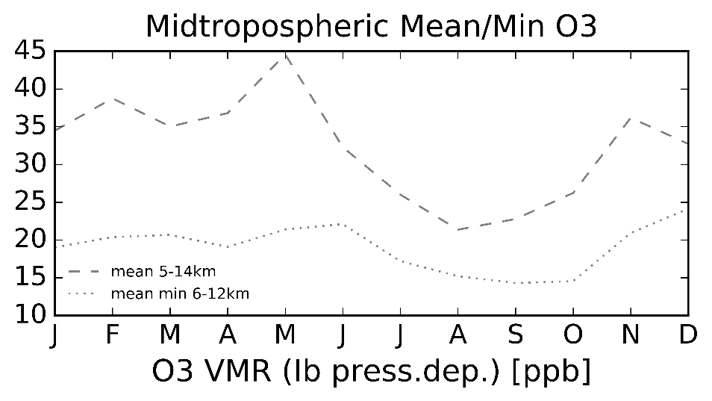
IV „Longterm“ Monthly Mean O₃
*
*
Relative Standard Deviation (RSD) from monthly means and monthly means of the free-tropospheric mean (5-14 km) and minimum (6-12 km) O₃ VMR of all individual soundings serve as examplatory statistical measures for seasonal variability

Slide 17
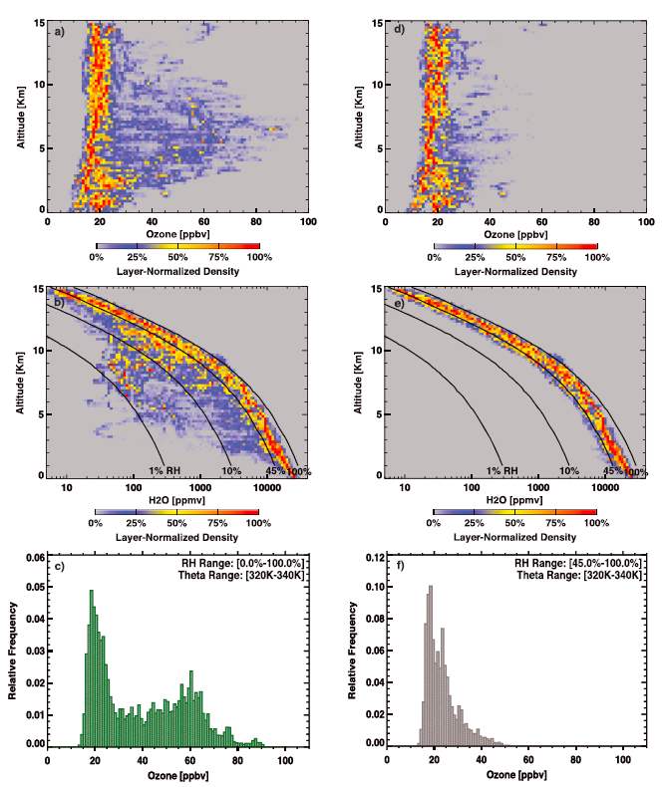
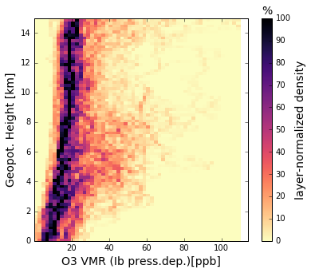
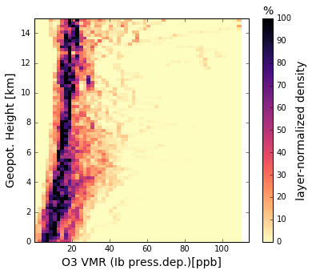
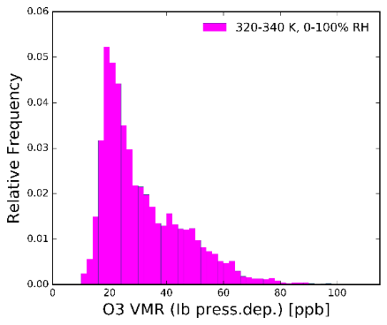
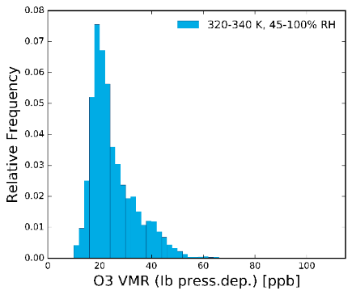
IV Bimodal distribution?
Pan et al. 2015
CONTRAST observations reveal a bimodal distribution of free tropospheric ozone
Primary mode:
(RH>45%) controlled by tropical convective overturning, which homogenizes air masses
Secondary mode: i.e. enhanced mid-trop. O₃ layers, controlled by non-local processes – under investigation: Randel et al. 2016, Anderson et al. 2016
Alternative explanation for low UT VMRs
Layer normalized densities relative to the maximum VMR
Relative Frequencies of VMR in 320-340 K layer
RH>45%
RH>45%
Data from Palau soundings (all years and seasons) do not reveal a pronounced bimodal distribution, but the primary mode is evident.
Seasonal analysis might show bimodality
Data from aircraft insitu measurements
in the TWP (from Guam) during
CONTRAST in January 2014
(Pan et al., 2015 & 2017)

Slide 18
V Transport and Origin of Air masses
Our approach: characterization of air masses by their relative ozone and water vapor abundance
Analysis of layered structures of High/Low O₃/H₂O in the tropical mid-troposphere has been done by various studies, mostly focusing on the origin of High O₃/ Low H₂O layers
(e.g. Newell et al. 1996, Stoller et al. 1999, Thouret et al. 2001, Hayashi et al. 2008 and more recently Pan et al. 2015, Anderson et al. 2016, Randel et al. 2017)
  Discussed possible origins of these layers are local and remote bio mass burning, transport of midlatitude UTLS air or tropical UT air
Analysis with Palau and coinciding StratoClim campaign data from Bangladesh is still ongoing
*

Slide 19

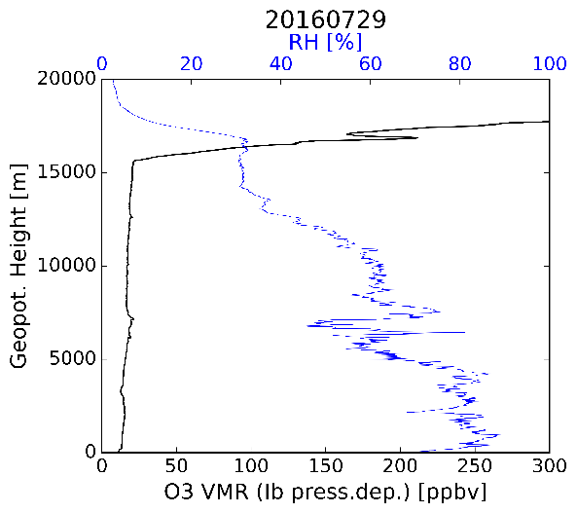
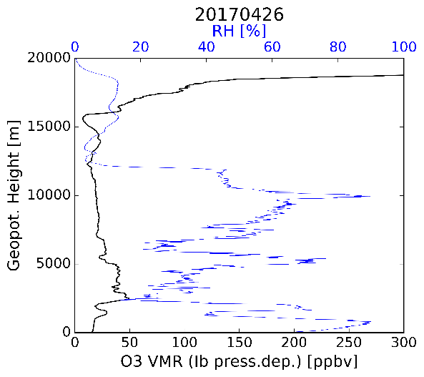
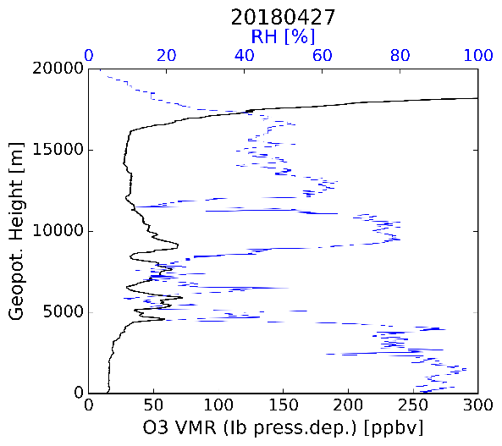
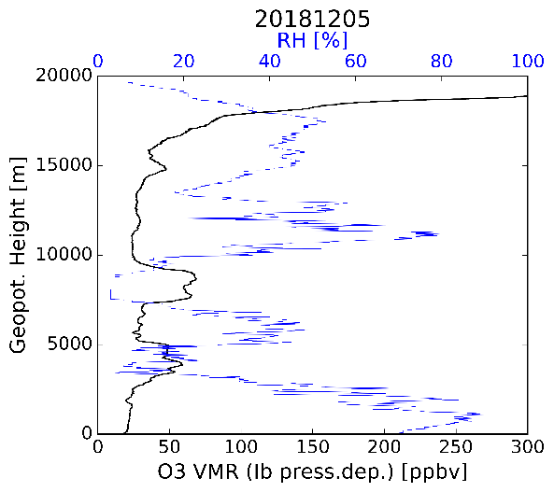
V O₃ vs. H₂O Seasonality
Examples of different combinations of
High/Low O₃/H₂O layers
Case studies and (statistical) analysis ongoing
Overall Lowest O₃ measured in the TTL: 7ppb!
Low O₃/ high H₂O
Low O₃/ low H₂O
High O₃/ high H₂O
High O₃/ low H₂O

Slide 20
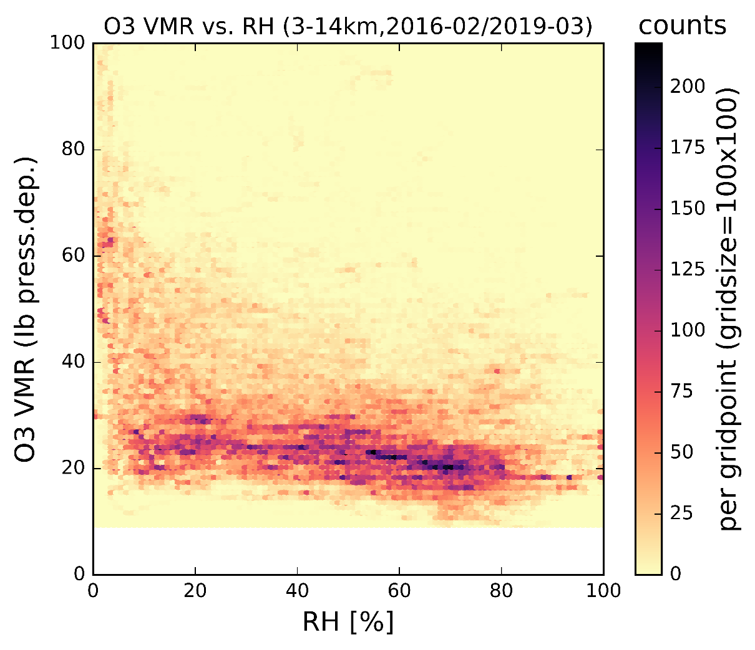
V Transport and Origin of Air masses
O₃
(3)
High Ozone
/ dry
(4)
High Ozone
/ wet
(2)
Low Ozone
/ dry
(1)
Low Ozone
/ wet
H₂O
Distribution of all free-tropospheric
profile data with O₃ relative to RH
Despite the dominance of low O₃ VMR (compare
bimodal analysis ), we group data in 4 categories
and hypothesize 4 different transport pathways
*

Slide 21

V Transport Pathways to the TWP
Extratropical stratosphere
Tropopause
O₃
Walker circulation
Trade winds
Clear sky cooling
Convective uplift
H₂O
Transport way,
color-coded for
O₃/H₂O relation
Hypothesis will be evaluated by back-trajectory analysis and in analogy to previous studies
South East Asia
PALAU
(134°E)
America
Dominating in Aug-Nov:
Occurance in Feb-Jun:
cv
*
Low Ozone / wet
(3) High Ozone / dry
*
(2) Low Ozone / dry
(4) High Ozone / wet
VERY Preliminary results from trajectory analysis of selected cases:
cv
(East)-Pacific air masses
Air masses from (South-East) Asia reaching Palau from the North
< 30 % RH

Slide 22
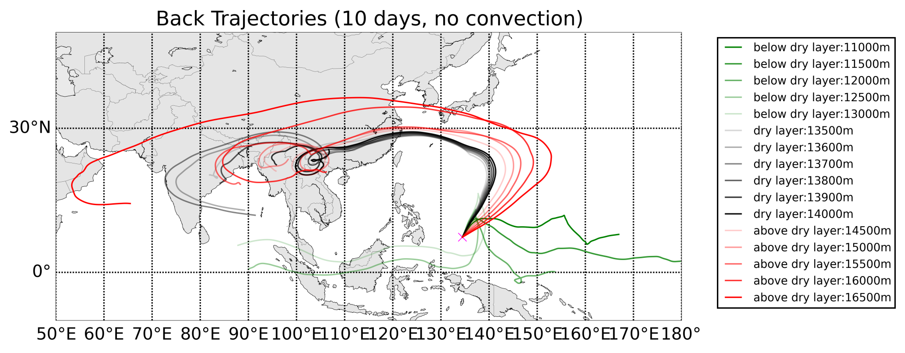
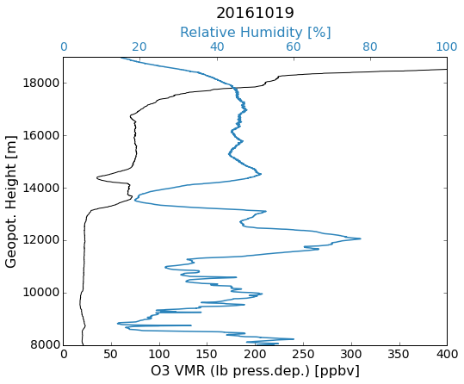
V Trajectory Analysis: Case Studies
Back-trajectories calculated with fully Lagrangian ATLAS model driven by ERA-interim wind fields and optional convective scheme (Wohltmann et al. 2019 in discussion @ GMDD)
Example: POSIDON case study for a High O₃/Low H₂O case, 19.10.2016
*
*
Analysis of trajectories including convection in progress

Slide 23
Summary
*
The Tropical West Pacific with its clean air is an important region
for the supply of chemical species to the stratosphere.
The Palau Atmospheric Observatory started operations in 01/2016 and fills an observational gap in this key region with a comprehensive setup.
3 years of ozone sounding data give insight on the seasonal cycle of tropospheric O₃ and relevant atmospheric processes, including to a certain extent interannual variability (El Nino).
Significant seasonal signals are the annual cycle in the TTL (~ Maximum in August) and the mid-troposphere (~ Minimum in August until October): transport to the stratosphere with longest lifetimes for different chemical species occurs in late boreal summer/fall;
no overall bimodal distribution of free tropospheric O₃ was found (compare Pan et al. 2015).
The relation between O₃ and H₂O in mid-tropospheric layers indicates different origins of air masses – we hypothesize four different ways of transport. Trajectory analysis including convective activity is still ongoing.
The Tropical West Pacific: Research Motivation
*
Palau
Atmospheric Observatory
*
Data Overview
*
Tropospheric O3 Variability
*
Transport and Origin of Airmasses
OUTLOOK

Slide 24
Outlook
First Paper presenting the dataset in preparation (Müller et al. 2019)
Data comparison with satellite measurements and SHADOZ stations
Back-trajectory and statistical analysis of O₃/H₂O layers in comparison to recent regional studies
Box-modelling of OH to further constrain the oxidizing capacity of this important stratospheric entry region

Slide 25
More Info
*

Slide 26
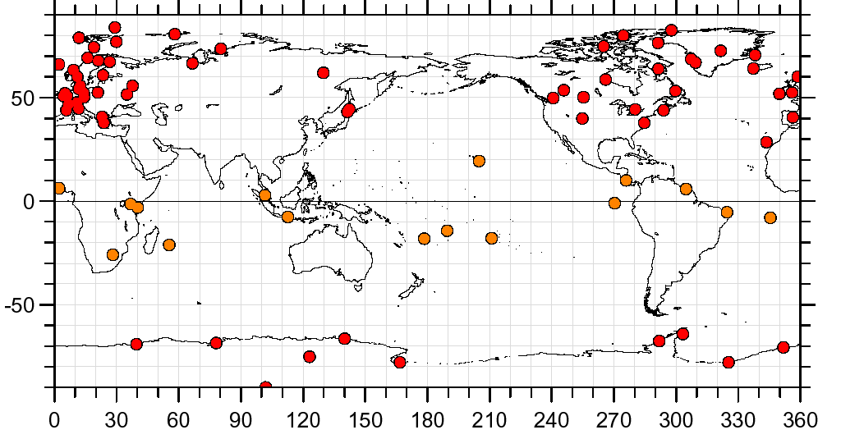
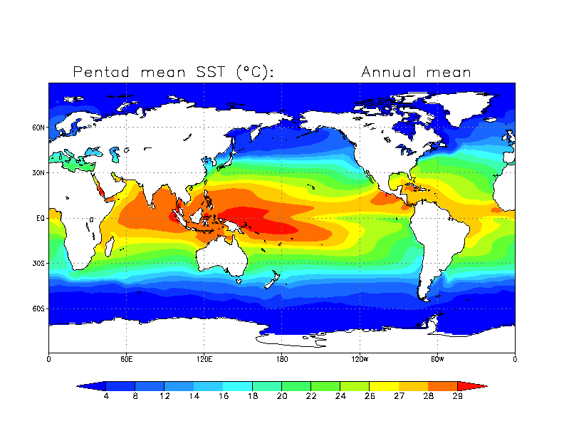
I The Tropical West Pacific (TWP)
Gap in the observational network (dots: Ozone Sounding Stations)
Long term annual mean sea surface temperature (SST) [ºC]
4
8
12
14
16
18
20
22
24
26
27
28
30
Highest SST globally: high energy convection
Upwelling branches of global atmospheric circulation patterns
Main wind direction: East, little anthropogenic influence

Slide 27

I The O₃ Minimimum Seasonality
TES tropospheric ozone columns
Rex et al., 2014
O₃ Minimum is persistent
Exists year round (strongest in NH summer & fall)
Is affected by ENSO (follows the warm pool)

Slide 28

I Tropospheric Oxidizing Capacity
In the absence of hydrocarbons, CO and NO_{x}, i.e. „clean“ air, the major source of OH is formation via:
This couples ozone concentration
and oxidizing capacity
and provides an efficient loss
mechanism for ozone in the
tropical West Pacific
$$O_{3}+hv→O({}_{}^{1}{D)+}O_{2}$$
$$O({}_{}^{1}{D)+H_{2}O→OH+OH}$$
Image: Markus Rex

Slide 29
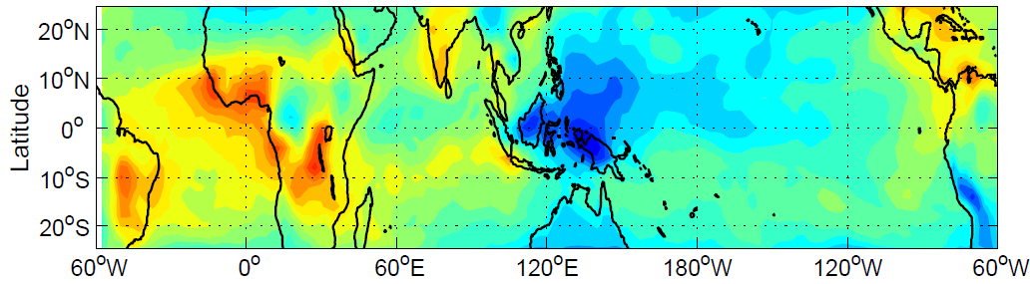
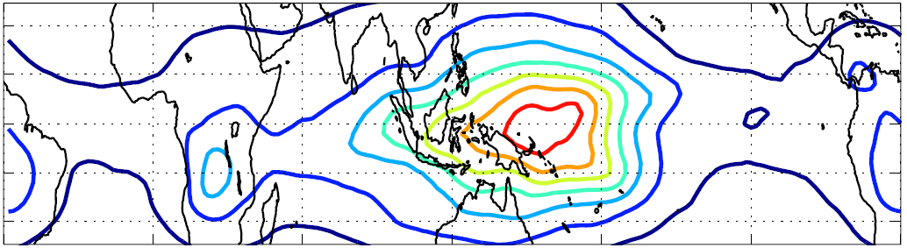
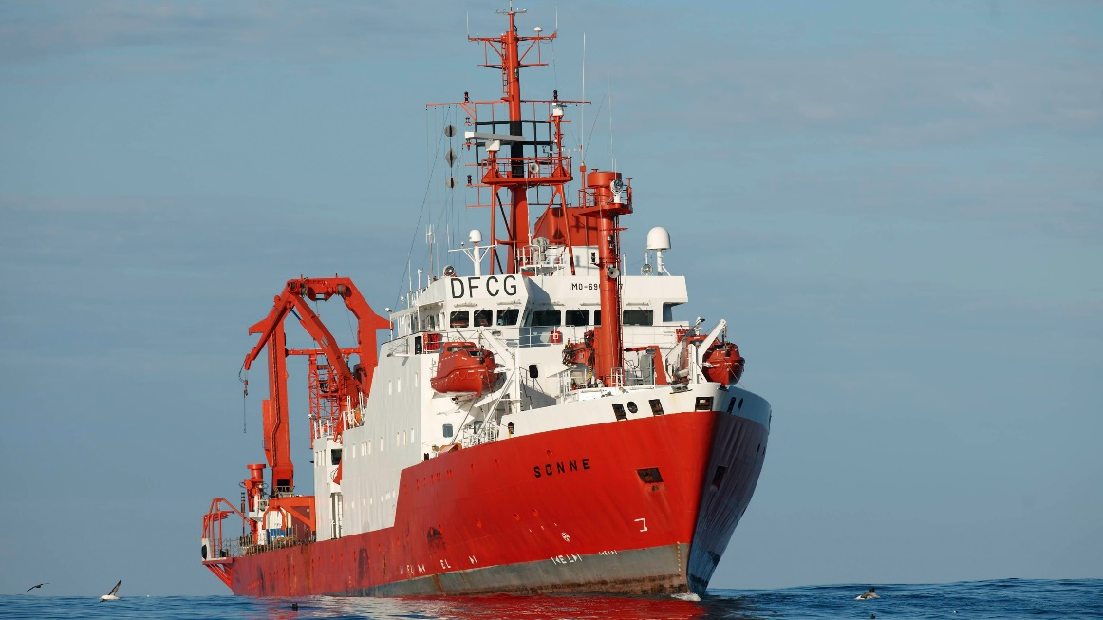
I The TWP: source for stratospheric air
Source of
strat. air
relative units
Density distribution function of the horizontal positions of the trajectories between boundary layer and
Lagrangian Cold Points
Red thick line: TransBrom Cruise 2009
Ozone sonde station
2
4
6
ATLAS
TransBrom Campaign with RV Sonne in 2009 (see e.g. Rex et al. 2014)
Image: Markus Rex
Rex et al., 2014

Slide 30

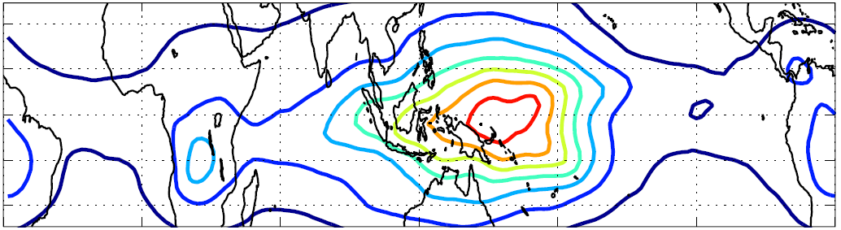
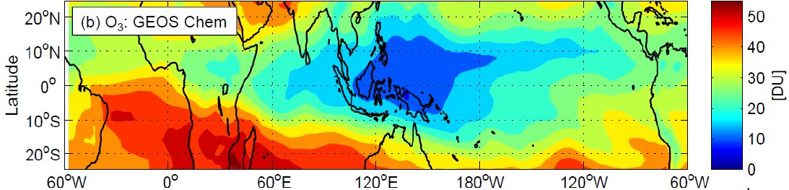
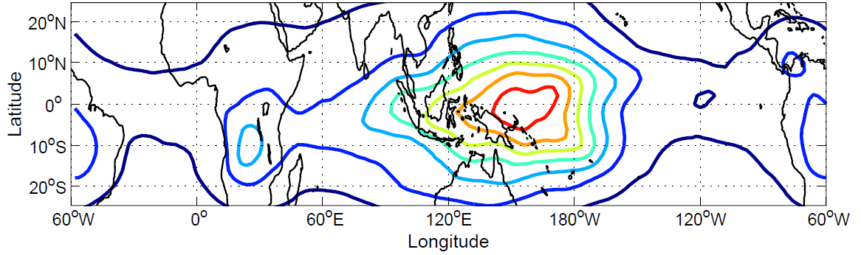
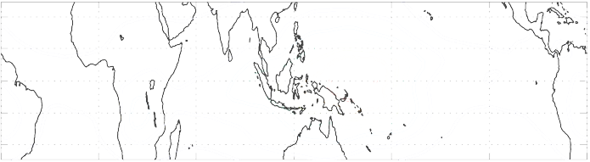

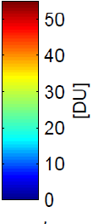
I The TWP: Research Motivation
Density distribution function of the horizontal positions of the trajectories between boundary layer and
Lagrangian Cold Points
Red thick line: TransBrom Cruise 2009
“Source of stratospheric air”
fully lagrangian ATLAS model
relative units
2
4
6
ATLAS
GEOS Chem:
Tropospheric ozone column
SO₂ gas phase
lifetime [days]
CH₂Br₂
Lifetime [days]
Ozone sondes:
tropospheric ozone column
25
286
7
69
GEOS Chem:
tropospheric OH column
Lifetime comparison for tropical Atlantic and West Pacific (values for mid-troposphere- 500 hPa at the equator for typical conditions)
Rex et al., 2014

Slide 31
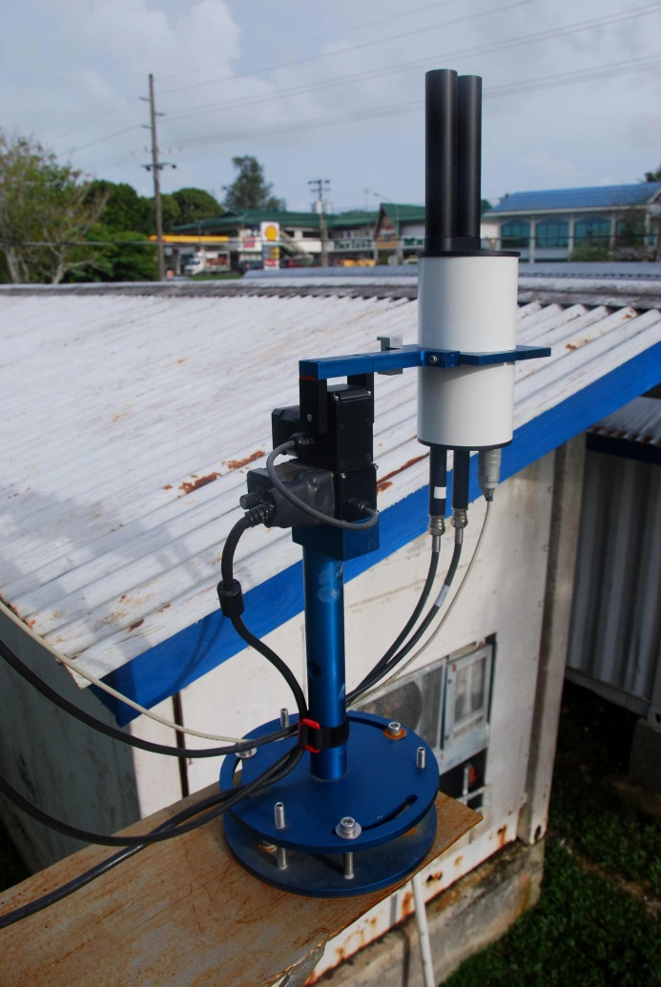




Instrumentation
Lidar:
Vertical profiles of
aerosol properties
Since 2018: multi-λ cloud
and aerosol lidar ComCAL
in new lab
MaxDOAS:
Pandora2S –
Pandonia Network
O₃, NO₂, AOD
(, H₂O, SO₂, …)
Operational: 10/2016-02/2017 12/2018 until now
*
FTIR Spectrometer:
Total abundances of
~ 20 chemical species
Research balloons:
Vertical profiles of
Ozone
Aerosol
Water vapour
Image: Katrin Müller
The Pandora 2S instrument in Palau is part of a few remote stations (PI: Jürgen Fischer, FU Berlin) within the larger PANDONIA network
Sponsored by ESA
Interested in the data? see www.pandonia.net
MICA:
Ground sampling of
OCS, CO, CO2, H2O
Temp. @ CRRF site

Slide 32
Instrumentation
*
Lidar:
Vertical profiles of
aerosol properties
Since 2018: multi-λ cloud
and aerosol lidar ComCAL
in new lab
MaxDOAS:
Pandora2S –
Pandonia Network
O₃, NO₂, AOD
(, H₂O, SO₂, …)
Continuous and intensive soundings
Since 01/2016
*
FTIR Spectrometer:
Total abundances of
~ 20 chemical species
Research balloons:
Vertical profiles of
Ozone
Aerosol
Water vapour
MICA:
Ground sampling of
OCS, CO, CO2, H2O
Temp. @ CRRF site

Slide 33
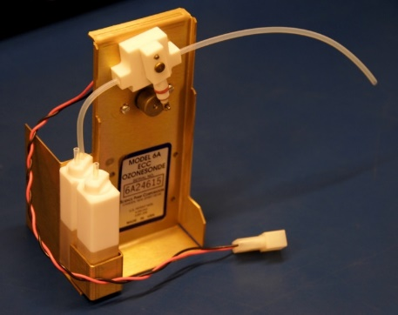









II ECC Sonde Measurement Principle
pump
Image: Vaisala Manual
ECC = Electrochemical Concentration Cell
Calculation of Ozone Partial Pressure
$$O_{3pp}=c∙(I−I_{b})∙T_{box}∙f_{pump}∙c_{pump}$$
Image: Katrin Müller
$$I_{b}$$
Chemical reaction
between $O_{3}$ and$KI$:
$$2KI+O_{3}+H_{2}O$$
$$→2KOH+I_{2}+O_{2}$$
$T_{box}$ - box/pump
temperature
$f_{pump}$ - ECC flow rate
$c_{pump}$ - empirical
correction for
pressure dependent
pump flow efficiency
$$e^{−}$$
$c$=$\frac{R}{χF}$
with $χ=2$ : yield ratio of electrons per ozone molecule
Sensing Solution: unsaturated | saturated
KI (+KBr and buffers)
*
Cathode reaction:
reduction of iodine
$${}_{ }^{}{I_{2}+2e^{−} →{2I}^{−}}$$
Anode reaction:
oxidation of iodide
$$3I^{−}{}_{ }^{}{ →{I_{3}^{}}^{−}+{2e}^{−}}$$
sensor background current
Controversial and treatment not standardized in the community
Origin and development unknown
flow of electrons is directly proportional to O₃

Slide 34

II ECC Sonde Detection Limit
Extratropical
West Pacific ~30º
Tropical
West Pacific
Background current correction is of great importance for the
tropical upper troposphere!
Standard approach:
Constant background current
correction
Pressure dependent background
current correction
Robust upper limit:
No background current correction
TransBrom 2009
Rex et al., 2014

Slide 35
II ECC Sonde Detection Limit
Contribution of the Background current
Overall instrumental uncertainty
0.01µA
0.05µA
0.10µA
0.05µA
0.01µA
0.10µA
GAW Report No. 201, 2011

Slide 36


III RH and T
Relative Humidity and Temperature profiles from Radiosonde measurements (Vaisala RS92 until 10/2017, then RS41)
February-June much drier than August-November
Lowest temperatures and highest Minimum in winter
min O3 in TTL region
min T

Slide 37




III CFH sonde example
sonde
< 27.10.2017
sonde
2.11.2017 >

Slide 38


IV El Nino 2015/2016
X
X
Positive OLR anomalies indicate suppressed convection and precipitation
Wind anomalies might reveal air reaching Palau from atypical directions
Air parcels from NW, S or SW could introduce pollutants from e.g. biomass burning, enhanced by irregular droughts
X
NOAA, bi-weekly ENSO update, 15.02.2016
Further analyses will follow…

Slide 39


IV Annual TTL cycle
*
300m Layer around 18.15km
min T
*
…more layer plots
Feedback during the El-Nino year in the upper troposphere: suppressed convection in NH spring/summer with less uplift of ozone-poor air from the ground or wash-out of ozone precursors
Reoccuring signal in the lower stratosphere: accumulation of ozone-rich air during the summer months which is then transported upwards and towards higher latitudes during winter by the residual circulation (Brewer-Dobson) →annual cycle

Slide 40








IV TTL
26.+ 28.+31.01.2016
TTL=
Tropical
Tropopause
Layer
Various existing definitions: LITERATURE HERE
Randel&Jensen 2013, nature geosciences
Transition zone located between ozone minimum (Ozonopause) and temperature minimum
(cold point Tropopause)
Overlapping processes:
  dominating, slow radiatively driven ascent
  beginning of photochem. ozone production
  meridional mixing of air from the extra-
  tropical lower stratosphere
Holten et al. 1995

Slide 41









IV Layer Plots

Slide 42
IV Seasonal variations Hanoi/Hong Kong
Hanoi
Hong Kong
Seasonal Variation of O₃ VMR from ozone sonde data from 09/2004-11/2011, Ogino et al. 2013

Slide 43


IV Relative Standard Deviations
RSD: Measure of variability for tropospheric O₃
Dominant peak in the TTL: the annual cycle
Minimum at ~10 km (not present for the El Nino year 2016) → maybe 2 regimes?
Relative high variability in the lower and mid troposphere
Further analysis and comparison with other (SHADOZ) stations required
*

Slide 44




IV Shifted Seasonal Mean O₃ Profiles
Shifted seasons were chosen
subjectively for their differences
in shape and structure
the known „S-shape“ profile
(e.g. Folkins et al. 2002, Pan et al.
2015) dominates mainly in FMA and
slightly less pronounced NDJ,
when the occurence of enhanced O₃ layers is highest
ASO months show a straight profile with little interannual variability and a steep onset of higher levels of (stratospheric) O₃ at lower heights than winter and spring months, i.e. a well-mixed troposphere with high-reaching convective uplift of ozone-poor air from the boundary layer
The lowest transition to the stratosphere occurs in MJJ months, when the Brewer-Dobson circulation is weakest. The MJJ profile resembles a „tilted“ instead of a straight line in the following months, lacking a pronounced ozonopause, accounting for the occurence of enhanced O3 layers in the upper troposphere and a lack of UT convective outflow

Slide 45




IV NDJ
Following a period of low Min and Mean (ASO), November shows increased values again, the lower of two annual peaks
The interannual variability is high, especially in January possibly due to El Nino conditions

Slide 46



IV FMA
The „S-Shape profiles“ (see e.g. Folkins 2002 or Pan et al. 2015) in FMA show relatively high Mean values
Background O₃ (Min) is quite steady around 20 ppb, significantly higher than during ASO months (14.5 ppb)

Slide 47



IV MJJ
Highest mean and greatest difference between Mean and Min occur in May, followed by declining values until August
A pronounced ozonopause occurs less often compared to the S-shape profiles of FMA months

Slide 48



IV ASO
Highest sampling rate throughout the year: best captured day-to-day variations
Free-tropospheric Min and Mean are lowest in August and October respectively with the smallest difference between Min and Mean
Background O₃ (Min) is quite steady around 14.5 ppb, significantly lower than during FMA months (20ppb)

Slide 49
V High O3 layer analysis
Hayashi et al. 2008 analyzed ozone sonde data from 3 different SHADOZ stations
Overall occurence of Enhanced O3 layers ~50% per year with seasonal variations
Watusek Samoa San Cristobal

Slide 50




V Trajectory Analysis: Case Study
Courtesy of Ru-Shan Gao
Pacific Oxidants, Sulfur, Ice, Dehydration and cONvection Experiment
WB-57
October 2016, from Guam
PIs: Ru-Shan Gao (NOAA) and Eric Jensen (NASA)
WB-57 aircraft, measuring O₃, H₂O, SO₂, N₂O, various halogenated trace gases…
3 simultaneous measurements near Palau
Palau Sonde
October 19th 2016 (ECC)
Unusual high O₃ event 19.10.2016 in the TTL along flight path between 133˚ and 145˚E, North of Palau (10˚-15˚N) – in agreement with Palau sonde
?
Courtesy of Andrew Rollins, NOAA

Slide 51






V Trajectory Analysis: Case Studies
Sonde altitude
Low O₃/ high H₂O
Low O₃/ low H₂O
High O₃/ high H₂O
High O₃/ low H₂O

Slide 52




V Trajectory Analysis: Case Studies
Sonde ozone
Low O₃/ high H₂O
Low O₃/ low H₂O
High O₃/ high H₂O
High O₃/ low H₂O

Slide 53















Measurement Routines
Images: KM and courtesy of Jürgen Gräser (AWI)

Slide 54














The beginning – and extention
Images: KM and courtesy of Jürgen Gräser (AWI) and Ingo Beninga (impres GmbH)

Slide 55













Visitors/Outreach
Images: KM and courtesy of Jürgen Gräser (AWI) and Jordis Tradowsky (Bodeker Scientific)

Slide 56
Acknowledgements
Contact: Katrin.Mueller@awi.de
StratoClim consortium
@AWI: Physics of the Atmosphere section with Daniel Kreyling, Jürgen Gräser, Holger Deckelmann, Siggi Debatin and others
@IUP: Justus Notholt, Winfried Markert, Tine Weinzierl
@impres GmbH: Ingo Beninga, Wilfried Ruhe
@Palau: Patrick Tellei (PCC), Pat and Lori Colin (CRRF), Sharon Patris (CRRF), Gerda Ucharm (CRRF), Ronnie Giman and CTSI, Thomas Schubert and many others

