Slide 1

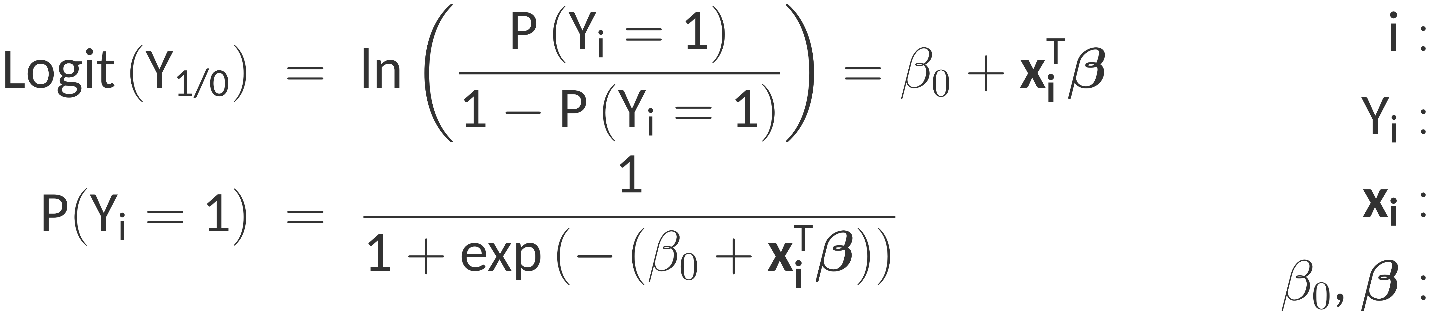
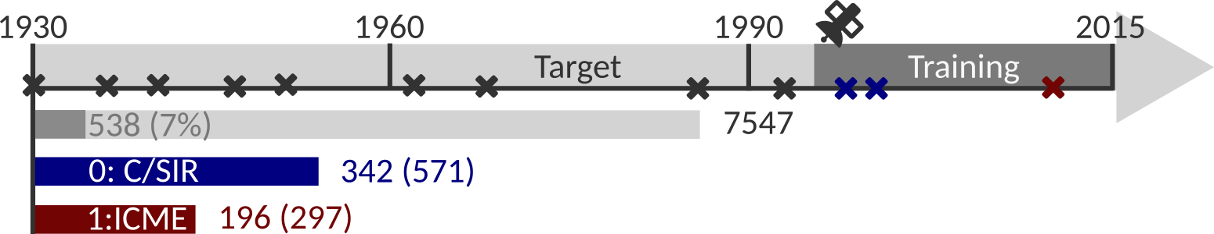
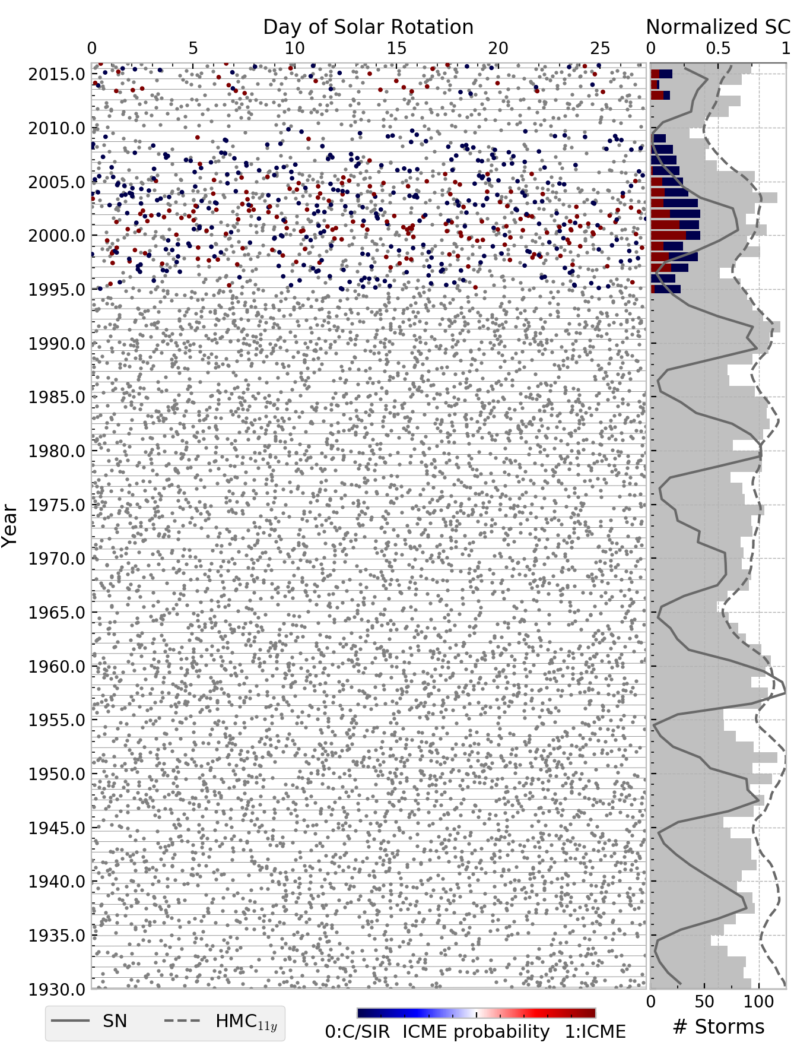

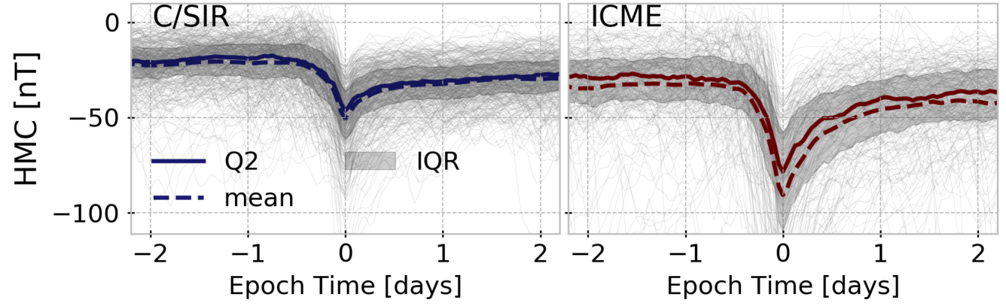
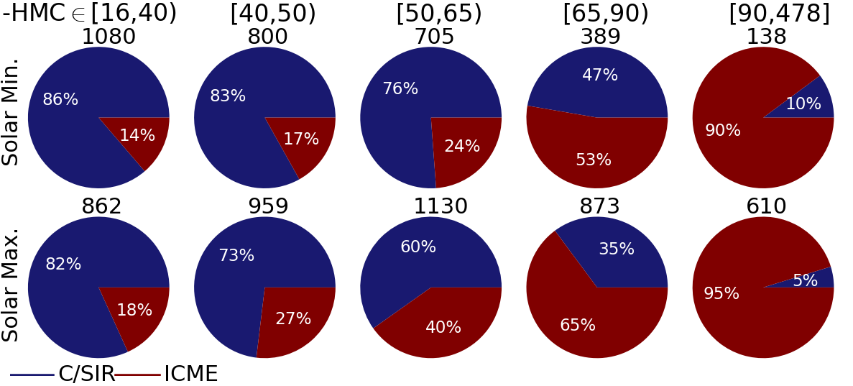
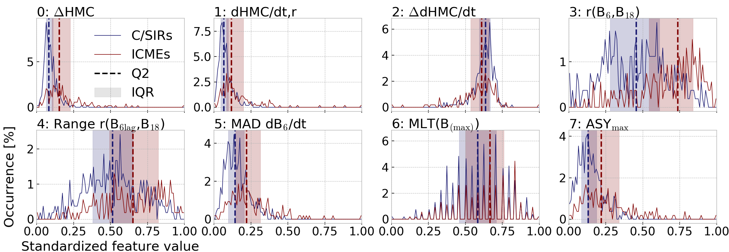

Historical geomagnetic storm drivers determined exclusively from ground-based magnetometer measurements
1
Key message
4
Setup
Setup
Model
A selection of 7547 past geomagnetic storm events (target set) is assigned to solar wind drivers using geomagnetic properties of 538 training events. The two driver classes are 0: Corotating/Stream Interaction Regions (C/SIRs) and 1: Interplanetary Coronal Mass Ejections (ICMEs).
Features of the geomagnetic field measured at ground can be used to identify geo-magnetic storm drivers in the pre-satellite era. We deliver a list of geomagnetic storms since 1930 together with probabilities for a C/SIR or ICME driving mechanism.
Event ID, i = 1, ..., n = 538
Driver class (binary)
Feature vector
Input data
6
Intercept, coefficients
Classification
a) Feature selection
c) Assessment of
best model
b) Hyperparameter optimization via grid search
Features / Model
Fig. Setup: Illustration of target and training storm events (crosses). The drivers of the training events are known.
24
2
5
Input data
23
Validation
HMC [nT] | Hourly Magnetospheric Currents index (Pick et al., 2019)
B_{MLT} [nT] | Magnetic field disturbance along dipole axis, sorted into MLT sectors.
C/SIR
ICME
Validation
Metric | MCC | HSS | ROC AUC | ACC | F1
Value | 0.54 | 0.54 | 0.86 | 0.78 | 0.71
C/SIR
276 TN | 66 FP | 342 N
50 FN | 146 TP | 196 P
326 PN | 212 PP | 538 POP
Fig. SEA:
Superposed epoch analysis of HMC for training events.
Click for B_{MLT}.
22
Tab. Performance Metrics & Confusion Matrix:
Matthew's Correlation Coefficient (MCC), Heidke Skill Score (HSS), Area Under Receiver Operating Curve (ROC AUC), Accuracy (ACC) & F1 score derived from the confusion matrix.
True
ICME
21
References
20
Predicted
3
7
“Madness”
Features
Results | Conclusions
From the input data 11 features are derived to enter the logistic regression model.
19
Storm recovery phase seems to be
more sensitive to driver class
than main phase
4 features with predictive capability
Use of B-field disturbance at high
latitudes might improve result
18
17
Fig. Class Statistics: Fractions of C/SIR & ICME driven storms in dependence on HMC peak and solar cycle phase.
8
Top reference
Fig. Features: Histograms of feature values (centered, scaled to unit variance) for C/SIR (blue) and ICME (red) driven storms from the training set. The Interquartile Range (IQR) is the range between the 75th and 25th percentiles. Q2 is the 50th percentile (median). All 11 features are shown on the detail slide “Features / Model”.
Fig. Classification: Target (gray) and training events (colored dots) in a year vs. solar rotation (27.28 days) plot (left) and events per year (bars) with normalized sunspot number (SN) and low-pass filtered HMC (right). Solar cycles (SC) are numbered in gray.
Pick et al., 2019: Evolution of large-scale magnetic fields from near Earth space during the last 11 solar cycles,
JGR Space Physics, doi: https://doi.org/10.1029/2018JA026185.

Slide 2
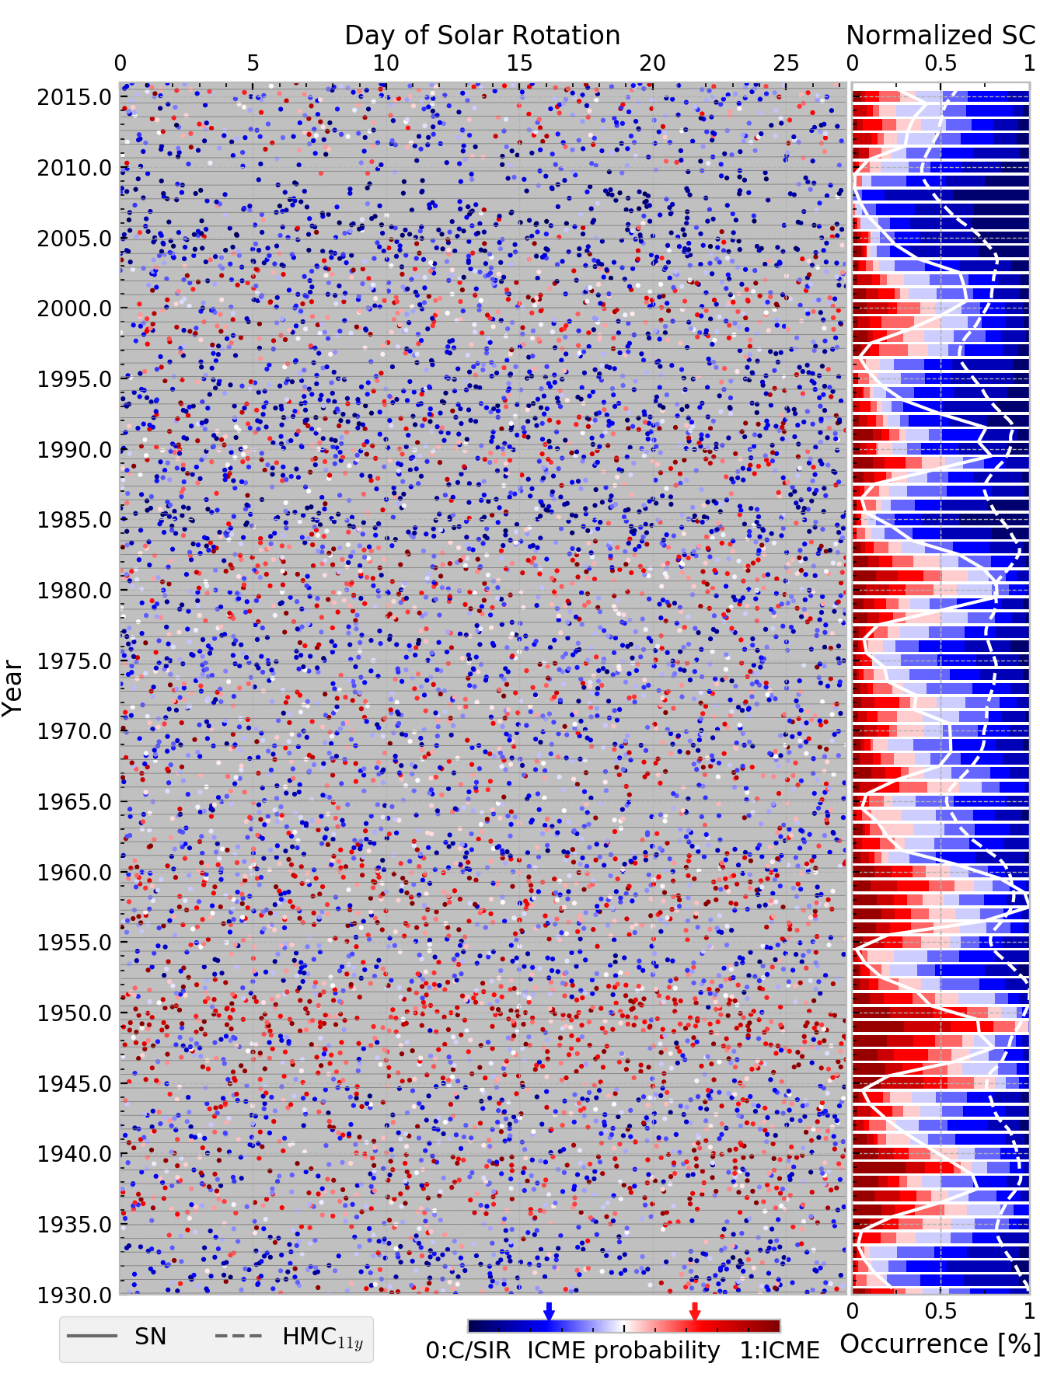

Historical geomagnetic storm drivers determined exclusively from ground-based magnetometer measurements
1
Key message
4
Setup
Setup
Model
A selection of 7547 past geomagnetic storm events (target set) is assigned to solar wind drivers using geomagnetic properties of 538 training events. The two driver classes are 0: Corotating/Stream Interaction Regions (C/SIRs) and 1: Interplanetary Coronal Mass Ejections (ICMEs).
Features of the geomagnetic field measured at ground can be used to identify geo-magnetic storm drivers in the pre-satellite era. We deliver a list of geomagnetic storms since 1930 together with probabilities for a C/SIR or ICME driving mechanism.
Event ID, i = 1, ..., n = 538
Driver class (binary)
Feature vector
Input data
6
Intercept, coefficients
Classification
a) Feature selection
c) Assessment of
best model
b) Hyperparameter optimization via grid search
Features / Model
Fig. Setup: Illustration of target and training storm events (crosses). The drivers of the training events are known.
24
2
5
Input data
23
Validation
HMC [nT] | Hourly Magnetospheric Currents index (Pick et al., 2019)
B_{MLT} [nT] | Magnetic field disturbance along dipole axis, sorted into MLT sectors.
C/SIR
ICME
Validation
Metric | MCC | HSS | ROC AUC | ACC | F1
Value | 0.54 | 0.54 | 0.86 | 0.78 | 0.71
C/SIR
276 TN | 66 FP | 342 N
50 FN | 146 TP | 196 P
326 PN | 212 PP | 538 POP
Fig. SEA:
Superposed epoch analysis of HMC for training events.
Click for B_{MLT}.
22
Tab. Performance Metrics & Confusion Matrix:
Matthew's Correlation Coefficient (MCC), Heidke Skill Score (HSS), Area Under Receiver Operating Curve (ROC AUC), Accuracy (ACC) & F1 score derived from the confusion matrix.
True
ICME
21
References
20
Predicted
3
7
“Madness”
Features
Results | Conclusions
From the input data 11 features are derived to enter the logistic regression model.
19
Storm recovery phase seems to be
more sensitive to driver class
than main phase
4 features with predictive capability
Use of B-field disturbance at high
latitudes might improve result
18
17
Fig. Class Statistics: Fractions of C/SIR & ICME driven storms in dependence on HMC peak and solar cycle phase.
8
Top reference
Fig. Features: Histograms of feature values (centered, scaled to unit variance) for C/SIR (blue) and ICME (red) driven storms from the training set. The Interquartile Range (IQR) is the range between the 75th and 25th percentiles. Q2 is the 50th percentile (median). All 11 features are shown on the detail slide “Features / Model”.
Fig. Classification: Classified events (63% C/SIRs in blue, 37% ICMEs in red) in a year vs. solar rotation (27.28 days) plot (left) and class occurrence ratios per year with normalized sunspot number (SN) and low-pass filtered HMC (right). Solar cycles (SC) are numbered in gray.
Pick et al., 2019: Evolution of large-scale magnetic fields from near Earth space during the last 11 solar cycles,
JGR Space Physics, doi: https://doi.org/10.1029/2018JA026185.

Slide 3
Historical geomagnetic storm drivers determined exclusively from ground-based magnetometer measurements
1
Key message
4
Setup
Setup
Model
A selection of 7547 past geomagnetic storm events (target set) is assigned to solar wind drivers using geomagnetic properties of 538 training events. The two driver classes are 0: Corotating/Stream Interaction Regions (C/SIRs) and 1: Interplanetary Coronal Mass Ejections (ICMEs).
Features of the geomagnetic field measured at ground can be used to identify geo-magnetic storm drivers in the pre-satellite era. We deliver a list of geomagnetic storms since 1930 together with probabilities for a C/SIR or ICME driving mechanism.
Event ID, i = 1, ..., n = 538
Driver class (binary)
Feature vector
Input data
6
Intercept, coefficients
Classification
a) Feature selection
c) Assessment of
best model
b) Hyperparameter optimization via grid search
Features / Model
Fig. Setup: Illustration of target and training storm events (crosses). The drivers of the training events are known.
24
2
5
Input data
23
Validation
HMC [nT] | Hourly Magnetospheric Currents index (Pick et al., 2019)
B_{MLT} [nT] | Magnetic field disturbance along dipole axis, sorted into MLT sectors.
C/SIR
ICME
Validation
Metric | MCC | HSS | ROC AUC | ACC | F1
Value | 0.54 | 0.54 | 0.86 | 0.78 | 0.71
C/SIR
276 TN | 66 FP | 342 N
50 FN | 146 TP | 196 P
326 PN | 212 PP | 538 POP
Fig. SEA:
Superposed epoch analysis of HMC for training events.
Click for B_{MLT}.
22
Tab. Performance Metrics & Confusion Matrix:
Matthew's Correlation Coefficient (MCC), Heidke Skill Score (HSS), Area Under Receiver Operating Curve (ROC AUC), Accuracy (ACC) & F1 score derived from the confusion matrix.
True
ICME
21
References
20
Predicted
3
7
“Madness”
Features
Results | Conclusions
From the input data 11 features are derived to enter the logistic regression model.
19
Storm recovery phase seems to be
more sensitive to driver class
than main phase
4 features with predictive capability
Use of B-field disturbance at high
latitudes might improve result
18
17
Fig. Class Statistics: Fractions of C/SIR & ICME driven storms in dependence on HMC peak and solar cycle phase.
8
Top reference
Fig. Features: Histograms of feature values (centered, scaled to unit variance) for C/SIR (blue) and ICME (red) driven storms from the training set. The Interquartile Range (IQR) is the range between the 75th and 25th percentiles. Q2 is the 50th percentile (median). All 11 features are shown on the detail slide “Features / Model”.
Fig. Classification: Target (gray) and training events (colored dots) in a year vs. solar rotation (27.28 days) plot (left) and events per year (bars) with normalized sunspot number (SN) and low-pass filtered HMC (right). Solar cycles (SC) are numbered in gray. Click to see classification result.
Pick et al., 2019: Evolution of large-scale magnetic fields from near Earth space during the last 11 solar cycles,
JGR Space Physics, doi: https://doi.org/10.1029/2018JA026185.

Slide 4
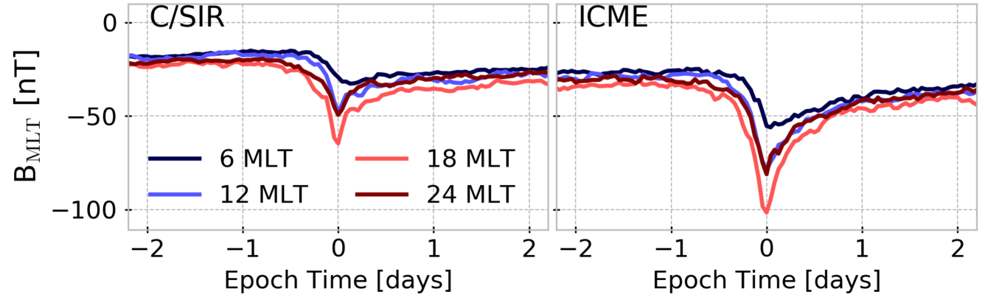
Historical geomagnetic storm drivers determined exclusively from ground-based magnetometer measurements
1
Key message
4
Setup
Setup
Model
A selection of 7547 past geomagnetic storm events (target set) is assigned to solar wind drivers using geomagnetic properties of 538 training events. The two driver classes are 0: Corotating/Stream Interaction Regions (C/SIRs) and 1: Interplanetary Coronal Mass Ejections (ICMEs).
Features of the geomagnetic field measured at ground can be used to identify geo-magnetic storm drivers in the pre-satellite era. We deliver a list of geomagnetic storms since 1930 together with probabilities for a C/SIR or ICME driving mechanism.
Event ID, i = 1, ..., n = 538
Driver class (binary)
Feature vector
Input data
6
Intercept, coefficients
Classification
a) Feature selection
c) Assessment of
best model
b) Hyperparameter optimization via grid search
Features / Model
Fig. Setup: Illustration of target and training storm events (crosses). The drivers of the training events are known.
24
2
5
Input data
23
Validation
HMC [nT] | Hourly Magnetospheric Currents index (Pick et al., 2019)
B_{MLT} [nT] | Magnetic field disturbance along dipole axis, sorted into MLT sectors.
C/SIR
ICME
Validation
Metric | MCC | HSS | ROC AUC | ACC | F1
Value | 0.54 | 0.54 | 0.86 | 0.78 | 0.71
C/SIR
276 TN | 66 FP | 342 N
50 FN | 146 TP | 196 P
326 PN | 212 PP | 538 POP
Fig. SEA:
Superposed epoch analysis of B_{MLT} for training events.
Click for HMC.
22
Tab. Performance Metrics & Confusion Matrix:
Matthew's Correlation Coefficient (MCC), Heidke Skill Score (HSS), Area Under Receiver Operating Curve (ROC AUC), Accuracy (ACC) & F1 score derived from the confusion matrix.
True
ICME
21
References
20
Predicted
3
7
“Madness”
Features
Results | Conclusions
From the input data 11 features are derived to enter the logistic regression model.
19
Storm recovery phase seems to be
more sensitive to driver class
than main phase
4 features with predictive capability
Use of B-field disturbance at high
latitudes might improve result
18
17
Fig. Class Statistics: Fractions of C/SIR & ICME driven storms in dependence on HMC peak and solar cycle phase.
8
Top reference
Fig. Features: Histograms of feature values (centered, scaled to unit variance) for C/SIR (blue) and ICME (red) driven storms from the training set. The Interquartile Range (IQR) is the range between the 75th and 25th percentiles. Q2 is the 50th percentile (median). All 11 features are shown on the detail slide “Features / Model”.
Fig. Classification: Target (gray) and training events (colored dots) in a year vs. solar rotation (27.28 days) plot (left) and events per year (bars) with normalized sunspot number (SN) and low-pass filtered HMC (right). Solar cycles (SC) are numbered in gray. Click to see classification result.
Pick et al., 2019: Evolution of large-scale magnetic fields from near Earth space during the last 11 solar cycles,
JGR Space Physics, doi: https://doi.org/10.1029/2018JA026185.

Slide 5
Historical geomagnetic storm drivers determined exclusively from ground-based magnetometer measurements
1
Key message
4
Setup
Setup
Model
A selection of 7547 past geomagnetic storm events (target set) is assigned to solar wind drivers using geomagnetic properties of 538 training events. The two driver classes are 0: Corotating/Stream Interaction Regions (C/SIRs) and 1: Interplanetary Coronal Mass Ejections (ICMEs).
Features of the geomagnetic field measured at ground can be used to identify geo-magnetic storm drivers in the pre-satellite era. We deliver a list of geomagnetic storms since 1930 together with probabilities for a C/SIR or ICME driving mechanism.
Event ID, i = 1, ..., n = 538
Driver class (binary)
Feature vector
Input data
6
Intercept, coefficients
Classification
a) Feature selection
c) Assessment of
best model
b) Hyperparameter optimization via grid search
Features / Model
Fig. Setup: Illustration of target and training storm events (crosses). The drivers of the training events are known.
24
2
5
Input data
23
Validation
HMC [nT] | Hourly Magnetospheric Currents index (Pick et al., 2019)
B_{MLT} [nT] | Magnetic field disturbance along dipole axis, sorted into MLT sectors.
C/SIR
ICME
Validation
Metric | MCC | HSS | ROC AUC | ACC | F1
Value | 0.54 | 0.54 | 0.86 | 0.78 | 0.71
C/SIR
276 TN | 66 FP | 342 N
50 FN | 146 TP | 196 P
326 PN | 212 PP | 538 POP
Fig. SEA:
Superposed epoch analysis of HMC for training events.
Click for B_{MLT}.
22
Tab. Performance Metrics & Confusion Matrix:
Matthew's Correlation Coefficient (MCC), Heidke Skill Score (HSS), Area Under Receiver Operating Curve (ROC AUC), Accuracy (ACC) & F1 score derived from the confusion matrix.
True
ICME
21
References
20
Predicted
3
7
“Madness”
Features
Results | Conclusions
From the input data 11 features are derived to enter the logistic regression model.
19
Storm recovery phase seems to be
more sensitive to driver class
than main phase
4 features with predictive capability
Use of B-field disturbance at high
latitudes might improve result
18
17
Fig. Class Statistics: Fractions of C/SIR & ICME driven storms in dependence on HMC peak and solar cycle phase.
8
Top reference
Fig. Features: Histograms of feature values (centered, scaled to unit variance) for C/SIR (blue) and ICME (red) driven storms from the training set. The Interquartile Range (IQR) is the range between the 75th and 25th percentiles. Q2 is the 50th percentile (median). All 11 features are shown on the detail slide “Features / Model”.
Fig. Classification: Classified events (63% C/SIRs in blue, 37% ICMEs in red) in a year vs. solar rotation (27.28 days) plot (left) and class occurrence ratios per year with normalized sunspot number (SN) and low-pass filtered HMC (right). Solar cycles (SC) are numbered in gray. Click to see starting position.
Pick et al., 2019: Evolution of large-scale magnetic fields from near Earth space during the last 11 solar cycles,
JGR Space Physics, doi: https://doi.org/10.1029/2018JA026185.

Slide 6
Historical geomagnetic storm drivers determined exclusively from ground-based magnetometer measurements
1
Key message
4
Setup
Setup
Model
A selection of 7547 past geomagnetic storm events (target set) is assigned to solar wind drivers using geomagnetic properties of 538 training events. The two driver classes are 0: Corotating/Stream Interaction Regions (C/SIRs) and 1: Interplanetary Coronal Mass Ejections (ICMEs).
Features of the geomagnetic field measured at ground can be used to identify geo-magnetic storm drivers in the pre-satellite era. We deliver a list of geomagnetic storms since 1930 together with probabilities for a C/SIR or ICME driving mechanism.
Event ID, i = 1, ..., n = 538
Driver class (binary)
Feature vector
Input data
6
Intercept, coefficients
Classification
a) Feature selection
c) Assessment of
best model
b) Hyperparameter optimization via grid search
Features / Model
Fig. Setup: Illustration of target and training storm events (crosses). The drivers of the training events are known.
24
2
5
Input data
23
Validation
HMC [nT] | Hourly Magnetospheric Currents index (Pick et al., 2019)
B_{MLT} [nT] | Magnetic field disturbance along dipole axis, sorted into MLT sectors.
C/SIR
ICME
Validation
Metric | MCC | HSS | ROC AUC | ACC | F1
Value | 0.54 | 0.54 | 0.86 | 0.78 | 0.71
C/SIR
276 TN | 66 FP | 342 N
50 FN | 146 TP | 196 P
326 PN | 212 PP | 538 POP
Fig. SEA:
Superposed epoch analysis of B_{MLT} for training events.
Click for HMC.
22
Tab. Performance Metrics & Confusion Matrix:
Matthew's Correlation Coefficient (MCC), Heidke Skill Score (HSS), Area Under Receiver Operating Curve (ROC AUC), Accuracy (ACC) & F1 score derived from the confusion matrix.
True
ICME
21
References
20
Predicted
3
7
“Madness”
Features
Results | Conclusions
From the input data 11 features are derived to enter the logistic regression model.
19
Storm recovery phase seems to be
more sensitive to driver class
than main phase
4 features with predictive capability
Use of B-field disturbance at high
latitudes might improve result
18
17
Fig. Class Statistics: Fractions of C/SIR & ICME driven storms in dependence on HMC peak and solar cycle phase.
8
Top reference
Fig. Features: Histograms of feature values (centered, scaled to unit variance) for C/SIR (blue) and ICME (red) driven storms from the training set. The Interquartile Range (IQR) is the range between the 75th and 25th percentiles. Q2 is the 50th percentile (median). All 11 features are shown on the detail slide “Features / Model”.
Fig. Classification: Classified events (63% C/SIRs in blue, 37% ICMEs in red) in a year vs. solar rotation (27.28 days) plot (left) and class occurrence ratios per year with normalized sunspot number (SN) and low-pass filtered HMC (right). Solar cycles (SC) are numbered in gray. Click to see starting position.
Pick et al., 2019: Evolution of large-scale magnetic fields from near Earth space during the last 11 solar cycles,
JGR Space Physics, doi: https://doi.org/10.1029/2018JA026185.

Slide 7




Historical geomagnetic storm drivers determined exclusively from ground-based magnetometer measurements
Setup
Input data
Features / Model
Validation
Leonie Pick, M.Sc.
Ph.D. Candidate
GFZ German Research Centre for Geosciences
Section 2.3 Geomagnetism
leonie.pick@gfz-potsdam.de
+49 331 288-28922
Find me on ResearchGate!
References
“Madness”

Slide 8
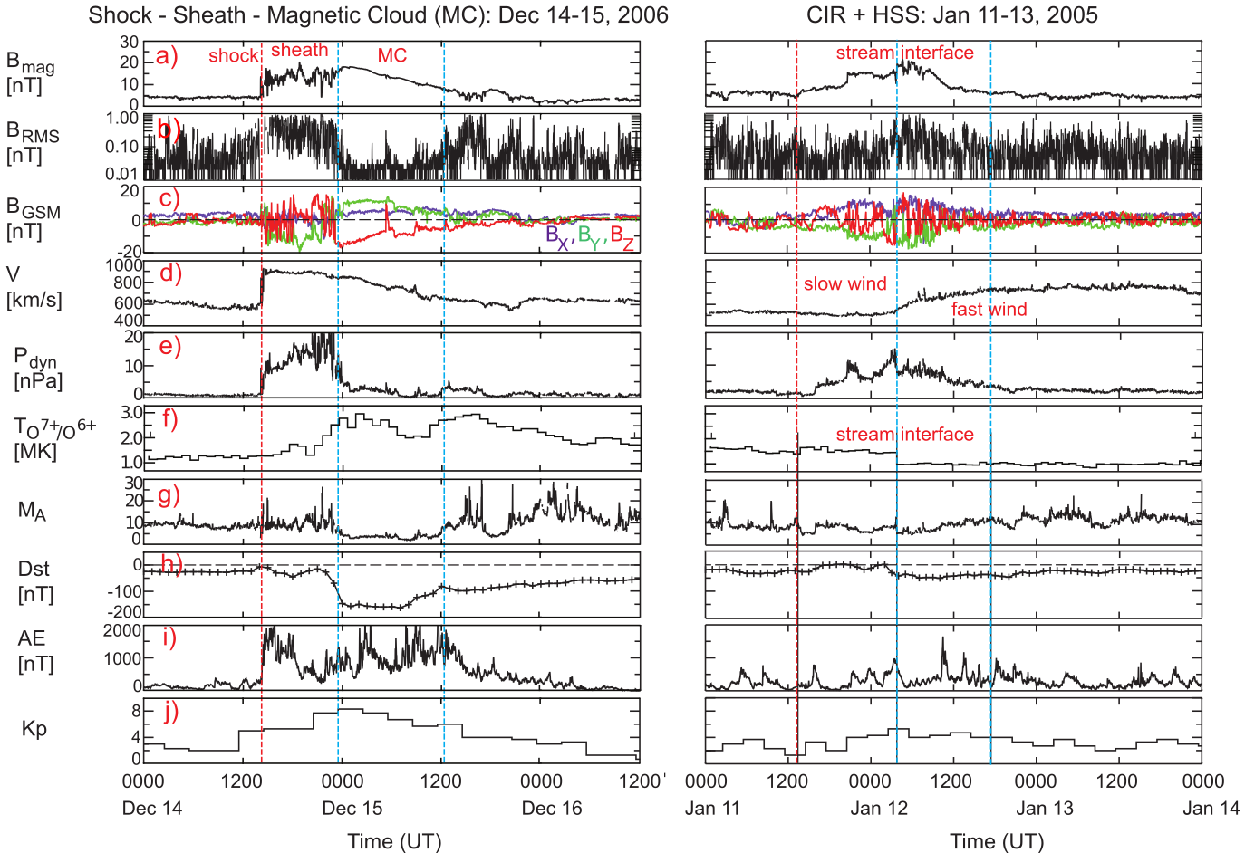
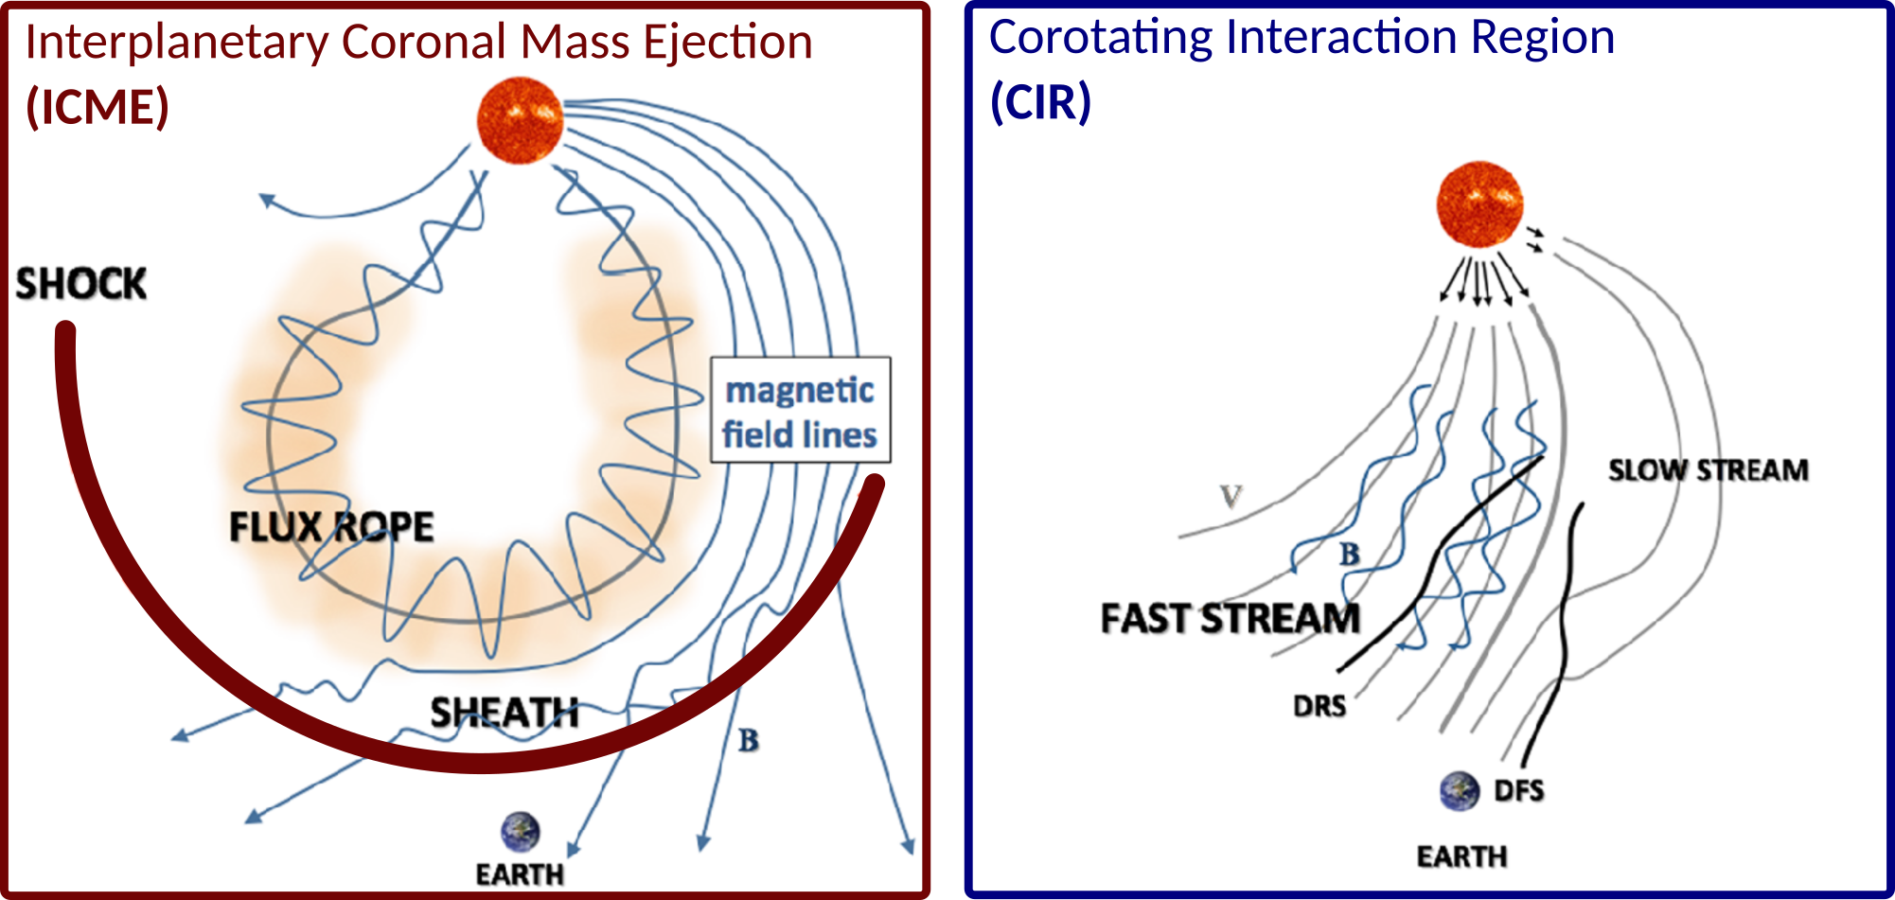
Historical geomagnetic storm drivers determined exclusively from ground-based magnetometer measurements
1
Setup
Training events (t₀):
Source | Time span | Data source | Signatures for classification | C/SIR | ICME
Jian et al., 2006a, b; 2011 | 1995 - 2009 | IMF & Plasma from Wind, ACE | Bsw, Vsw, Np, Tp, β, Pt | 522 | 223
Turnet et al., 2009 (Richardson et al., 2000) | 1995 - 2004 | OMNI-2, low res. | Bsw, Vsw, Np, Tp, BDE, ... | 29 | 48
Shen et al., 2017 | 2013 - 2016 | OMNI-2, high res. | Bsw, Vsw, Np, SYM-H | 20 | 26
 |  |  |  | 571 | 297
Input data
Features / Model
Tab. Training events: Resources for peak times and classes of training storm events.
Validation
References
“Madness”
Fig. Sketch of ICME & CIR: Sketch of an ICME (left) and a CIR (right). DRS and DFS mean developing reverse and forward shock, respectively. Figure taken from Kilpua et al., 2017.
Fig. Solar wind and geomagnetic responses: Responses to an ICME (left) and CIR (right) based on OMNI data (1-min for solar wind and AE, 1-hour for Dst and Kp). Vertical lines in the left plot are the ICME shock and the boundaries of the magnetic cloud. Vertical lines in the right plot are the start of the CIR, the stream interface and the end of the CIR (from CIR catalog by L. Jian). Figure taken from Kilpua et al., 2017.

Slide 9
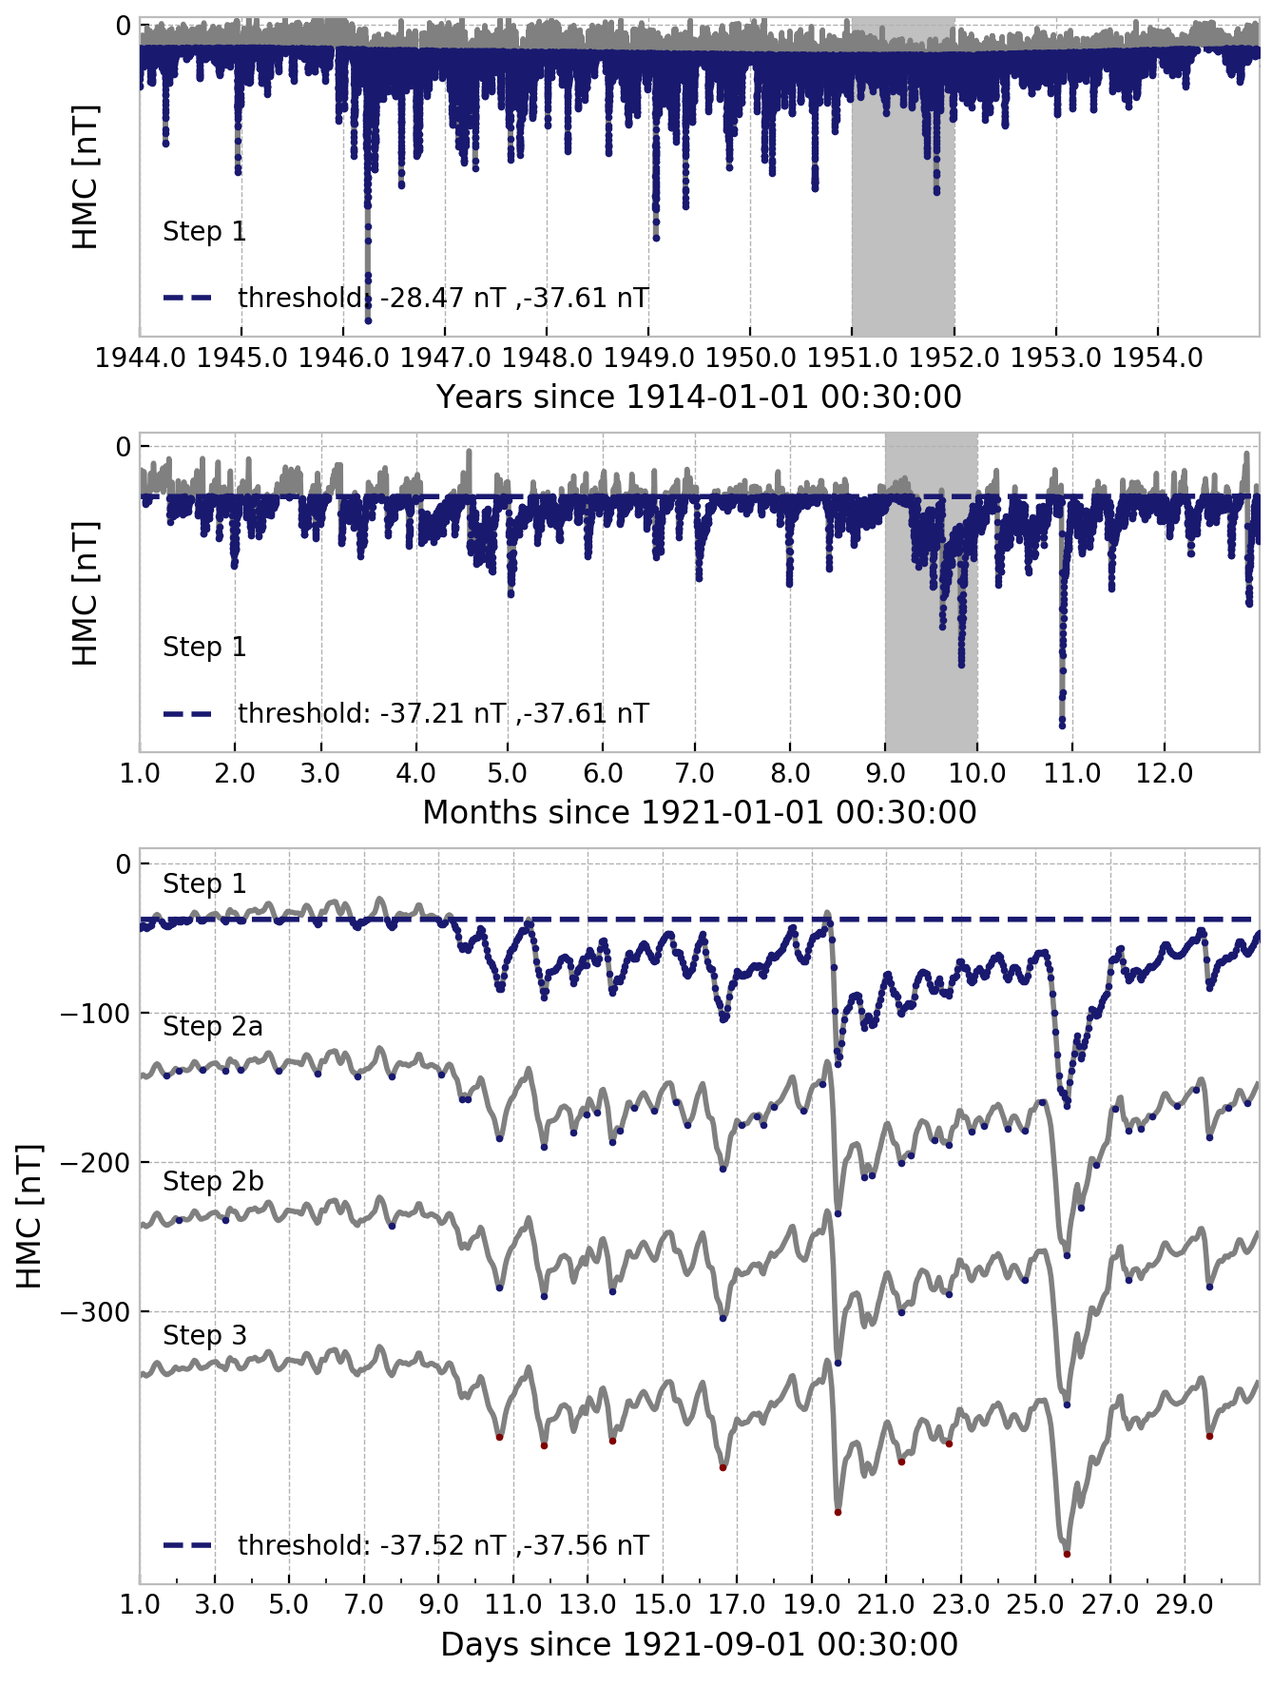
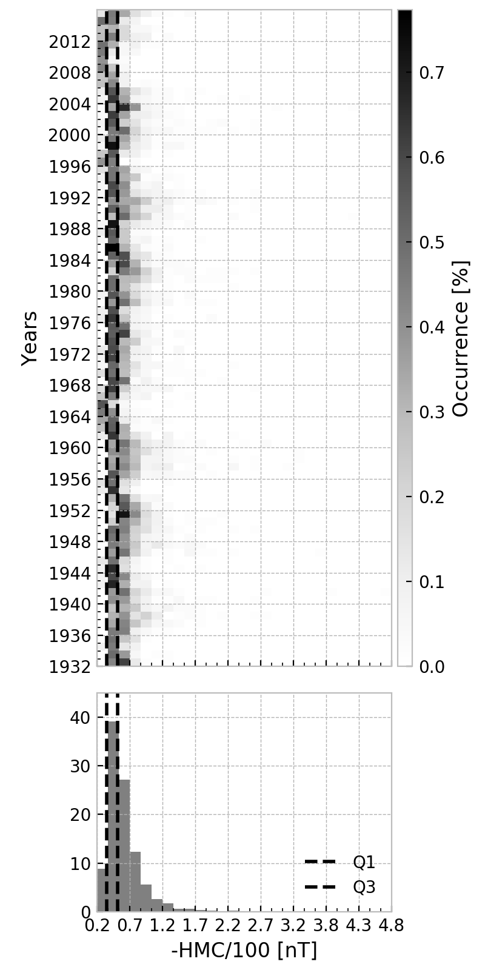
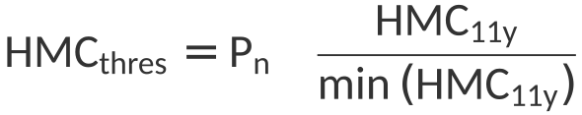
Historical geomagnetic storm drivers determined exclusively from ground-based magnetometer measurements
2
Setup
Target events (t_{e}):
The selection of target event involves three steps:
Apply solar cycle dependent threshold on complete HMC time series:
Identify single events from series of UT hours:
  Find HMC local minima based on “gradient search” (dHMC/dt).
  Select events that are separated by more than Δt hours.
Select events with a HMC drop greater than ΔHMC_{5d}.
The parameters P_{n}, Δt and ΔHMC_{5d} are found by maximizing
while allowing a loss of training events up to 40% (~347 events).
Input data
Features / Model
Validation
Parameter | Description | Optimum
P_{n} [nT] | n-th HMC percentile | 29 (P₂₉ = -37.6 )
Δt [h] | Minimum inter-event time | 26
ΔHMC_{5d} [nT] | HMC - HMC_{5d} | 7
References
“Madness”
Tab. Selection parameters: Optimized selection parameters for target events.
HMC_{5d, 11y}: Low-pass filtered HMC with cutoff period at 5 days or 11 years.
Fig. Event selection steps: Illustration of target event selection steps at different time resolutions from annual (top) to daily (bottom).
Fig. HMC distribution: HMC index distribution of target events. The interquartile range falls between -39 and -66 nT (dashed lines). The median (Q2) is located at -50 nT. Click for Kp distrubution.

Slide 10
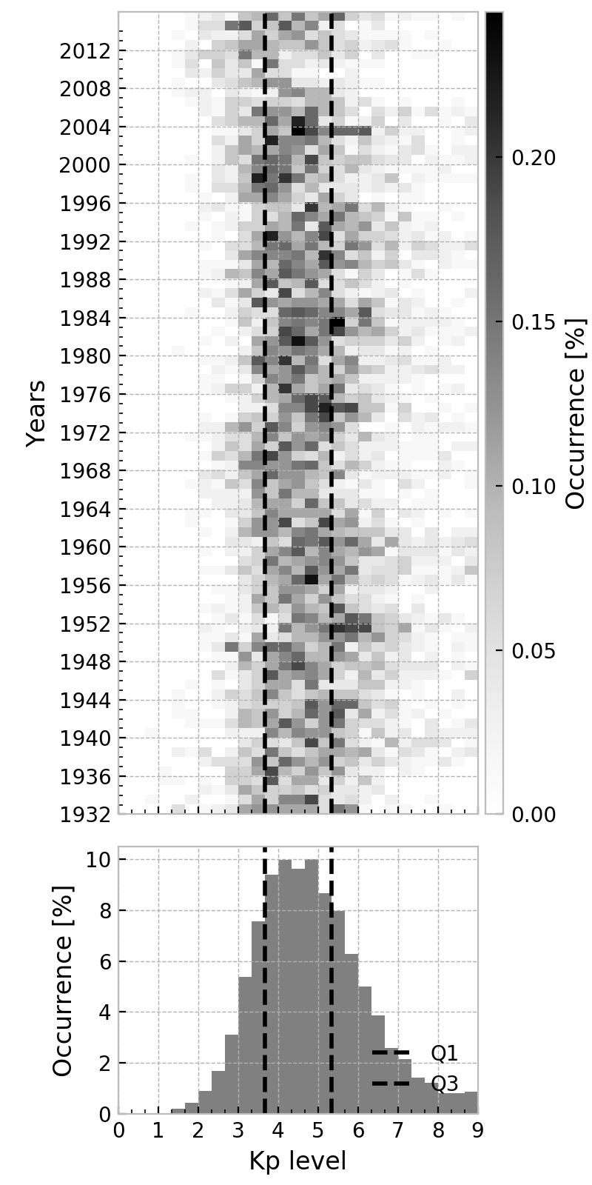
Historical geomagnetic storm drivers determined exclusively from ground-based magnetometer measurements
2
Setup
Target events (t_{e}):
The selection of target event involves three steps:
Apply solar cycle dependent threshold on complete HMC time series:
Identify single events from series of UT hours:
  Find HMC local minima based on “gradient search” (dHMC/dt).
  Select events that are separated by more than Δt hours.
Select events with a HMC drop greater than ΔHMC_{5d}.
The parameters P_{n}, Δt and ΔHMC_{5d} are found by maximizing
while allowing a loss of training events up to 40% (~347 events).
Input data
Features / Model
Validation
Parameter | Description | Optimum
P_{n} [nT] | n-th HMC percentile | 29 (P₂₉ = -37.6 )
Δt [h] | Minimum inter-event time | 26
ΔHMC_{5d} [nT] | HMC - HMC_{5d} | 7
References
“Madness”
Tab. Selection parameters: Optimized selection parameters for target events.
HMC_{5d, 11y}: Low-pass filtered HMC with cutoff period at 5 days or 11 years.
Fig. Event selection steps: Illustration of target event selection steps at different time resolutions from annual (top) to daily (bottom).
Fig. Kp distribution: Kp index distribution of target events. The interquartile range falls between 4- and 5+ (dashed lines). The median (Q2) is located at 5-.
Click for HMC distribution.

Slide 11
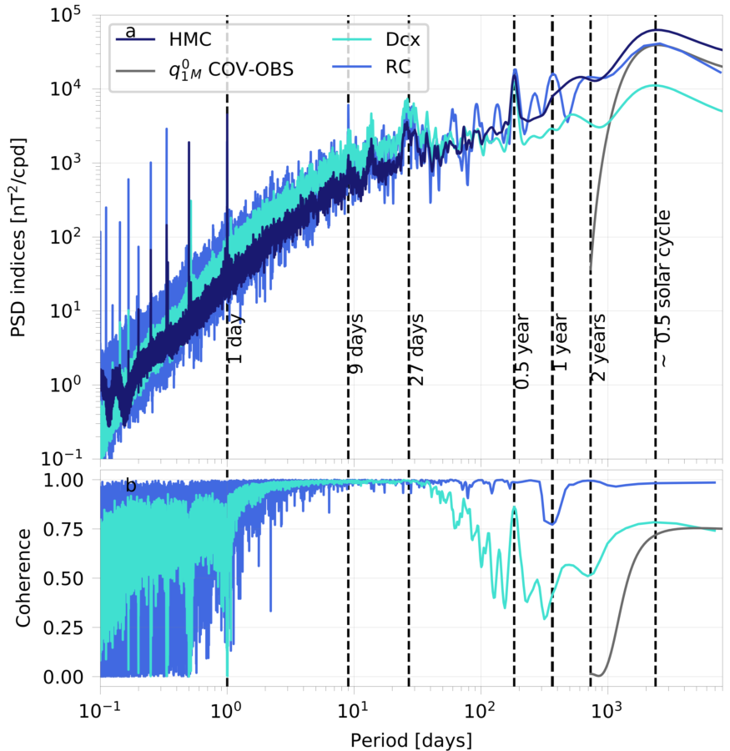
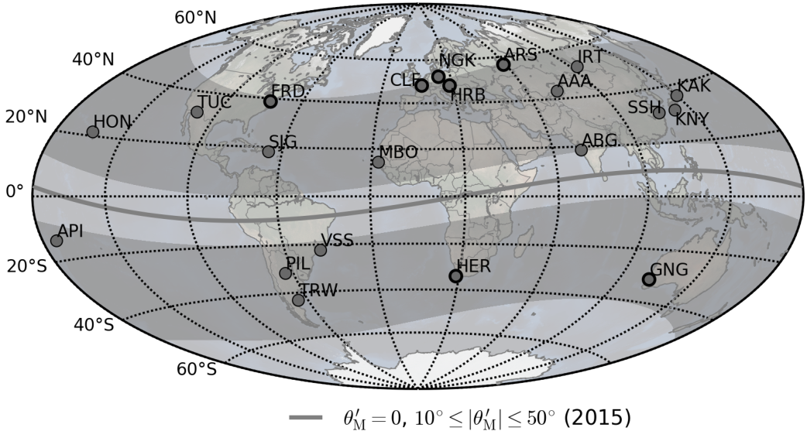
Historical geomagnetic storm drivers determined exclusively from ground-based magnetometer measurements
1
Setup
Hourly Magnetospheric Currents Index (HMC)
The HMC index (Pick et al., 2019; available via GFZ Data Services) measures the activity of large-scale magnetospheric currents on Earth's surface from 1900 to 2015. It resolves the absolute intensity of low-frequency variations, especially at periods relevant to the solar cycle (~11 yr), more robustly than existing geomagnetic indices. HMC is based on hourly means of vector magnetic field measurements from 21 mid latitude geomagnetic observatories (and their predecessors) obtained from World Data Centre for Geomagnetism, Edinburgh.
Input data
Features / Model
Validation
References
“Madness”
Fig. Geomagnetic observatories: The observatories contributing to HMC are located within 50° of geomagnetic latitude (gray shaded), excluding the equator (gray line). Between 1930 and 2015 seven out of 21 observatories (thick circles) have predecessors, so that data from a total of 14+7*2=28 observatories are used in this study.
Fig. HMC Spectrum: Power spectral density (a) and magnitude squared coherence (b) of HMC and comparable indices Dcx (Mursula & Karinen, 2005), RC (Olsen et al., 2014) and the external axial dipole coefficient of COV-OBS.x1 (Gillet et al., 2015, periods ≥ 2 years).

Slide 12
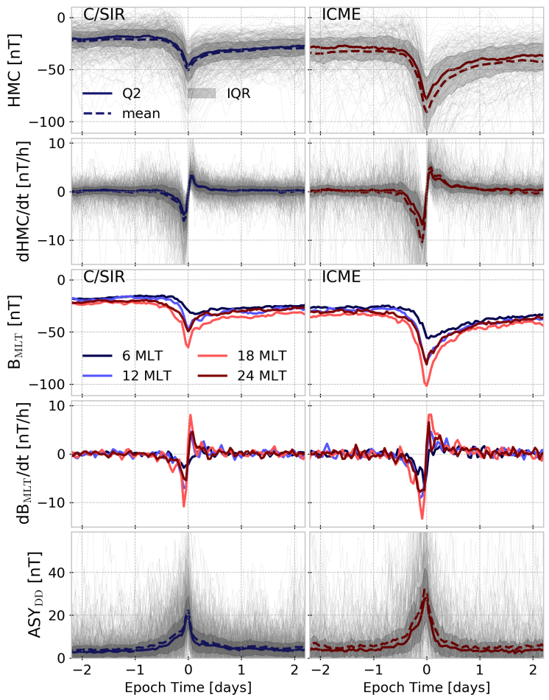
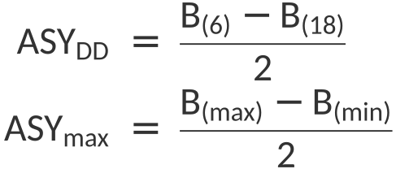
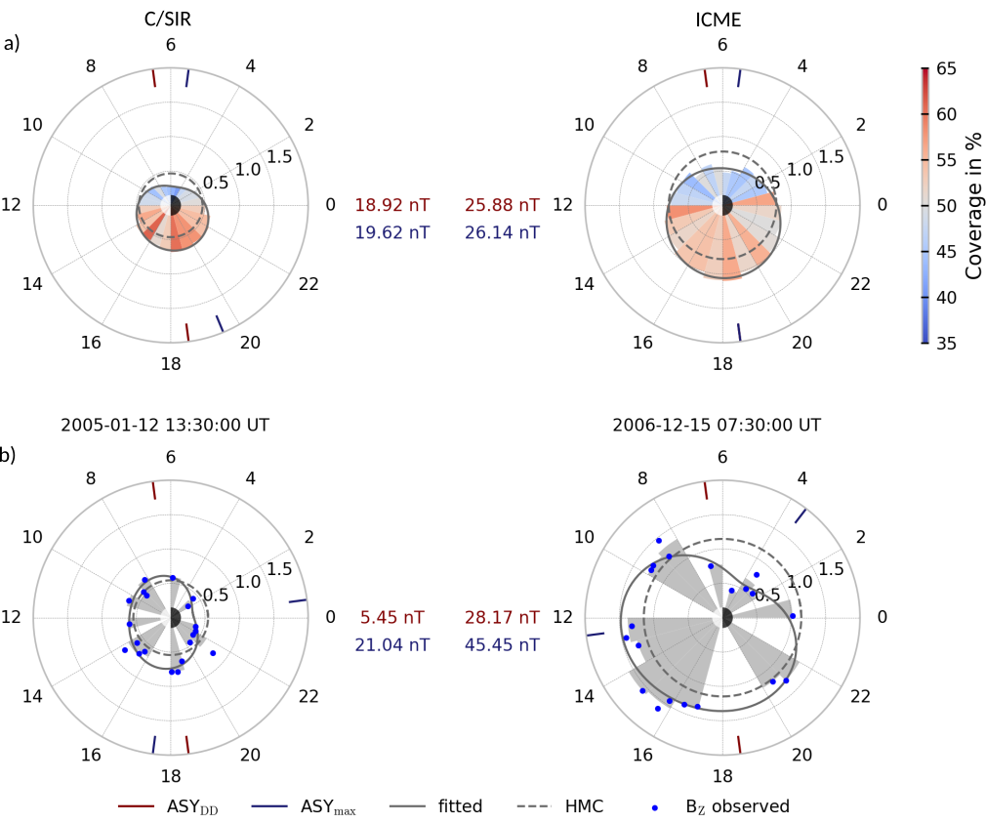
Historical geomagnetic storm drivers determined exclusively from ground-based magnetometer measurements
2
Setup
Magnetic field disturbance (B_{MLT})
The magnetic field disturbance (B in nT) from individual observatories are sorted into 1-h magnetic local time (MLT) bins, centered on half hours, and termed B₍₀₎, B₍₁₎, ..., B₍₂₃₎. Two measures of B-field asymmetry are:
To mitigate the problem of missing values the data is averaged over six 1-h MLT bins to give:
B₆ centered on 06:30 h (dawn), B₁₂ on 12:30 h (noon), B₁₈ on 18:30 h (dusk) and B₀ on 00:30 h (midnight).
Input data
Features / Model
Validation
References
“Madness”
Fig. Magnetic field disturbance in MLT sectors for storm peaks:
Magnetic field residua (radial direction, -100 nT) at storm peak time per 1-h MLT sector (angle; noon left, midnight right) for
a) the median of 538 target events,
b) two examplary storms.
The “fitted” line is calculated from a 2nd order Fourier Fit to the 24 B_{(MLT)} values. 100% measurement coverage means that the MLT sector was sampled by at least one observatory at all storm peak hours.
Fig. Superposed epoch analysis of training events: Five basic HMC related properties (rows) of superposed C/SIR (left) and ICME (right) driven storms with epoch times given by the event peaks (local HMC minima). IQR is the interquartile range, Q2 is the 50th percentile (median).

Slide 13
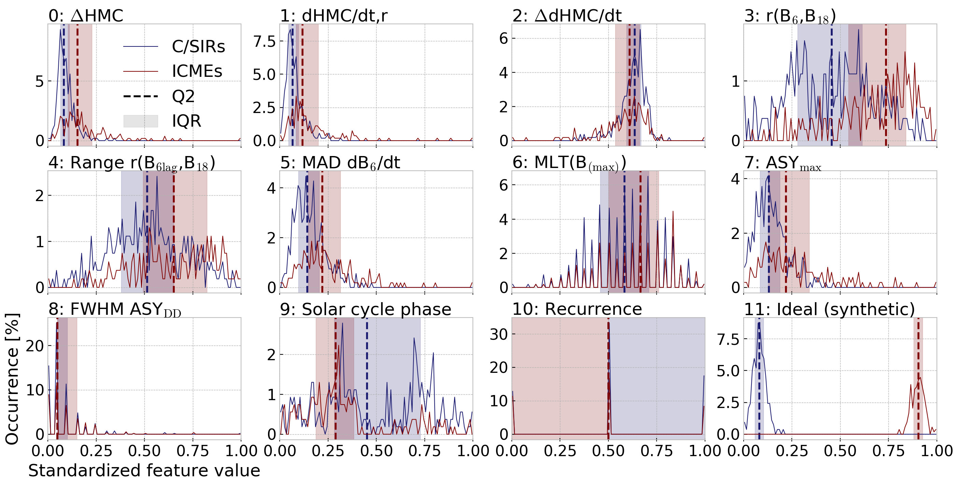
Historical geomagnetic storm drivers determined exclusively from ground-based magnetometer measurements
1
Setup
Features
ID | Feature name | Description
0 | ΔHMC | HMC - HMC_{1y} at storm peak (t_{e})
1 | dHMC/dt,r | Mean rate of HMC change over interval starting at max. dHMC/dt after t_{e} and ending 12 h after t_{e} (recovery phase).
2 | ΔdHMC/dt | Difference between dHMC/dt,r (Feature 1) and dHMC/dt,l. dHMC/dt,l is the same as dHMC/dt,r but for the 12 h time interval prior to t_{e} (main phase).
3 | r(B₆,B₁₈) | Pearson's correlation coefficient (r) of magnetic field residua at dawn (B₆) and dusk (B₁₈) during interval [t_{e}, t_{e}+24 h].
4 | Range r(B_{6 lag},B₁₈) | Range in r(B₆, B₁₈) for lags [-12,12] h applied to B₆.
5 | MAD dB₆/dt | Median Absolute Deviation, i.e. variance, for the rate of B₆ change during [t_{e}, t_{e} + 24h].
6 | MLT(B_{(max)}) | Number of hours during [t_{e} - 48h, t_{e} -24h] at which B_{(max)} is located at MLT smaller than 17 h.
7 | ASY_{max} | Greatest ASY_{max} during [t_{e}-24h, t_{e}].
8 | FWHM ASY_{DD} | Full Width at Half Maximum (hours) of ASY_{DD.}
9 | Solar cycle phase | Rate of change in HMC_{11y} at t_{e}.
10 | Recurrence | Either 0, 1 or 2: 0: Event does not recur in target set. 1: Event recurs once in target set with a period of 27.28 days (1 solar rotation, tolerance of 26 h). 2: Event recurs twice.
Input data
Features / Model
Validation
References
“Madness”
Fig. Features: Histograms of standardized (centered, scaled to unit variance) features for C/SIR (blue) and ICME (red) driven storms with Interquartile Range (IQR) and 50th percentile (Q2, median). Feature 11 is a synthetic “ideal” feature.
Tab. Features: 11 features derived from ground-based magnetometer data.
HMC_{ny}: Low-pass filtered HMC with cutoff period at n years; t_{e}: UT of event peak; MLT: Magnetic local time.

Slide 14
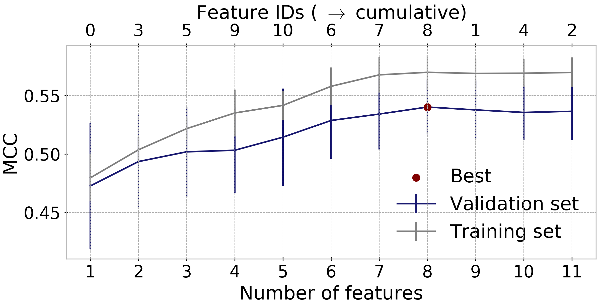
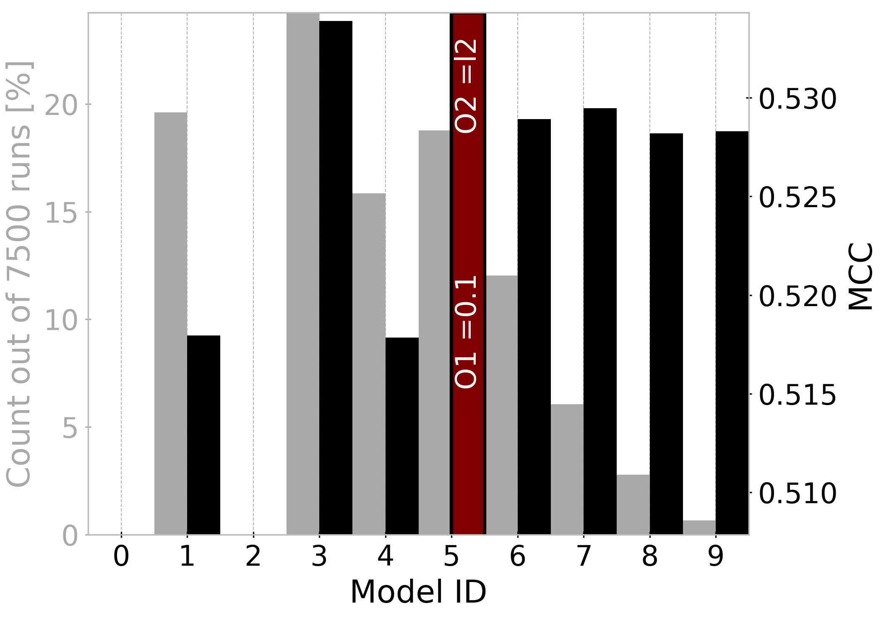
Historical geomagnetic storm drivers determined exclusively from ground-based magnetometer measurements
2
Setup
Features & Model
ID | Feature name | Description | Coefficients (β)
0 | ΔHMC | HMC - HMC_{1y} at storm peak (t_{e}) | 0.63
1 | dHMC/dt,r | Mean rate of HMC change over interval starting at max. dHMC/dt after t_{e} and ending 12 h after t_{e} (recovery phase).
2 | ΔdHMC/dt | Difference between dHMC/dt,r (Feature 1) and dHMC/dt,l. dHMC/dt,l is the same as dHMC/dt,r but for the 12 h time interval prior to t_{e} (main phase).
3 | r(B₆,B₁₈) | Pearson's correlation coefficient (r) of magnetic field residua at dawn (B₆) and dusk (B₁₈) during interval [t_{e}, t_{e}+24 h]. | 0.77
4 | Range r(B_{6 lag},B₁₈) | Range in r(B₆, B₁₈) for lags [-12,12] h applied to B₆.
5 | MAD dB₆/dt | Median Absolute Deviation, i.e. variance, for the rate of B₆ change during [t_{e}, t_{e} + 24h]. | 0.63
6 | MLT(B_{(max)}) | Number of hours during [t_{e} - 48h, t_{e} -24h] at which B_{(max)} is located at MLT smaller than 17 h. | 0.28
7 | ASY_{max} | Greatest ASY_{max} during [t_{e}-24h, t_{e}]. | 0.31
8 | FWHM ASY_{DD} | Full Width at Half Maximum (hours) of ASY_{DD.} | 0.16
9 | Solar cycle phase | Rate of change in HMC_{11y} at t_{e}. | -0.42
10 | Recurrence | Either 0, 1 or 2: 0: Event does not recur in target set. 1: Event recurs once in target set with a period of 27.28 days (1 solar rotation, tolerance of 26 h). 2: Event recurs twice. | -0.32
a)
Fig. Feature Selection:
An optimum of 8 features is found in terms of Matthew's correlation coefficient (MCC). Results are averaged over a 4-fold cross-validation with 134 (135) events per fold, repeated 25 times. Vertical lines indicate 2·std.
Input data
Features / Model
Validation
b)
Fig. Model Optimization:
10 combinations of parameters O1 & O2 are tested in a nested K-fold cross-validation with K=3 in the inner loop (optimization) and K=4 in the outer loop (validation). Both loops are repeated 25 times, resulting in 7500 runs per combination.
Gray bars show the fraction of total runs for which model x has the highest MCC, black bars show MCC of model x, averaged over all runs.
References
“Madness”
Tab. Features: 11 features derived from ground-based magnetometer data.
HMC_{ny}: Low-pass filtered HMC with cutoff period at n years; t_{e}: UT of event peak; MLT: Magnetic local time.
“Best” model:
8 features (0,3,5,6,7,8,9,10)
Inverse regularization strength (O1): 0.1
Penalty (O2): L2-norm
Intercept (β₀): -0.17
Iterations: 29

Slide 15
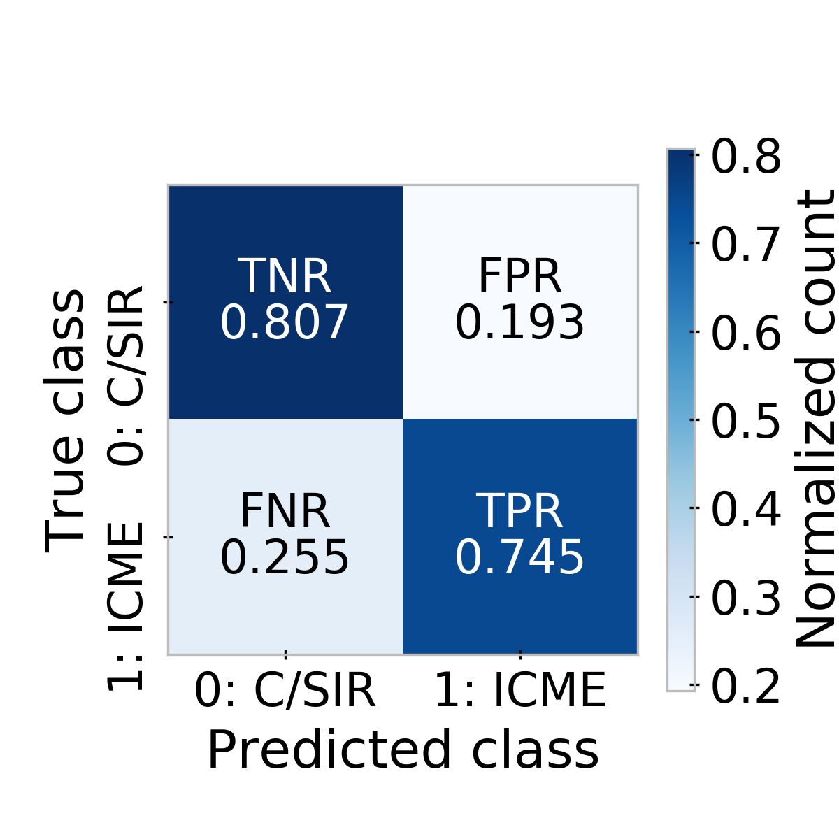
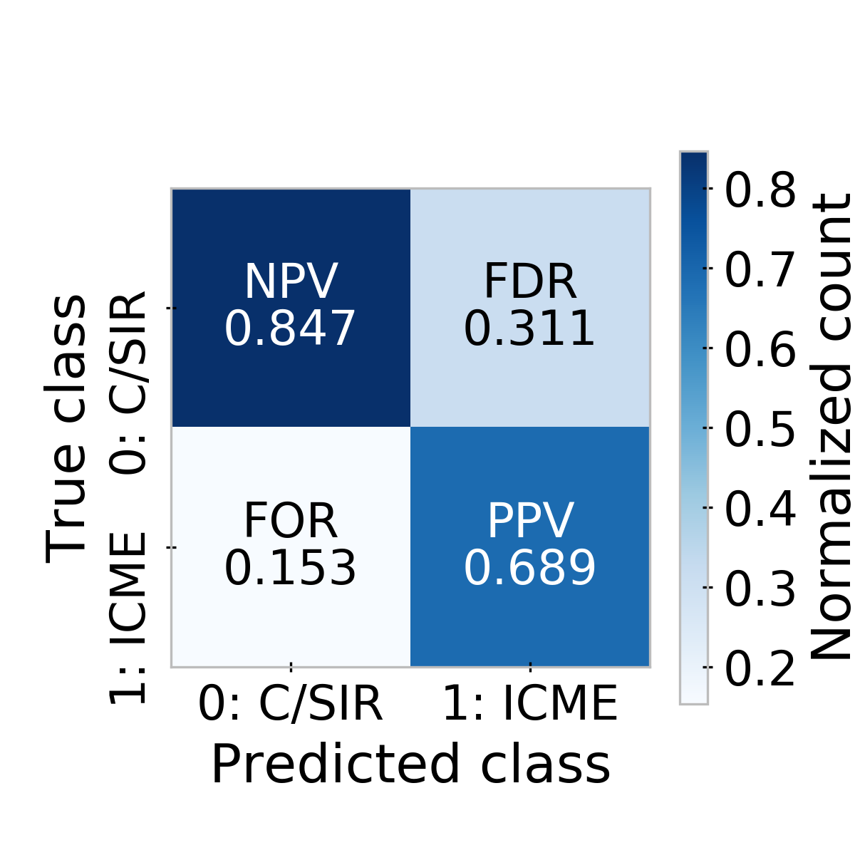
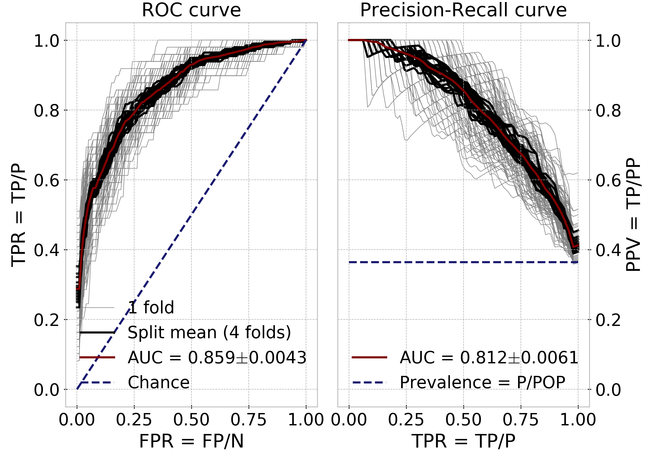
Historical geomagnetic storm drivers determined exclusively from ground-based magnetometer measurements
Setup
a)
b)
276 TN | 66 FP | 342 N
50 FN | 146 TP | 196 P
326 PN | 212 PP | 538 POP
Performance Metrics | Value | Std
Matthew's correlation coefficient MCC = (TP·TN-FP·FN)/√(TP+FP)·(TP+FN)·(TN+FP)·(TN+FN) | 0.54 0.57 | 0.013 0.005
Heidke Skill Score HSS = 2·(TP·TN-FN·FP)/[(TP+FN)·(FN+TN)+(TP+FP)·(FP+TN)] | 0.54 0.57 | 0.012 0.005
Accuracy ACC = (TP+TN)/(POP) | 0.78 0.80 | 0.005 0.003
Diagnostic odds ratio DOR = (TPR·TNR)/(FPR·FNR) | 13.29 14.57 | 1.296 0.503
F1 score F1a = 2·PPV·TPR/(PPV+TPR) F1b = 2·NPV·TNR/(NPV+TNR) | 0.71/0.82 0.73/0.84 | 0.009/0.004 0.003/0.002
Frequency bias FB = (TP+FP)/(TP+FN) | 1.08 1.09 | 0.018 0.012
Informedness BM = TPR+TNR-1 | 0.55 0.58 | 0.014 0.005
Markedness MK = PPV+NPV-1 | 0.53 0.56 | 0.011 0.006
Input data
Features / Model
c)
Validation
References
“Madness”
Fig. Confusion matrix: Confusion matrix (black square, a). N & P are the condition negative & positive, PN and PP are the predicted P and N. Row normalized confusion matrix (b) and column normalized confusion matrix (c).
Tab. Metrics: Some metrics commonly used to assess the skill of a (binary) classifier.
MCC is used here to a) select the most discriminative features and b) optimize the hyperparameters. Values in the upper rows are calculated on the validation sets and those in the bottom rows are from the training sets.
Fig. Diagnostics: Receiver Operating Curves (ROC, left) and Precision-Recall Curves (right) from 4-fold cross-validation, repeated 25 times (100 curves). The Area-Under-Curve (AUC) is given for the mean curves (red).

Slide 16
Historical geomagnetic storm drivers determined exclusively from ground-based magnetometer measurements
Setup
Geomagnetic models and indices:
Gillet et al., 2015: Stochastic forecasting of the geomagnetic field from the COV-OBS.x1 geomagnetic field model, and candidate models for IGRF-12, Earth, Planets and Space, 67(71),
http://doi.org/10.1186/s40623-015-0225-z.
Mursula & Karinen, 2005: Explaining and correcting the excessive semiannual variation in the Dst index, Geophysical Research Letters, 32(L14107), doi: https://doi.org/10.1029/2005GL023132.
Olsen et al., 2014: The CHAOS-4 geomagnetic field model, Geophysical Journal International, 197(2), 815–827, http://doi.org/10.1093/591gji/ggu033.
Pick & Korte, 2018: HMC index V. 1.0., GFZ Data Services, http://doi.org/10.5880/GFZ.2.3.2018.006.
Pick et al., 2019: Evolution of large-scale magnetic fields from near-Earth space during the last 11 solar cycles, Journal of Geophysical Research: Space Physics, 124,
http://doi.org/10.1029/2018JA026185.
Training events:
Jian et al., 2006: Properties of Stream Interactions at One AU During 1995 – 2004, Solar Physics, 239(337), http://doi.org/10.1007/s11207-006-0132-3.
Jian et al., 2006: Properties of Interplanetary Coronal Mass Ejections at One AU During 1995 – 2004, Solar Physics, 239(393), http://doi.org/10.1007/s11207-006-0133-2.
Jian et al., 2011: Comparing Solar Minimum 23/24 with Historical Solar Wind Records at 1 AU, Solar Physics, 274(321), http://doi.org/10.1007/s11207-011-9737-2.
Richardson et al., 2000: Sources of geomagnetic activity over the solar cycle: Relative importance of coronal mass ejections, high-speed streams, and slow solar wind, Journal of Geophysical Research, 105(A8), pp. 18.203-18.213.
Shen et al., 2017: Statistical study of the storm time radiation belt evolution during Van Allen Probes era: CME- versus CIR-driven storms, J. Geophysical Research: Space Physics, 122, 8327–8339,
http://doi.org/10.1002/2017JA024100.
Turner et al., 2009: Geoefficiency and energy partitioning in CIR-driven and CME-driven storms, Journal of Atmospheric and Solar-Terrestrial Physics, 71, 1023–1031, http://doi.org/10.1016/j.jastp.2009.02.005.
Properties of ICMEs and SIRs (exemplary):
Borovsky & Denton, 2006: Differences between CME-driven storms and CIR-driven storms, Journal of Geophysical Reserach, 111(A07S08), http://doi.org/10.1029/2005JA011447.
Kilpua et al., 2017: Geoeffective Properties of Solar Transients and Stream Interaction Regions, Space Science Reviews, 212, 1271–1314, http://doi.org/10.1007/s11214-017-0411-3.
Occurrence statistics of C/SIR and ICME driven storms (exemplary):
Richardson & Cane, 2012: Solar wind drivers of geomagnetic storms during more than four solar cycles, J. Space Weather and Clim., 2(A01), http://doi.org/10.1051/swsc/2012001.
Machine learning (exemplary):
Campareale et al. (eds.), 2018: Machine Learning for Space Weather, Elsevier, ISBN: 978-0-12-811788-0.
Liemohn et al., 2018: Model evaluation guidelines for geomagnetic index predictions, Space Weather, 16, http://doi.org/10.1029/2018SW002067.
Input data
Features / Model
Validation
References
“Madness”

