Slide 1
Fast herbicide transport in a small agricultural catchment: modellers meet experimentalists
Lorenz Ammann
Tobias Doppler
Christian Stamm
Peter Reichert
Fabrizio Fenicia

Slide 2
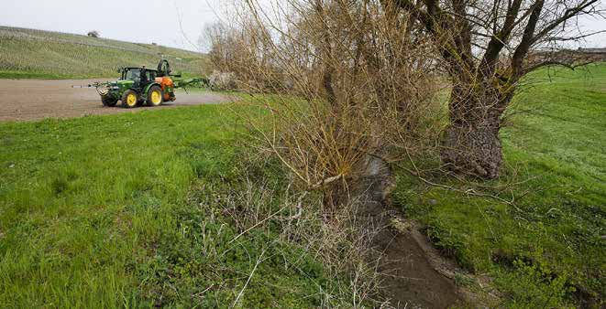
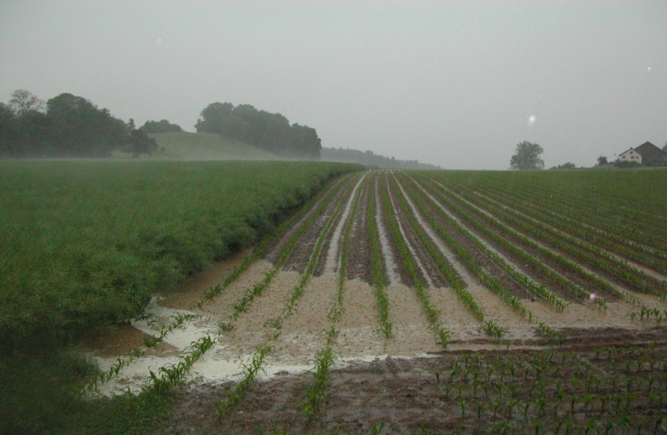
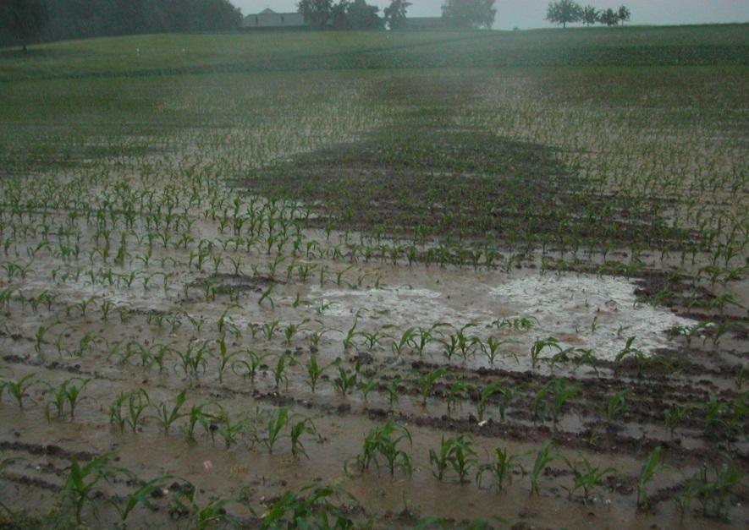
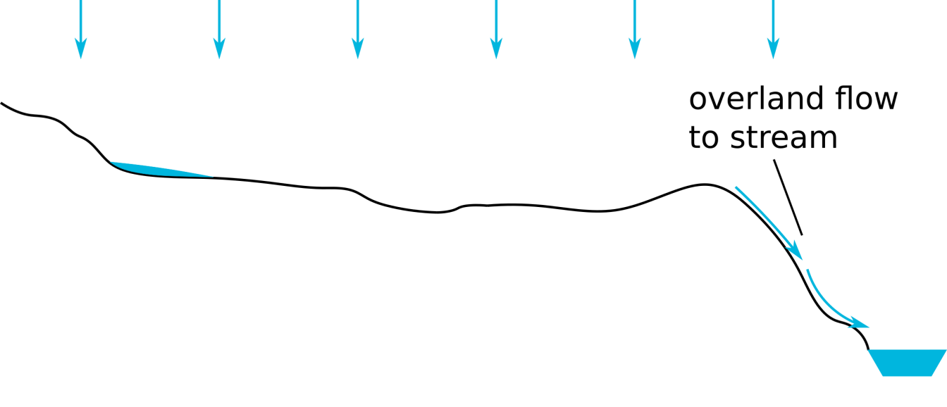
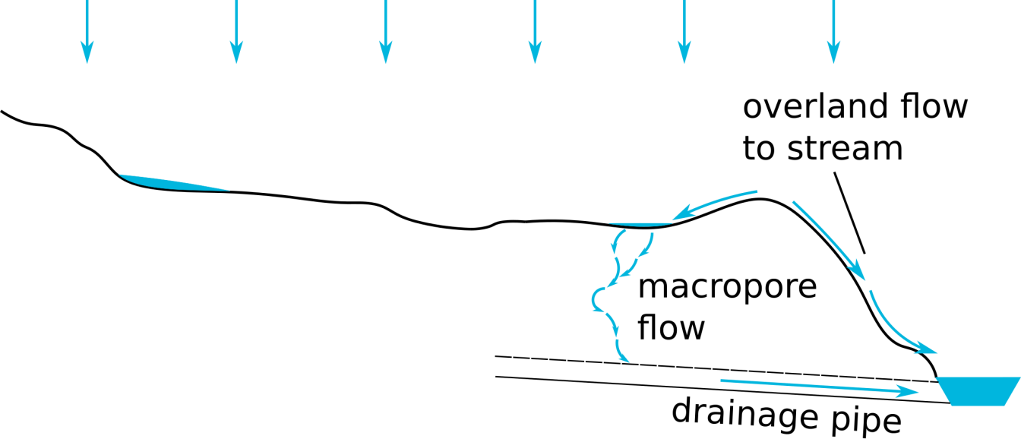
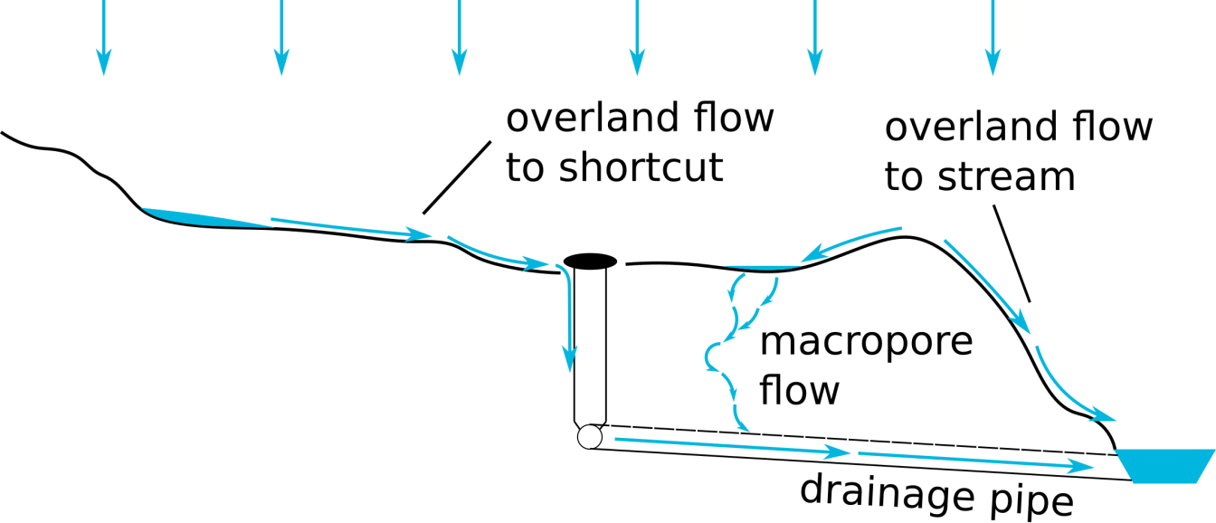
Fast herbicide transport in a small agricultural catchment: modellers meet experimentalists
Drainage pipes
© Tobias Doppler
© Gabriela Brändle, Agroscope
Manhole
© Tobias Doppler
Notes:
Hi everyone! In agricultural headwater catchments, peak herbicide concentrations during rainfall events exceed environmental quality standards on a regular basis. Well-known important fast transport paths are direct overland flow to streams and macropore flow to drainage pipes. In an extensive experimental study in Northern Switzerland, my colleagues performed a controlled herbicide application experiment, with concentration measurements every 15 min during rain events. In this experiment, they identified a third important fast pathway: overland flow to artificial shortcuts on the soil surface. These can be e.g. manholes of the drainage system. We constructed the perceptual model of the transport processes in the catchment and translated it to a conceptual transport model. This was done in close collaboration with experimentalists in many iterations of identifying model deficits and correcting them.

Slide 3
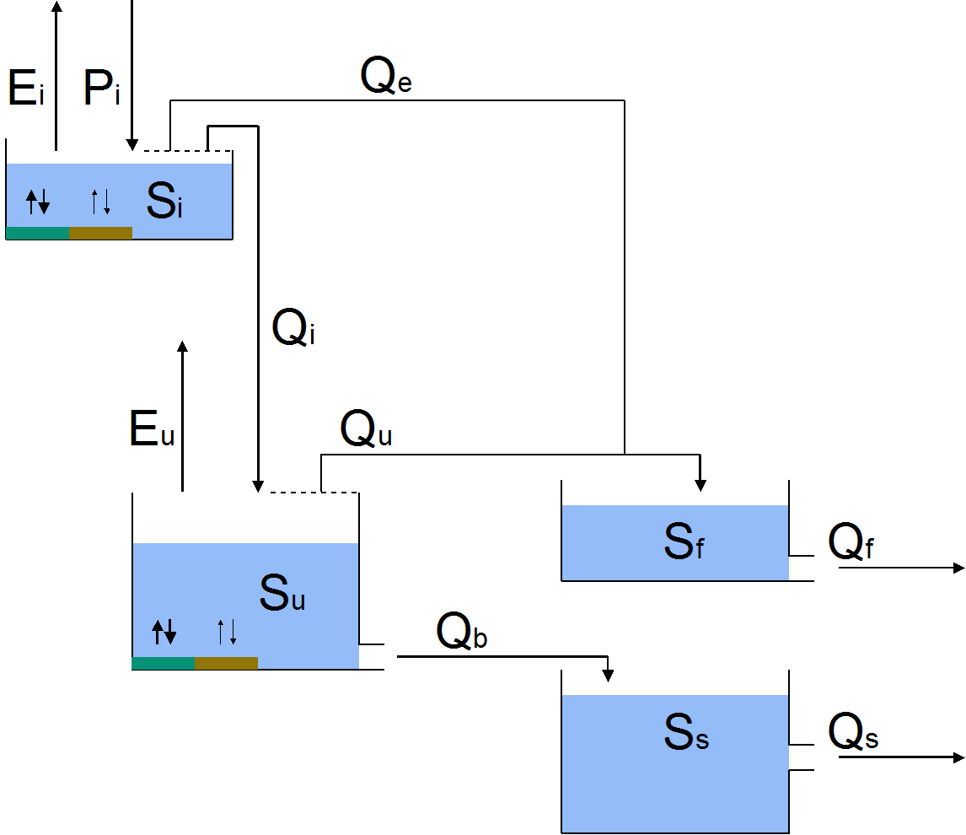
Fast herbicide transport in a small agricultural catchment: modellers meet experimentalists
Model
Deterministic, conceptual “bucket”-model
Semi-distributed, based on HRUs (drainage pipes, shortcuts)
Considering sorption, mobilization, transport and degradation
Calibration
Bayesian equivalent of multi-objective calibration to streamflow and concentration
Using a recently published likelihood framework
Joint estimation of hydrological, chemical and error model parameters
Approximation of full posterior distribution
Numerical technique: affine invariant ensemble MCMC sampler (emcee)
Notes:
The resulting model is a deterministic, conceptual “bucket” model. It is semi-distributed and based on HRUs which represent the spatial elements enabling fast transport, i.e. drainage pipes and shortcuts. It considers sorption, mobilization, transport and degradation. In a calibration sense, the problem can be seen as Bayesian equivalent of multi-objective calibration to streamflow and concentration. We used a recently published likelihood framework that allows to overcome well-known problems of joint inference of hydrological, chemical and error model parameters to approximate the full posterior distribution. For this, we use an affine invariant ensemble MCMC sampler.

Slide 4
Fast herbicide transport in a small agricultural catchment: modellers meet experimentalists
Experimentalists
Modellers
Bayesian approach
Notes:
In short, if you would like to chat about how to bridge the gap between experimentalists and modellers with the help of Bayesian techniques, and how to integrate experimental knowledge at every step of a modelling study, come visit me at Spot X!

Slide 5
Fast herbicide transport in a small agricultural catchment: modellers meet experimentalists
Model,
Likelihood
$$p(\left.θ\right|y)$$
$$∝$$
$$p($$
$$\left.y\right|$$
$$θ)$$
$$p(θ)$$
Posterior, Results
Sampler
Data, Case study
Prior
= click me

Slide 6
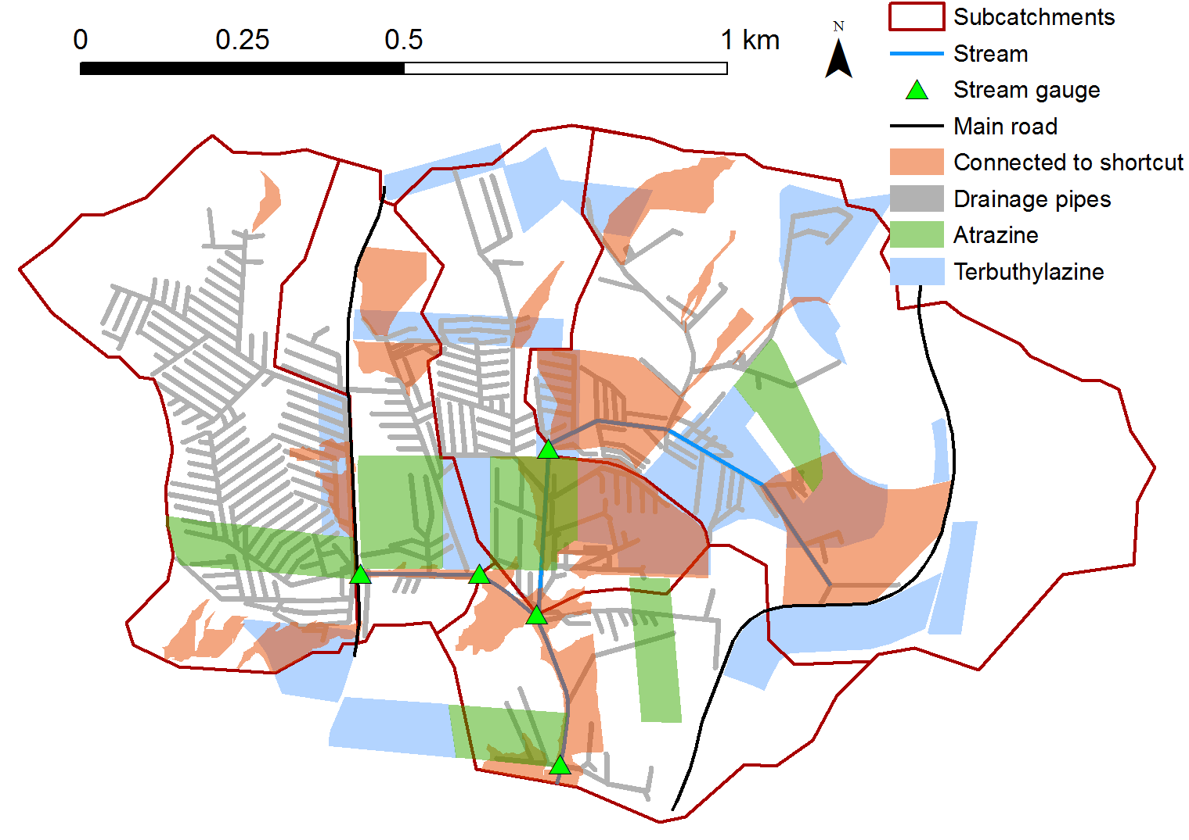
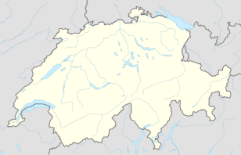
Data basis
Data type | No. of locations | Duration | Interval
Rain gauge | 2 | 1 year | 10 min
Stream gauge | 4 | 6 months | 5 min
Concentra-tion | 4 | 6 months | 15 min (event-based)
GW level | 11 | 1 year | 15 min
Soil moisture | 4 | 1 year | 1 hour
Overland flow | 16 | 6 months | Event-based
Soil profile | 4 | - | -
Doppler et al., 2012, HESS

Slide 7
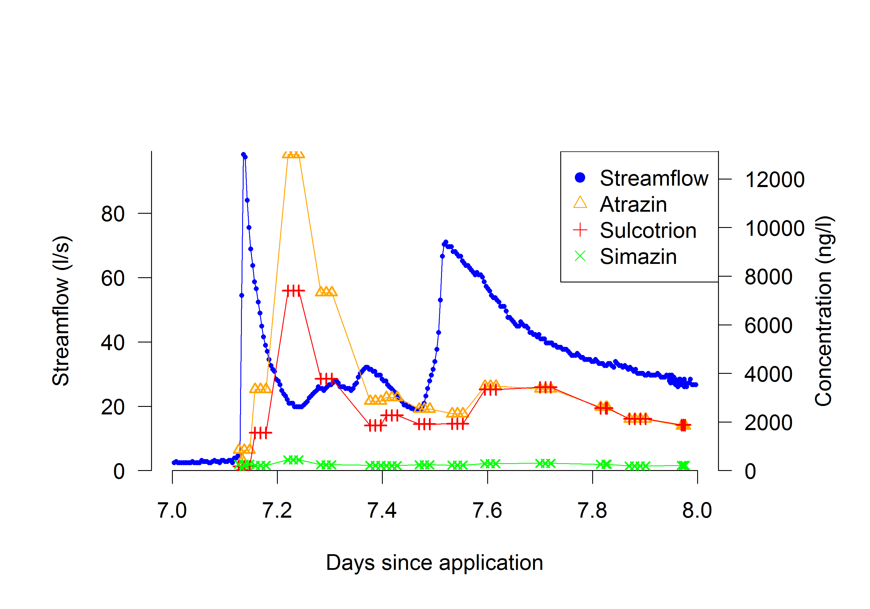
Data basis

Slide 8
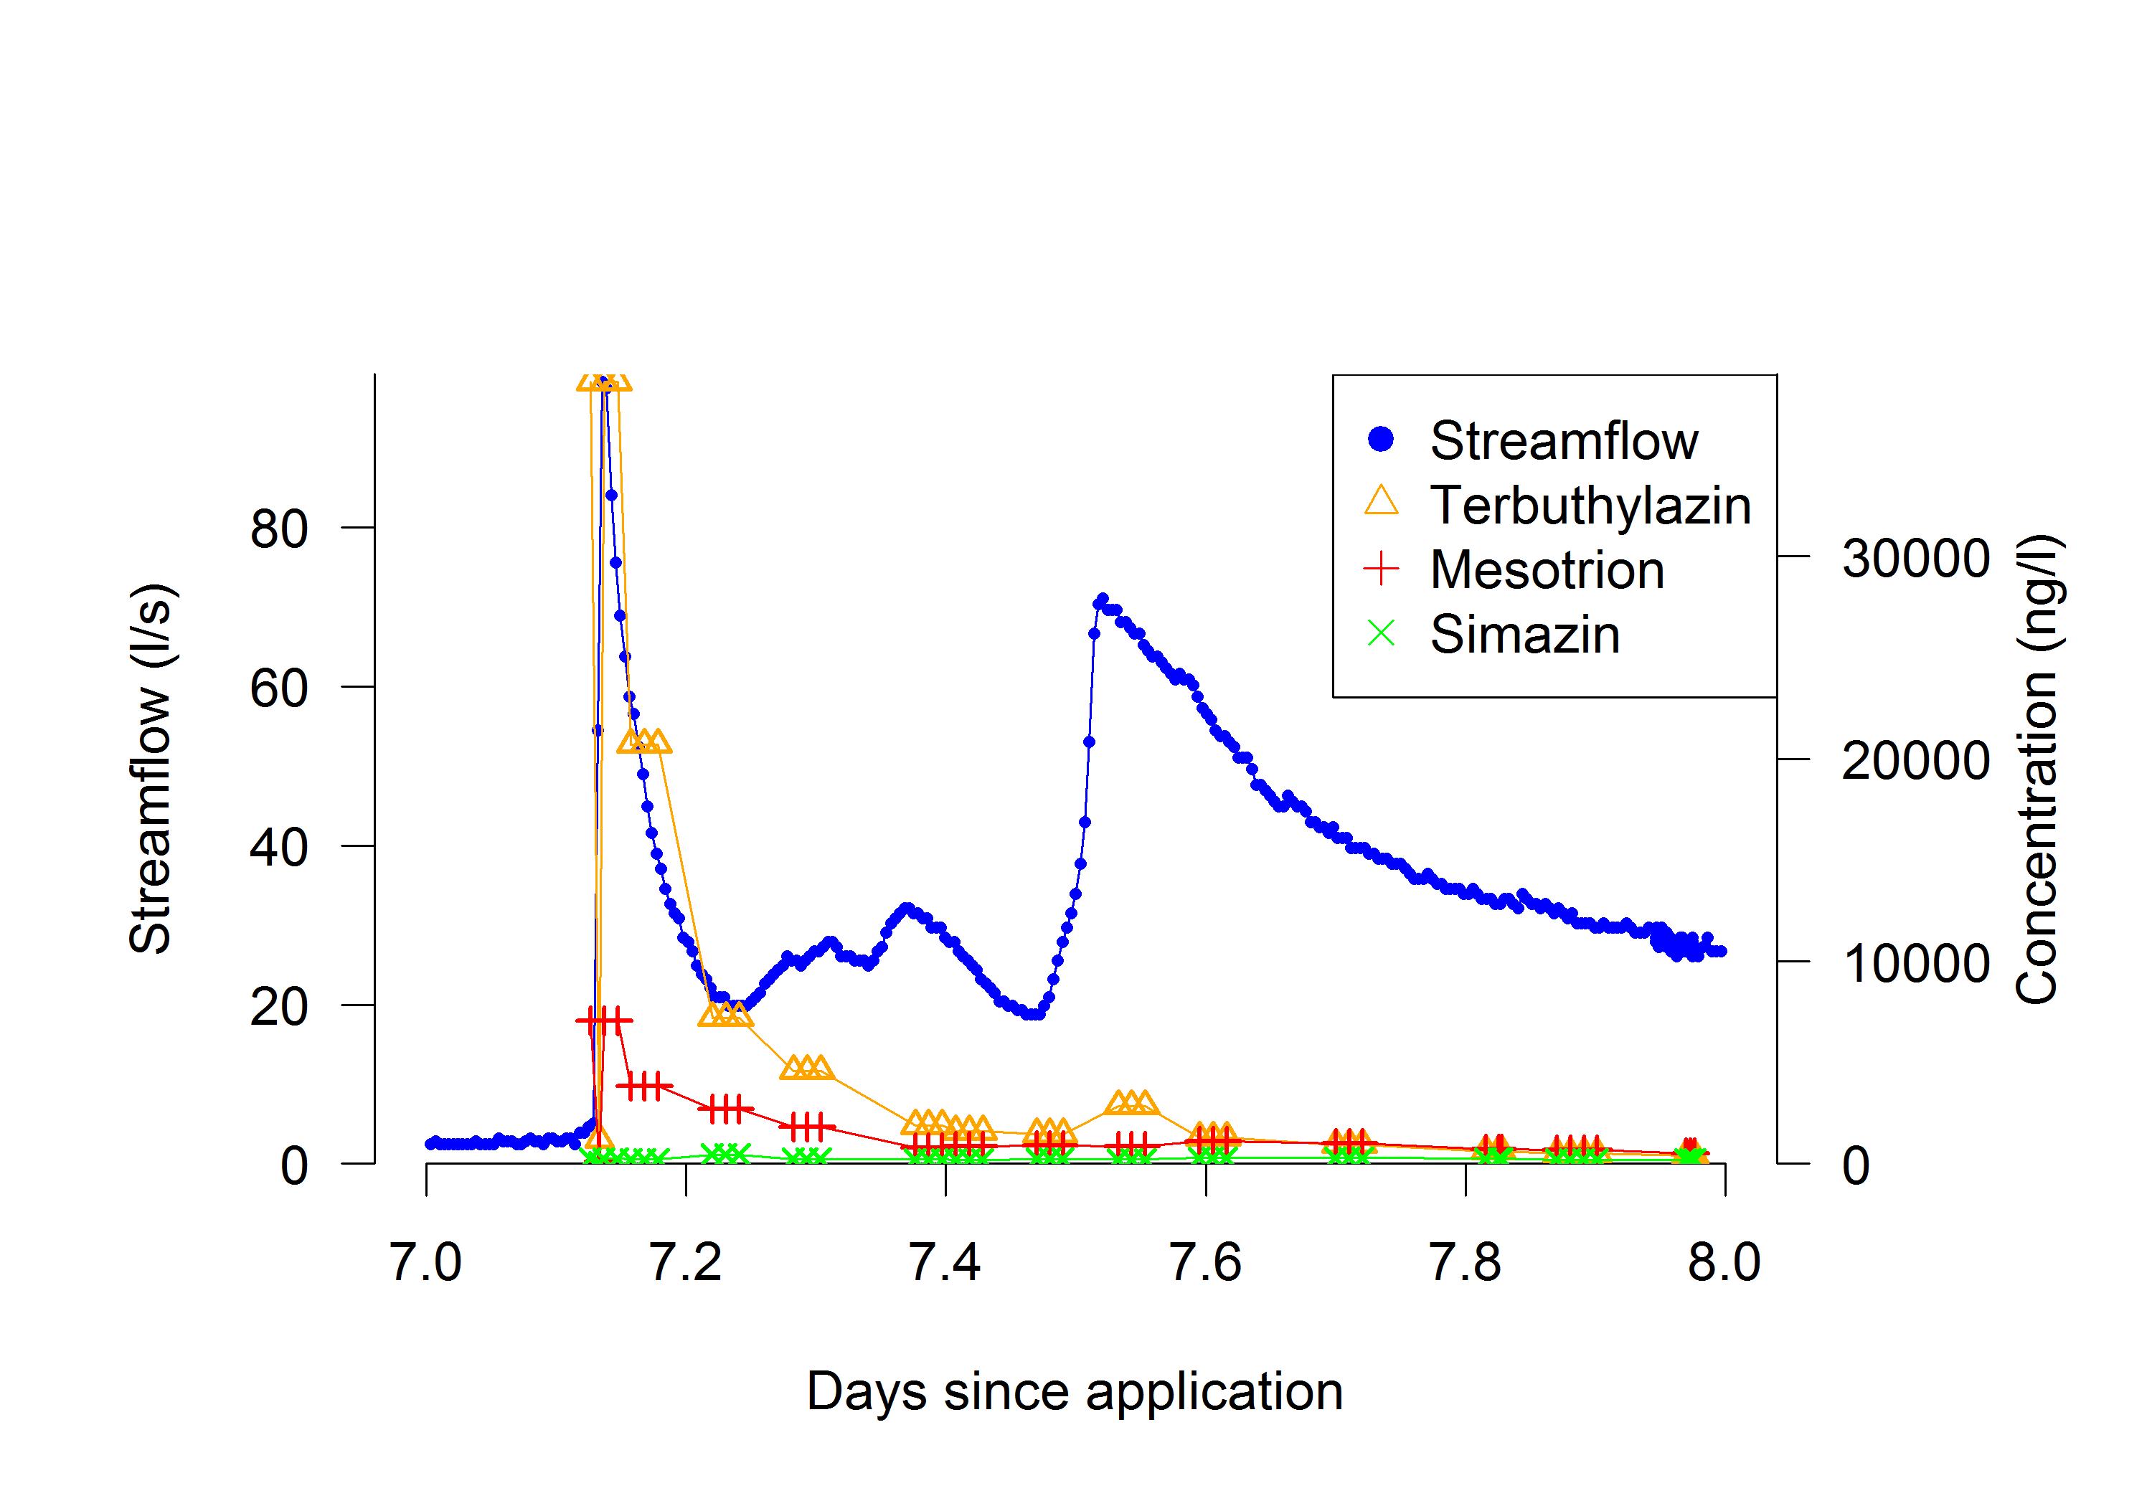
Data basis

Slide 9
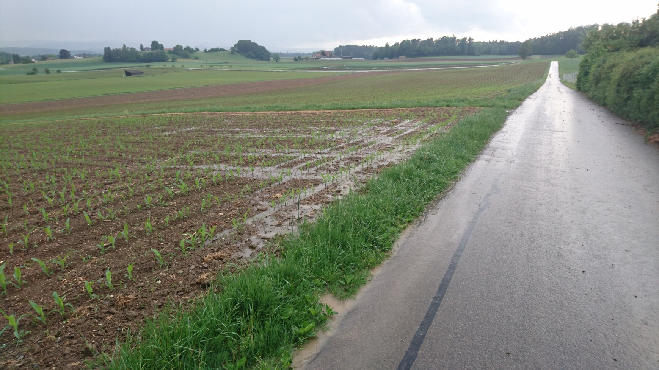
Data basis

Slide 10
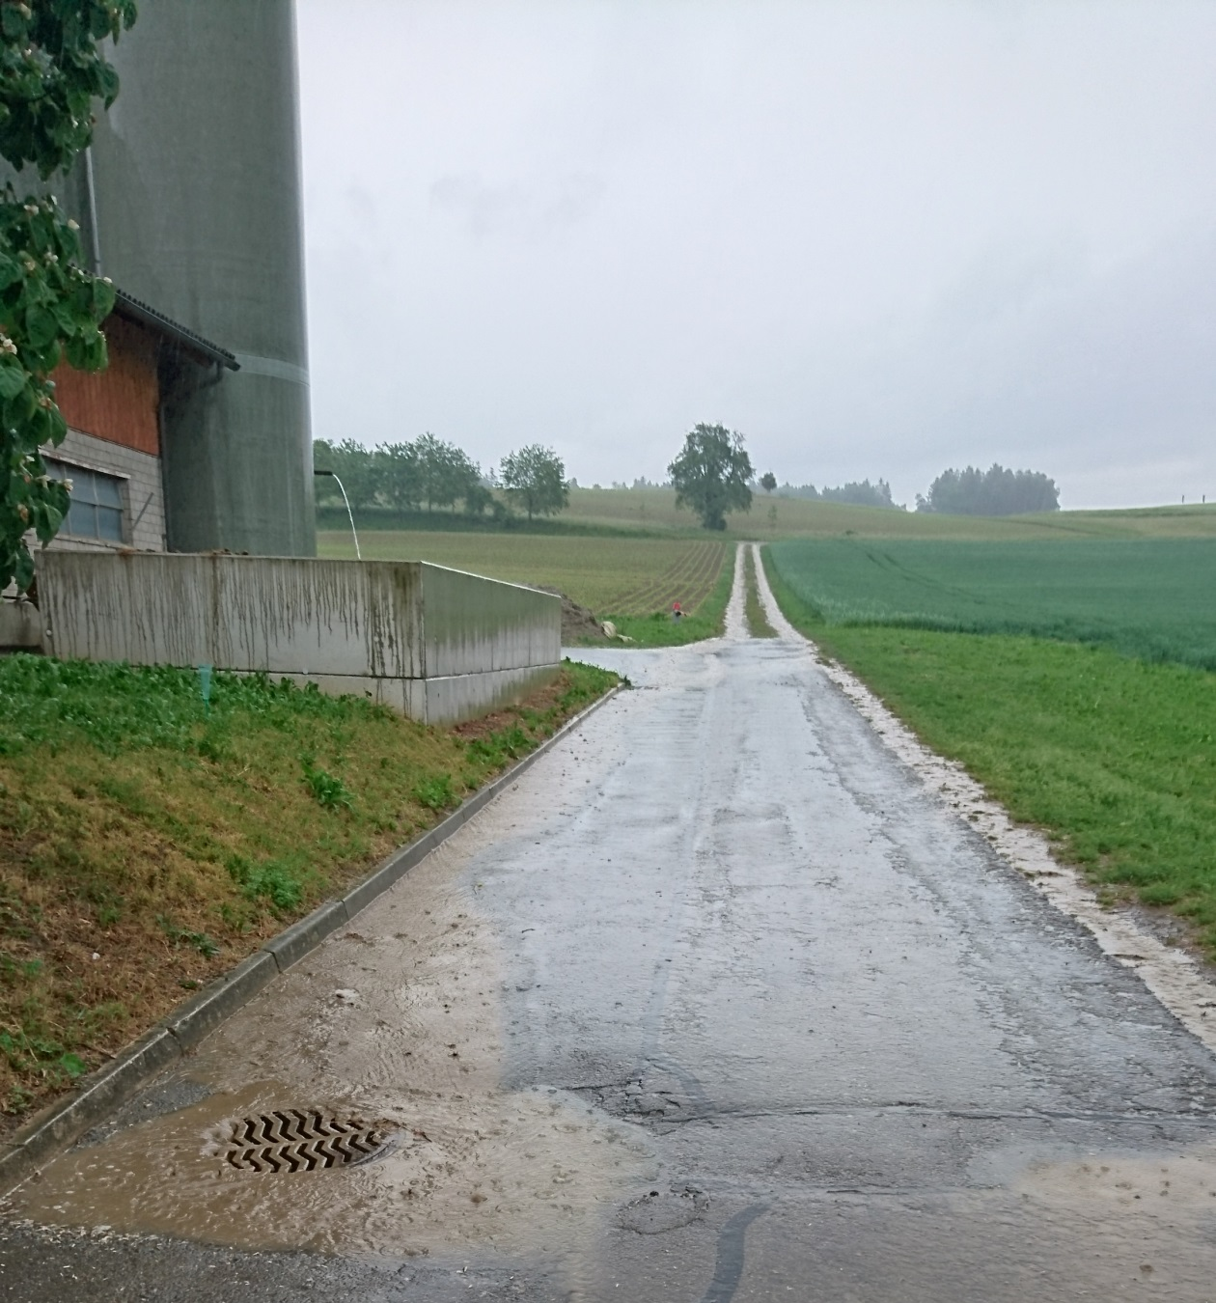
Data basis

Slide 11
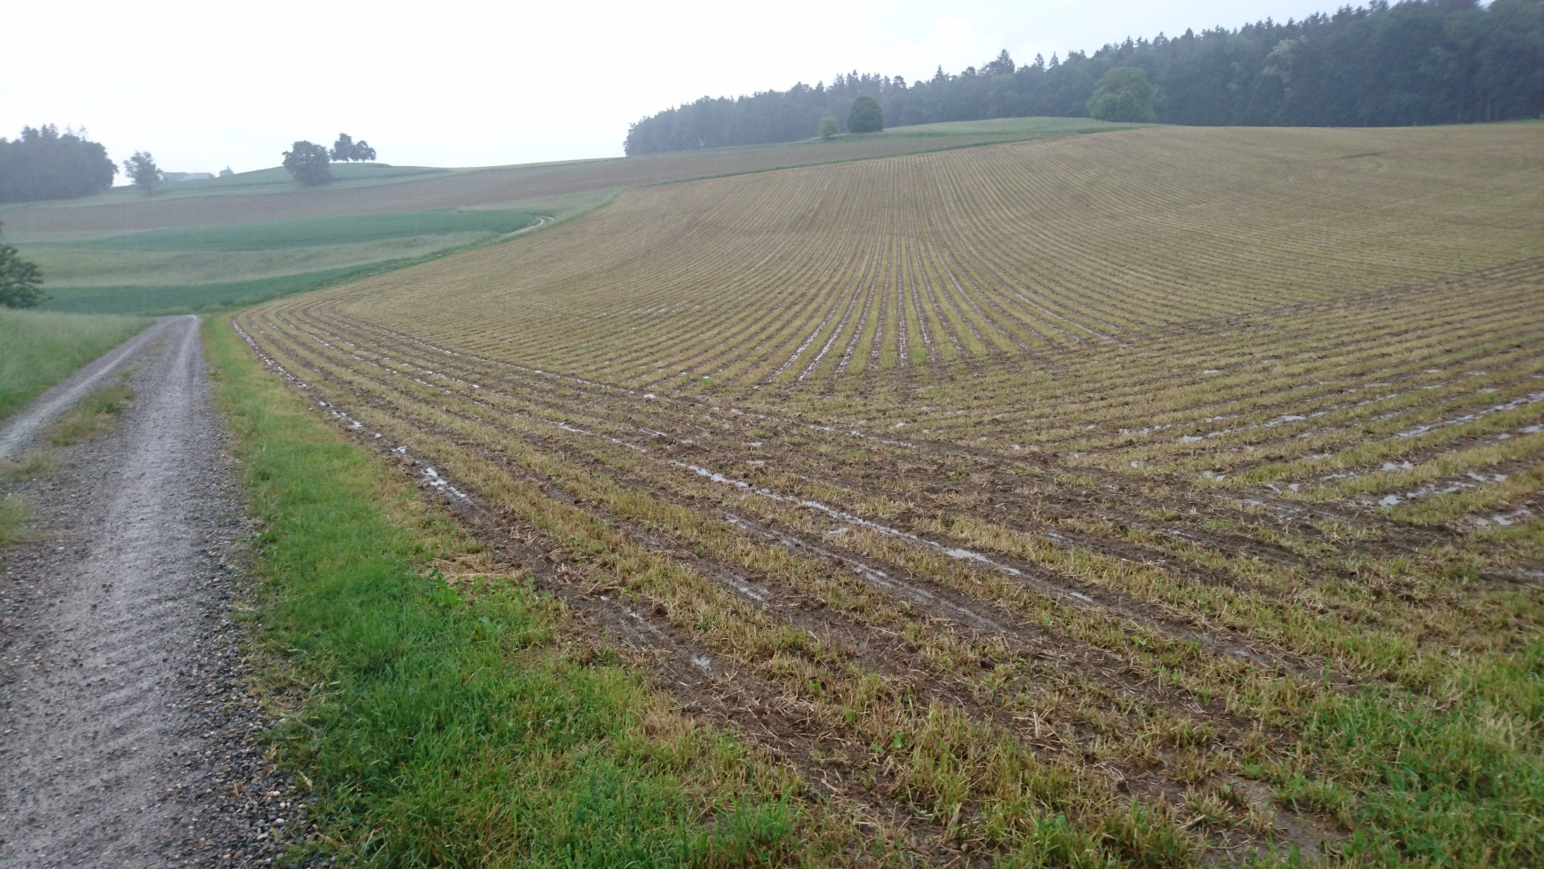
Data basis

Slide 12
Likelihood
$$Y_{obs}\left(θ,φ\right)=$$
$$y_{mod}\left(θ\right)+$$
$$Z\left(y_{mod},ψ\right)$$
Stochastic model output
Deterministic transport model
Stochastic error

Slide 13
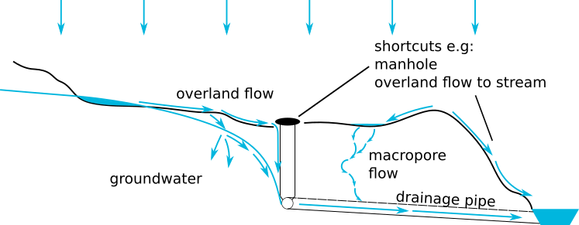
Deterministic transport model
Perceptual model
Conceptual model

Slide 14
Perceptual model
The perceptual model is based on the experimentalists view of the most important transport processes of water and herbicides in the studied catchment:
Runoff from impervious surfaces
Overland flow from fields reaching artificial shortcuts (manholes)
Direct macropore flow to drainage pipes
Infiltration to groundwater and subsurface flow to drainage pipes

Slide 15
Conceptual model
The conceptual model is based on hydrological response units (HRUs, see map) to reflect the spatial elements that constitute the fast transport pathways. It considers sorption and degradation.
A different model structure (configuration) is applied to each HRU reflecting the different types of hydrological processes occurring in that HRU. The model structures were discussed in detail with experimentalists and adapted in an iterative procedure using SUPERFLEX, a framework for conceptual hydrological and water quality models.
Parameters for the same processes in different HRUs are identical, e.g. sorption processes are assumed to be the same everywhere in the catchment. This makes the model more parsimonious.
Remaining areas
Connected to shortcut
Drained
Impervious

Slide 16
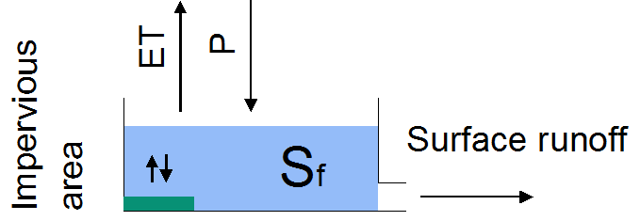
Conceptual model: impervious areas
Although impervious areas like streets and residential areas make up only ca. 5 % of the catchment area, they are the most important fast transport pathway for water. A large part of the impervious areas is directly connected to the stream.
Pesticides can reach impervious surfaces e.g. through spray drift. The number of sorption sites is assumed to be very limited on impervious surfaces.

Slide 17
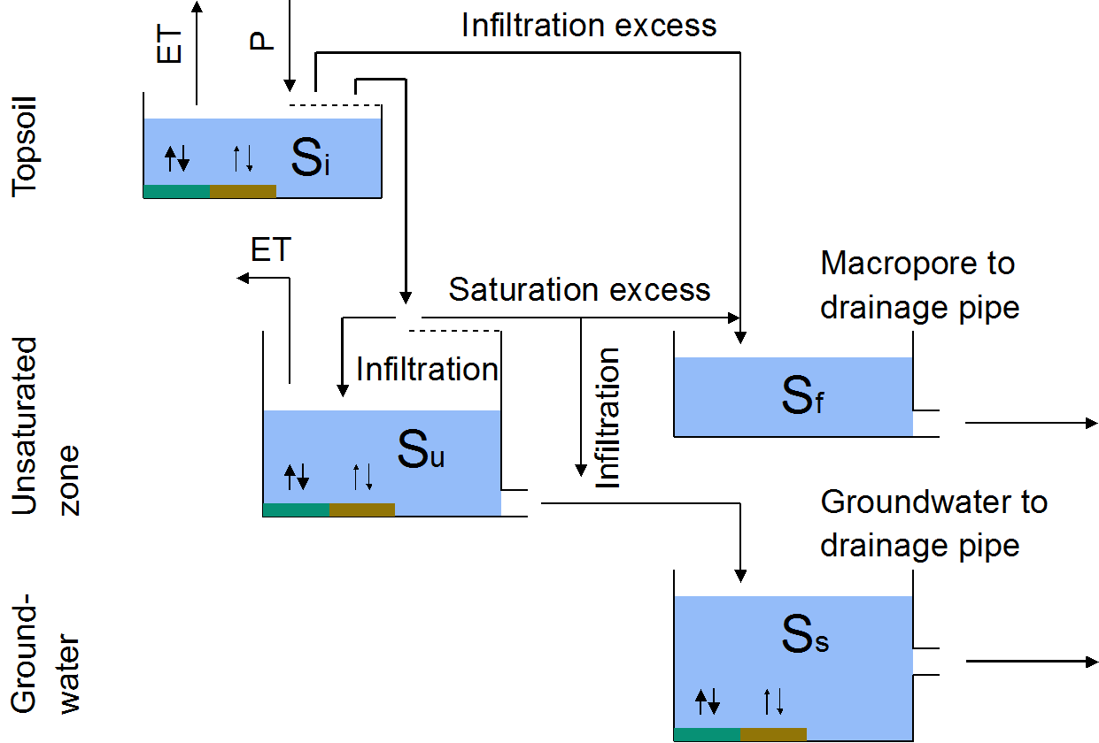
Conceptual model: drained areas
Drainage pipes are known to be important elements in water and contaminant transport.
A major fast transport path of herbicides is direct flow from the soil surface via macropores to drainage pipes, while the slower path via infiltration to groundwater and subsequent drainage is more important for water in this HRU.
Note that fast (green boxes) and slow sorption (brown boxes) is considered in the model, where the former is assumed to be in equilibrium at any time.

Slide 18
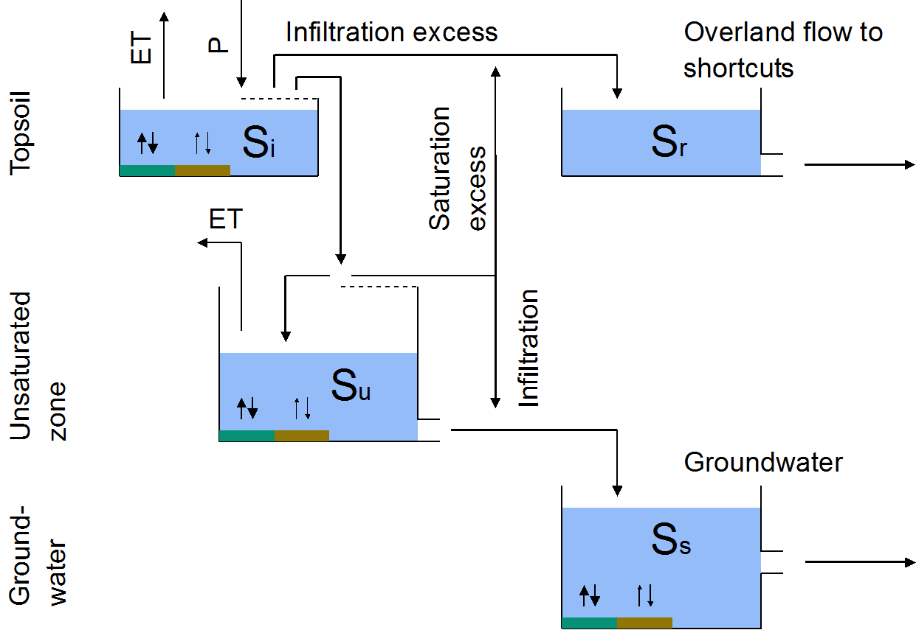
Conceptual model: connected to shortcut
Artificial shortcuts (e.g. manholes for the drainage system) are believed to be an important fast transport path of herbicides in the studied catchment.
In this HRU, due to the topographical connection, infiltration and saturation excess overland flow can reach artificial shortcuts, which are represented by a very fast reservoir (S_{r}).

Slide 19
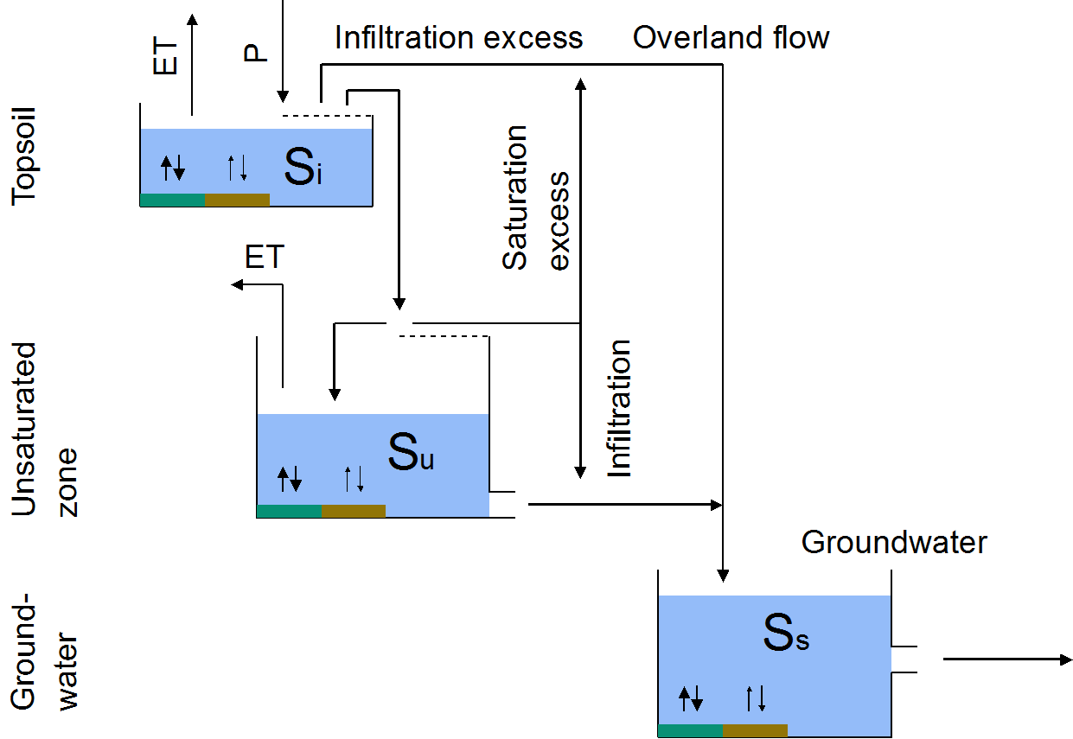
Conceptual model: remaining areas
In areas that are neither topographically connected to shortcuts nor drained, herbicide and water fluxes can only reach the stream via the groundwater path.

Slide 20
Likelihood framework
A new probabilistic framework for deterministic hydrological models
Allows to consider:
Heteroscedastic and skewed (non-Gaussian) distribution of errors
Non-stationary correlation of errors
Non-negativity of measurements
Varying time step sizes (arising due to flow-proportional sampling)
Main idea:
$$Q$$ | Streamflow
$$p(Q)$$ | Probability of observing $Q$
$$D_{Q}(Q_{det},ψ)$$ | Probability distribution of $Q$, given model output $Q_{det}$ and error model parameters $ψ$
$$f_{DQ}$$ | Density of$D_{Q}$
$$F_{DQ}$$ | Cumulative distribution of $D_{Q}$

Slide 21
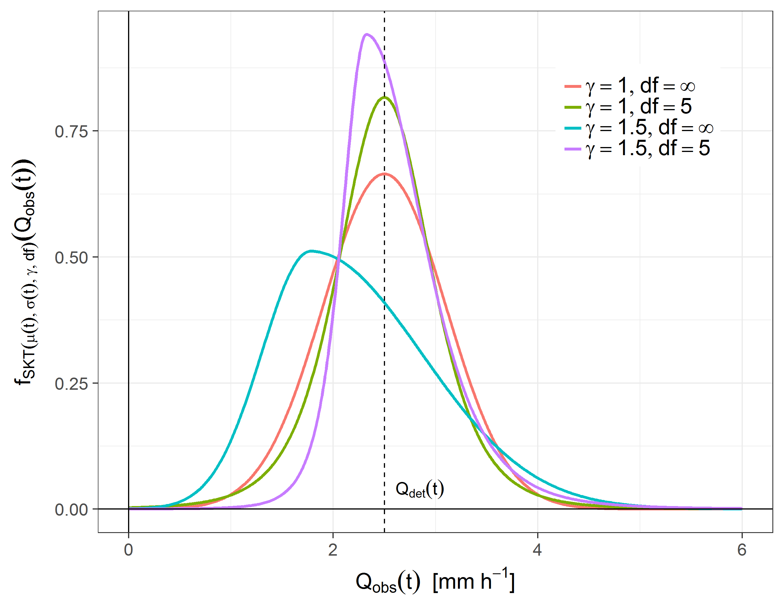
Likelihood framework
A new probabilistic framework for deterministic hydrological models
Allows to consider:
Heteroscedastic and skewed (non-Gaussian) distribution of errors
Non-stationary correlation of errors
Non-negativity of measurements
Varying time step sizes (arising due to flow-proportional sampling)
Main idea:
$$Q$$ | Streamflow
$$p(Q)$$ | Probability of observing $Q$
$$D_{Q}(Q_{det},ψ)$$ | Probability distribution of $Q$, given model output $Q_{det}$ and error model parameters $ψ$
$$f_{DQ}$$ | Density of$D_{Q}$
$$F_{DQ}$$ | Cumulative distribution of $D_{Q}$

Slide 22
Likelihood framework
$Q$: | Streamflow [M³T⁻¹]
$p(Q)$: | Probability of observing $Q$
$D_{Q}(Q_{det},ψ)$: | Probability distribution of $Q$, given model output $Q_{det}$ and error model parameters $ψ$
$f_{DQ}$: | Density of$D_{Q}$
$F_{DQ}$: | Cumulative distribution of $D_{Q}$
$η$: | Transformed streamflow
$τ$: | Correlation time [T]
: | Gaussian normal distribution

Slide 23
Likelihood framework
$Q$: | Streamflow [M³T⁻¹]
$p(Q)$: | Probability of observing $Q$
$D_{Q}(Q_{det},ψ)$: | Probability distribution of $Q$, given model output $Q_{det}$ and error model parameters $ψ$
$f_{DQ}$: | Density of$D_{Q}$
$F_{DQ}$: | Cumulative distribution of $D_{Q}$
$η$: | Transformed streamflow
$τ$: | Correlation time [T]
: | Gaussian normal distribution

Slide 24
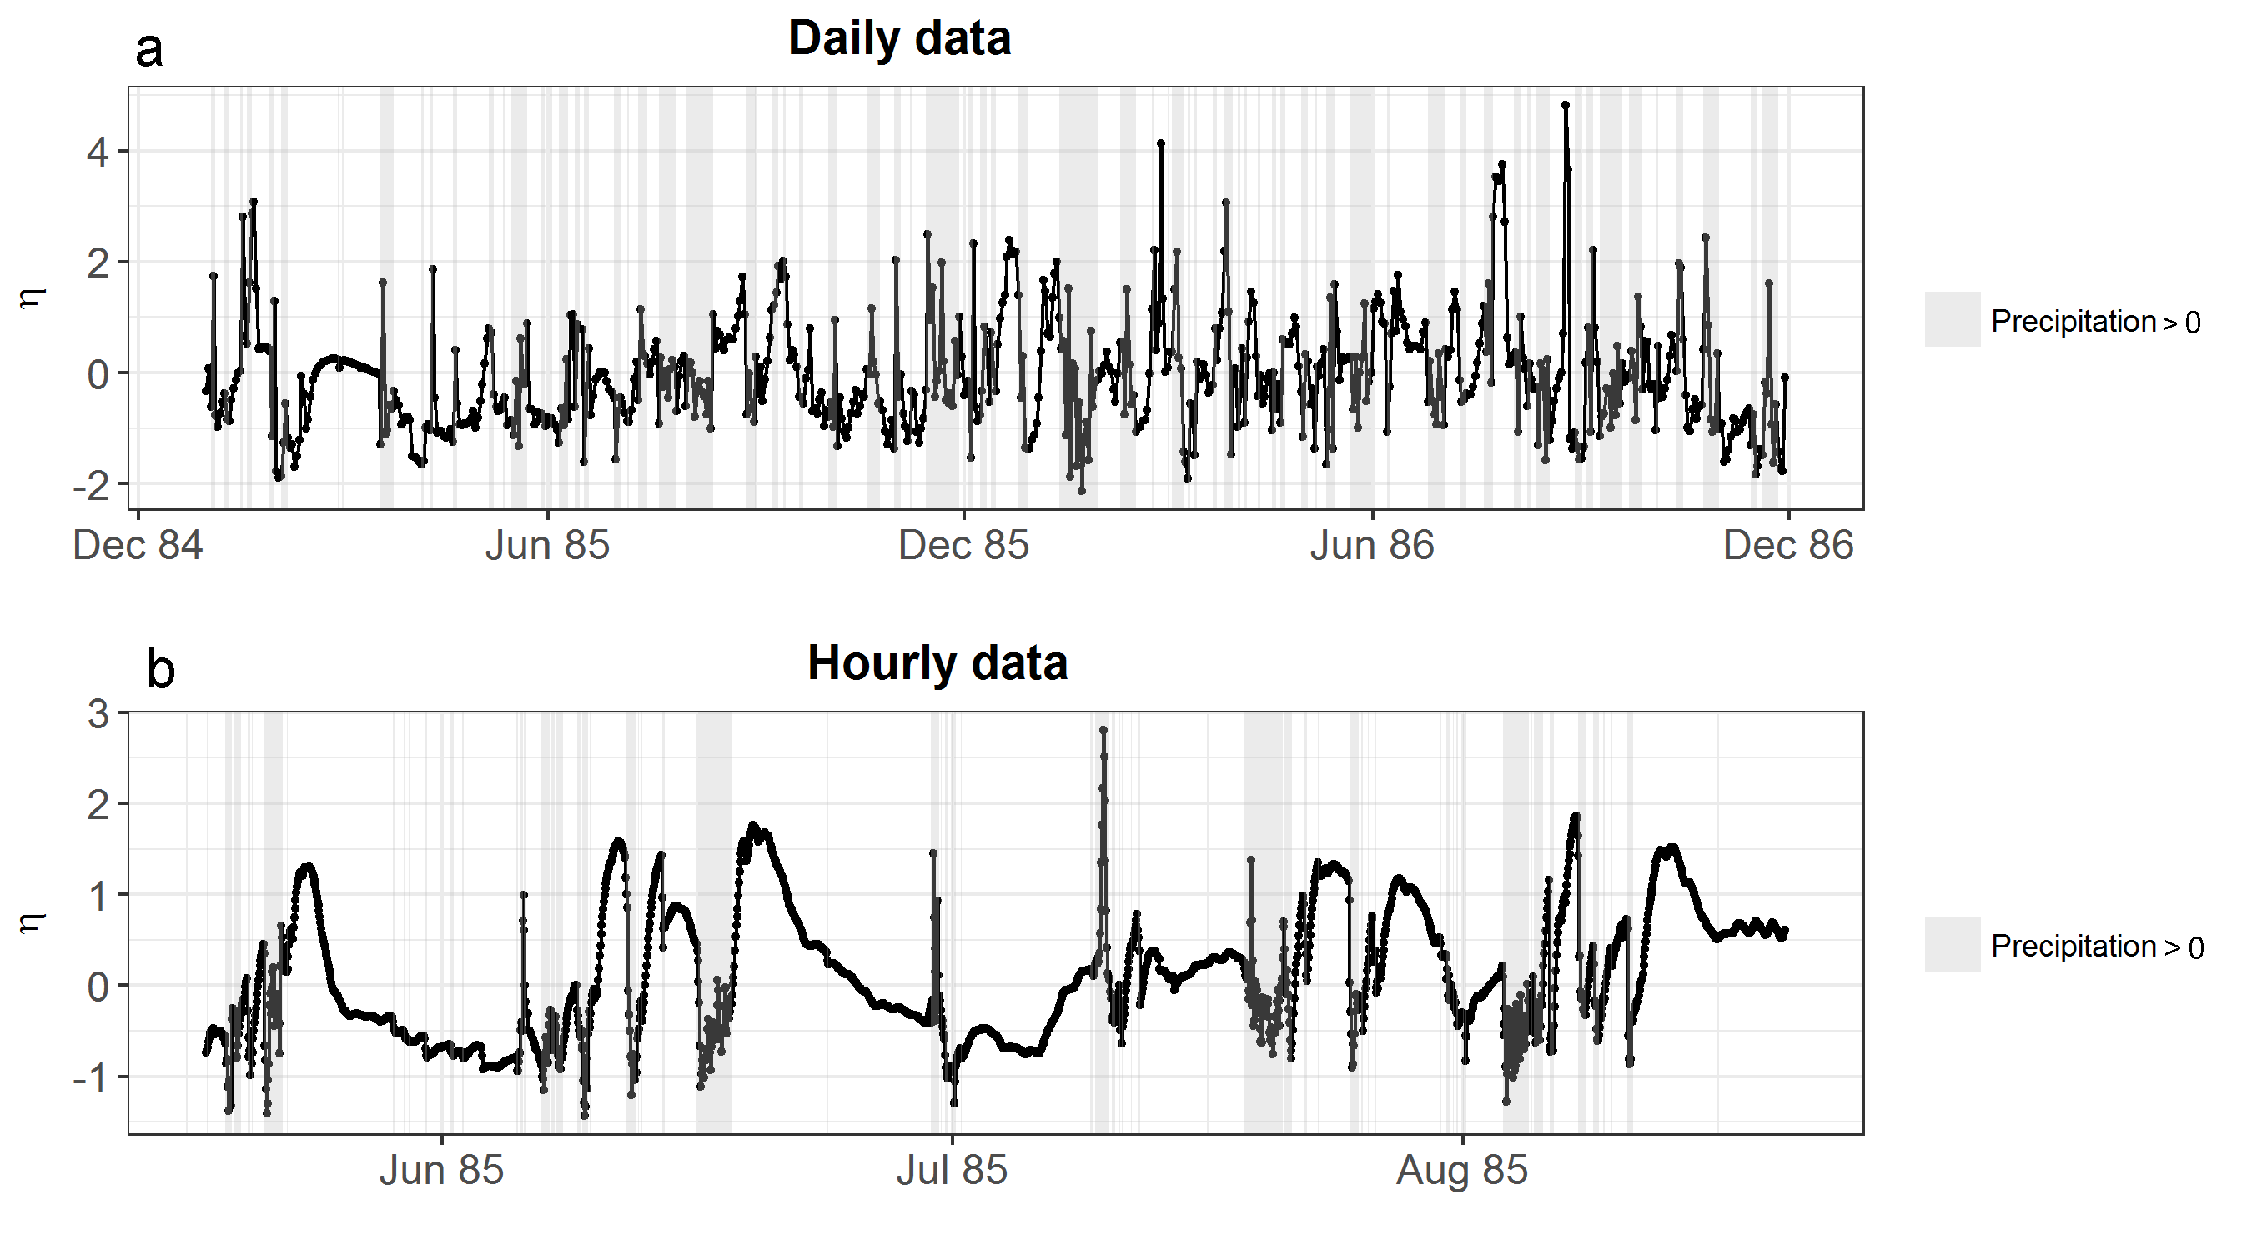
Likelihood framework
$Q$: | Streamflow [M³T⁻¹]
$p(Q)$: | Probability of observing $Q$
$D_{Q}(Q_{det},ψ)$: | Probability distribution of $Q$, given model output $Q_{det}$ and error model parameters $ψ$
$f_{DQ}$: | Density of$D_{Q}$
$F_{DQ}$: | Cumulative distribution of $D_{Q}$
$η$: | Transformed streamflow
$τ$: | Correlation time [T]
: | Gaussian normal distribution

Slide 25
Results
Posterior parameter distributions
Deterministic model output at $\max_{}{p(\left.θ\right|y)}$
Concentration and streamflow
Water flow paths
Pollutant distribution in topsoil
Pollutant flow paths

Slide 26
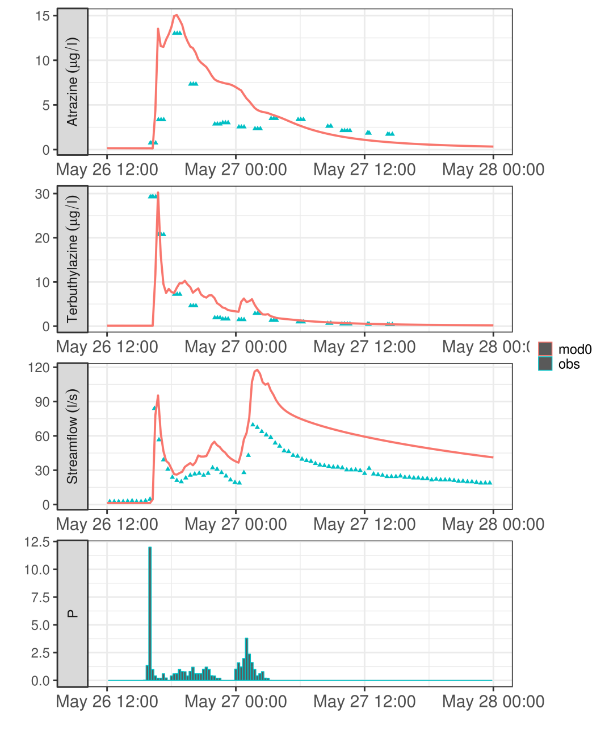
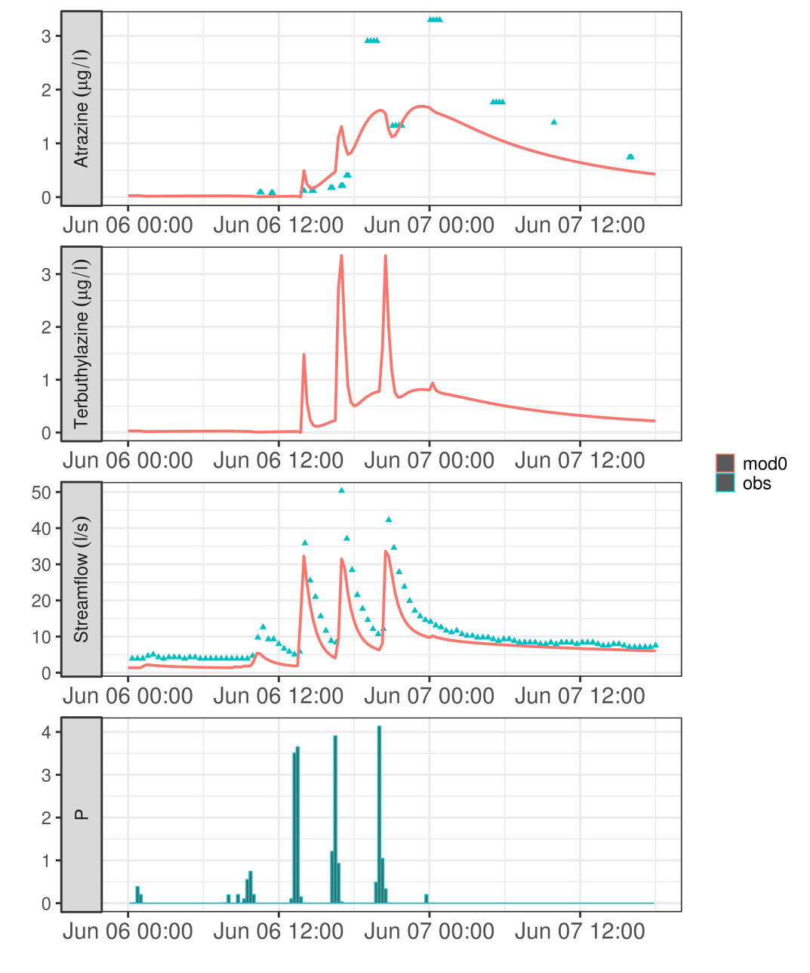
Concentration and streamflow

Slide 27
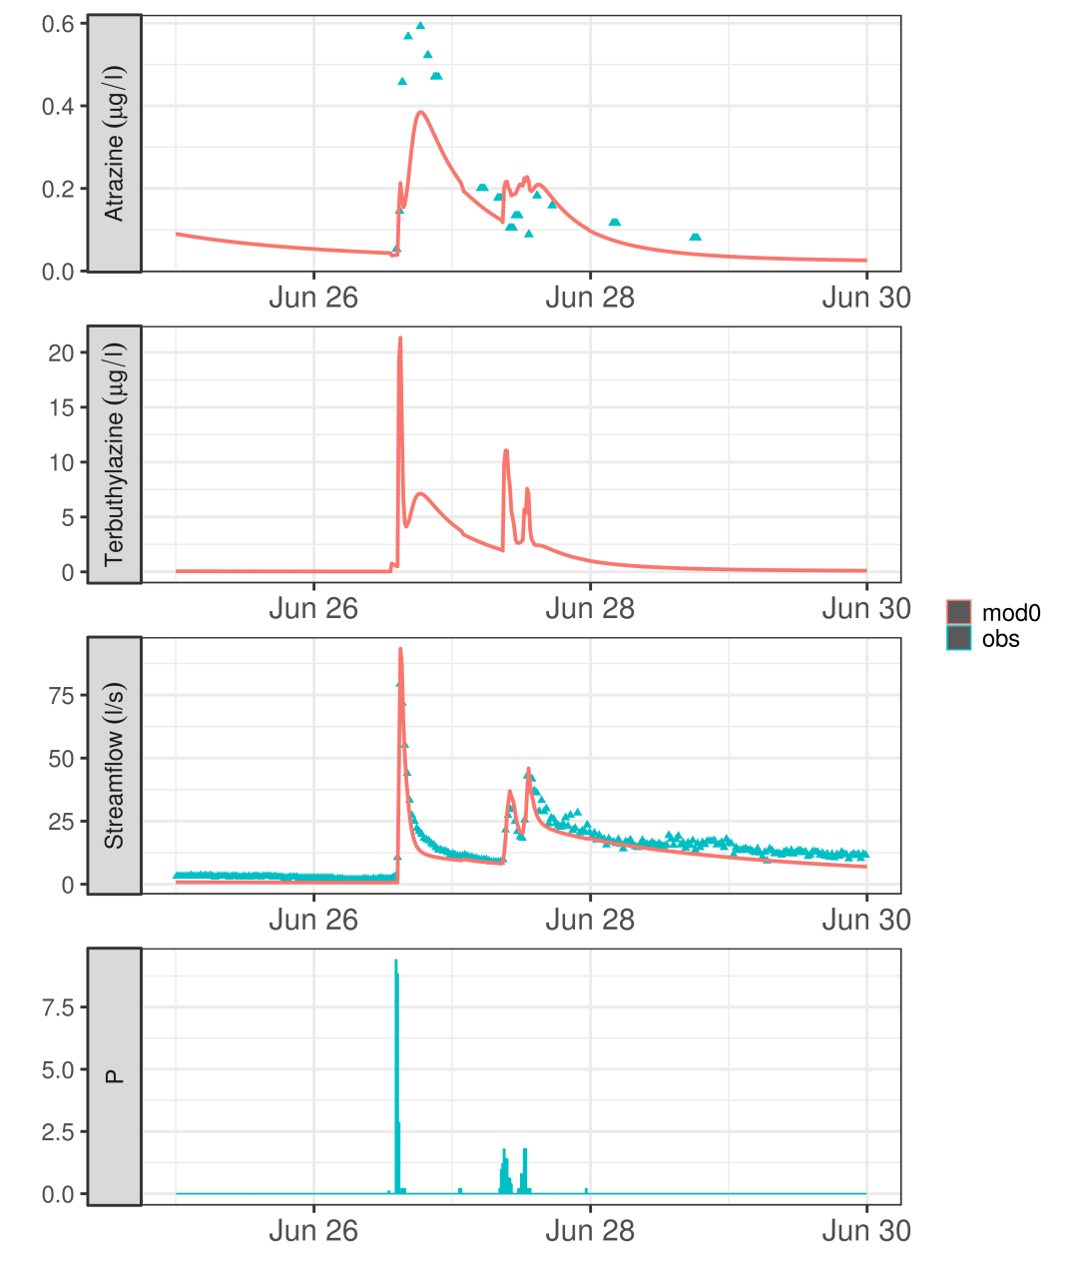
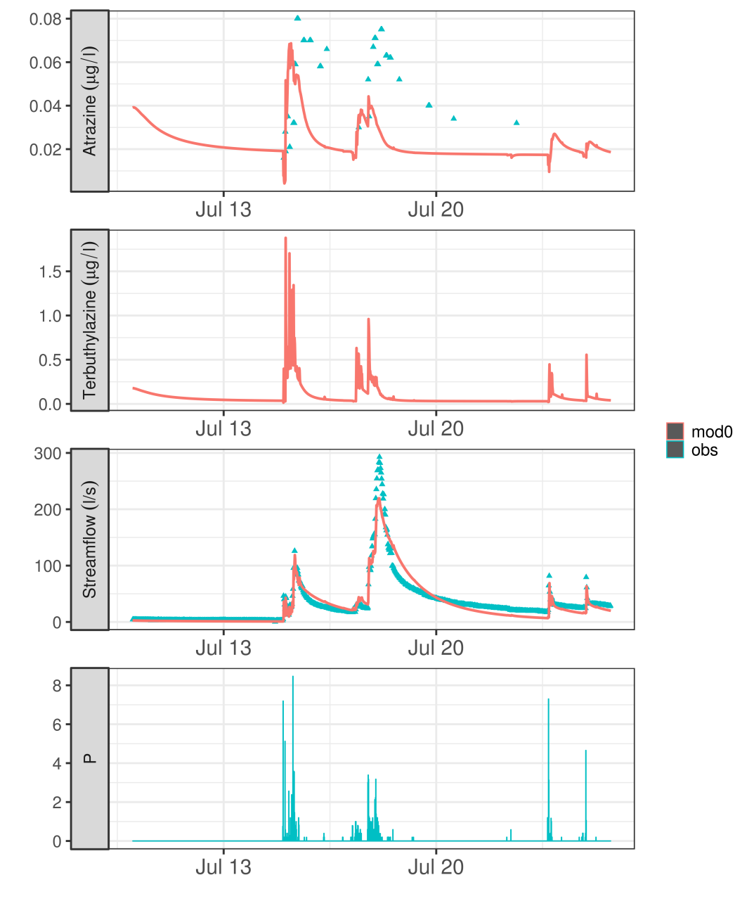
Concentration and streamflow

Slide 28
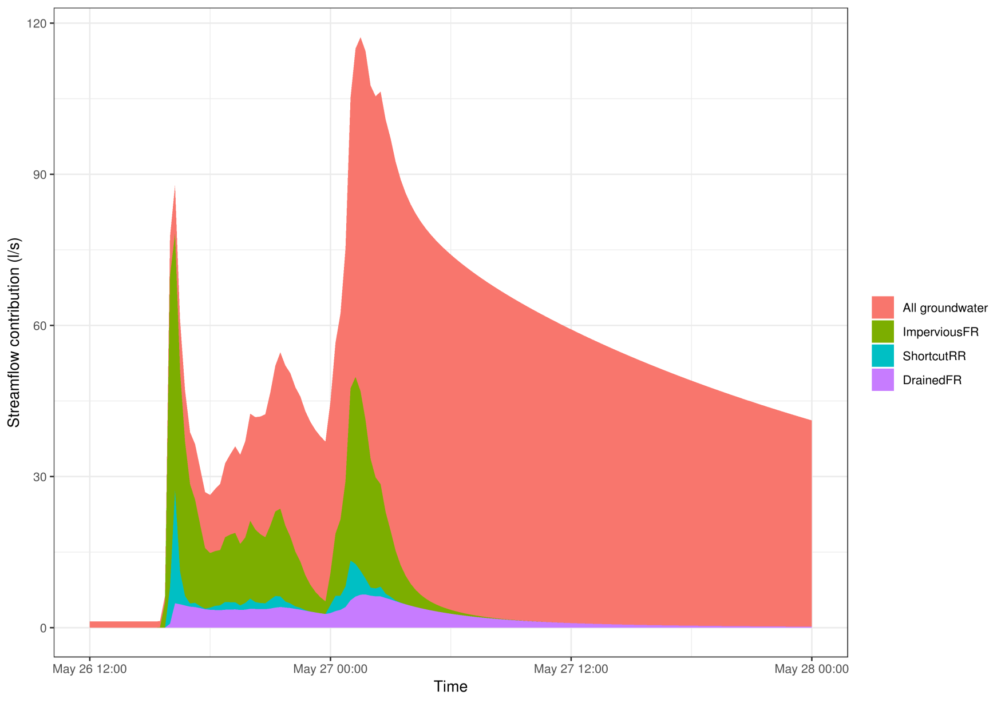
Water flow paths

Slide 29
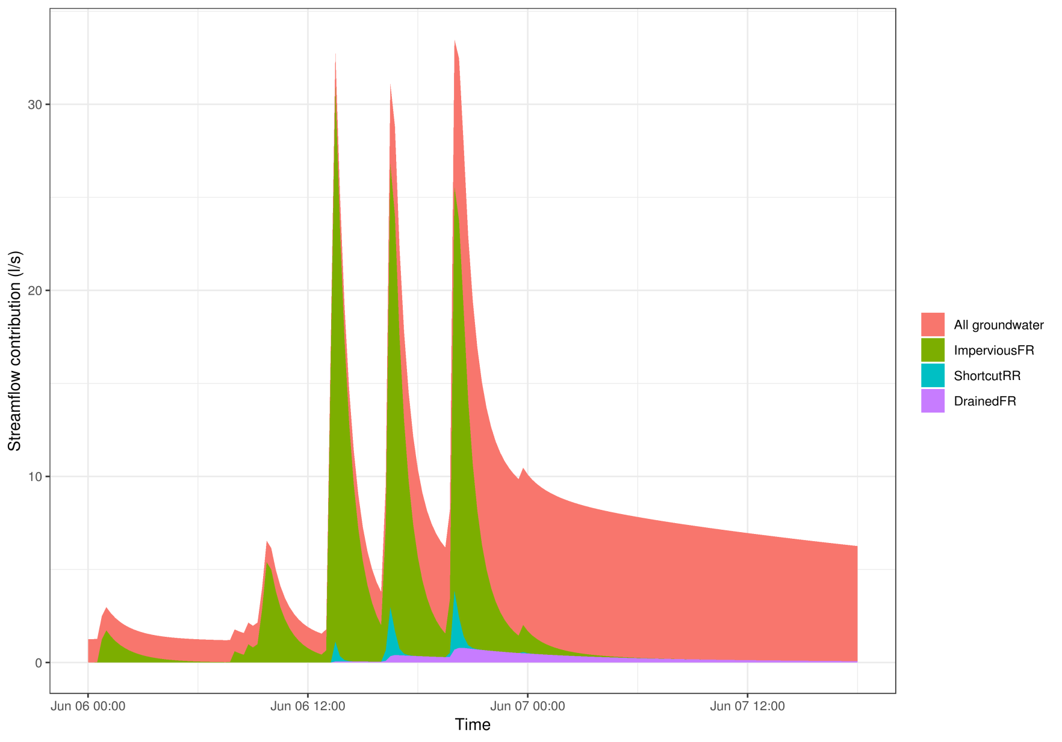
Water flow paths

Slide 30
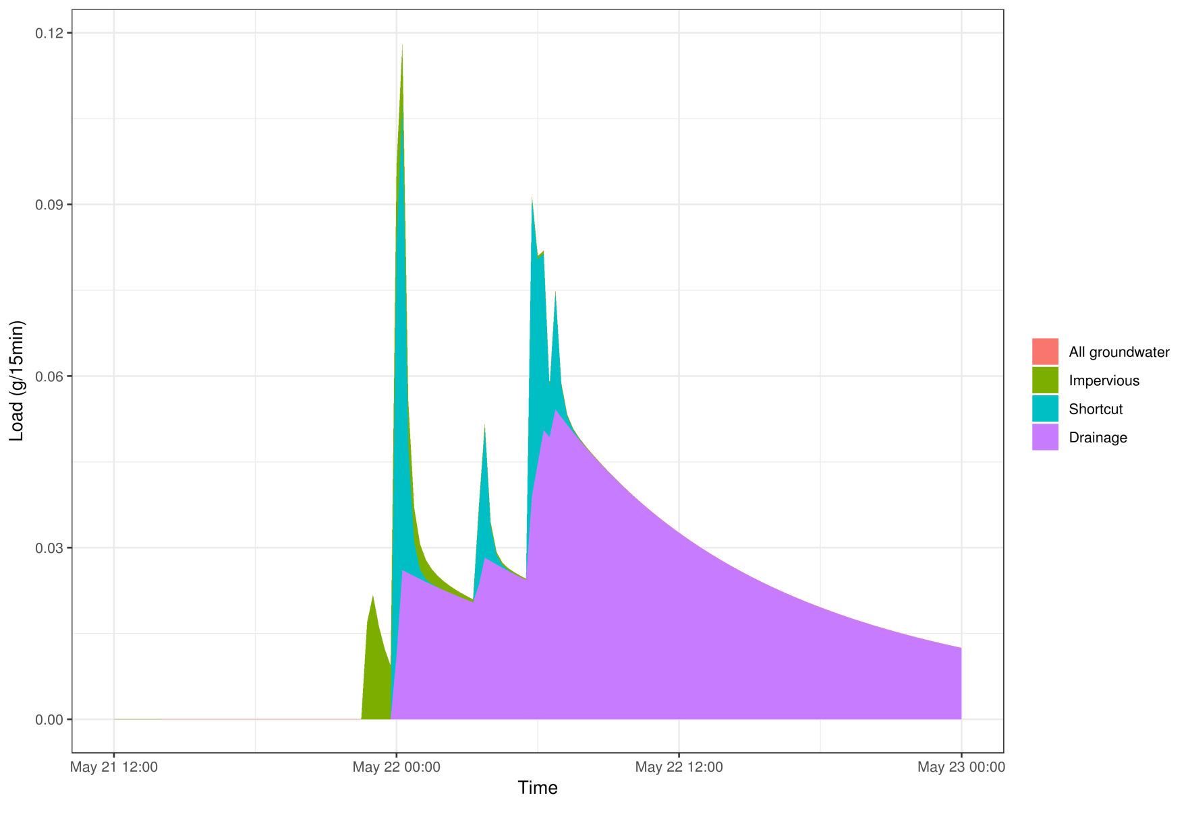
Pollutant flow paths
Atrazine

Slide 31
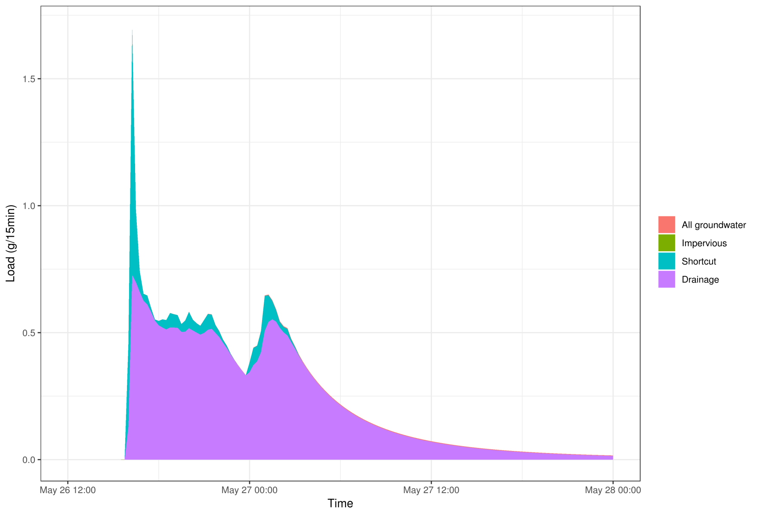
Pollutant flow paths
Atrazine

Slide 32
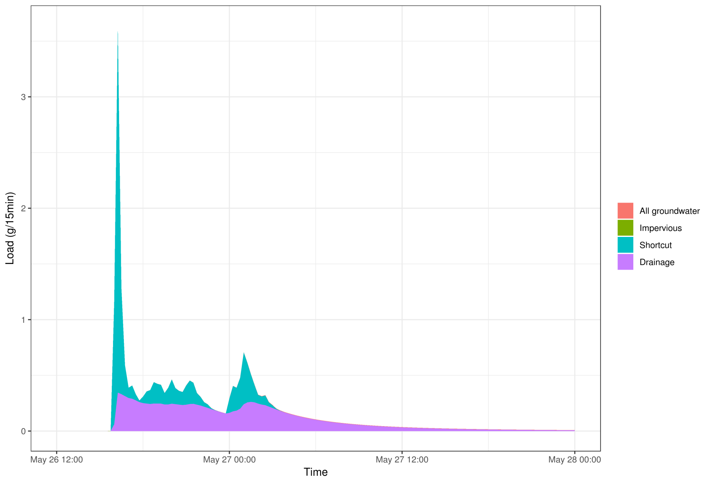
Pollutant flow paths
Terbuthylazine

Slide 33
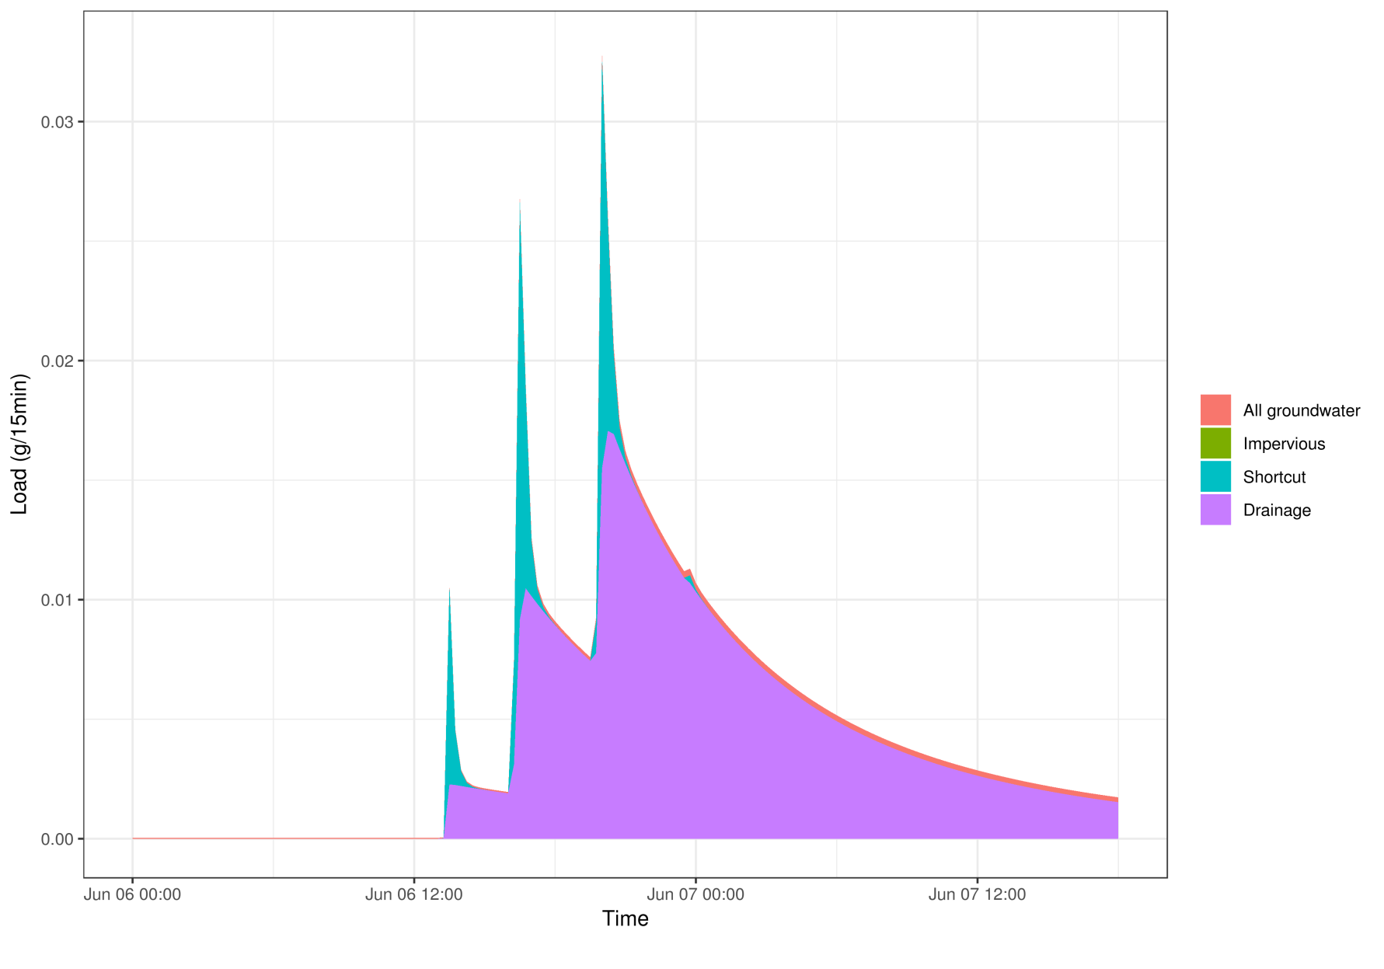
Pollutant flow paths
Atrazine

Slide 34
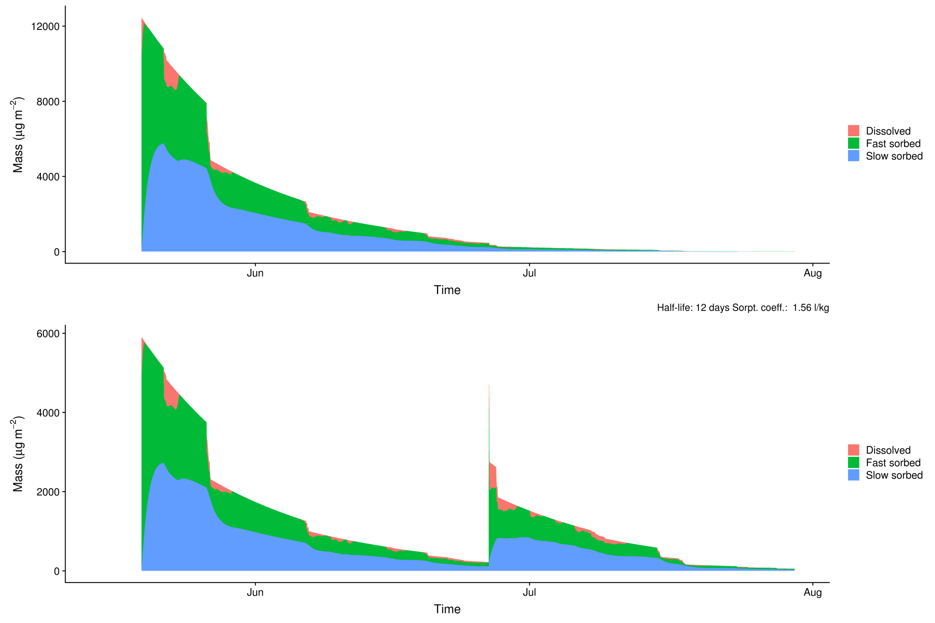
Distribution of pollutants in soil
Atrazine
Terbuthylazine

Slide 35
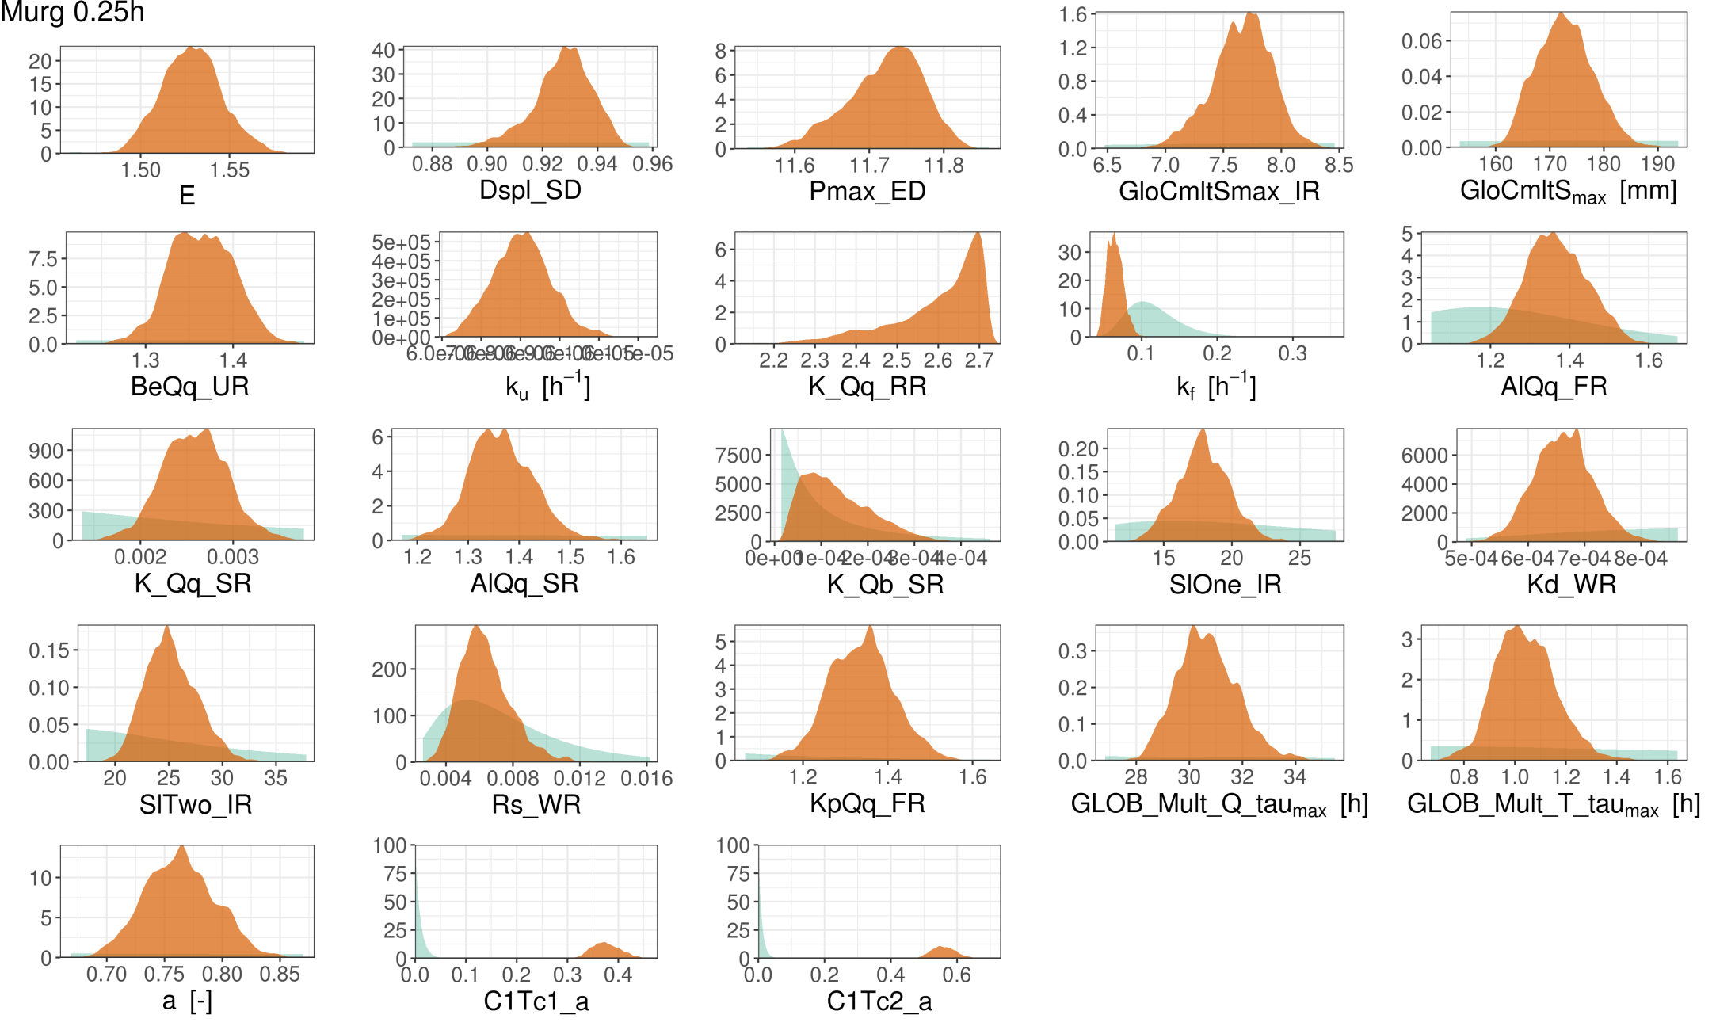
Marginal posterior parameter distribution

Slide 36
Contact information and credits
ETH Zurich
Department of Environmental Systems Science (D-USYS)
Universitätsstrasse 16
8092 Zürich
www.ethz.ch/en.html
Publisher: D-USYS, Eawag
Project funding: Swiss National Science Foundataion (SNSF)
Images: Gabriela Brändle (slide 2), Tobias Doppler (slide 2), Experimentalist: CC BY-NC 4.0, Modeller: CC0 (slide 4, 5), Home button: CC0 (all slides)
Acknowledgements: Volker Prasuhn, Sebastian Stoll
© ETH Zurich, April 2019

