Slide 1
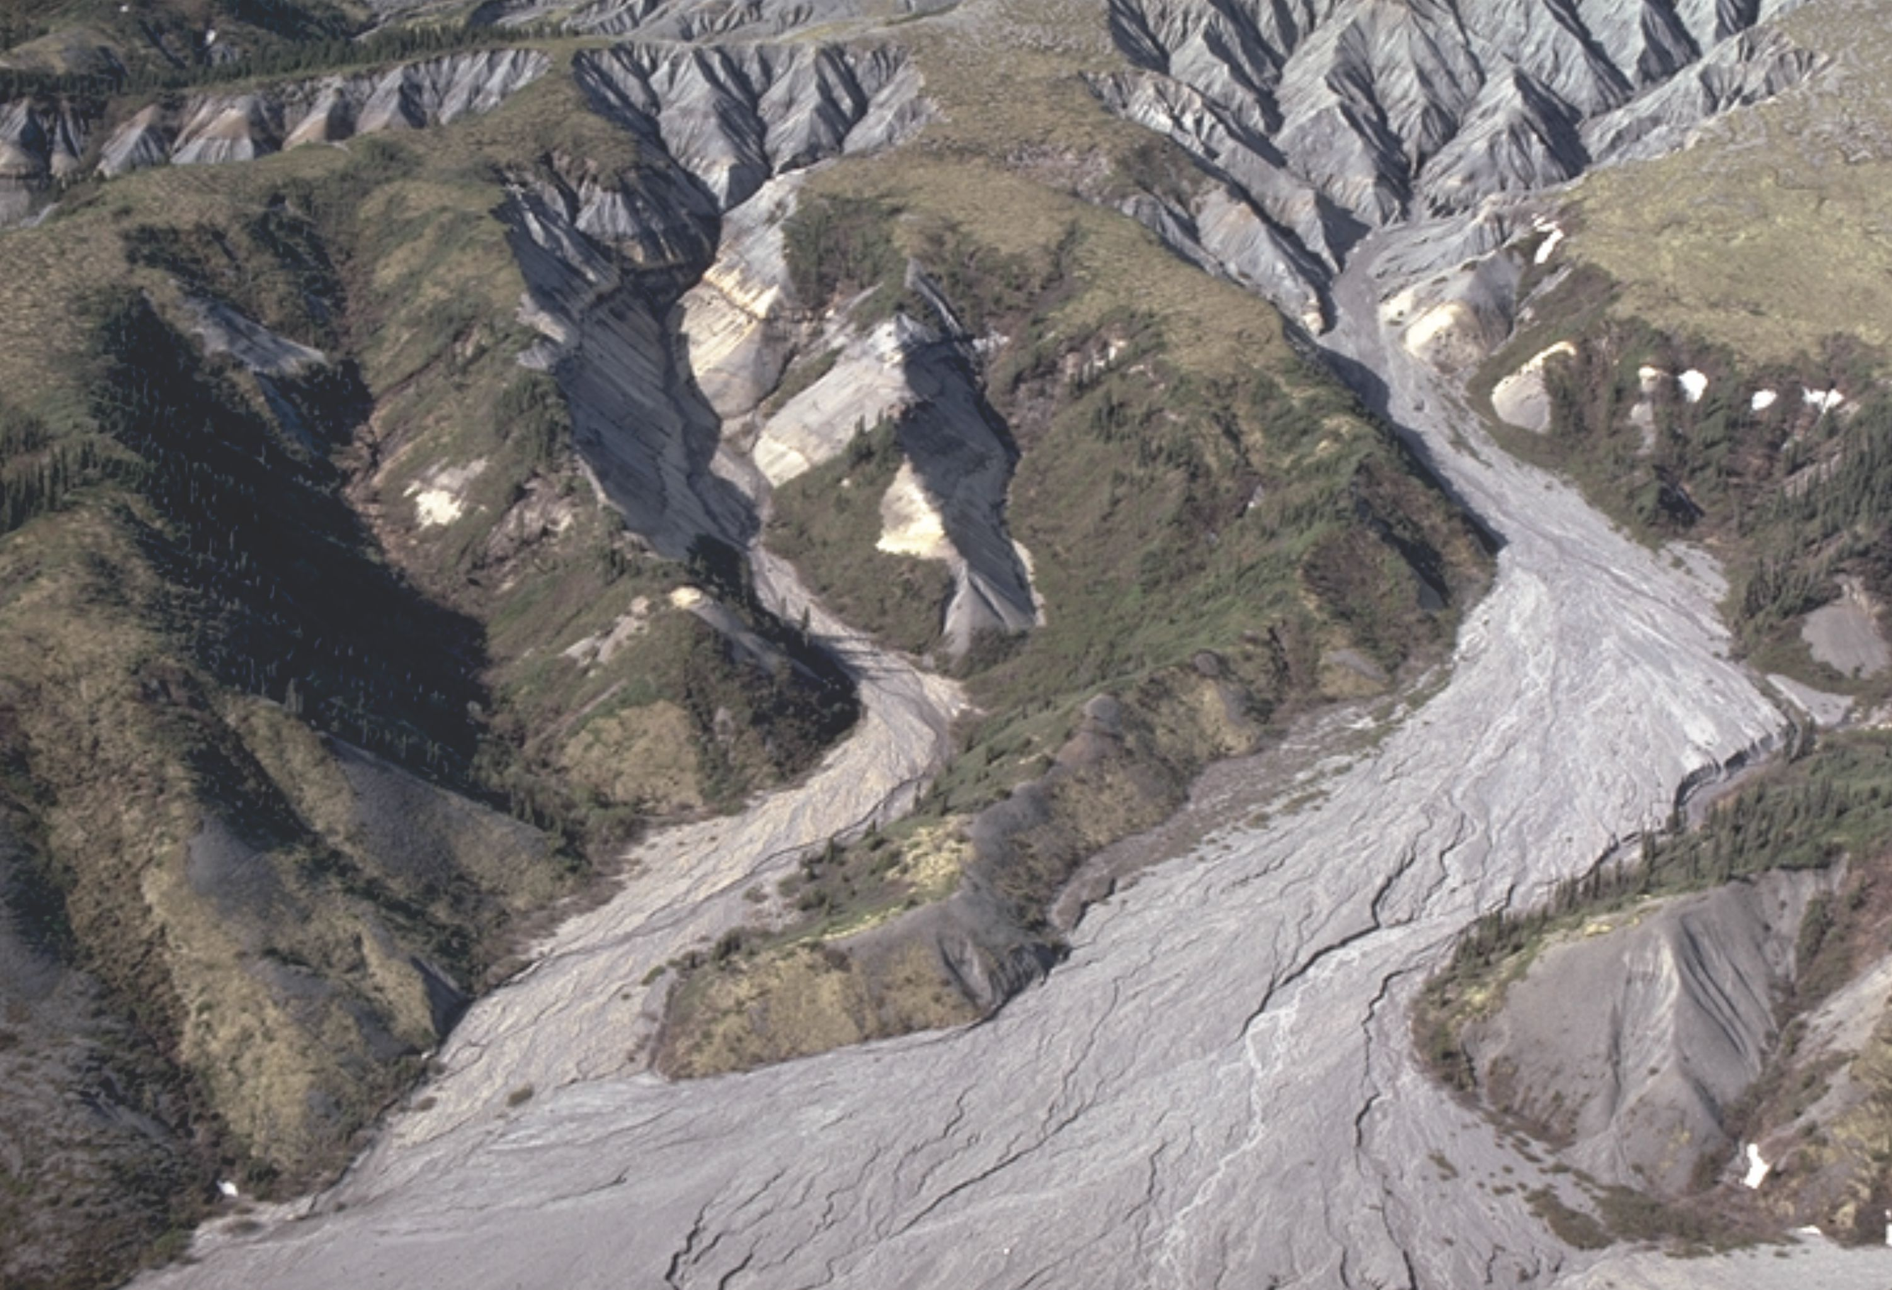
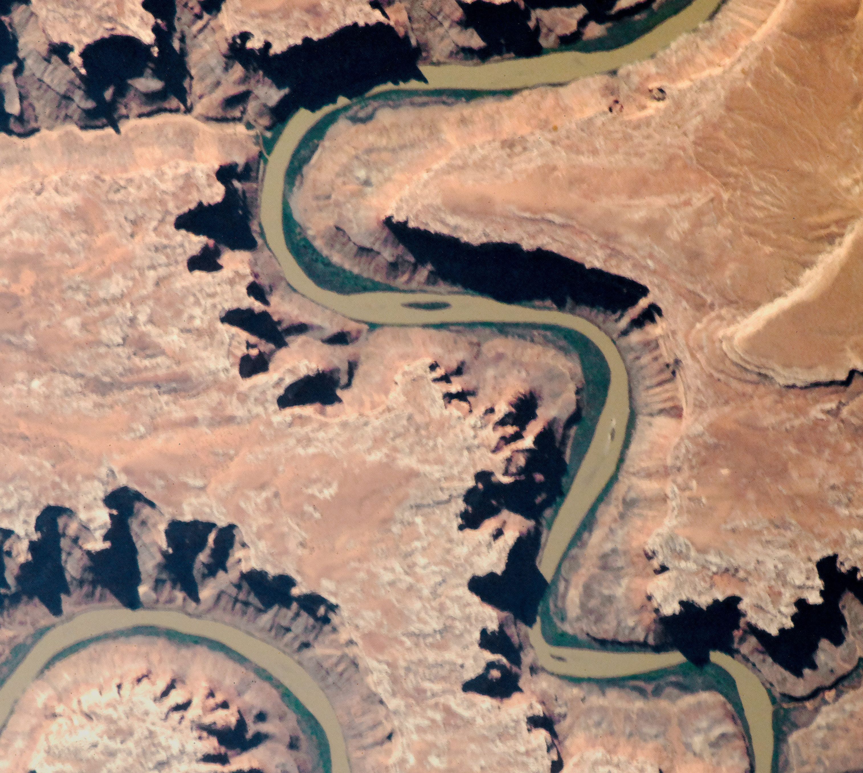
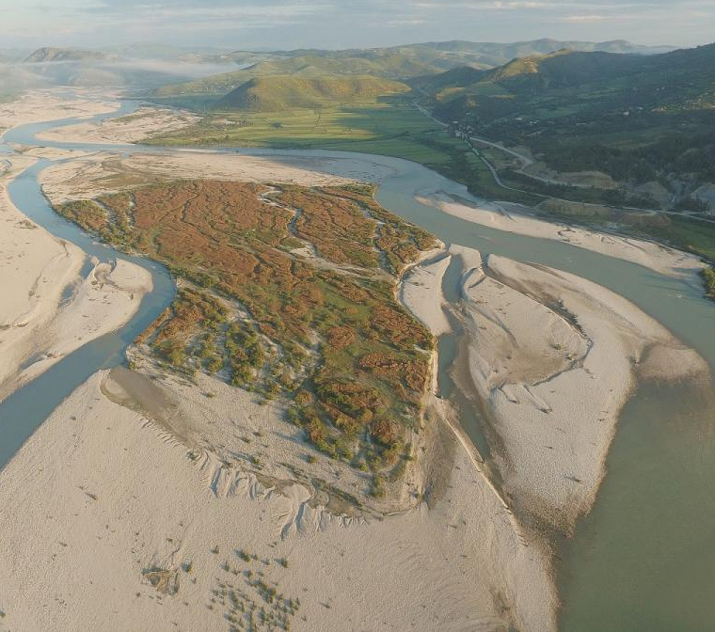
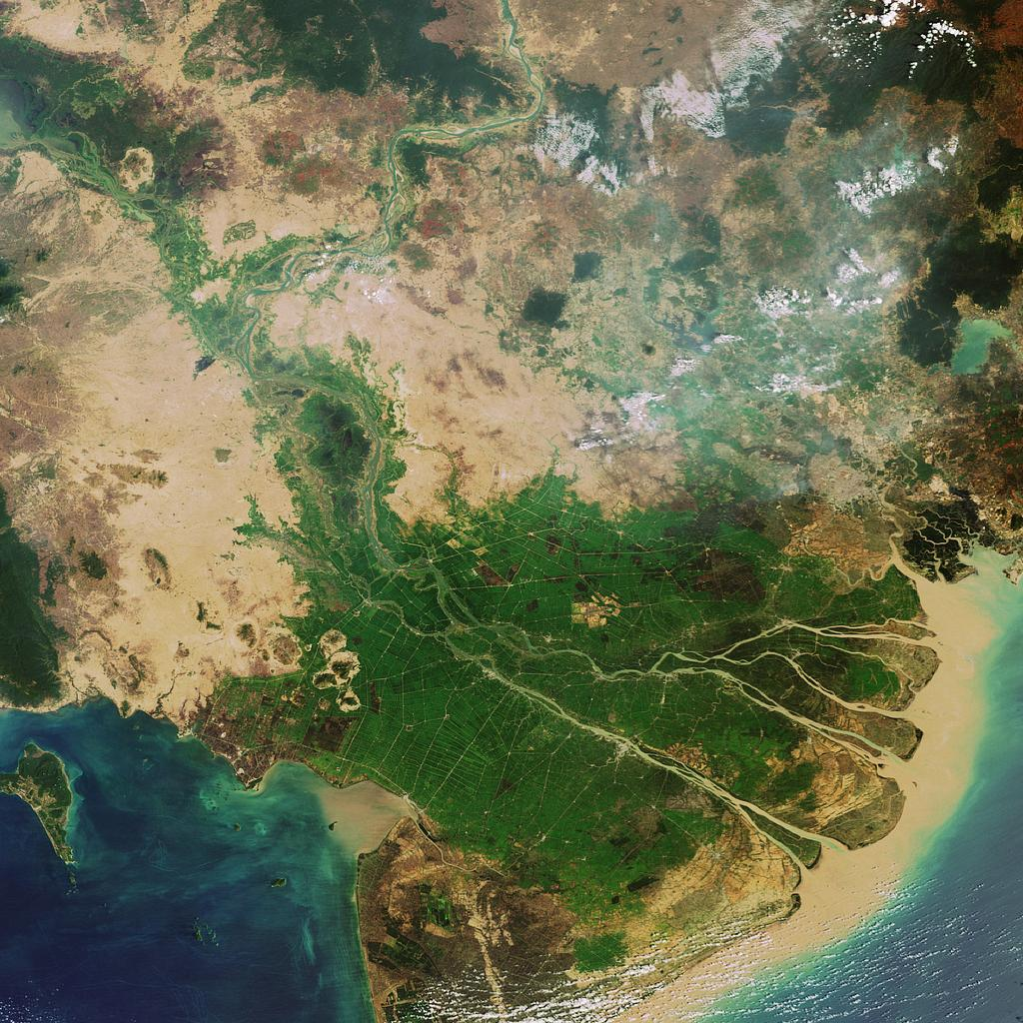
CASCADE : a toolbox for network-scale sediment connectivity assessment
  Marco Tangi, Rafael Schmitt, Simone Bizzi, Andrea Castelletti
Tertiary Hills, Northwest Territories
(geological-digressions atlas)
Green river, Utah
(NASA Visible Earth)
Vjosa River, Albania ,Balkan
(AMBER EU H2020)
Mekong Basin
(Kondolf, UC Berkeley)
Notes:
Definition of sediment connectivity
Impact of sediment alteration
Importance of this cumulated impact at the network scale
Network scale, quantification
Few model exists at the network scale that quantify source-sink relationship, i.e. sediment connectivity, and can assess cumulative impact of alteration

Slide 2
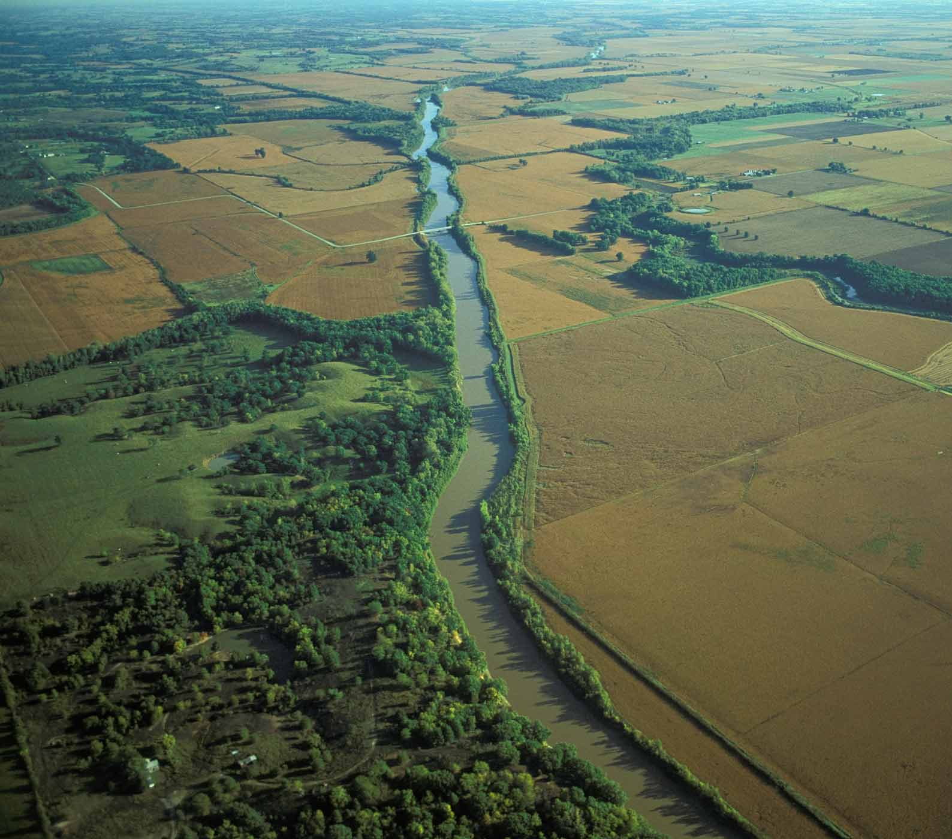
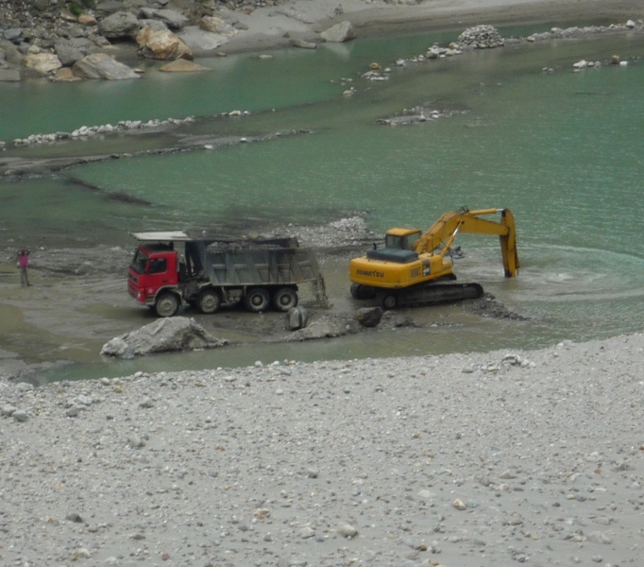
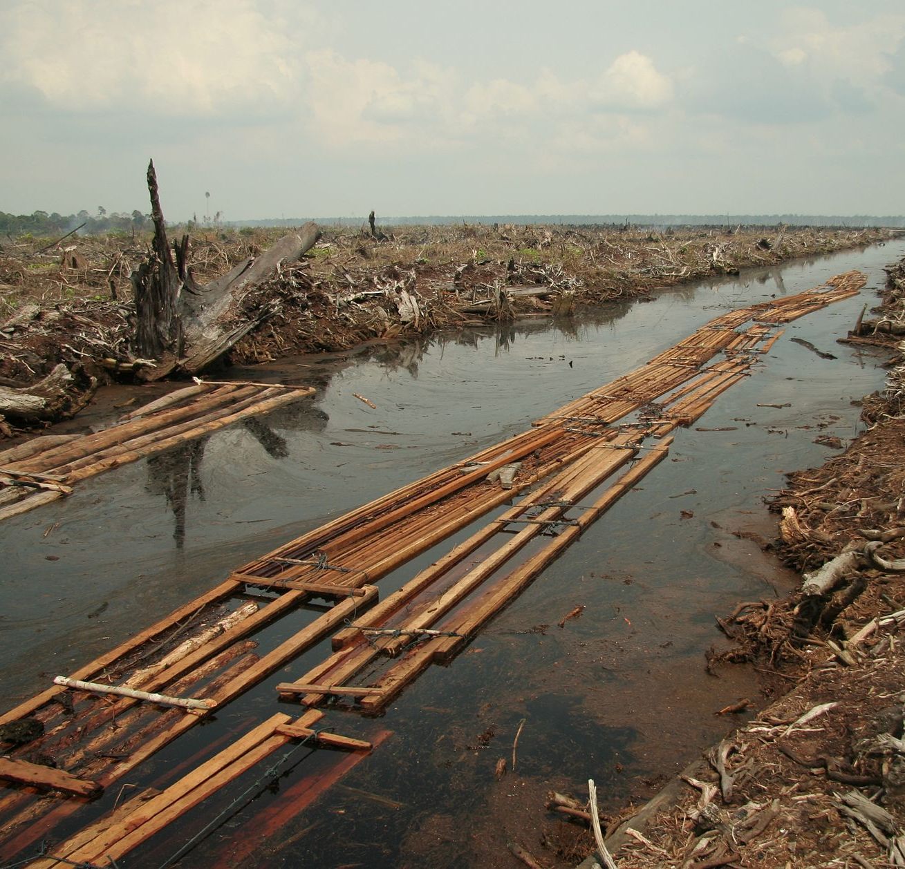
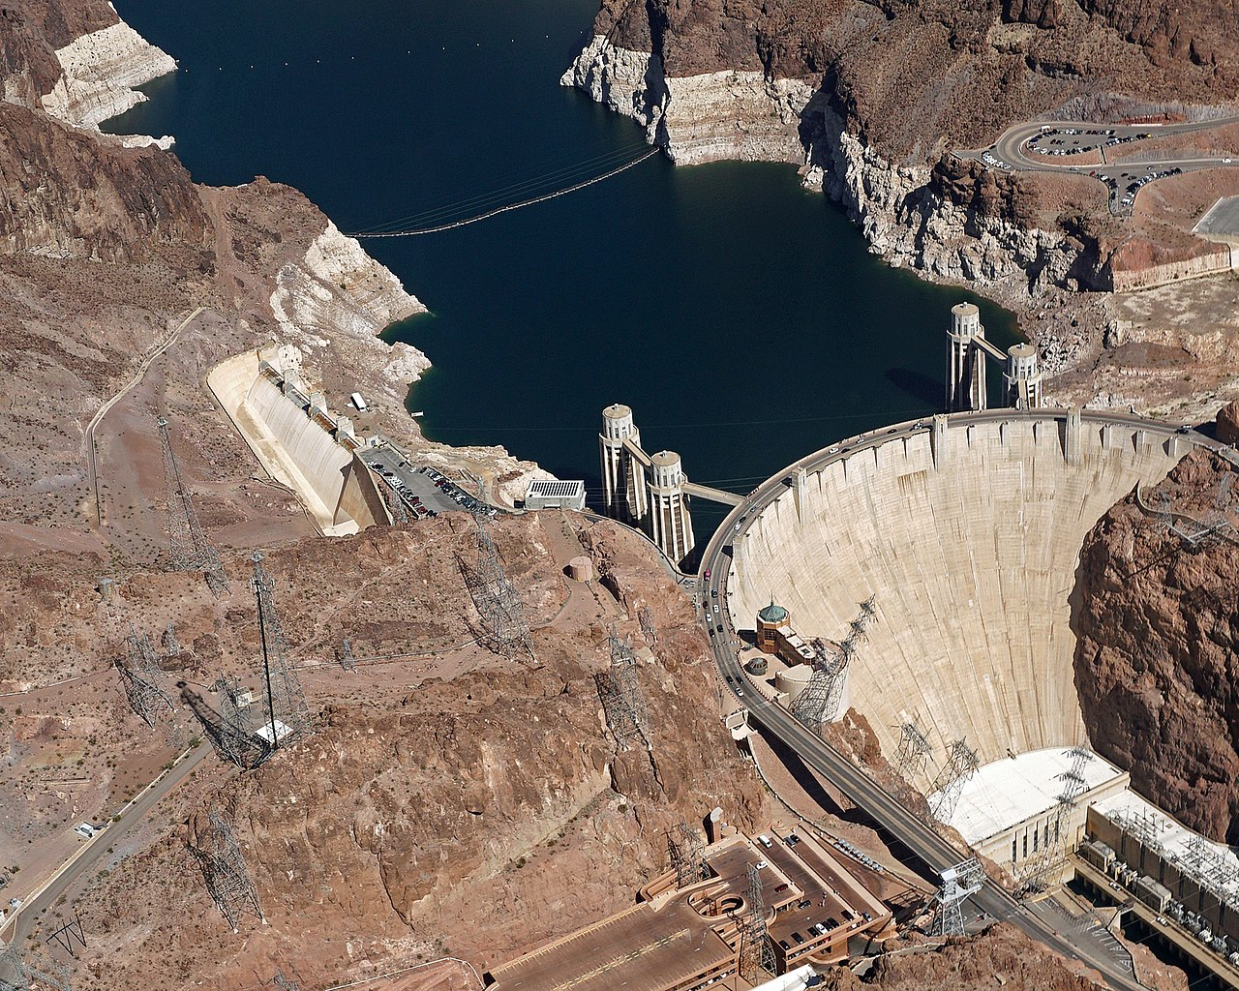
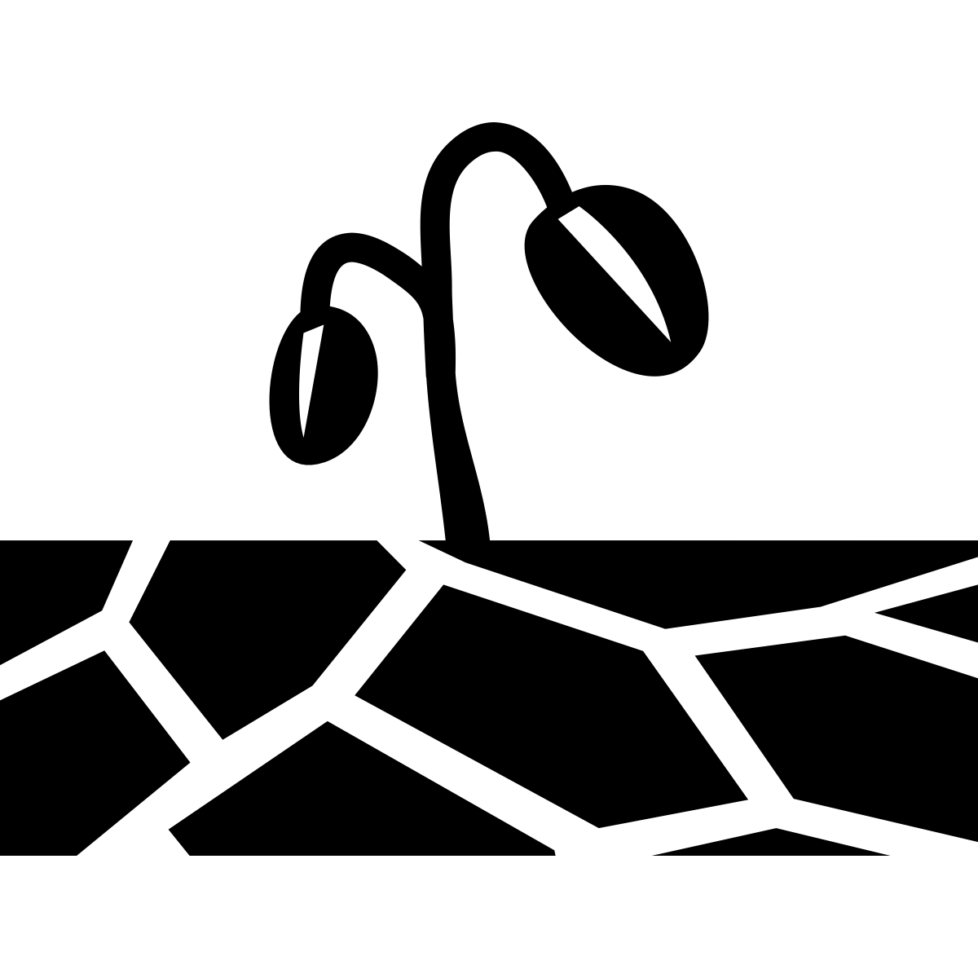
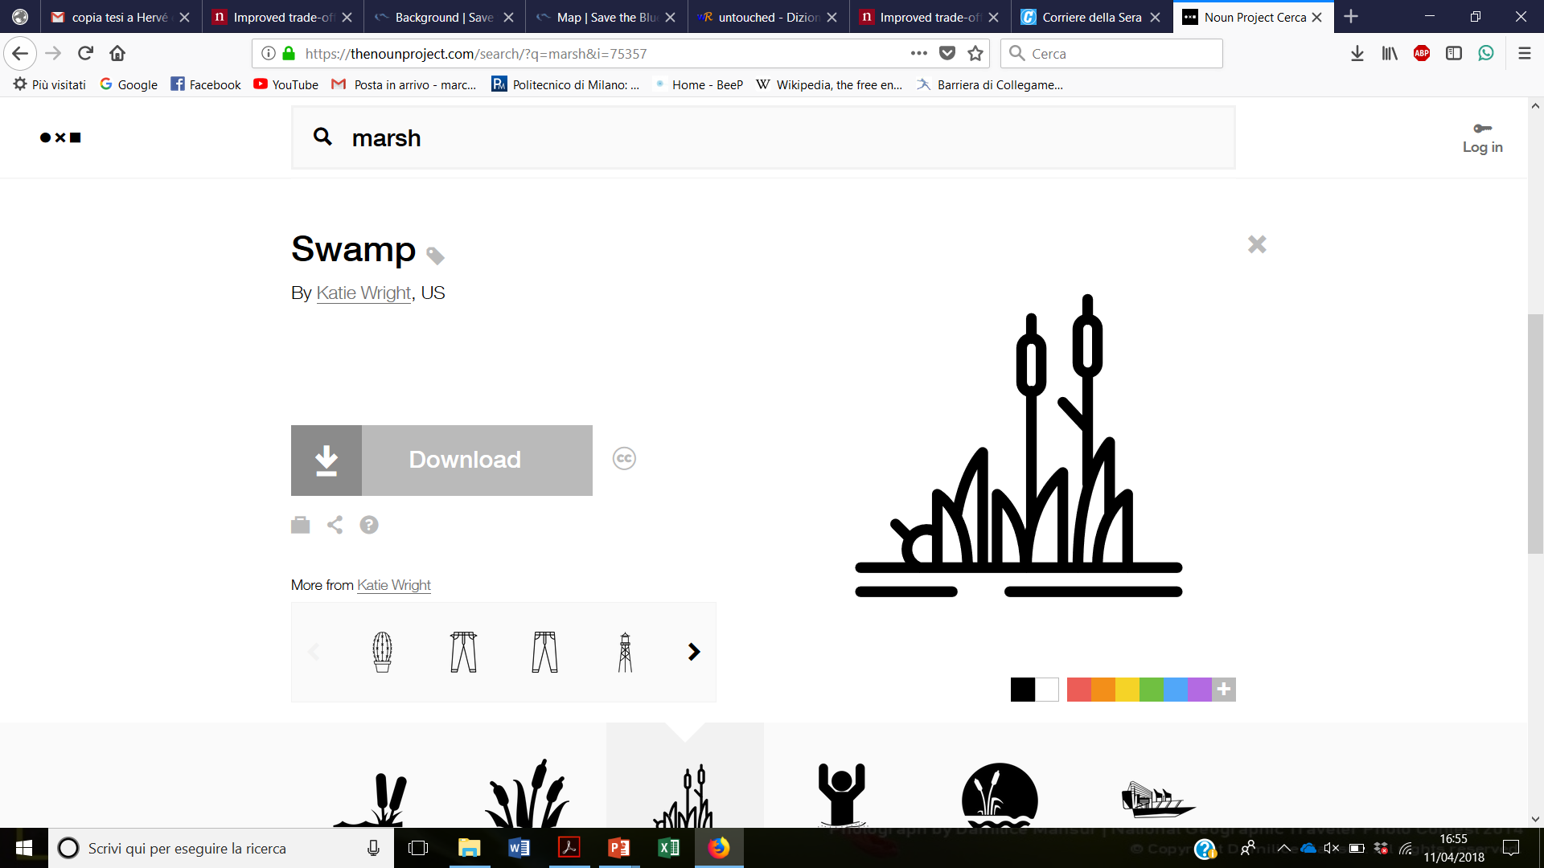
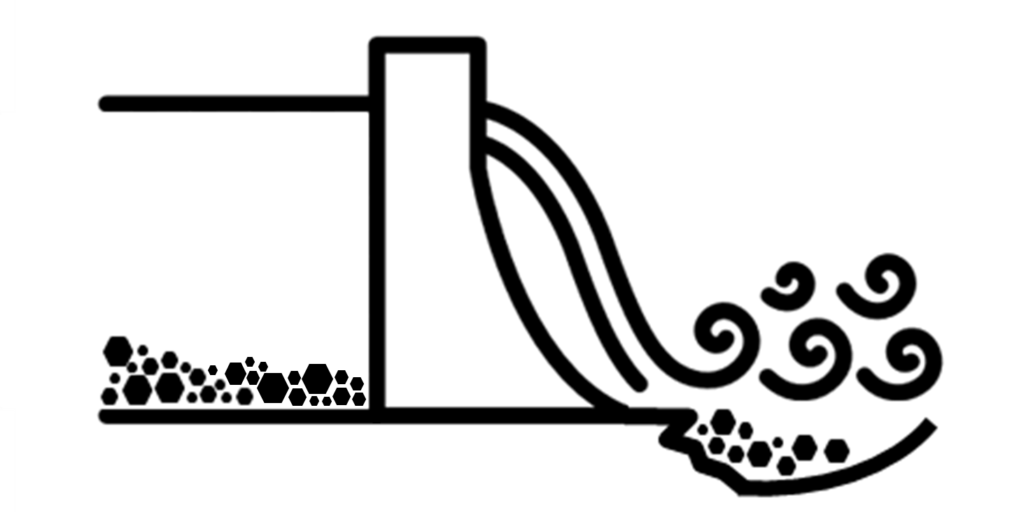

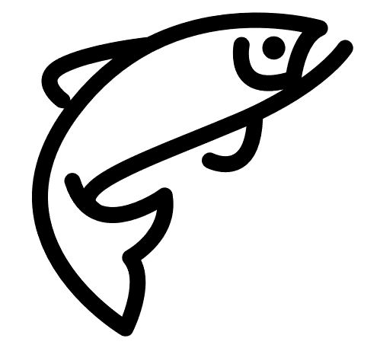
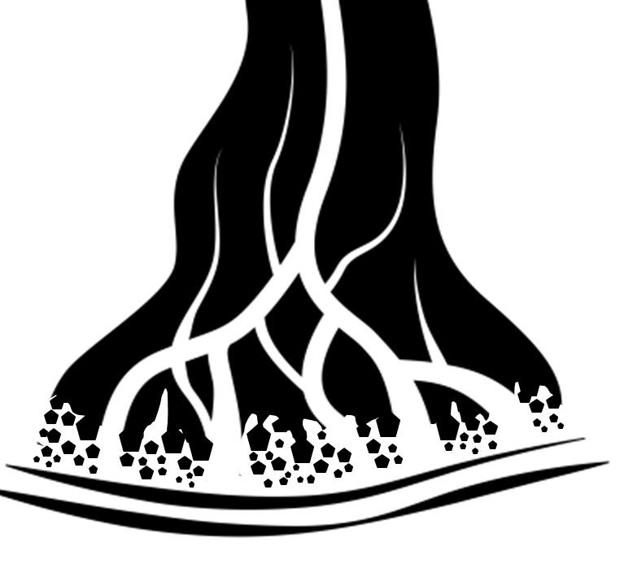
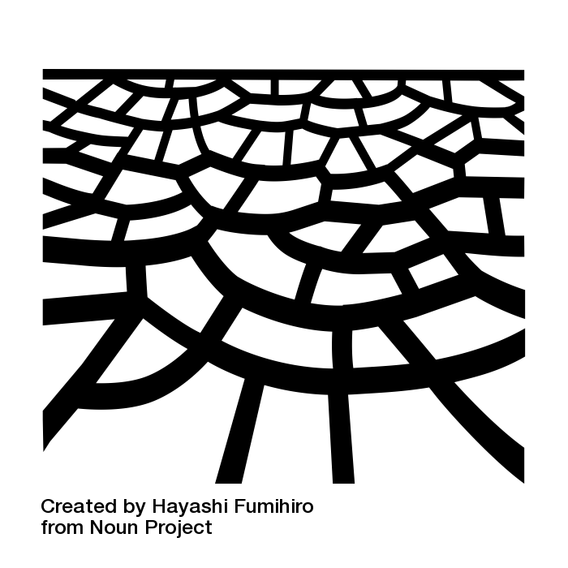

CASCADE : a toolbox for network-scale sediment connectivity assessment
  Marco Tangi, Rafael Schmitt, Simone Bizzi, Andrea Castelletti
Channelization in Chariton River, Missouri
(Jim Rathert)
Riverbed mining on the Sutlej River, India
(Samir Mehta/International Rivers)
Deforestation in Indragiri Hulu, Sumatra
(Aidenvironment, 2006)
Hoover Dam, Colorado river
(Mario Roberto Durán Ortiz)
Impacts of sediment connectivity alteration
Loss of fertility in floodplains
Damages to fluvial ecosystems
Dam filling and foot erosion
Bank erosion and channel incision
Impacts on animal life cycle and health
Coastal erosion
Notes:
Definition of sediment connectivity
Impact of sediment alteration
Importance of this cumulated impact at the network scale
Network scale, quantification
Few model exists at the network scale that quantify source-sink relationship, i.e. sediment connectivity, and can assess cumulative impact of alteration

Slide 3

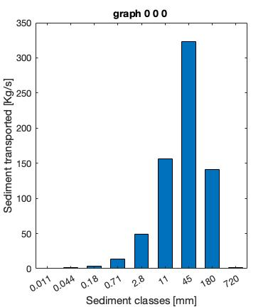
CASCADE : a toolbox for network-scale sediment connectivity assessment
  Marco Tangi, Rafael Schmitt, Simone Bizzi, Andrea Castelletti
Sediment flux transported
Sediment provenance
0.3
18
30
60
130
155
165
195
244
265
340
600
680
Flow direction
Sediment delivered
Notes:
Data scarce environments as well as in
Sediment fluxes as field datav for validations

Slide 4
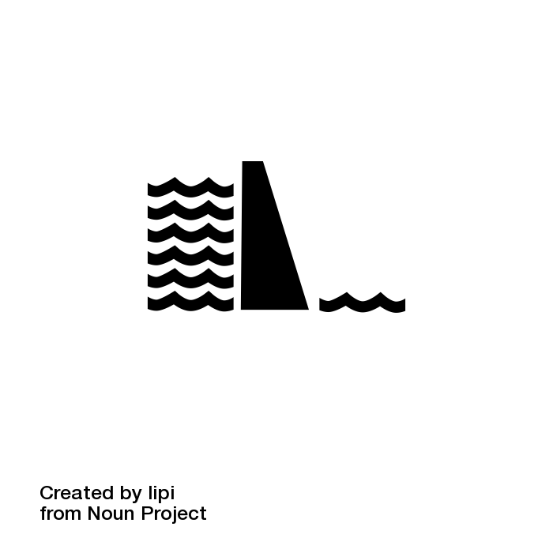
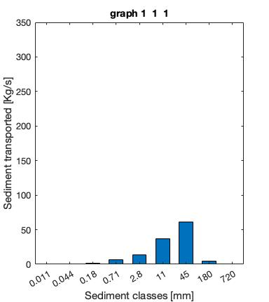
CASCADE : a toolbox for network-scale sediment connectivity assessment
  Marco Tangi, Rafael Schmitt, Simone Bizzi, Andrea Castelletti
Sediment flux transported
Sediment provenance
0.3
18
30
60
130
155
165
195
244
265
340
600
680
Flow direction
Sediment delivered
Notes:
Introduce alterations like dams of sediment reintroduction

Slide 5

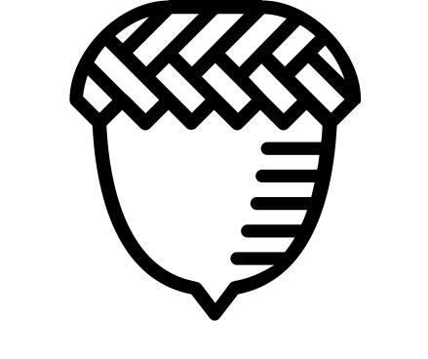


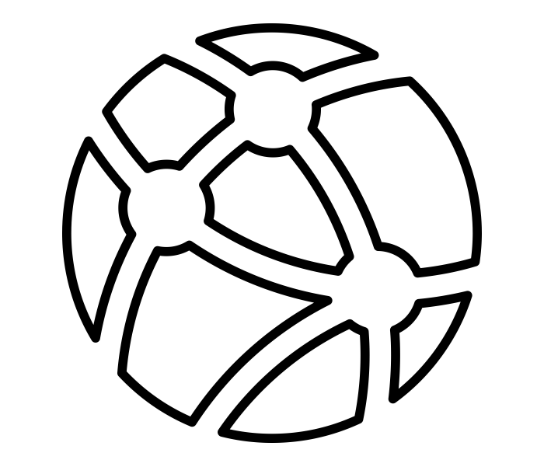

CASCADE : a toolbox for network-scale
sediment connectivity assessment
  Marco Tangi (1), Rafael Schmitt (2) , Simone Bizzi (1), Andrea Castelletti (1)
  (1) Politecnico of Milano, (2) The Natural Capital Project and Woods Institute for the Environment, Stanford University.
Research Topic
Introduction on the definition of river sediment connectivity and the CASCADE model principles
The model – In a Nutshell
Brief description of the toolbox framework and outputs
The model – Step by step
In-detail delineation of the steps necessary to implement the toolbox on a case study
Try CASCADE
Interactive exploration of the application of CASCADE for the analysis of dam siting options on a real case study
Links and references
Links for the CASCADE website and GitHub repository and references for the papers with CASCADE applications
All the links are shown as raised buttons

Slide 6
CASCADE : a toolbox for network-scale sediment connectivity assessment
Research topics
Research topic
Sediment connectivity is a complex property of river networks: many different sources supply sediment at specific locations, with a specific supply rate, and a specific distribution of input grain sizes.
Morphologic properties of the network (i.e., river gradient and width) and water discharge determine the capacity of the river to transport different grain sizes, leading to different patterns of connectivity in space and time.
1/4

Slide 7
CASCADE : a toolbox for network-scale sediment connectivity assessment
Research topic
CASCADE (CAtchment Sediment Connectivity And DElivery) is a modelling framework that combines concepts of network modelling with empirical sediment transport formulas to provide spatially fully distributed information on sediment transport and connectivity in river networks.
2/4

Slide 8
CASCADE : a toolbox for network-scale sediment connectivity assessment
Research topic
CASCADE takes advantage of increasing availability of geomorphic and hydrologic data in large-basins or at global scales to describe sediment connectivity in data scarce environments. Applications include optimization of dam portfolios for minimal sediment trapping, identification of dominant sources of sediment for reservoir storage loss, and evaluation of impacts of sediment connectivity alterations under different sediment management strategies.
3/4

Slide 9
CASCADE : a toolbox for network-scale sediment connectivity assessment
Research topic
The CASCADE toolbox is an open source MATLAB toolbox for the application of CASCADE on river network. The toolbox include several customization features, interactive visualization tools and a complete documentation, and is available for download from the CASCADE website and the GitHub repository.
Links and References
4/4

Slide 10

CASCADE : a toolbox for network-scale sediment connectivity assessment
The Model – In a nutshell
a) CASCADE first extracts the river network and assigns hydro-morphologic parameters to each reach.
b) Second, user-defined external sources are described in terms of sediment supply rates and supplied grain size distribution. Dams can also be included by specifying their sediment trap efficiency.
c) Third, the sediment connectivity is described as a combination of individual sediment transport processes called cascades, each one with a unique source and downstream path.
In each reach, the model determines the reach sediment budget by applying empirical sediment transport formulas, and then deposits part of the fluxes transported by the passing cascades or creates a new cascade to adjust to this threshold.
The resulting outputs are information on sediment flux and origins in each river reach and information on the fate of sediment from each source as it travels through the downstream network.
In a nutshell
Go to step by step description

Slide 11

CASCADE : a toolbox for network-scale sediment connectivity assessment
The Model – Step By Step
Network extraction and characterization
Definition of external sources and barriers
Sediment routing and connectivity evaluation
Step by step
Go to description in a nutshell

Slide 12
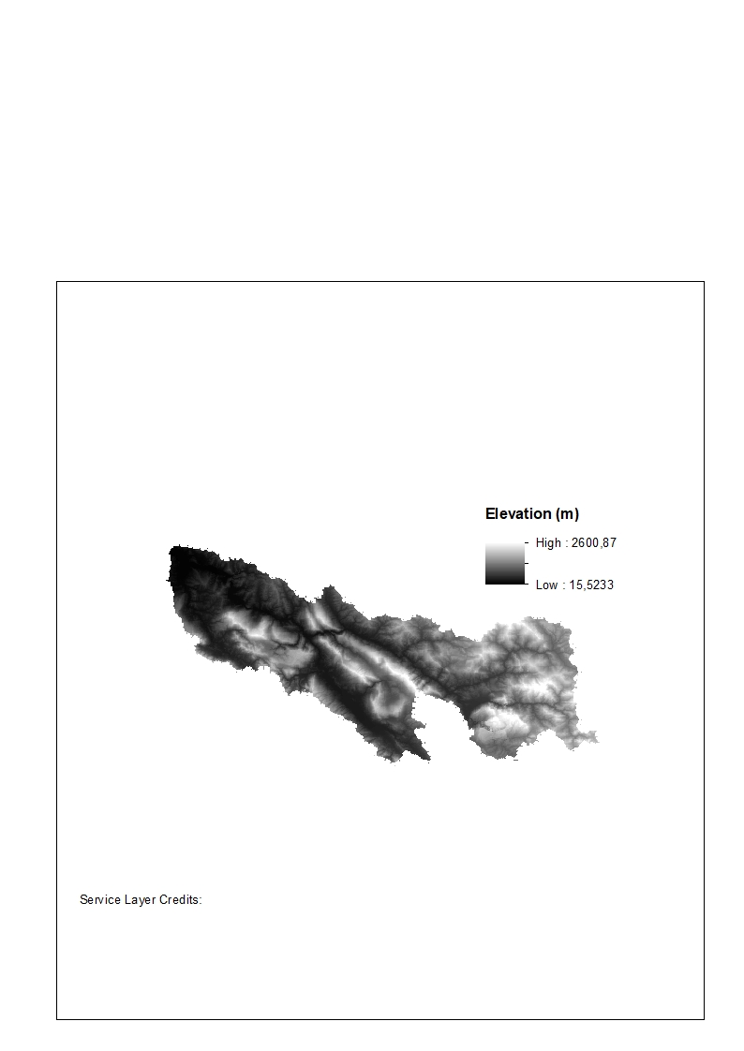
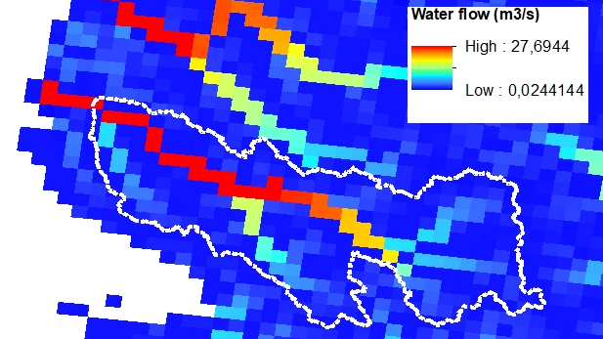
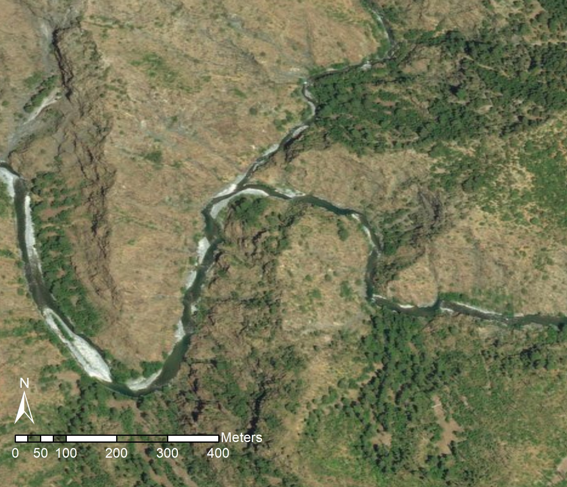
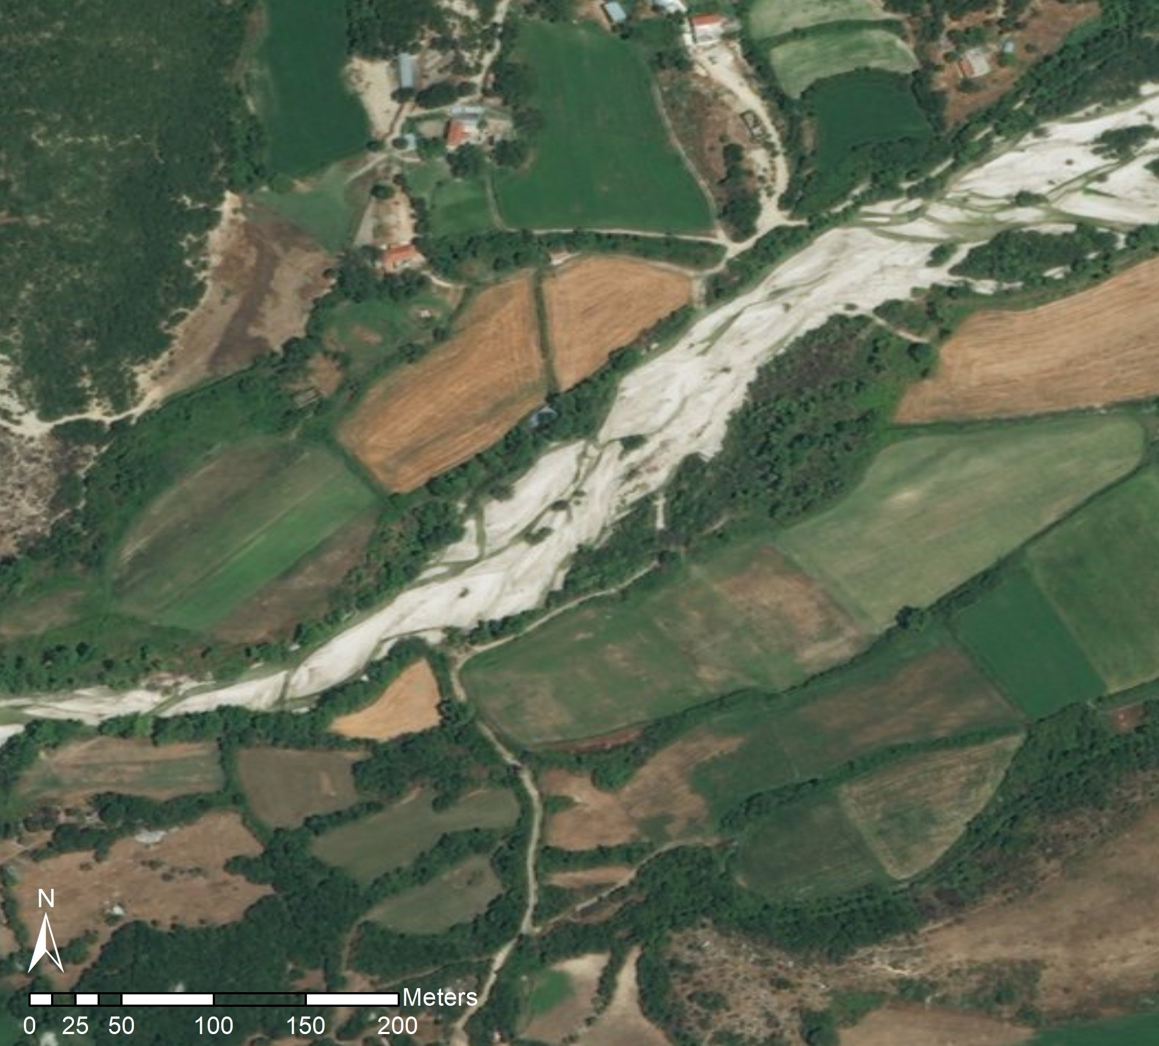

CASCADE : a toolbox for network-scale sediment connectivity assessment
The Model – Step By Step
Network extraction and characterization
Visualization of the network extraction process
CASCADE represents the river network as a directed graph consisting of nodes and reaches. Each reach is assigned a set of homogeneous hydromorphologic attributes related to sediment transport.
The river network, and attributes like the reach length, slope and drainage area can be extracted from DEMs.
Satellite images can be employed to deriver the channel width, while water discharge can be obtained from interpolation of gauging stations datasets or spatially distributed hydrological models.
Since CASCADE models the instantaneous sediment transport fluxes in Kg/s for a single water flow scenario, a single discharge value is needed for each reach.
Digital elevation model (DEM)
-> Network & Slope
Distributed hydrological model
-> Water discharge
Definition of external sources and barriers
Google Earth imagery
-> Active channel width
Sediment routing and connectivity evaluation

Slide 13
CASCADE : a toolbox for network-scale sediment connectivity assessment
The Model – Step By Step
Network extraction and characterization
Dams
Definition of external sources and barriers
Attributes
Location
Trapping efficiency per sediment class
The CASCADE toolbox can consider user-defined sediment sources from the hillslopes or river banks and dams and barriers that retain sediment.
These elements are defined by a single location on a reach, and influence the sediment routing either by depositing part of the incoming sediment flux or increasing the sediment flux delivered to a reach.
External contributions
Attributes
Location
Sediment flux delivered
Grain size distribution
Sediment routing and connectivity evaluation

Slide 14
CASCADE : a toolbox for network-scale sediment connectivity assessment
The Model – Step By Step
Network extraction and characterization
Visualization of the sediment routing process
Definition of external sources and barriers
Sediment routing and connectivity evaluation
To model sediment connectivity, CASCADE uses principles of graph theory, which suit the network representation of the river system:
The sediment delivery process is described via a combination of “cascades”, each defined as a routing pattern of a specific sediment source along the network.
Each cascade derives from a source in the network, transport a specific sediment flux and its path toward the outlet node of the network is defined by the network topology. While passing though the reaches, cascades may lose part of their flow via deposition, until either it depletes completely, or it reach the outlet.
1/4

Slide 15
CASCADE : a toolbox for network-scale sediment connectivity assessment
The Model – Step By Step
Network extraction and characterization
Visualization of the sediment routing process
Definition of external sources and barriers
Sediment routing and connectivity evaluation
User-defined sediment sources generate sediment fluxes which interact and increase the flow of the cascade originated in a reach or create a new cascade.
In contrast, dams placed on a network node causes the deposition of part of the sediment load of incoming cascades according to their trap efficiency.
2/4

Slide 16
CASCADE : a toolbox for network-scale sediment connectivity assessment
The Model – Step By Step
Network extraction and characterization
Visualization of the sediment routing process
Definition of external sources and barriers
Sediment routing and connectivity evaluation
In the model framework, each source is the beginning of multiple sub-cascades (lines in figure on the left).
This structure allows each sediment source to supply not only a single grain size, but rather a distribution of multiple grain sizes.
The toolbox creates cascades composed of a fixed a-priori number of sediment classes (three in the figure).
This framework is useful to represent more realistically processes supplying different grain sizes classes to the river network, e.g., mass movements might supply both very fine and very coarse sediment fractions at the same location.
3/4

Slide 17
CASCADE : a toolbox for network-scale sediment connectivity assessment
The Model – Step By Step
?
Network extraction and characterization
Transport capacity equations implemented in the toolbox
Wilcock & Crowe
Engelund & Hansen
Yang
Wong & Parker
Definition of external sources and barriers
Click for more detail on how the reach features influence the Wilcock and Crowe transport capacity equation
Sediment routing and connectivity evaluation
The hydrologic and geomorphic attributes are used to compute the transport capacity of each reach, i.e. the amount of energy available in a reach for the transport of sediment of a specific size.
In each reach, CASCADE computes a sediment budget for each grain size.
This means that if the sediment influx of a grain size class into a reach exceed the transport capacity of that reach, part of the sediment will be deposited on the river bed.
Instead, if more energy is available, new sediment can be entrained and transported, if available from the river bed or hillslope contributions, generating a new cascade.
High transport capacity
High water discharge
Steep slope
Narrow channel
Fine bed GSD
Low transport capacity
Low water discharge
Slight slope
Large channel
Coarse bed GSD
4/4
Try CASCADE

Slide 18

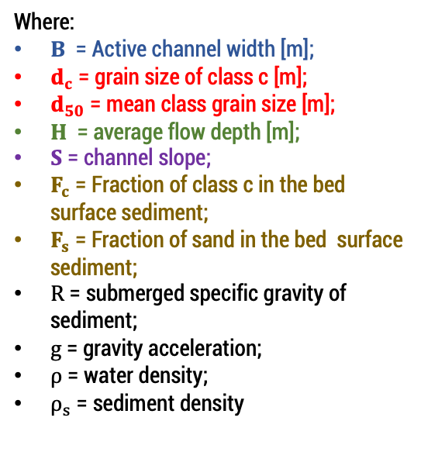

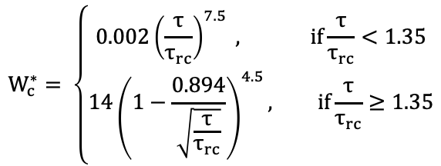











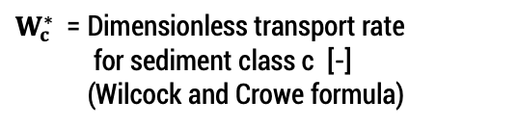
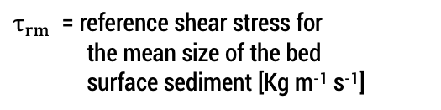
CASCADE : a toolbox for network-scale sediment connectivity assessment
Wilcock and Crowe – Transport capacity
Take me back please
for the love of God
$Q_{c}$ = Transport capacity for sediment
  class c [Kg s⁻¹]
$$Q_{c}=B W_{c}^{∗} F_{c} { ρ}_{s} {\left(\frac{τ}{ρ}\right)}^{3/2}{(R ∗g)}^{−1}$$
Where:
$B$ = Active channel width [m];
$d_{c}$ = grain size of class c [m];
$d_{50}$ = mean class grain size [m];
$H$ = average flow depth [m];
$S$ = channel slope;
$F_{c}$ = Fraction of class c in the bed surface sediment;
$F_{s}$ = Fraction of sand in the bed surface sediment;
$R$ = submerged specific gravity of sediment;
$g$ = gravity acceleration;
$ρ$ = water density;
$ρ_{s}$ = sediment density
$$W_{c}^{∗}= \left\{\begin{aligned}0.002{\left(\frac{τ}{τ_{rc}}\right)}^{7.5} , if\frac{τ}{τ_{rc}}<1.35 \\ 14{\left(1−\frac{0.894}{\sqrt{\frac{τ}{τ_{rc}}}}\right)}^{4.5}, if\frac{τ}{τ_{rc}}≥1.35\end{aligned}\right.$$
$W_{c}^{∗}$ = Dimensionless transport rate
  for sediment class c [-]
  (Wilcock and Crowe formula)
$τ$ = bed shear stress [Kg m⁻¹ s⁻¹]
$$τ = ρ g H S$$
$τ_{rc}$ = reference shear stress for
  sediment class c [Kg m⁻¹ s⁻¹]
$$τ_{rc}=τ_{rm }\left(\frac{d_{c}}{d_{50}}\right)$$
$$B$$
$$H$$
$τ_{rm}$ = reference shear stress for
  the mean size of the bed
  surface sediment [Kg m⁻¹ s⁻¹]
$$S$$
$τ_{rm }=$ $ρ g R{ d}_{50} \left(0.021+0.015 e^{−20 F_{s}}\right)$
$d_{50}$ , $d_{c}$
$F_{c}$ , $F_{s}$

Slide 19
CASCADE : a toolbox for network-scale sediment connectivity assessment
CASCADE simulation
In this section we showcase the different features of CASCADE for the evaluation of sediment alteration for different dam portfolios
In the simulation, sediment are delivered in the network only from source reaches and external sources (blue diamonds)
The instantaneous sediment fluxes visualized are identified with a
1 year return period discharge input
Active
Not active
Press on a dam to include or remove it.
Instantaneous sediment flux transported in each reach [Kg/s]
0.3
30
130
165
244
340
680
Try CASCADE
The case study presented is the Vjosa river, a gravel bed river in south Albania
Begin
More info

Slide 20
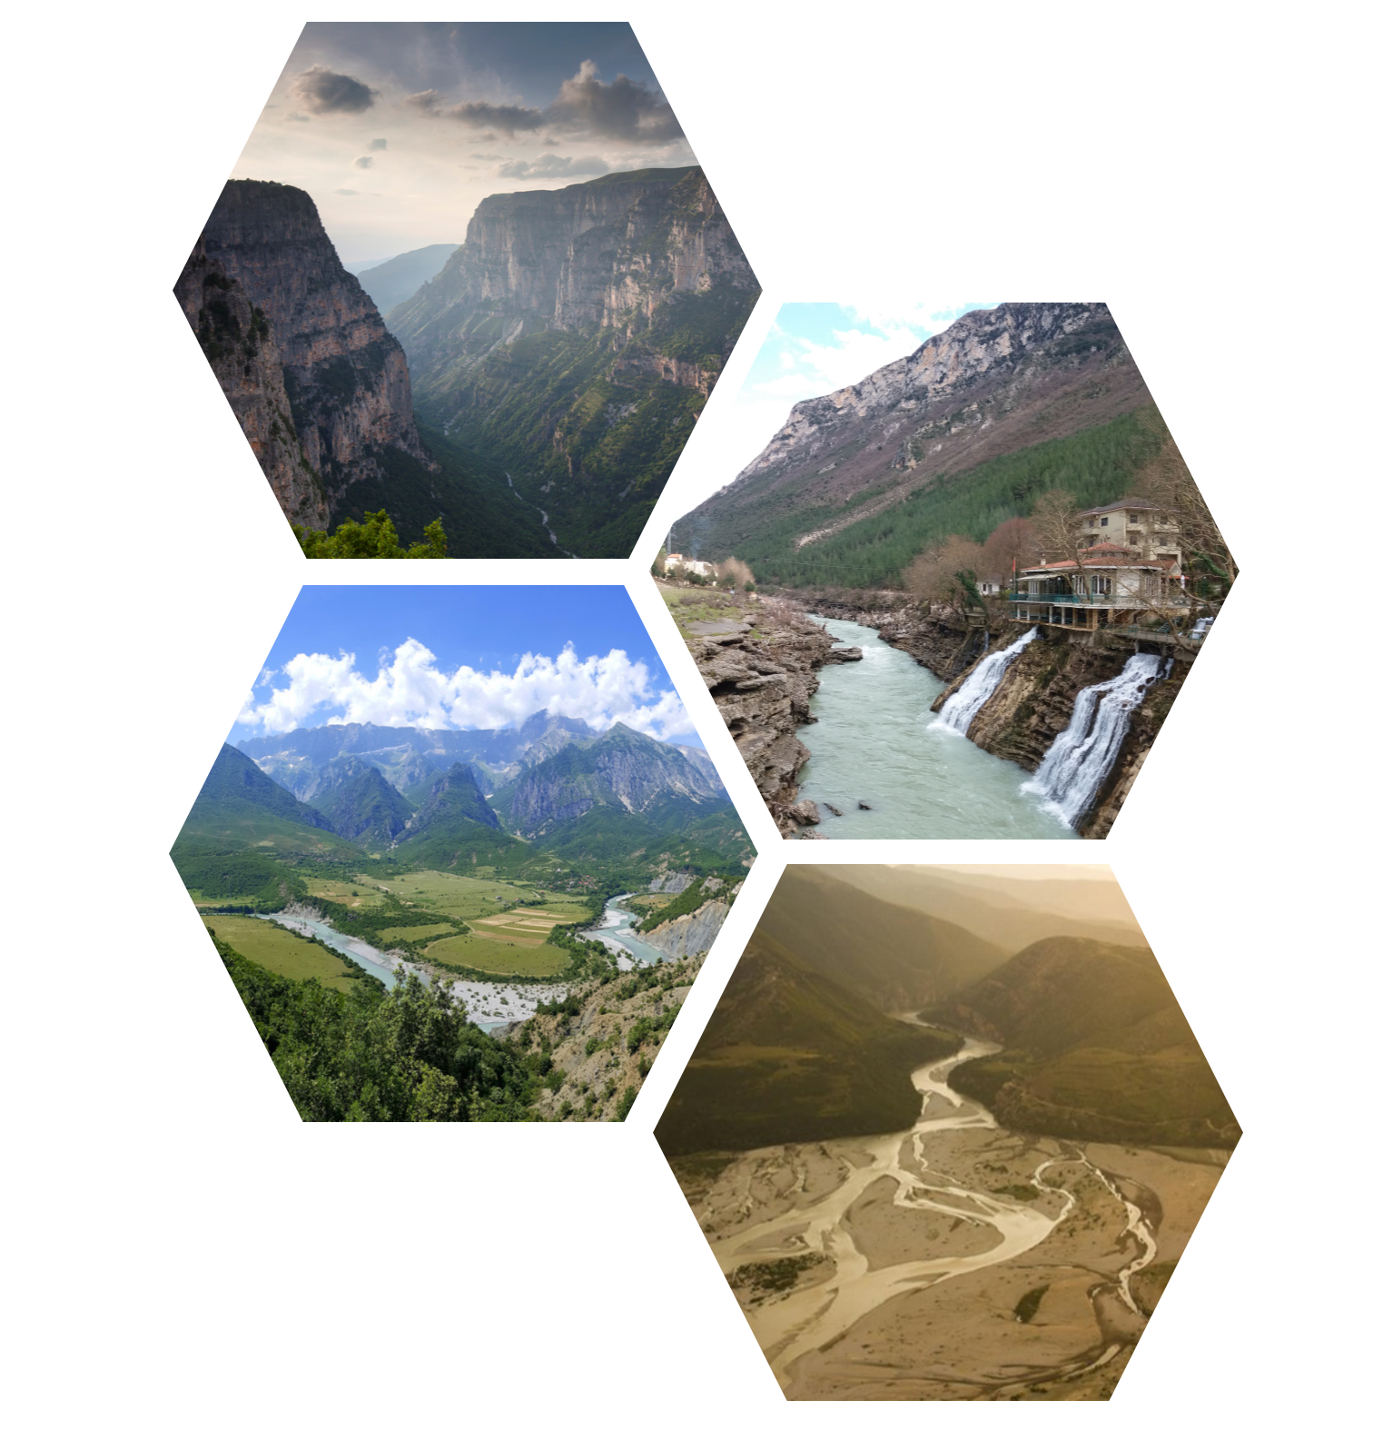
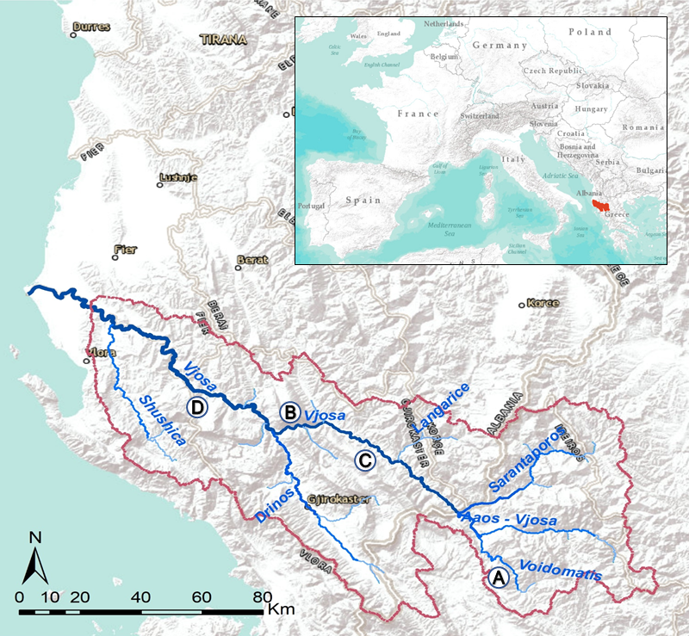
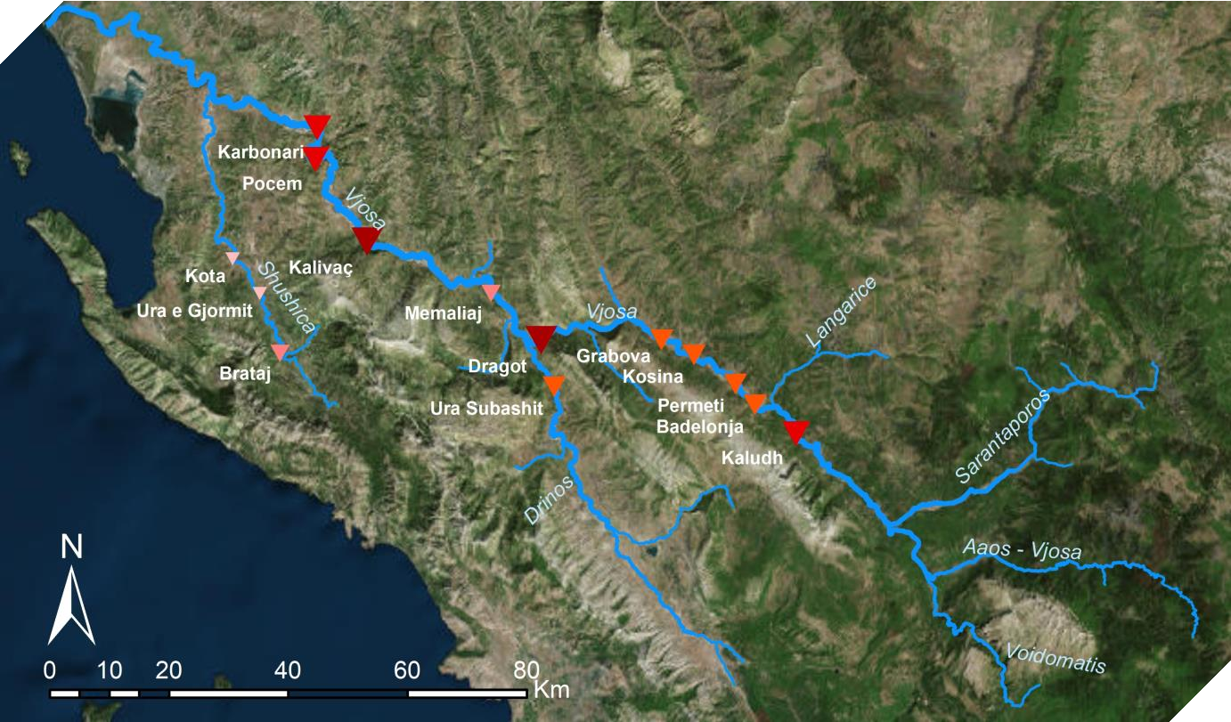
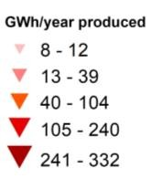
CASCADE : a toolbox for network-scale sediment connectivity assessment
CASCADE simulation – Vjosa river
The Vjosa river is a springs from the Pindus mountains, in the Balkans, and flows for most of its course in south Albania.
                Catchment area = 6,700 Km² Length = 272 Km
The Vjosa river basin is considered one of the last wild European rivers, it sustains many pristine fluvial ecosystems and exhibits numerous unique landscapes
A
B
C
D
The Vjosa river system, along with many other Balcan rivers, is now interested by large hydropower development plans.
Begin simulation

Slide 21
CASCADE : a toolbox for network-scale sediment connectivity assessment
CASCADE simulation
Instantaneous sediment flux transported in each reach [Kg/s]
Sediment provenance for the outlet reach (in blue) [Kg/s]
0.3
18
30
60
130
155
165
195
244
265
340
600
680
Flow direction
Sediment delivered to the outlet per class

Slide 22
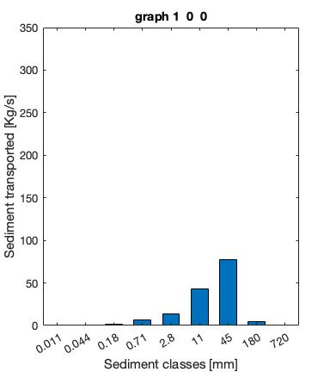
CASCADE : a toolbox for network-scale sediment connectivity assessment
CASCADE simulation
Instantaneous sediment flux transported in each reach [Kg/s]
Sediment provenance for the outlet reach (in blue) [Kg/s]
0.3
18
30
60
130
155
165
195
244
265
340
600
680
Flow direction
Sediment delivered to the outlet per class

Slide 23
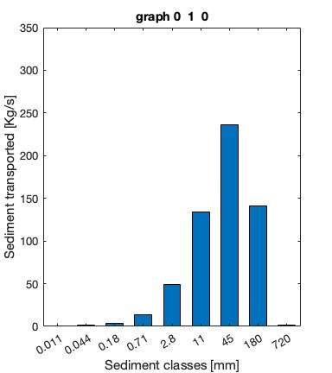
CASCADE : a toolbox for network-scale sediment connectivity assessment
CASCADE simulation
Instantaneous sediment flux transported in each reach [Kg/s]
Sediment provenance for the outlet reach (in blue) [Kg/s]
0.3
18
30
60
130
155
165
195
244
265
340
600
680
Flow direction
Sediment delivered to the outlet per class

Slide 24
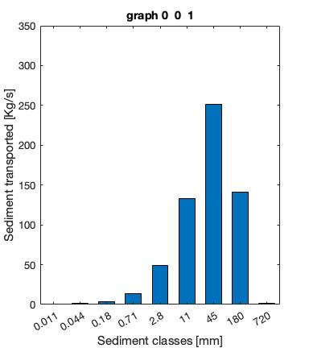
CASCADE : a toolbox for network-scale sediment connectivity assessment
CASCADE simulation
Instantaneous sediment flux transported in each reach [Kg/s]
Sediment provenance for the outlet reach (in blue) [Kg/s]
0.3
18
30
60
130
155
165
195
244
265
340
600
680
Flow direction
Sediment delivered to the outlet per class

Slide 25
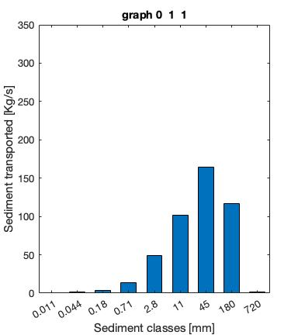
CASCADE : a toolbox for network-scale sediment connectivity assessment
CASCADE simulation
Instantaneous sediment flux transported in each reach [Kg/s]
Sediment provenance for the outlet reach (in blue) [Kg/s]
0.3
18
30
60
130
155
165
195
244
265
340
600
680
Flow direction
Sediment delivered to the outlet per class

Slide 26
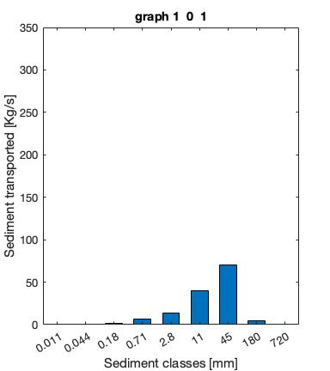
CASCADE : a toolbox for network-scale sediment connectivity assessment
CASCADE simulation
Instantaneous sediment flux transported in each reach [Kg/s]
Sediment provenance for the outlet reach (in blue) [Kg/s]
0.3
18
30
60
130
155
165
195
244
265
340
600
680
Flow direction
Sediment delivered to the outlet per class

Slide 27

CASCADE : a toolbox for network-scale sediment connectivity assessment
CASCADE simulation
Instantaneous sediment flux transported in each reach [Kg/s]
Sediment provenance for the outlet reach (in blue) [Kg/s]
0.3
18
30
60
130
155
165
195
244
265
340
600
680
Flow direction
Sediment delivered to the outlet per class

Slide 28
CASCADE : a toolbox for network-scale sediment connectivity assessment
CASCADE simulation
Instantaneous sediment flux transported in each reach [Kg/s]
Sediment provenance for the outlet reach (in blue) [Kg/s]
0.3
18
30
60
130
155
165
195
244
265
340
600
680
Flow direction
Sediment delivered to the outlet per class

Slide 29
Visualization of the steps of the model
X
The Model

Slide 30
Comparison between CASCADE routing with and without user-defined sediment contributions and dams
X
Without dams and external sediment contributions
With dams and external sediment contributions

Slide 31
Visualization of the sub-cascade routing
X

Slide 32
Location and main tributaries of the Vjosa river network
X

Slide 33
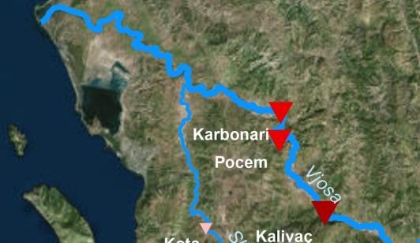
Planned locations for large dam projects on the Vjosa river network
X
Source : Sogreah report, 2008

Slide 34
CASCADE : a toolbox for network-scale sediment connectivity assessment
Useful references and links
The CASCADE toolbox is an explorative, static tool.
It uses the available information on a basin to describe the sources-sinks relations and compute the sediment budget for all the reaches in the network, while considering network connectivity thanks to its graph structure.
CASCADE is designed to have low computational time, allowing for extensive sensitivity analysis on the model inputs, especially sediment supply (e.g. reach transport or supply limited) and grain size distribution.
If field data on sediment transport or bed grain size distribution are available, even if few, they can be used to significantly narrow the range of acceptable simulations.
CASCADE, integrated with available filed data, allows to expand our understanding of system connectivity and support the planning of management measures.
Validation & Links
Go to Links
1/3

Slide 35
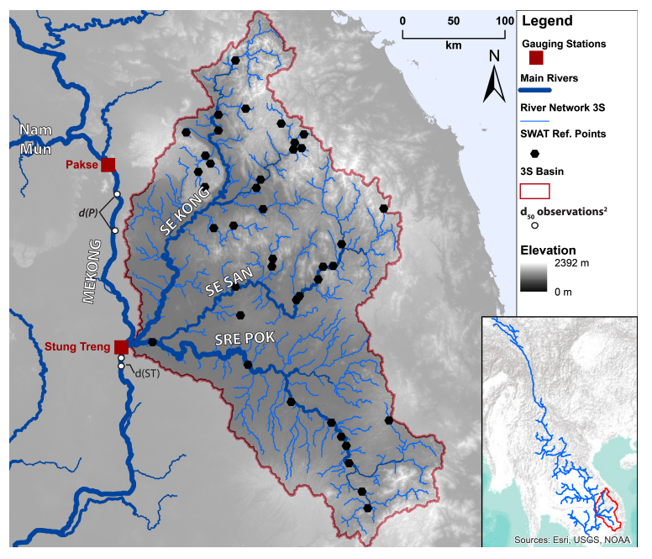
CASCADE : a toolbox for network-scale sediment connectivity assessment
CASCADE validation - example
The 3S basin, composed by the basins of the Se Kong, Se San and Sre Pok river, is a sub-basin of the Mekong river. It is a major contributor of sand to the basin and it’s interested by large scale dams development plans, that threatens to completely disconnect the 3S basin from the Mekong.
The 3S basin is a large and poorly monitored, with only two gauging stations providing estimates on sediment delivery and grains size distribution.
Validation & Links
Go to Links
2/3

Slide 36
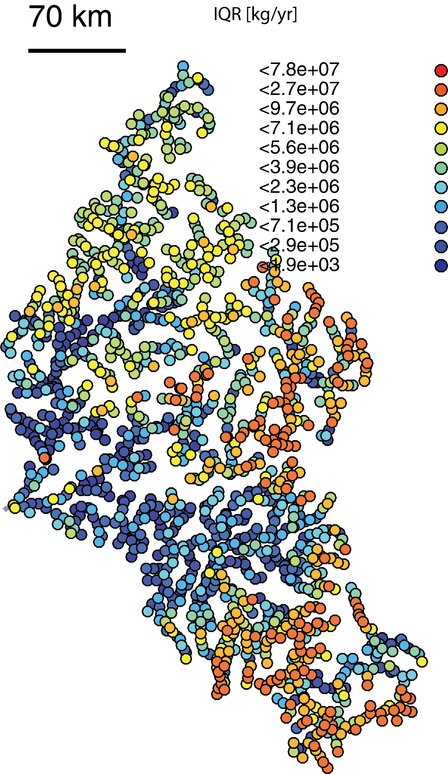
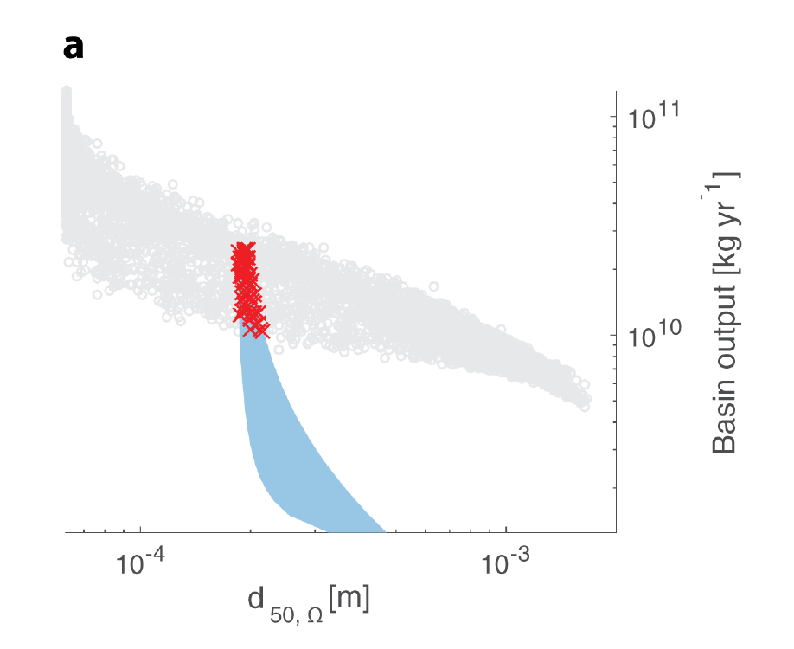
CASCADE : a toolbox for network-scale sediment connectivity assessment
CASCADE validation - example
CASCADE was applied to the 3S, and an extensive sensitivity analysis was performed with different input of sediment delivery and GSD in each reach.
The available field data were used to narrow the number of acceptable CASCADE simulations.
CASCADE simulations outputs (gray dots) Vs range of possible sediment fluxes at the outlet (in blue, based on available field data)
Characterization of sediment transfers and uncertainty in the three sub-basins in the 3S
Example of acceptable CASCADE simulation
Validation & Links
Go to Links
3/3
Figures from Schmitt et al., 2016, JGR, doi:10.1002/2016JF004105

Slide 37
CASCADE : a toolbox for network-scale sediment connectivity assessment
Useful references and links
CASCADE papers :
Schmitt, R. J., Bizzi, S., & Castelletti, A. (2016).
  Tracking multiple sediment cascades at the river network scale identifies controls and emerging patterns of sediment connectivity. Water Resources Research, 52(5), 3941-3965.
Schmitt, R. J., Bizzi, S., Castelletti, A., & Kondolf, G. M. (2018).
  Improved trade-offs of hydropower and sand connectivity by strategic dam planning in the Mekong. Nature Sustainability, 1(2), 96.
Schmitt, R. J., Bizzi, S., Castelletti, A. F., & Kondolf, G. M. (2018).
  Stochastic modeling of sediment connectivity for reconstructing sand fluxes and origins in the unmonitored Se Kong, Se San, and Sre Pok tributaries of the Mekong River. Journal of Geophysical Research: Earth Surface, 123(1), 2-25
The CASCADE toolbox is freely available for download on:
www.cascademodel.org (website)
github.com/mtangi/cascademodel (GitHub folder)
Validation & Links
Go to validation

