Slide 1
Cerium -Hf-Nd-Sr-Pb isotope constraints on the Azores
source composition and plume-rift interaction.
Paul Beguelin¹, Michael Bizimis¹, Michael Willig², Andreas Stracke², Christoph Beier³, Simon Turner⁴
¹University of South Carolina (USA), ²WWU Münster (Germany), ³University of Helsinki (Finland), ⁴Macquarie University - Sydney (Australia)
Written summary
We present ¹³⁸Ce/¹³⁶Ce and ¹⁷⁶Hf/¹⁷⁷Hf isotope ratios on respectively 14 and 41 previously well characterized (Nd-Sr-Pb isotopes, chemistry) subaerial and submarine samples from Eastern and Central Azores islands, situated along the Terceira Rift.
São Miguel and the João de Castro Seamount (JdC) show twin steep arrays extending to isotopically enriched compositions in ε_{Nd}-ε_{Hf}, and depleted ε_{Ce} for JdC. We use correlations with Pb isotopes to constrain possible age/composition values for this extreme source component and identify a very good match with compositionally heterogeneous Archean recycled oceanic crust. In contrast, central Azores lavas (Terceira, São Jorge) require the recycling of young (<700 Ma) altered/dehydrated oceanic crust.
Isotope data reveal a limited lateral expression of mantle endmembers along the Terceira Rift, which is consistent with westward asthenospheric flow of hybrid peridotite along a tilted lithosphere/asthenosphere boundary and melt extraction at eruptive centers along the Rift. This suggests short-scale (70 km) oriented migration of mantle endmembers is a feature of melts erupting along rifts perpendicular to ridges.
Cerium isotope data show a concave mixing trend in ε_{Ce}-ε_{Nd} and ε_{Ce}-ε_{Hf} for central Azores islands which cannot be solely explained by the sampling of isotopically depleted young recycled oceanic crust with high Ce/Nd and Ce/Hf trace element ratios. Rather, these data suggest a strong gradient in melting degree between two mixing endmembers: F<1% for the isotopically depleted source and F>5% for the isotopically enriched.
See Béguelin et al. (2017, GCA) for more on this project
2 Minutes summary
Results
Archean oceanic crust in the source of Eastern Azores
Young oceanic crust in the source of Central Azores
Spatial expression of plume sources along the Terceira Rift
New constraints from cerium isotopes
This project was funded by a SPARC research grant from the University of South Carolina (to P.B.)
and by the US National Science Foundation, grant OCE-1624315 (to M.B.)

Slide 2
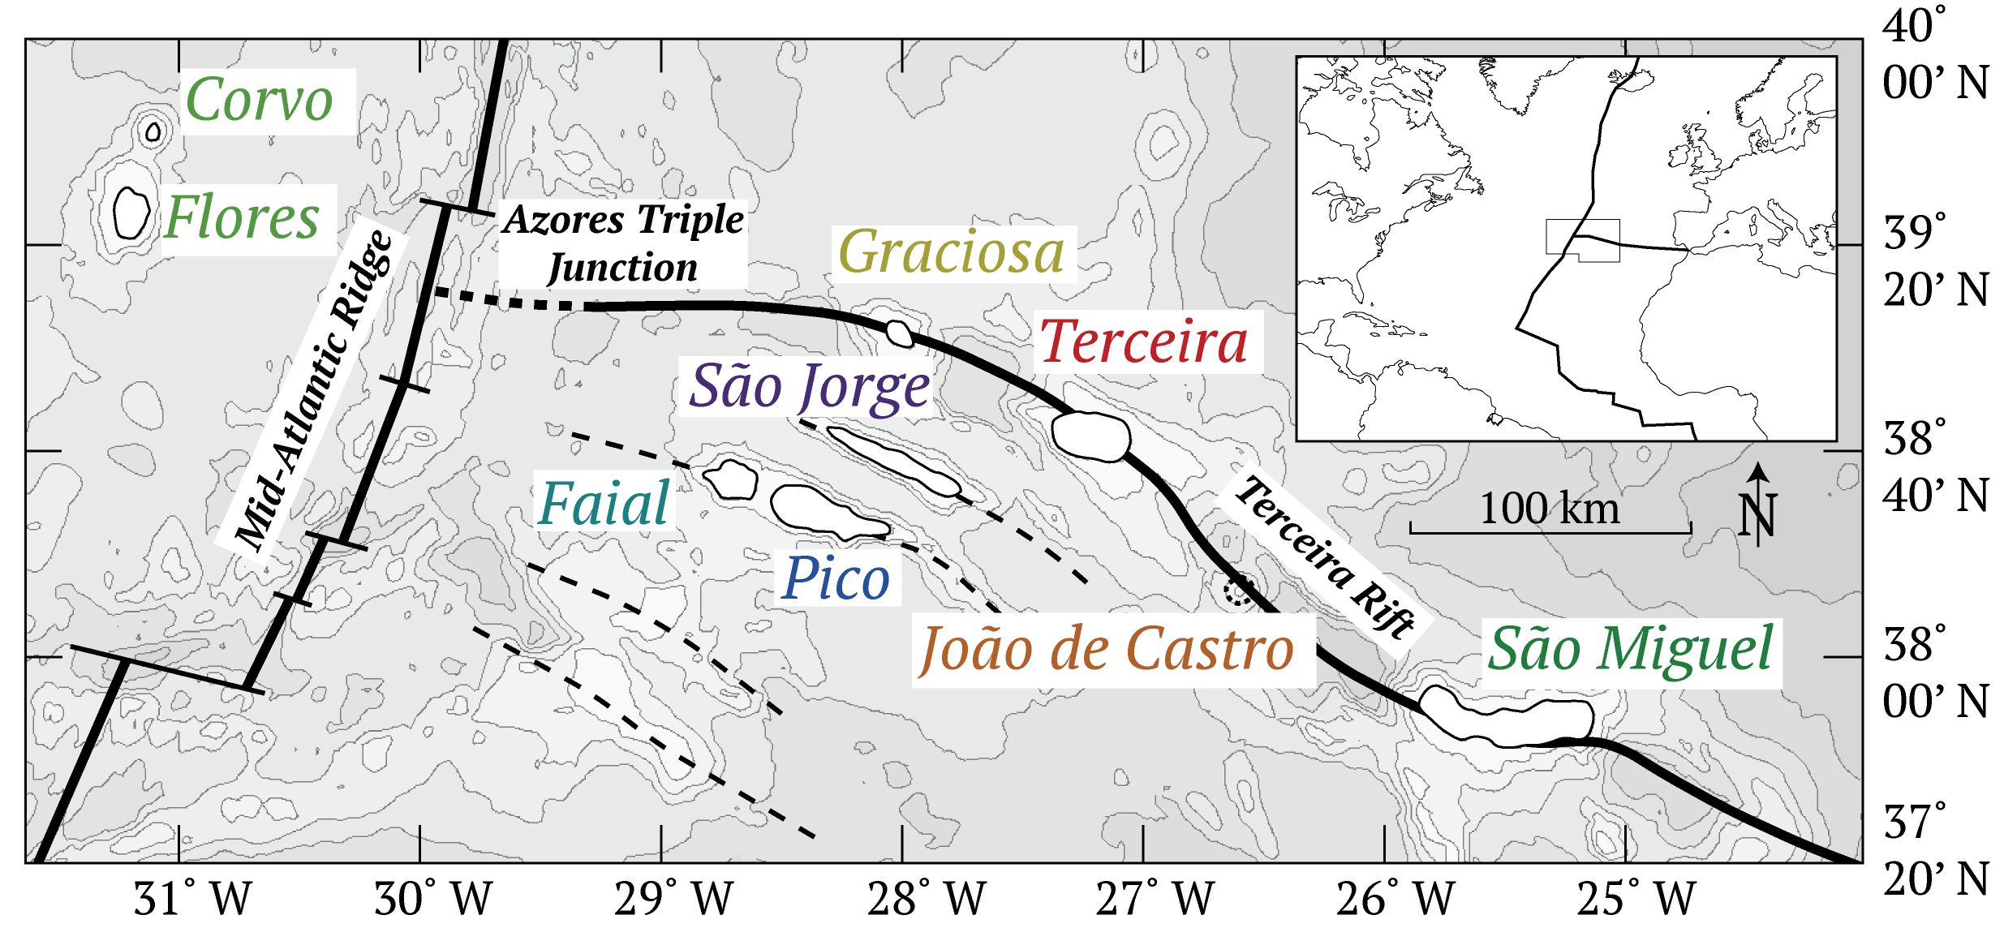
Cerium -Hf-Nd-Sr-Pb isotope constraints on the Azores source composition and plume-rift interaction.
2 minutes summary
Mantle Array
Willig and Stracke (2019) data:
MORB
OIB
Mantle Array

Slide 3
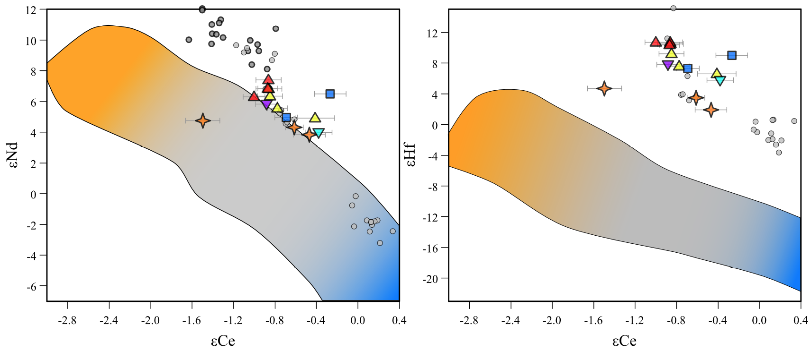
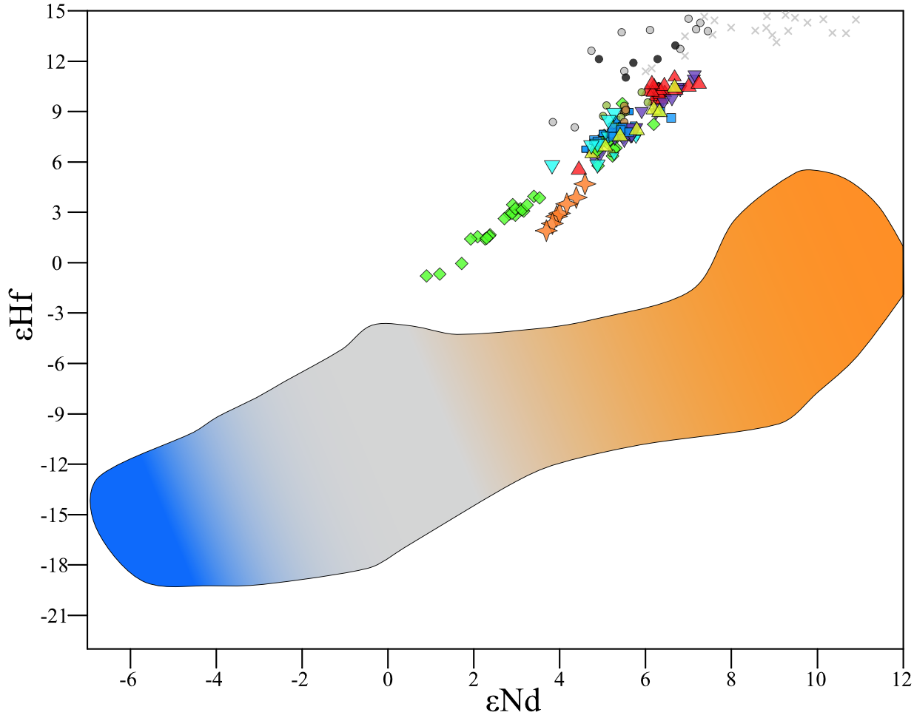
Cerium -Hf-Nd-Sr-Pb isotope constraints on the Azores source composition and plume-rift interaction.
2 minutes summary
mantle array
(Willig and
Stracke, 2019)
D-MORB
D-MORB
N-MORB
mantle array (Chauvel et al., 2008)
Willig and Stracke
(2019) data:
MORB
OIB
2.75 Ga recycled MORB
From the Gale et al. (2013)
compilation
E-MORB
N-MORB
E-MORB
mantle array
(Willig and
Stracke, 2019)
D-MORB
Isotopic modeling results for the source of São Miguel and João de Castro lavas suggest the presence of compositionally heterogeneous (D-MORB to E-MORB) Archean (2.75 Ga) recycled oceanic crust in their source. These results imply the compositional heterogeneity of oceanic crust was conserved during mixing and stirring in the convecting mantle.
N-MORB
E-MORB

Slide 4
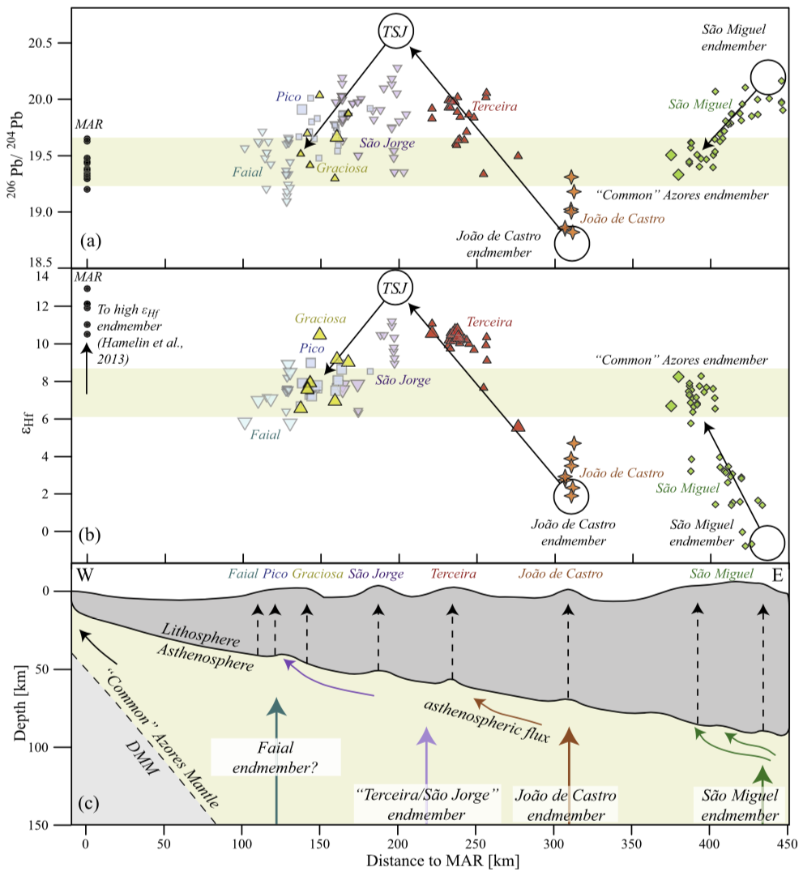
Cerium -Hf-Nd-Sr-Pb isotope constraints on the Azores source composition and plume-rift interaction.
2 minutes summary
The limited lateral expression of mantle endmembers along the Terceira Rift is consistent with westward asthenospheric flow of hybrid peridotite along a tilted lithosphere/asthenosphere boundary and melt extraction at eruptive centers along the Rift.
These data suggest short-scale (70 km) oriented migration of mantle endmembers is a feature of melts erupting along rifts perpendicular to ridges.
See Béguelin et al. (2017, GCA)
for more on this project

Slide 5
Cerium -Hf-Nd-Sr-Pb isotope constraints on the Azores source composition and plume-rift interaction.
Results
Mantle Array
Willig and Stracke (2019) data:
MORB
OIB
Mantle Array

Slide 6
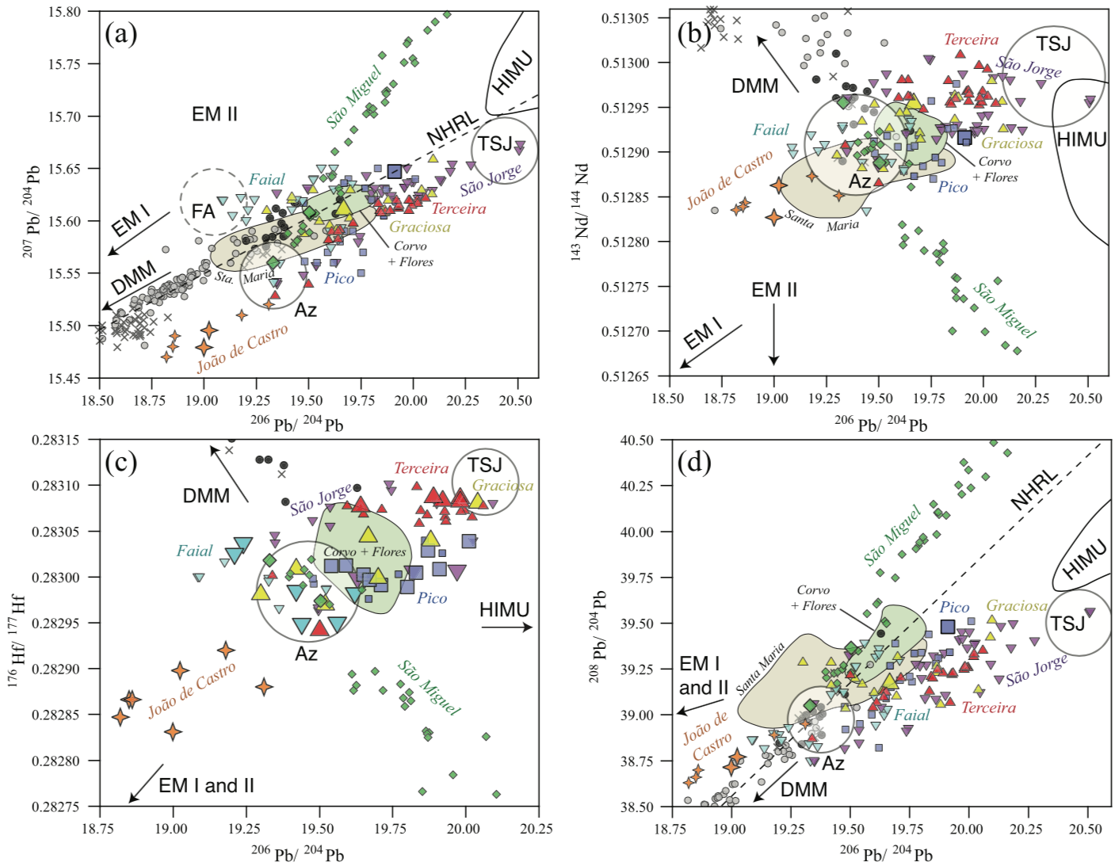
Cerium -Hf-Nd-Sr-Pb isotope constraints on the Azores source composition and plume-rift interaction.
Results
See Béguelin et al. (2017, GCA) for more on this project

Slide 7
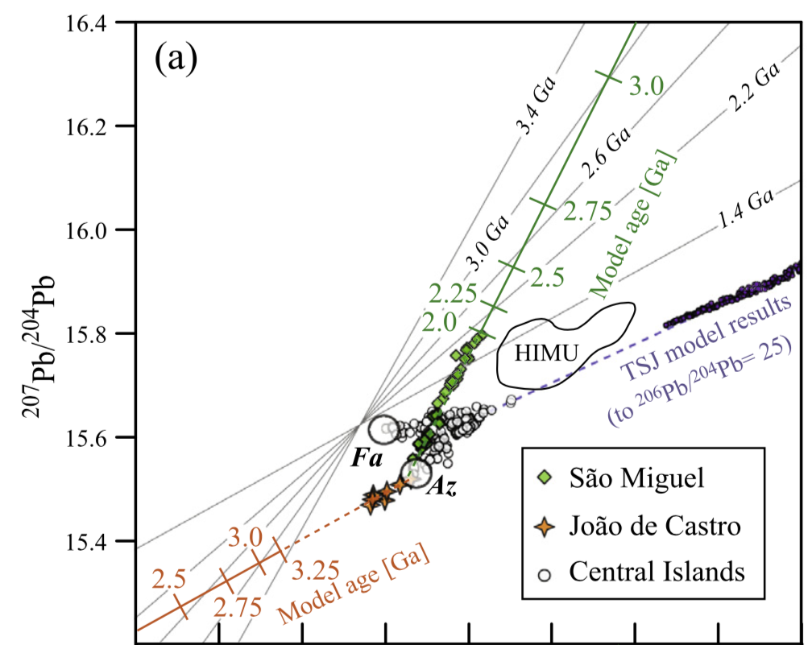
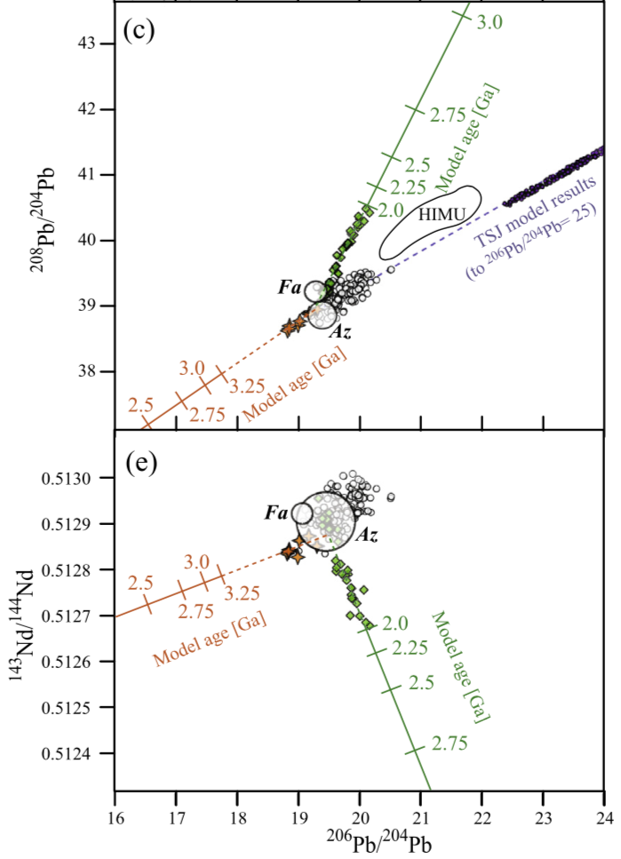
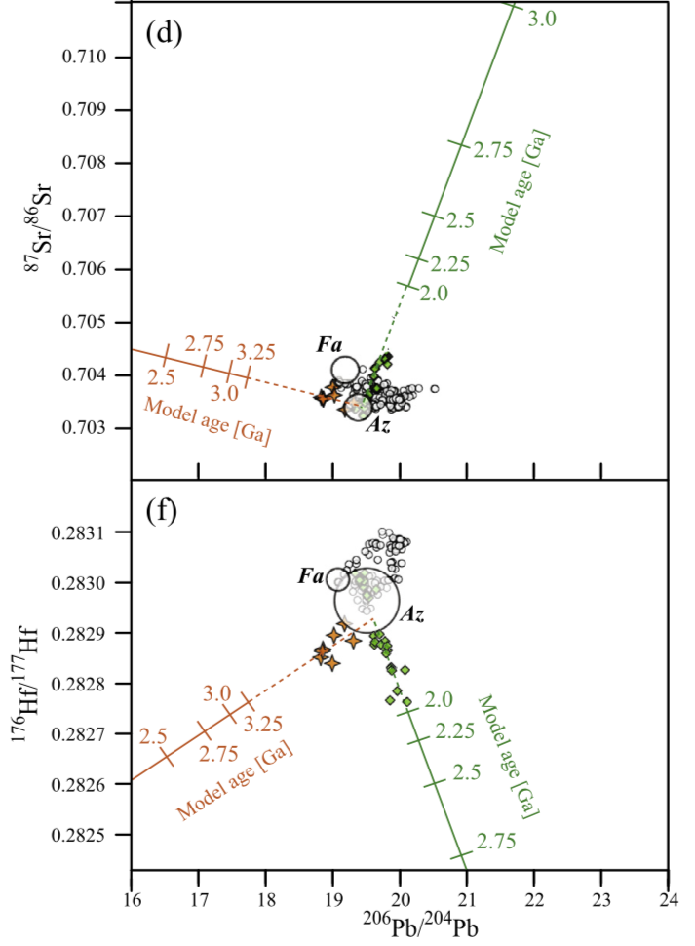
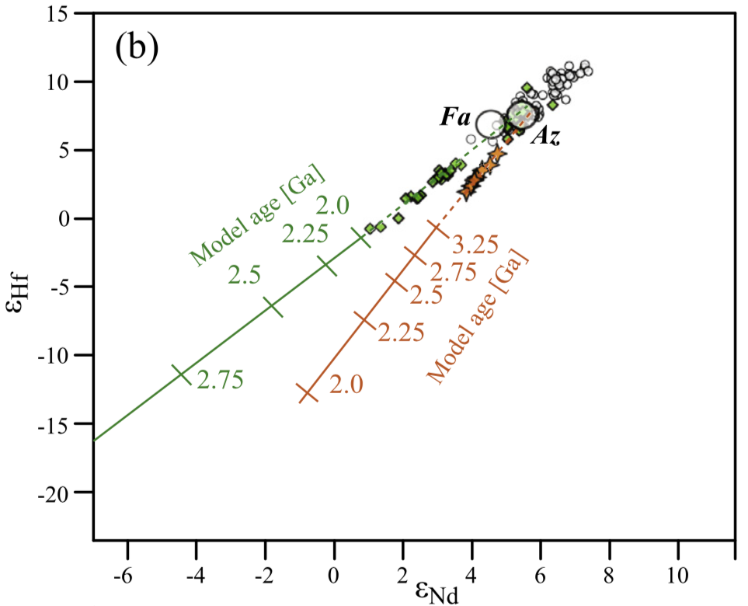
Cerium -Hf-Nd-Sr-Pb isotope constraints on the Azores source composition and plume-rift interaction.
Archean oceanic crust in the source of Eastern Azores
Correlations between Pb and Sr-Nd-Hf isotopes are used to identify possible age/isotope composition pairs for the São Miguel and João de Castro endmembers, assuming a unique recycling age. These age/isotope ratios pairs are then used to calculate corresponding parent/daughter ratios (next slide).
See Béguelin et al. (2017, GCA) for more on this project

Slide 8
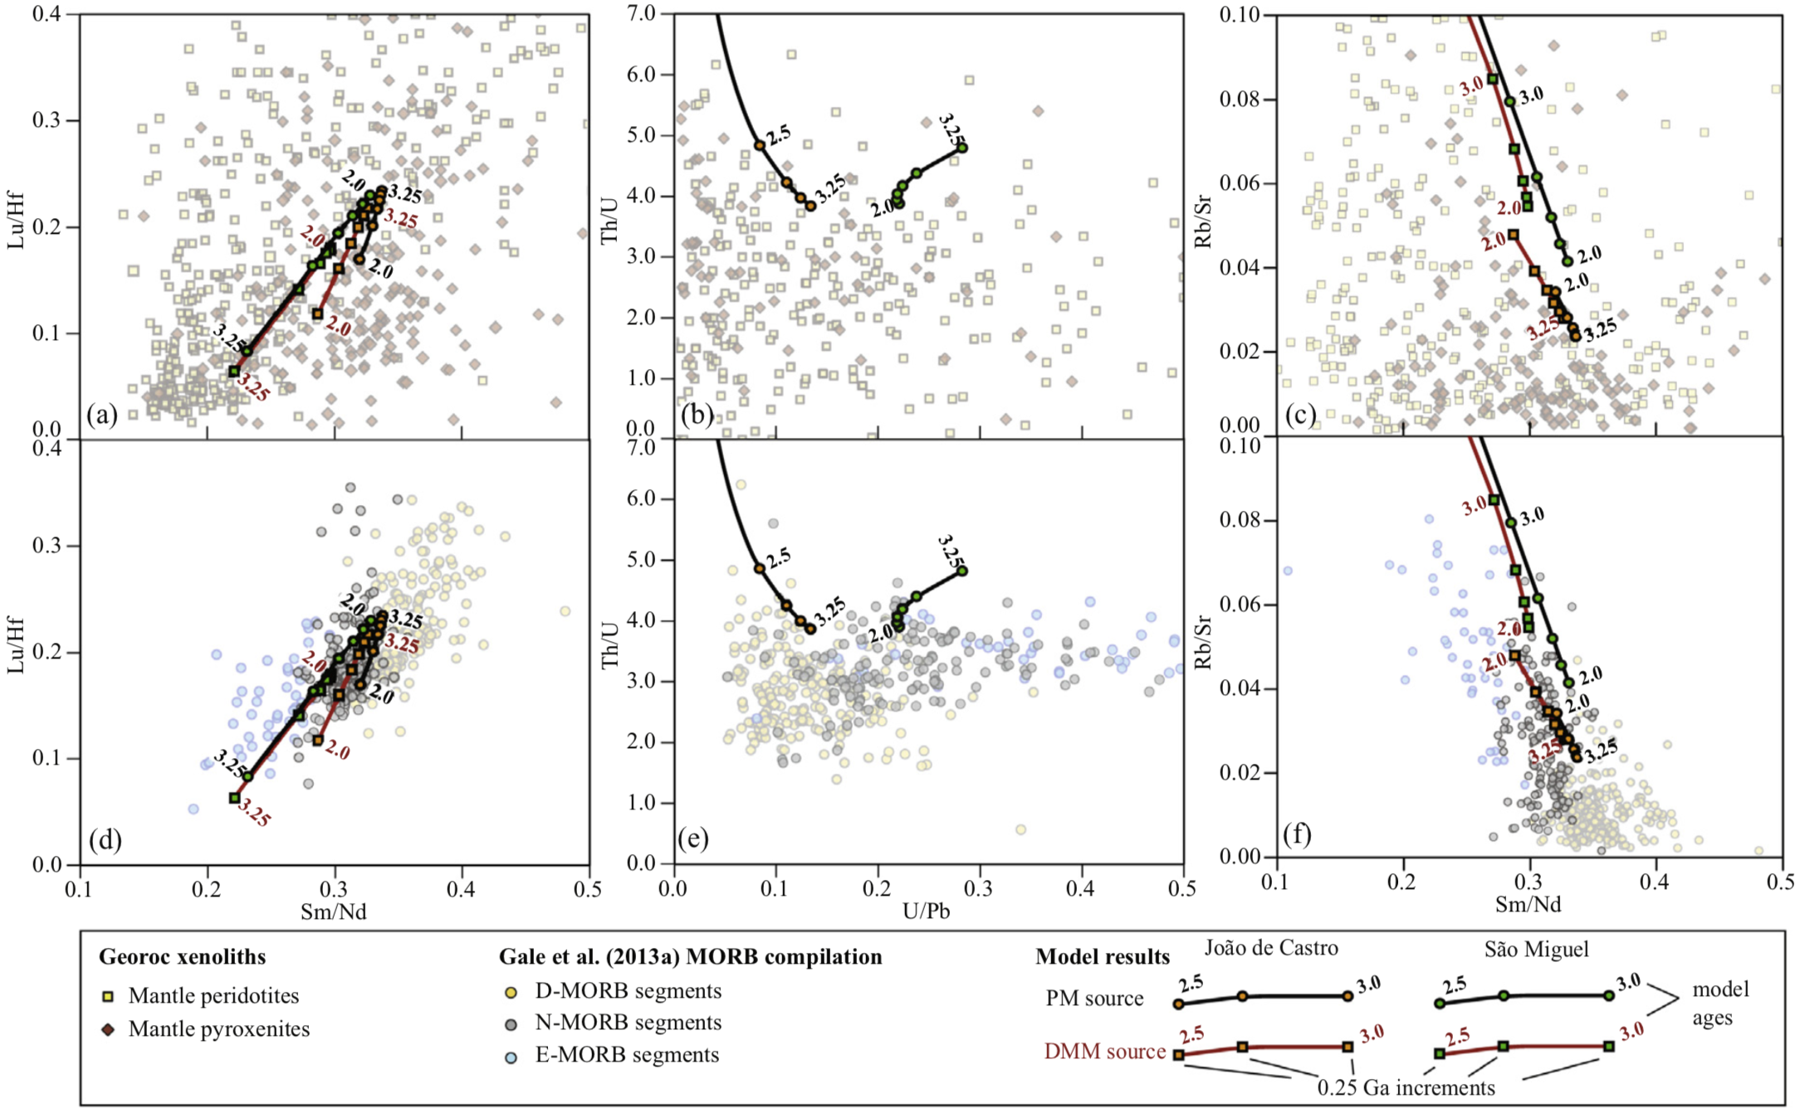
Cerium -Hf-Nd-Sr-Pb isotope constraints on the Azores source composition and plume-rift interaction.
Archean oceanic crust in the source of Eastern Azores
Match high Archean Th/U
(Elliott et al., 1999)
Model results show a broad correspondence with recycled mantle lithosphere (upper panels), but a tight match with recycled MORBs. We therefore favor the scenario where São Miguel and João de Castro sample recycled E-MORB and D-MORB, respectively.

Slide 9
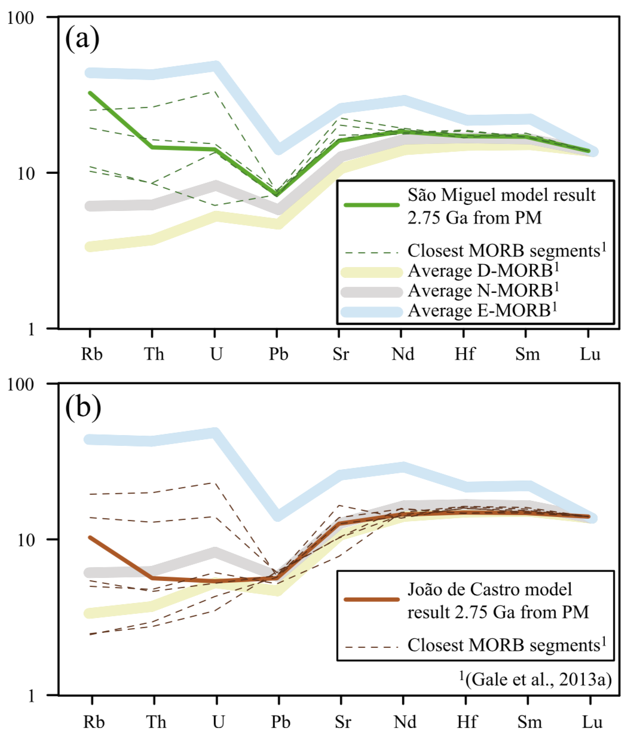
Cerium -Hf-Nd-Sr-Pb isotope constraints on the Azores source composition and plume-rift interaction.
Archean oceanic crust in the source of Eastern Azores
São Miguel and João de Castro sample a single package of heterogeneous recycled Archean oceanic crust (~2.75Ga).
MORB segments corresponding to these compositions are found in the global record of today’s MORB lavas.

Slide 10
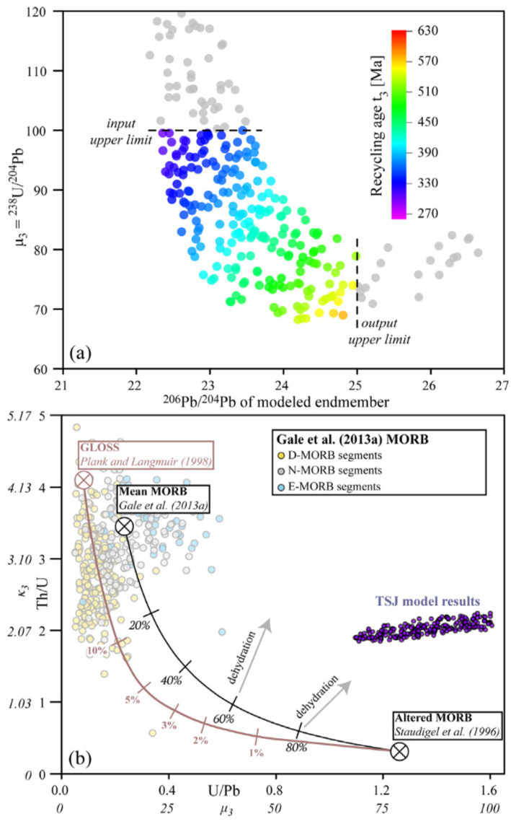
Cerium -Hf-Nd-Sr-Pb isotope constraints on the Azores source composition and plume-rift interaction.
Young oceanic crust in the source of Central Azores (Terceira, São Jorge)

Slide 11
Cerium -Hf-Nd-Sr-Pb isotope constraints on the Azores source composition and plume-rift interaction.
Spatial expression of plume sources along the Terceira Rift
The limited lateral expression of mantle endmembers along the Terceira Rift is consistent with westward asthenospheric flow of hybrid peridotite along a tilted lithosphere/asthenosphere boundary and melt extraction at eruptive centers along the Rift.
These data suggest short-scale (70 km) oriented migration of mantle endmembers is a feature of melts erupting along rifts perpendicular to ridges.
See Béguelin et al. (2017, GCA)
for more on this project

Slide 12
Cerium -Hf-Nd-Sr-Pb isotope constraints on the Azores source composition and plume-rift interaction.
New constraints from cerium isotopes
Mixing endmember with high Ce/Nd, but low time-integrated La/Ce compared to Sm/Nd.
Mixing endmember with high Ce/Hf, but low time-integrated La/Ce compared to Lu/Hf.
concave trend
mixing with
recycled Archean MORB
concave trend
mantle array
(Willig and Stracke, 2019)
mixing with
recycled Archean MORB
mantle array
(Willig and Stracke, 2019)
Young recycled oceanic crust (Terceira - São Jorge component)?
PM-normalized | Ce/Nd | Ce/Hf | Nd/Hf | La/Ce | Sm/Nd | Lu/Hf
D-MORB (Gale et al., 2013) | 0.8 | 0.8 | 0.9 | 0.8 | 1.1 | 0.9
N-MORB (Gale et al., 2013) | 0.9 | 0.9 | 1.0 | 0.9 | 1.0 | 0.8
E-MORB (Gale et al., 2013) | 1.3 | 1.7 | 1.3 | 1.2 | 0.8 | 0.6
→ Ce/Nd and Ce/Hf enrichment in MORBs is not enough to explain the curvature of the Central Azores trend (requires a 4x enrichment)

Slide 13
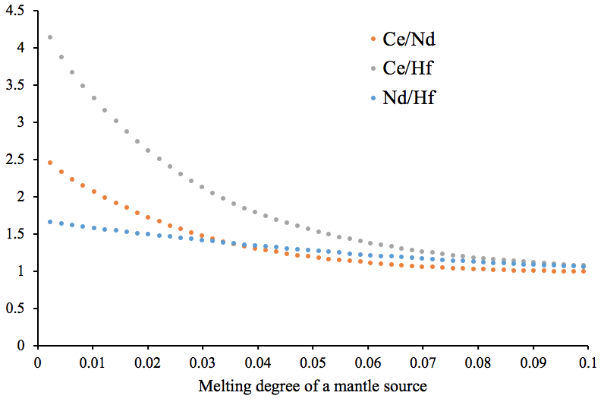
Cerium -Hf-Nd-Sr-Pb isotope constraints on the Azores source composition and plume-rift interaction.
New constraints from cerium isotopes
Mixing endmember with high Ce/Nd, but low time-integrated La/Ce compared to Sm/Nd.
I
Mixing endmember with high Ce/Hf, but low time-integrated La/Ce compared to Lu/Hf.
I
concave trend
concave trend
II
mixing with
recycled Archean MORB
II
mantle array
(Willig and Stracke, 2019)
mixing with
recycled Archean MORB
mantle array
(Willig and Stracke, 2019)
Gradient in degree of melting?
A concave trend can be explained by mixing low degree melts of an isotopically depleted source with higher degree melts of an isotopically enriched source.
Endmember
I
Endmember
II

