Slide 1
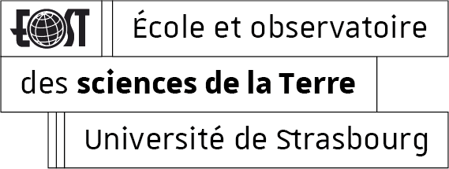
From monodisperse to polydisperse: the influence of grain size distribution on the mechanical behavior of porous synthetic rocks Lucille Carbillet, Michael J. Heap, Fabian B. Wadsworth, Patrick Baud
How are synthetic samples with variable grain size distributions prepared?
How do monodisperse synthetic samples compare to polydisperse synthetic samples ?
What is the influence of grain size distribution on the mechanical properties?

Slide 2
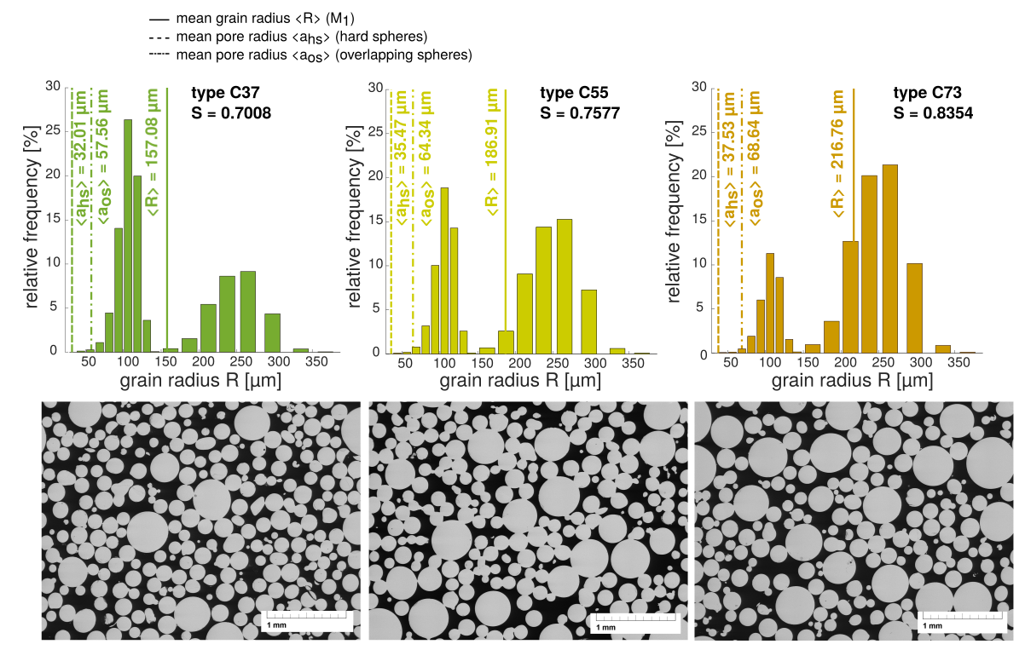
How are synthetic samples with variable grain size distributions prepared?
20 x 40 mm samples with bimodal distributions
variable proportions of the bead size ranges :
0.15 – 0.25 mm (3) ; 0.4 – 0.6 mm (2) ; 1.0 – 1.3 mm (1)

Slide 3
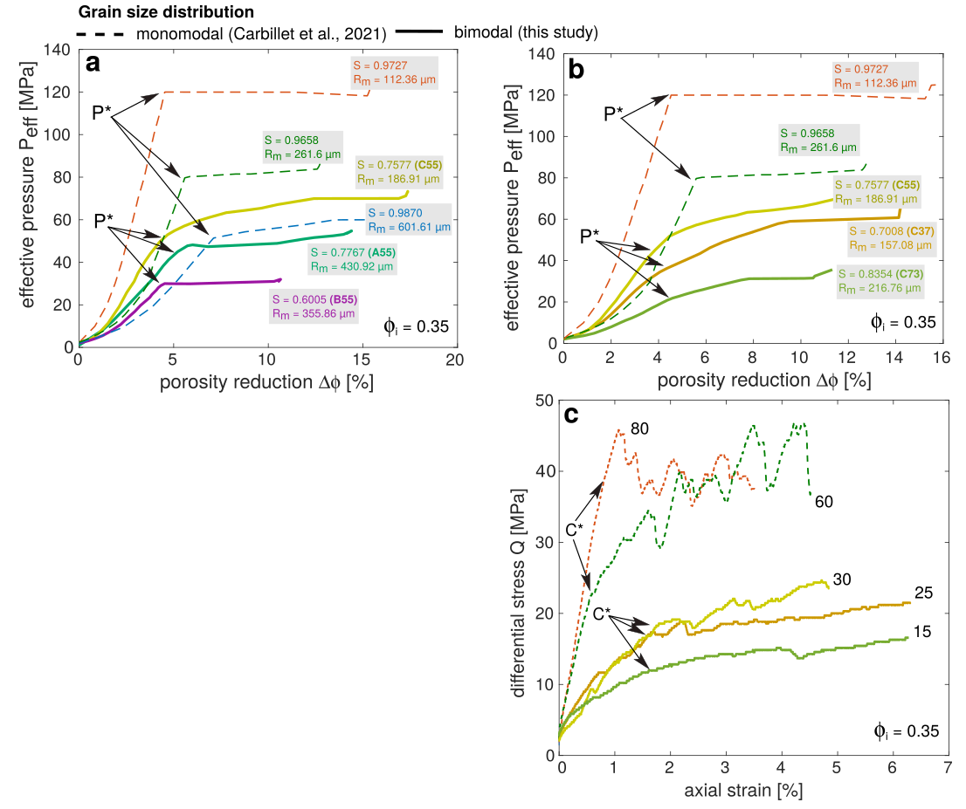
How do polydisperse samples compare to monodisperse samples ?
Under hydrostatic loading, polydisperse samples smoothly transition to inelastic compaction by grain crushing at P* and then show hardening ;
For a given porosity, samples with bimodal grain size distributions are a lot weaker than samples with a monomodal distribution ;
HYDROSTATIC
σ₁ = σ₂ = σ₃
For triaxial compression tests, the post-yielding behavior of synthetic samples with a bimodal distribution shows hardening and no stress drops, which are often attributed to compaction localisation.
σ₁
σ₂ = σ₃
TRIAXIAL
σ₁ > σ₂ = σ₃

Slide 4
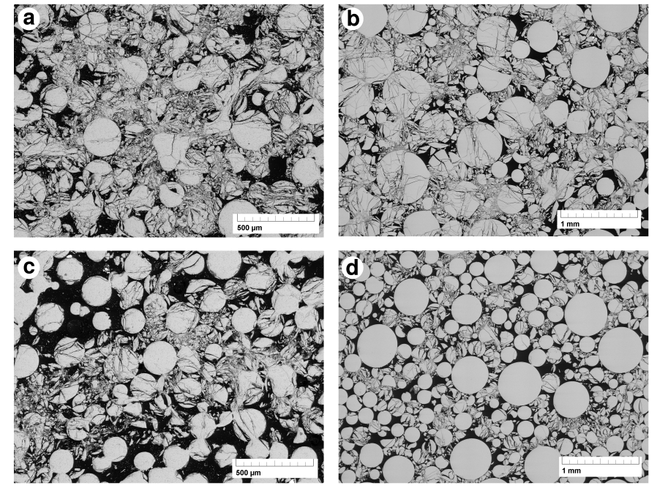
Grain size distribution
monomodal (Carbillet et al., 2021) bimodal (this study)
Experiment
How do polydisperse samples compare to monodisperse samples ?
For both types of distribution, samples deformed under hydrostatic compression undergo delocalised and extensive grain crushing ;
In bimodal samples deformed in the regime of shear-enhanced compaction, strain is concentrated to the smaller grains in between the big grains which remain intact.
HYDROSTATIC
σ₁ = σ₂ = σ₃
σ₁
σ₂ = σ₃
TRIAXIAL
σ₁ > σ₂ = σ₃

Slide 5
Concluding remarks
We successfully prepared unit synthetic samples with carefully controlled porosity and bimodal grain size distributions ;
Synthetic samples composed of variable proportions of two grain sizes are weaker than synthetic samples only made of one or the other grain size ;
For a given porosity, increasing polydispersivity decreases the compactive strength ;
Under triaxial compression in the regime of shear-enhanced compaction, the small grains in between the big ones concentrate strain, so that bigger grains remain intact and compaction localisation does not take place.
Thank you for your attention !
email lcarbillet@unistra.fr
twitter @lucillecbt

