Slide 1
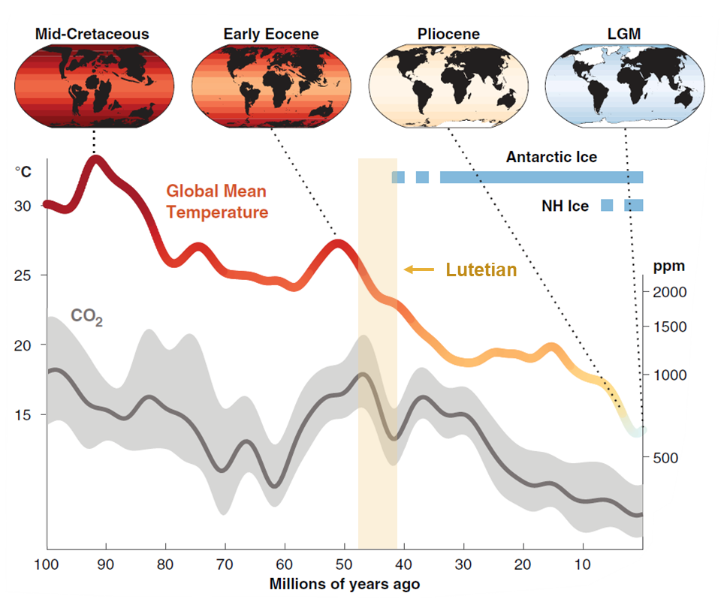
A stable oxygen isotope record of weather-timescale variability in the Eocene greenhouse world, using the giant marine gastropod Campanile giganteum
Nick Van Horebeek¹, Johan Vellekoop^{1,2}, Alexander J. Clark¹, Niels J. de Winter^{2,3}, Yannick Stroobandt¹, and Robert P. Speijer¹
¹Department of Earth and Environmental Sciences, KU Leuven
²Analytical, Environmental and Geo- Chemistry, Vrije Universiteit Brussel
³Department of Geosciences, Universiteit Utrecht
Tierney et al. 2020, Science

Slide 2
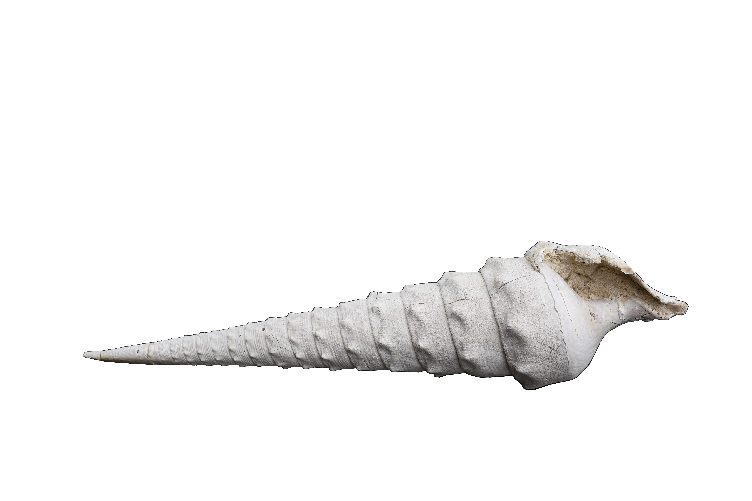
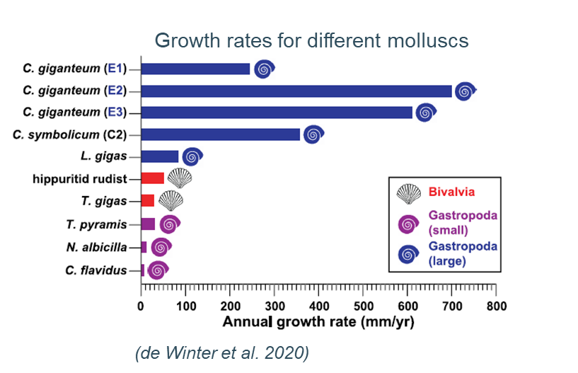
What makes Campanile giganteum special?
Exceptionally high resolution
5 cm

Slide 3
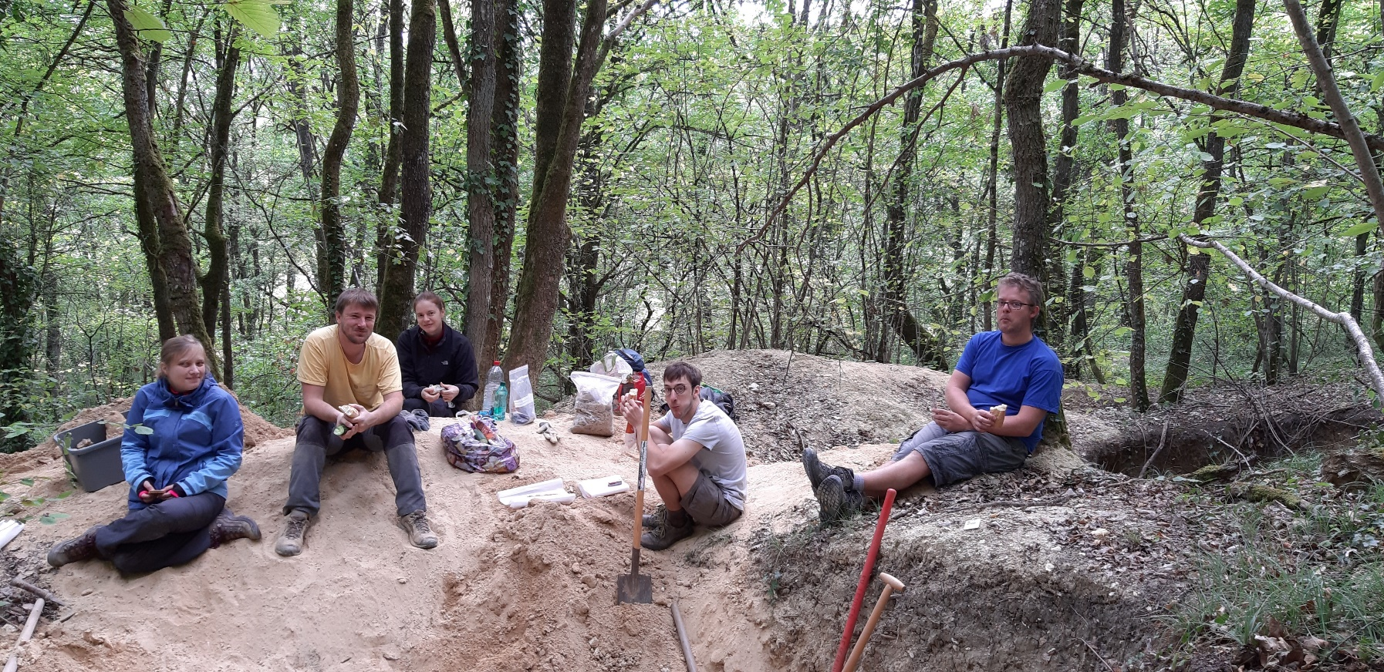
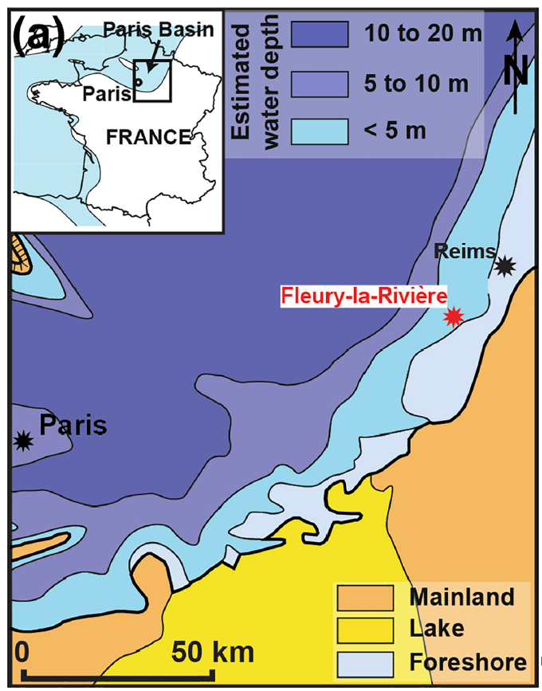
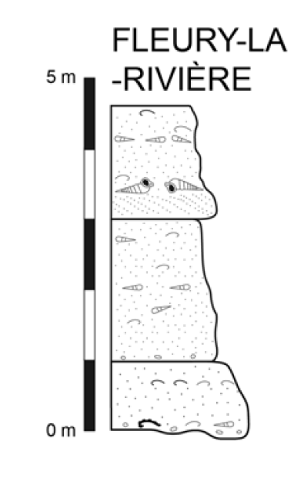
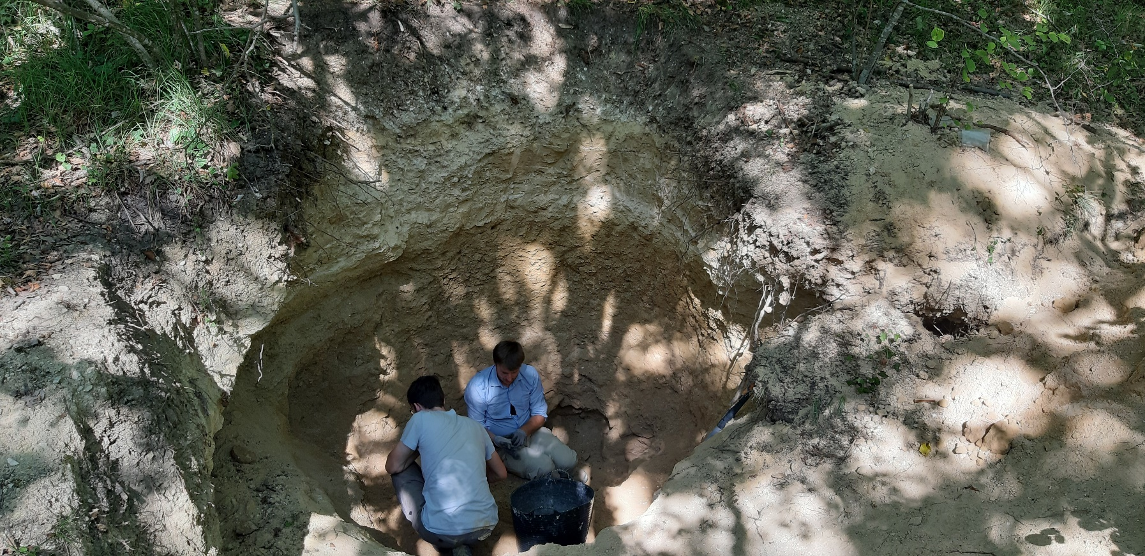
Setting
Campanile giganteum
(de Winter et al. 2020)
(Dominici & Zuschin 2016)

Slide 4
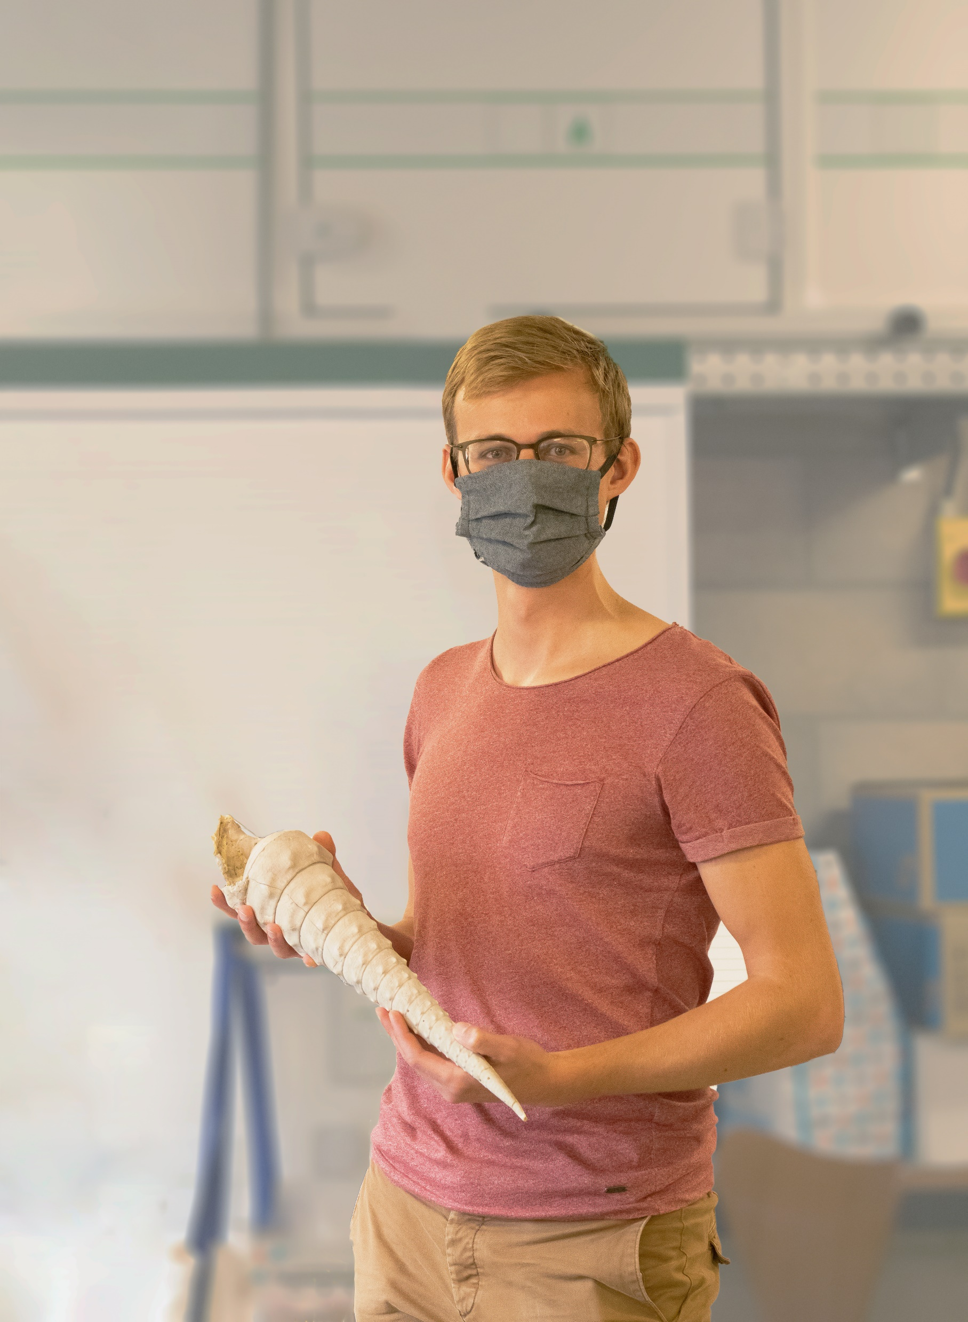
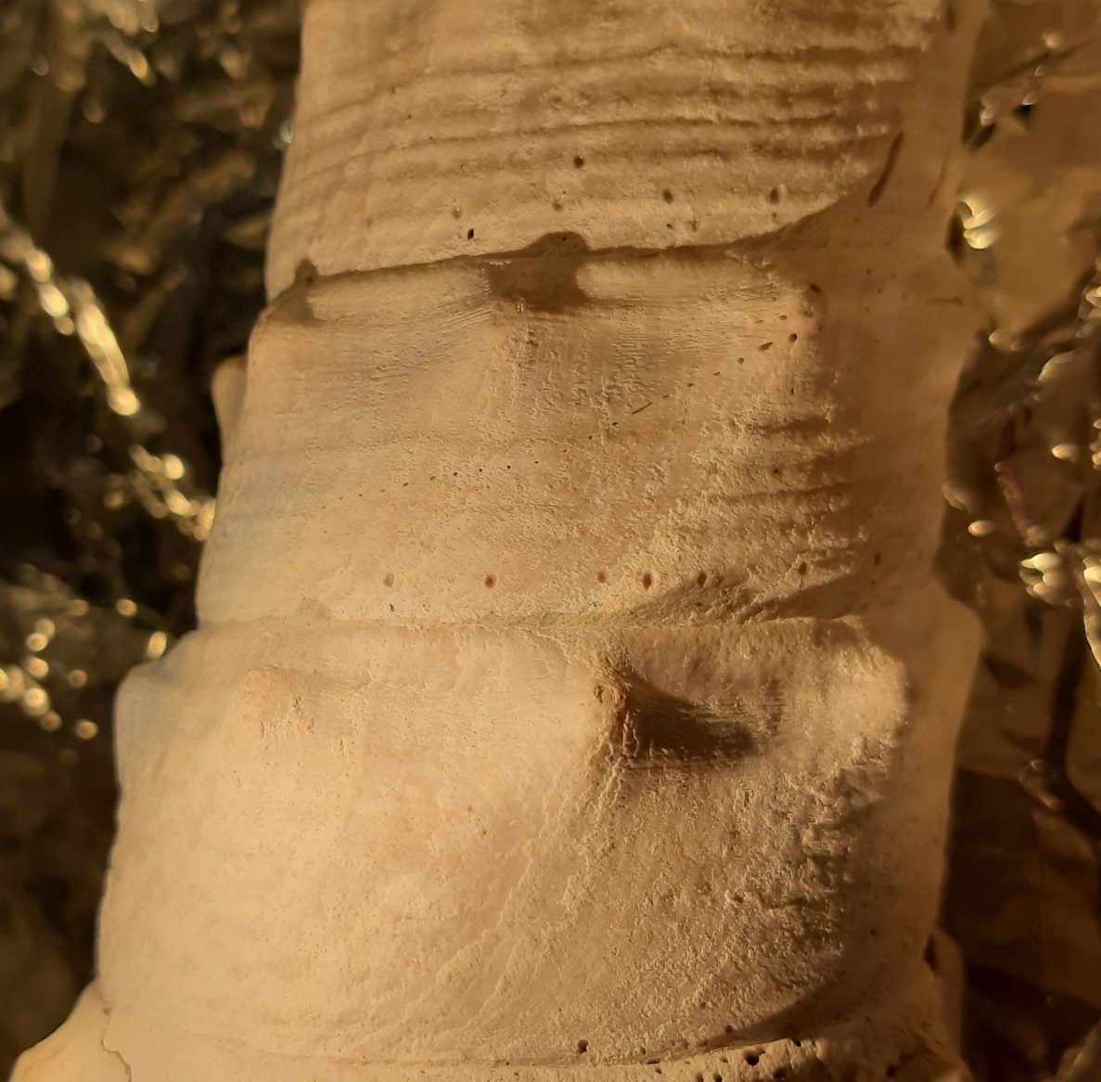
Methods
Sampling density: 3-6 mm + growth impairments
Drill bit: 0.5 mm
5 cm

Slide 5
Results
1
2
3
4
5
Van Horebeek et al. in prep.

Slide 6
Results age model
Modelled δ18O values with Judd et al. 2018
Summer
Winter
1
2
3
4
5
6
8
Van Horebeek et al. in prep.

Slide 7
Conclusion
Future research
Increase sample density
Clumped isotopes
Lower δ¹⁸O variations in spring and autumn. The variation in δ¹⁸O is largest in summer.
Extremely high temporal resolution.
 | Resolution (days)
Winter | 6 – 22.5
Spring + Autumn | 1.8 – 2.5
Summer | 1 - 2

