Slide 1





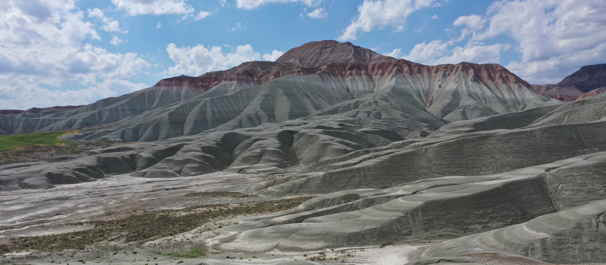


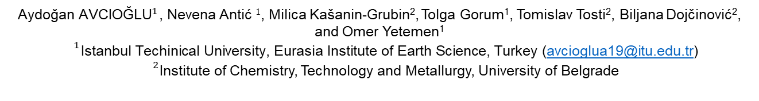
Seasonal influences on weathering processes in Turkish Badlands:
Laboratory-based climate experiments
${\text{Aydo}\text{ğ}\text{an} \text{AVCIO}\text{Ğ}\text{LU}}^{1}$, Nevena Antić $1$, Milica Kašanin-Grubin², Tolga Gorum¹, Tomislav Tosti², Biljana Dojčinović², and Omer Yetemen¹
$${}^{1}\text{Istanbul} \text{Techinical} \text{University}\text{, }\text{Eurasia} \text{Institute} \text{of} \text{Earth} \text{Science}\text{, }\text{Turkey}\text{ (}\text{avcioglua}\text{19@}\text{itu}\text{.}\text{edu}\text{.}\text{tr}\text{)}$$
${}^{2}$Institute of Chemistry, Technology and Metallurgy, University of Belgrade
I’m participating
in OSPP!
Scan the QR code
to find my abstract

Slide 2
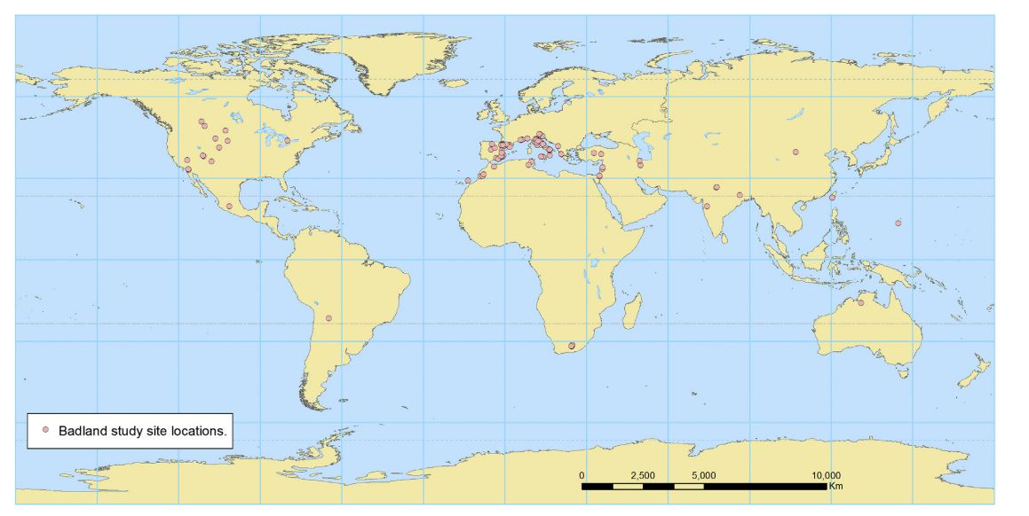
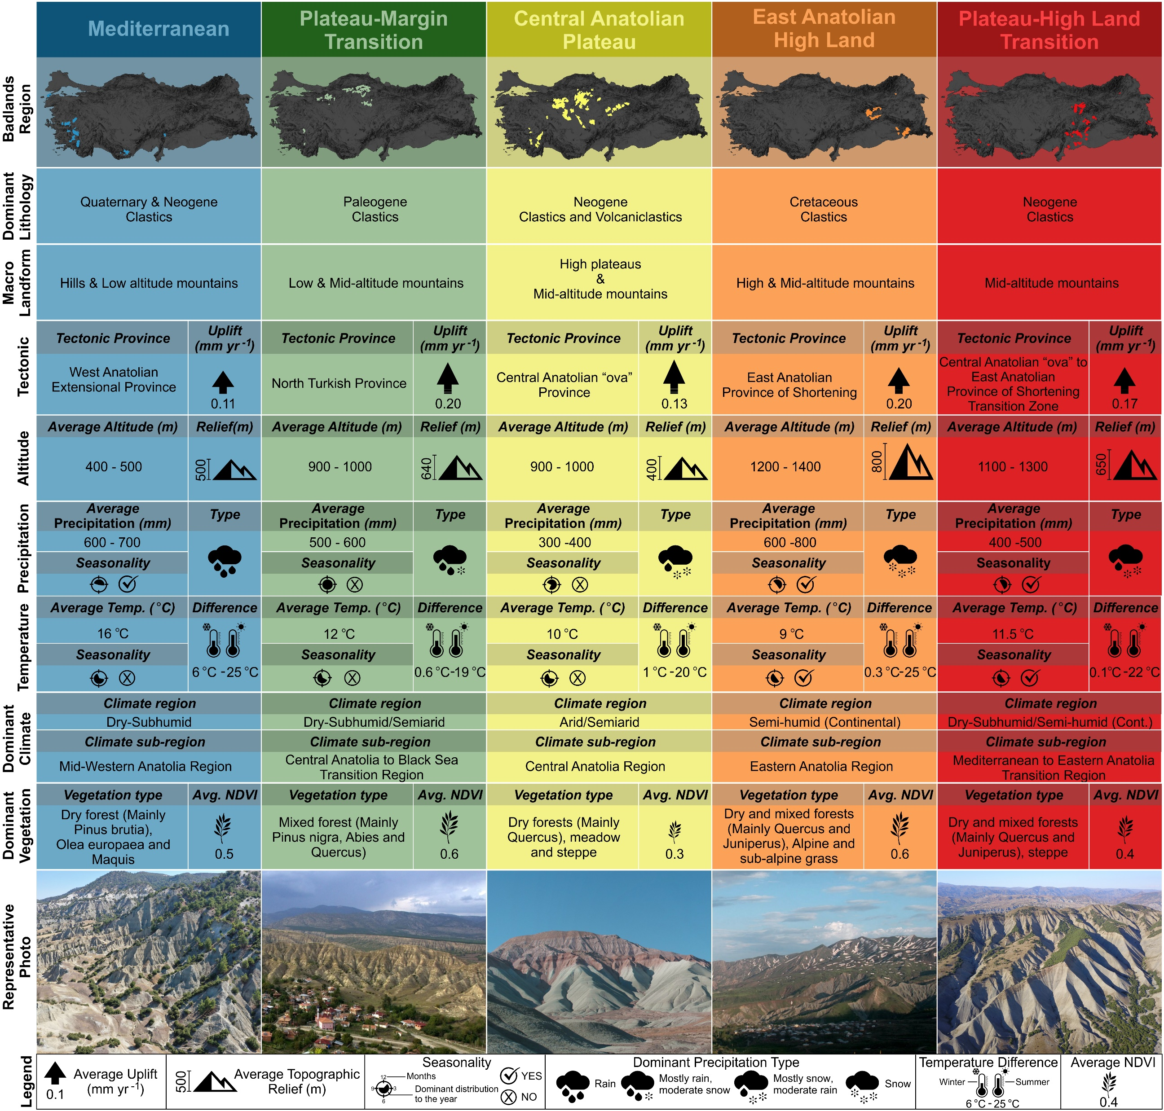
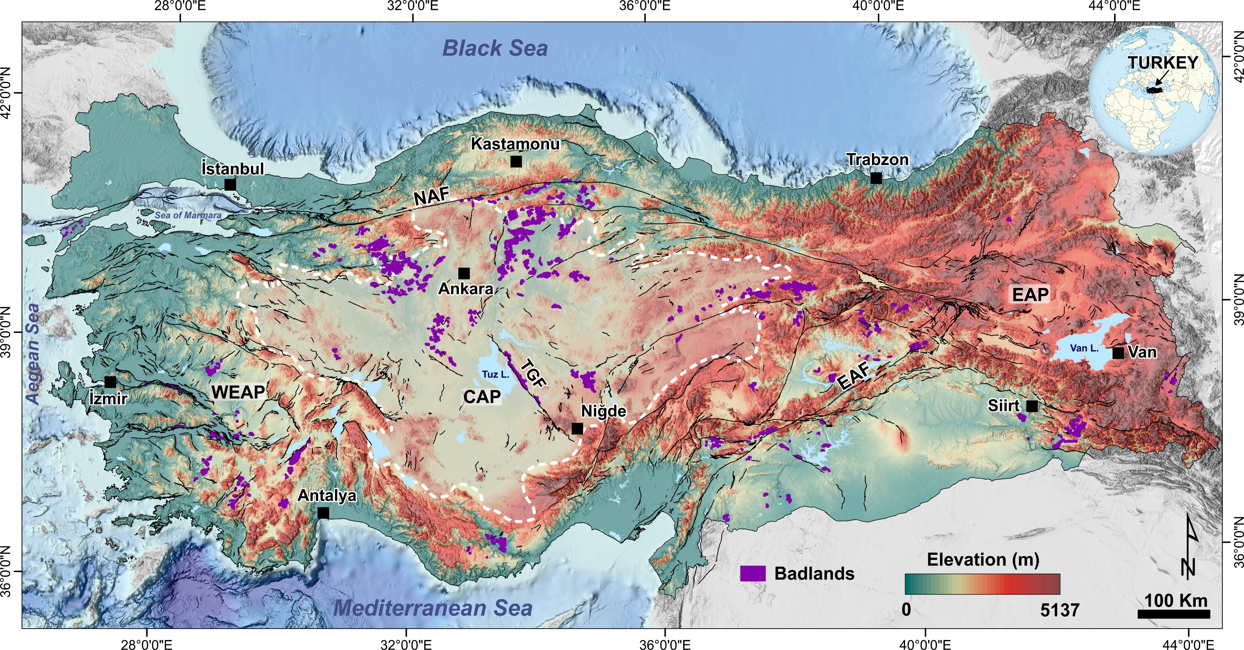
* (Martínez-Murillo & Nadal-Romero, 2018)
(Avcioglu et al., 2022)

Slide 3

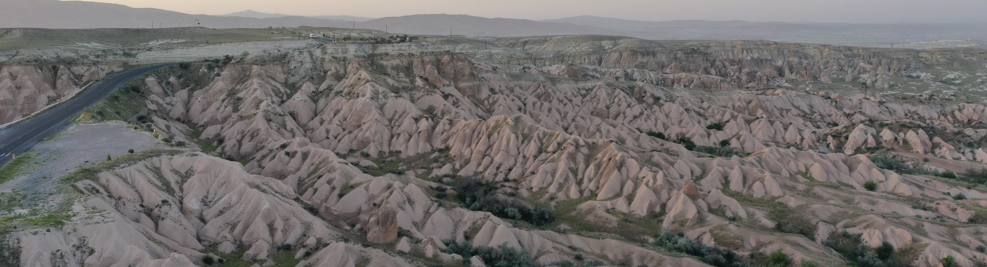
The main goal of this study is to determine weathering processes growing as responses of the different badland material (i.e., lithology, morphology, and climate) to the controlled laboratory experiments simulating the variations in climate (e.g., precipitation and temperature).

Slide 4
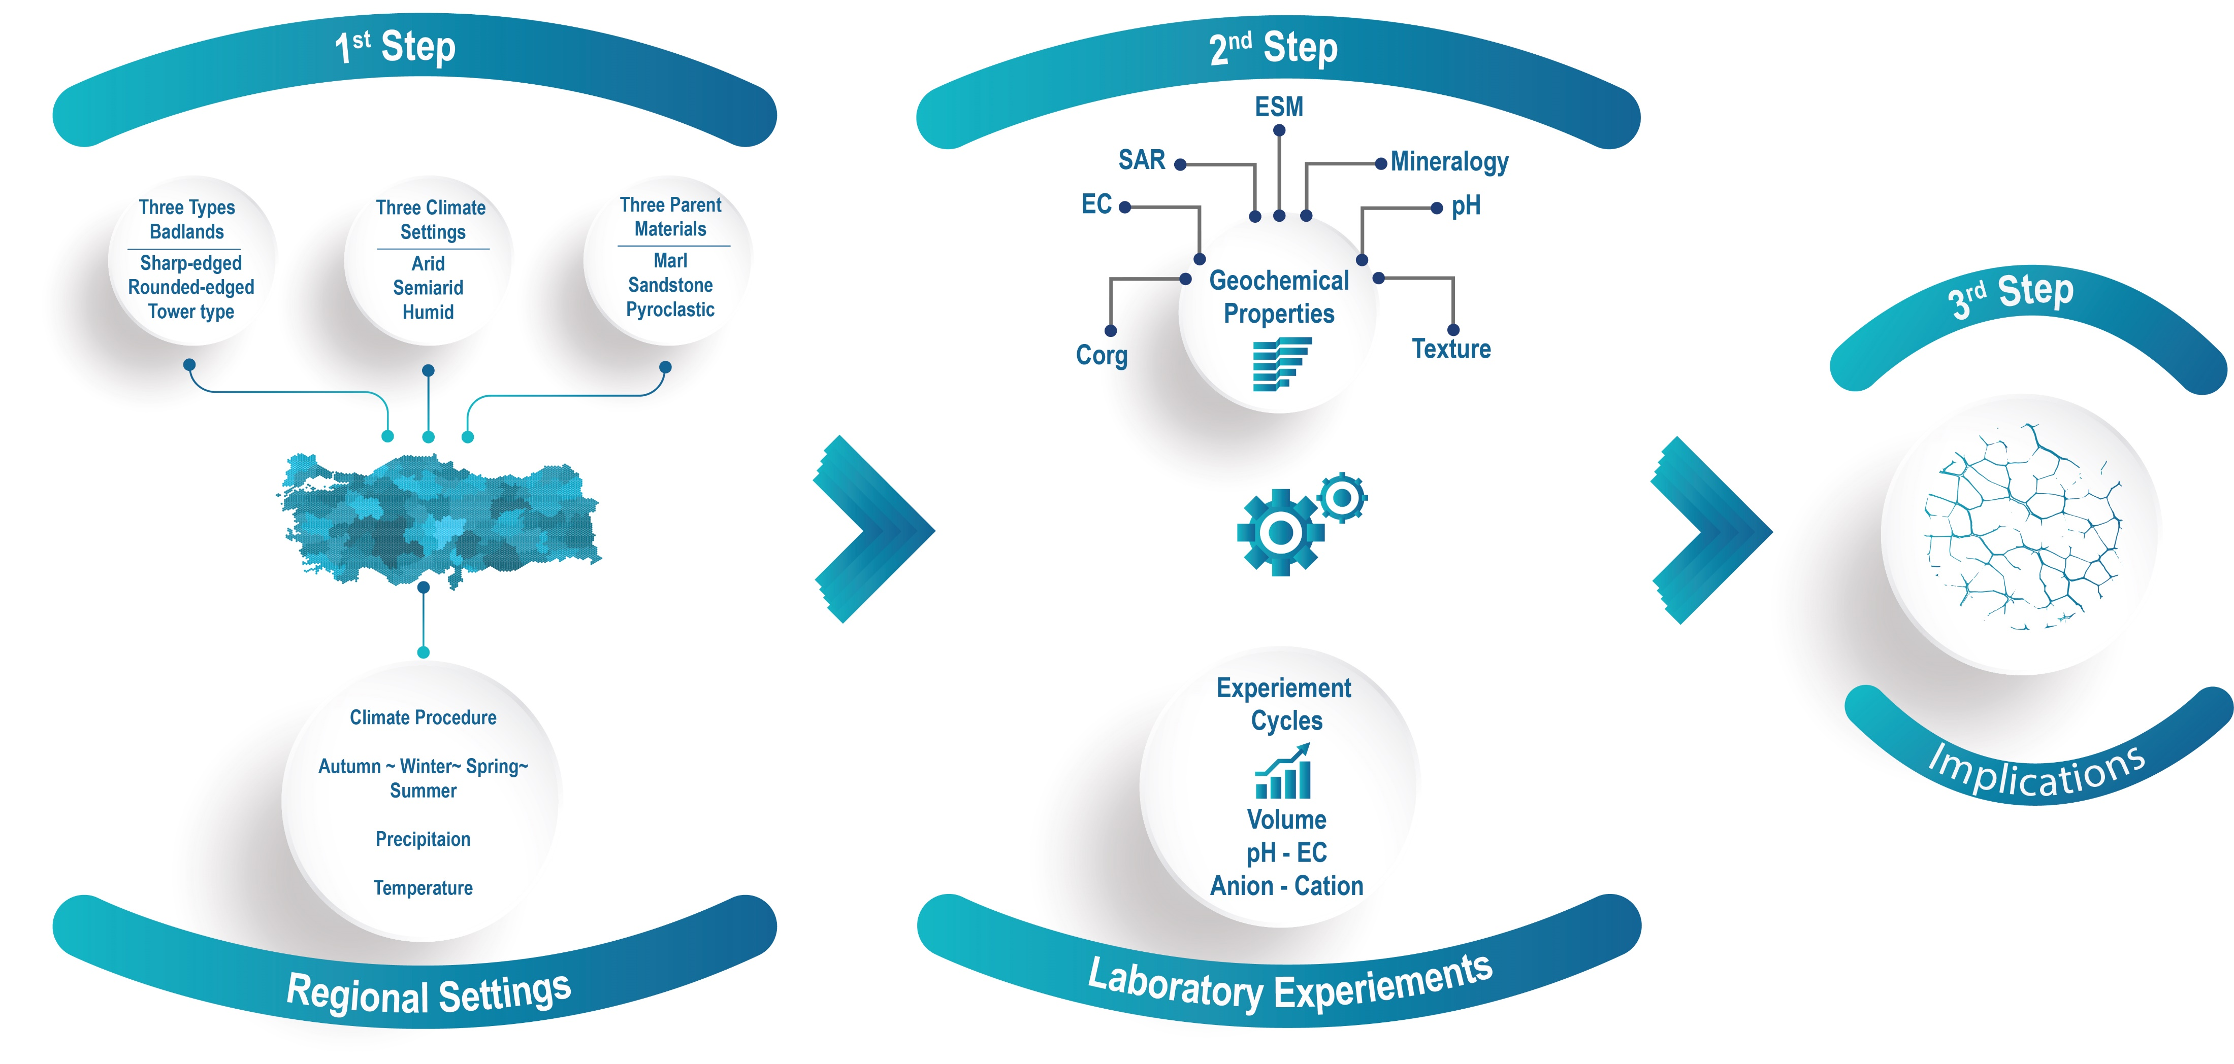
Work flow

Slide 5
Climate protocols
Precipitation (mm) | Autumn | Winter | Spring | Summer | Annual
Arid | 63.6 | 107.5 | 89.8 | 37.1 | 298
Mediterranean | 114.8 | 211.7 | 138.6 | 26.7 | 491.8
Humid | 185.2 | 331.7* | 273.2 | 24.8 | 814.9
Cappadocia | 79.7 | 108.3* | 149.6 | 46.9 | 384.5
Temperature
 | Autumn | Winter | Spring | Summer |  |  | Autumn | Winter | Spring | Summer
Arid | 13.40 | 2.33 | 11.30 | 22.13 |  | Arid | Room | Fridge | Fridge/Room | Sun
Mediterranean | 16.80 | 7.03 | 15.27 | 26.43 |  | Mediterranean | Room/Sun | Fridge | Room | Sun
Humid | 14.33 | -0.23 | 11.47 | 25.63 |  | Humid | Fridge/Room/Sun | Freezer | Fridge/Room | Sun
Cappodocia | 10.43 | 0.03 | 9.47 | 20.13 |  | Cappodocia | Fridge/Room ~Sun | Freezer ~Fridge | Fridge/Room | Sun

Slide 6
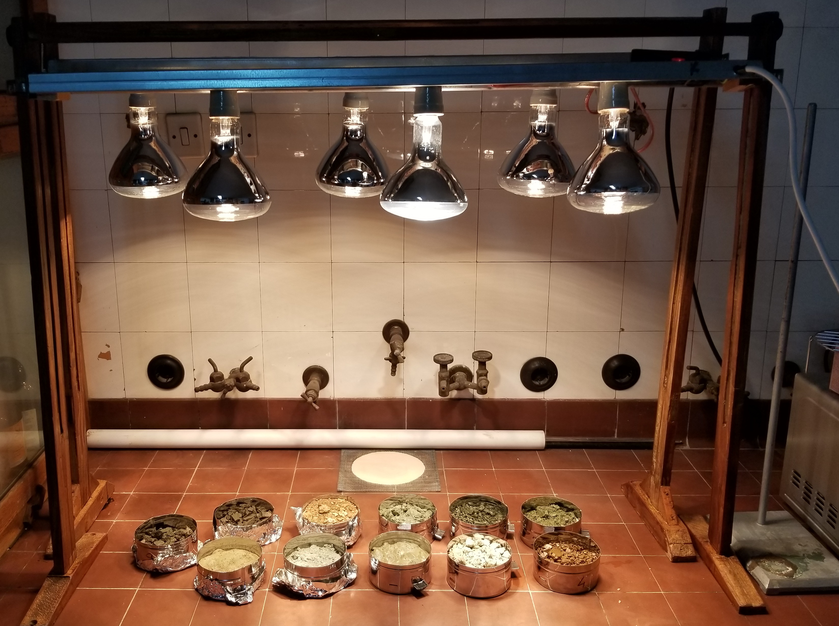
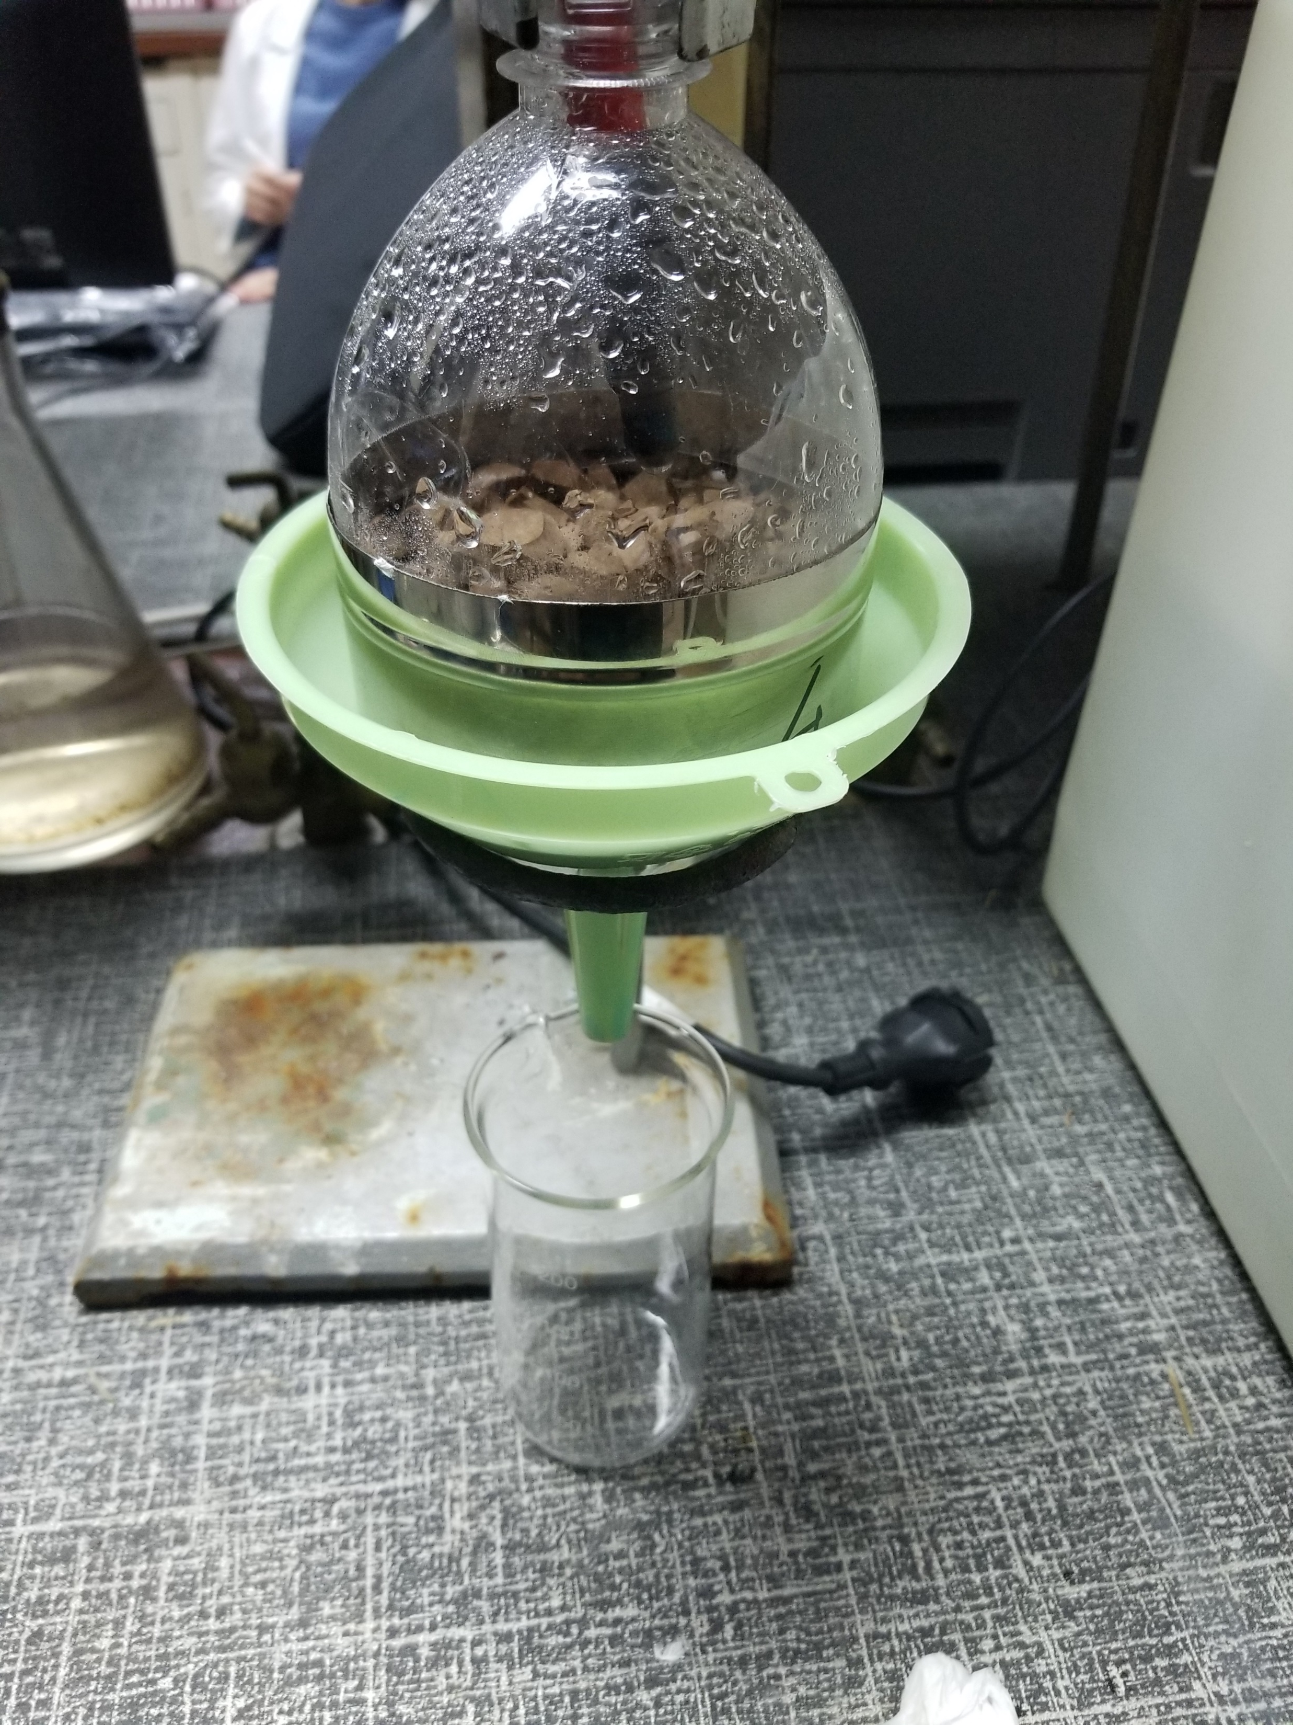
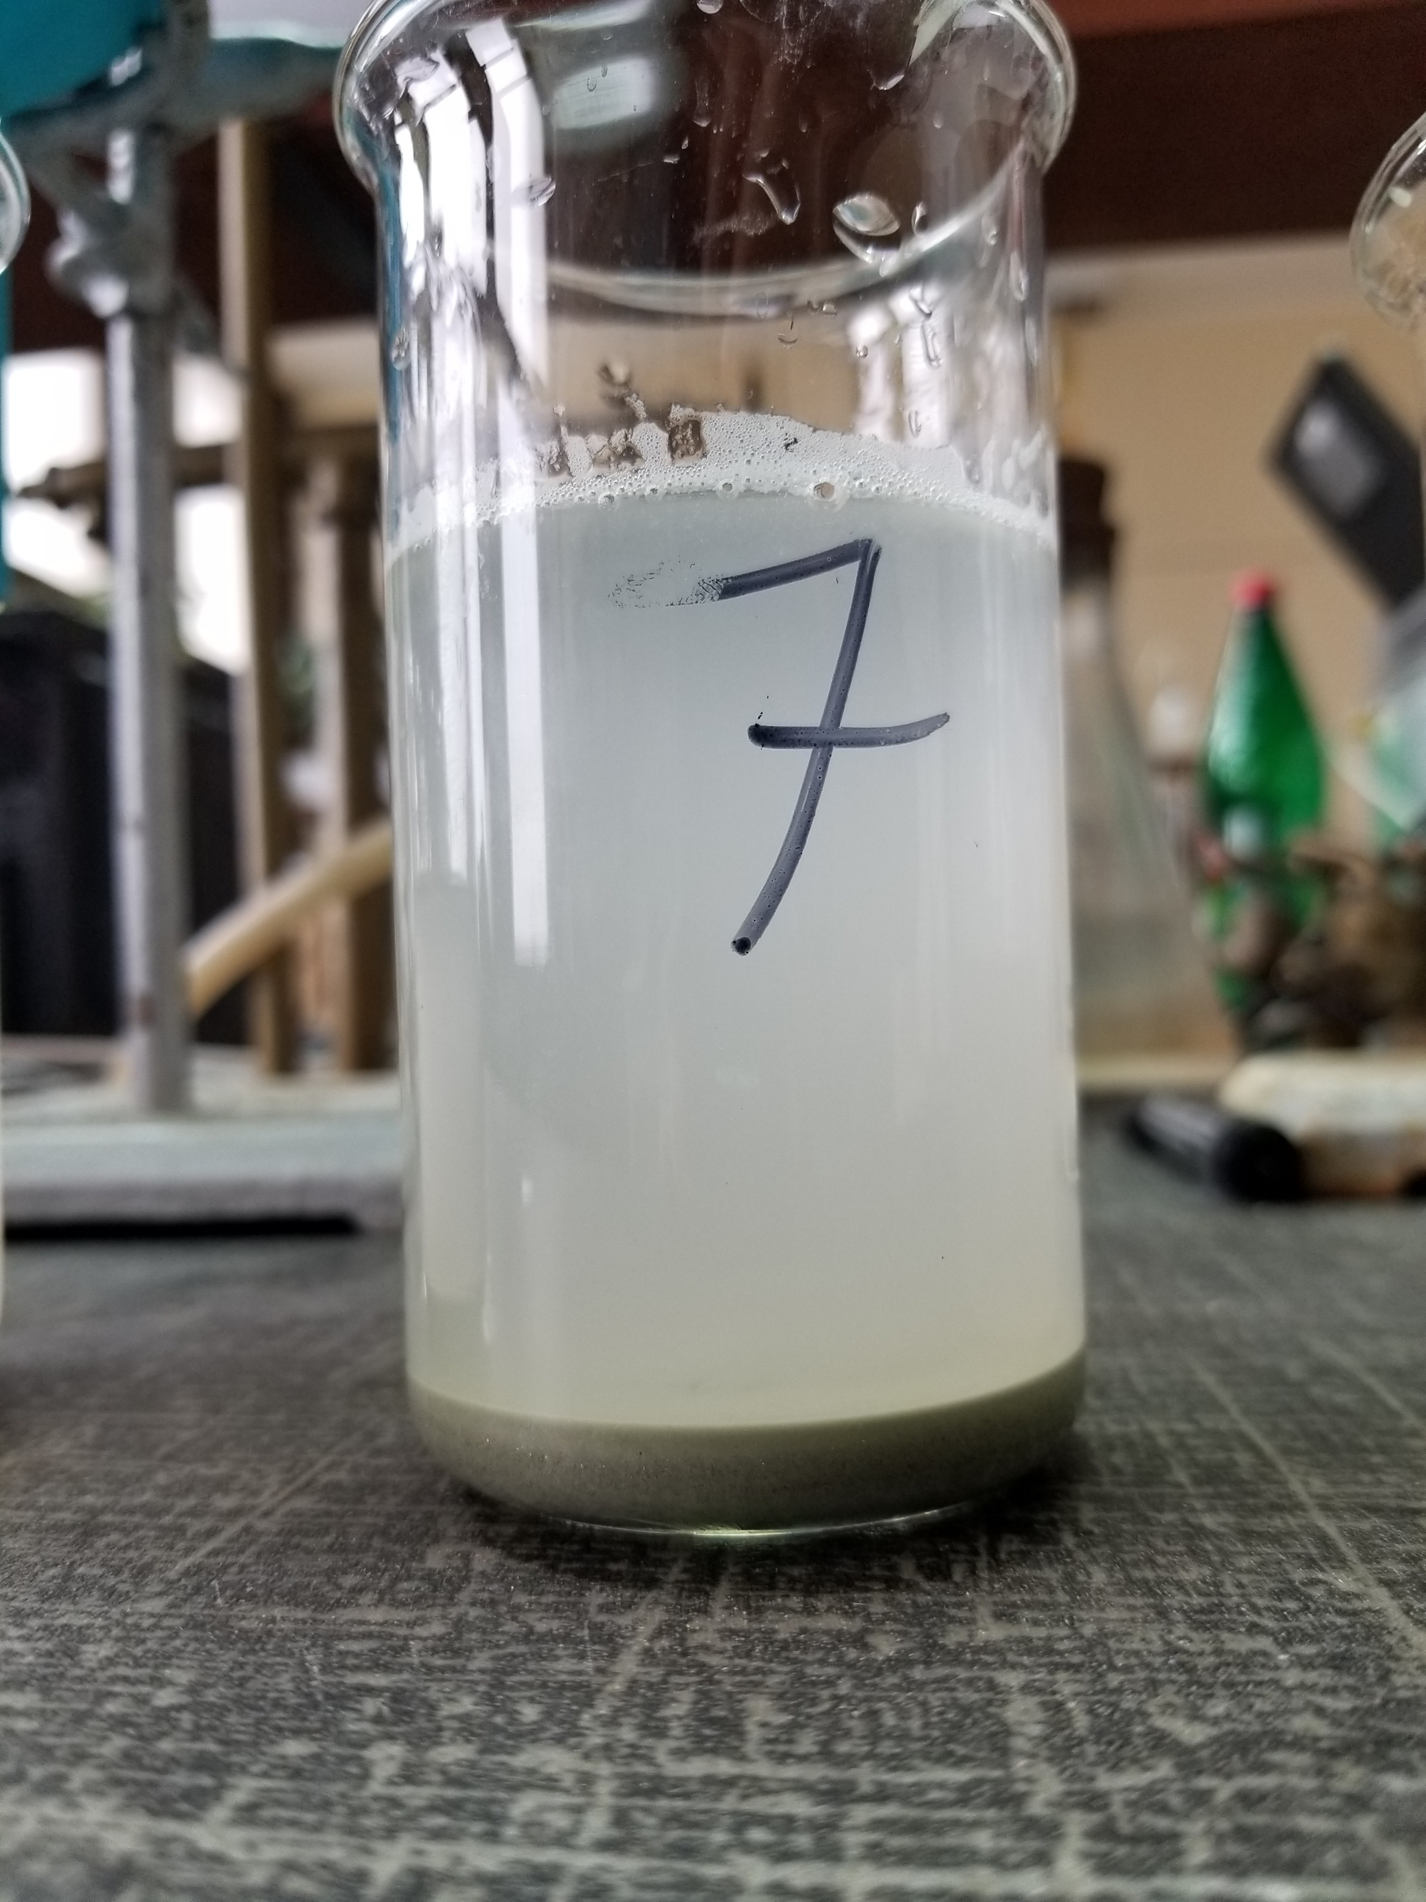
The main steps of our experiements.
1st
2nd
3rd

Slide 7
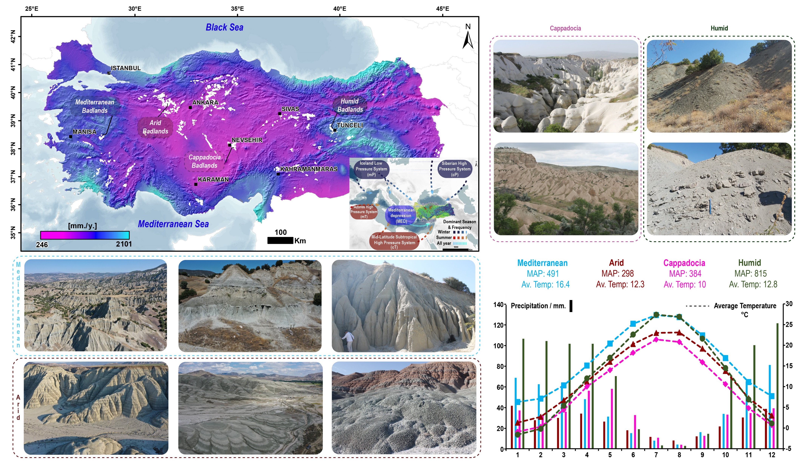
Study areas

Slide 8
SLN - 1 - TR - Bdrck
SLN - 2 - Bdrck
SLN - 3 - Bdrck
CAP - 4
T - 2
Sandstone
Samples
pyrcolastics
Sandstone
NLH - 1 - Bdrck
NLH - 23
CAP - 7
T - 4
NLH - 27
Mudstone
NLH - 26

Slide 9
Arid
Mediterranean
Cappadocia
Humid
Results

Slide 10
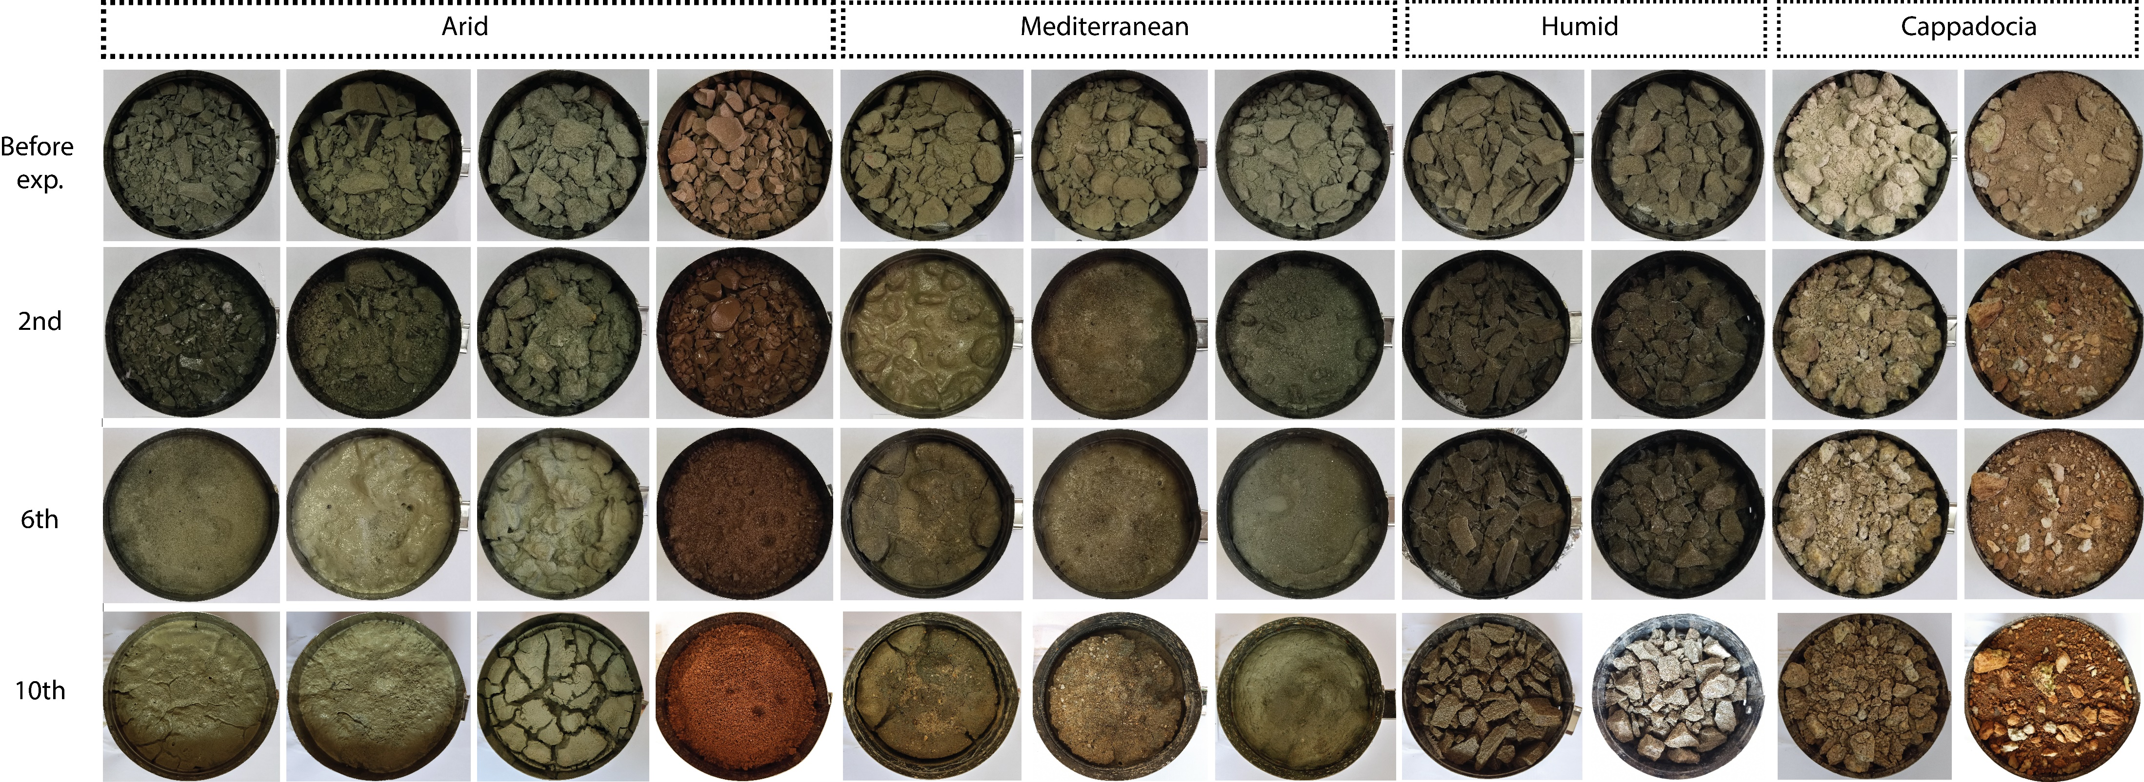
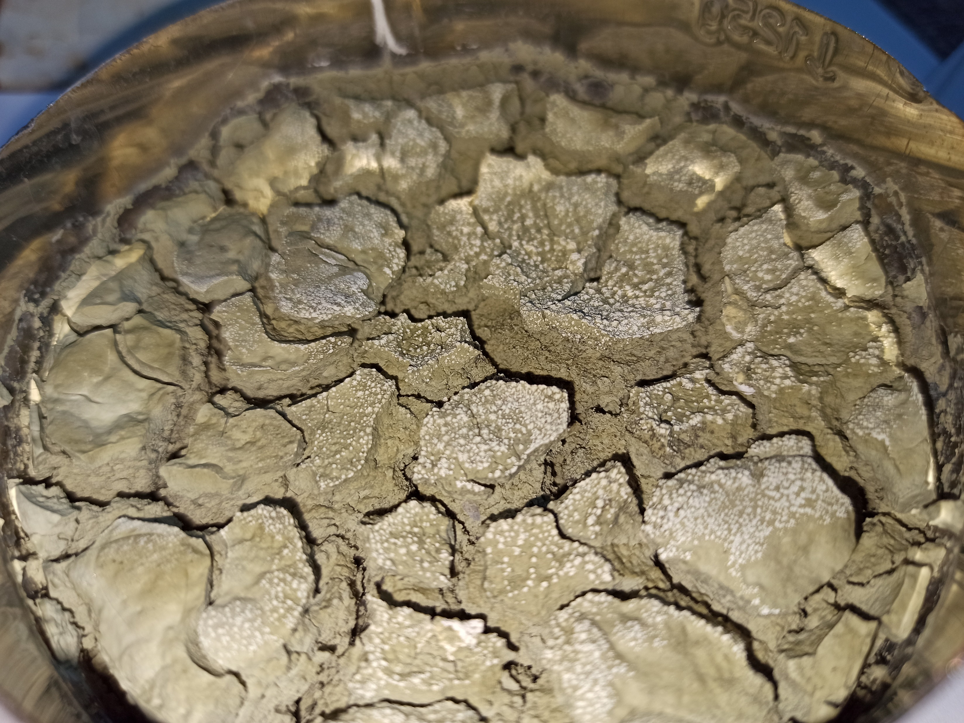
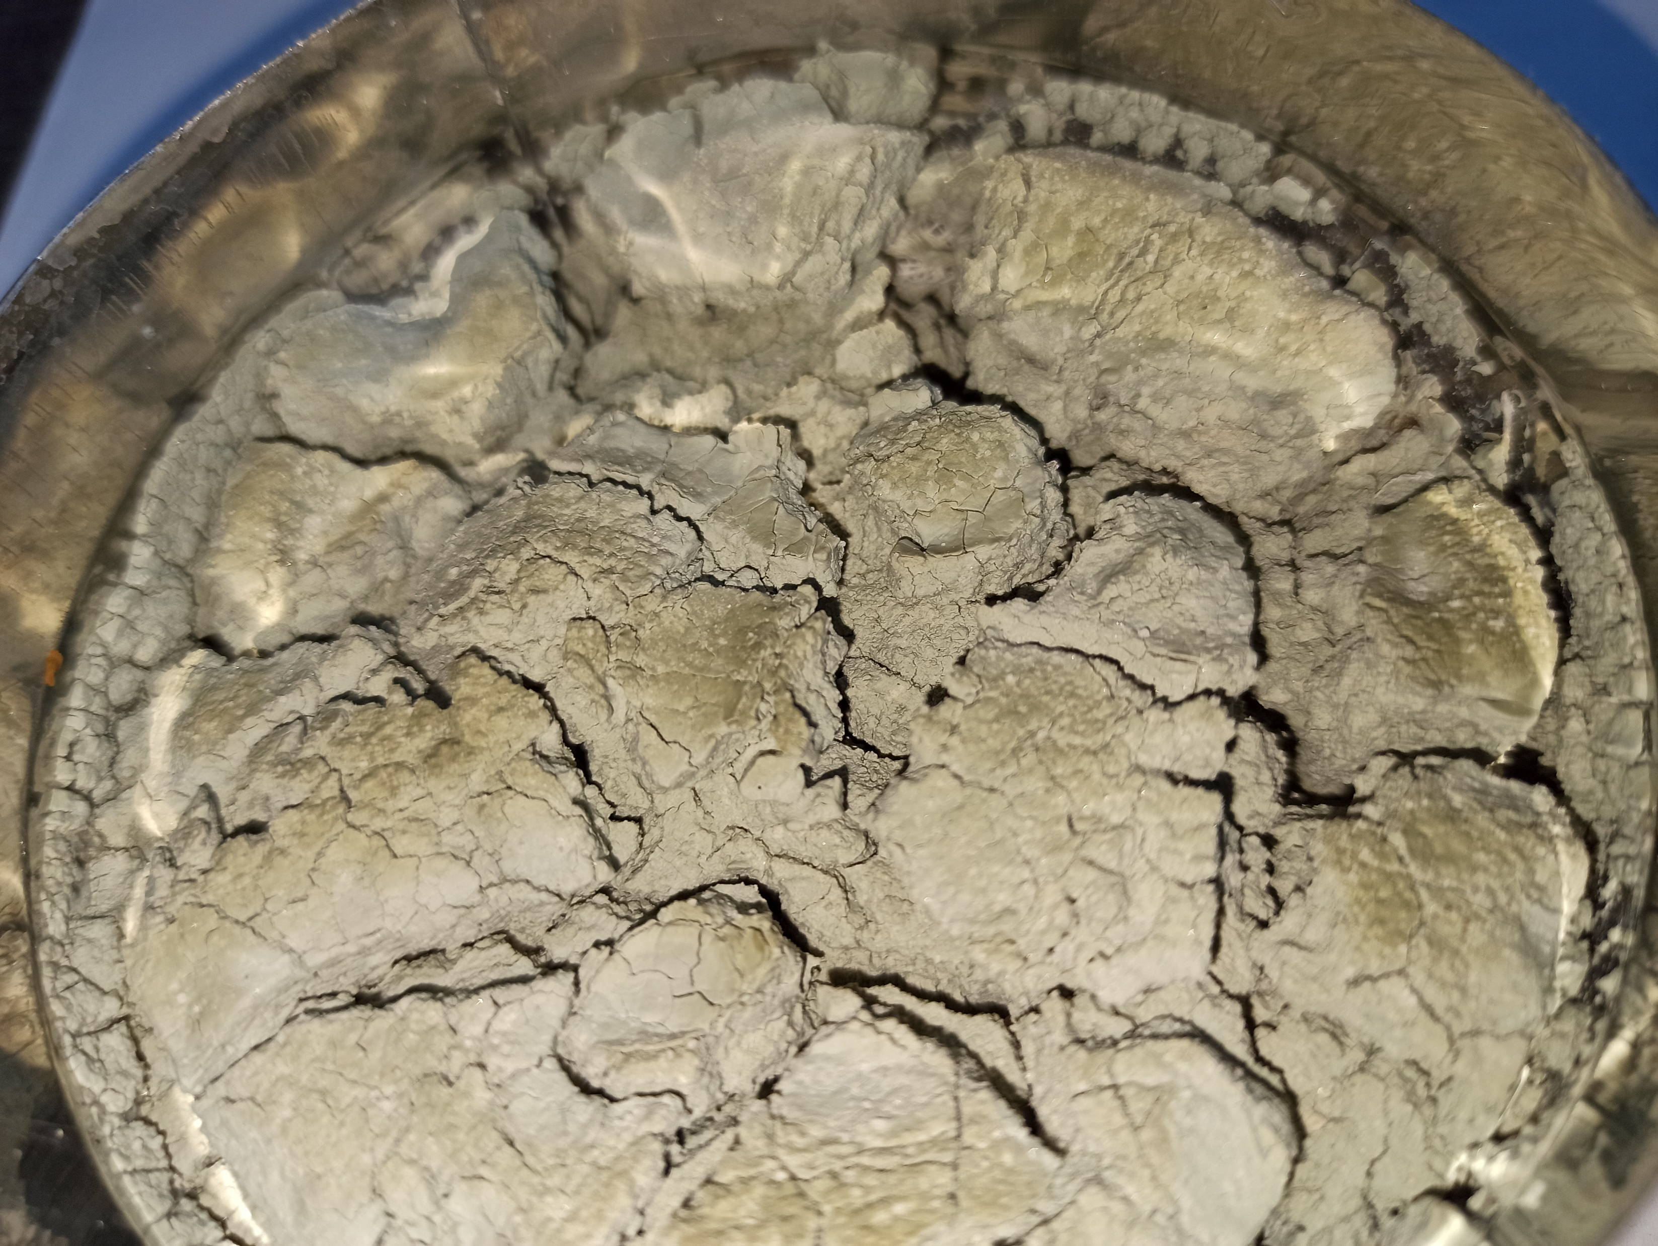
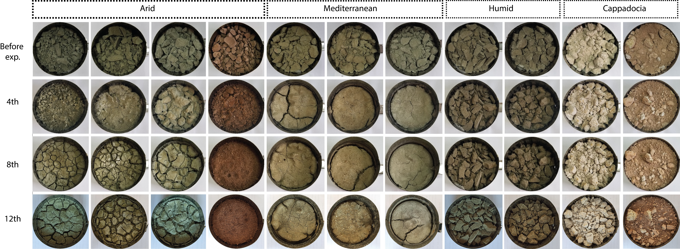
Results
NLH - 23
NLH - 1 - Bdrck
After Winter
8 cm
After Summer

Slide 11
Fluctuations in ions between cycles.
Results

Slide 12
Fluctuations in ions between cycles.
Results

Slide 13
Key points
Preliminary results show that seasonal variations in climate give rise to fluctuation in EC – pH and ions that potentially affect the amount and degree of dispersivity of the materials.
One of the most obvious results shows that dry spell series are responsible for crust formation, and development and enlarging cracks on the badlands surface.
The observed high sediment flux during autumn cycles after the drying period may indicate that less but more intense precipitation during summer or autumn can be triggered more sediment flux than the winter which has two or threefold more precipitation.

Slide 14
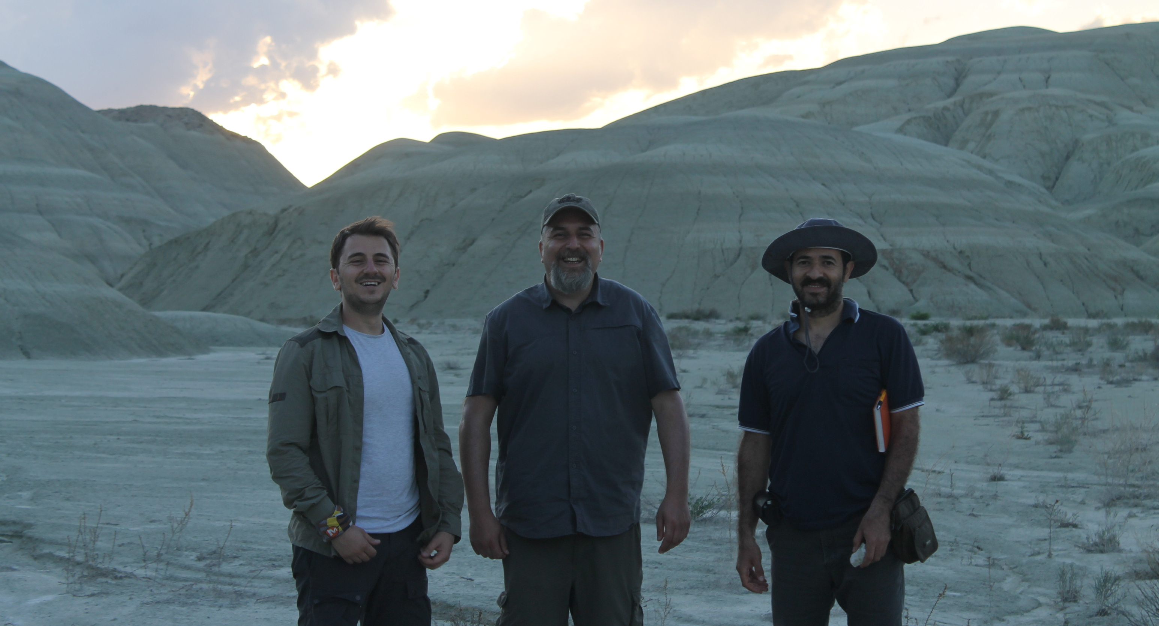
I’m participating
in OSPP!
Scan the QR code
to find my abstract
Thank you for your attention!
Questions?
*This study has been produced benefiting from the 2232 International Fellowship for Outstanding Researchers Program of the Scientific and Technological Research Council of Turkey (TUBITAK) through grant 118C329.
avcioglua19@itu.edu.tr

