Slide 1
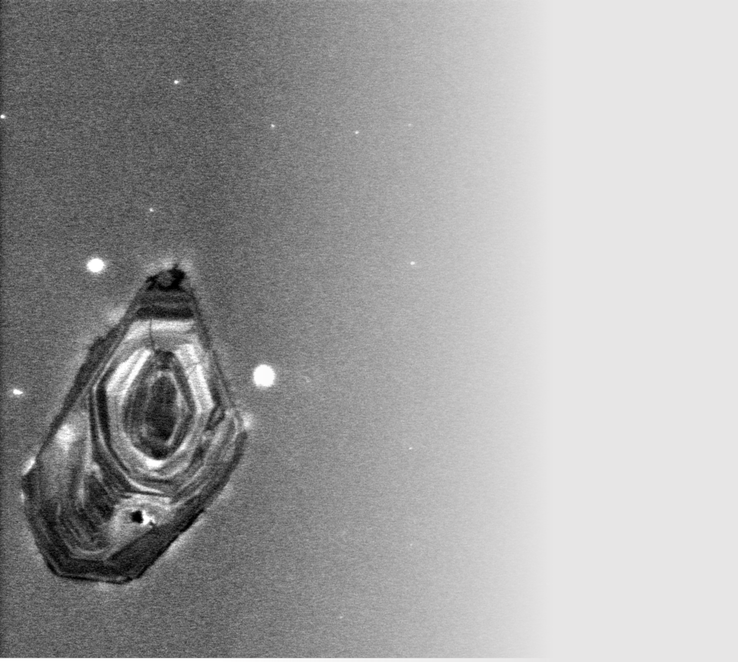
Secular change in the age of TTG sources during the Archean from in-situ Sr and Hf isotope analysis by LA-MC-ICPMS
Kira Musiyachenko, Matthijs A. Smit, Summer Caton, Robert B. Emo, Melanie Kielman-Schmitt, Ellen Kooijman, Anders Scherstén, Jaana Halla, Wouter Bleeker, J. Elis Hoffmann, Om Prakash Pandey, Arathy Ravindran, Alessandro Maltese, Klaus Mezger

Slide 2
What are TTGs?
TTG
Stage 2 partial melting
Amphibolite (crust)
Age of the source
Stage 1 partial melting
Peridotite (mantle)
Their initial radiogenic isotope composition is a function of age and P/D ratio of the source rocks

Slide 3
Radiogenic isotopes (Rb-Sr and Lu-Hf)
Source
The source of TTG magmas
Crustal residence time for TTGs
Rb-Sr
Link with pending questions
crust mantle plots (simple)

Slide 4
Radiogenic isotopes (Rb-Sr and Lu-Hf)
Reworking
Introducing juvenile source
Rb-Sr
Reworking
Introducing juvenile source
“function of age and P/D ratio of the source”

Slide 5
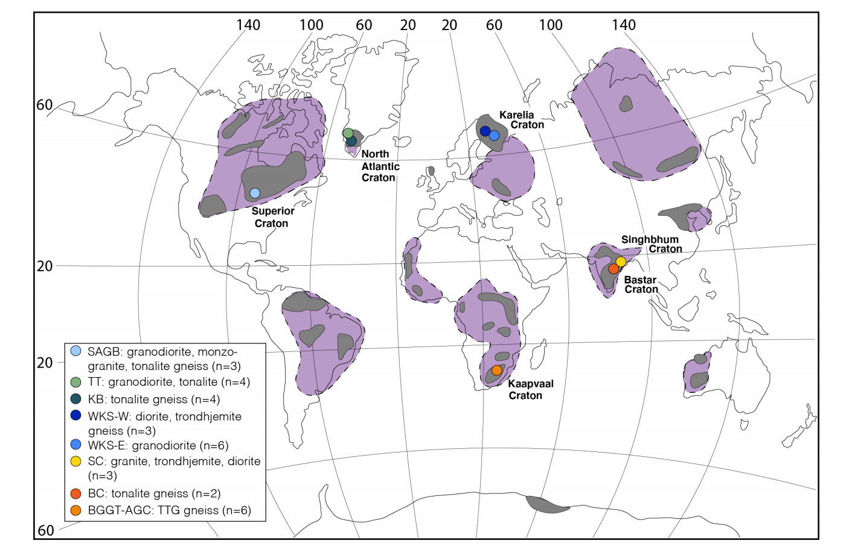
Sampling locations
Neoarchean
Mesoarchean
Paleoarchean
Eoarchean
Hadean
Archean
2500
2800
3200
3600
4000
4544

Slide 6
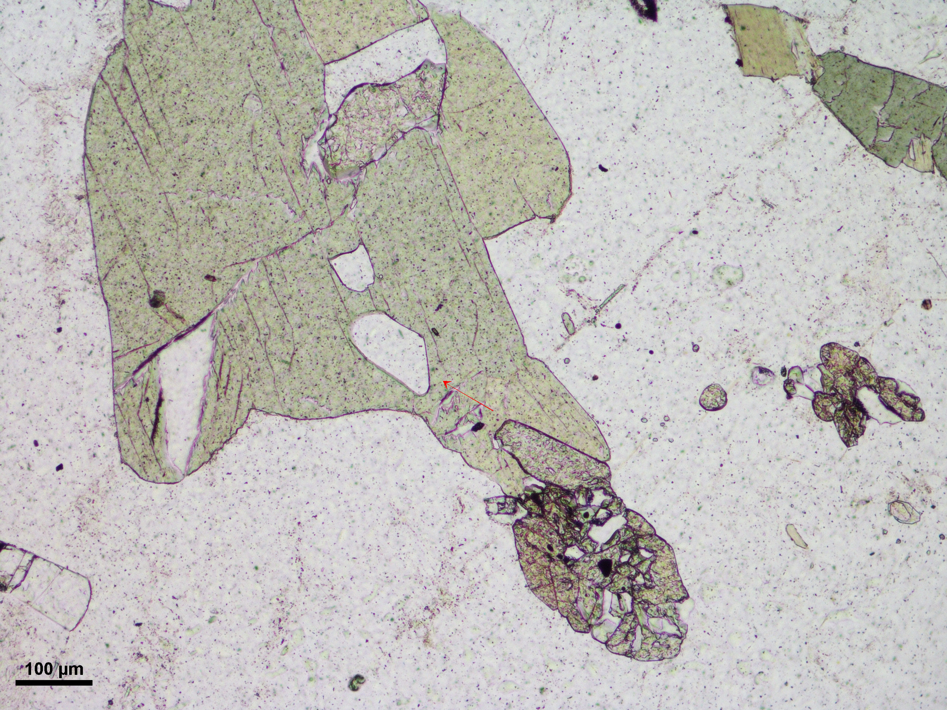
Method: Sr isotopes in primary apatite grains
Textural control
Magmatic amphibole
Apatite

Slide 7
Crustal evolution – Sr isotopes in apatites from TTGs
Sr isotopic data (from Summer et al., in rev.)

Slide 8
Crustal evolution – Sr isotopes in apatites from TTGs
Incidence of young sources increases since Eoarchean
Change of geodynamic setting?
Or efficiency/frequency of the same process?
Sr isotopic data (from Summer et al., in rev.)

Slide 9
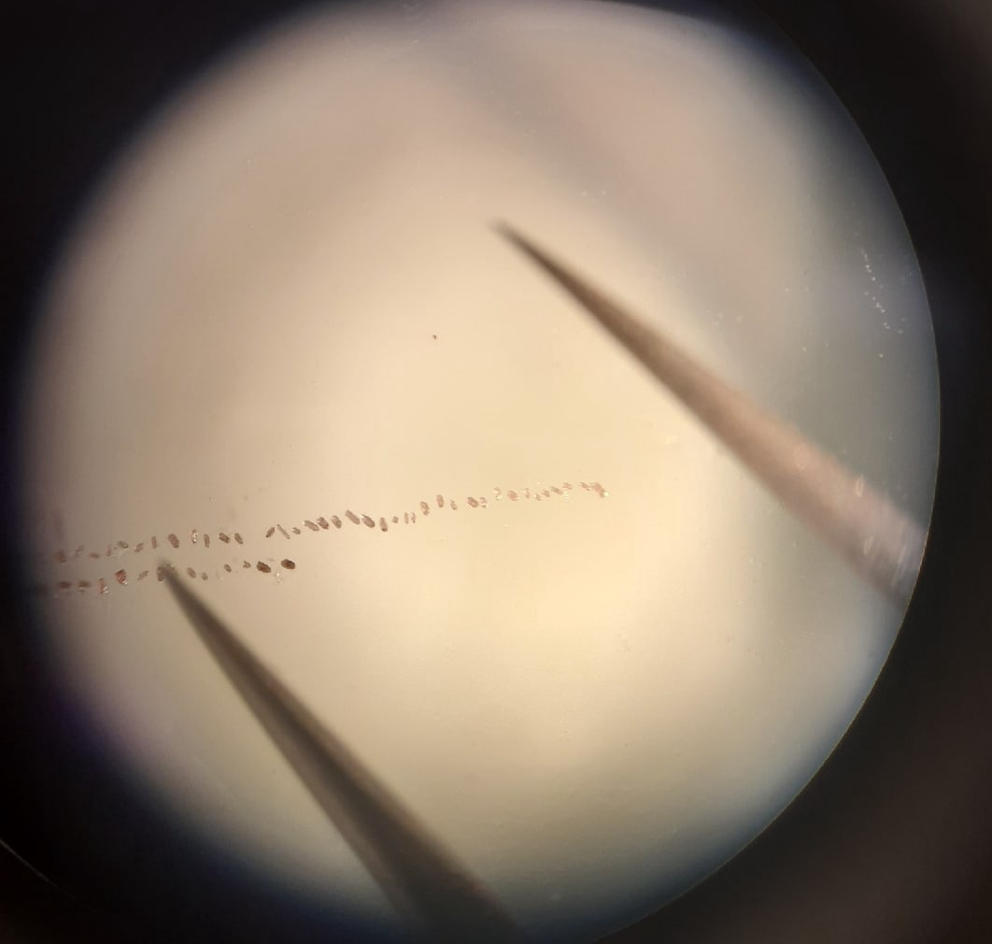
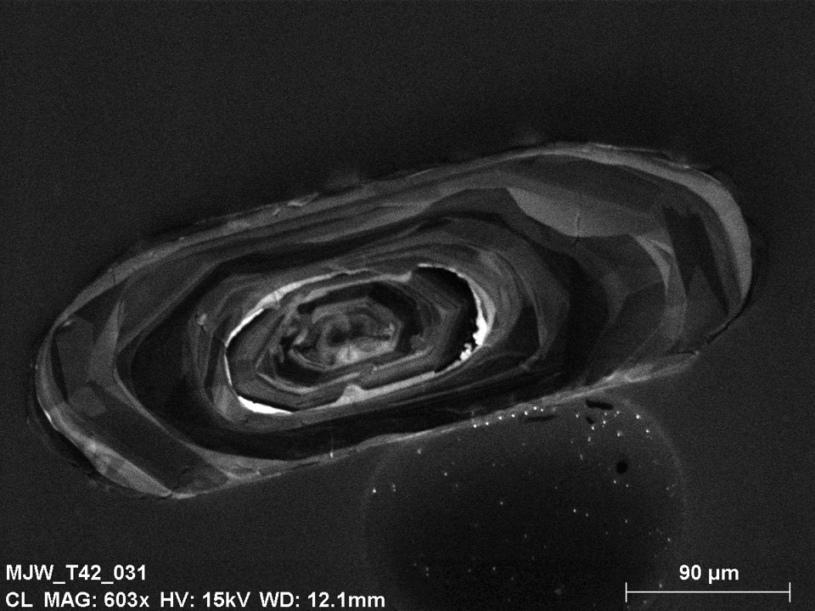
Method: Hf isotopes in zircons
²⁰¹Pb/²⁰⁶Pb age
¹⁷⁶Hf/¹⁷⁷Hf

Slide 10
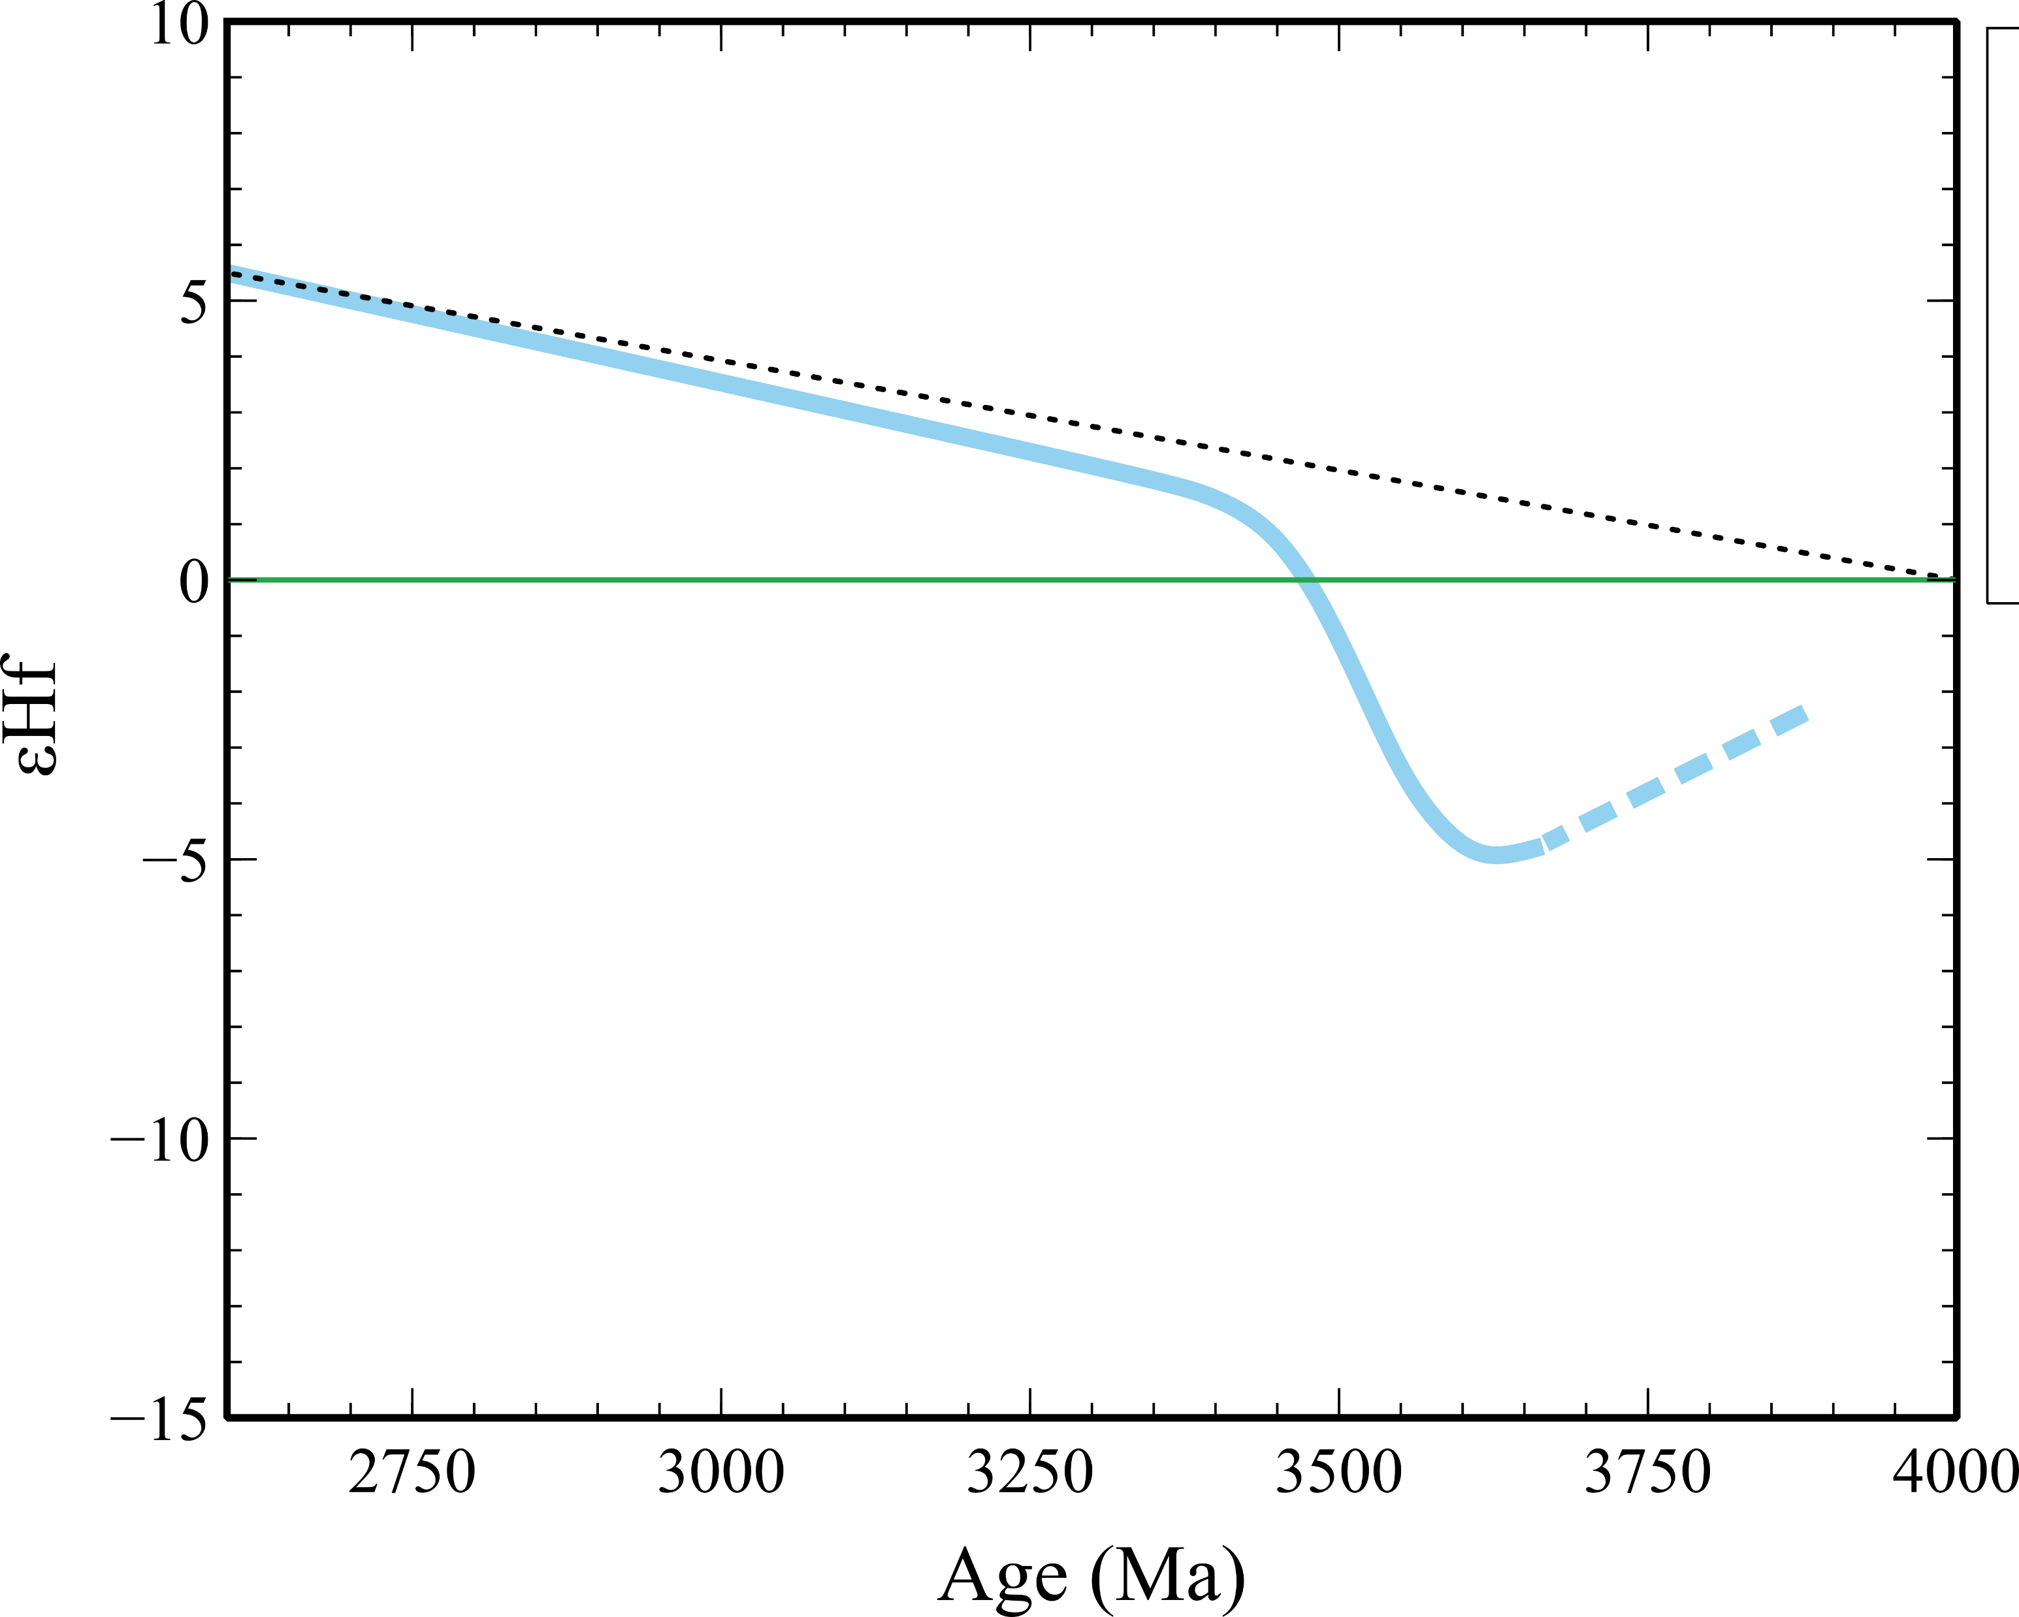
Crustal evolution – Hf isotopes in zircons from TTGs
Compiled database

Slide 11
Implications
Change of geodynamic setting?
Or efficiency/frequency of the same process?
Ongoing study:
Hf isotopes in zircons
B isotopes
REE and trace elements

