Slide 1
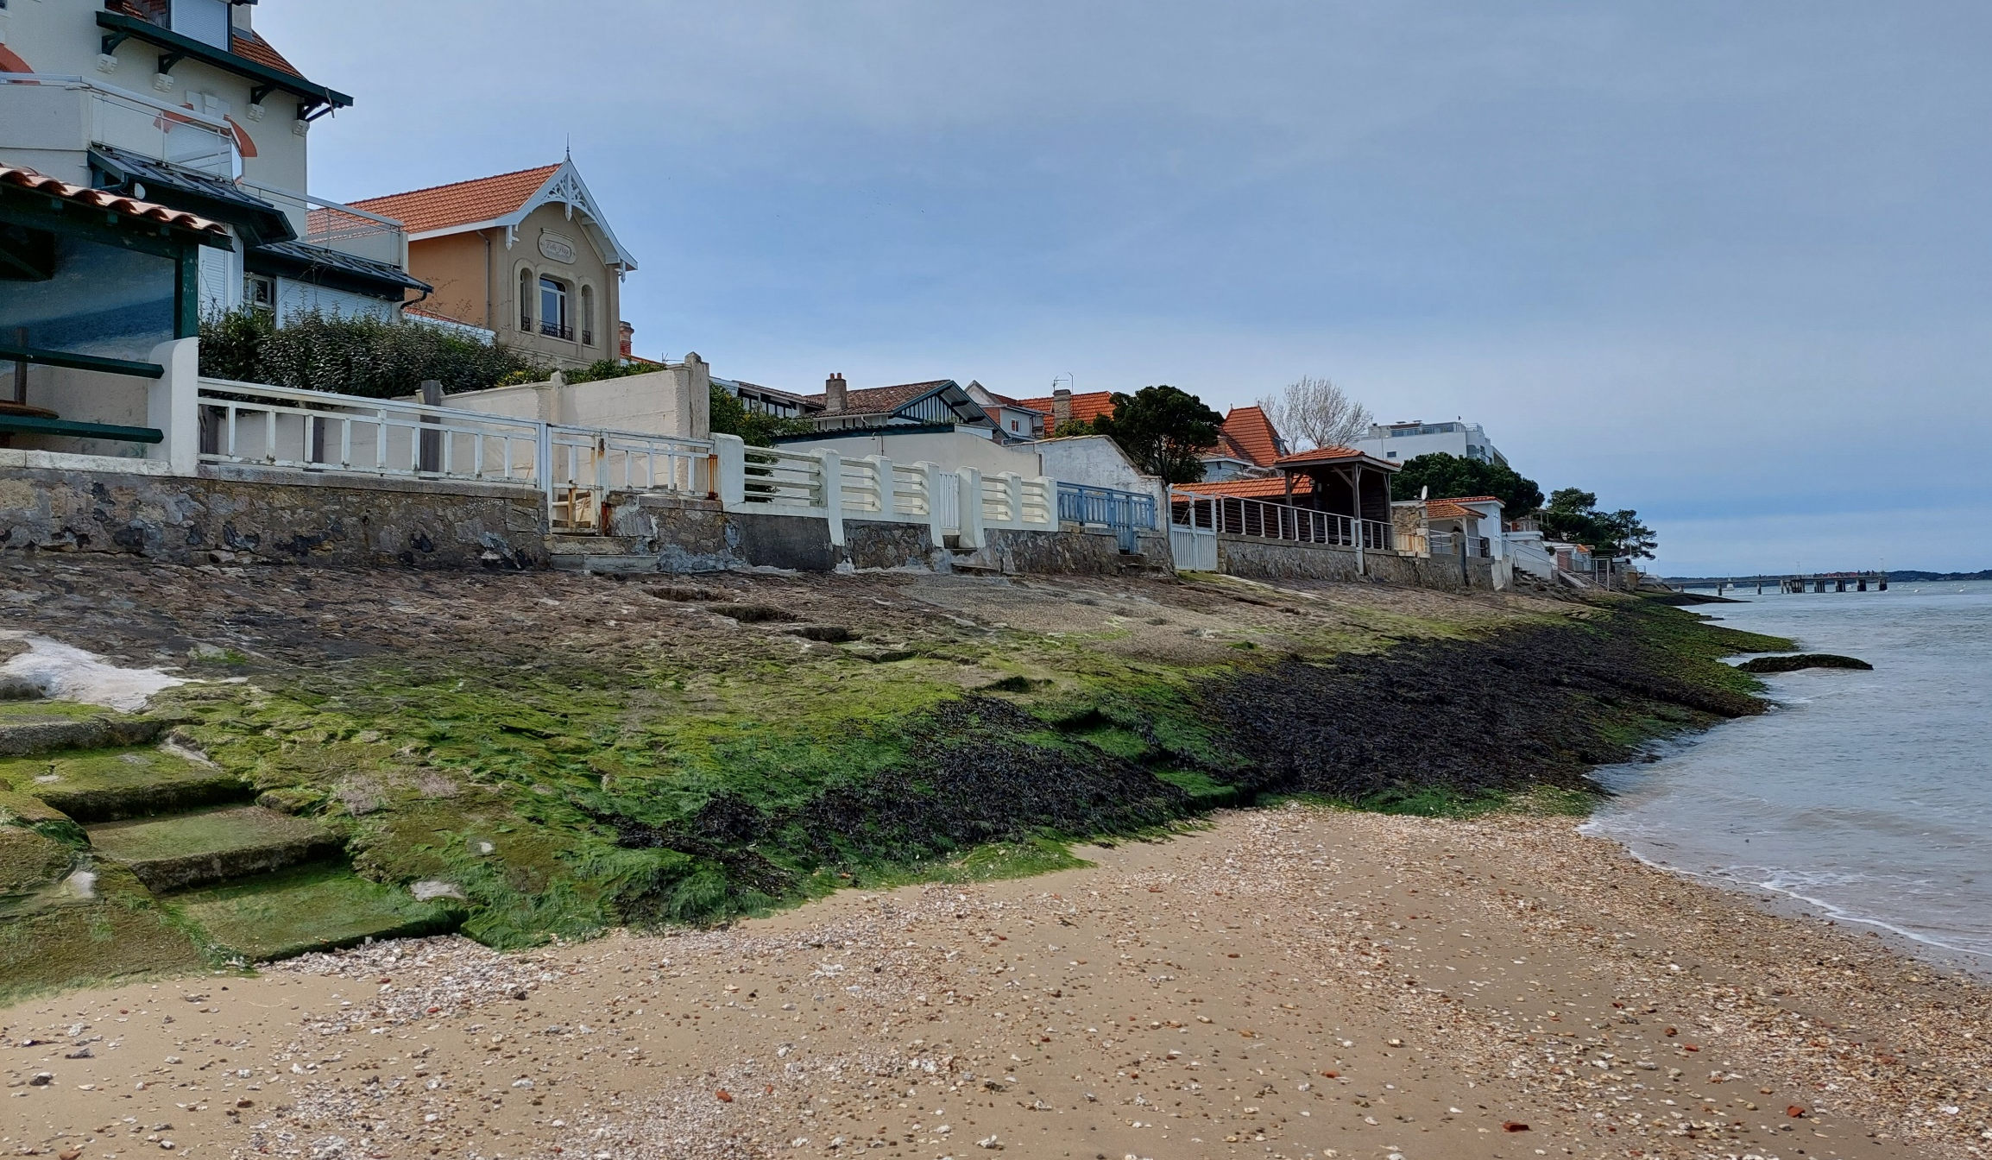
COASTMOVE: A global agent-based model of adaptation and migration decisions in face of sea level rise
Arcachon, France
Sem Duijndam
Lars Tierolf, Toon Haer, Jens de Bruijn, Wouter Botzen, Lena Reimann, Marijn Ton, and Jeroen Aerts

Slide 2
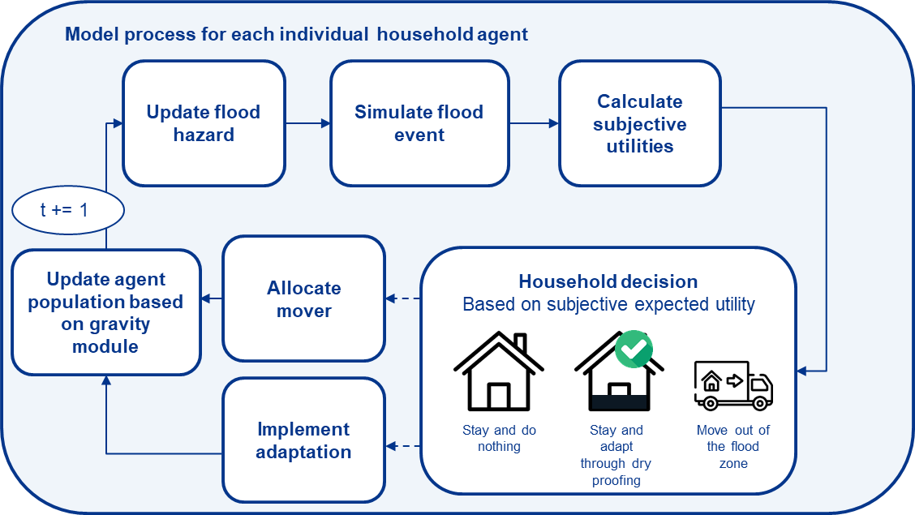
Modelling schedule
Notes:
Hierna Plaatje floodplain met regio. Grafieken van maken. Daarna regios, daarna Frankrijk

Slide 3
Contact and further references
DYNAMO-M: a global modelling approach of both coastal adaptation and migration under projections of future development
Simulating local decision making under scenarios of global change
Further references
Duijndam, S. J., Botzen, W. J., Hagedoorn, L. C., & Aerts, J. C. (2022). Anticipating sea‐level rise and human migration: A review of empirical evidence and avenues for future research. Wiley Interdisciplinary Reviews: Climate Change, 13(1), e747.
Aerts, J. C. J. H. (2020). Integrating agent-based approaches with flood risk models: A review and perspective. Water Security, 11, 100076.
Ruig, L. T. de, Haer, T., Moel, H. de, Orton, P., Botzen, W. J. W., & Aerts, J. C. J. H. (2022). An agent-based model for evaluating reforms of the National Flood Insurance Program: A benchmarked model applied to Jamaica Bay, NYC. Risk Analysis. https://doi.org/10.1111/RISA.13905
Haer, T., Botzen, W. J. W., & Aerts, J. C. J. H. (2019). Advancing disaster policies by integrating dynamic adaptive behaviour in risk assessments using an agent-based modelling approach. Environmental Research Letters, 14(4). https://doi.org/10.1088/1748-9326/ab0770
Link to abstract
Contact
lars.tierolf@vu.nl

