Slide 1
2D numerical modelling of Tethyan-type ophiolite emplacement: The role of overriding plate age, serpentinization, and OCT width.
Publication supported by FCT- project UID/GEO/50019/2013 – IDL
A.S. Gomes^{1,2}, F.M. Rosas^{1,2}, J.C. Duarte^{1,2}, N. Riel³, W.P. Schellart⁴, J. Almeida⁵
¹Departamento de Geologia, Faculdade de Ciências, Universidade de Lisboa, 1749-016 Lisboa, Portugal.
² Instituto Dom Luiz, Faculdade de Ciências, Universidade de Lisboa, Portugal.
³Institute of Geosciences, Johannes Gutenberg University, Mainz, Germany
⁴Faculty of Earth and Life Sciences, Vrije Universiteit Amsterdam, Amsterdam, Netherlands.
⁵Instituto Dom Luiz, Universidade da Beira Interior, Portugal
agomes@alunos.fc.ul.pt
Research supported by FCT through scholarship SFRH/BD/146726/2019 and through project UIDB/50019/2020-IDL

Slide 2
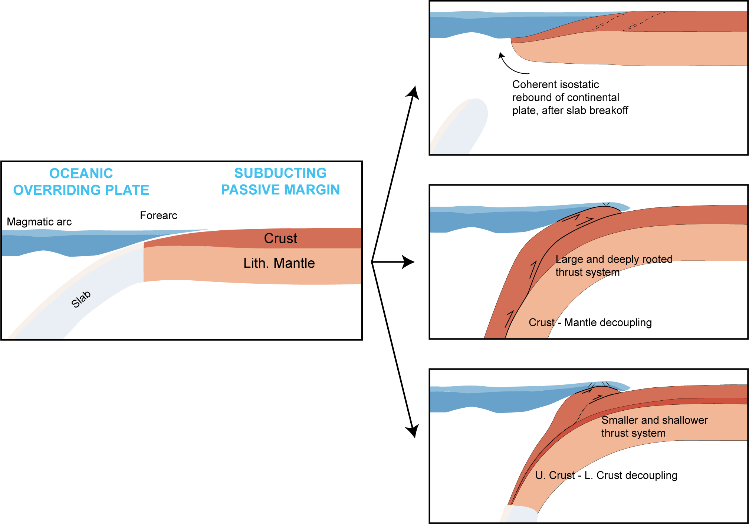
Tethyan-type ophiolite emplacement
e.g. Wakabayashi & Dilek (2003); Edwards et. al (2015)
e.g. Chemenda et. al (1996)
e.g. Duretz et. al (2016); Porkoláb et. al (2021)

Slide 3
What we did:
Gravity-driven 2D numerical models testing:
Overriding-plate age [10 vs 60 Myr]
Overriding-plate serpentinization [presence vs absence]
Continental margin width [narrow vs wide]

Slide 4
Preview
OCEANIC OVERRIDING PLATE
SUBDUCTING PASSIVE MARGIN
Please come join me at screen 3!

Slide 5
2D numerical modelling of Tethyan-type ophiolite emplacement: The role of overriding plate age, serpentinization, and OCT width.
Publication supported by FCT- project UID/GEO/50019/2013 – IDL
A.S. Gomes, F.M. Rosas, J.C. Duarte, N. Riel, W.P. Schellart, J. Almeida
agomes@alunos.fc.ul.pt
Purpose
Setup
Results
Discussion
Research supported by FCT through scholarship SFRH/BD/146726/2019 and through project UIDB/50019/2020-IDL

Slide 6
Purpose
Much is still unknown about the physical constraints that control the ophiolite emplacement process.
Many Tethyan-type ophiolites are emplaced at a young age. Is this a coincidence or the result of a broader geodynamical control? How does the age of the overriding plate influence this process?
Serpentinization is a common process within oceanic plates. Many ophiolites display basal highly tectonized serpentinization layers. How is the presence of a weakened serpentinized layer expected to affect the emplacement of the ophiolite?
Present-day passive margins range in width from a few dozen to several hundreds of kilometres. How is the continental subduction-exhumation(-emplacement) process influenced by such differing margin configurations? Can we infer the initial margin extent of past collision zones?
We attempt to broaden our understanding of this process by testing these variables on numerical models
Overriding-plate age [10 vs 60 Myr]
Overriding-plate serpentinization [presence vs absence]
Continental margin width [narrow vs wide]

Slide 7
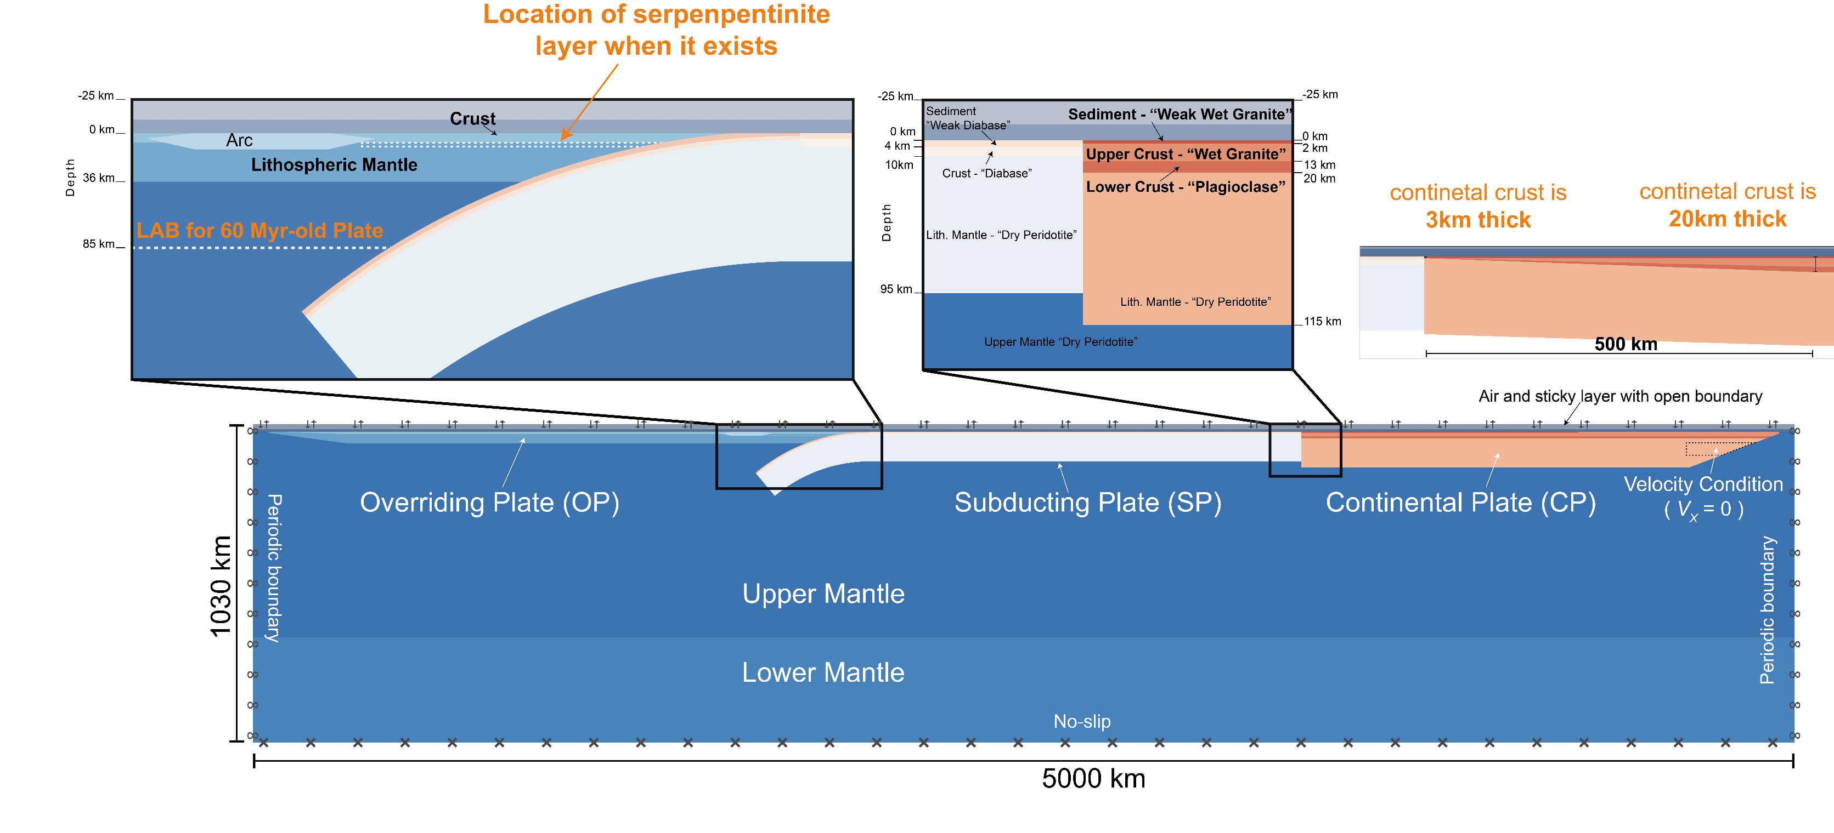
Setup
2D Thermo-mechanical models
Using the Underworld code (particle-in-cell, FEM)
Gravity-driven
Simulated free-surface
P, T, and $\dot{ε}$ dependent visco-plastic rheologies
1.5x1.5 km cells around the collision zone
In the model w/ the wide margin

Slide 8
Results
VARIABLES
10 Myr-old OP
60 Myr-old OP
500 km-wide Margin
Overriding Plate
Overriding Plate
Passive Margin
WITHOUT serpentinite layer
Slab
Slab
Serpentinite
Serpentinite
WITH
serpentinite layer
[Click on the images above to go directly to the corresponding experiment]

Slide 9
Results: Benchmark (10Myr old plate, no serpentinization)
Back to Results

Slide 10
Results: Benchmark (10Myr old plate)
Back to Results

Slide 11
Results: 60Myr old plate
For comparison: Benchmark (10My old plate)
Back to Results

Slide 12
Results: 10Myr old plate w/ serpentinization
For comparison: Benchmark (10My old plate)

Slide 13
Results: PTt paths comparison
10 Myr old plate No serpentinization
10 Myr old plate With serpentinization
Back to Results

Slide 14
Results: 60Myr old plate w/ serpentinization
For comparison: 60Myr old plate without serpentinization
Back to Results

Slide 15
Results: Serpentinization
Young Plate
Old Plate
Back to Results

Slide 16
Results: 500 km-long “tapered” passive margin
For comparison: Benchmark, “blunt” passive margin
Back to Results

Slide 17
Discussion (1/2)
Tethyan-type ophiolite emplacement is physically viable under a wide range of initial conditions, which include:
Both young and old overriding plate
Both a pristine and a serpentinized overriding plate
Both a narrow (“blunt”), and a wide (“tapered”) passive margin.
However, important differences exist in the subduction-exhumation-emplacement cycle for the different scenario (see next page).
Back to Results

Slide 18
Discussion (2/2)
The increase in overriding plate age mainly results in:
A delayed exhumation onset, but an earlier ophiolite emplacement.
A reduced possibility for RT instabilities within the subduction channel, which is much narrower.
The addition of a weak serpentinization layer on the OP results in:
The semi decoupling of the OP crust and mantle.
An indentation of the OP mantle with the subduction cont. crust.
This results in higher and more prolonged compressive stress in the cont. crust
A stress driven pop-up extrusion of the cont. crust (as opposed to buoyancy-driven)
A lubricating effect that facilitates the separation/emplacement of the ophiolite.
A wide and tapered margin results in:
A very fast initial subduction of the cont. plate (less buoyant).
A much deeper crustal subduction, accompanied by a delayed exhumation.
A single exhuming “bulge” instead of several small RT instabilities.
The possibility for the emplacement of a double ophiolite.
Back to Results

Slide 19
Extra Material
Back to Results

Slide 20
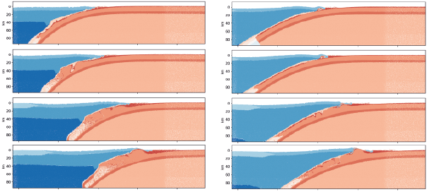
10Myr old plate
60Myr old plate
15 Myr
20 Myr
30 Myr
39 Myr
Back to Results

Slide 21
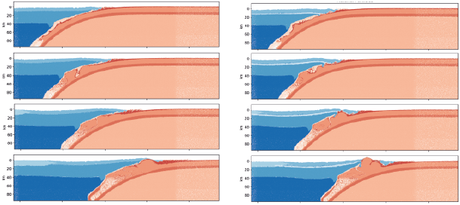
No serpentinization
With serpentinization
15 Myr
20 Myr
26 Myr
39 Myr
Back to Results

Slide 22
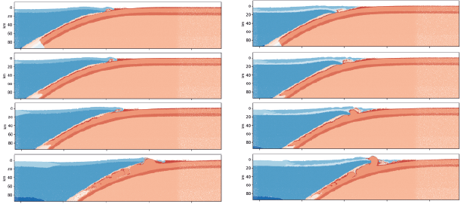
60Myr old plate
No serpentinization
60Myr old plate
With serpentinization
15 Myr
20 Myr
24 Myr
30 Myr
Back to Results

Slide 23
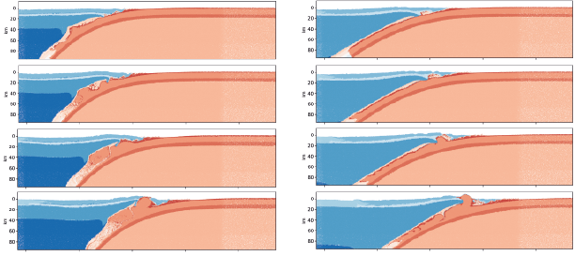
10Myr old plate
With serpentinization
60Myr old plate
With serpentinization
15 Myr
20 Myr
24 Myr
30 Myr
Back to Results

Slide 24
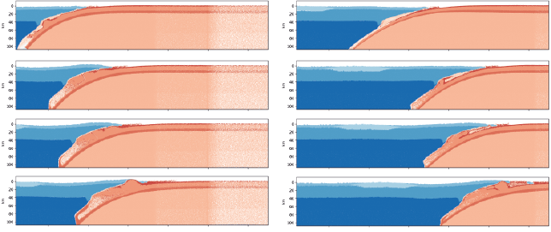
Benchmark
500 km-long passive margin
16 Myr
27 Myr
31 Myr
42 Myr
Back to Results

