Slide 1
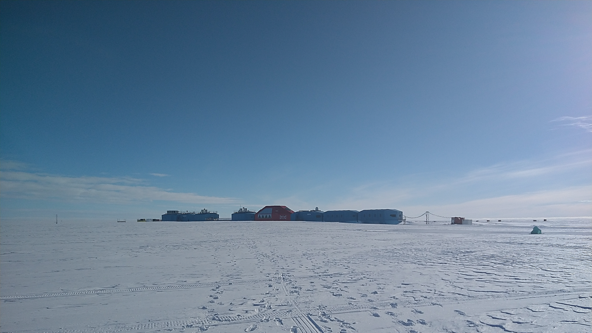
Snowpack nitrate photolysis drives the summertime atmospheric nitrous acid (HONO) budget in coastal Antarctica
A study of HONO at Halley VI Research Station, Antarctica
Millie Bond^{1,2}, Markus Frey¹, Jan Kaiser², Freya Squires¹, Anna Jones¹, Jörg Kleffmann³
1 – British Antarctic Survey, UK
2 – University of East Anglia, Norwich, UK
3 – University of Wuppertal, Germany
amend37@bas.ac.uk

Slide 2
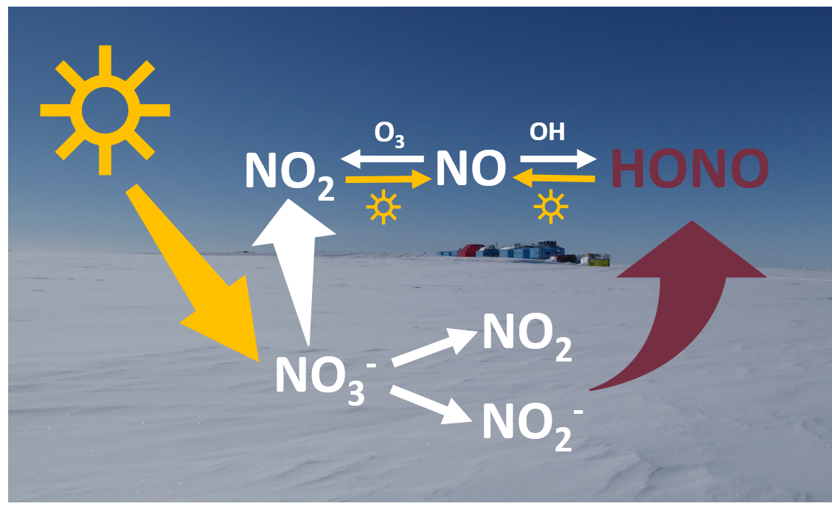
What is already known about HONO?
2 minute madness

Slide 3
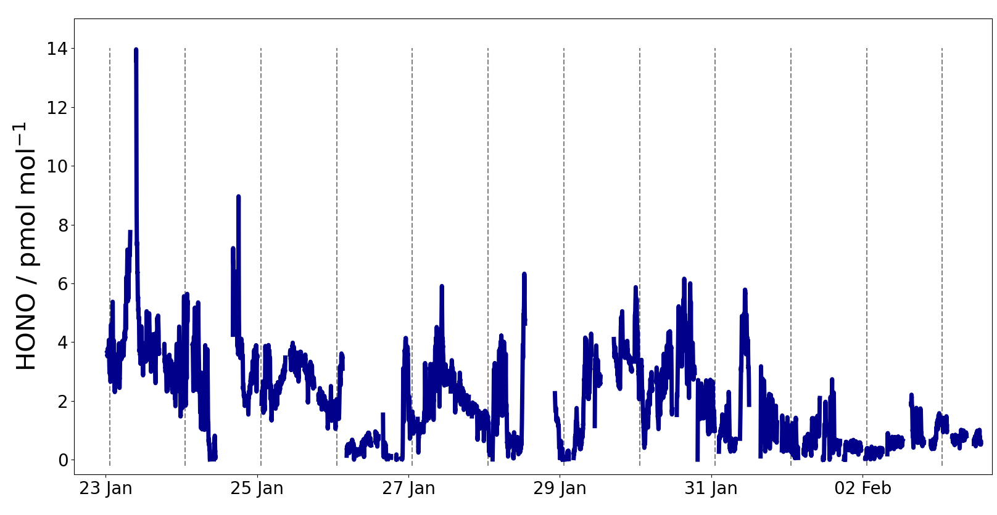
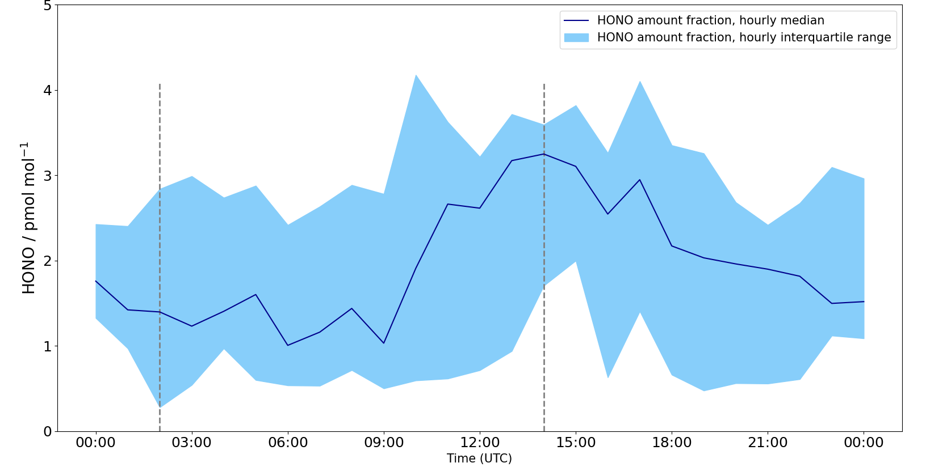
HONO at Halley Research Station, Antarctica
2 minute madness
HONO between < 0.3 and 14 pmolmol⁻¹, mean is 2.1 pmolmol⁻¹.
Peak in HONO concentration at solar noon supporting a photochemical source.
HONO budget: the flux of HONO from the snow contributes >10 times that of gas phase HONO formation.
What is the flux of HONO out of the snow?
How much HONO is expected from nitrate photolysis?
How important is HONO as an OH source at Halley?
How is HONO detected and the flux measured?

Slide 4
Contents
Read our paper here!
https://doi.org/10.5194/acp-2022-845
2 minute madness slides
Introduction to HONO
Detecting HONO
HONO measurement site
HONO amount fraction time series
Diurnal cycle in HONO mixing ratio
HONO in other Antarctic locations
Flux-gradient method
HONO flux from the snow
Estimate of HONO flux from nitrate photolysis
Setting up a simple box model
Estimating snowpack HONO production
OH production by HONO
Summary and conclusions
These are hyperlinks to specific slides
Previous slide
Returns to this slide
Next slide

Slide 5
Introducing HONO
Photolysis of nitrate, NO₃⁻ , in snow has been established to produce NO_{x} .
HONO also seems to be emitted from sunlit snow but the exact reaction driving its release remains unknown.
HONO is photolyzed to release OH so can have important implications for the HO_{x} budget.
In the polar regions, the usual OH radical formation pathway (ozone photolysis and reaction of O(¹D) with H₂O) is limited by the low water vapour concentration: understanding other OH sources is crucial.
A diagram showing NO_{x} production by sunlit snow, as well as snowpack NO₂ and NO₂⁻ which may be HONO precursors.

Slide 6
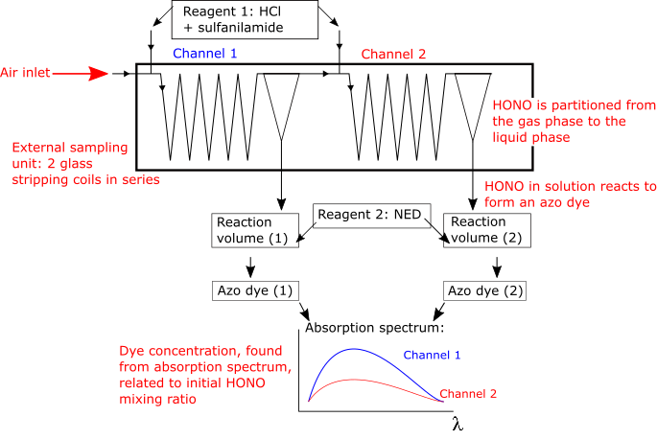
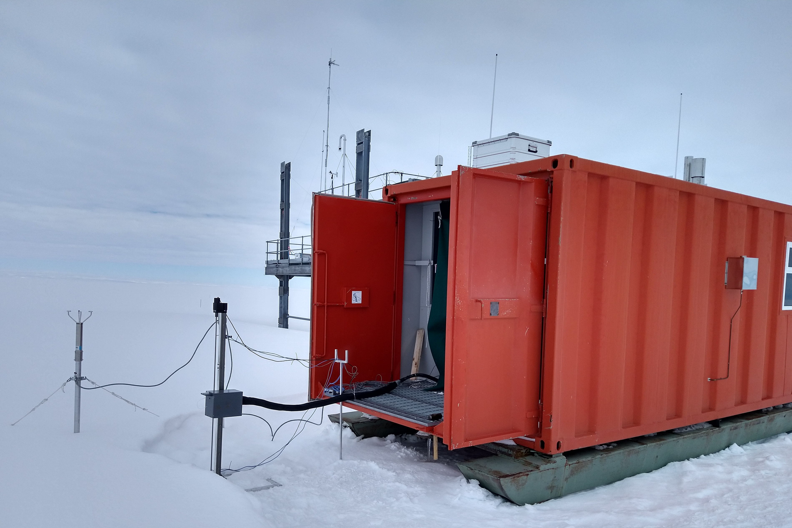
Detecting HONO
HONO amount fraction was measured with a LOng Path Absorption Photometer (LOPAP):
HONO in air
NO⁺ in solution
Azo dye
Light absorption by
dye
Dye concentration
HONO concentration
External sampling unit
Main instrument
The LOPAP sampling unit mounted outside the shipping container in which the LOPAP was housed

Slide 7
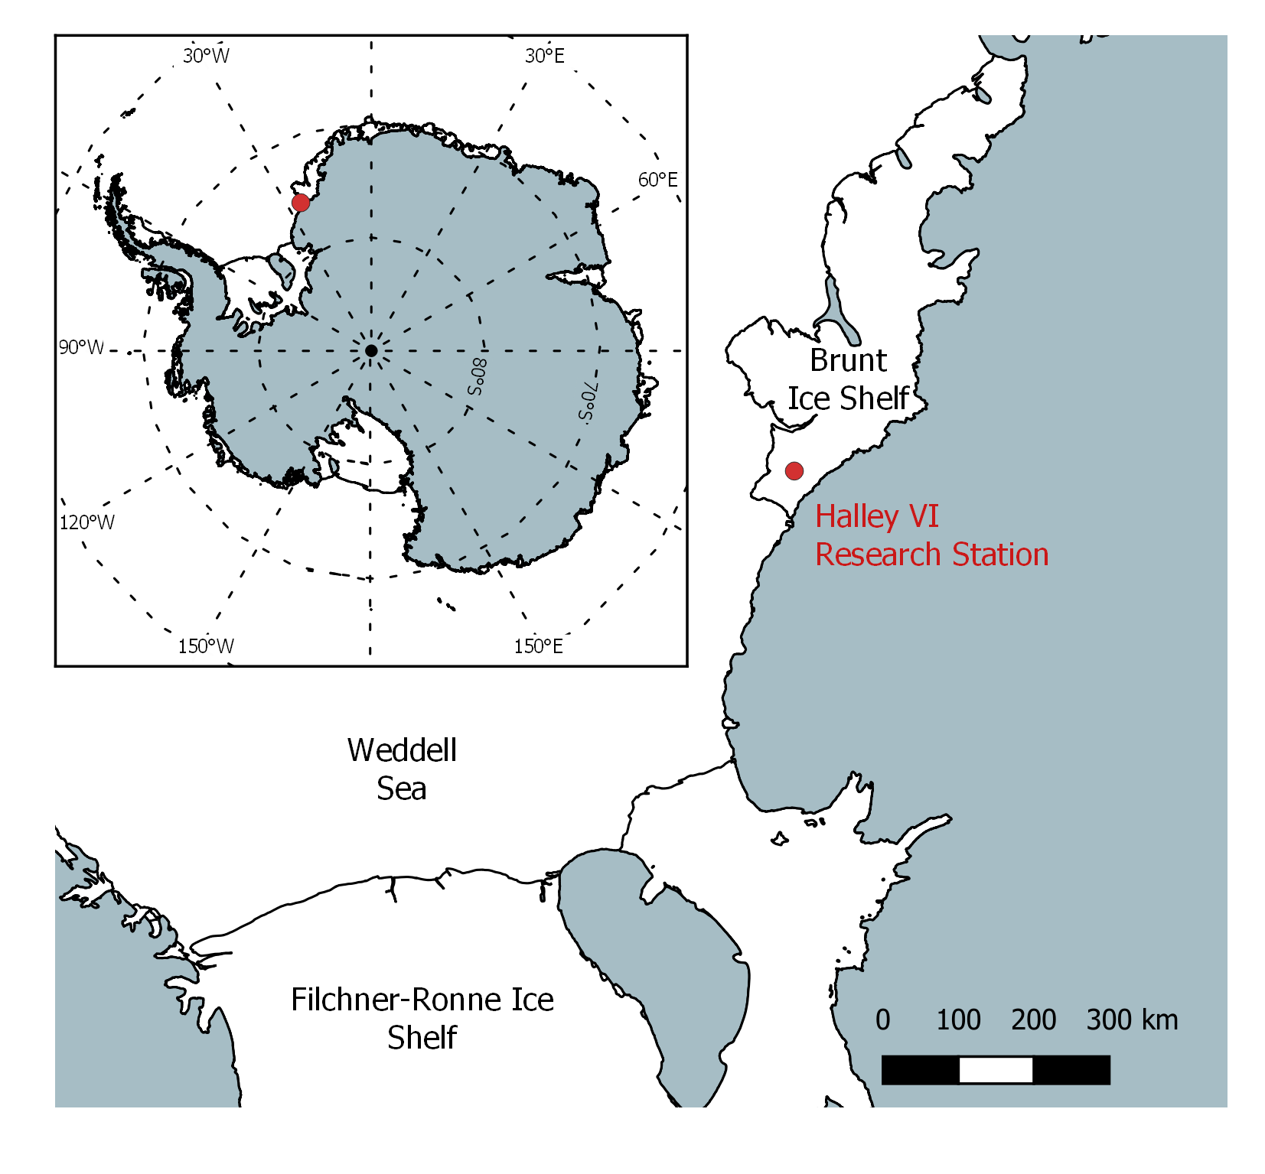
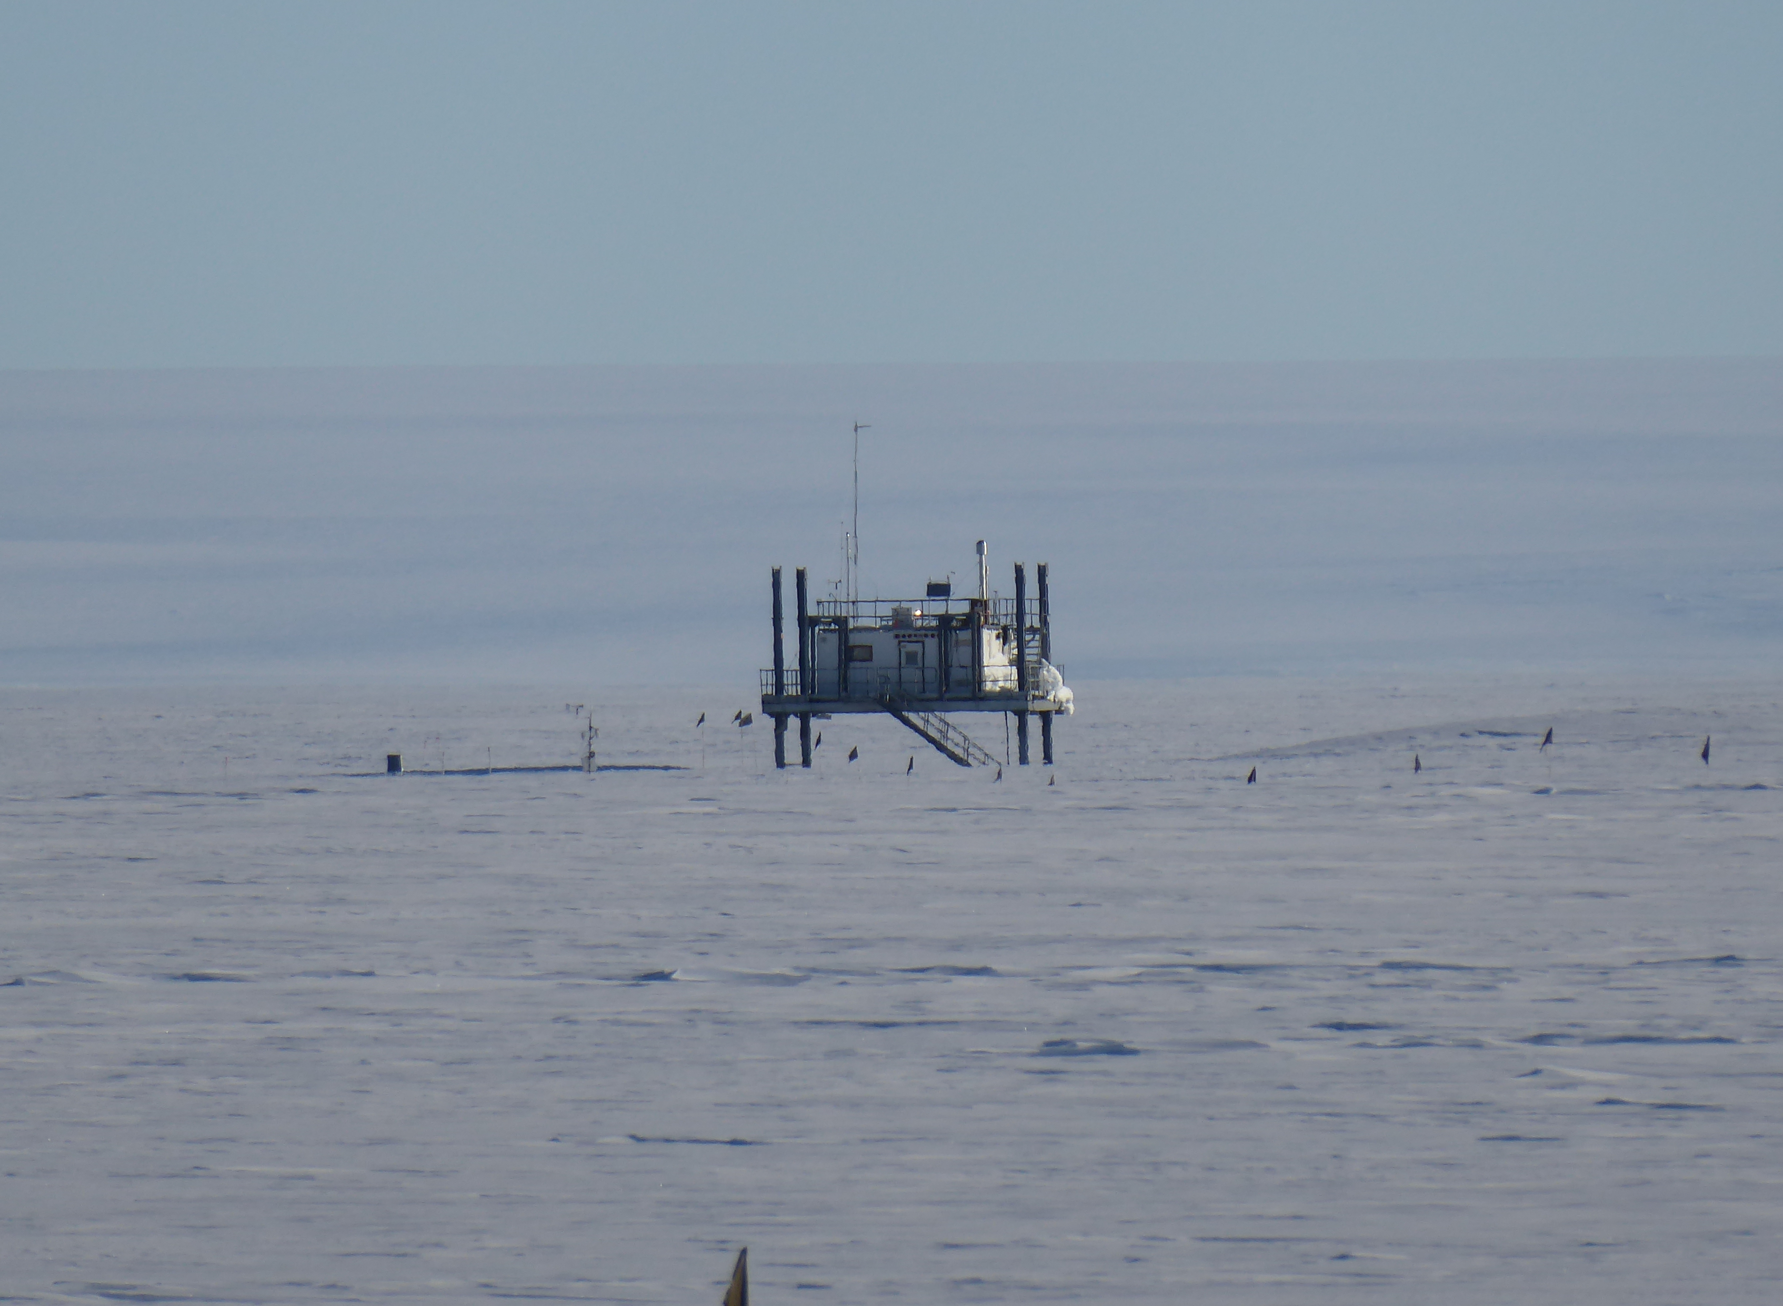
HONO measurement site
Halley VI Research Station, Brunt Ice Shelf, Antarctica:
Measurements made in clean air sector (CAS), away from the station’s generators and vehicles.
Halley clean air sector lab
The CAS lab

Slide 8
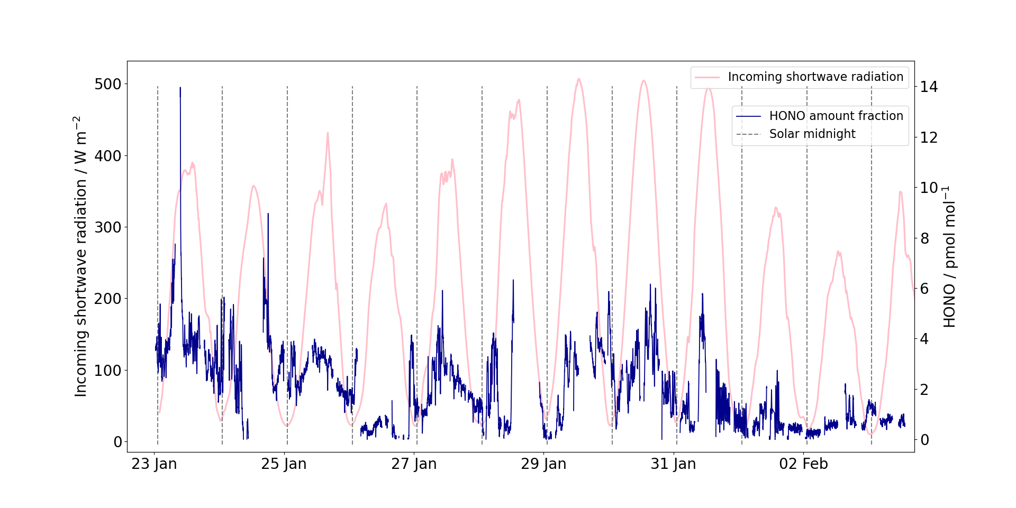
HONO amount fraction time series

Slide 9
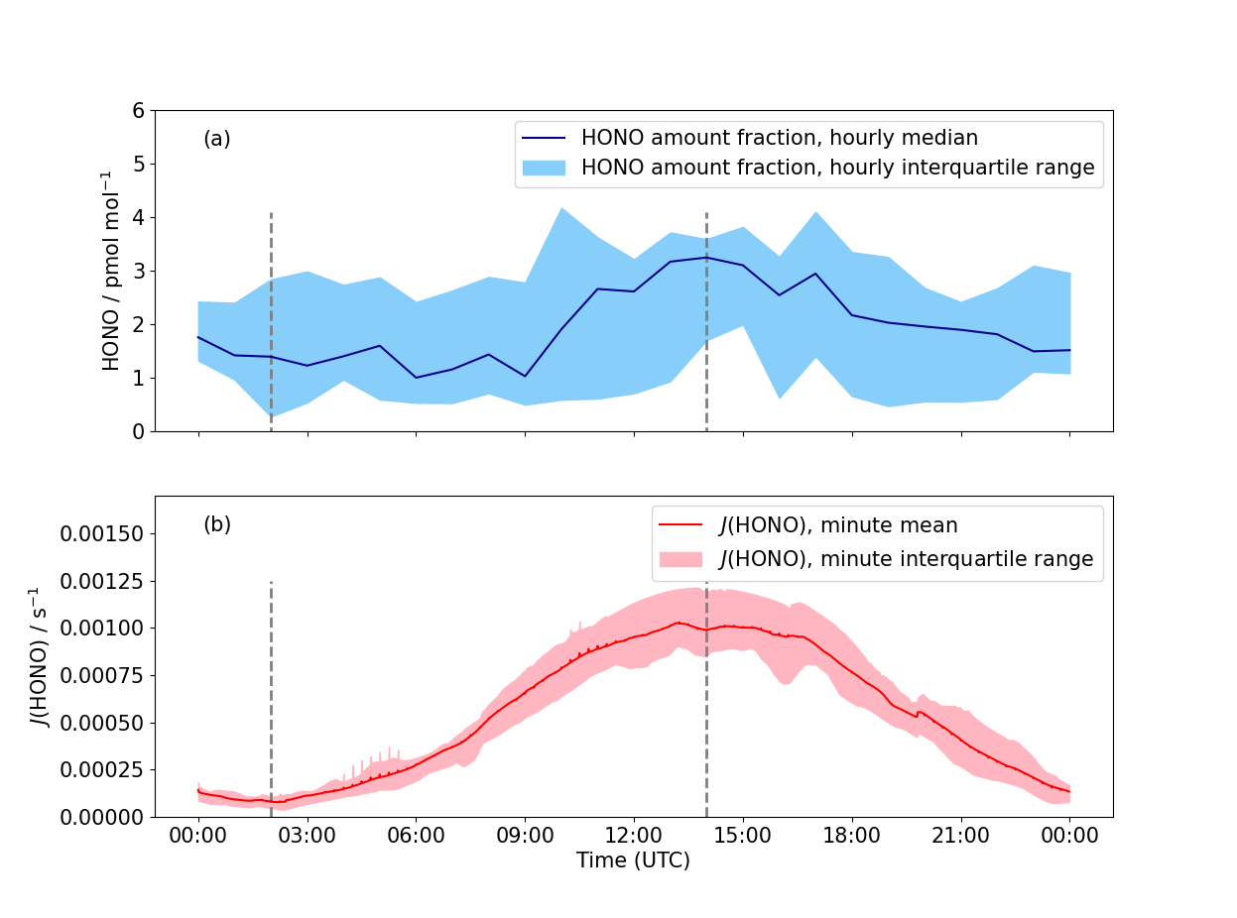
Diurnal cycle in HONO mixing ratio

Slide 10
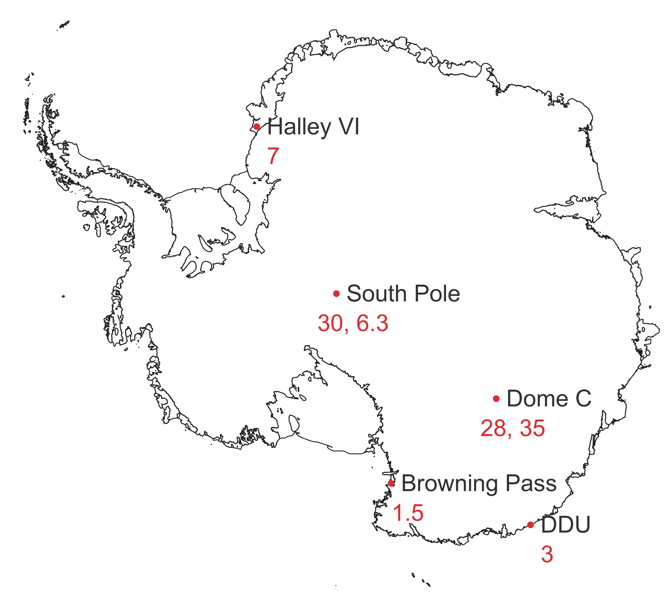
HONO amount fraction
HONO amount fractions between < 0.3 and 14 pmolmol⁻¹ with a mean of 2.1 pmolmol⁻¹.
These are some of the lowest ever HONO amount fractions observed in Antarctica, see map.
HONO has previously been measured at Halley but it is thought that the true amount fraction was overestimated. The LOPAP used for this campaign allows for interference correction so this should not be an issue.
Mean atmospheric HONO amount fractions (in pmol mol⁻¹) measured previously in the Antarctic

Slide 11
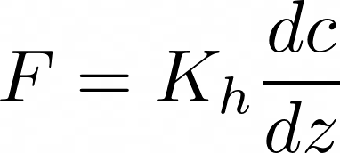
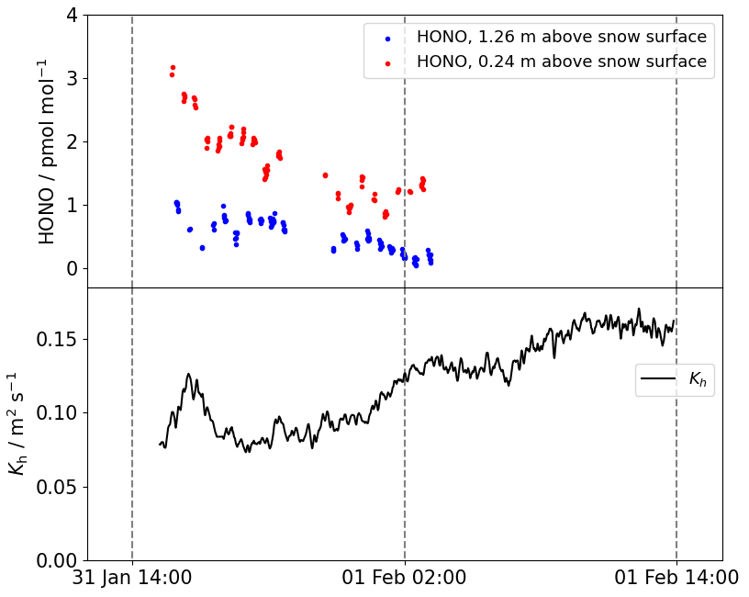
Flux-gradient method
Concentration gradient
HONO flux measured using the flux gradient method.
HONO amount fraction measured at two heights by raising and lowering the LOPAP inlet on an automatic elevator.
Diffusion coefficient (K_{h}) estimated from wind speed and temperature gradient measurements.
Flux
Diffusion coefficient
for heat
The LOPAP inlet on its automatic elevator

Slide 12
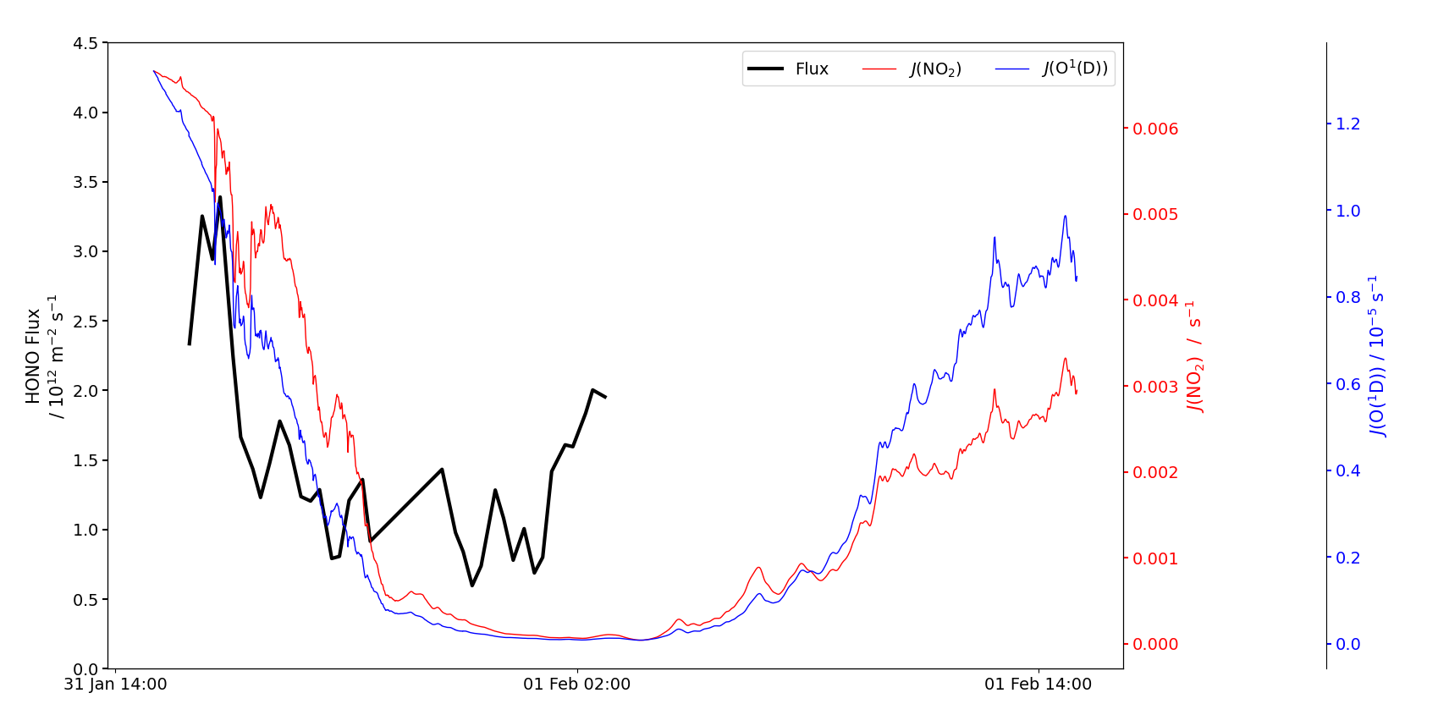
HONO flux from the snow
HONO flux is between 0.5 and 3.4 × 10¹² m⁻² s⁻¹ from the snow surface.
The flux appears to decrease between solar noon and midnight suggesting it is photochemically driven.

Slide 13
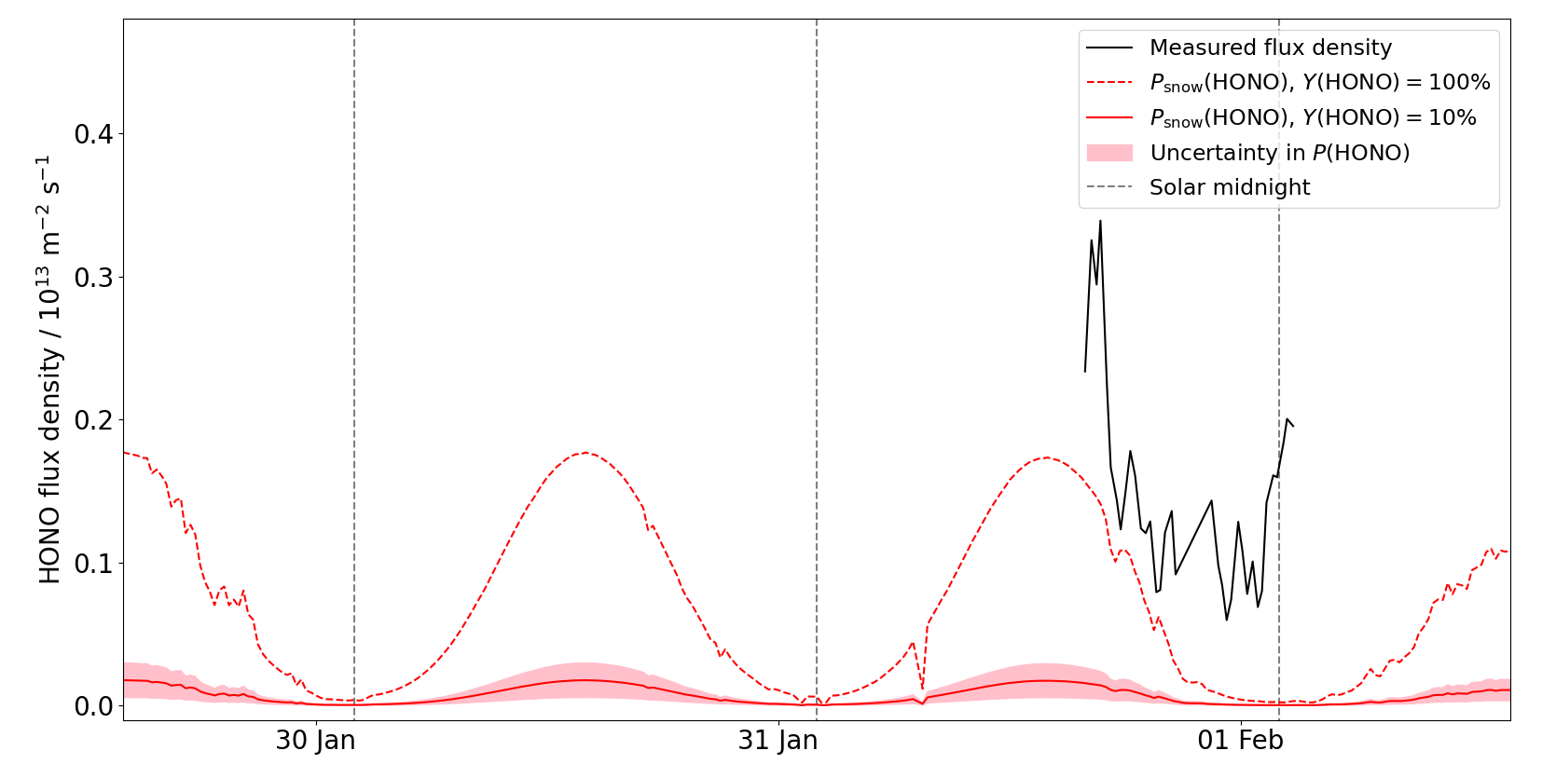
Estimate of HONO flux from snow nitrate
HONO formation in the snowpack is related to nitrate photolysis.
A HONO flux from this reaction, P_{snow}(HONO), can be calculated. Nitrate photolysis produces both NO_{x} and HONO; the HONO yield, Y(HONO), is not precisely known.
A 100% HONO yield would lead to a maximum production rate of 1.9﻿×﻿﻿10¹² m⁻² s⁻¹, close to the measured flux.
The estimated flux from nitrate photolysis for different values of the HONO yield.

Slide 14
Box model of HONO sources and sinks
The rates of key HONO reactions can be combined with the measured HONO concentration to estimate a HONO flux from the snow, P_{ss}(HONO).
The following reactions were included:
HONO formation through OH and NO combination:
OH + NO + M → HONO + M (k₁)
HONO loss through photolysis:
HONO + hν → OH + NO (J(HONO))
Loss through reaction of OH and HONO:
OH + HONO → H₂O + NO₂ (k₂)
P_{ss}(HONO) is plotted on the next slide. The mixing height, h, is unknown so the calculation was done for different values.

Slide 15
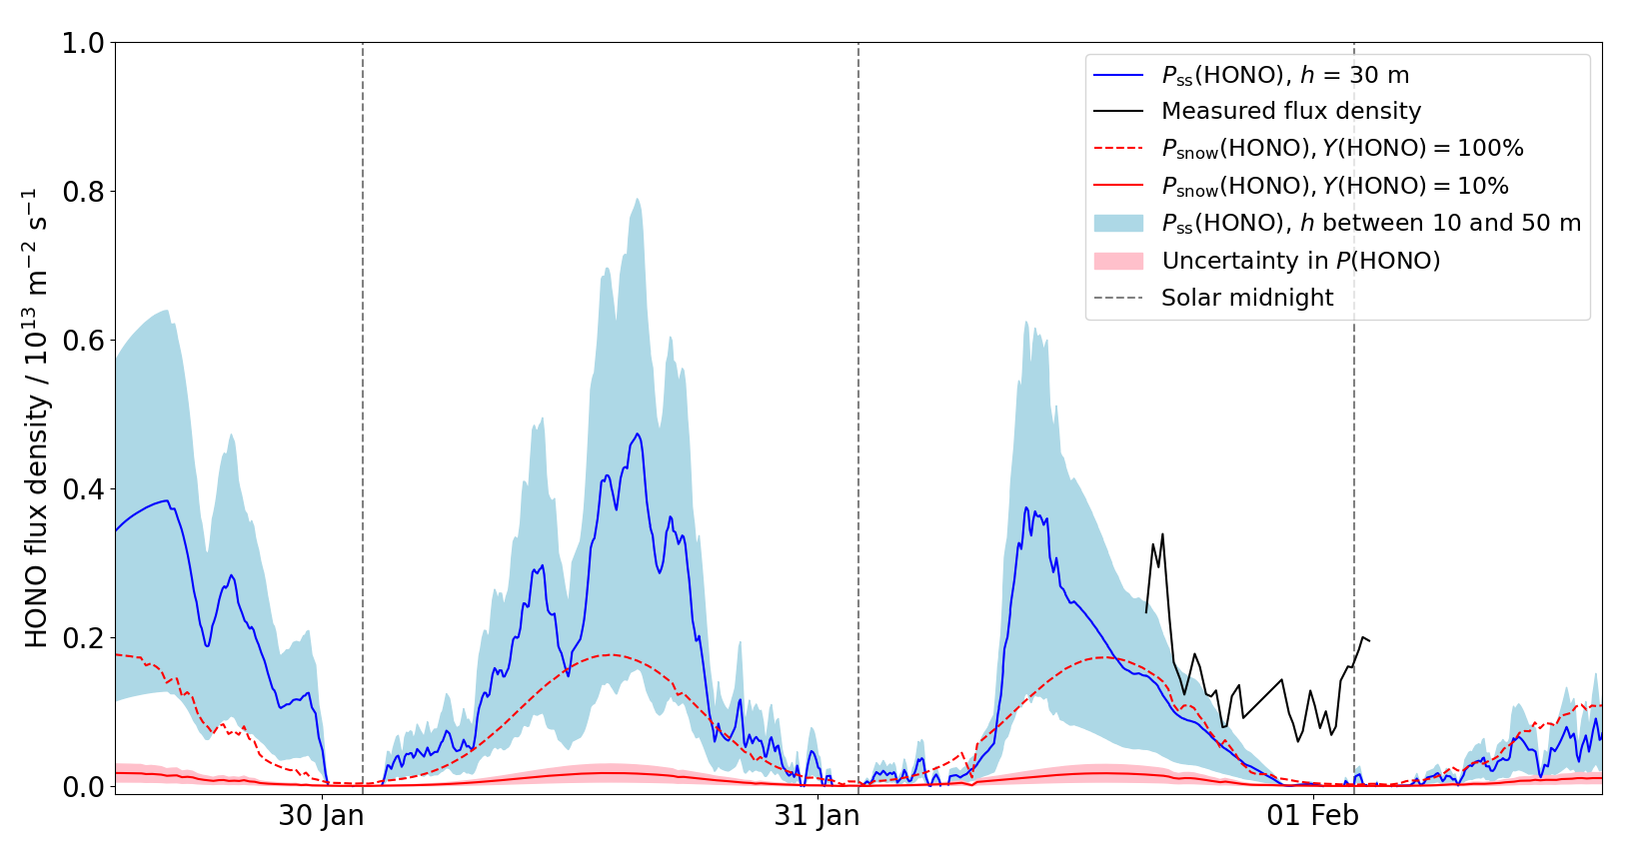
Estimating snowpack HONO production
Box model: snowpack HONO production estimated (with different values for the mixing height) using rates of known gas phase HONO reactions.
Estimated HONO production from nitrate photolysis, with different values for the HONO yield

Slide 16
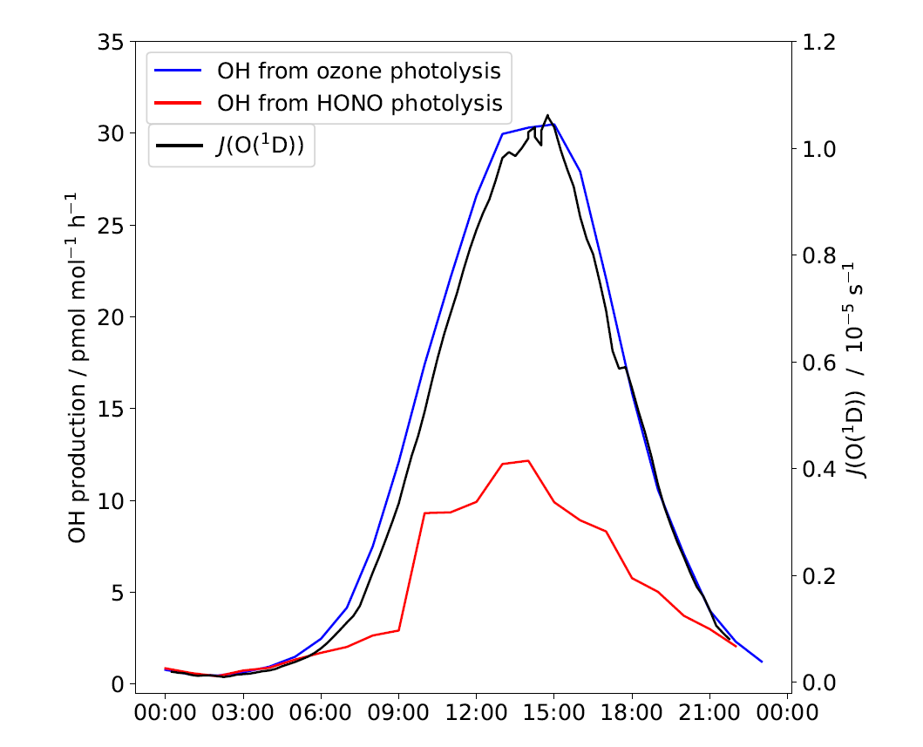
OH production by HONO
HONO photolysis is an OH source
At many Antarctic locations, such as the South Pole and Dome Concordia, the low temperature leads to very low water vapour concentrations which limits OH production through photolysis of ozone and hydrolysis of O(¹D).
At Halley the water vapour concentration is not limiting. This plot shows that OH formation through ozone photolysis still dominates.
However, HONO photolysis cannot be discounted as an OH source at Halley.

Slide 17
Summary & Conclusions
Read our paper here!
https://doi.org/10.5194/acp-2022-845
HONO amount fraction at Halley is low, mean 2.1 pmol mol^{-﻿1}, and shows a diurnal cycle peaking at solar noon.
There is a flux of HONO from the snow of 0.5 to 3.4 × 10¹² m⁻² s⁻¹.
The measured flux is close to the estimated HONO production from nitrate photolysis suggesting this reaction is a driver of HONO release.
In a simple box model of HONO sources and sinks, the flux density required to reach the measured atmospheric amount fraction is comparable to that measured, and contributes >10 times that of gas phase HONO production to the HONO budget.
HONO is an important OH source at Halley: these measurements suggest that HONO could contribute up to 12 pmol mol⁻¹ h⁻¹ of OH.
Key references
Jones, A. et al. (2000) ‘Speciation and Rate of Photochemical NO and NO₂ Production in Antarctic Snow’, Geophysical Research Letters, 27(3), pp. 345–348.
Kleffmann, J. et al. (2002) ‘A New Instrument (LOPAP) for the Detection of Nitrous Acid (HONO)’, Environmental Science and Pollution Research, 9(special issue 4), pp. 48–54.
Legrand, M. et al. (2014) ‘Large mixing ratios of atmospheric nitrous acid (HONO) at Concordia (East Antarctic Plateau) in summer: A strong source from surface snow?’, Atmospheric Chemistry and Physics, 14(18), pp. 9963–9976.
Villena, G. et al. (2011) ‘Nitrous acid (HONO) during polar spring in Barrow, Alaska: A net source of OH radicals?’, Journal of Geophysical Research Atmospheres, 116(24), pp. 1–12.

