Slide 1
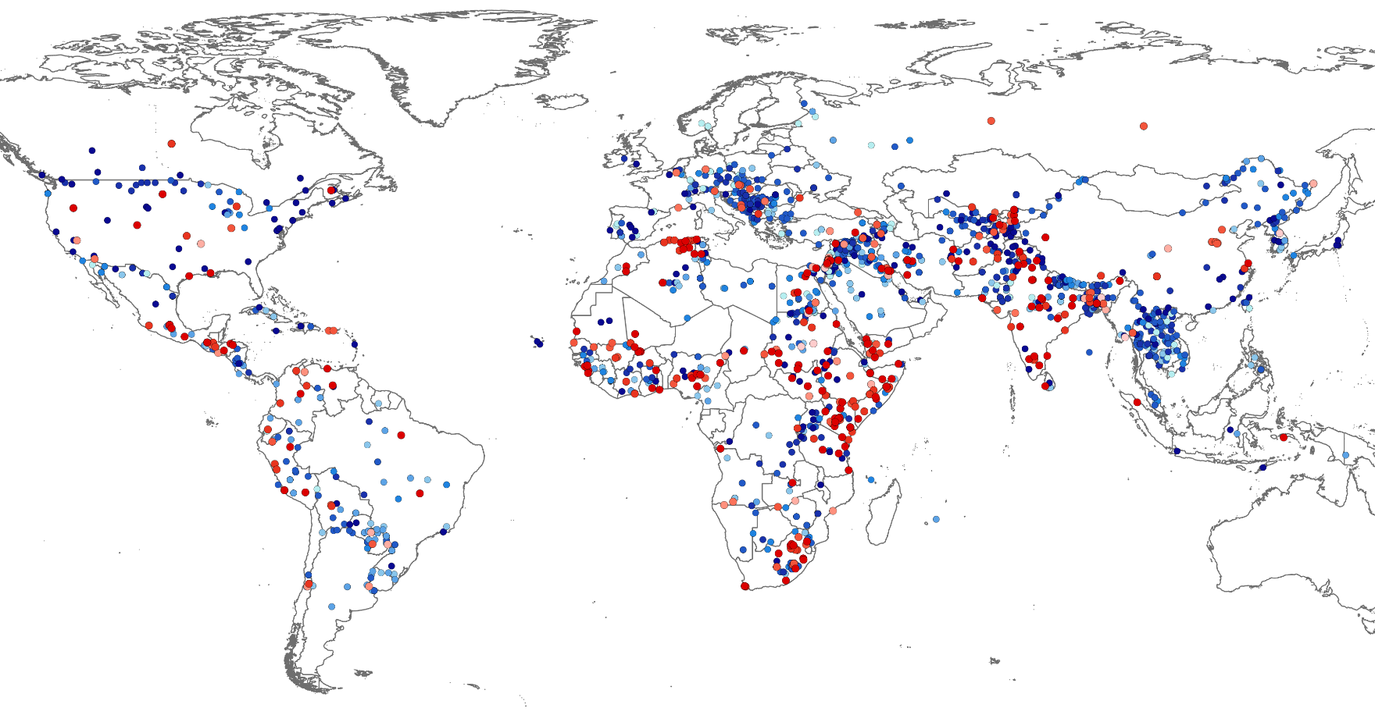
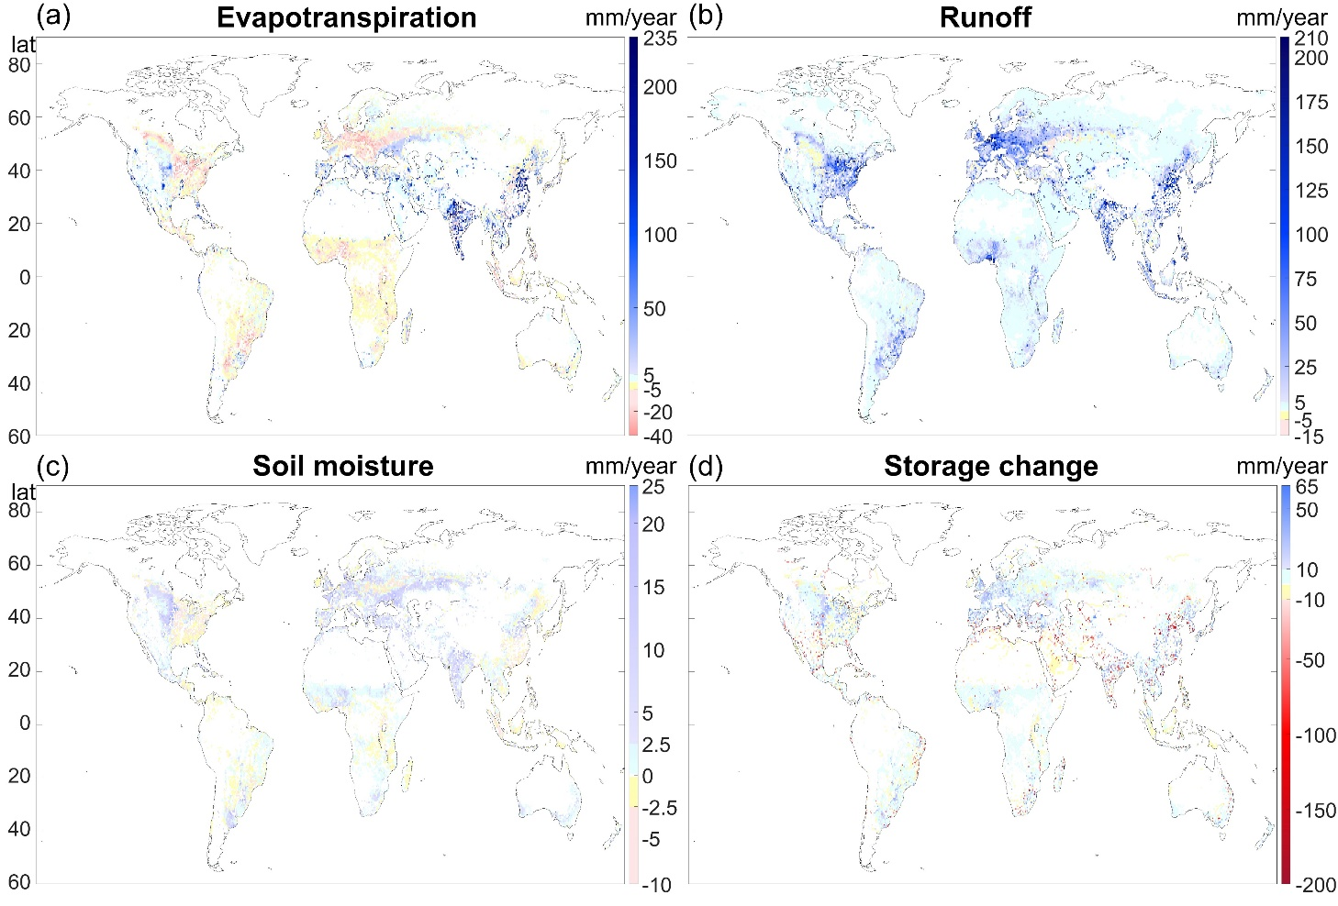
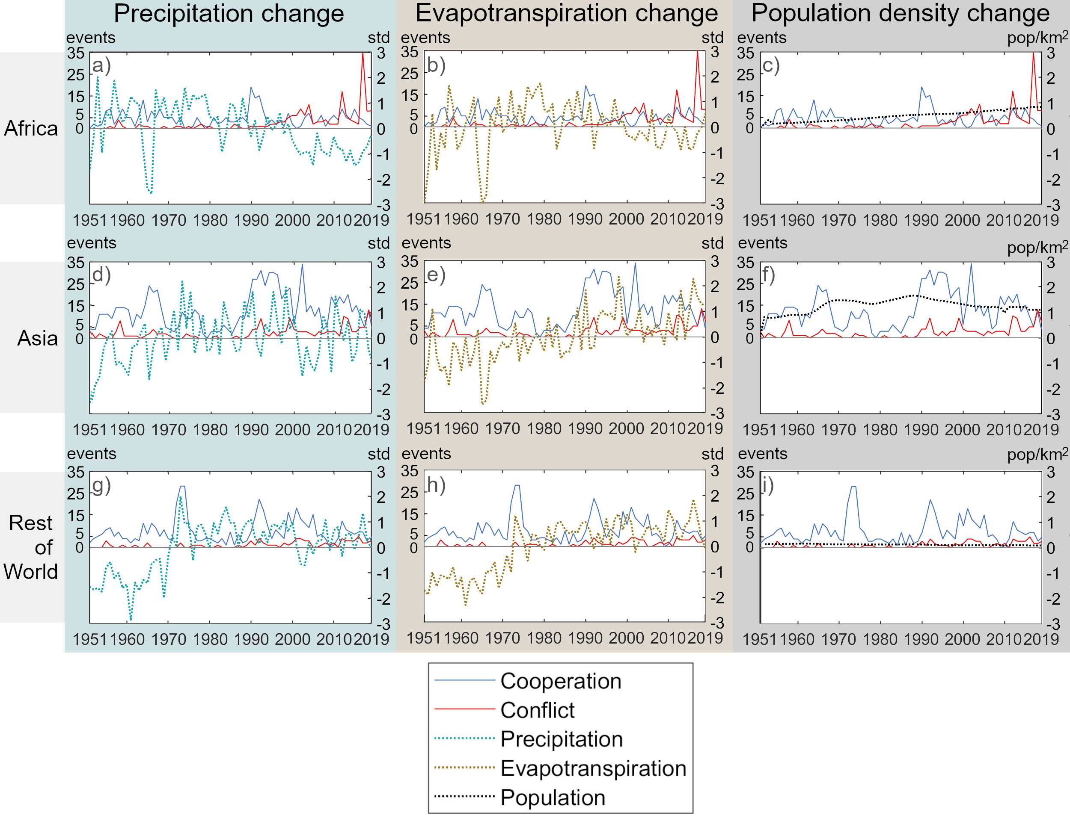
Humans, Water, and Climate Change Global Analysis of Conflicts and Cooperation and their Potential Drivers
Elisie Kåresdotter, Siyuan Li, Haozhi Pan, and Zahra Kalantari
How is climate change affecting human conflict and cooperation over water?
Where?
Trends?
Human or climate-driven water change?
What research gaps remain?
CLICK QUESTIONS OR FIGURES FOR MORE INFO
Can cooperation mitigate water conflict?

Slide 2
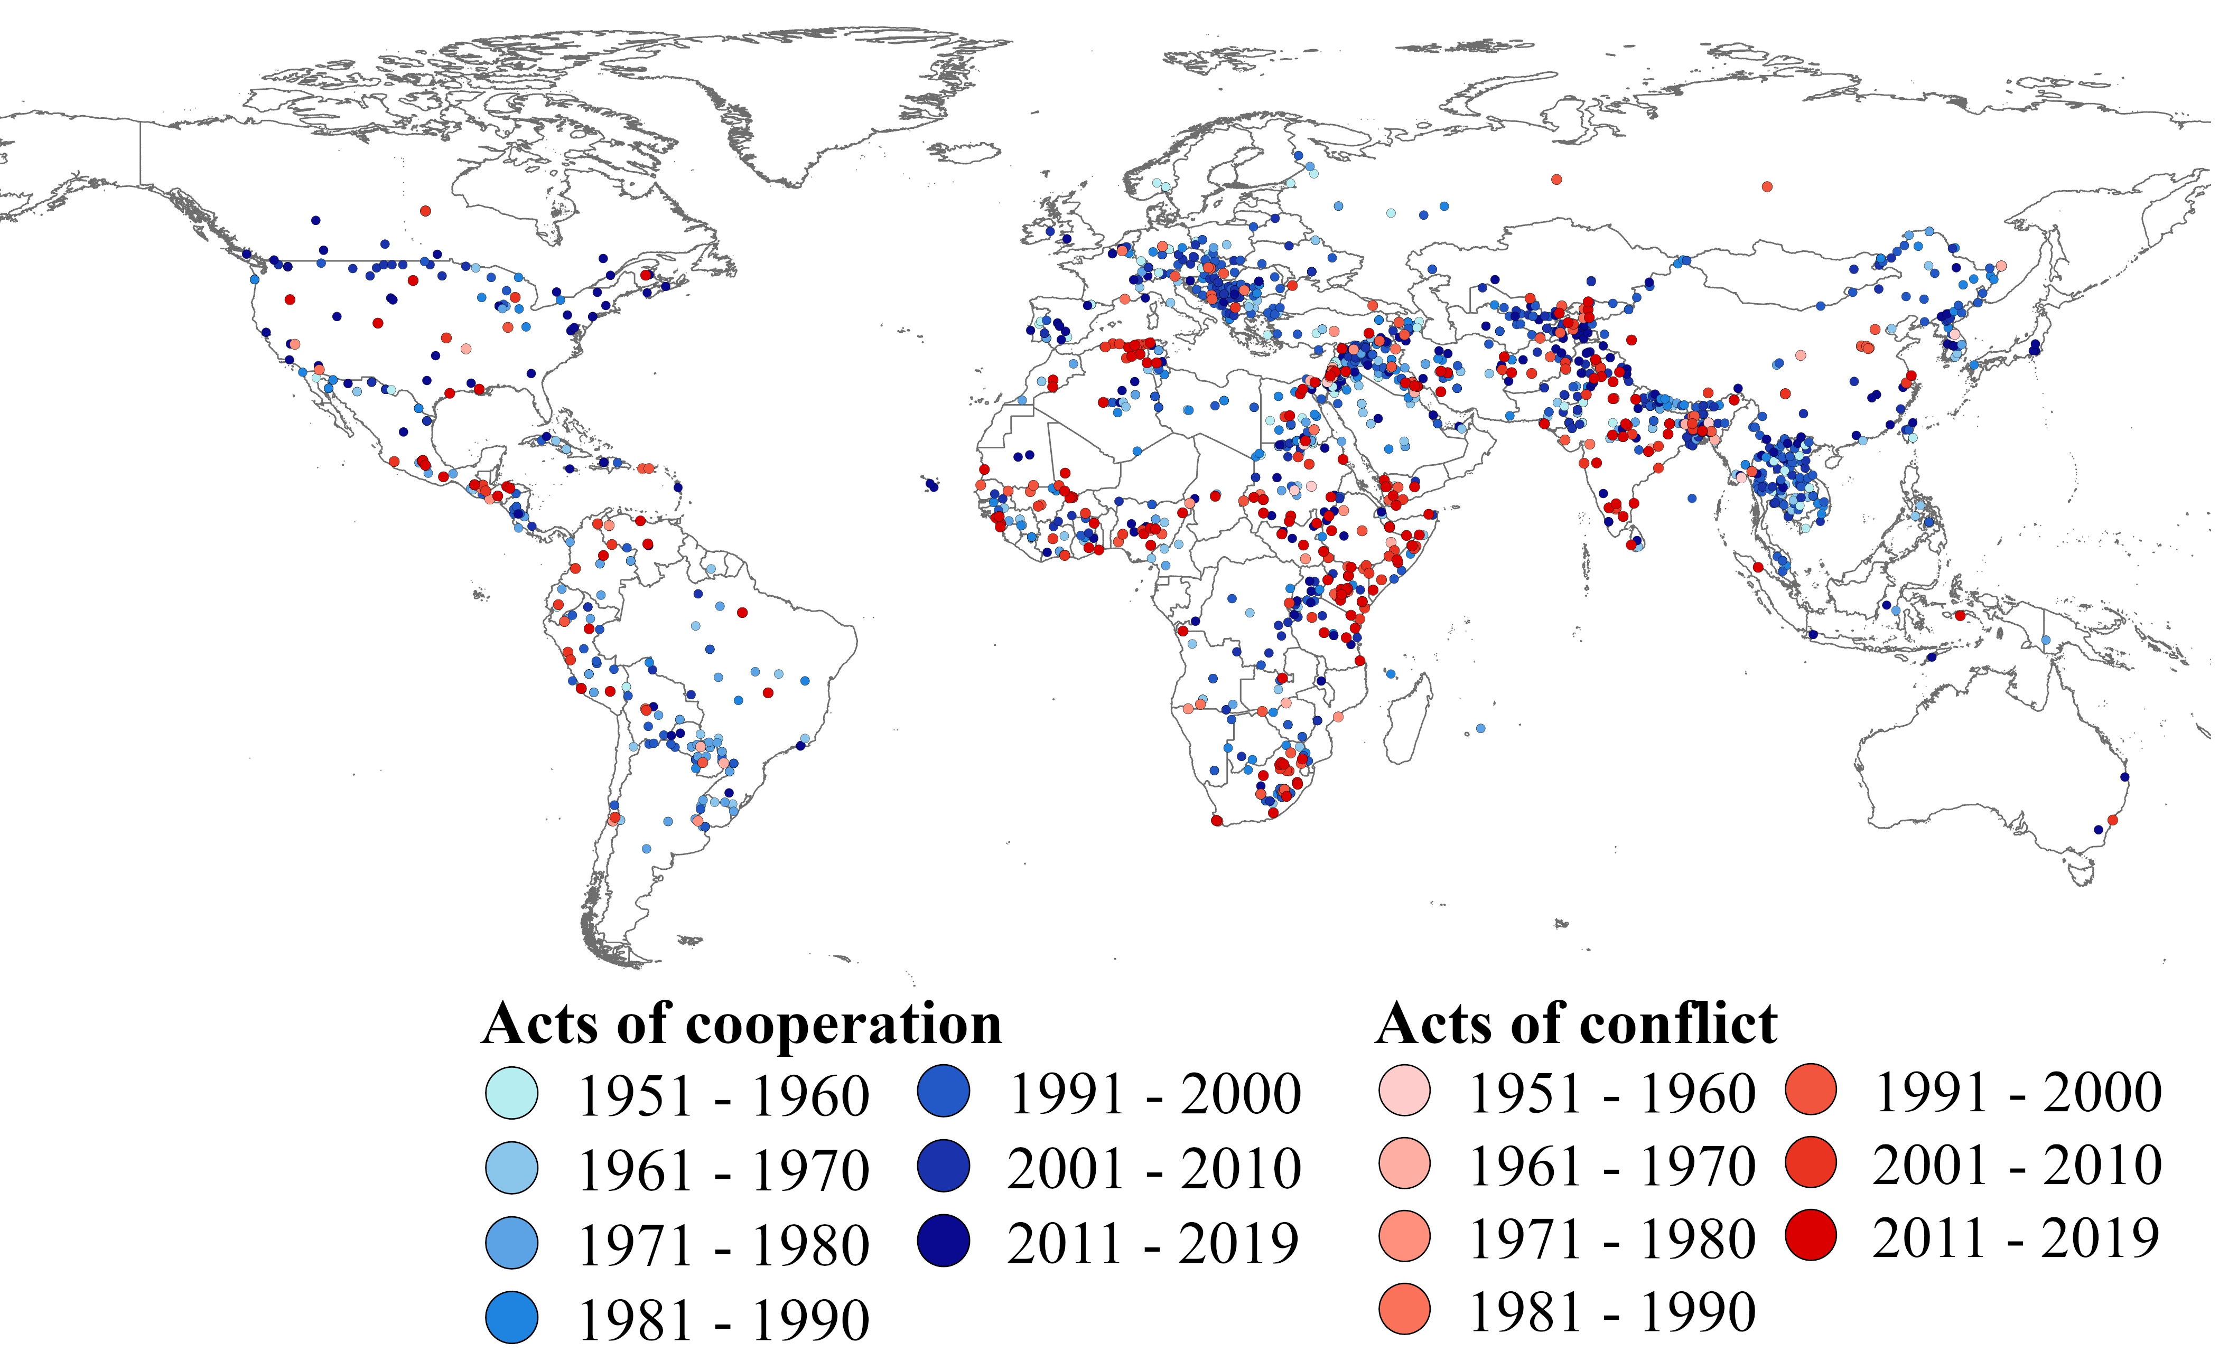
An openly available comprehensive water cooperation and conflict dataset
An extended more up-to-date event database was created by:
Merging the Water Conflict Chronology & Transboundary Freshwater Disputes Databases.
Extension of cooperation events beyond 2008 using a news search.
Water availability plays an important part, as dry areas tend to have both more conflict and cooperation.
Download dataset
CONFLICT – COOP TRENDS
HUMAN WATER CHANGE
REGIONAL
CHANGE & CONFLICT
GAPS
MAP
CONNECTIONS
COOPE-RATION
WHERE

Slide 3
Trends in cooperation and conflict events
Worrying trend
Conflicts have increased
Cooperation has decreased
The most changes have happened in Africa and Asia
Read the article
CONFLICT – COOP TRENDS
HUMAN WATER CHANGE
REGIONAL
CHANGE & CONFLICT
GAPS
MAP
CONNECTIONS
COOPE-RATION
WHERE

Slide 4
How have humans affected hydrological variables?
Analyzing human effects on hydrology using the Water Balance Model (WBM) with 2 scenarios: one including and one excluding human effects on hydrological flows
The colors in the figure represent increases (blue) or decreases (red) resulting from human activities.
Largest difference in highly populated areas
Dams also coincide with large-scale hydrological differences
Read the article
CONFLICT – COOP TRENDS
HUMAN WATER CHANGE
REGIONAL
CHANGE & CONFLICT
GAPS
MAP
CONNECTIONS
COOPE-RATION
WHERE

Slide 5
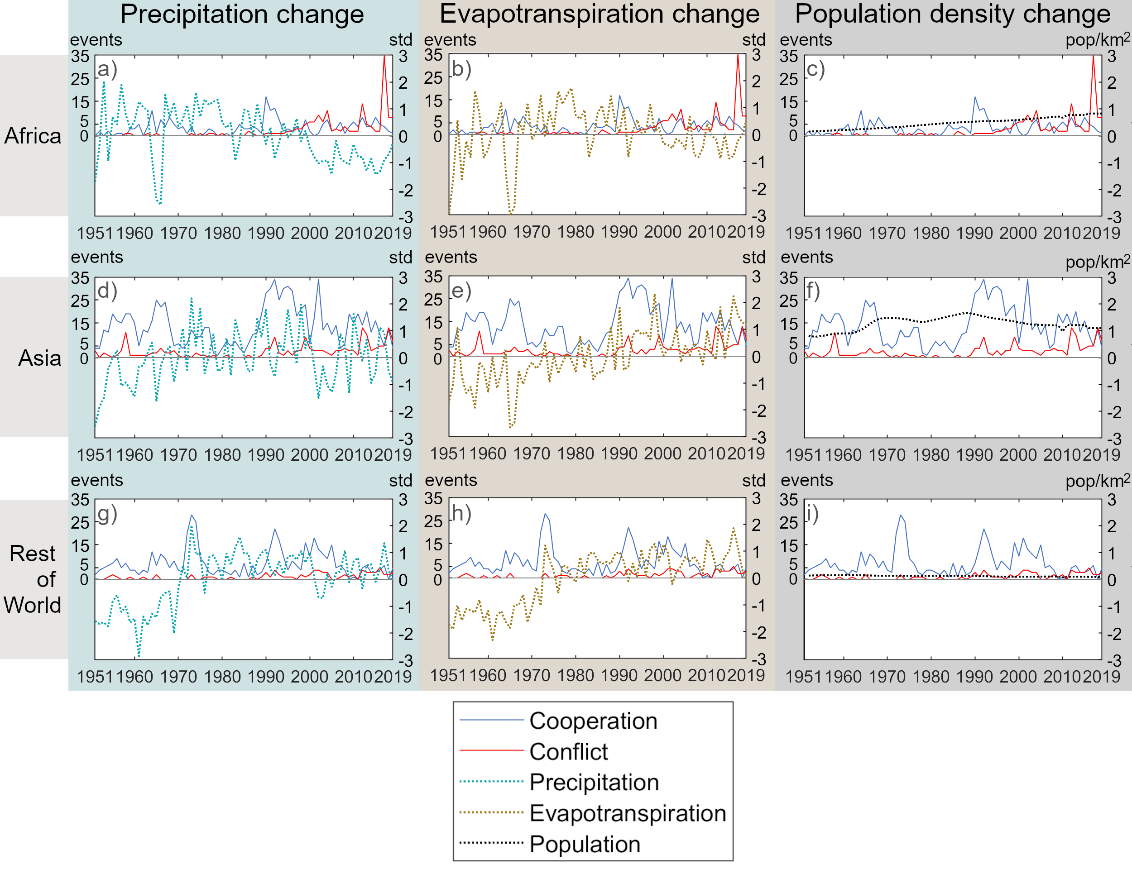
Regional hydrological changes and events
Africa: Shift coincided with prolonged drought (a)
Supported by event description relating to access to drinking water, water infrastructure, and farmer-herder conflicts
Asia: Shift coincided with increased evapotranspiration (e) caused by human activities such as dams and increased population density (f).
Supported by event descriptions relating to irrigation and dam construction.
Read the article
CONFLICT – COOP TRENDS
HUMAN WATER CHANGE
REGIONAL
CHANGE & CONFLICT
GAPS
MAP
CONNECTIONS
COOPE-RATION
WHERE

Slide 6
Distribution of Water Conflict Studies in a Changing Climate
Literature review on water conflict and what drives them in a changing climate
Majority of studies in Africa & part of Asia, corresponding to areas with the most water conflicts
More research is needed for other areas, especially as conflicts tend to be regionally different.
CONFLICT – COOP TRENDS
HUMAN WATER CHANGE
REGIONAL
CHANGE & CONFLICT
GAPS
MAP
CONNECTIONS
COOPE-RATION
WHERE

Slide 7
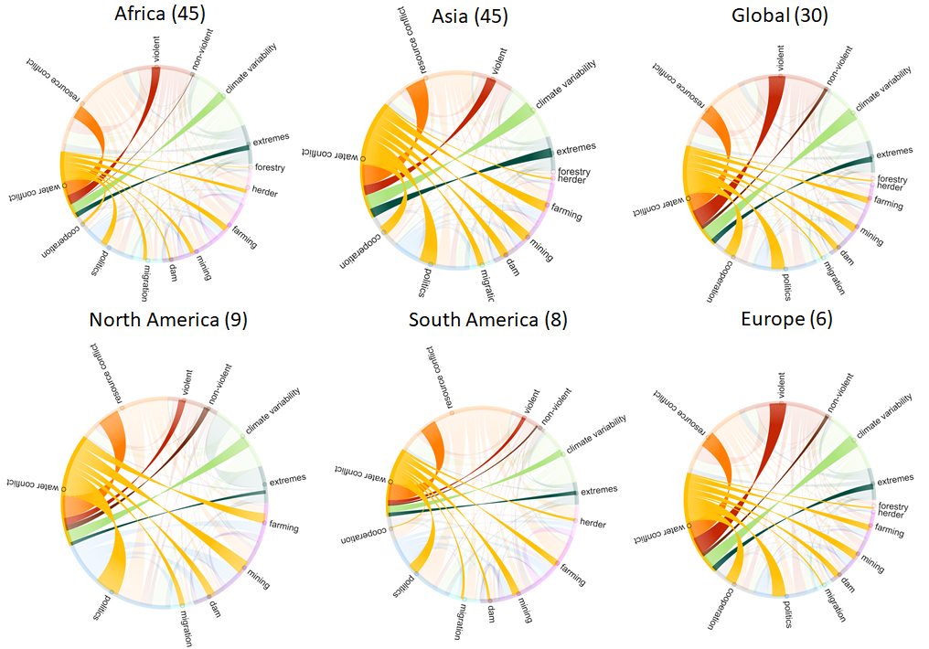
Regional Connections in Water Conflicts
Connection = mentioned in the article together when talking about conflicts
Water conflict & resource conflicts largely connected
Politics play an important part, especially for more affluent countries
Non-violent conflicts less mentioned despite being the majority of conflicts.
CONFLICT – COOP TRENDS
HUMAN WATER CHANGE
REGIONAL
CHANGE & CONFLICT
GAPS
MAP
CONNECTIONS
COOPE-RATION
WHERE

Slide 8
The water conflict – cooperation dilemma
Cooperation can mitigate future water conflicts in almost all situations
Reduction of expected conflicts from cooperation is 52% higher in areas with high water stress
However, cooperation is not effective at all for less affluent countries (lowest 25% GDP per capita) unless more affluent countries are involved.
The dilemma:
The richer countries have the leverage and power to cooperate and mitigate water conflict,
But they are sometimes active inducers of conflict as they can profit from water conflicts.
CONFLICT – COOP TRENDS
HUMAN WATER CHANGE
REGIONAL
CHANGE & CONFLICT
GAPS
MAP
CONNECTIONS
COOPE-RATION
WHERE

Slide 9
Contact me
Vote for me
elisie.karesdotter@natgeo.su.se
linkedin.com/in/elisie-karesdotter/
CONFLICT – COOP TRENDS
HUMAN WATER CHANGE
REGIONAL
CHANGE & CONFLICT
GAPS
MAP
CONNECTIONS
COOPE-RATION
WHERE

