Slide 1



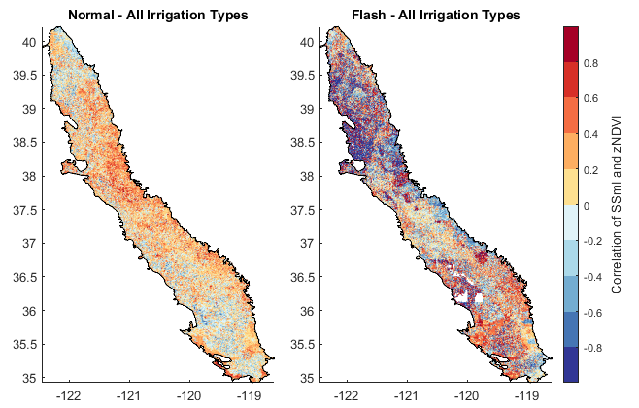

Hypothesis 2 - Aridity
Longer drought duration will result in more spatially homogeneous drought characteristics and more negative impacts on vegetation.
Hypothesis 3 - Irrigation
The aridity of a region will strongly impact the agricultural vegetation response of a region to drought.
Irrigation will provide a tempering effect on adverse vegetation responses to both flash and normal drought, independent of aridity.
Hypothesis 1 - Duration
A Comparison of Agriculture-related Characteristics of Flash and Traditional Drought
Not exactly…
Sarah Quỳnh Giang Hồ, Allan Buras, Ye Tuo
True, but…
Preprint available!
Not exactly…
Notes:
Hi everyone! My name is Sarah Ho and I’m excited to discuss with you today my research on the impacts of flash and traditional, or what I’ll call normal, drought on agriculture with an exemplary study in the California Central Valley. This work is concerned with the differences in the study area’s responses to these two types of drought, particularly as they relate to agriculture. And, as an aside, the preprint of this manuscript is currently under review and available to the public via the QR code.
This work is based on these three hypotheses. I wanted to know how duration, aridity, and irrigation would affect crop responses to normal and flash drought, which in this study is defined via soil moisture. Duration is explored in two ways: first, as a difference between the rapid onset and brevity of flash drought versus the typically longer and slower-developing normal drought; and secondly, within each drought type to see if longer duration necessarily means worse effects. Aridity is investigated to contextualize these responses in different climatic regimes. And lastly, irrigation is explored to determine its potential tempering impact on adverse responses.
Our work yielded some surprising results as they relate to these hypotheses, and I look forward to discussing them with you!

Slide 2





A Comparison of Agriculture-related Characteristics of Flash and Traditional Drought
Overview
Why soil moisture and
not evapotranspiration?
Drought Identification:
Flash vs Normal
Hypothesis 2 - Aridity
Longer drought duration and type will result in more spatially homogeneous drought characteristics and more negative impacts on vegetation.
Hypothesis 3 - Irrigation
The aridity of a region will strongly impact the agricultural vegetation response of a region to drought.
Irrigation will provide a tempering effect on adverse vegetation responses to both flash and normal drought, independent of aridity.
Hypothesis 1 - Duration
Conclusions
Methods: Relative Duration
Sarah Quỳnh Giang Hồ, Allan Buras, Ye Tuo
^{PICO Spot 3b.2}
^{Abstract}
^{sarah.ho@kit.edu}
^{@SarahQuynhGiang}
Conclusions
Methods: Aridity
Conclusions
Methods: Vegetation Response
Study Area: The
California Central Valley
Study Area:
Datasets

Slide 3
A Comparison of Agriculture-related Characteristics of Flash and Traditional Drought
Overview
Use the arrows for a step-by-step walkthrough!
Navigate to a specific page using the orange buttons!
This takes you back to the title page!
OSPP Voting
Article Preprint
Sarah Quỳnh Giang Hồ, Allan Buras, Ye Tuo
^{PICO Spot 3b.2}
^{sarah.ho@kit.edu}
^{@SarahQuynhGiang}
Tap on an image to see an enlarged version (if available)!
The golden poppy is California’s state flower and a personal favorite of the corresponding author ☺

Slide 4
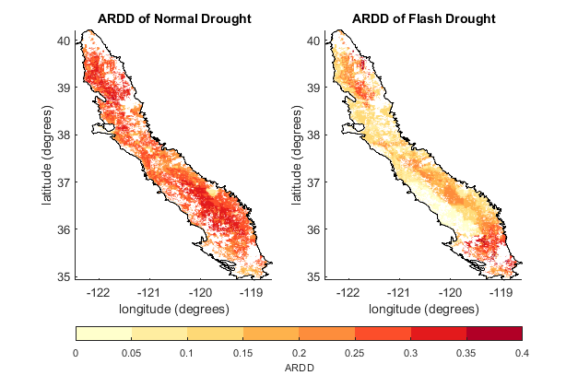
Overview
Drought Identification per Li et al. (2020)
using Standardized Soil Moisture
Flash Drought
Normal Drought
Determine Characteristics and Spatial Distributions
Average Relative Drought Duration
Vegetation Response
25-60 days in length
Meets rapid intensification criteria
25+ days in length
Average fraction of time a given pixel spends in drought events [%]
Correlation with NDVI z-score
Investigate Relationships
Relative Duration and Vegetation Response
Aridity and Vegetation Response
Irrigation and Vegetation Response
Effects of soil texture
Contribution of soil moisture
Impact of aridity
4

Slide 5
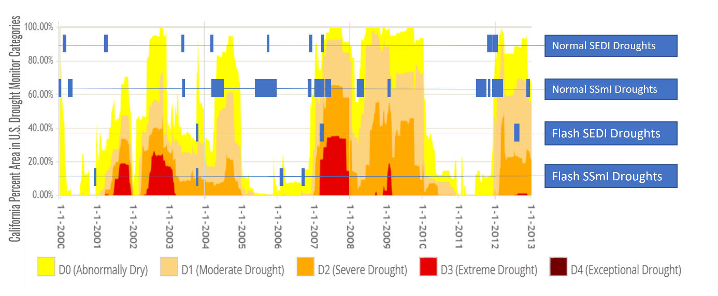
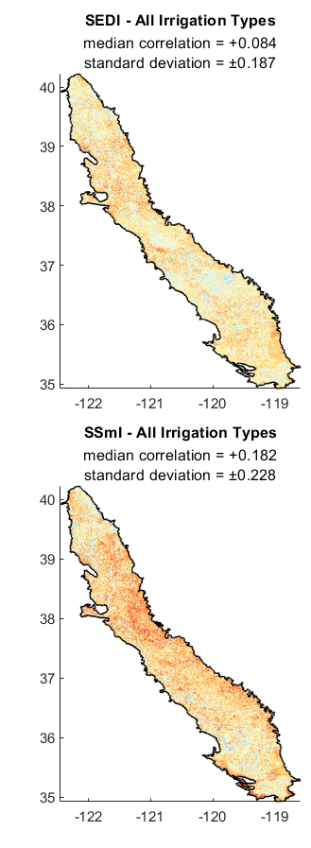
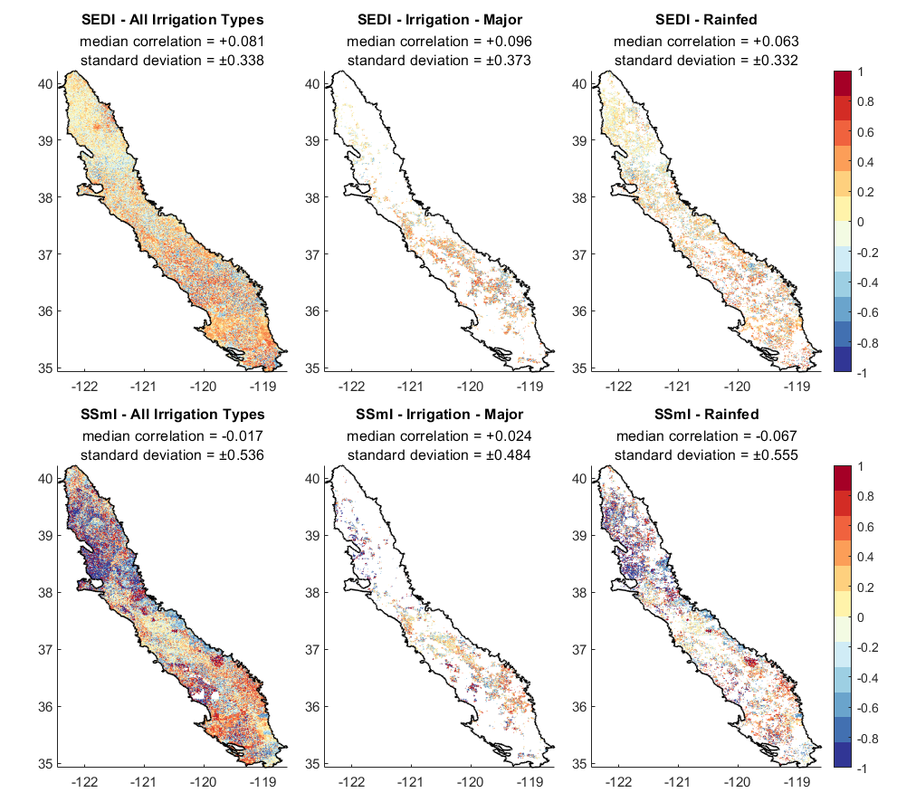
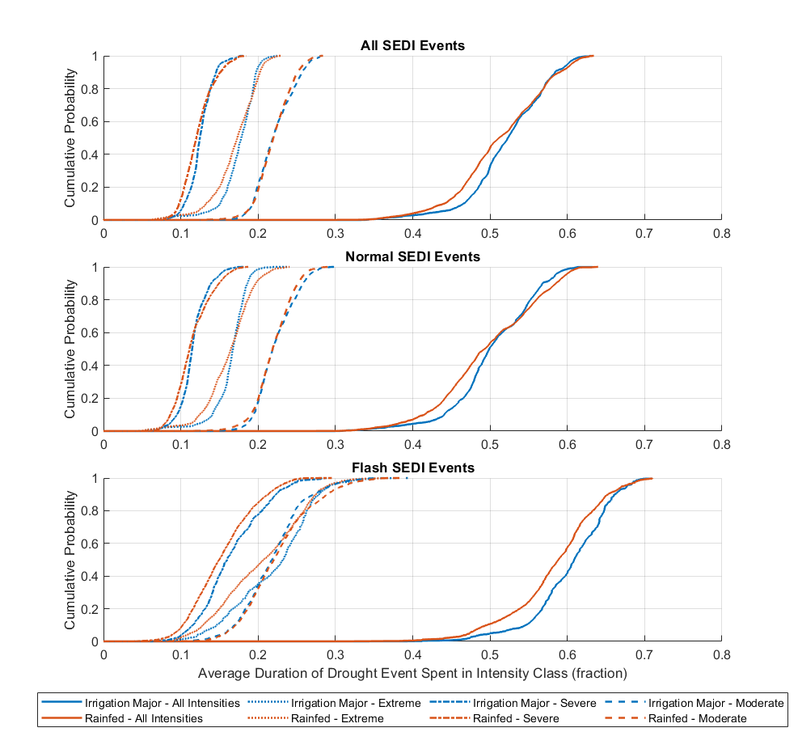
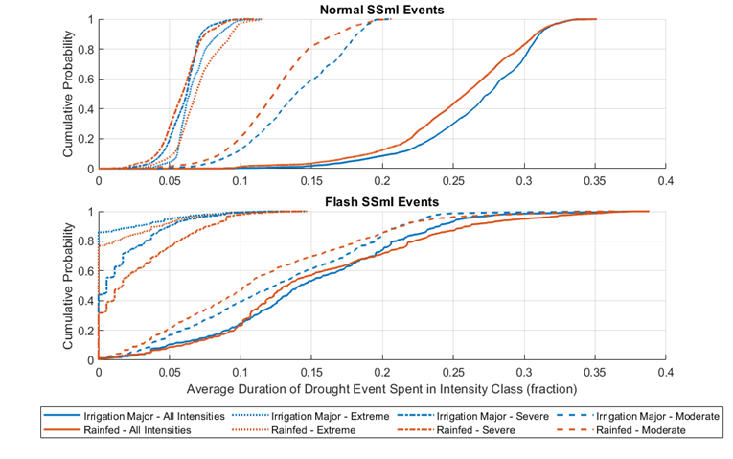
Why soil moisture and
not evapotranspiration?
Sarah Quỳnh Giang Hồ, Allan Buras, Ye Tuo
A Comparison of Agriculture-related Characteristics of Flash and Traditional Drought
More drought events
Drought Identification:
Flash vs Normal
More drastic change in behavior between flash and normal
Clearer spatial patterns

Slide 6
Sarah Quỳnh Giang Hồ, Allan Buras, Ye Tuo
A Comparison of Agriculture-related Characteristics of Flash and Traditional Drought
Why soil moisture and
not evapotranspiration?

Slide 7
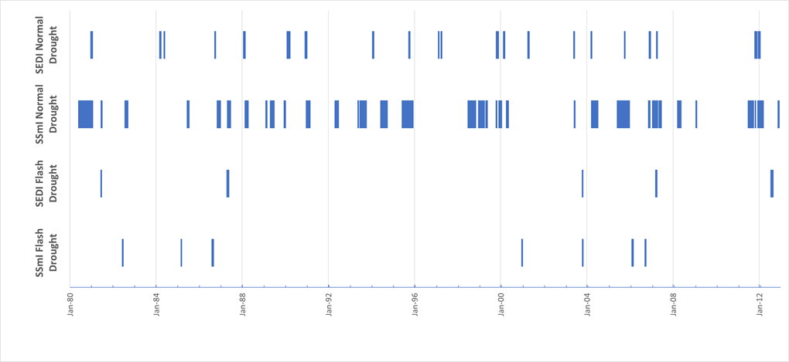
Flash and normal SEDI droughts tend to alight well (at least temporally) with SSmI droughts
Sarah Quỳnh Giang Hồ, Allan Buras, Ye Tuo
A Comparison of Agriculture-related Characteristics of Flash and Traditional Drought
Drought Identification:
Flash vs Normal

Slide 8
Sarah Quỳnh Giang Hồ, Allan Buras, Ye Tuo
A Comparison of Agriculture-related Characteristics of Flash and Traditional Drought
Why soil moisture and
not evapotranspiration?

Slide 9
Sarah Quỳnh Giang Hồ, Allan Buras, Ye Tuo
A Comparison of Agriculture-related Characteristics of Flash and Traditional Drought
Why soil moisture and
not evapotranspiration?

Slide 10
Study Area: The California Central Valley
Study Area: Datasets
Sarah Quỳnh Giang Hồ, Allan Buras, Ye Tuo
A Comparison of Agriculture-related Characteristics of Flash and Traditional Drought
The northern half of the study region (above 38th parallel) tends to be cooler and wetter than the southern half

Slide 11
Study Area: Datasets
Study Area: The
California Central Valley
Methods: Vegetation Response
Sarah Quỳnh Giang Hồ, Allan Buras, Ye Tuo
A Comparison of Agriculture-related Characteristics of Flash and Traditional Drought
Methods: Aridity
Drought Identification:
Flash vs Normal
Data Type | Source | Period | Use
Digital elevation map | SRTM (NASA-JPL 2013) | - | Calculate ET (for aridity)
Root zone SM, P, components for ET | WLDAS (Erlingis et al., 2021) | 1 Jan 1980 – 31 Dec 2012 | Calculate ET, aridity, SSmI for drought identification
Normalized Difference Vegetation Index (NDVI) | MODIS (Spruce et al., 2016) | 1 Jan 2000 – 31 Dec 2012 | Calculate vegetation response
Irrigation crop mask | GFSAD 1km (Teluguntla et al., 2015) | 2010 | Determining irrigation type
Historical drought data | USDM (Svoboda et al., 2002) | 1 Jan 2000 – 31 Dec 2012 | Validating drought identification
Soil texture | California Soil Resource Lab (Walkinshaw et al., 2022) | - | Calculate permanent wilting point

Slide 12
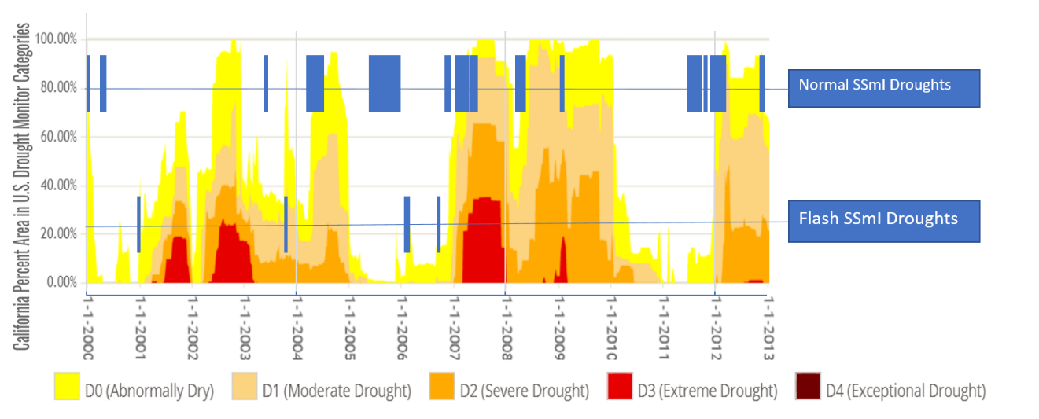
Drought Identification: Flash vs Normal
Sarah Quỳnh Giang Hồ, Allan Buras, Ye Tuo
A Comparison of Agriculture-related Characteristics of Flash and Traditional Drought
Calculate Standardized Indices
Standardized Soil Moisture Index
Find spatially connected drought clusters
Clusters are adjacent pixels with an index value of -1 or less
Determine length and intensification criteria
5-day scale
At least 1.6% of study area
Flash drought: 25-60 days; sufficiently rapid intensification
Normal drought:
25+ days, no intensification criteria
Methods: More Details about the Standardized Index Calculation
Methods: More Details about the Drought Identification Method
(Li et al., 2020)

Slide 13
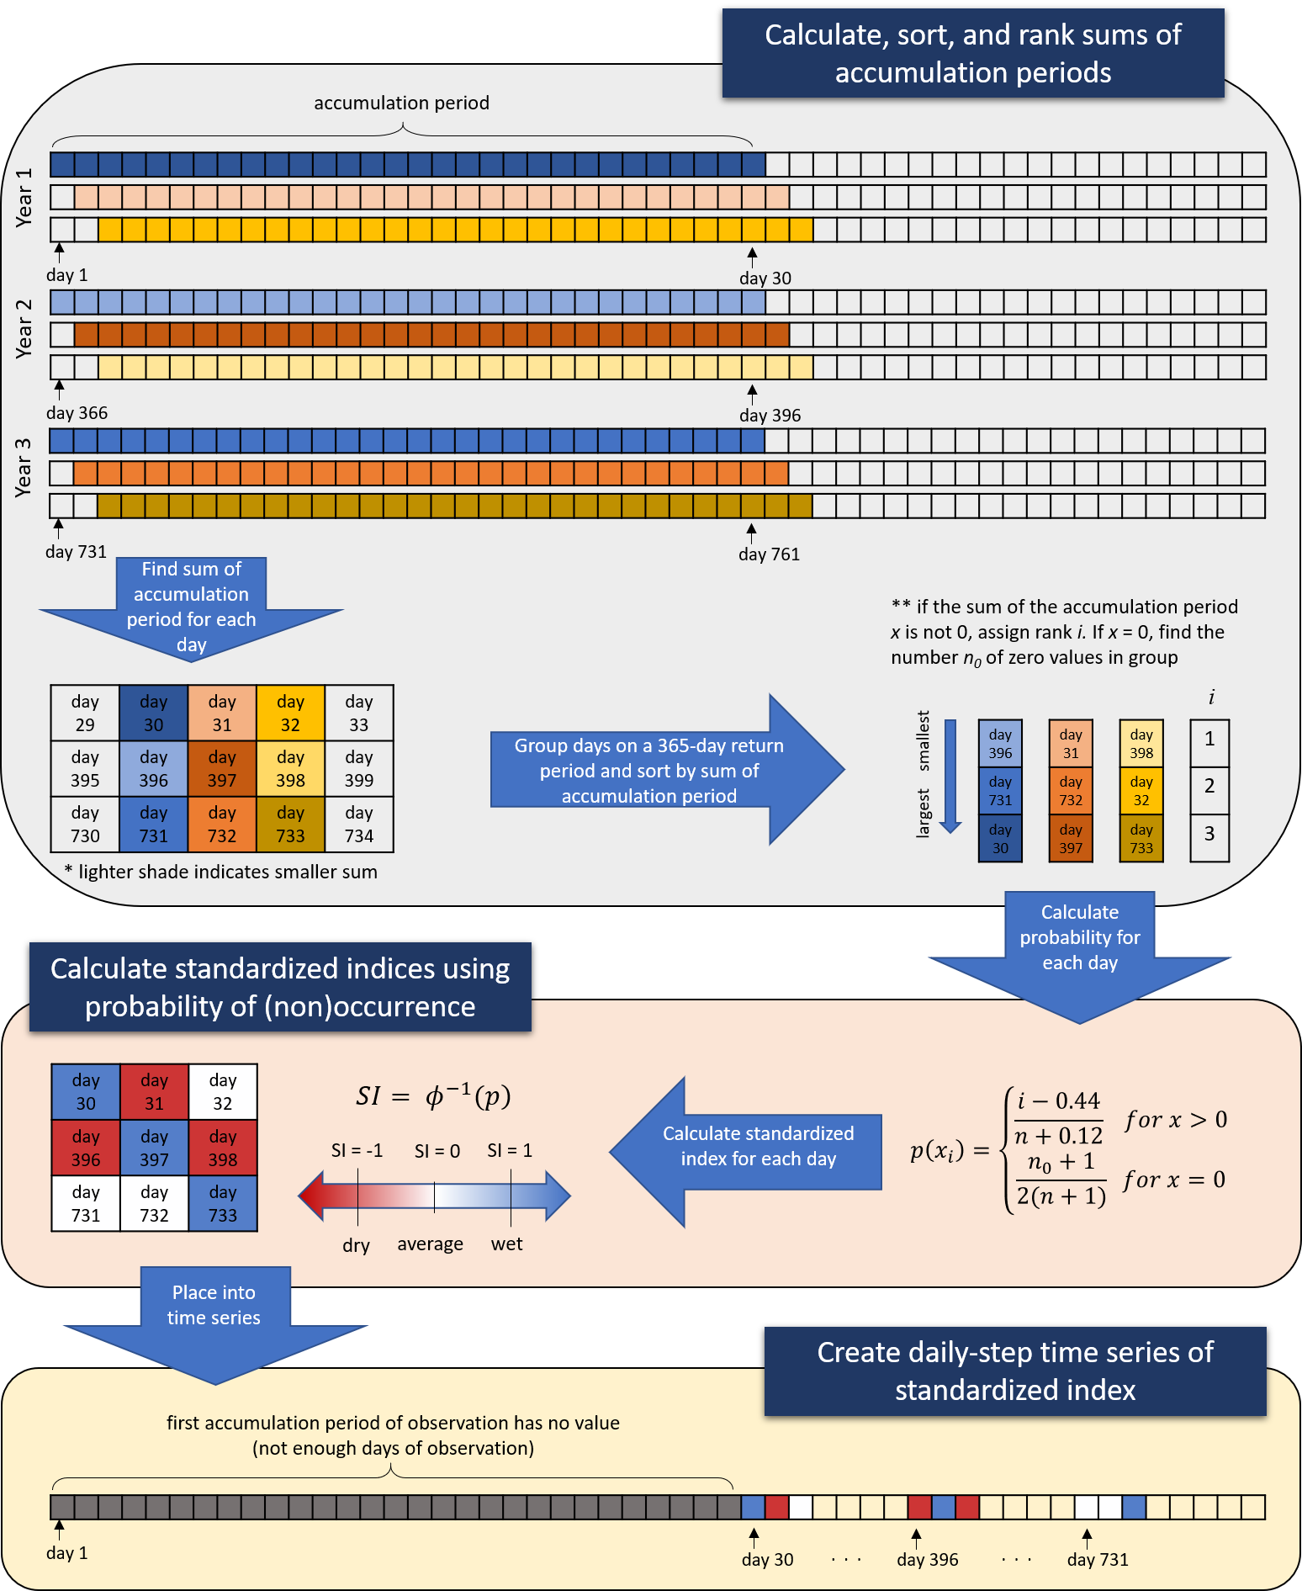
Methods: More Details about the Standardized Index Calculation
Sarah Quỳnh Giang Hồ, Allan Buras, Ye Tuo
A Comparison of Agriculture-related Characteristics of Flash and Traditional Drought
Graphic used with permission from (Ho et al., 2021)
Drought Identification:
Flash vs Normal
Using the Gringorten plotting position to avoid distribution fitting
(Farahmand & AghaKouchak, 2015)
Using the Weibull non-exceedance probability to deal with potential zero-data occurrences (Stagge et al., 2015)

Slide 14
Methods: More Details about the Drought Identification Method (1)
Adapted from (Li et al., 2020)
Sarah Quỳnh Giang Hồ, Allan Buras, Ye Tuo
A Comparison of Agriculture-related Characteristics of Flash and Traditional Drought
Find clusters whose size is 1.6% of study area
Clusters are adjacent pixels with SI <= -1
Check for spatial connection of clusters between time steps
Spatial connection = overlap area that is 50% the area of the smaller cluster and 1.6% the area of the study region
Find 25+ consecutive days with spatially connected clusters
These are drought events!
Day 1
Day 3
Drought Identification:
Flash vs Normal
Day 2

Slide 15
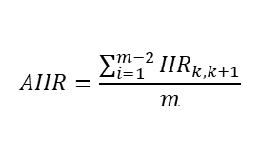
Methods: More Details about the Drought Identification Method (2)
Adapted from (Li et al., 2020)
Sarah Quỳnh Giang Hồ, Allan Buras, Ye Tuo
A Comparison of Agriculture-related Characteristics of Flash and Traditional Drought
Find development phase using the drought patch intensity (DPI)
Calculate the instantaneous (IIR) and average intensification rates (AIIR)
Apply flash drought identification criteria
Duration of 25-60 days
$$DPI= \sum_{i=1}^{n}{SI}$$
𝐷𝑃𝐼= ∑26_(𝑖=1)^𝑛▒𝑆𝐼
Development phase = time to lowest DPI
AIIR <= 45th percentile of development phase IIR
Drought Identification:
Flash vs Normal
$$AIIR=\frac{\sum_{i=1}^{m−2}{{IIR}_{k,k+1}}}{m}$$

Slide 16
Methods: More Details about the Drought Identification Method (3)
Adapted from (Li et al., 2020)
Sarah Quỳnh Giang Hồ, Allan Buras, Ye Tuo
A Comparison of Agriculture-related Characteristics of Flash and Traditional Drought
The original method recommends a second flash drought intensification criterion: there must be at least one timestep where the IIR is less than or equal to the 25th percentile of the change in cumulative standard value (CSV):
Additionally, while the original method used the 40th percentile, we decided to use the 45th percentile because it yielded a similar occurrence rate in SEDI- and SSmI-defined drought
Drought Identification:
Flash vs Normal
However, since this study uses a daily time step, the change in CSV is equivalent to the IIR:
Thus this second criterion is superfluous and is omitted.

Slide 17
This event in June of 2011 met the intensification criteria, but was too long (107 days) to be considered flash drought
Sarah Quỳnh Giang Hồ, Allan Buras, Ye Tuo
A Comparison of Agriculture-related Characteristics of Flash and Traditional Drought
Drought Identification:
Flash vs Normal
34 events were identified from 1980-2012; 13 of which were between 2000-2012
7 events were identified from 1980-2012; 4 of which were between 2000-2012

Slide 18
Methods: Vegetation Response
z-Score: Contextualizing today’s NDVI
$${zNDVI}_{ijk}=\frac{{NDVI}_{ijk}−{\overline{NDVI}}_{ij} }{σ_{ij}}$$
〖𝑧𝑁𝐷𝑉𝐼〗_𝑖𝑗𝑘=(〖𝑁𝐷𝑉𝐼〗_𝑖𝑗𝑘−(𝑁𝐷𝑉𝐼) ̅_𝑖𝑗 )/𝜎_𝑖𝑗
i = specific pixel
j = timestep in year
k = year
Normalized Difference Vegetation Index (NDVI)
Measure of vegetation greenness
Correlation with SSmI
During drought events
Lacks historical contextualization
Statistically significant correlations (p < 0.05)
Sarah Quỳnh Giang Hồ, Allan Buras, Ye Tuo
A Comparison of Agriculture-related Characteristics of Flash and Traditional Drought
Adverse Response
Beneficial Response

Slide 19
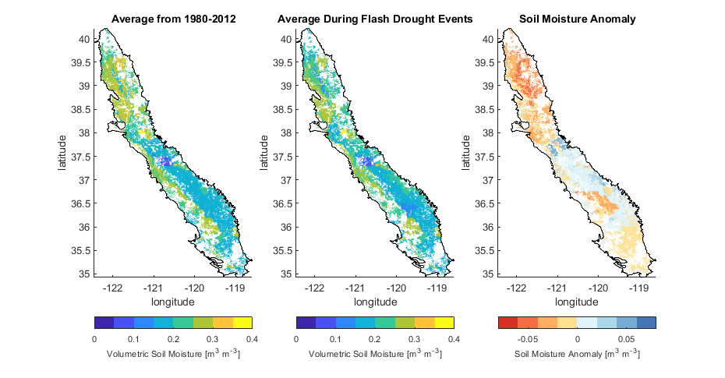
Adverse Response
Sarah Quỳnh Giang Hồ, Allan Buras, Ye Tuo
A Comparison of Agriculture-related Characteristics of Flash and Traditional Drought
Overview
The beneficial responses could also be due to soil moisture never reaching critical conditions
Study Area: The
California Central Valley
Methods: Vegetation Response
Conclusions – Duration
More beneficial responses in the northern and more humid half of the region, possibly because flash drought conditions can result in more radiation / sun / heat, which may be good for plants
Beneficial Response
Conclusions – Aridity

Slide 20
The decreased soil moisture during flash drought events doesn’t seem to reach the permanent wilting point– this indicates that despite drought conditions, there is still adequate water for plants
Sarah Quỳnh Giang Hồ, Allan Buras, Ye Tuo
A Comparison of Agriculture-related Characteristics of Flash and Traditional Drought
Methods: Vegetation Response

Slide 21
Flash drought distributions seem quite random, but irrigated shows a hint of a normal distribution
Sarah Quỳnh Giang Hồ, Allan Buras, Ye Tuo
Irrigated normal drought leans closer to 0
A Comparison of Agriculture-related Characteristics of Flash and Traditional Drought
Methods: Vegetation Response
Conclusions – Irrigation

Slide 22
Methods: Relative Duration
Relative Drought Duration
For a single drought event,
Average Relative Drought Duration (ARDD)
The average of the RDs for all events
$$RDD= \frac{days spent in drought}{total length of drought}$$
𝑅𝐷𝐷= (𝑑𝑎𝑦𝑠 𝑠𝑝𝑒𝑛𝑡 𝑖𝑛 𝑑𝑟𝑜𝑢𝑔ℎ𝑡)/(𝑡𝑜𝑡𝑎𝑙 𝑙𝑒𝑛𝑔𝑡ℎ 𝑜𝑓 𝑑𝑟𝑜𝑢𝑔ℎ𝑡)
$${ARDD}_{i}= \frac{\sum_{1}^{n}{{RDD}_{i}}}{n}$$
〖𝐴𝑅𝐷𝐷〗_𝑖= (∑2_1^𝑛▒〖𝑅𝐷𝐷〗_𝑖 )/𝑛
Describes persistence or prominence in drought events
Sarah Quỳnh Giang Hồ, Allan Buras, Ye Tuo
A Comparison of Agriculture-related Characteristics of Flash and Traditional Drought

Slide 23
Sarah Quỳnh Giang Hồ, Allan Buras, Ye Tuo
A Comparison of Agriculture-related Characteristics of Flash and Traditional Drought
Spatial patterns of ARDD in flash drought seem more similar to permanent wilting point than to aridity
Overview
Study Area: The
California Central Valley
Methods: Relative Duration
Conclusions – Duration

Slide 24
This definition of flash drought seems to favor rapidly spreading drought over rapidly intensifying
Sarah Quỳnh Giang Hồ, Allan Buras, Ye Tuo
A Comparison of Agriculture-related Characteristics of Flash and Traditional Drought
Methods: Relative Duration

Slide 25
Methods: Aridity
Calculate Aridity
Calculate Actual Evapotranspiration
Using the FAO-56 Penman-Monteith equation
$$Aridity= \frac{\sum{Precipitation}}{\sum{Potential ET}}$$
𝐴𝑟𝑖𝑑𝑖𝑡𝑦= (∑1▒𝑃𝑟𝑒𝑐𝑖𝑝𝑖𝑡𝑎𝑡𝑖𝑜𝑛)/(∑1▒〖𝑃𝑜𝑡𝑒𝑛𝑡𝑖𝑎𝑙 𝐸𝑇〗)
Lower aridity = drier
Sarah Quỳnh Giang Hồ, Allan Buras, Ye Tuo
A Comparison of Agriculture-related Characteristics of Flash and Traditional Drought

Slide 26
Sarah Quỳnh Giang Hồ, Allan Buras, Ye Tuo
A Comparison of Agriculture-related Characteristics of Flash and Traditional Drought
Methods: Aridity

Slide 27
Sarah Quỳnh Giang Hồ, Allan Buras, Ye Tuo
A Comparison of Agriculture-related Characteristics of Flash and Traditional Drought
ARDD is mostly independent of aridity—this is unsurprising, since the soil moisture data does not include added water from irrigation
Conclusions – Duration

Slide 28
Sarah Quỳnh Giang Hồ, Allan Buras, Ye Tuo
A Comparison of Agriculture-related Characteristics of Flash and Traditional Drought
While improvement due to very short flash drought conditions does make sense, we would expect the vegetation response to worsen with increasing duration. This is not the case in most of these scenarios
Conclusions – Duration

Slide 29
Sarah Quỳnh Giang Hồ, Allan Buras, Ye Tuo
A Comparison of Agriculture-related Characteristics of Flash and Traditional Drought
Irrigation generally seems to improve the vegetation response in both forms of drought
Conclusions – Irrigation
This aridity band (arid regions) shows less improvement than expected
This aridity band (drier semi-arid regions) shows the greatest improvement between irrigated and rainfed

Slide 30
Additional hotspots are likely due to more pixels within that aridity band
Sarah Quỳnh Giang Hồ, Allan Buras, Ye Tuo
A Comparison of Agriculture-related Characteristics of Flash and Traditional Drought
Conclusions – Irrigation
Strong occurrence of improved vegetation in cooler arid regions

Slide 31
A Comparison of Agriculture-related Characteristics of Flash and Traditional Drought
Conclusion: Hypothesis 1 – Duration
Longer drought duration and type result in more spatially homogeneous drought characteristics.and more negative impacts on vegetation.
Hypothesis 1 - Duration
While longer normal drought does indeed have more negative impacts on vegetation, longer duration within a type does not necessarily indicate a more negative response.
Sarah Quỳnh Giang Hồ, Allan Buras, Ye Tuo
Methods: Relative Duration
Methods: Vegetation Response
Drought Identification:
Flash vs Normal

Slide 32
Conclusion: Hypothesis 2 – Aridity
The aridity of a region strongly impacts the agricultural vegetation response of a region to drought, but not as strongly as expected.
Hypothesis 2 - Aridity
Specifically, more humid regions tend to benefit short-term due to lack of actual plant water deficits.
Sarah Quỳnh Giang Hồ, Allan Buras, Ye Tuo
A Comparison of Agriculture-related Characteristics of Flash and Traditional Drought
Methods: Vegetation Response
Methods: Aridity

Slide 33
Conclusion: Hypothesis 3 – Irrigation
Irrigation provides a tempering effect on adverse vegetation responses to both flash and normal drought, independent of aridity. though the impacts seem to differ with aridity.
Hypothesis 3 - Irrigation
While overall, irrigation does seem to reduce adverse vegetation response, the impact seems to vary with aridity.
Sarah Quỳnh Giang Hồ, Allan Buras, Ye Tuo
A Comparison of Agriculture-related Characteristics of Flash and Traditional Drought
Methods: Aridity
Methods: Vegetation Response

Slide 34
Thanks for stopping by!
Sarah Quỳnh Giang Hồ, Allan Buras, Ye Tuo
Hypothesis 2 - Aridity
Longer drought duration and type result in more spatially homogeneous drought characteristics.and more negative impacts on vegetation.
Hypothesis 3 - Irrigation
The aridity of a region strongly impacts the agricultural vegetation response of a region to drought, but not as strongly as expected.
Irrigation provides a tempering effect on adverse vegetation responses to both flash and normal drought, independent of aridity. though the impacts seem to differ with aridity.
Hypothesis 1 - Duration
While longer normal drought does indeed have more negative impacts on vegetation, longer duration within a type does not necessarily indicate a more negative response.
Specifically, more humid regions tend to benefit short-term due to lack of actual plant water deficits.
While overall, irrigation does seem to reduce adverse vegetation response, the impact seems to vary with aridity.
A Comparison of Agriculture-related Characteristics of Flash and Traditional Drought
Preprint available!
OSPP Voting
^{sarah.ho@kit.edu}
^{@SarahQuynhGiang}

