Slide 1
Impact-based seasonal rainfall forecasting to trigger early action for droughts
Tim Busker, Hans de Moel, Bart van den Hurk and Jeroen Aerts
PhD candidate @ VU Amsterdam
tim.busker@vu.nl

Slide 2
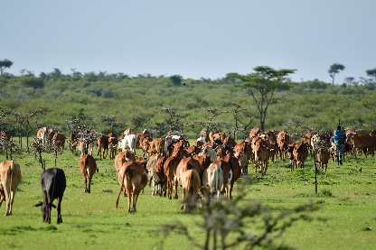
“Below-normal’’ seasonal rainfall leads to a constellation of drought impacts
Environmental impacts
$$Cattle prices$$
Below-normal rainfall?

Slide 3
“Below-normal’’ seasonal rainfall leads to a constellation of drought impacts
Direct livestock impacts
$$Cattle prices$$
Below-normal rainfall?

Slide 4
“Below-normal’’ seasonal rainfall leads to a constellation of drought impacts
Direct human impacts
$$Cattle prices$$
Below-normal rainfall?

Slide 5
The Potential Economic Value (PEV) of SEAS5 rainfall forecasts
The way to translate forecasts to concrete action triggers
Potential Economic Value (PEV) $= \frac{E_{C}−E_{F}}{E_{C}−E_{P}}$
$$October−November−December \left(OND\right) season$$

Slide 6
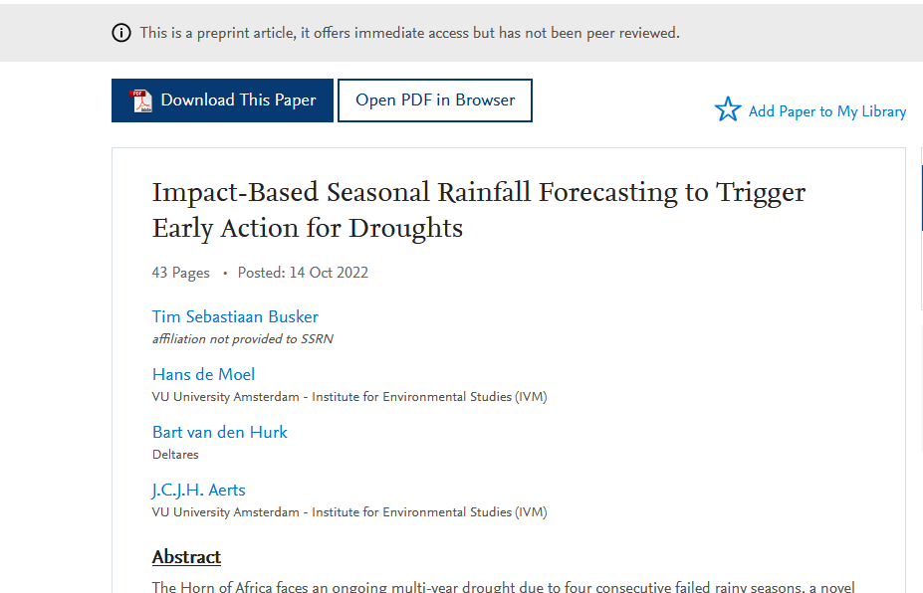
Thank you for listening!
The paper
The DOWN2EARTH project
Busker, T. S., de Moel, H., van den Hurk, B., & Aerts, J. C. J. H. (2023). Impact-Based Seasonal Rainfall Forecasting to Trigger Early Action for Droughts. Science of the Total Environment (under Review). https://doi.org/10.2139/SSRN.4247666

Slide 7
Supplementary material

Slide 8
Early action for droughts in East Africa is often cost-efficient
Action trigger
MAM
OND
Impact reduction
Expenses (€)
Seas5 drought early-warning
Action costs
Expenses without early-action
Trigger level
Expenses with early-action
Total rainfall
January | February | March | April | May | June | July | August | September | October | November | December

Slide 9
CHIRPS rainfall climatology in mm/month (1981-2020)

Slide 10
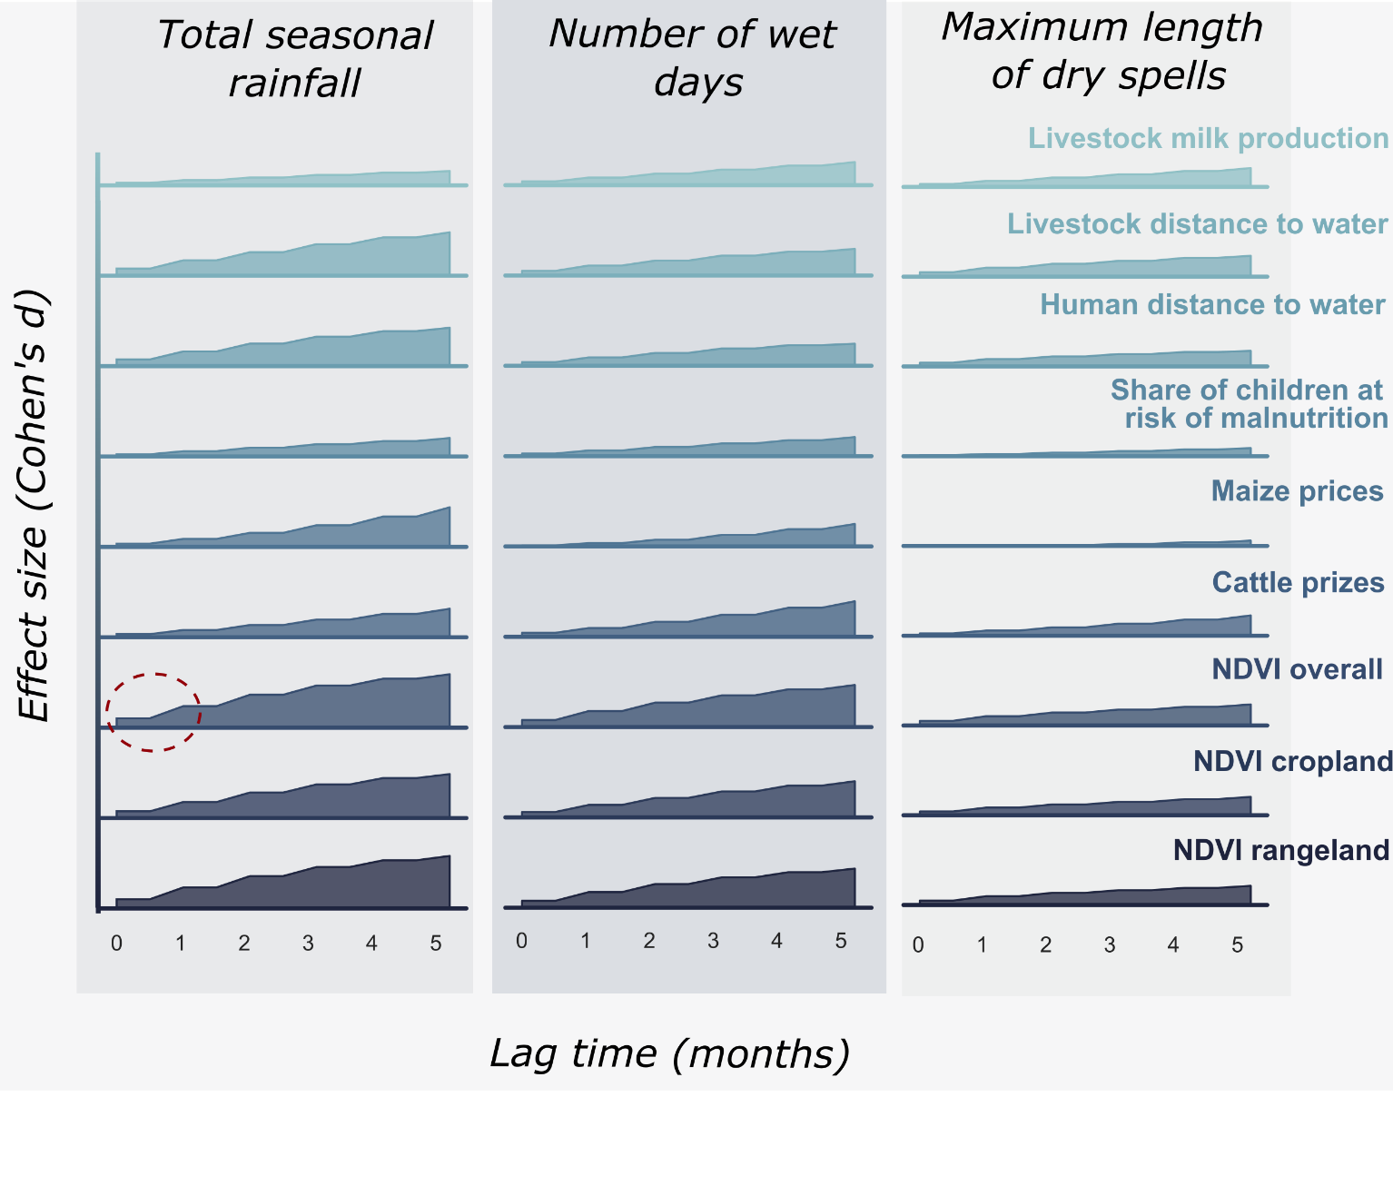
Total seasonal rainfall was found to be the most impactfull rainfall indicator
Based on >10 years of drought impact data from Kenya
$$Effect on impact development (Cohen^{′}s D)$$

Slide 11
Forecast validation of ECMWF SEAS5 as input to the PEV analysis
Hindcasts of MAM and OND total precipitation, covering the 1981-2021 period;
Lead times of 7 months, 25 ensemble members on a 0.4 degree lat/lon grid;
CHIRPS rainfall dataset as reference;
Skill score: ROC-AUC
Classified droughts as <33th percentile (i.e. below-normal) of seasonal climatology for both OND and MAM season

Slide 12
The Potential Economic Value (PEV) to trigger action
The way to translate forecasts to concrete action triggers
$$Savings using forecasts$$
P𝑜𝑡𝑒𝑛𝑡𝑖𝑎𝑙 𝐸𝑐𝑜𝑛𝑜𝑚𝑖𝑐 𝑉𝑎𝑙𝑢𝑒 (𝑃𝐸𝑉)
$$\frac{E_{C}−E_{F}}{E_{C}−E_{P}}$$
=
$$Savings using perfect forecast$$
$$E_{\begin{aligned}C \\ \end{aligned}}=Expenses without forecasts$$
$E_{F}$ $=Expenses using realistic forecasts$
$$E_{P}=Expenses using perfect forecasts$$

Slide 13
The Potential Economic Value (PEV) for the two main rainy seasons (MAM and OND)
$$March−April−May$$
$$\left(MAM\right)$$
$$rainy season$$
$$October−November−December$$
$$\left(OND\right)$$
$$rainy season$$

Slide 14
Triggering action on ensemble forecasts
Early warning
Early action
Seas5 drought forecast
threshold
Total rainfall

Slide 15
Triggering action on ensemble forecasts
Early warning
Early action
Seas5 drought forecast
threshold
Total rainfall

Slide 16
Triggering action on ensemble forecasts
Early warning
Early action
Seas5 drought forecast
threshold
Action costs (C)
Total rainfall
Cost-loss ratio =
Action benefit (prevented loss) (L)

Slide 17
The Potential Economic Value (PEV) of SEAS5 forecasts
Setting concrete action triggers under uncertainty
}
Probability on below-normal rainfall

Slide 18
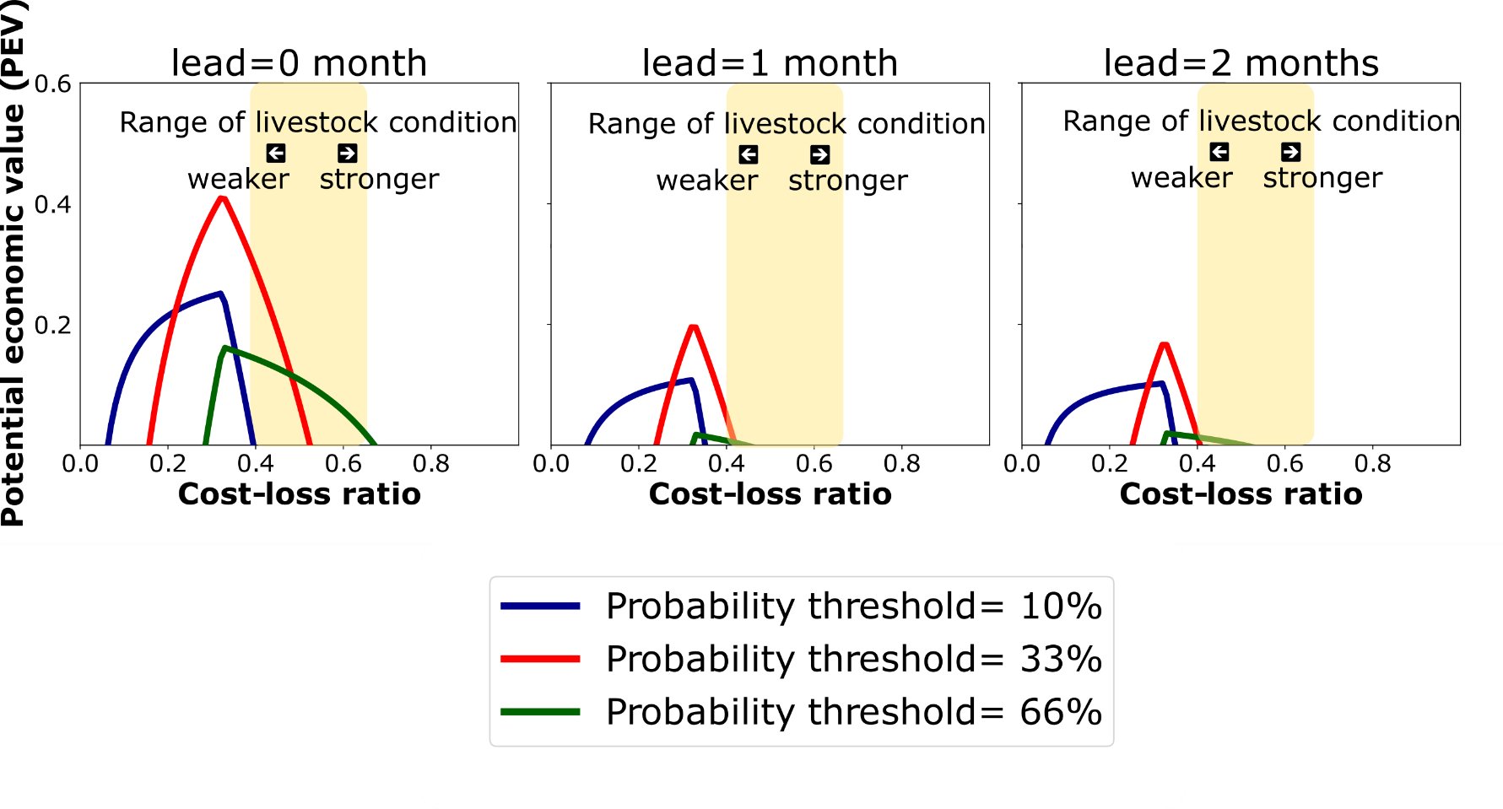
Practical example - Early livestock destocking in Kenya
}
cost-loss ratio found for livestock destocking
=
Probability on below-normal rainfall

Slide 19
Conclusions
Conclusions
Seasonal rainfall forecasts from ECMWF can (and should be) used to trigger early actions in East Africa;
Most effective ahead of the OND season for Kenya, and especially for Somalia;
However:
Caution should be taken when setting early action triggers for the MAM season..
Optimal triggers are very context-specific and should be tailored to different users;

