Slide 1


Exploring trends, patterns, and drivers of African surface water dynamics
PICO Presentation – April 18, 2024
Patrick Sogno, Igor Klein, Soner Uereyen, Felix Bachofer, Claudia Kuenzer
Notes:
Thank you for the introduction
Let me give you a small peek into trends, patterns, and drivers of African Surface Water Dynamics.
As you know, Africa is facing a set of escalating challenges. Both in the form of changing resource availability due to climate change
And a rapid increase in population, which is prognosed to become even more dynamic in the next decade.

Slide 2
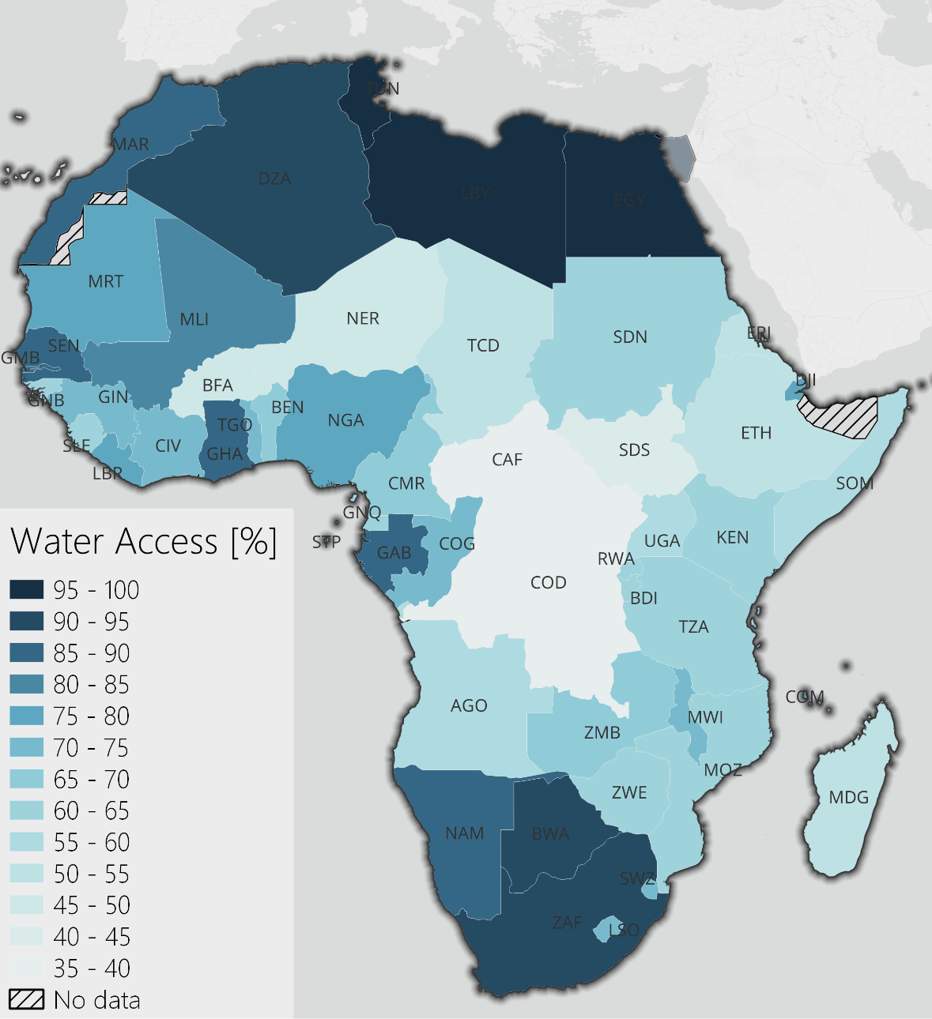
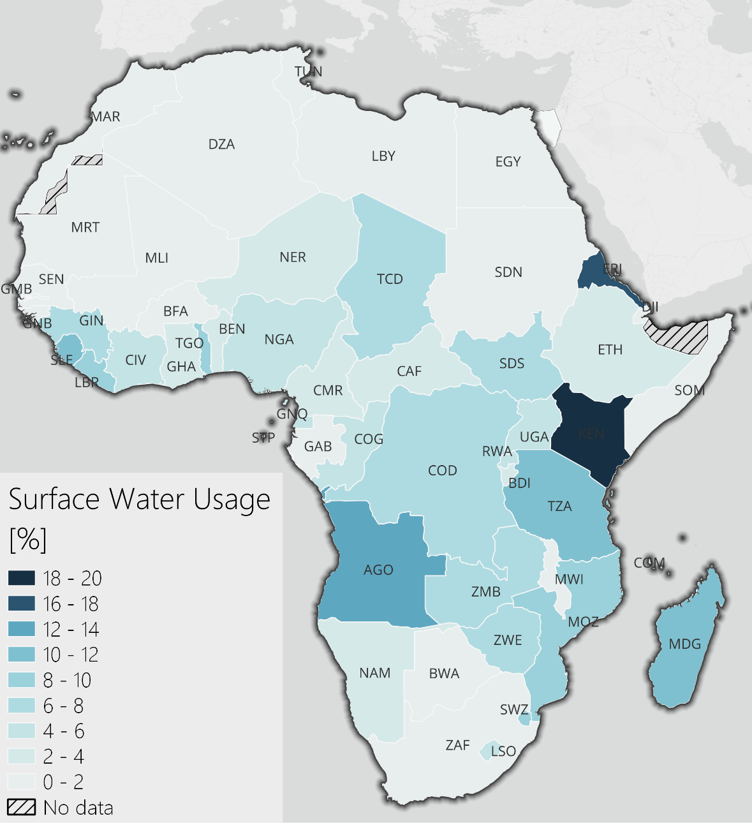
African Surface Water Dynamics – Background
Percentage of population with at least basic access to water in Africa. Situation in 2022, except for Eritrea, here the last reported number is from 2016 (data: Unicef, 2023).
Percentage of population using surface water. Situation in 2022, except for Eritrea, here the last reported number is from 2016 (data: Unicef, 2023).
Notes:
Combine this with a lack of water access in large parts of the continent. And a strong dependence on surface water access, especially in the poorer regions …

Slide 3
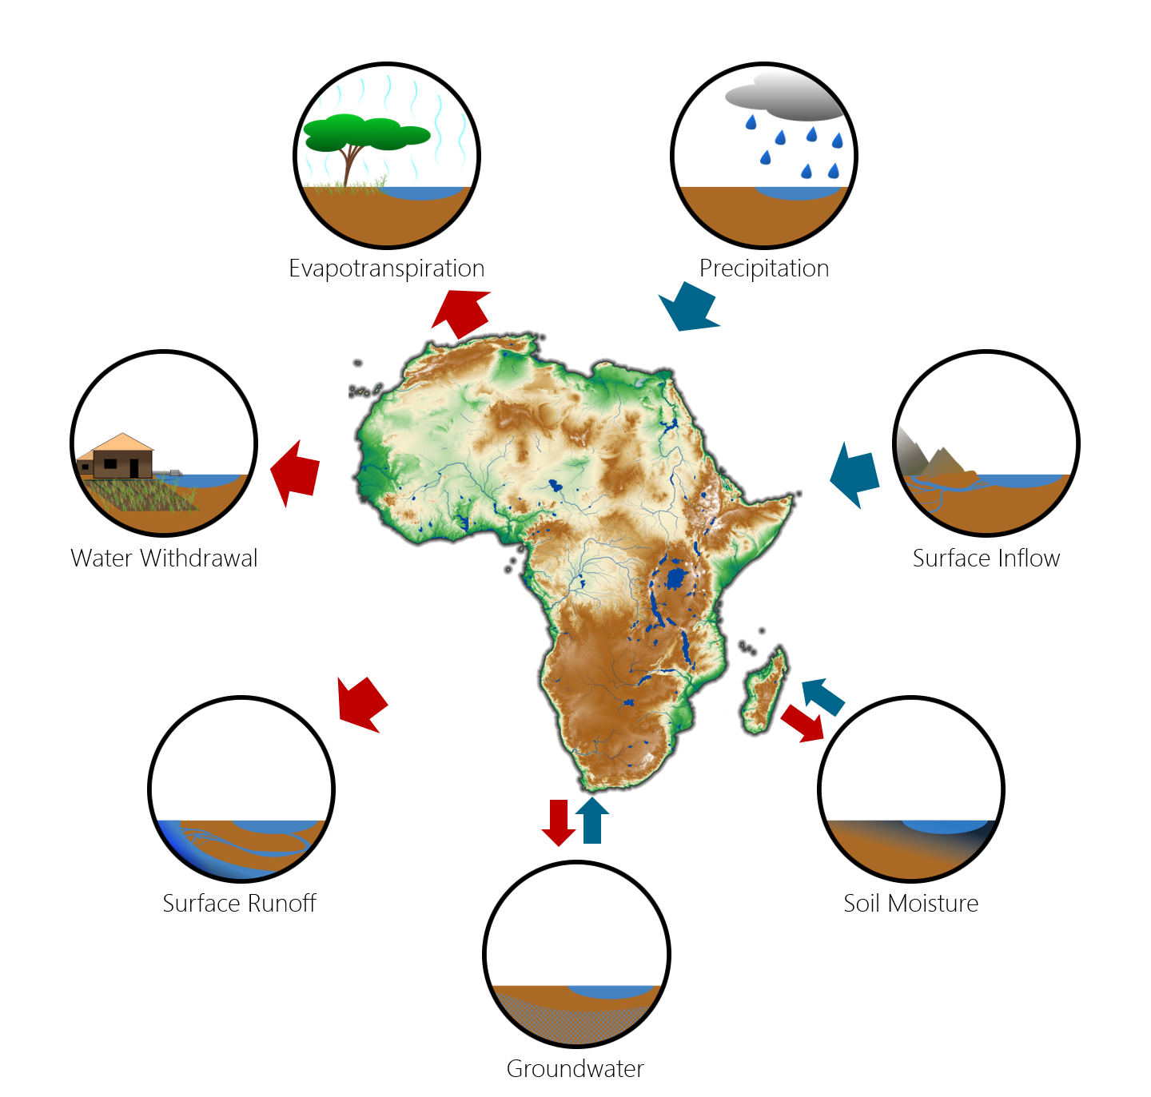
Impacts on African Surface Water
Effective management must be based on accurate information
What trends can we identify in African surface water?
What drives the most important lakes and reservoirs?
Are there similarities between the lakes and their drivers? What can we learn from them?
Hydrological impacts on African surface water bodies (Sogno et al., in preparation).
Notes:
And we understand that we urgently need effective water resource management and sustainable development if we want to avert major crises.
Such effective management must be based on accurate information however, which is in part still not available.
The questions we tackled in our research are:
What trends can we identify in African surface water?
What drives surface water, specifically the major lakes and reservoirs?
And are there similarities between lakes and their drivers? ...
If so, what can we learn from them?

Slide 4
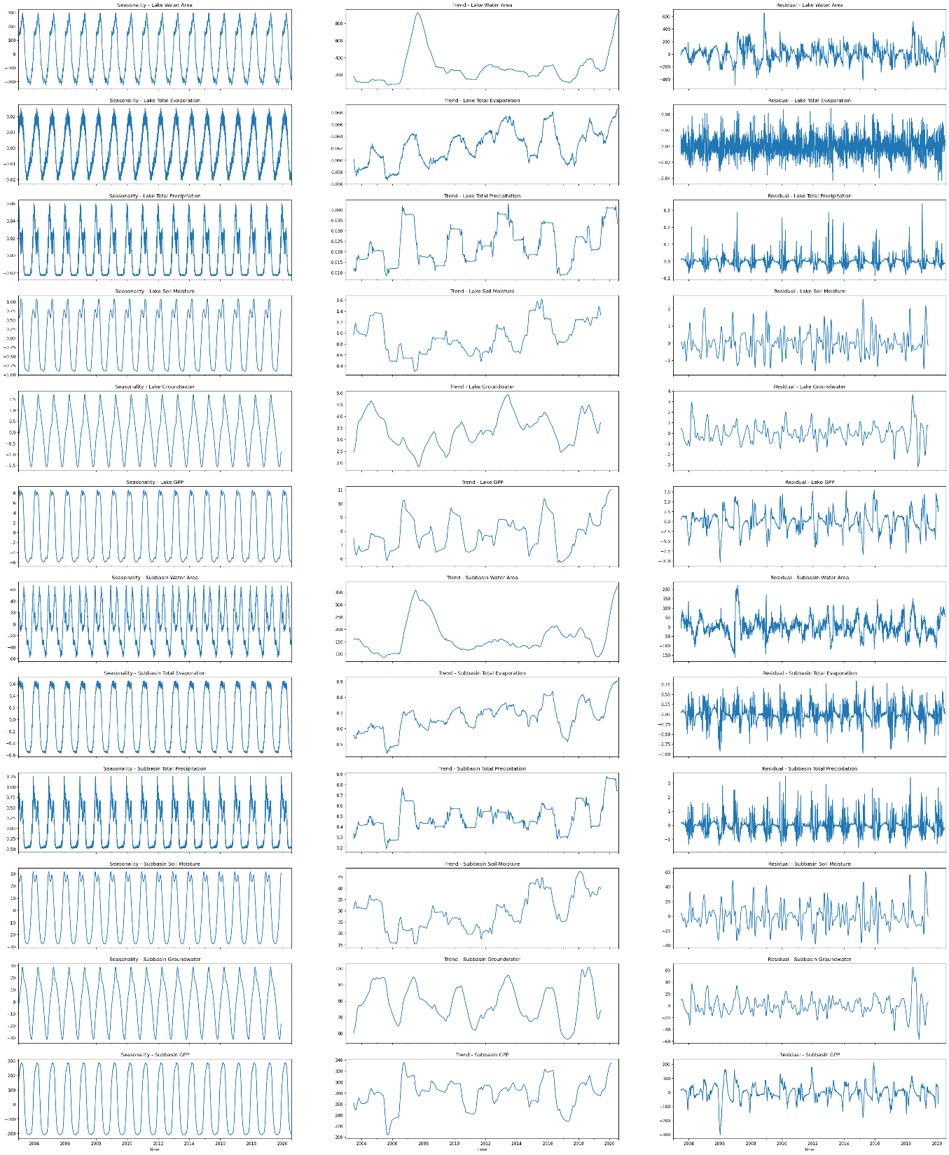
Utilized Datasets
Dependent variable (GWP lake extent)
Values at lake level
Independent variables for causal analysis (each on lake and subbasin level):
Subbasin-wide surface water
Total Evaporation (~ Evapotranspiration)
Total Precipitation
Soil Moisture
Groundwater
Gross Primary Productivity
Values at subbasin level
Notes:
We leverage daily time series for the timeframe of 2003 to 2020 …
That cover both the surface water extent and potential impacting variables from the atmosphere, biosphere, and hydrosphere domain
We performed a causal analysis for all major African lakes and reservoirs

Slide 5
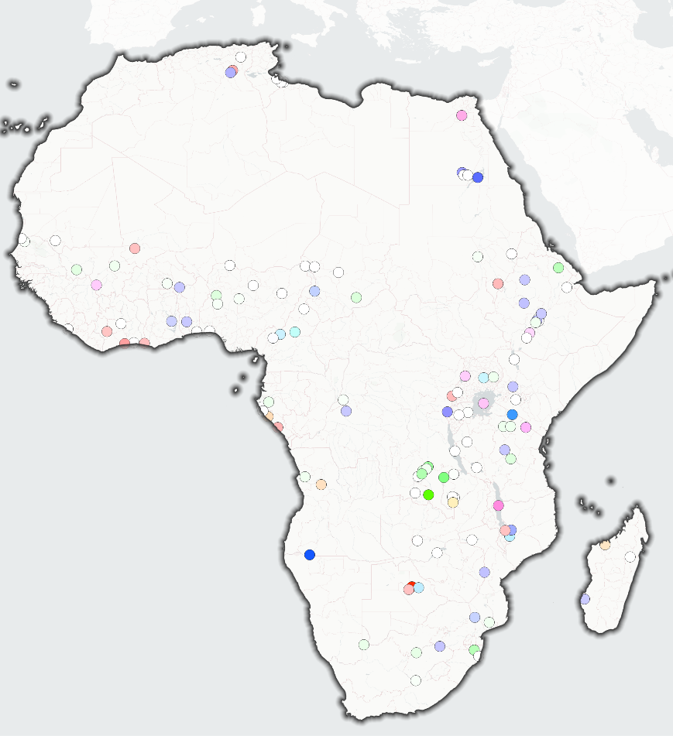

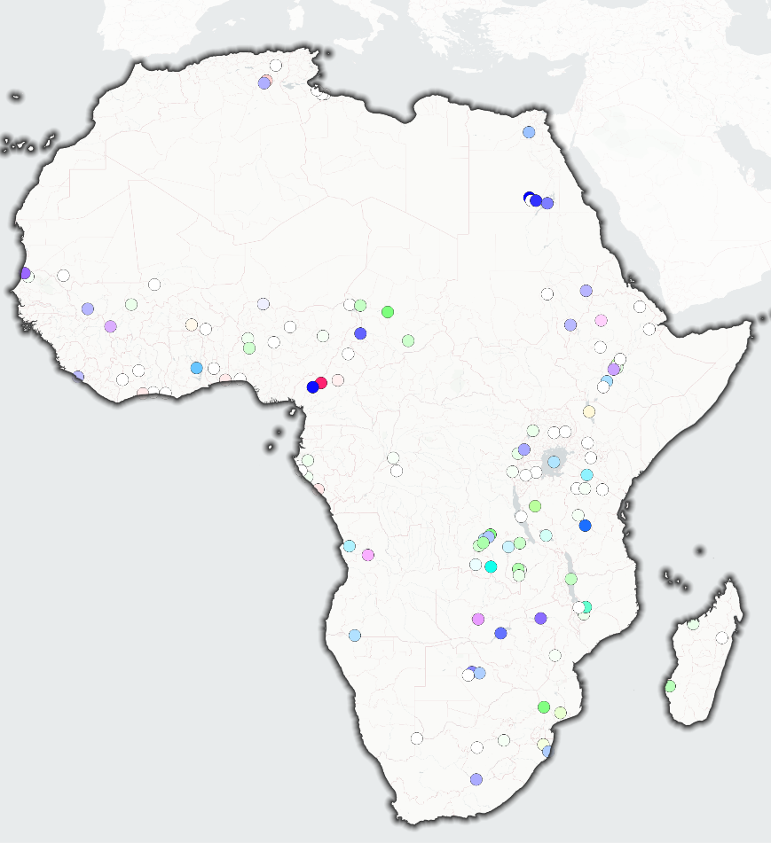

Causal Analysis of Surface Water Dynamics
Full Timeframe
Dry Seasons
Wet Seasons
Atmosphere Interaction
Positive Causal Impacts
Biosphere Interaction
Soil Interaction
Notes:
.
Our findings show that:
Most lakes are positively driven by atmospheric interaction (mainly precipitation)
There is also substantial soil interaction, especially with the African Great Lakes, which hints towards groundwater recharge

Slide 6

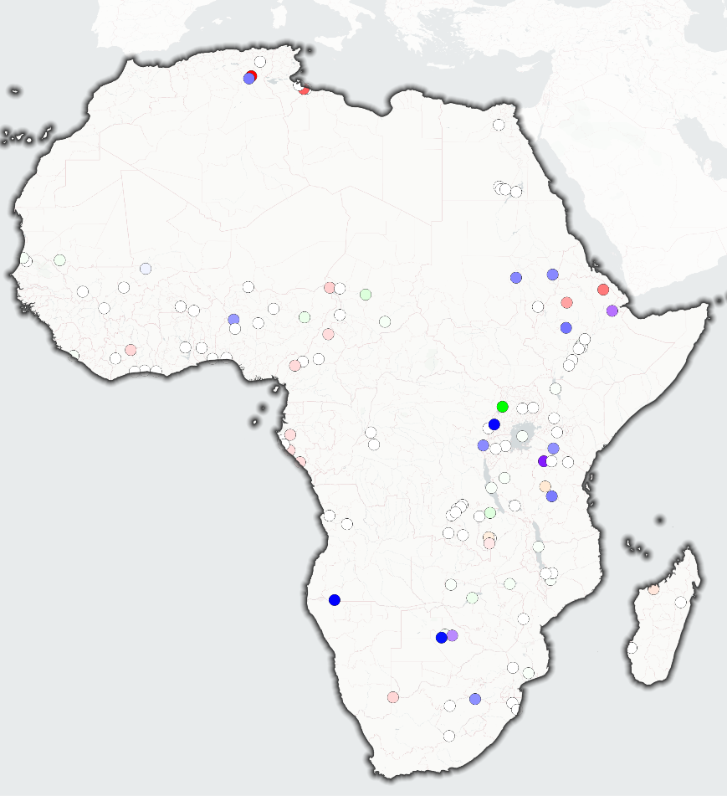
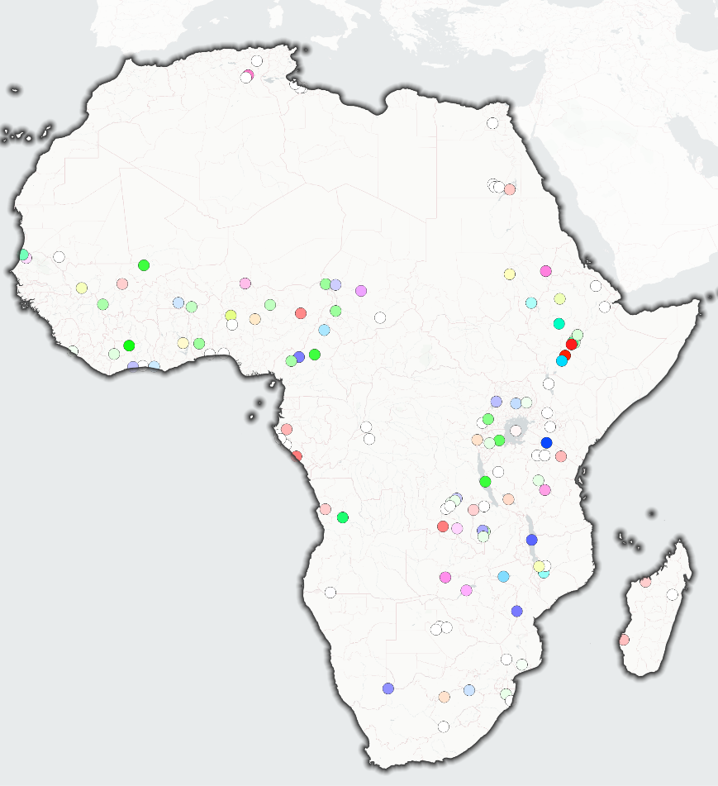
Causal Analysis of Surface Water Dynamics
Full Timeframe
Dry Seasons
Wet Seasons
Atmosphere Interaction
Negative Causal Impacts
Biosphere Interaction
Soil Interaction
Notes:
Negative drivers are often a mixture of evaporation, seepage, and biosphere interaction, here we suspect that much of this comes in the form of water abstraction

Slide 7


Thank you
Photo: Patrick Sogno
Patrick Sogno (patrick.sogno@dlr.de)
German Aerospace Center (DLR)
German Remote Sensing Data Center (DFD)
Land Surface Dynamics Department (LAX)
Notes:
If I could peak your interest, I invite you to come find me at PICO spot 3.6.
Have a great day, and see you later.

Slide 8


Exploring trends, patterns, and drivers of African surface water dynamics
PICO Presentation – April 18, 2024
Patrick Sogno, Igor Klein, Soner Uereyen, Felix Bachofer, Claudia Kuenzer
patrick.sogno@dlr.de
OSPP Voting

Slide 9










→ Abstract
→ Background
→ Dynamic Similarity
→ References
→ Datasets
→ Methodology
→ Review
→ Trend Analyses
→ Causal Relationships

Slide 10
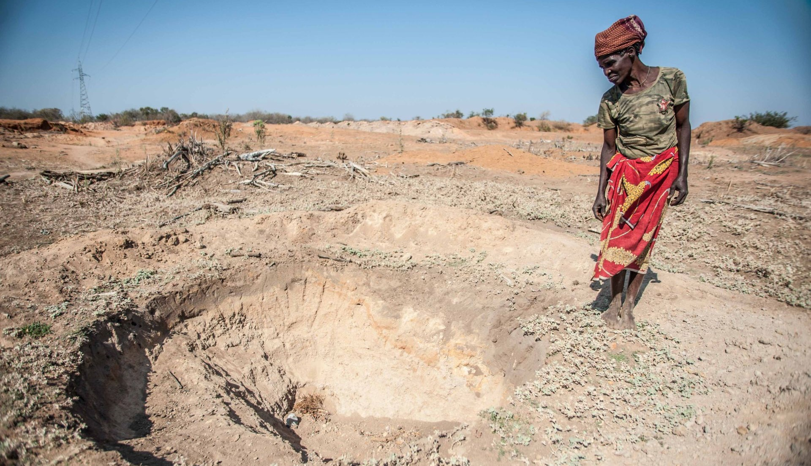
Escalating Challenges
Photo: Aurélie Marrier d‘Unienville / IFRC

Slide 11
Rapid Population Increase
Asia
Population Change in Millions
Africa
Latin America and the Carribean
Northern America
Europe
Data: United Nations, Department of Economic and Social Affairs, Population Division (2022). World Population Prospects 2022.

Slide 12
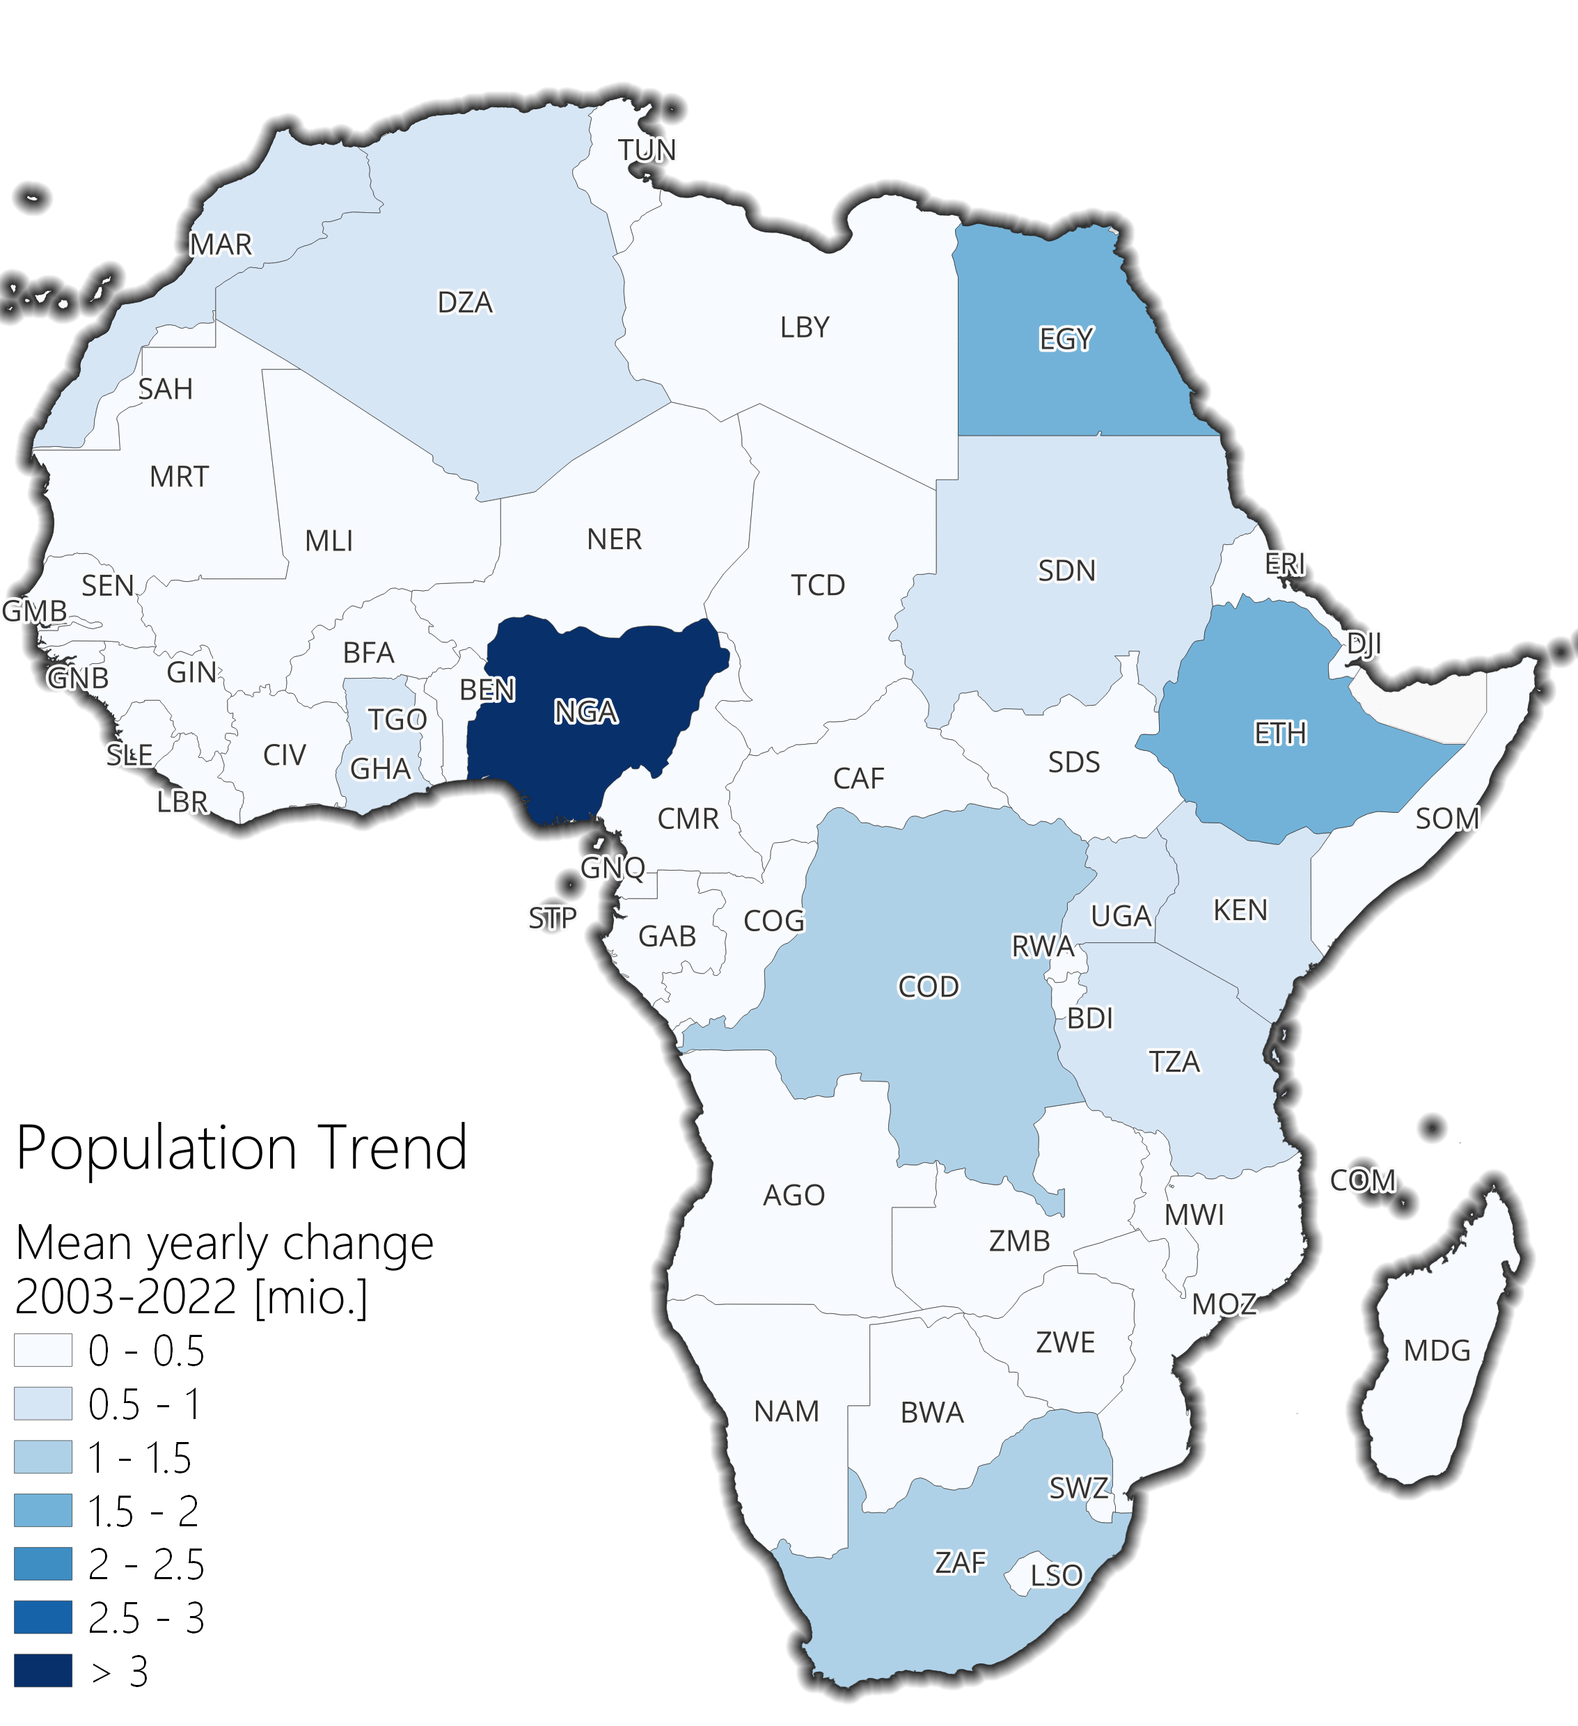

Rapid Population Increase
Asia
Population Change in Millions
Africa
Latin America and the Carribean
Northern America
Europe
Data: United Nations, Department of Economic and Social Affairs, Population Division (2022). World Population Prospects 2022.
Data: United Nations, Department of Economic and Social Affairs, Population Division (2022). World Population Prospects 2022.

Slide 13
African Surface Water Dynamics – Background
Percentage of population with at least basic access to water in Africa. Situation in 2022, except for Eritrea, here the last reported number is from 2016 (data: Unicef, 2023).
Percentage of population using surface water. Situation in 2022, except for Eritrea, here the last reported number is from 2016 (data: Unicef, 2023).

Slide 14
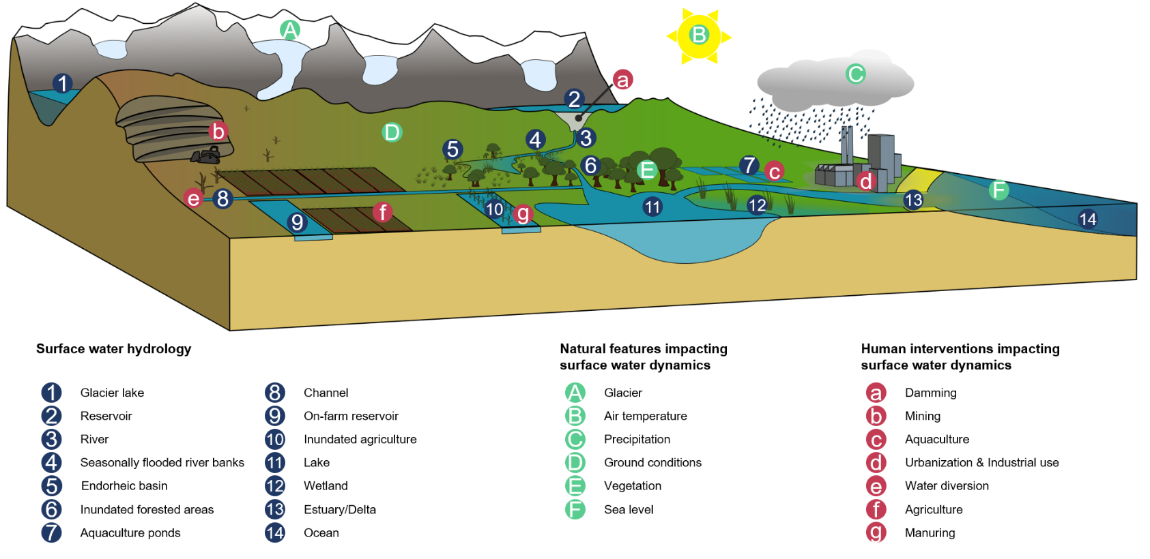
Impacts on Surface Water Dynamics
The availability of surface water is dependent on drivers from multiple spheres
These drivers impact surface water to varying degrees in different areas
This makes accurate representations of ongoing dynamics and predictions of future developments difficult
Using remote sensing, we can analyze the development of potential drivers alongside surface water dynamics to understand their interactions
Model overview of surface water hydrology including natural and anthropological influences that affect surface water
dynamics (Sogno et al., 2022).

Slide 15
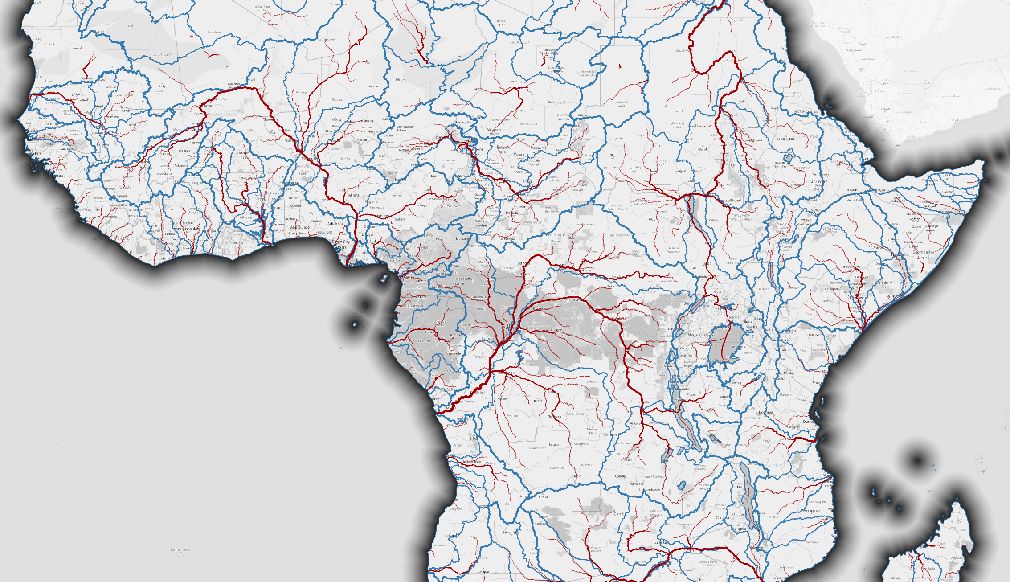
Background

Slide 16
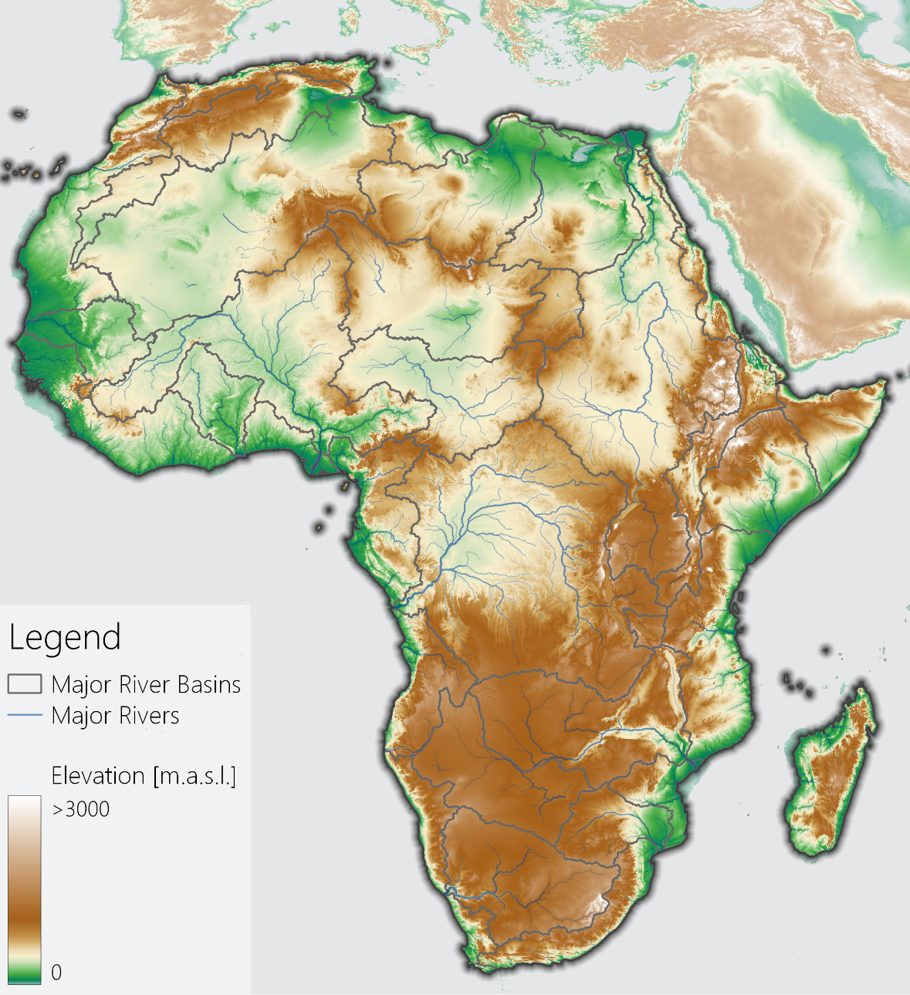
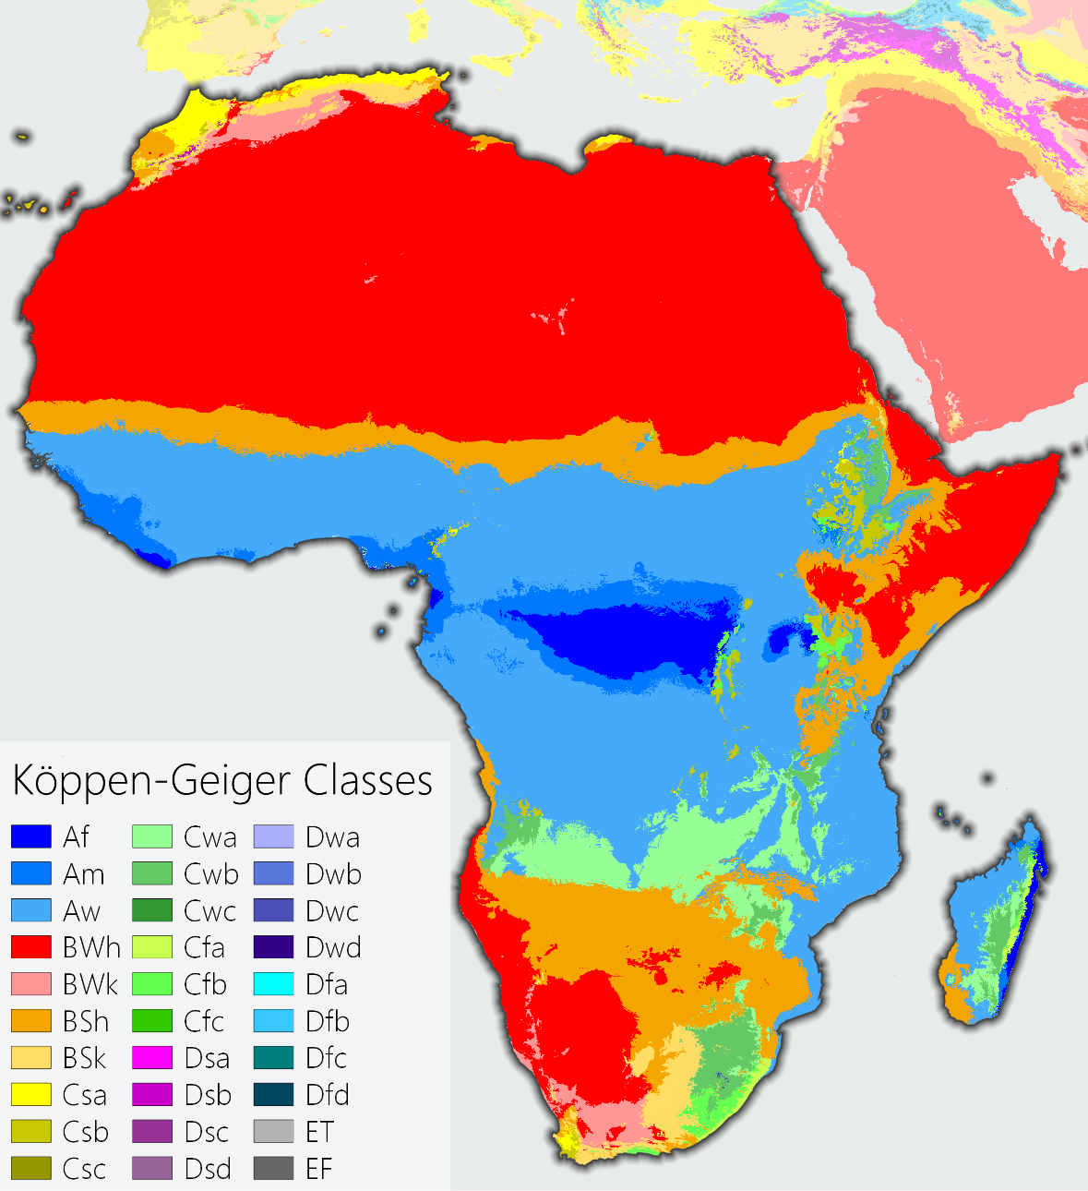
African Surface Water Dynamics – Background
Topography and major river basins with the corresponding rivers. Elevation data based on Mapzen DEM (Sogno et al., in preparation).
Köppen-Geiger climates for the reference period of 1990-2020 based on Beck et al. (2018) (Sogno et al., in preparation).

Slide 17
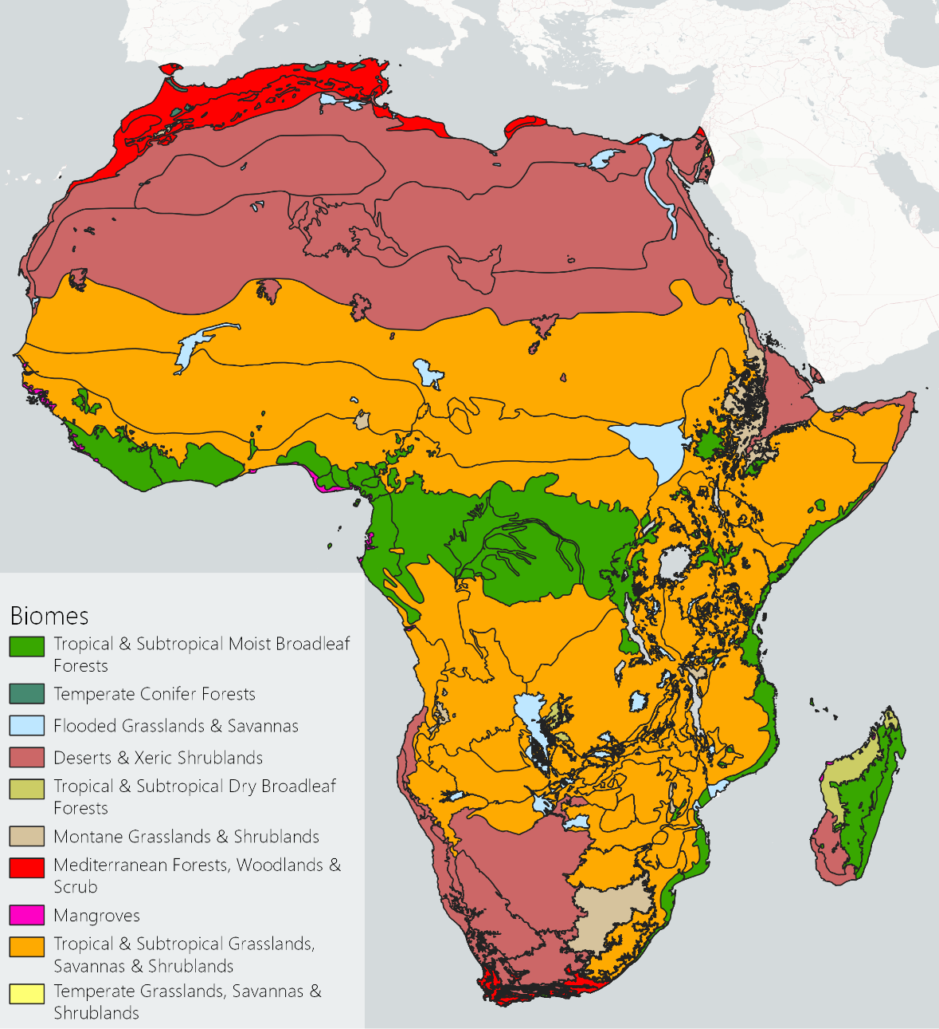
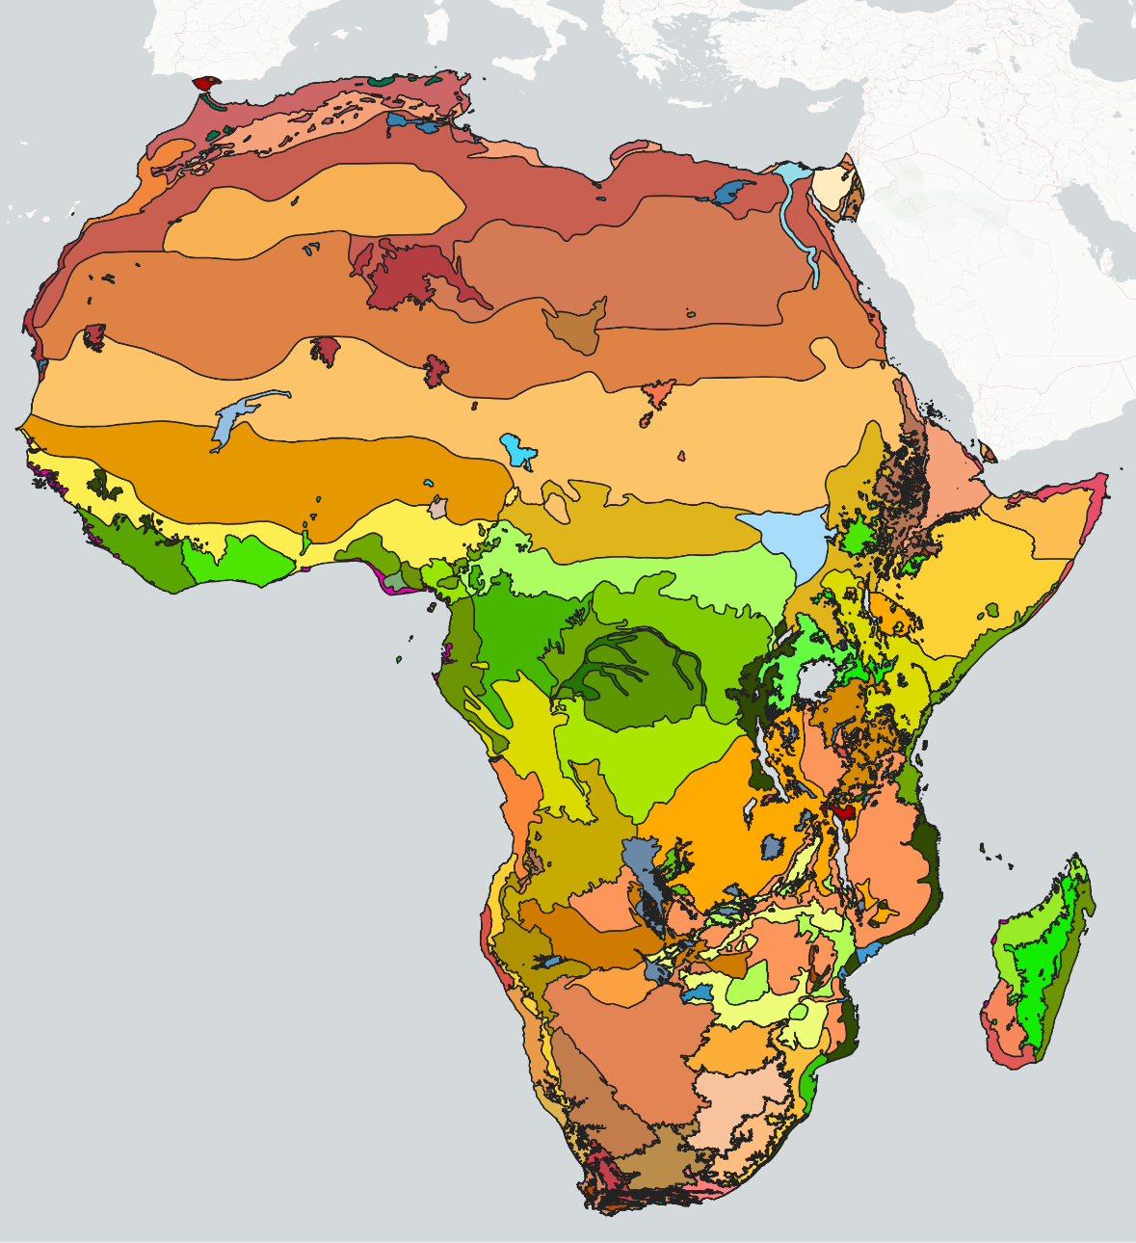
African Surface Water Dynamics – Background
km²/yr
km²/yr
African Biomes based on Dinerstein et al. (2017).
African Ecoregions based on Dinerstein et al. (2017). Multiple ecoregions make up one biome. Because of the multitude of ecoregions, no legend is given here.

Slide 18
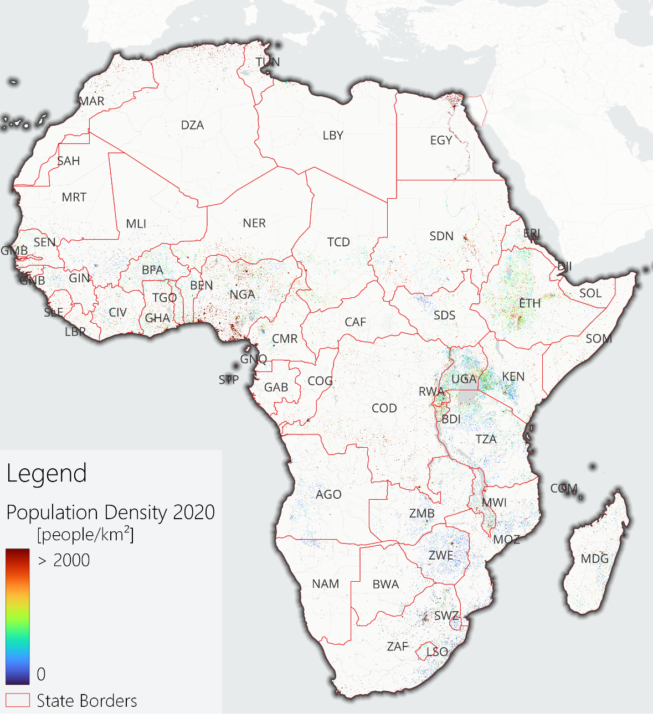
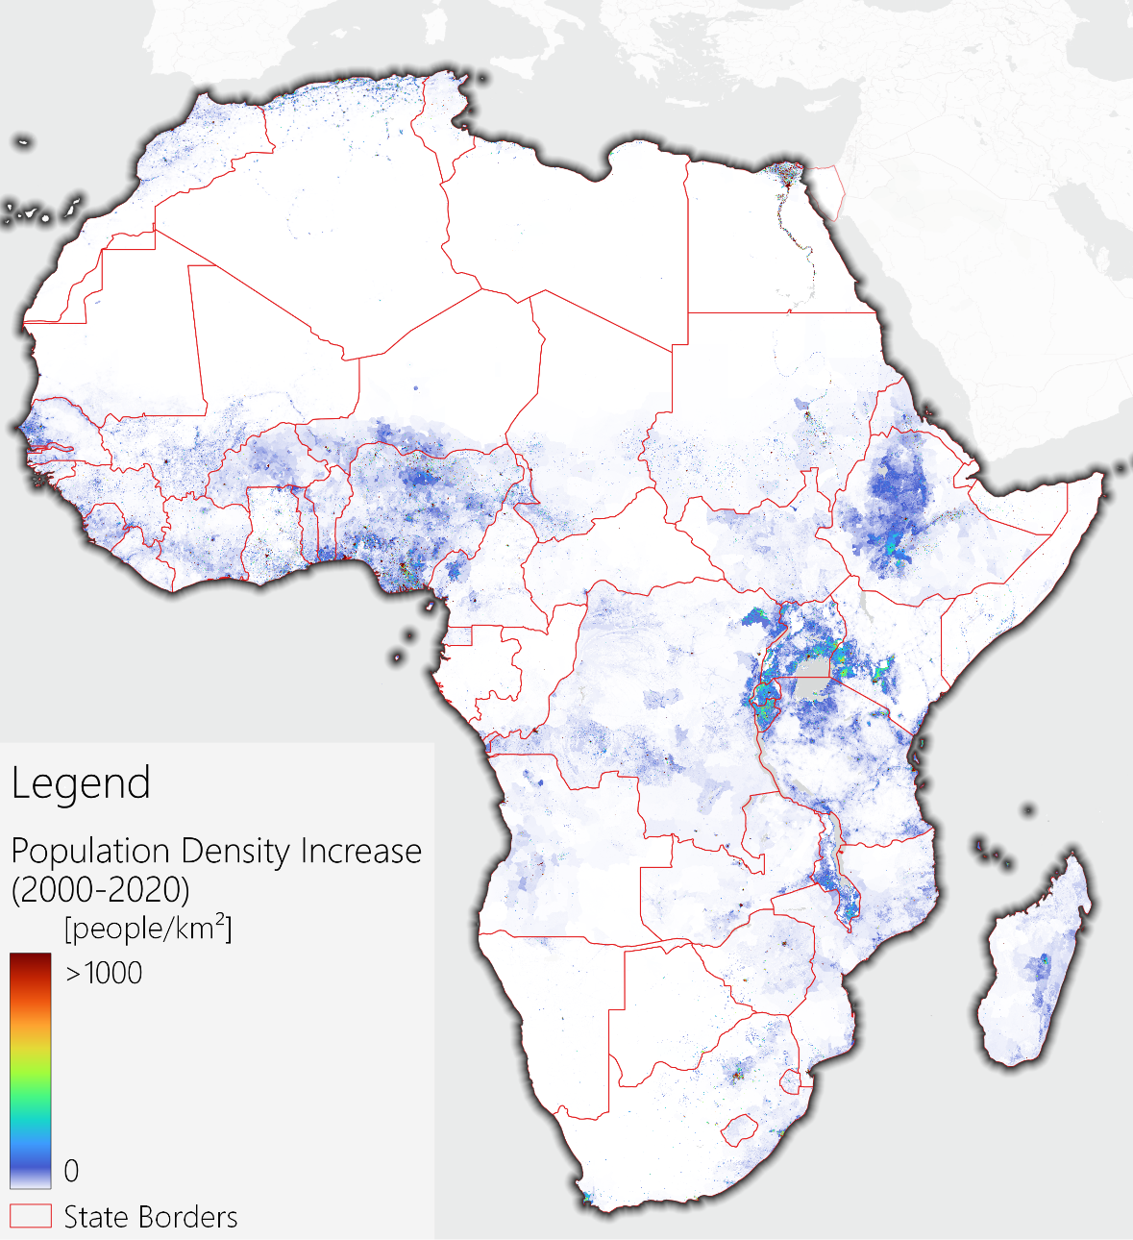
African Surface Water Dynamics – Background
Population density per km² based on Bondarenko et al. (2020) (Sogno et al., in preparation).
Population density increase per km² between 2000 and 2020 based on WorldPop (2016), data DOI:10.5258/SOTON/WP00004).

Slide 19
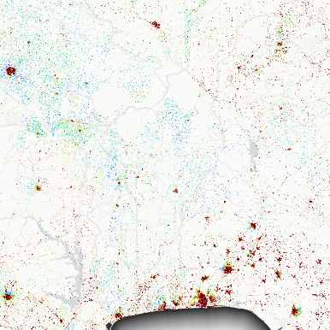
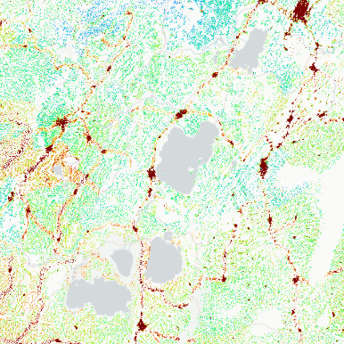
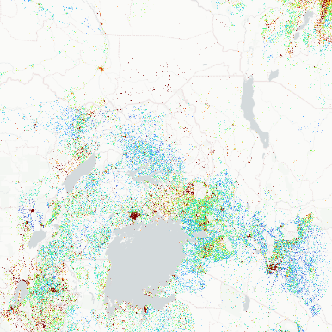
African Surface Water Dynamics – Background
Lower Volta and Niger
High population concentration and complex international relations
Heavily urbanized areas, such as Lagos, Nigeria (~16.5 million inhabitants), which has grown >220% since 2000
Ethiopian Main Rift
Highland area with high population concentration
Strong human intervention in surface water dynamics with visible impacts on surface water trends of the endorheic basin
African Great Lakes
High population concentration, especially around Lake Victoria, with complex international relations
As the headwater region of the Nile River, changes in this area have implications for much of the continent
Population density per km² based on Bondarenko et al. (2020). Zooms are provided for the Lower Niger and Volta, the Ethiopian Main Rift, and the northern part of the African Great Lakes (Sogno et al., in preparation).

Slide 20
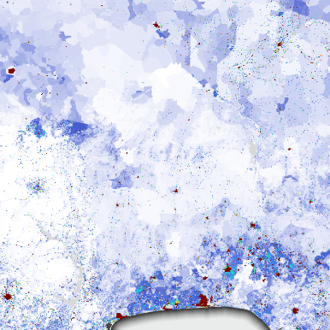
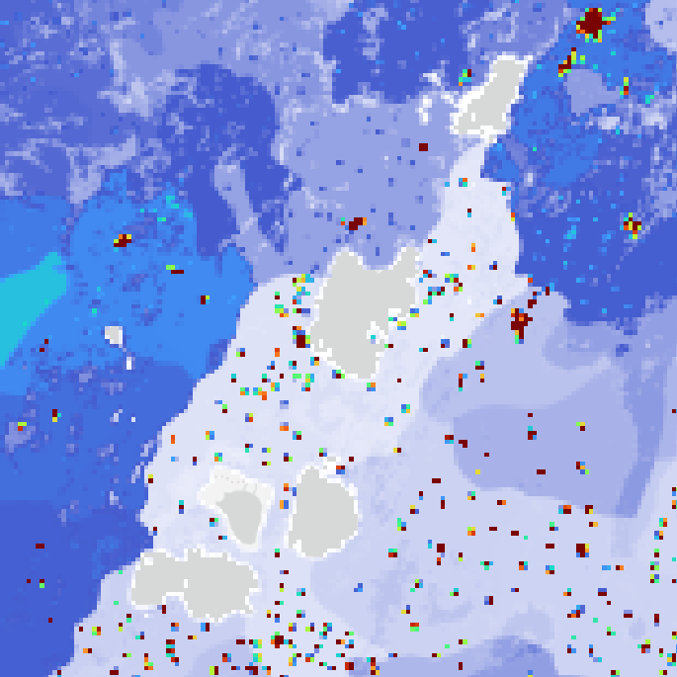
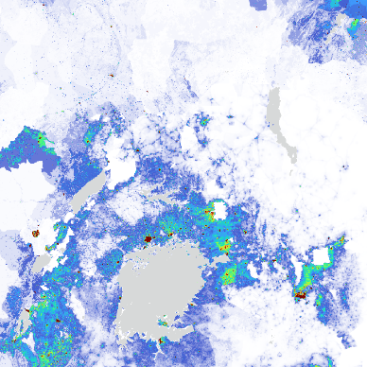
African Surface Water Dynamics – Background
Lower Volta and Niger
High population concentration and complex international relations
Heavily urbanized areas, such as Lagos, Nigeria (~16.5 million inhabitants), which has grown >220% since 2000
Ethiopian Main Rift
Highland area with high population concentration
Strong human intervention in surface water dynamics with visible impacts on surface water trends of the endorheic basin
African Great Lakes
High population concentration, especially around Lake Victoria, with complex international relations
As the headwater region of the Nile River, changes in this area have implications for much of the continent
Population density increase per km² based on WorldPop (2016), data DOI:10.5258/SOTON/WP00004). Zooms are provided for the Lower Niger and Volta, the Ethiopian Main Rift, and the northern part of the African Great Lakes.

Slide 21
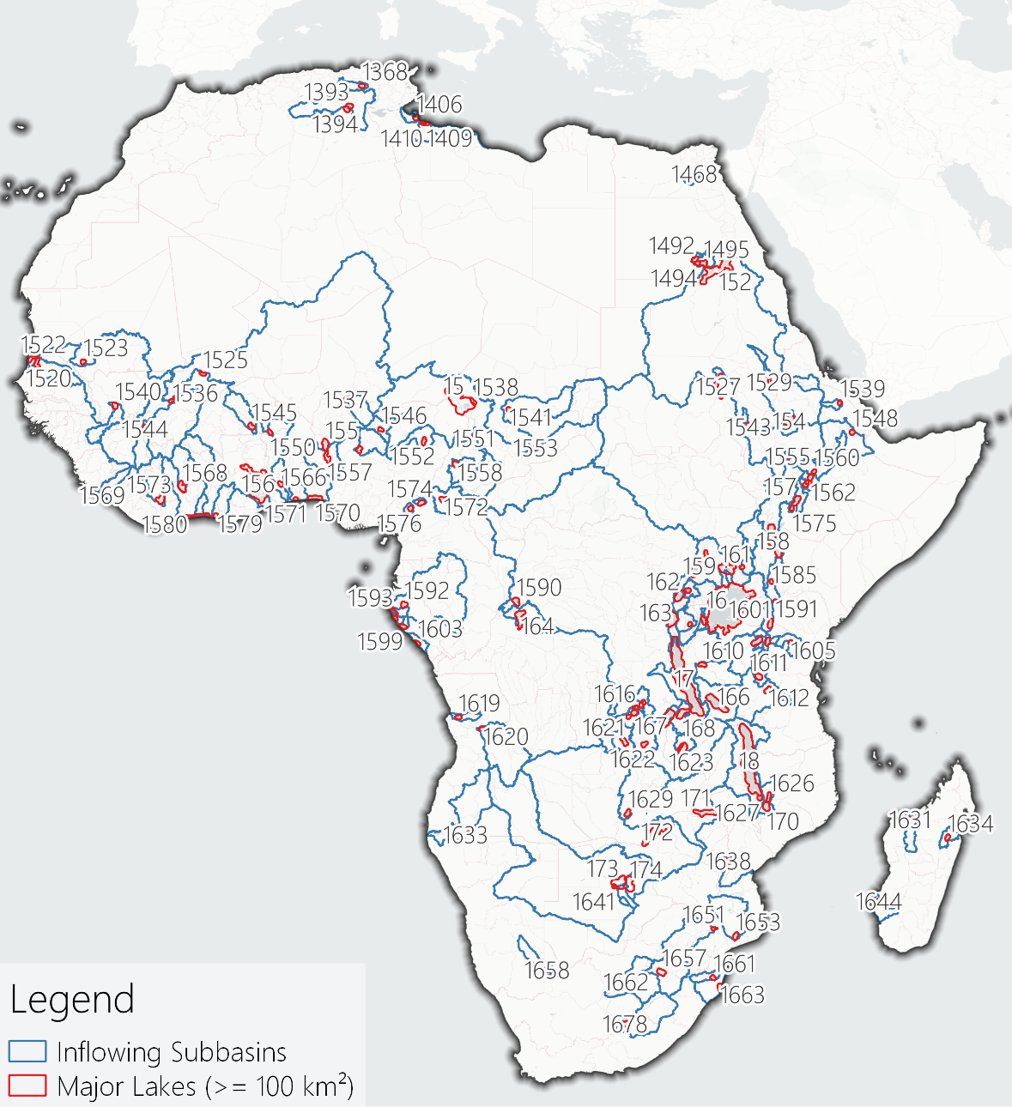
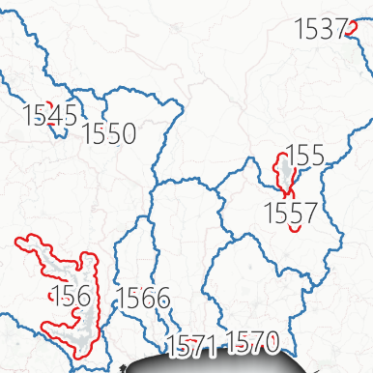
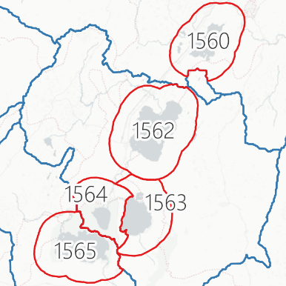
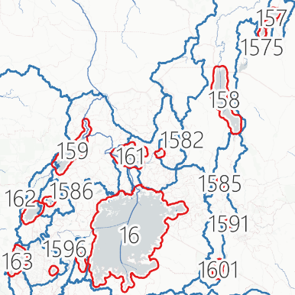
African Surface Water Dynamics – Background
Lower Volta and Niger
High population concentration and complex international relations
Heavily urbanized areas, such as Lagos, Nigeria (~16.5 million inhabitants), which has grown >220% since 2000
Ethiopian Main Rift
Highland area with high population concentration
Strong human intervention in surface water dynamics with visible impacts on surface water trends of the endorheic basin
African Great Lakes
High population concentration, especially around Lake Victoria, with complex international relations
As the headwater region of the Nile River, changes in this area have implications for much of the continent
Major lakes and their respective inflowing subbasins. Zooms are provided for the Lower Niger and Volta, the Ethiopian Main Rift, and the northern part of the African Great Lakes (Sogno et al., in preparation).

Slide 22
Impacts on African Surface Water
Effective management must be based on accurate information
What trends can we identify in African surface water?
What drives the most important lakes and reservoirs?
Are there similarities between the lakes and their drivers?
Hydrological impacts on African surface water bodies (Sogno et al., in preparation).
Notes:
And we understand that we urgently need effective management and sustainable development if we want to avert major crises.
Such effective management must be based on accurate information however, which is in part still not available.
The questions we tackled in our research are:
What trends can we identify in African surface water?
What drives surface water, specifically the major lakes and reservoirs?
And are there similarities between lakes and their drivers? ...

Slide 23
Impacts on African Surface Water
Effective management must be based on accurate information
What trends can we identify in African surface water?
What drives the most important lakes and reservoirs?
Are there similarities between the lakes and their drivers? What can we learn from them?
Hydrological impacts on African surface water bodies (Sogno et al., in preparation).
Notes:
And if so, what can we learn from them?

Slide 24
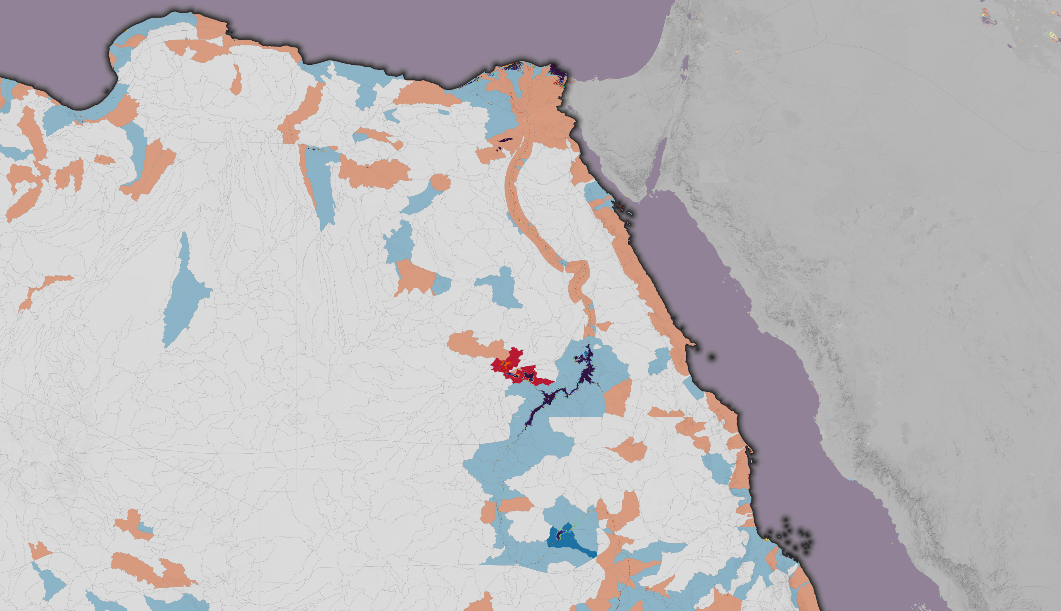
Trends at various scales

Slide 25
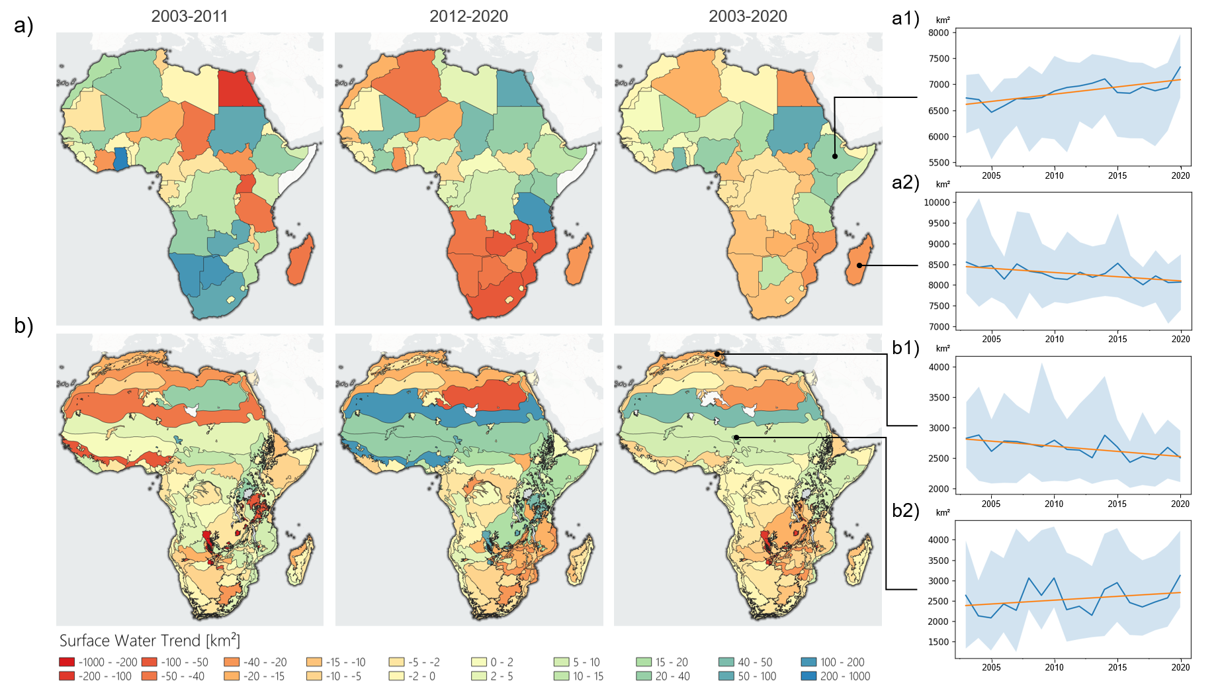
African Surface Water Trends
Long-term linear trends for Africa on country (a) and ecoregion (b) scale. Trends are shown for two examples of (a) and (b), respectively: (a1 – Ethiopia, a2 – Madagascar, b1 – Mediterranean woodlands and forests, and b2 – Lake Chad flooded savanna. The blue line in the trend plots shows the respective mean surface water area over the years. The blue area in the trend plots covers the values between the minimum and maximum observed water area per year. The orange line is the linear regression. Ecoregions: Dinerstein et al. (2017) (Sogno et al., in preparation).

Slide 26
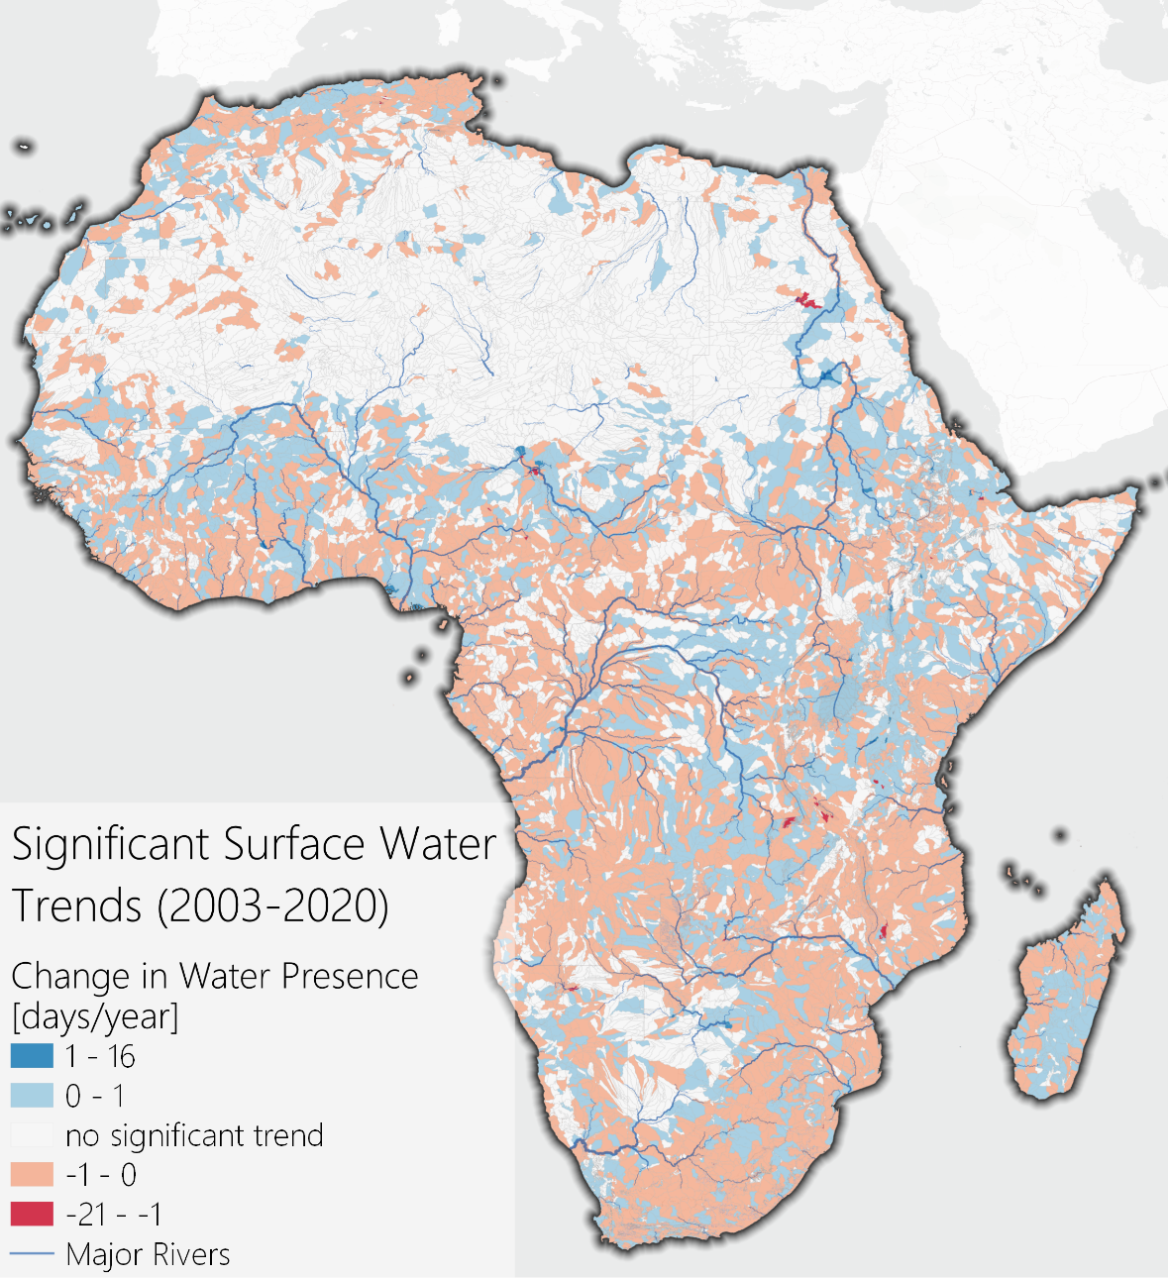
African Surface Water Trends
Aggregating surface water trends to national or ecoregion borders may mask complex interactions that are taking place at smaller scales
African water trends on small hydrologically relevant units – SHUs – (=intersection of HydroBASIN Level 7, state borders, and ecoregions).

Slide 27
African Surface Water Trends
Aggregating surface water trends to national or ecoregion borders may mask complex interactions that are taking place at smaller scales
To address this, trends were analyzed for the smallest hydrologically relevant units
African water trends on small hydrologically relevant units – SHUs – (=intersection of HydroBASIN Level 7, state borders, and ecoregions).

Slide 28
African Surface Water Trends
Aggregating surface water trends to national or ecoregion borders may mask complex interactions that are taking place at smaller scales
To address this, trends were analyzed for the smallest hydrologically relevant units
These units are intersections of subbasins with ecoregions and administrative boundaries
African water trends on small hydrologically relevant units – SHUs – (=intersection of HydroBASIN Level 7, state borders, and ecoregions).

Slide 29
African Surface Water Trends
Aggregating surface water trends to national or ecoregion borders may mask complex interactions that are taking place at smaller scales
To address this, trends were analyzed for the smallest hydrologically relevant units
These units are intersections of subbasins with ecoregions and administrative boundaries
Regarding the entire continent, relevant patterns are:
African water trends on small hydrologically relevant units – SHUs – (=intersection of HydroBASIN Level 7, state borders, and ecoregions).

Slide 30
African Surface Water Trends
Aggregating surface water trends to national or ecoregion borders may mask complex interactions that are taking place at smaller scales
To address this, trends were analyzed for the smallest hydrologically relevant units
These units are intersections of subbasins with ecoregions and administrative boundaries
Regarding the entire continent, relevant patterns are:
  Tendentially increasing trends in the Sahel (A)
A
African water trends on small hydrologically relevant units – SHUs – (=intersection of HydroBASIN Level 7, state borders, and ecoregions).

Slide 31
African Surface Water Trends
Aggregating surface water trends to national or ecoregion borders may mask complex interactions that are taking place at smaller scales
To address this, trends were analyzed for the smallest hydrologically relevant units
These units are intersections of subbasins with ecoregions and administrative boundaries
Regarding the entire continent, relevant patterns are:
  Tendentially increasing trends in the Sahel (A)
  Tendentially decreasing trends in the “Aw” climates (B)
A
B
African water trends on small hydrologically relevant units – SHUs – (=intersection of HydroBASIN Level 7, state borders, and ecoregions).

Slide 32
African Surface Water Trends
Aggregating surface water trends to national or ecoregion borders may mask complex interactions that are taking place at smaller scales
To address this, trends were analyzed for the smallest hydrologically relevant units
These units are intersections of subbasins with ecoregions and administrative boundaries
Regarding the entire continent, relevant patterns are:
  Tendentially increasing trends in the Sahel (A)
  Tendentially decreasing trends in the “Aw” climates (B)
  Tendentially decreasing trends in the Lower Congo Basin (C)
A
B
C
African water trends on small hydrologically relevant units – SHUs – (=intersection of HydroBASIN Level 7, state borders, and ecoregions).

Slide 33
African Surface Water Trends
Aggregating surface water trends to national or ecoregion borders may mask complex interactions that are taking place at smaller scales
To address this, trends were analyzed for the smallest hydrologically relevant units
These units are intersections of subbasins with ecoregions and administrative boundaries
Regarding the entire continent, relevant patterns are:
  Tendentially increasing trends in the Sahel (A)
  Tendentially decreasing trends in the “Aw” climates (B)
  Tendentially decreasing trends in the Lower Congo Basin (C)
  Tendentially decreasing trends in the African Southeast (D)
A
B
C
D
African water trends on small hydrologically relevant units – SHUs – (=intersection of HydroBASIN Level 7, state borders, and ecoregions).

Slide 34
African Surface Water Trends
Aggregating surface water trends to national or ecoregion borders may mask complex interactions that are taking place at smaller scales
To address this, trends were analyzed for the smallest hydrologically relevant units
These units are intersections of subbasins with ecoregions and administrative boundaries
Regarding the entire continent, relevant patterns are:
  Tendentially increasing trends in the Sahel (A)
  Tendentially decreasing trends in the “Aw” climates (B)
  Tendentially decreasing trends in the Lower Congo Basin (C)
  Tendentially decreasing trends in the African Southeast (D)
  Tendentially increasing trends in headwater regions like the Ethiopian Highlands (E) and the Lualaba River (F)
A
E
B
F
C
D
African water trends on small hydrologically relevant units – SHUs – (=intersection of HydroBASIN Level 7, state borders, and ecoregions).

Slide 35
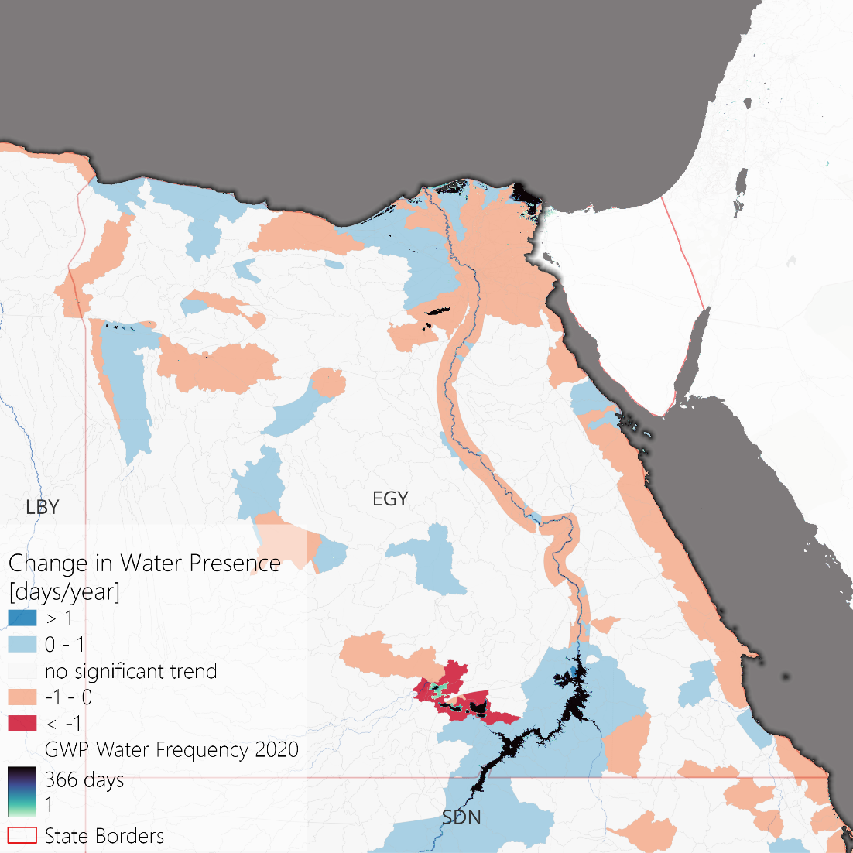
African Surface Water Trends – Regional Examples
Lower Nile
Significant impact of Lake Nasser (large reservoir in southern Egypt) on the Lower Nile and the Nile Delta
Drying Toshka Lakes (west of Lake Nasser), which have been flooded in the late 1990s and since then been intensively used (agriculture!) leading to dry-outs in the late 2010s
The Toshka Lakes are only flooded after extreme rainfalls in the Upper Nile Basin that lead to Nile waters spilling from Lake Nasser into a sequence of depressions in the desert
The most recent flooding was in 2019, the visualized GWP water frequency of 2020 therefore shows the re-flooding of the lakes
Water trends on SHUs – regional examples.

Slide 36
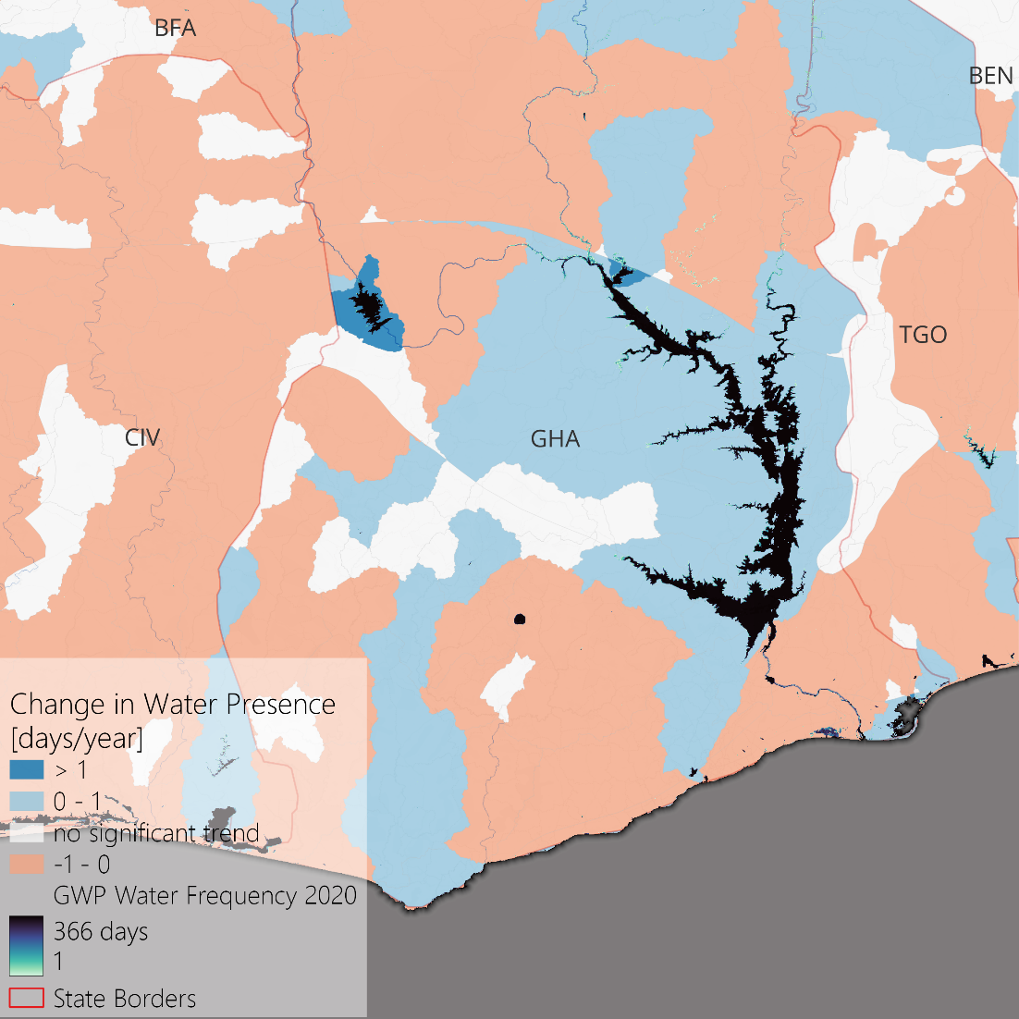
African Surface Water Trends – Regional Examples
Lower Volta
The Lower Volta River generally faces decreasing trends
Lake Volta however (large reservoir in Ghana) seems to be managed in a way that stabilizes and reverses the trend of all inflowing rivers
This stabilization comes at the cost of decreasing outflow, as visibile South of Lake Volta
Water trends on SHUs – regional examples.

Slide 37
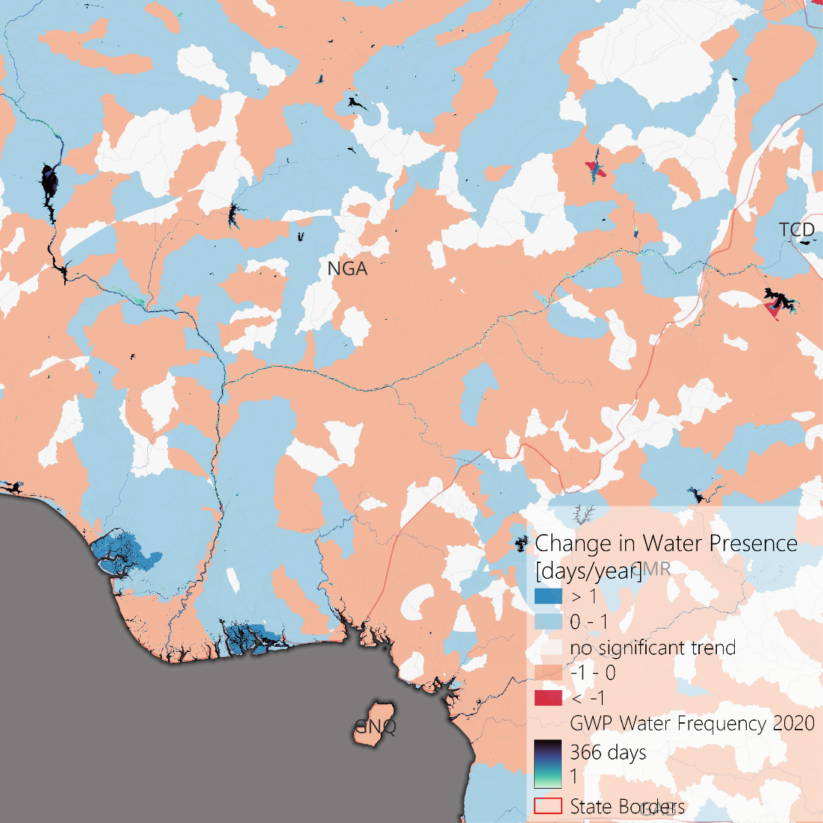
African Surface Water Trends – Regional Examples
Lower Niger
The Lower Niger River sees decreasing trends, leading to decreasing water occurrence in the Lower Niger Delta
The Niger River has a complex hydrological regime, crossing multiple countries and climate zones
In its lower stretch, the Niger is dammed multiple times, forming the Kainji Reservoir and Jebba Reservoir
As it seems, the larger impact on the Lower Niger‘s trend stems from dammed tributaries (e.g., the Benue – inflowing from Cameroon in the east – that is dammed in the Lac Lagdo and has lead to tensions between the states in the past)
Water trends on SHUs – regional examples.
Notes:
Interesting newspaper articles on Lac Lagdo:
Why a dam in Cameroon causes devastating floods in Nigeria every year | Pulse Nigeria
Lagdo Dam: How Nigerians are paying for the irresponsibilities of past governments - Ventures Africa

Slide 38
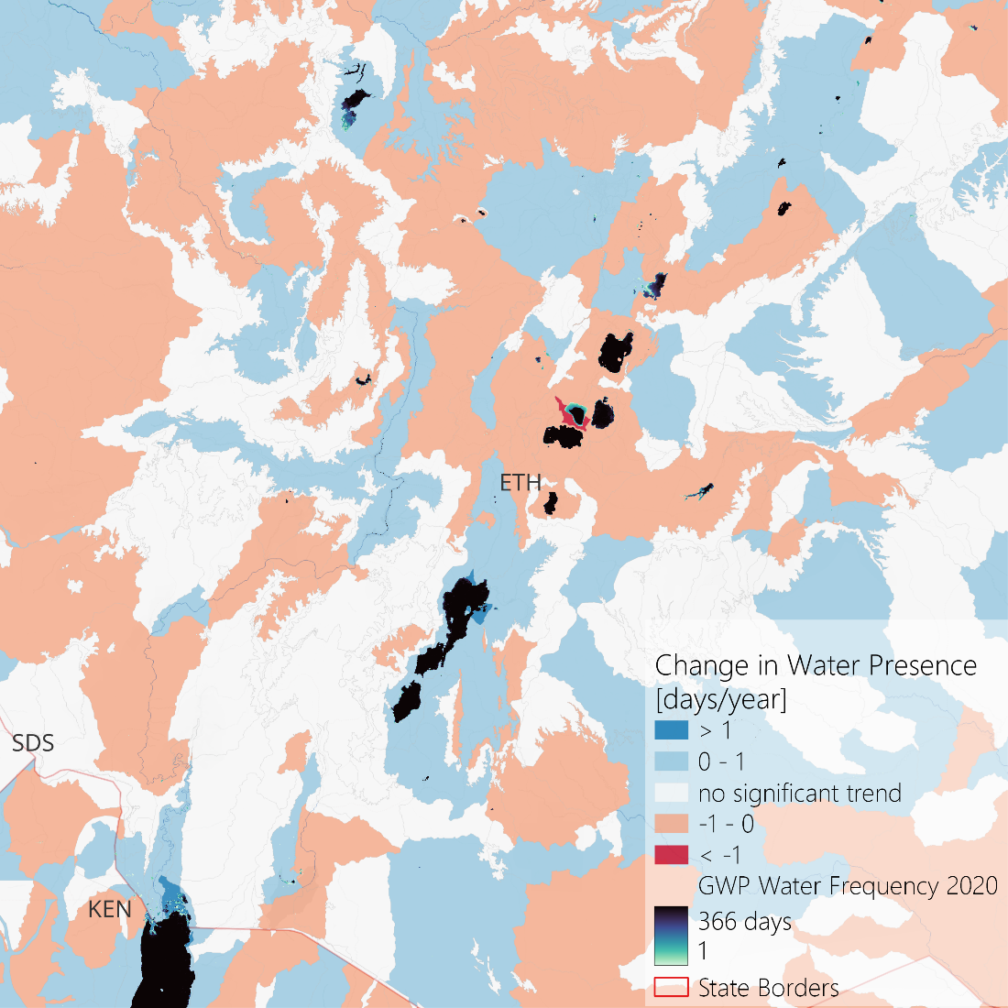
African Surface Water Trends – Regional Examples
Ethiopian Main Rift
Within the Ethiopian Main Rift are several lakes that belong to endorheic basins
Especially the clustered lakes Ziway, Abayata, and Langano (visible in the center of the map) have an interesting dynamic
Lake Abayata is the lowest of the three lakes and the endpoint of an endorheic basin
Due to water extraction from the two feeding branches, as well as water extraction from Lake Abayata itself, the lake shrinks
Although Ziway and Langano are also affected by water extraction, they stay stable, offsetting the abstracted water with decreased outflows towards Lake Abayata
Water trends on SHUs – regional examples.

Slide 39
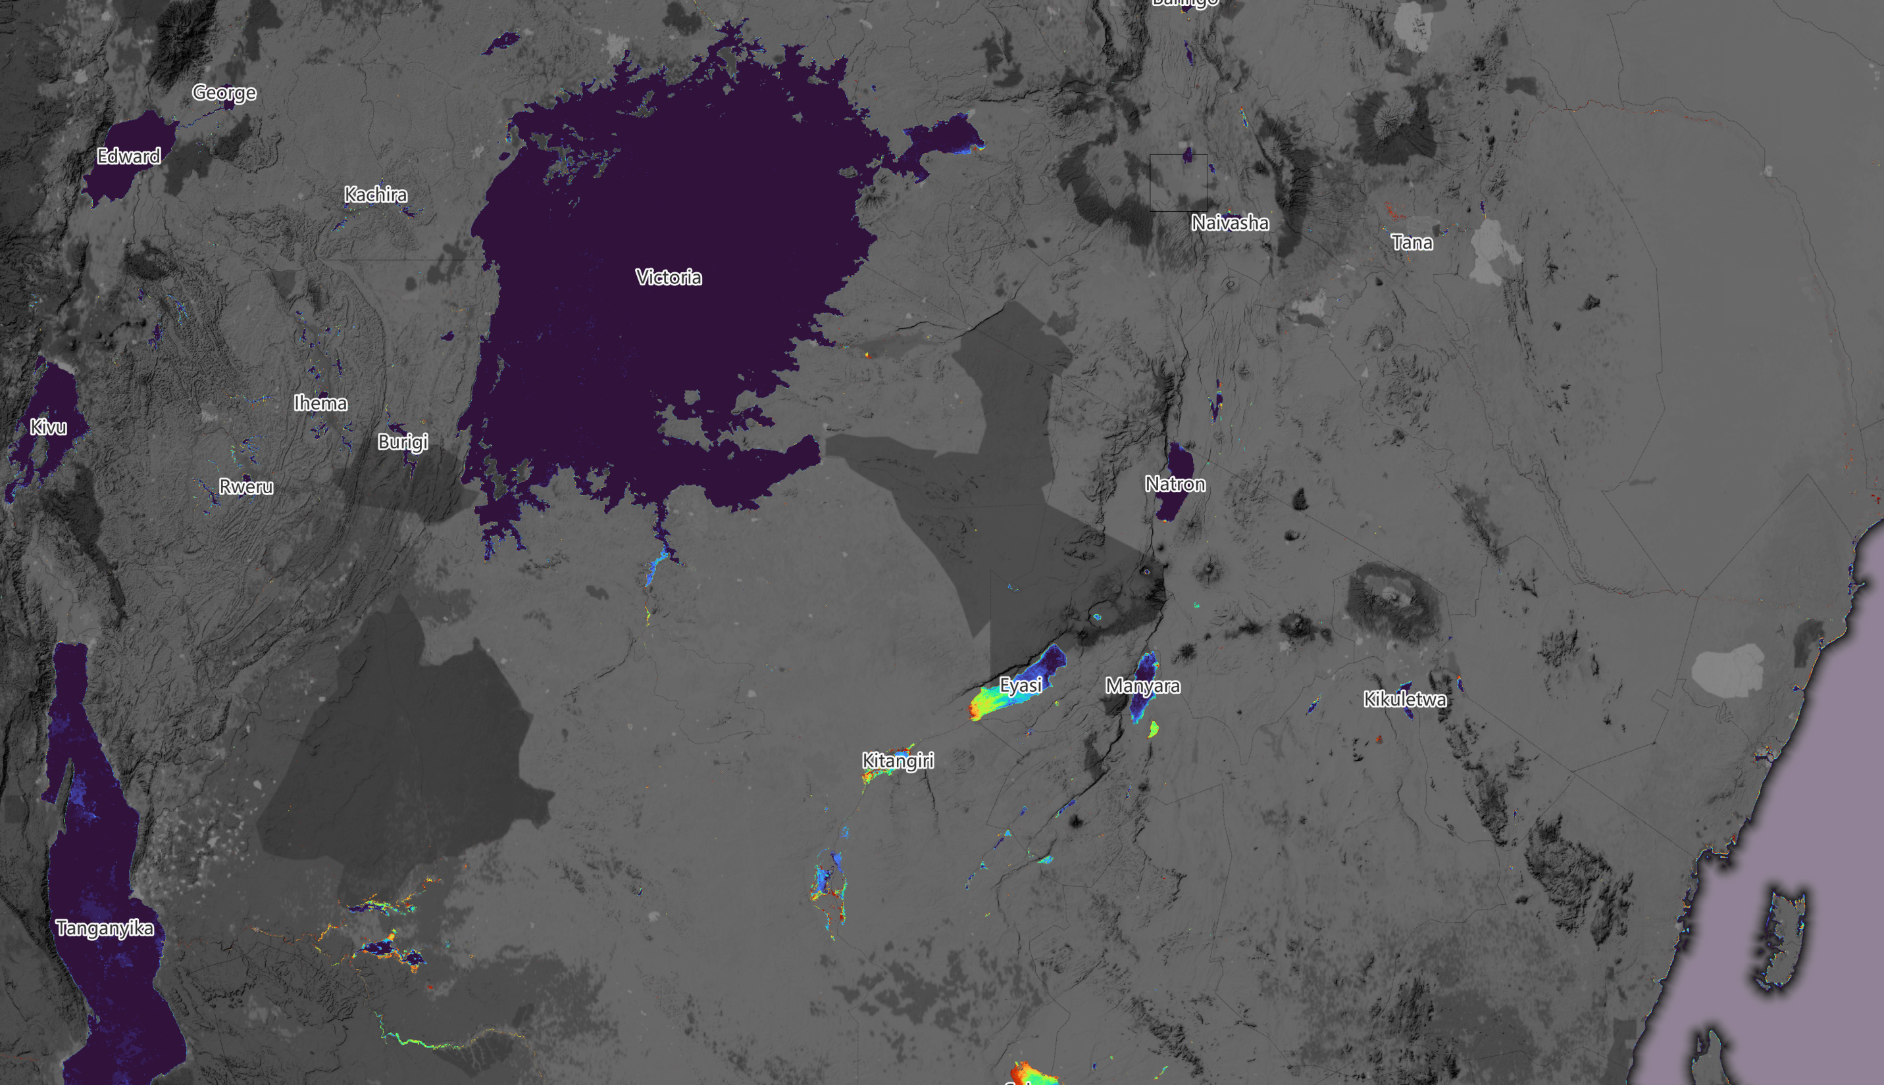
Leveraging daily time series
Notes:
We leverage daily time series for the timeframe of 2003 to 2020 …

Slide 40
Utilized Datasets
Variable name | Dataset name and access | Spatial Resolution | Temporal Resolution | Included in Dynamic Similarity Analysis? | Included in Causal Analysis? | Geographical scale (lake/subbasin/none)
Surface water | GWP (Klein et al., 2021) | 250 m | daily | yes | yes | Lake/subbasin
Air temperature (T) | ERA5-Land (Muñoz Sabater, 2023) | 9 km | hourly | yes | no | Lake/subbasin
Dew point temperature (D) |  |  |  | yes | no | Lake/subbasin
Potential Evaporation (PET) |  |  |  | yes | no | Lake/subbasin
Total Evaporation (ET) |  |  |  | yes | yes | Lake/subbasin
Surface solar radiation downwards (SSRD) |  |  |  | yes | no | Lake/subbasin
Precipitation (P) |  |  |  | yes | yes | Lake/subbasin
Gross Primary Productivity (GPP) | Global MODIS and FLUXSAT-derived Daily Gross Primary Production, V2 (Joiner and Yoshida, 2021) | 5 km | daily | yes | yes | Lake/subbasin
Groundwater (GW) | GLWS2.0 (Gerdener et al., 2023) | 50 km | monthly | yes | yes | Lake/subbasin
Soil Moisture (SM) |  |  |  | yes | yes | Lake/subbasin
North Atlantic Oscillation (NAO) index | NAO Index (NOAA / National Weather Service, 2023) | – | daily | yes | no | none
Indian Ocean Dipole (IOD) index | IOD Index (NASA JPL, 2023) | – | weekly | yes | no | none

Slide 41
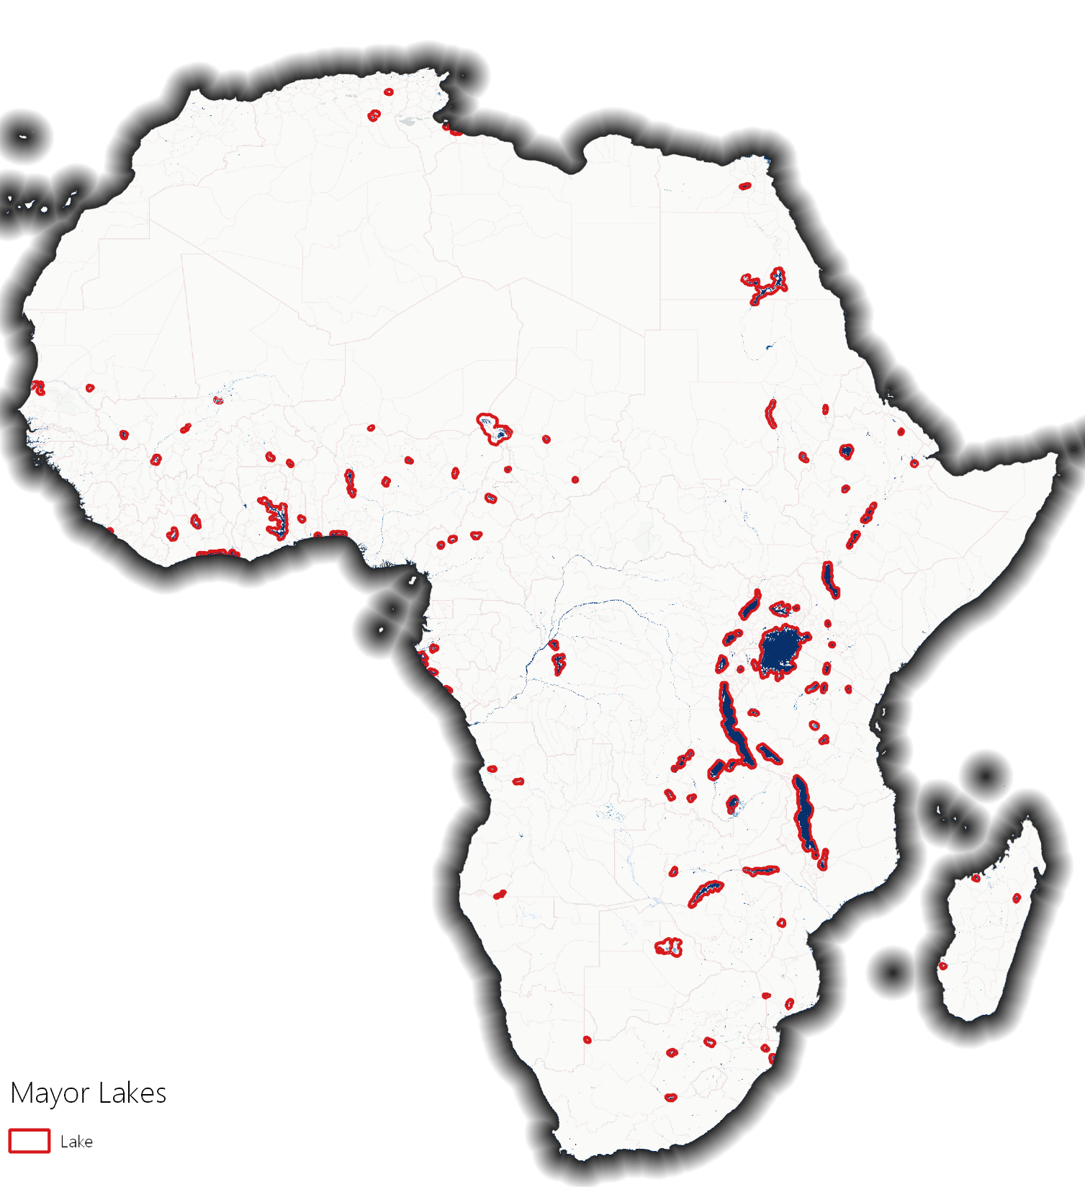
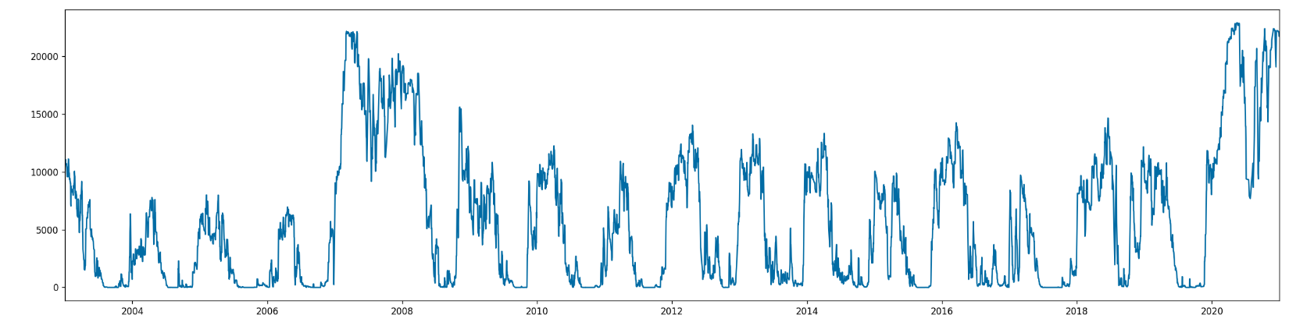
Daily Time Series Decomposition
Water area Lake Eyasi – endorheic salt lake
high
low
Time series decomposition for African Major Lakes. Exemplary case: Lake Eyasi (Sogno et al., in preparation).

Slide 42
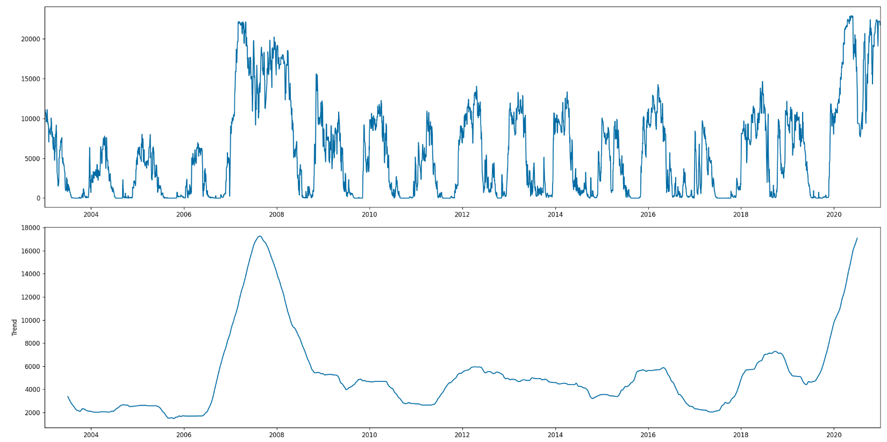
Daily Time Series Decomposition
Water area Lake Eyasi – endorheic salt lake
high
low
high
low
Time series decomposition for African Major Lakes. Exemplary case: Lake Eyasi (Sogno et al., in preparation).

Slide 43
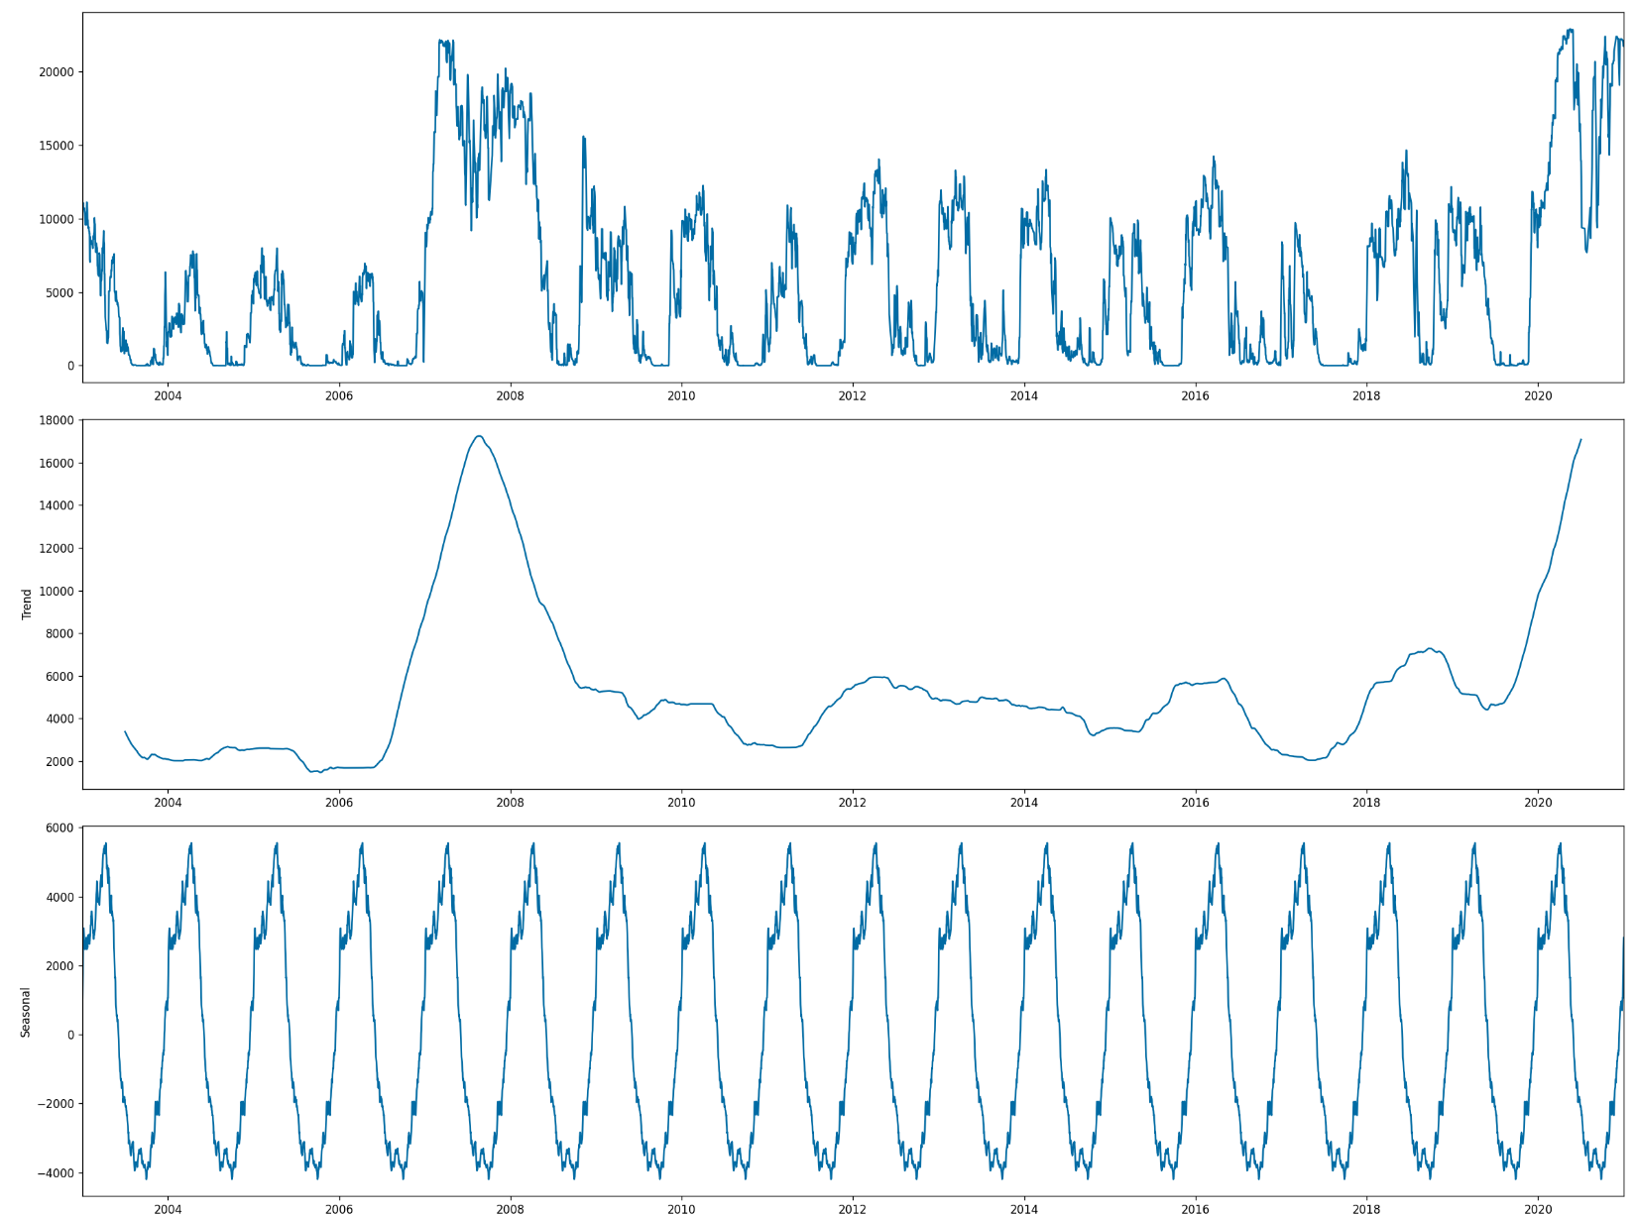
Daily Time Series Decomposition
Water area Lake Eyasi – endorheic salt lake
high
low
high
low
high
low
Time series decomposition for African Major Lakes. Exemplary case: Lake Eyasi (Sogno et al., in preparation).

Slide 44
Daily Time Series Decomposition
Water area Lake Eyasi – endorheic salt lake
high
Raw signal
Reported flood events
low
high
Trend signal
Exceptional wet phases
low
high
Seasonal signal
low
Wet season
Dry season
Time series decomposition for African Major Lakes. Exemplary case: Lake Eyasi (Sogno et al., in preparation).

Slide 45
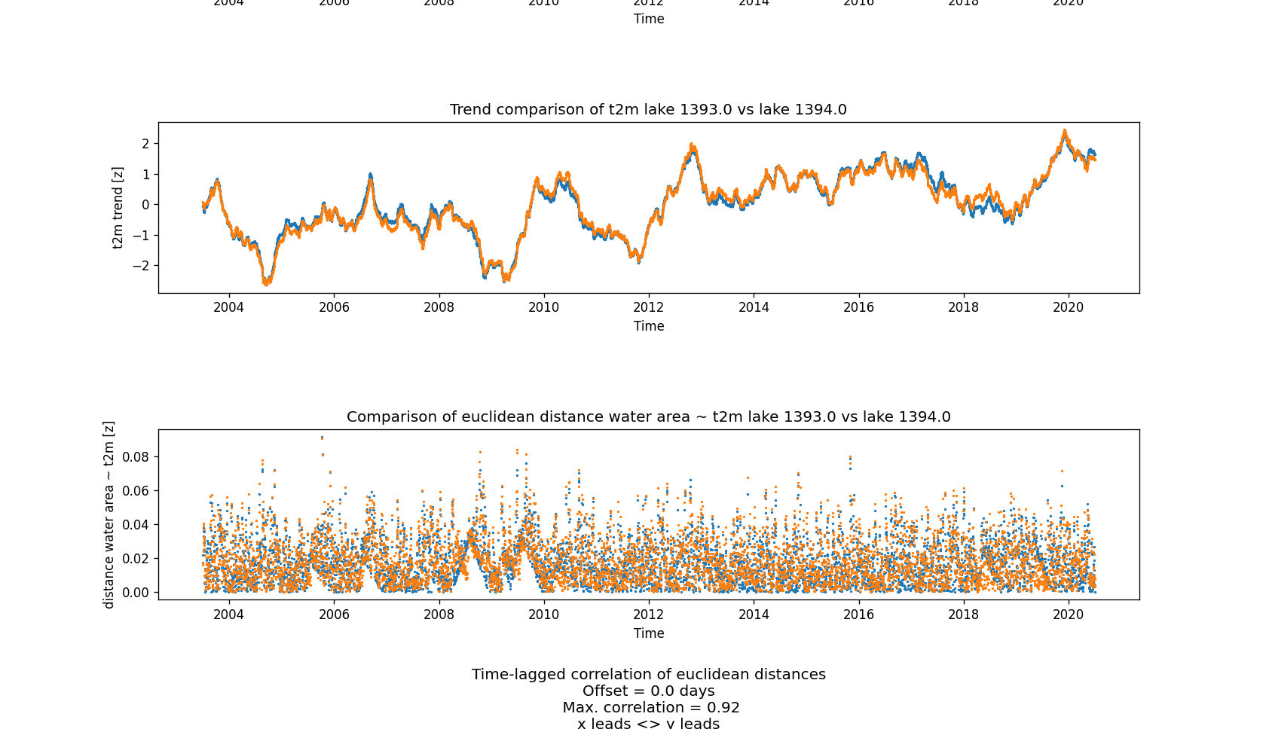
Similarity in lake dynamics

Slide 46
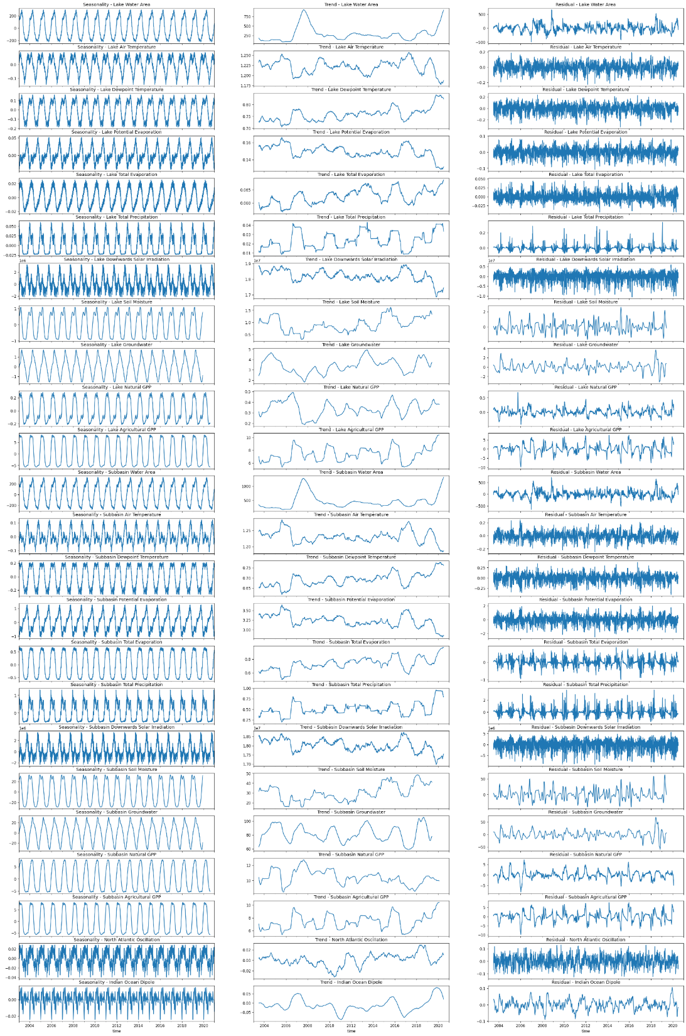
Utilized Datasets
Values at lake level
Dependent variable (GWP lake extent)
Independent variables (each on lake and subbasin level):
Subbasin-wide surface water
Air temperature
Dewpoint temperature
Potential Evporation
Total Evaporation (~ Evapotranspiration)
Total Precipitation
Downwards Solar Irradiation
Soil Moisture
Groundwater
Natural GPP
Agricultural GPP
North Atlantic Oscillation
Indian Ocean Dipole
Values at subbasin level
Large-scale oscillations

Slide 47
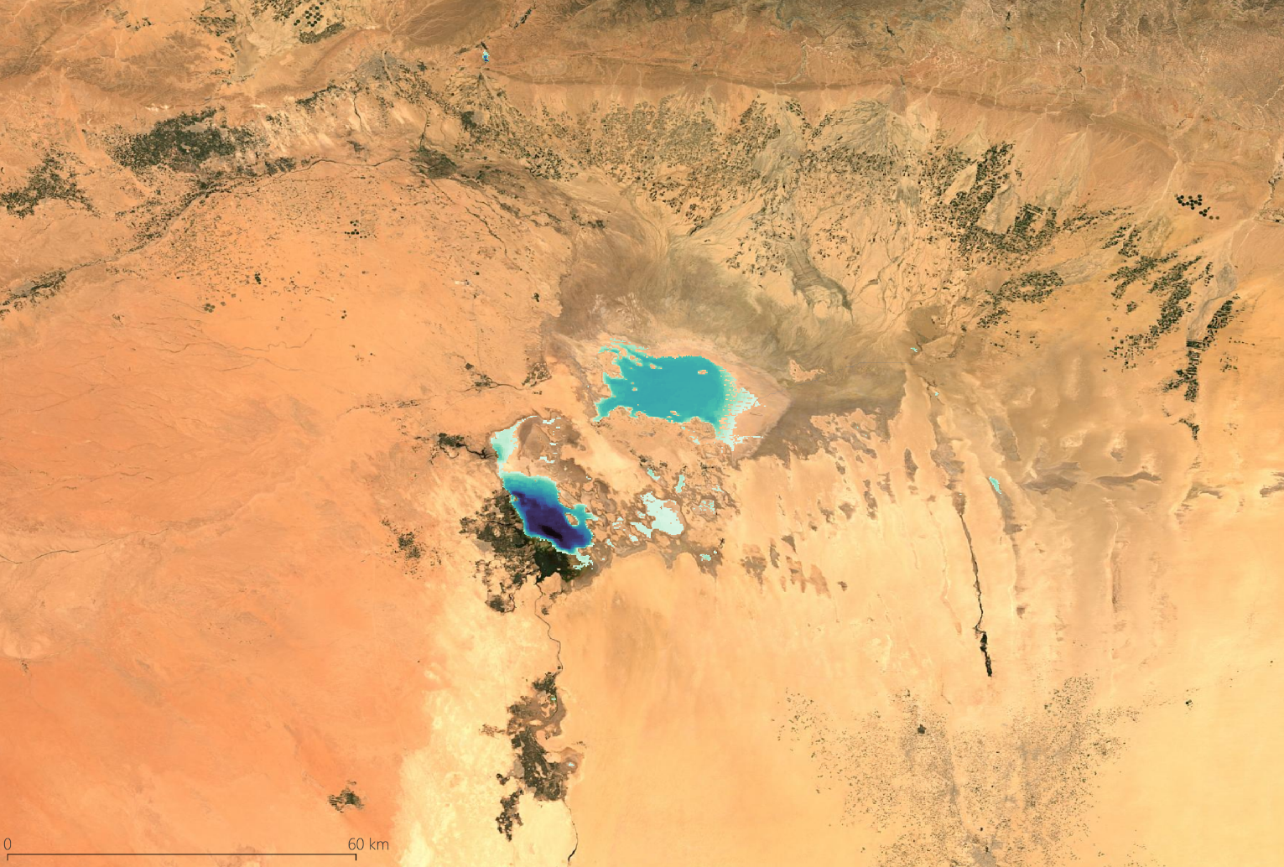
Lake Dynamic Similarities
Based on similarities in the behavior of the dependent variable (lake extent) in response to the independent variables, lakes that “behave similarly” can be found
Example:
Chott Melrhir and Chott Felrhir
  Both are seasonal salt lakes in northeastern Algeria
Sentinel-2 true-color composite 2020. In blue: GWP water frequency 2020 in Chott Melrhir (NE) and Chott Felrhir (SW).

Slide 48
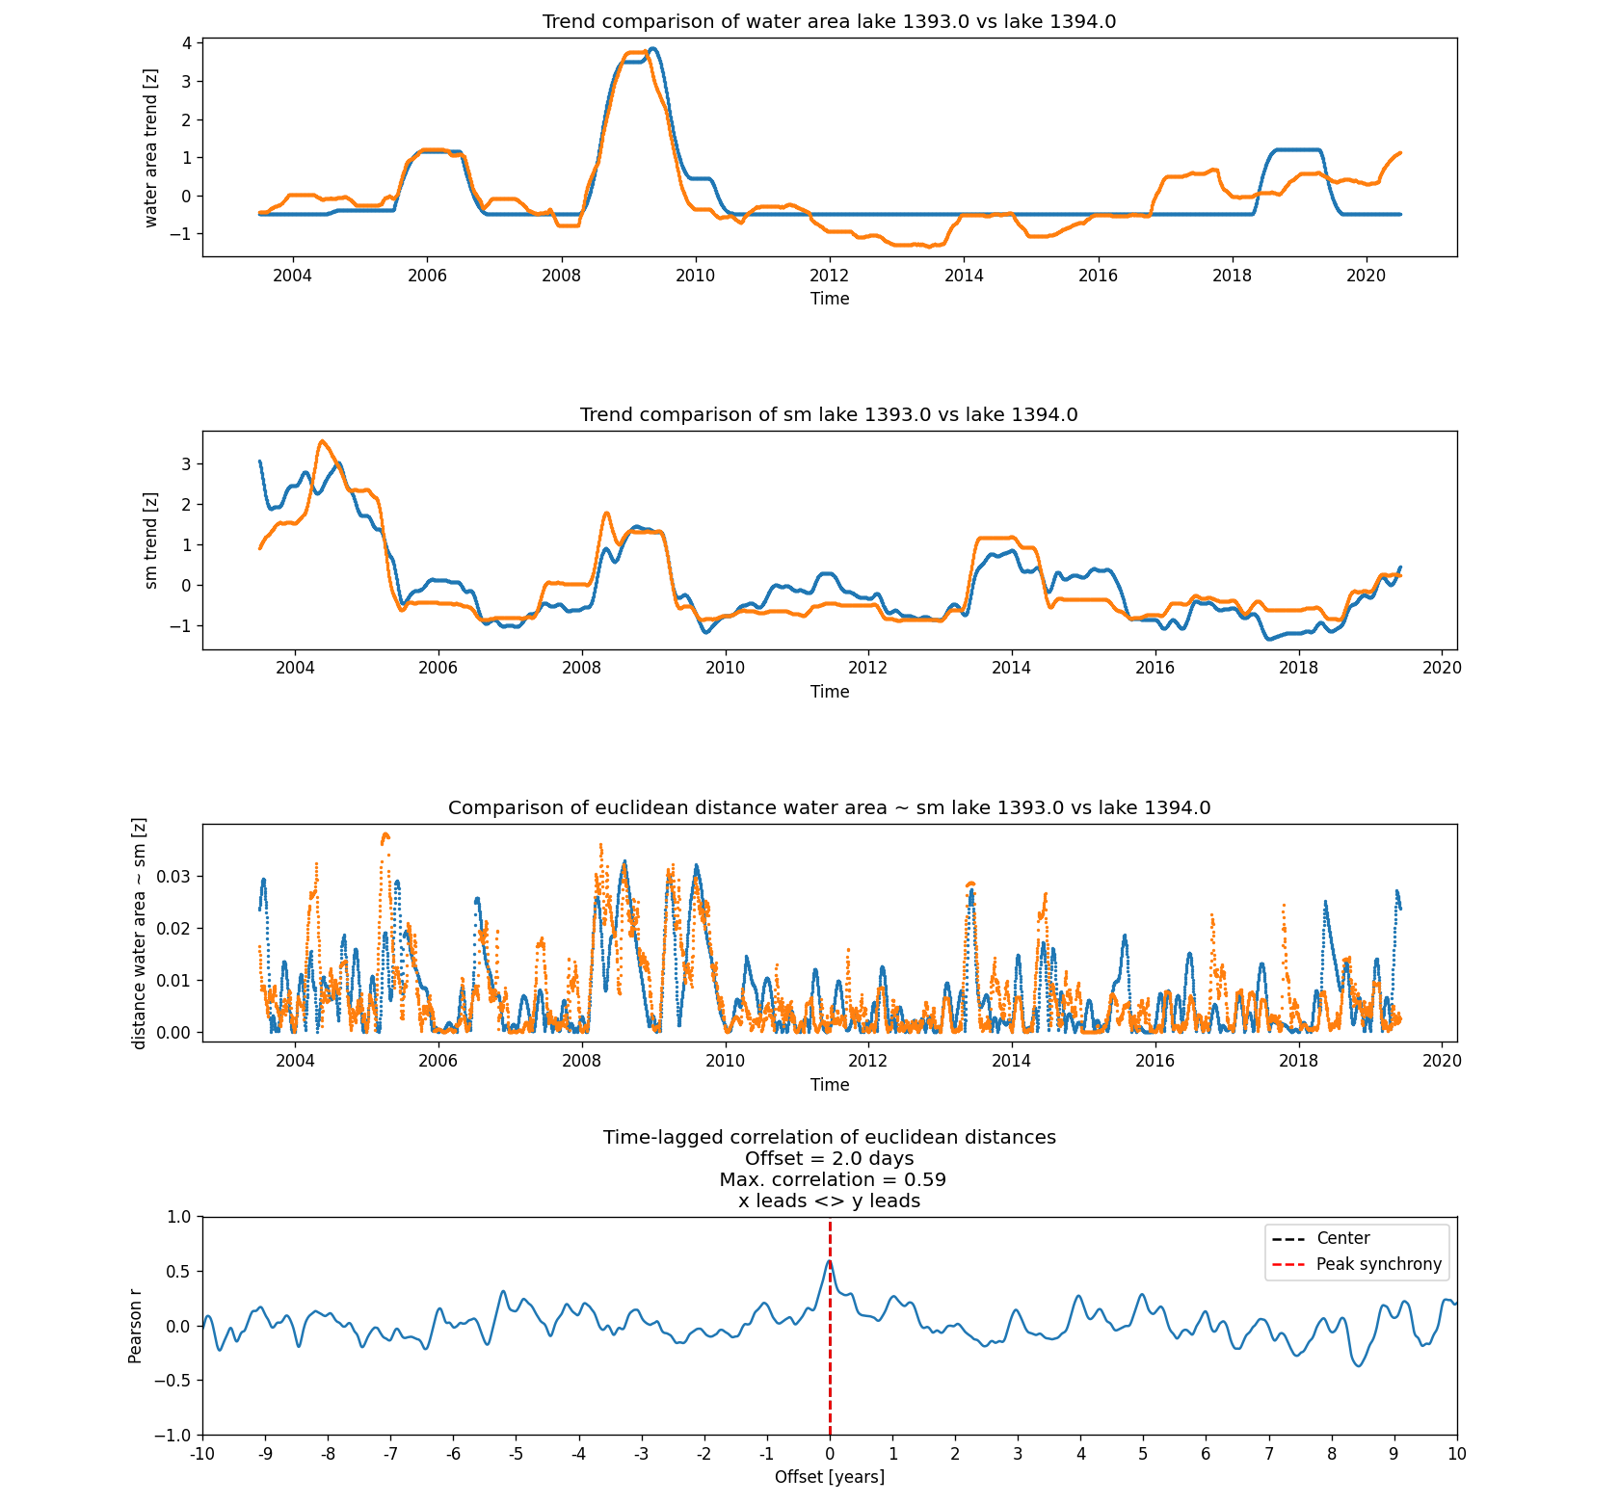
Lake Dynamic Similarities
Based on similarities in the behavior of the dependent variable (lake extent) in response to the independent variables, lakes that “behave similarly” can be found
Example:
Chott Melrhir and Chott Felrhir
  Both are seasonal salt lakes in northeastern Algeria
  While their lake trends show some similarity, Chott Felrhir has a more dynamic, increasing trend since 2013
  By comparing the Euclidean distance between zscore-weighed values of the dependent and independent variables through cross-correlation, similar behavior can be found despite different lake sizes and trend developments
  To quantify the similarity, the number of variables where the cross-correlation exceeds 0.5 is divided by the number of independent variables available for both lakes
Calculation of dynamic similarity between Chott Melrhir and Chott Felrhir in their reaction to changes in soil moisture.

Slide 49
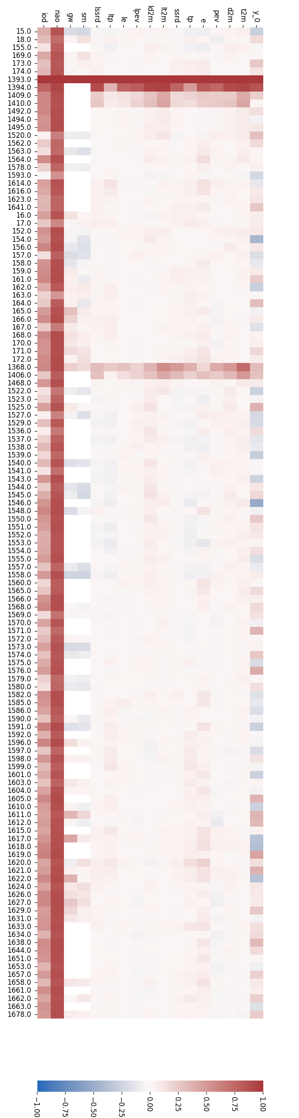
Lake Dynamic Similarities
Based on similarities in the behavior of the dependent variable (lake extent) in response to the independent variables, lakes that “behave similarly” can be found
Example:
Chott Melrhir and Chott Felrhir
  Both are seasonal salt lakes in northeastern Algeria
  While their lake trends show some similarity, Chott Felrhir has a more dynamic, increasing trend since 2013
  By comparing the Euclidean distance between zscore-weighed values of the dependent and independent variables through cross-correlation, similar behavior can be found despite different lake sizes and trend developments
  To quantify the similarity, the number of variables where the cross-correlation exceeds 0.5 is divided by the number of independent variables available for both lakes
  Extend this to all considered variables and the result looks like this:
Dynamic similarity indication for Chott Melrhir

Slide 50
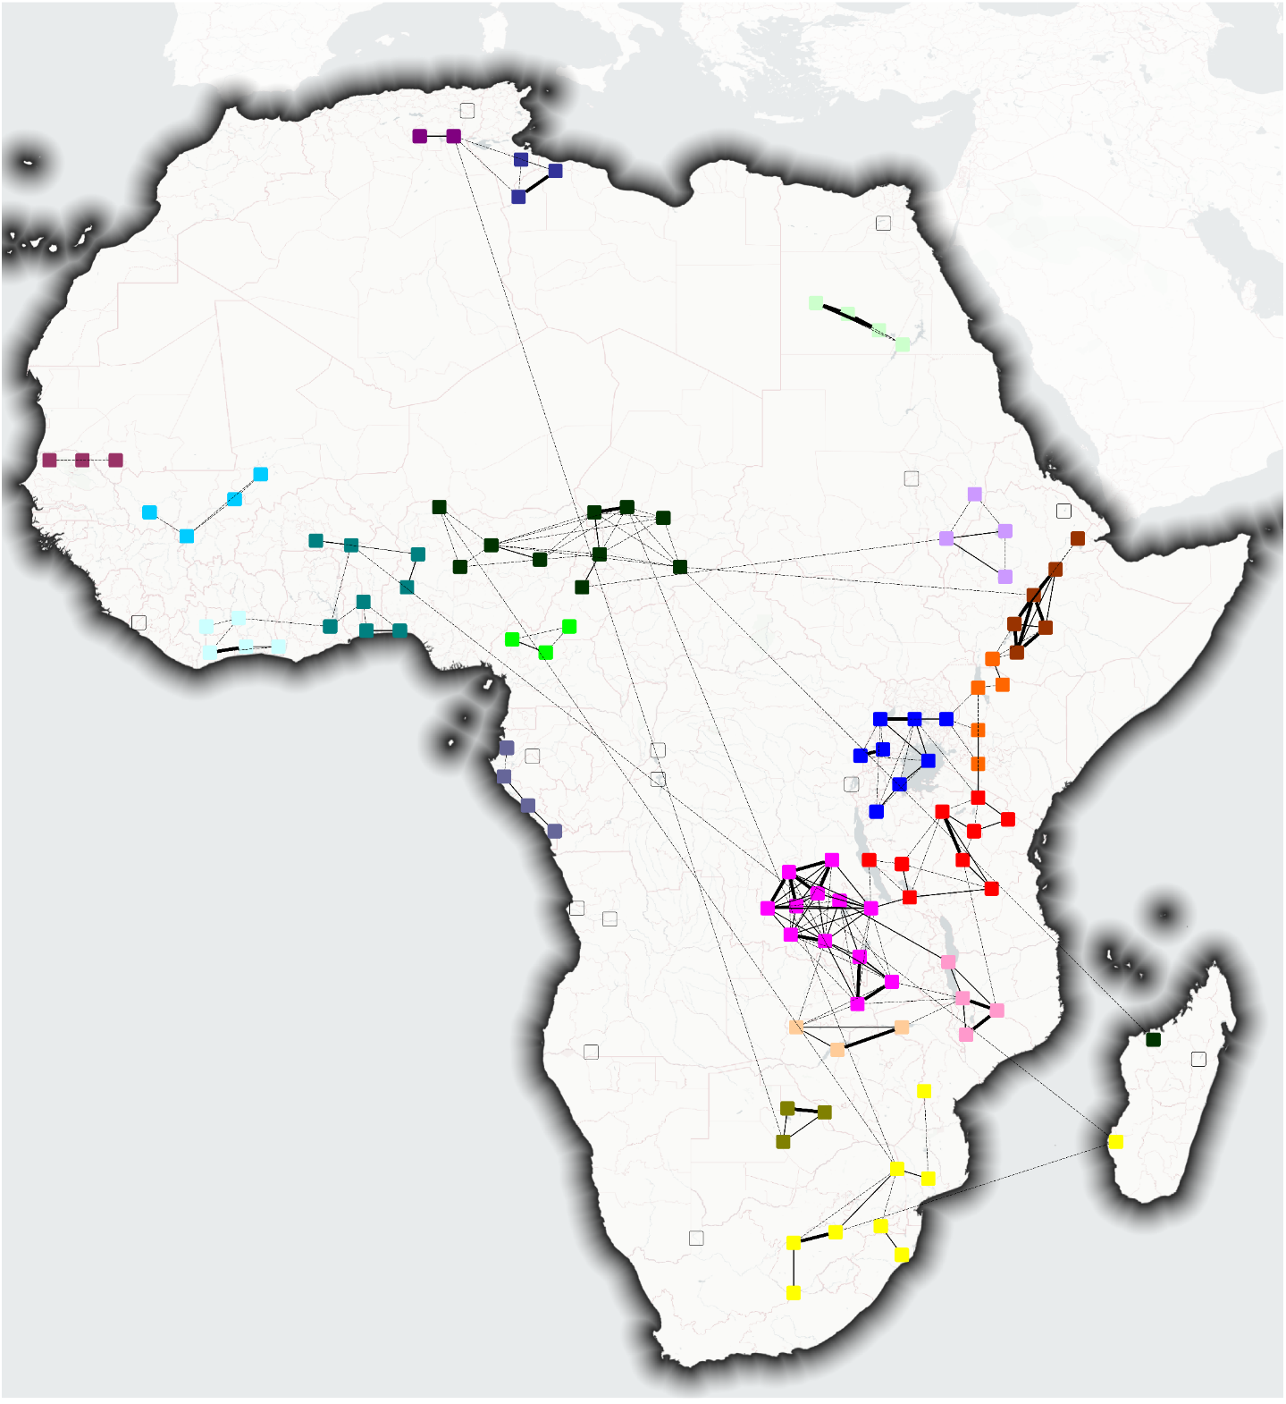

Lake Dynamic Similarities
By calculating this “dynamic similarity” for all African major lakes, we can identify clusters of lakes with similar responses to independent variables
These identified clusters are:
  The Chott Cluster (A)
  The Sebkha Cluster (B)
  The Nasser-Toshka Cluster (C)
  The Senegal Cluster (D)
  The Mali Cluster (E)
  The Ivory Coast Cluster (F)
  The Volta-Niger Cluster (F)
  The Chad Cluster (H)
  The Sanaga Cluster (I)
  The Gabon Cluster (J)
  The Nile Cluster (K)
  The Ethiopian Rift Cluster (L)
  The Turkana Cluster (M)
  The Victoria Cluster (N)
  The Tanganyika Cluster (O)
  The Mweru Cluster (P)
  The Malawi Cluster (Q)
  The Zambezi Cluster (R)
  The Salt Pan Cluster (S)
  The Southern Cluster (T)
A
B
C
D
E
H
K
G
F
L
I
M
J
N
O
P
Q
R
Lake Node
> 20% Dynamic Similarity
S
> 50% Dynamic Similarity
T
> 80% Dynamic Similarity
Dynamic similarity clusters (Sogno et al., in preparation).

Slide 51
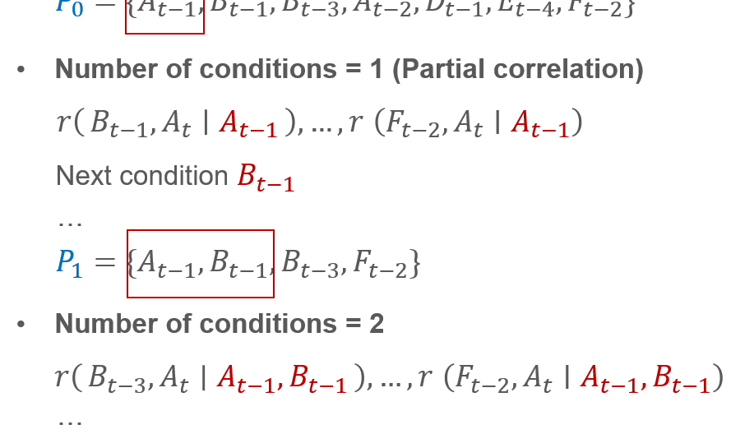
Causal analysis - methodology

Slide 52
Utilized Datasets
Dependent variable (GWP lake extent)
Values at lake level
Independent variables for causal analysis (each on lake and subbasin level):
Subbasin-wide surface water
Total Evaporation (~ Evapotranspiration)
Total Precipitation
Soil Moisture
Groundwater
Gross Primary Productivity
Values at subbasin level
Notes:
That cover both the surface water extent and potential impacting variables from the atmosphere, biosphere, and hydrosphere domain

Slide 53
Causal Analysis of Surface Water Dynamics
Basic idea:
  Identify potential relationships by correlating suspected drivers with target variable (water extent) at various time steps
  Investigate partial correlations at different temporal lags and ensure independent impact of potential drivers
Output:
  Potential causes (positive and negative drivers) of surface water dynamics with significant impact

Slide 54

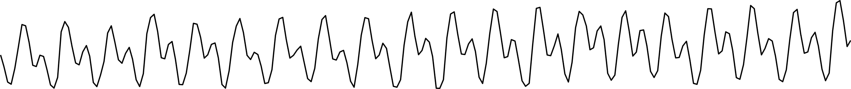
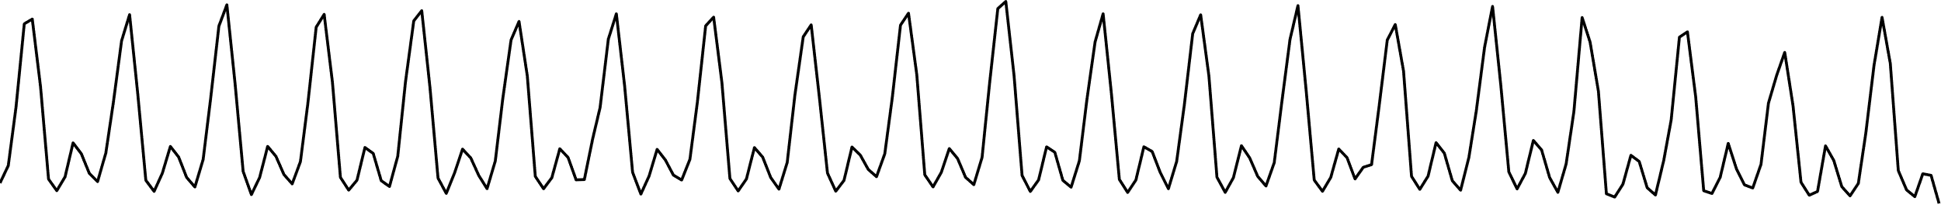

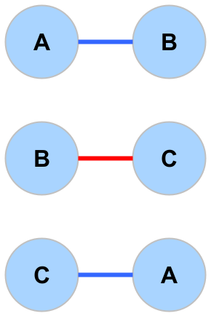


Causal Analysis of Surface Water Dynamics
Which process is influencing variable “A”?
A
Optical:
Sentinel-3A (300m), MODIS (250m), AVHRR (1km)
Radar:
Envisat ASAR WSM (150m)
Sentinel-2A/B, SPOT, IKONOS
Sentinel-1A/B, TSX
➔ Sentinel-1
global coverage
up-to-date
dense time series available S1A operational since October 2014, twin satellite mode with S1B since October 2016
B
C
D
E
Bivariate analysis
Spurious correlation
Multivariate analysis
Autocorrelation
Indirect
dependency
Common driver

Slide 55

Causal Analysis of Surface Water Dynamics
Peter and Clark Momentary Conditional Independence (PCMCI)
Using partial correlation to quantify the relations within a high-dimensional feature space
Overcome spurious correlations
Visualize detected links by graphs
Runge 2018, Runge et al. 2019
D
A
B
$$r(A_{t−1,}B_{t} ∣Iterate through$$
$$conditions)$$
A
C
C
D
B

Slide 56
PCMCI
1. Step: Estimate „Parents“
A
Number of conditions = 0
Correlation of $A_{t}$ with all other variables (+ temporal lag)
Optical:
Sentinel-3A (300m), MODIS (250m), AVHRR (1km)
Radar:
Envisat ASAR WSM (150m)
Sentinel-2A/B, SPOT, IKONOS
Sentinel-1A/B, TSX
➔ Sentinel-1
global coverage
up-to-date
dense time series available S1A operational since October 2014, twin satellite mode with S1B since October 2016
B
$r\left(B_{t−1}, A_{t}\right), …, r$ $\left(F_{t−5}, A_{t}\right)$
C
$$P_{0}=\{A_{t−1},B_{t−1},B_{t−3},A_{t−2},D_{t−1},E_{t−4},F_{t−2}\}$$
D
Number of conditions = 1 (Partial correlation)
E
$r\left(B_{t−1}, A_{t} ∣ A_{t−1}\right), …, r$ $\left(F_{t−2}, A_{t}∣A_{t−1}\right)$
F
Next condition $B_{t−1}$
…
…
t-5
t-4
t-3
t-2
t-1
t
$$P_{1}=\{A_{t−1},B_{t−1},B_{t−3},F_{t−2}\}$$
Number of conditions = 2
$r\left(B_{t−3}, A_{t} ∣ A_{t−1},B_{t−1}\right), …, r$ $\left(F_{t−2}, A_{t}∣A_{t−1},B_{t−1}\right)$
…
$$P_{2}=\{A_{t−1},B_{t−1},F_{t−2}\}$$
Algorithm converges:
$$P_{A}=P_{2}$$
(Number of „parents“ in $P_{i}$ ≥ Conditions for next iteration)
Runge 2018, Runge et al. 2019

Slide 57

PCMCI
2. Step: Estimate strength of links
A
What is the influence of C on A at lag 2?
Optical:
Sentinel-3A (300m), MODIS (250m), AVHRR (1km)
Radar:
Envisat ASAR WSM (150m)
Sentinel-2A/B, SPOT, IKONOS
Sentinel-1A/B, TSX
➔ Sentinel-1
global coverage
up-to-date
dense time series available S1A operational since October 2014, twin satellite mode with S1B since October 2016
B
$$r\left(C_{t−2}, A_{t} ∣ P_{A },P_{C}\right)$$
C
D
3. Step: Visualize links
E
F
…
t-5
t-4
t-3
t-2
t-1
t
Runge 2018, Runge et al. 2019

Slide 58

Unveiling causal relationships

Slide 59







Causal Analysis of Surface Water Dynamics
Full Timeframe
Dry Seasons
Wet Seasons
Dominant causal impact on major lakes (Sogno et al., in preparation).

Slide 60
Causal Analysis of Surface Water Dynamics
Full Timeframe
Dry Seasons
Wet Seasons
Atmosphere Interaction
Positive Causal Impacts
Biosphere Interaction
Soil Interaction
Positive causal impacts on major lakes (Sogno et al., in preparation).
Notes:
Our findings show that:
Most lakes are positively driven by atmospheric interaction (mainly precipitation)
There is also substantial soil interaction, especially with the African Great Lakes, which hints towards groundwater recharge

Slide 61
Causal Analysis of Surface Water Dynamics
Full Timeframe
Dry Seasons
Wet Seasons
Atmosphere Interaction
Negative Causal Impacts
Biosphere Interaction
Soil Interaction
Negative causal impacts on major lakes (Sogno et al., in preparation).
Notes:
Negative drivers are often a mixture of evaporation, seepage, and biosphere interaction, here we suspect that much of this comes in the form of water abstraction

Slide 62


Lake Causal Similarities
A
B
C
D
E
H
K
We reassessed the found dynamic similarities and applied the network analysis only to variables that have a significant causal impact on a lake’s dynamic
The same lake clusters exist as in the “dynamic similarity” investigation, but with fewer long-range interconnections
G
F
L
I
M
J
N
O
P
Q
Lake Node
R
> 20% Causal Similarity
S
> 50% Causal Similarity
> 80% Causal Similarity
T
Causal similarity clusters (Sogno et al., in preparation).

Slide 63
Thank you
Photo: Patrick Sogno
Patrick Sogno (patrick.sogno@dlr.de)
German Aerospace Center (DLR)
German Remote Sensing Data Center (DFD)
Land Surface Dynamics Department (LAX)

