Slide 1








Climate Risk and Vulnerability Assessment (CRVA) for the Port of
Heraklion in Greece
Anastasios Perdios¹, Antonios Boutatis², Andreas Langousis¹, Panagiotis Biniskos², Eva Kypraiou²,
Konstantina Korda², and Alexandros Zacharof³
¹Department of Civil Engineering, University of Patras, Greece; ²Rogan Associates S.A., 5 Chatzigianni Mexi Str., Athens 11528, Greece; ³European Investment Bank, 98-100 boulevard Konrad Adenauer, L-2950 Luxembourg

Slide 2

Objectives
Climate change
is expected to impact the maritime sector, including the port industry.
Ports are associated with increased infrastructure investments, and experience operational challenges from the increased sea levels and extreme weather conditions.
The present study attempts to assess the impacts of climate change on port operations associated with:
Changes in mean sea level, storm surges and wave characteristics.
Reduced visibility caused by intense precipitation and/or fog.
Disruption of port operations due to high wind speeds, drainage system induced flooding, as well as river discharges and sediment transfer in the harbor basin.
EGU General Assembly 2024

Slide 3
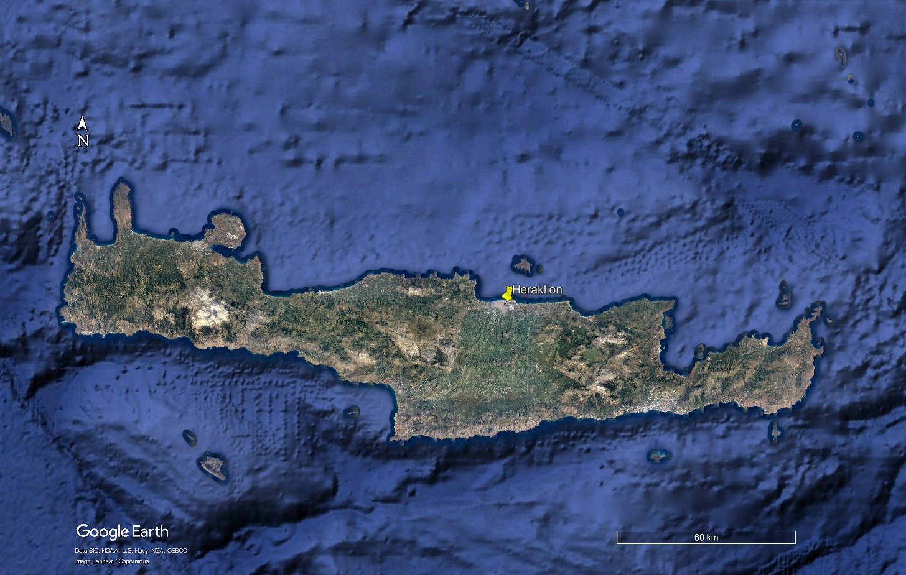
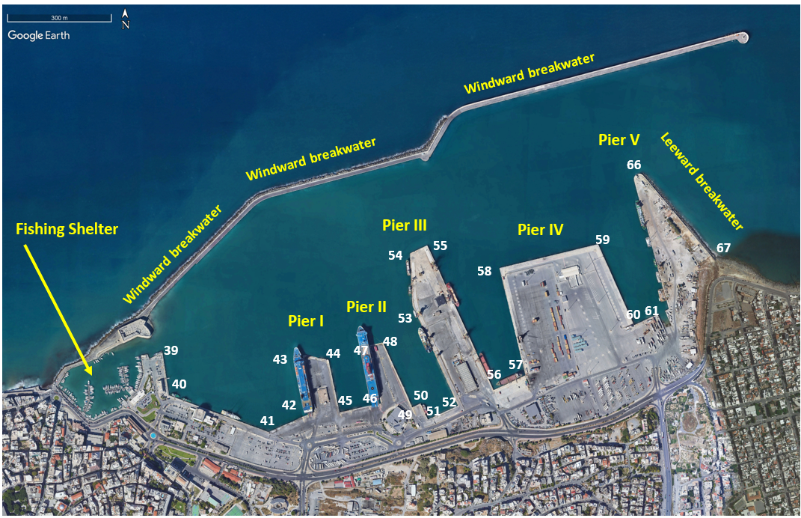
Study Area
The Port of Heraklion is located in the North side of the island of Crete and is one of the main ports of national importance in the Greek Maritime Network.
Port of Heraklion
Sylamianos and Mesampelies rivers have their outlets at the eastern (Pier V) and western (Pier I) parts of the port of Heraklion.
Brief technical characteristics
Multi-purpose port, as it has a ferry terminal, a cruise terminal, and general bulk cargo and container terminal.
Sylamianos outlet
The Heraklion Port consists of three harbor basins:
An internal one (Venetian Port) with an area of 35,300 m² at the western side of the Port.
Two external basins with areas of 426,561 m² and 355,756 m², respectively, within which five piers (I, II, III, IV, and V) are formed.
Mesampelies outlet
EGU General Assembly 2024

Slide 4

Current Climate Data
Precipitation
1st revision of the flood risk management plans of the island of Crete
Wind, Temperature
Hellenic National Meteorological Service
Water Levels
Water level change indicators for the European coast from 1977 to 2100 derived from climate projections
Wave Parameters
Mediterranean Sea Waves Reanalysis
EGU General Assembly 2024

Slide 5

Future Climate Data
Precipitation
SWICCA program (Service for Water Indicators in Climate Change Adaption, 2015 - 2018)
Wind
EURO-CORDEX ensemble, HIRHAM5 RCM (Regional Climate Model) nested in (downscaled from) EC-EARTH GCM (Global Climate model)
Water Levels
Water level change indicators for the European coast from 1977 to 2100 derived from climate projections
Wave Parameters
Water level change indicators for the European coast from 1977 to 2100 derived from climate projections
EGU General Assembly 2024

Slide 6
Water Levels
Current Climate
Future Climate
 | Historical (1977-2005) | Reanalysis (2001-2017)
Highest Astronomical Tide (m) | 0.122 | 0.122
Lowest Astronomical Tide (m) | -0.094 | -0.094
Storm Surge Level - 90th percentile (m) | 0.070 | 0.069
Mean Sea Level (m) | 0.0029 | 0.0029
Total Water Level - 90th percentile (m) | 0.072 | 0.075
Storm Surge Level (m) – 100 years return period | 0.451 | 0.410
Total Water Level (m) – 100 years return period | 0.438 | 0.395
TWL: Total Water Level
 | TWL (m) | Changes in TWL compared to the reference period (m)
Historical (1977-2005) | 0.072 | -
Reanalysis (2001-2017) | 0.075 | ~ 0.00
RCP 8.5 (2041-2070) | -0.306 | ~ -0.25
RCP 4.5 (2071-2100) | -0.443 | ~ -0.37
 | TWL (m) T = 100 yr | Changes in TWL compared to the reference period (m) T = 100 yr
Historical (1977-2005) | 0.438 | -
Reanalysis (2001-2017) | 0.395 | ~ - 0.045
RCP 8.5 (2041-2070) | 0.716 | ~ +0.30
RCP 4.5 (2071-2100) | 0.869 | ~ +0.45
EGU General Assembly 2024

Slide 7
Wave Conditions
Significant Wave Height
Peak Wave Period
Significant Wave Height (m)
Historical (1977-2005) | 3.19
Reanalysis (2001-2017) | 2.334
RCP 8.5 (2041-2070) | 3.025
RCP 4.5 (2071-2100) | 3.201
Peak Wave Period (sec)
Historical (1977-2005) | 9.611
Reanalysis (2001-2017) | 9.024
RCP 8.5 (2041-2070) | 9.423
RCP 4.5 (2071-2100) | 9.366
A slight decreasing trend is observed as we progress towards the end of the 21st century
No significant change is observed throughout the 21st century
 | Peak Wave Period (sec) – T = 100 yr | Changes in Peak Wave Period compared to the reference period (sec) T = 100 yr
Historical (1977-2005) | 16.536 | -
Reanalysis (2001-2017) | 16.223 | ~ - 0.30
RCP 8.5 (2041-2070) | 17.556 | ~ + 1.00
RCP 4.5 (2071-2100) | 16.813 | ~ + 0.30
Significant Wave Height (m) T = 100 yr
Historical (1977-2005) | 8.96
Reanalysis (2001-2017) | 5.771
RCP 8.5 (2041-2070) | 8.693
RCP 4.5 (2071-2100) | 8.537
A slight decreasing trend is observed as we progress towards the end of the 21st century
EGU General Assembly 2024

Slide 8
Wind Speeds
Current Climate
Future Climate
estimated (10-min)
Observed data (3-hourly)
Use a semi-empirical expression to transform the CCDF derived from observations to 10-min wind velocity estimates.
Climate Change Factors (CCFs) are used to rescale the statistics obtained from historical observations to future climates
For both future periods, the effect of climate change on the frequency of high wind speeds is negligible.
The 10-min wind speed limit of 20 m/s set by international standards and regulations is estimated to be exceeded with probability 0.3%, which corresponds roughly to 27 hours operation halt per year due to strong winds.
Consistency with findings on wave characteristics
EGU General Assembly 2024

Slide 9
Precipitation
To assess the influence of climate change on IDF estimates, we make direct use of the climate change factors reported in the context of SWICCA program (Service for Water Indicators in Climate Change Adaption, 2015 - 2018)
Current Climate
Future Climate
The return period T of intense storms will decrease in the future, or equivalently, storms of the same magnitude as those observed in the past will become more frequent.
Port of Heraklion
1st revision of the flood risk management plans
Rainfall intensities in excess of 115 mm/h are expected to significantly affect visibility (< 500 m) and cause disruptions in port operation due to drainage system failure and consequent flooding.
EGU General Assembly 2024

Slide 10
Key Findings and Conclusions
The effect of climate change on the frequency of high wind speeds is negligible, and the same holds for the characteristics of extreme waves.
However, climate change induced sea level rise is foreseen to magnify the wave impact on port structures and, consequently, increase the final cost of constructions.
The return period of intense rainstorms is expected to decrease in the future, or similarly, storms of the same magnitude as those observed in the past will become more frequent.
The design storms of rivers Sylamianos and Mesampelies, are expected to become twice as frequent in the future. Specifically, their return period will be approximately halved from T = 50 years to T ≈ 25 years.
The increase in the frequency of intense storms, under future climatic conditions, causes the average yearly soil loss induced by precipitation events to also increase, leading to approximately 15 - 20% higher sediment deposition volumes in the port basin.
Due to the expected increase of the sediment deposition inside the harbor basin, more frequent inspection of depths shall be performed, and subsequently more frequent dredging should be implemented.
EGU General Assembly 2024

Slide 11
Acknowledgements
The presented work has been conducted under the project Climate Risk and Vulnerability Assessment (CRVA) for the Heraklion Port Authority" (project code: AA 011391-002/CC15302), which has been financed by the EIB under the InvestEU Advisory Hub.
EGU General Assembly 2024

