Slide 1





Estimation of the Peak Runoff Coefficient on Small Catchments in Slovakia
(EGU24-8187)
EGU 2024
Biogeosiences: BG3.1
Vienna, April 17, 2024
PAULÍKOVÁ Lynda^{1*}, KOHNOVÁ Silvia¹, VÝLETA Roman¹
1 Department of Land and Water Resources Management, Slovak University of Technology in Bratislava (Slovakia)
* Contact: lynda.paulikova@stuba.sk

Slide 2
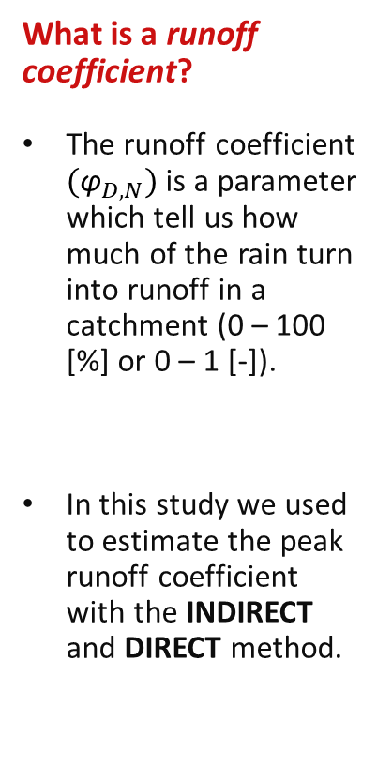
First of all...
What is a runoff coefficient?
The runoff coefficient ${\text{(}\text{φ}}_{D,N})$is a parameter which tell us how much of the rain turn into runoff in a catchment (0 – 100 [%] or 0 – 1 [-]).
In this study we used to estimate the peak runoff coefficient with the INDIRECT and DIRECT method.
What is time of concentration?
It is the amount of time it takes for water to flow from the most remote point in a catchment to the watershed outlet.
In this study we used two form of estimation tc according to the authors Kirpich (1940) and Nash (1960).
What is included in the presented study?
The presented study has two parts. Both parts deal with catchments and the estimation of runoff coefficient off them by using different methods and input data.
The presented study uses as input data from Slovak Hydrometerological Institute (SHMI).
What was the task of the authors?
Some data from SHMI had to be further processed to obtain the key factors in formulas (e.g., selection of maximum flows for summer and winter). The study's result is the estimation of 68 runoff coefficients with the INDIRECT method (the first part of the study) and 84 with the INDIRECT and DIRECT method (the second part of the study).

Slide 3
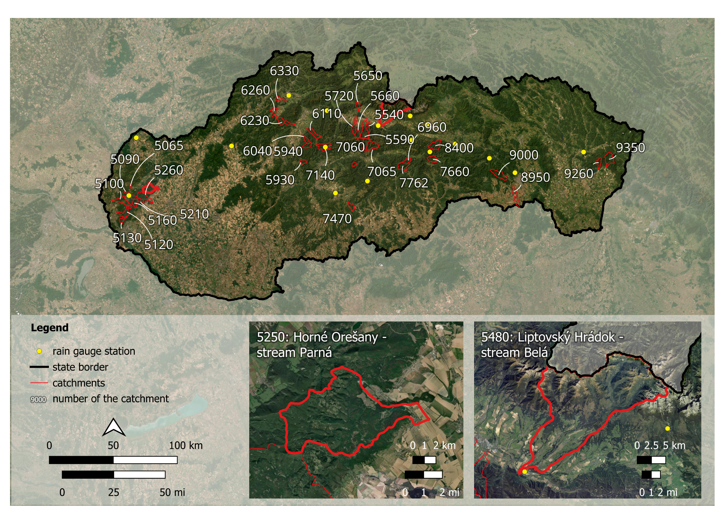
Case study
For part 1 of the study
34 small catchments from Slovakia (not larger than 50 km² or 20 mi²), used for the estimation with the indirect method,
For part 2 of the study
two catchments (Horné Orešany, stream Parná, and Liptovský Hrádok, stream Belá) used for estimation with the indirect and direct method).
Graphic:
Lynda Paulíková (Slovak University of Technology in Bratislava) • World Imagery: Esri, DigitalGlobe, GeoEye, i-cubed, USDA FSA, USGS, AEX, Getmapping, Aerogrid, IGN, IGP, swisstopo, and the GIS User Community • Data: SHMI
EGU 2024 • Biogeosiences BG3.1

Slide 4
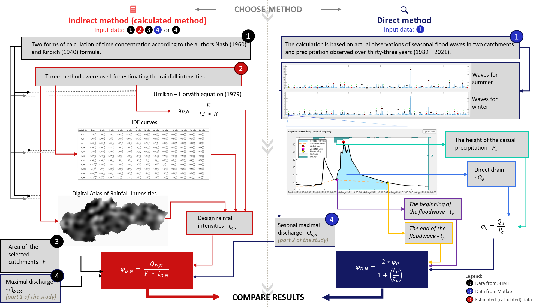

Slide 5
Part 1 of the study:
Estimation of runoff coefficient for the 100-year rainfall event with the INDIRECT METHOD
CASE STUDY:
34 catchments not larger than 5O km² (approx. 20 mi²)
The following graphic:
Lynda Paulíková (Slovak University of Technology in Bratislava) • Maps: World Imagery: Esri, DigitalGlobe, GeoEye, i-cubed, USDA FSA, USGS, AEX, Getmapping, Aerogrid, IGN, IGP, swisstopo, and the GIS User Community • Digitálny model reliéfu DMR3.5 (100m), Author: GKÚ Bratislava . Avalaiabe<https://www.geoportal.sk/sk/zbgis/na-stiahnutie/> • Data: SHMI
EGU 2024 • Biogeosiences BG3.1

Slide 6
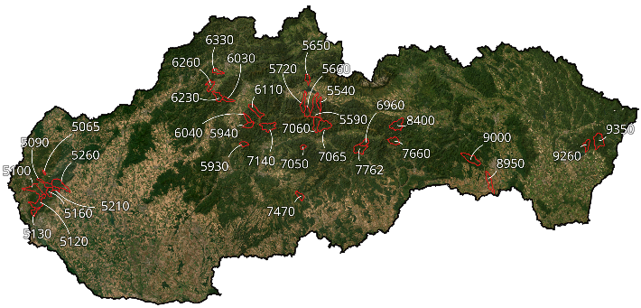
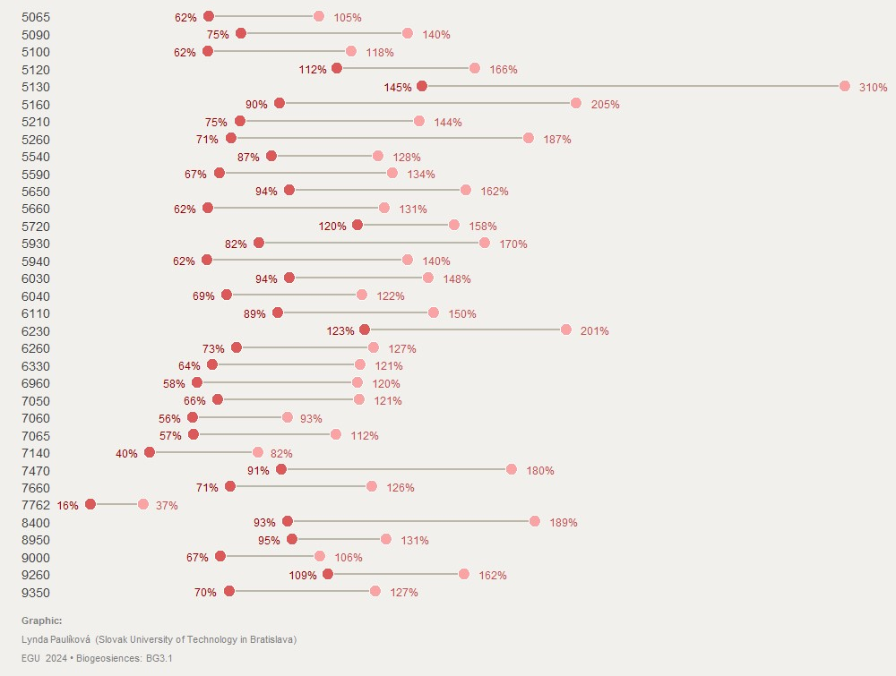
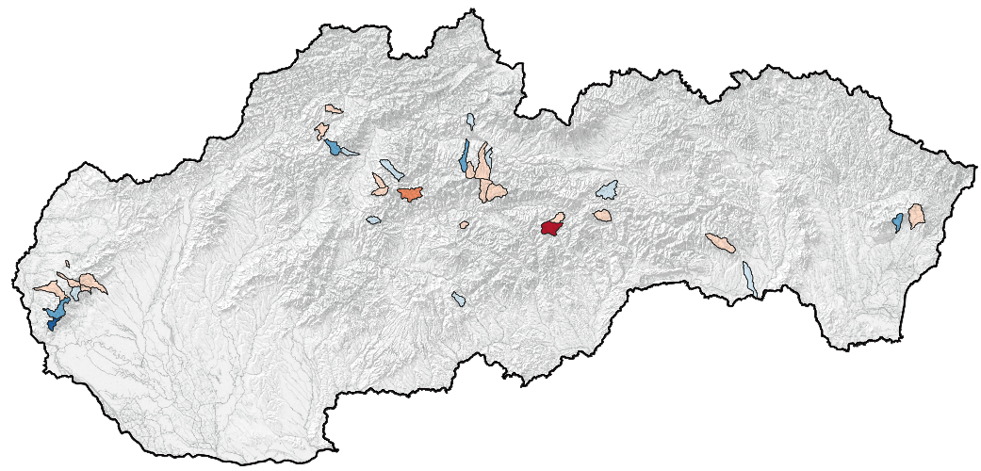
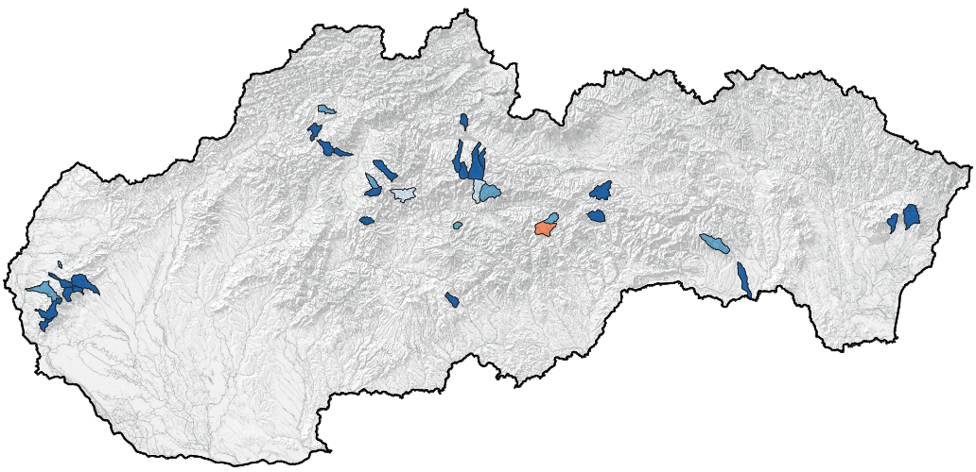
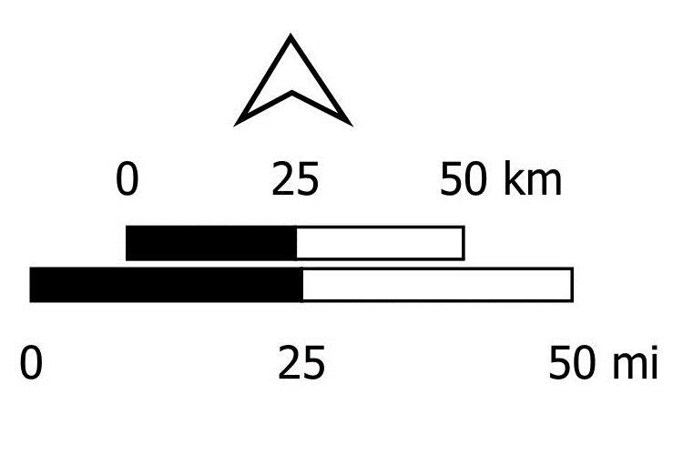
Estimated runoff coefficient [%] for the 100-year rainfall event using the Urcikán – Horváth equation (1979) and the time of concentration according to Kirpich (1940) and Nash (1960)
Catchments and their ID
Kirpich (1940)
Nash (1960)

Slide 7
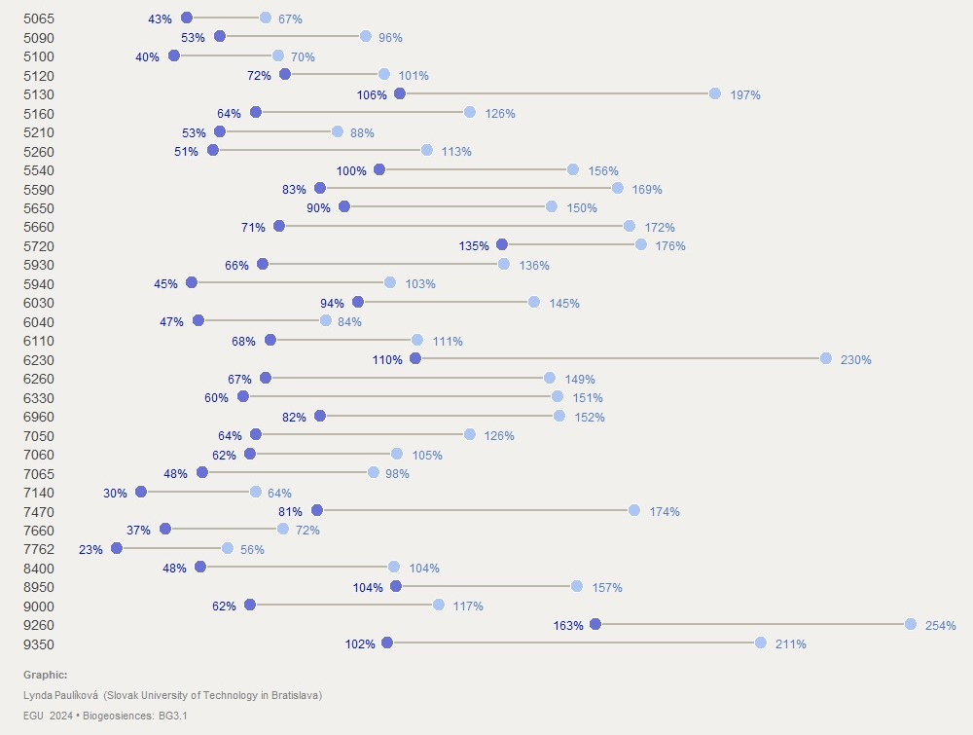
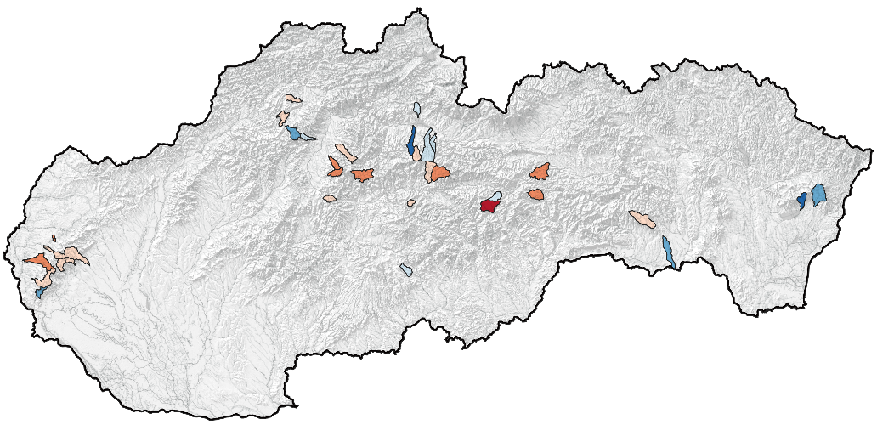
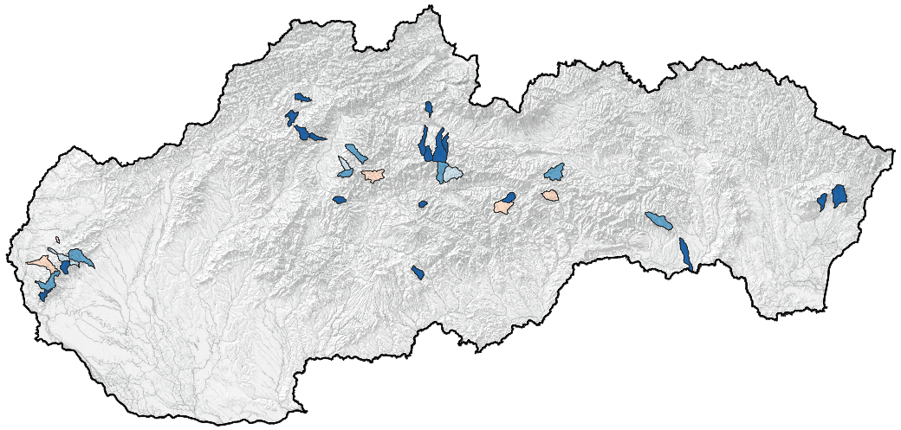
Estimated runoff coefficient [%] for the 100-year rainfall event using the IDF curves and the time of concentration according to Kirpich (1940) and Nash (1960)
Catchments and their ID
Kirpich (1940)
Nash (1960)

Slide 8
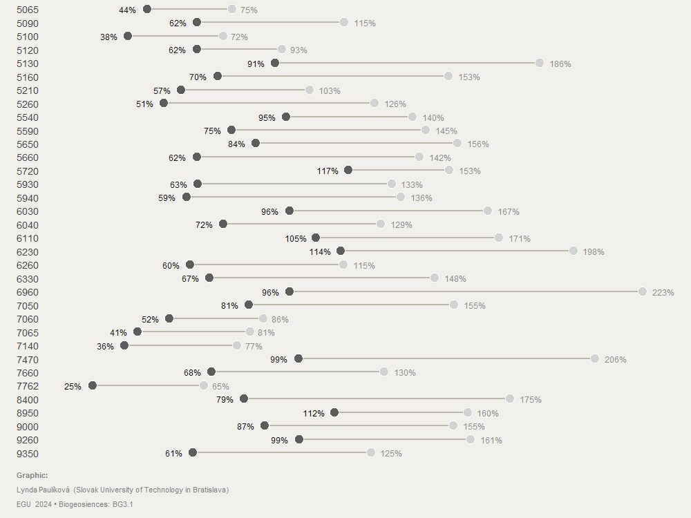
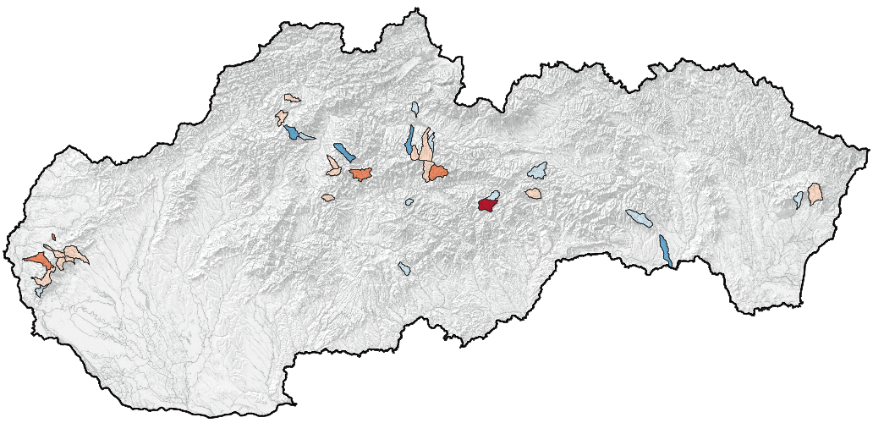
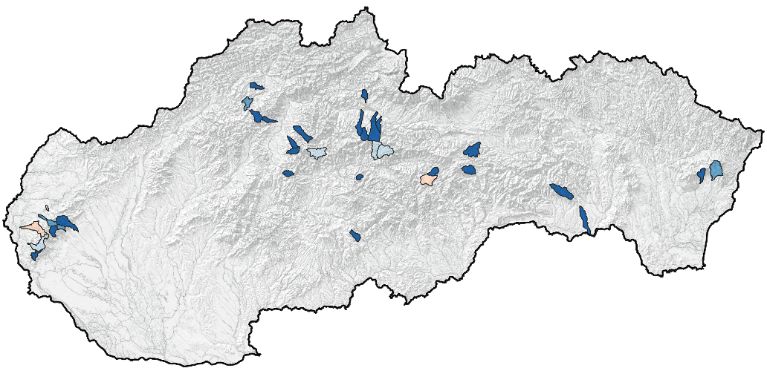
Estimated runoff coefficient [%] for the 100-year rainfall event using the Digital Atlas of Rainfall Intensities and the time of concentration according to Kirpich (1940) and Nash (1960)
Catchments and their ID
Kirpich (1940)
Nash (1960)

Slide 9
Part 2 of the study:
Estimation of runoff coefficient for the 2, 5, 10, 20, 50 and 100 -year rainfall event with the INDIRECT and DIRECT METHOD
CASE STUDY:
2 catchments: Horné Orešany – stream Parná, and Liptovský Hrádok – stream Belá

Slide 10
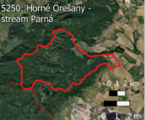
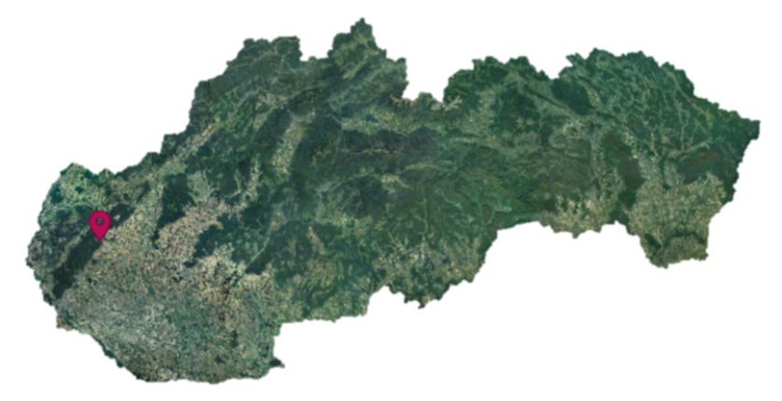


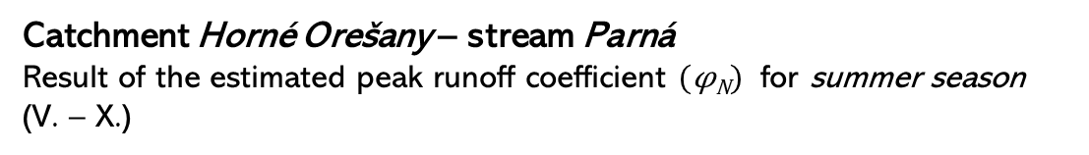
Catchment Horné Orešany – stream Parná
Result of the estimated peak runoff coefficient $(\text{φ}\text{N}\text{)}$ for summer season
(V. – X.)
Direct method
Indirect method
2
5
10
20
50
100
Return period in years
Legend:
Size of the estimated peak runoff coefficient
Used estimation methods
Urcikán – Horváth (tc Kirpich)
Digital atlas (tc Kirpich)
Urcikán – Horváth (tc Nash)
Digital atlas (tc Nash)
IDF curves (tc Kirpich)
Johnson′s distribution
IDF curves (tc Nash)

Slide 11
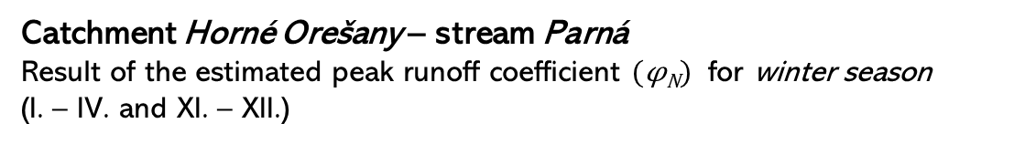
Catchment Horné Orešany – stream Parná
Result of the estimated peak runoff coefficient $(\text{φ}\text{N}\text{)}$ for winter season
(I. – IV. and XI. – XII.)
Direct method
Indirect method
2
5
10
20
50
100
Return period in years
Legend:
Size of the estimated peak runoff coefficient
Used estimation methods
Urcikán – Horváth (tc Kirpich)
Digital atlas (tc Kirpich)
Urcikán – Horváth (tc Nash)
Digital atlas (tc Nash)
IDF curves (tc Kirpich)
Johnson′s distribution
IDF curves (tc Nash)

Slide 12
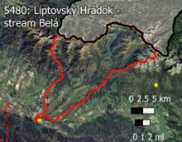
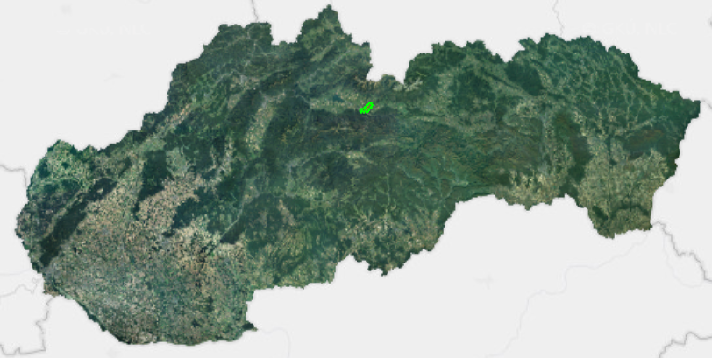
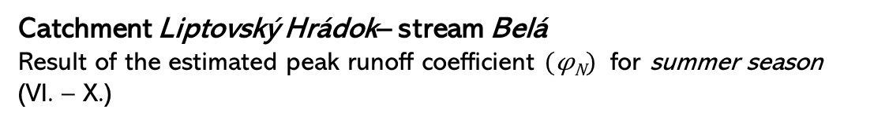
Catchment Liptovský Hrádok– stream Belá
Result of the estimated peak runoff coefficient $(\text{φ}\text{N}\text{)}$ for summer season
(VI. – X.)
Direct method
Indirect method
2
5
10
20
50
100
Return period in years
Legend:
Size of the estimated peak runoff coefficient
Used estimation methods
Urcikán – Horváth (tc Kirpich)
Digital atlas (tc Kirpich)
Urcikán – Horváth (tc Nash)
Digital atlas (tc Nash)
IDF curves (tc Kirpich)
Johnson′s distribution
IDF curves (tc Nash)

Slide 13
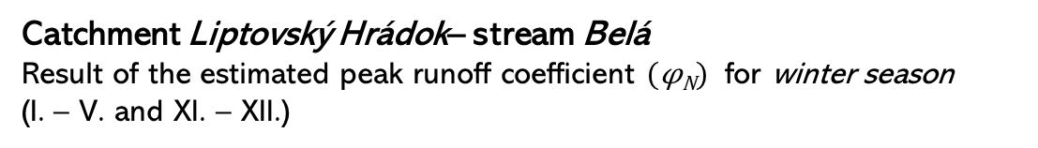
Catchment Liptovský Hrádok– stream Belá
Result of the estimated peak runoff coefficient $(\text{φ}\text{N}\text{)}$ for winter season
(I. – V. and XI. – XII.)
Direct method
Indirect method
2
5
10
20
50
100
Return period in years
Legend:
Size of the estimated peak runoff coefficient
Used estimation methods
Urcikán – Horváth (tc Kirpich)
Digital atlas (tc Kirpich)
Urcikán – Horváth (tc Nash)
Digital atlas (tc Nash)
IDF curves (tc Kirpich)
Johnson′s distribution
IDF curves (tc Nash)

Slide 14
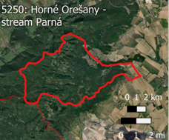
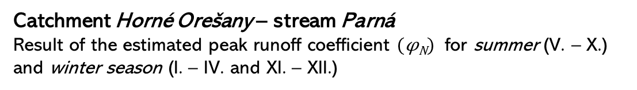
Catchment Horné Orešany – stream Parná
Result of the estimated peak runoff coefficient $(\text{φ}\text{N}\text{)}$ for summer (V. – X.) and winter season (I. – IV. and XI. – XII.)

Slide 15
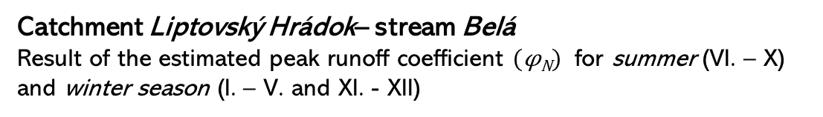
Catchment Liptovský Hrádok– stream Belá
Result of the estimated peak runoff coefficient $(\text{φ}\text{N}\text{)}$ for summer (VI. – X) and winter season (I. – V. and XI. - XII)

Slide 16

Conclusion
Indirect method – overpowered runoff coefficients (larger than 100%)
Indirect method - large differences between seasons (summer, winter)
The question of entering Q (summer, winter, the whole year...)
Direct method - lowest estimated runoff coefficients
The question of the type of basin (mountainous, flat...)
Is the Q₁₀₀ really caused by 100-year rainfall event? (another factors)
Another subject of research

