Slide 1







Projected shifts and dynamics in blue and green water resources availability
Our project website
See my abstract
Simon P. Heselschwerdt^{1,2} and Peter Greve^{1,2}
1. Climate Service Center Germany (GERICS), Helmholtz-Zentrum Hereon, Hamburg, Germany
2. Institute of Environmental Science and Geography, University of Potsdam, Potsdam, Germany

Slide 2





The Blue Green Water Share (BGWS)
The Blue Green Water Share describes the partitioning of precipitation into blue and green water fluxes:
Green Water Flux
Proxy: Transpiration
$$BGWS= \frac{Runoff −Transpiraton}{Precipitation}$$
Precipitation
How is the BGWS globally distributed using the multimodel mean of 14 historical CMIP6 simulations?
Blue Water Flux
Proxy: Runoff

Slide 3
Historical BGWS
How does the BGWS globally change under the SSP3-7.0 scenario?
Higher latitudes and altitudes present a larger blue water share.
Regions with extensive vegetation and/or limited precipitation favour green water.

Slide 4
$Δ$ BGWS Under the SSP3-7.0
Increasing Green Water Share due to growing vegetation.
Increasing Green Water Share with declining precipitation.
Increasing Blue Water Share due to more and intensified precipitation.

Slide 5



Home Slide - Historical BGWS
Vote for
me
Click here for:
1. Title Slide
2. BGWS Definition
3. Historical BGWS Map
4. 𝚫 BGWS Map
5. Mechanisms Behind BGWS
6. Key Insights
Click on region to find out more!
Previous
slide
Return to
this slide
Next
slide

Slide 6
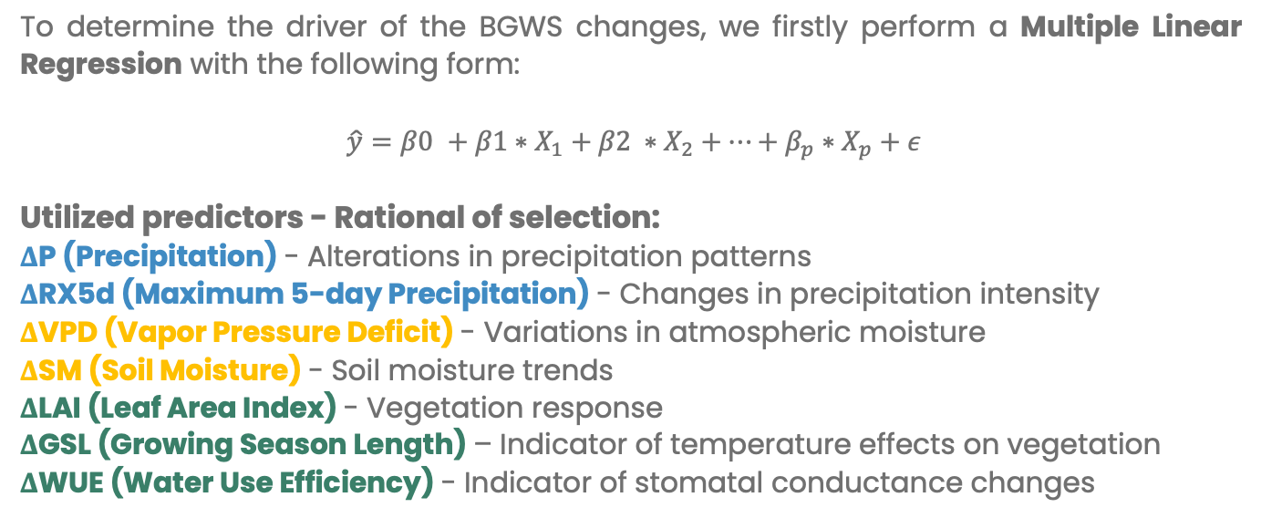
Multiple Regression Analysis
To determine the driver of the BGWS changes, we firstly perform a Multiple Linear Regression with the following form:
$$\hat{y}=β\text{0} +β1∗X_{1}+β2 ∗X_{2}+…+β_{p}∗X_{p}+ε$$
Utilized predictors - Rational of selection:
ΔP (Precipitation) - Alterations in precipitation patterns
ΔRX5d (Maximum 5-day Precipitation) - Changes in precipitation intensity
ΔVPD (Vapor Pressure Deficit) - Variations in atmospheric moisture
ΔSM (Soil Moisture) - Soil moisture trends
ΔLAI (Leaf Area Index) - Vegetation response
ΔGSL (Growing Season Length) – Indicator of temperature effects on vegetation
ΔWUE (Water Use Efficiency) - Indicator of stomatal conductance changes
How do we handle multicollinearity? How do we assess the variable importance?

Slide 7
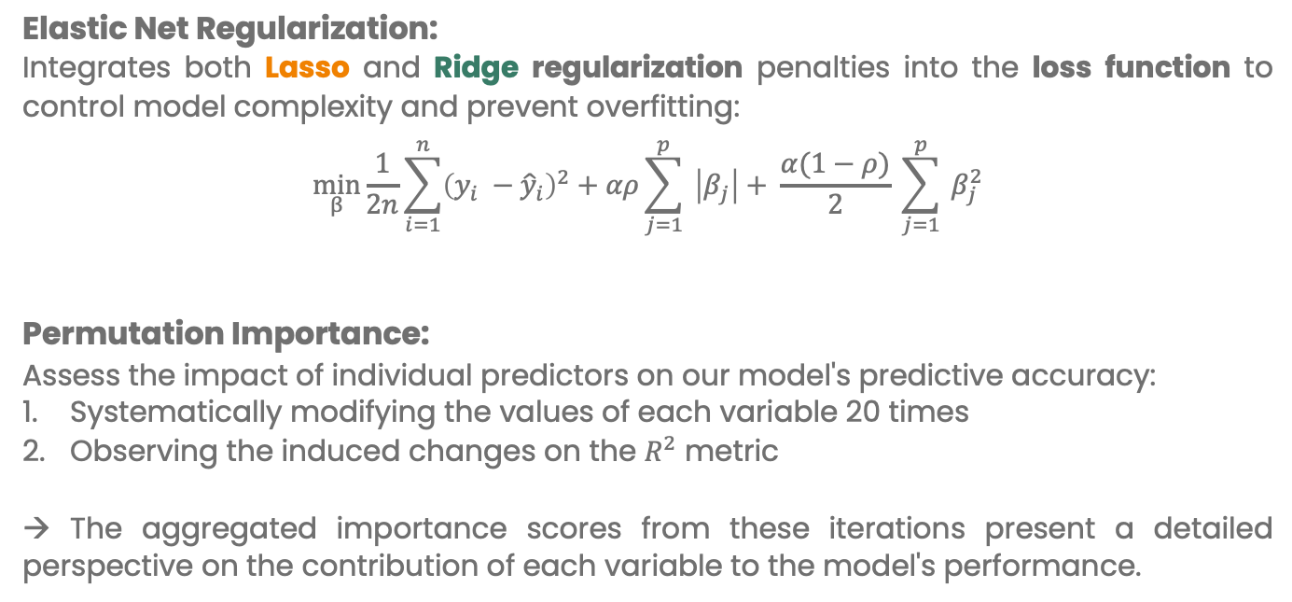
Regularization AND Variable Importance
Elastic Net Regularization:
Integrates both Lasso and Ridge regularization penalties into the loss function to control model complexity and prevent overfitting:
$$\min_{β}{\frac{1}{2n}\sum_{i=1}^{n}{{\left(y_{i} −{\hat{y}}_{i}\right)}^{2}+αρ\sum_{j=1}^{p}{ \left|β_{j}\right|+ \frac{α(1−ρ)}{2}}}} \sum_{j=1}^{p}{ β_{j}^{2}}$$
Permutation Importance:
Assess the impact of individual predictors on our model's predictive accuracy:
Systematically modifying the values of each variable 20 times
Observing the induced changes on the $R^{2}$ metric
→ The aggregated importance scores from these iterations present a detailed perspective on the contribution of each variable to the model's performance.
L1 Penalty
L2 Penalty

Slide 8


Mechanisms behind BGWS Dynamics
Warmer temperatures
Elevated CO₂
Longer and warmer growing seasons
Plant physiological responses enhance surface resistance
Additional vegetation
growth
Declining precipitation
& only little vegetation
change
Increasing precipitation
magnitudes and intensities
Transpiration gain
Runoff gain
Vegetation decline

Slide 9
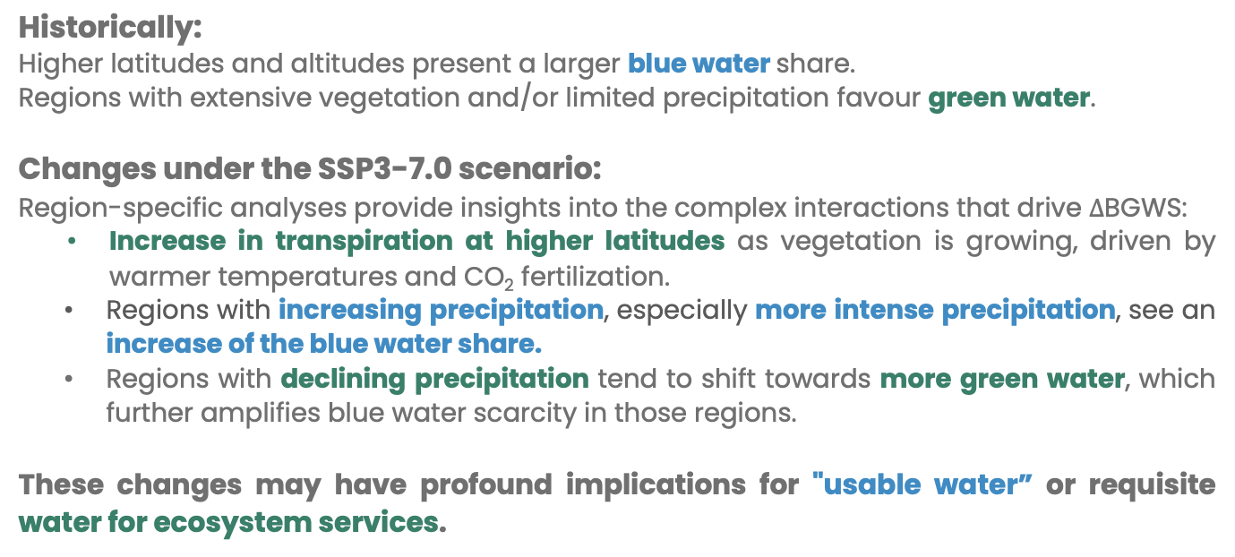
Key Insights
Historically:
Higher latitudes and altitudes present a larger blue water share.
Regions with extensive vegetation and/or limited precipitation favour green water.
Changes under the SSP3-7.0 scenario:
Region-specific analyses provide insights into the complex interactions that drive $∆$BGWS:
  Increase in transpiration at higher latitudes as vegetation is growing, driven by warmer temperatures and CO₂ fertilization.
  Regions with increasing precipitation, especially more intense precipitation, see an increase of the blue water share.
  Regions with declining precipitation tend to shift towards more green water, which further amplifies blue water scarcity in those regions.
These changes may have profound implications for "usable water” or requisite water for ecosystem services.

Slide 10
Northern Europe
How do we compute the variable importance?
Historical
Regional Variable Change under SSP3-7.0
Change under SSP3-7.0
Variable Importance
Increasing Green Water share due to growing vegetation.
Strong seasonality. Click on season:
JJA
DJF

Slide 11
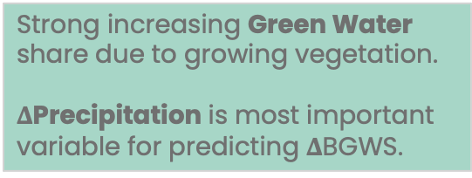
Northern Europe - JJA
Historical
Regional Variable Change under SSP3-7.0
Historical
Change under SSP3-7.0
Historical - SSP3-7.0
Variable Importance
Strong increasing Green Water share due to growing vegetation.
$Δ$Precipitation is most important variable for predicting $Δ$BGWS.
Back to region slide

Slide 12
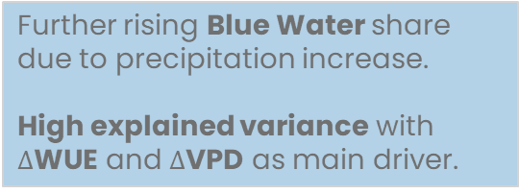
Northern Europe - DJF
Historical
Regional Variable Change under SSP3-7.0
Historical
Change under SSP3-7.0
Historical - SSP3-7.0
Variable Importance
Further rising Blue Water share due to precipitation increase.
High explained variance with $Δ$WUE and $Δ$VPD as main driver.
Back to region slide

Slide 13
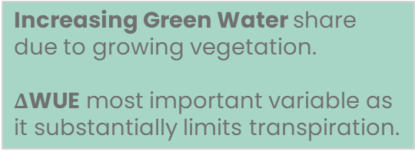
W. North America
How do we compute the variable importance?
Historical
Regional Variable Change under SSP3-7.0
Change under SSP3-7.0
Variable Importance
Increasing Green Water share due to growing vegetation.
$Δ$WUE most important variable as it substantially limits transpiration.

Slide 14
N. South America
How do we compute the variable importance?
Historical
Regional Variable Change under SSP3-7.0
Change under SSP3-7.0
Variable Importance
Rising Green Water share due to strong precipitation decline.
Vegetation growth further amplifies Blue Water loss.

Slide 15
Mediterranean
How do we compute the variable importance?
Regional Variable Change under SSP3-7.0
Historical
Change under SSP3-7.0
Rising Green Water share with strong P decline and Veg growth.
Strong seasonality. Click on season:
Variable Importance
JJA
DJF

Slide 16
Mediterranean - JJA
Regional Variable Change under SSP3-7.0
Historical
Change under SSP3-7.0
Increasing Green Water share with high uncertainty.
Strong precipitation decline is driving transpiration loss.
Variable Importance
Back to region slide

Slide 17
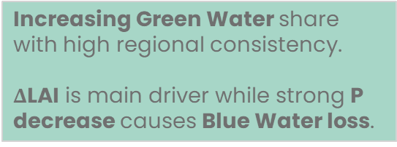
Mediterranean - DJF
Regional Variable Change under SSP3-7.0
Historical
Change under SSP3-7.0
Increasing Green Water share with high regional consistency.
$Δ$LAI is main driver while strong P decrease causes Blue Water loss.
Variable Importance
Back to region slide

Slide 18
Central Africa
How do we compute the variable importance?
Historical
Change under SSP3-7.0
Regional Variable Change under SSP3-7.0
Variable Importance
Increasing Blue Water share with amplified Precipitation (P & RX5day).
Water Use Efficiency (WUE) increase negatively effects transpiration change.

Slide 19
East Asia
How do we compute the variable importance?
Historical
Regional Variable Change under SSP3-7.0
Change under SSP3-7.0
Rising Blue Water share with precipitation & SM increase.
Diverse region with strong seasonality. Click on season:
Variable Importance
JJA
DJF

Slide 20
East Asia - JJA
Historical
Regional Variable Change under SSP3-7.0
Change under SSP3-7.0
Increasing Blue Water share with Soil Moisture (SM) as main driver.
Precipitation increase & high SM result in saturation-excess runoff.
Variable Importance
Back to region slide

Slide 21
East Asia - DJF
Historical
Regional Variable Change under SSP3-7.0
Change under SSP3-7.0
Increasing Green Water share with strong vegetation growth.
Variable Importance
Back to region slide

