Slide 1





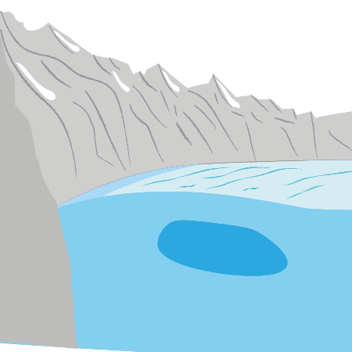
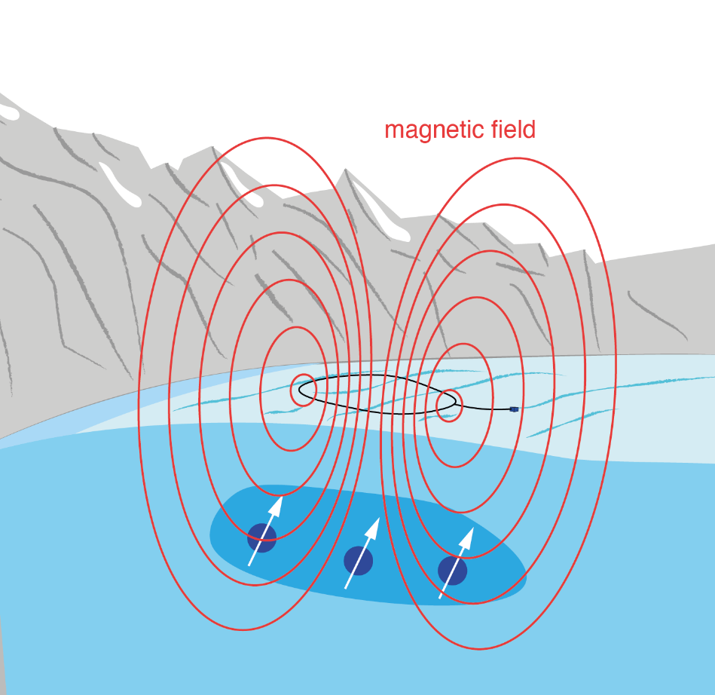
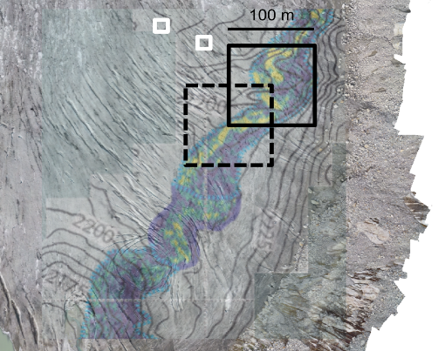

Exploring englacial hydrology with surface nuclear magnetic resonance
Meet the authors
2 min madness
1 The challenge
4 The data
Re[s(t)]/nV
2 The technique
?
Im[s(t)]/nV
3 The survey
5 The modelling

Slide 2
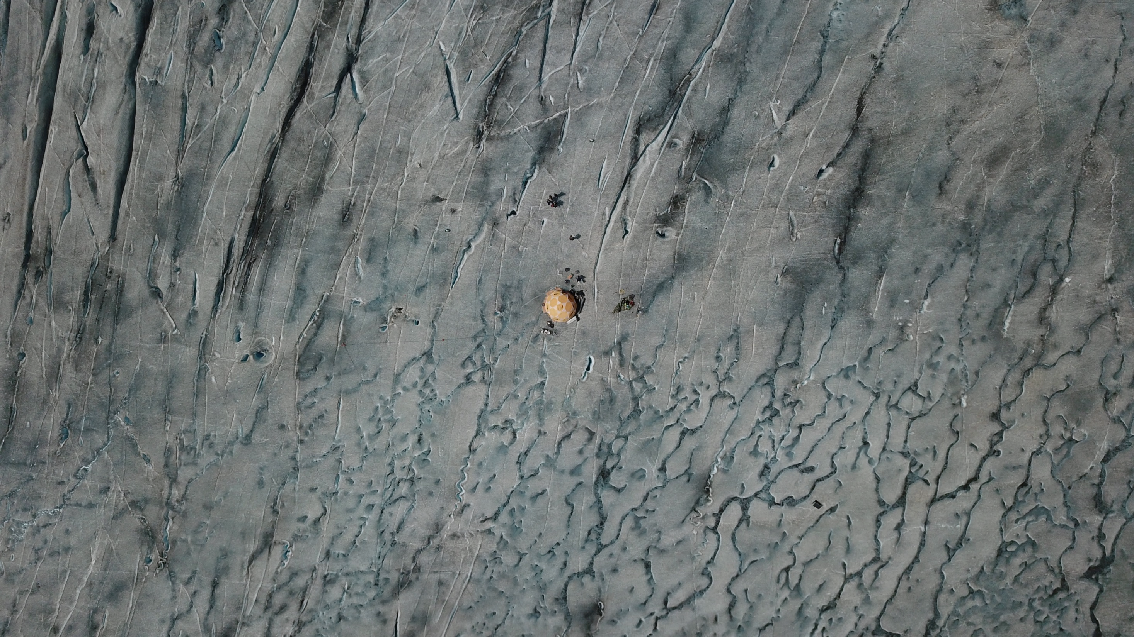




Exploring englacial hydrology with surface nuclear magnetic resonance
Laura Gabriel, Marian Hertrich, Raphael Moser, Christophe Ogier, Hansruedi Maurer, Daniel Farinotti
Photo credit: Janosch Beer

Slide 3
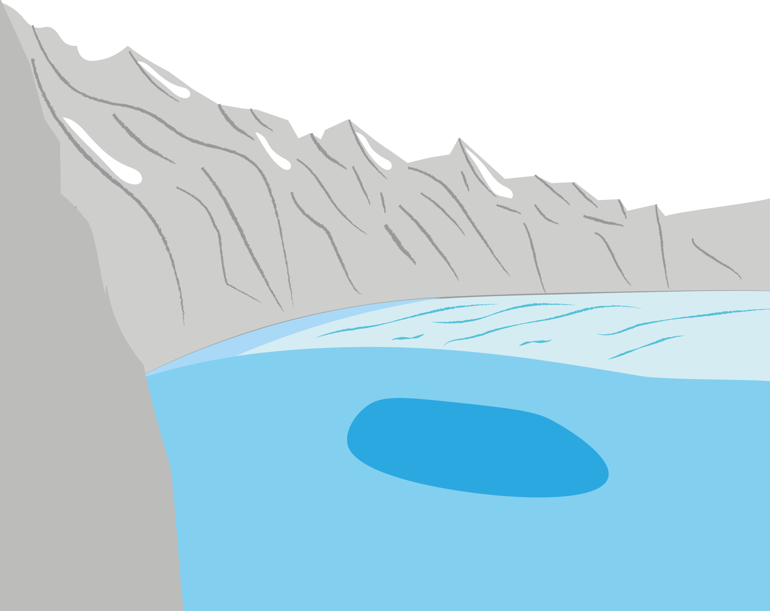
What is the challenge?
How much water do we have here?
Visualization: Moritz Müller

Slide 4
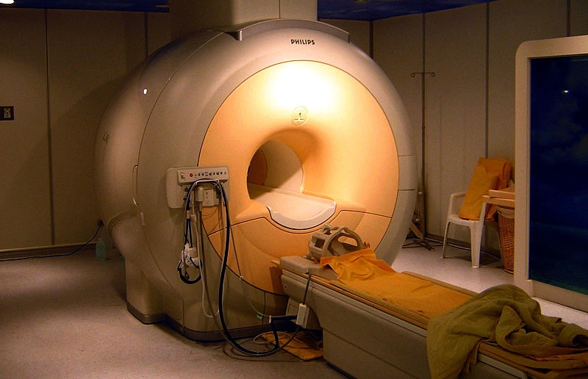
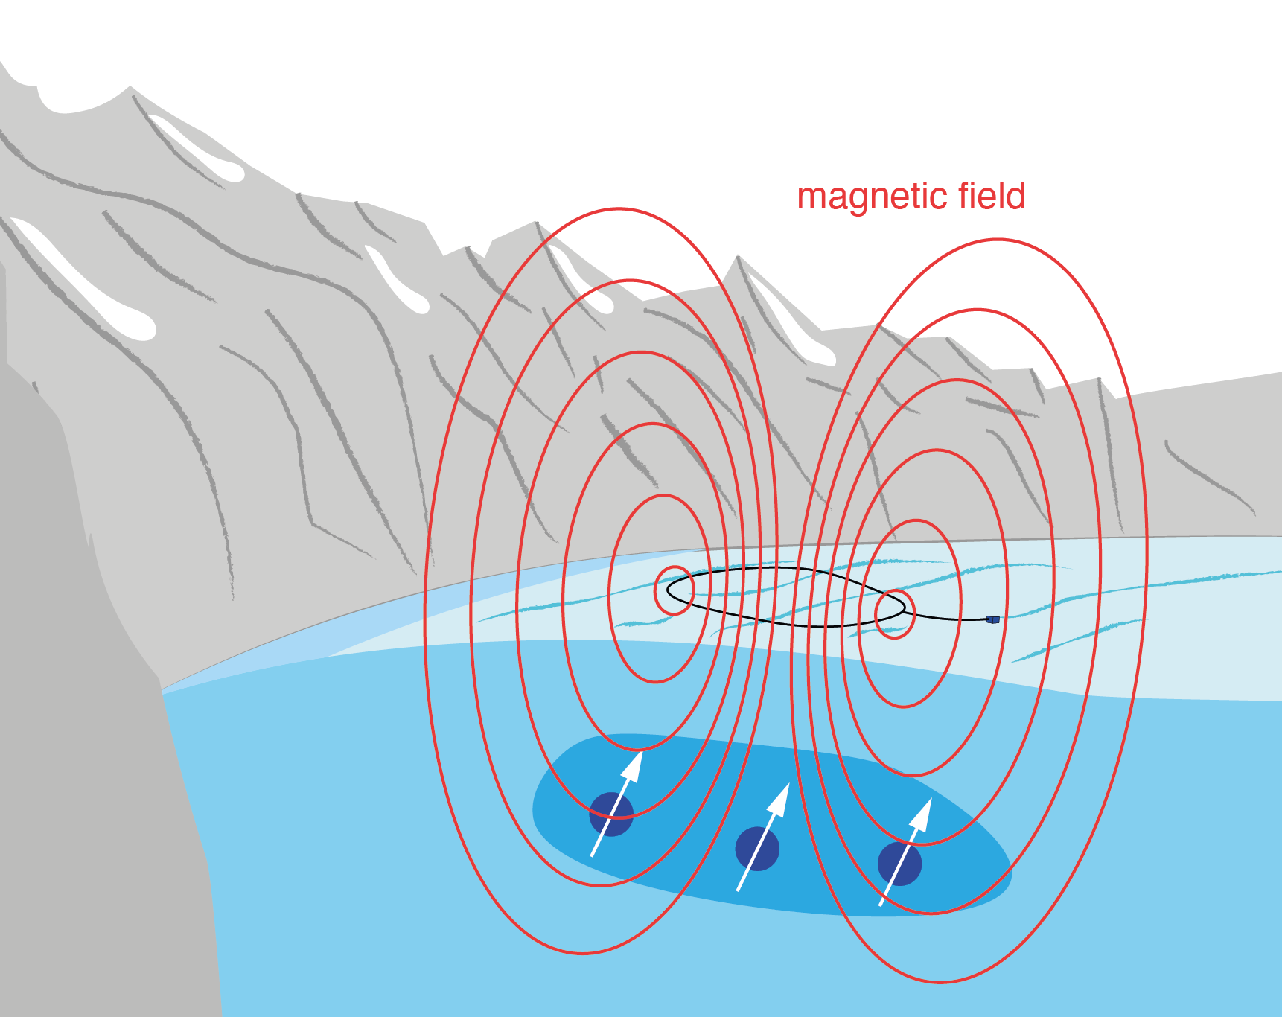
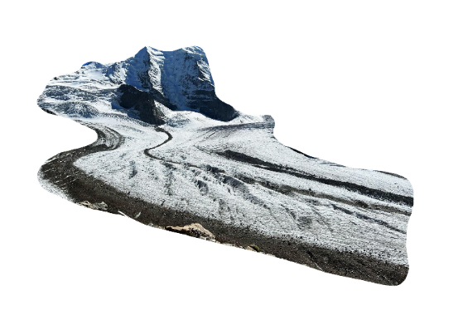
Surface nuclear magnetic resonance
Non-invasive, direct detection of liquid water
Credit: KasugaHuang, https://commons.wikimedia.org/wiki/File:Modern_3T_MRI.JPG
Visualization: Moritz Müller
Credit: Moritz Müller
Visualisation: Moritz Müller

Slide 5


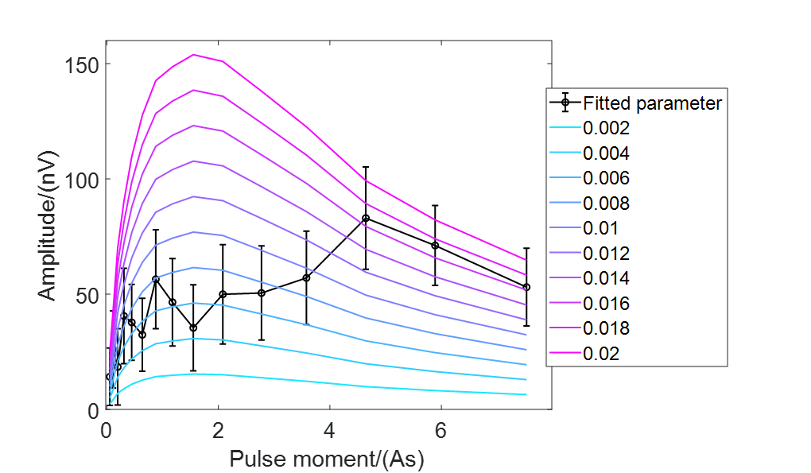
What can we learn from noisy data?
Which water models are (in-)compatible with our data?
Church, G. et al., Ground-penetrating radar imaging reveals glacier’s drainage network in 3D. The Cryosphere 15, 3975–3988 (2021)

Slide 6

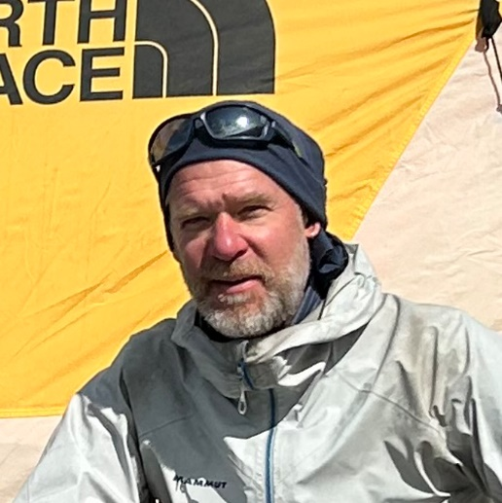
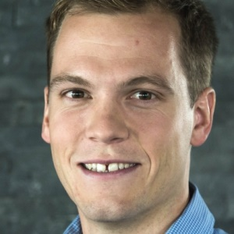
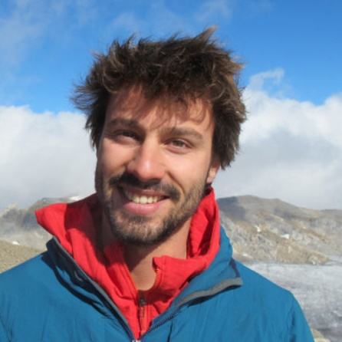
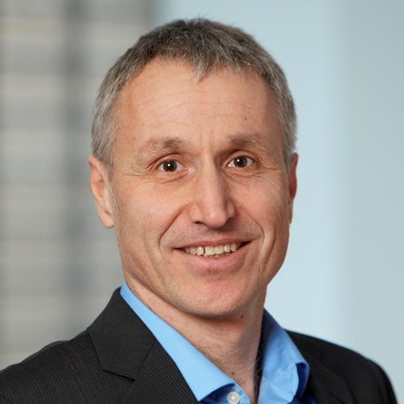
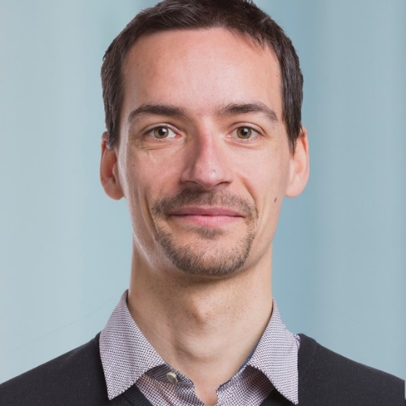



The team
Laura Gabriel^{1,2}, Marian Hertrich³, Raphael Moser^{1,2}, Christophe Ogier^{1,2}, Hansruedi Maurer⁴, Daniel Farinotti^{1,2}
¹ Laboratory of Hydraulics, Hydrology and Glaciology (VAW), ETH Zurich,
Hönggerbergring 26, CH-8093 Zürich (lagabrie@ethz.ch)
² Swiss Federal Institute for Forest, Snow and Landscape Research (WSL),
Zürcherstrasse 111, CH-8903 Birmensdorf
³ Bedretto Underground Laboratory for Geosciences and Geoenergies, ETH Zurich, Sonneggstrasse 5, CH-8092 Zürich
⁴ Institute of Geophysics, ETH Zurich, Sonneggstrasse 5, CH-8092 Zürich
Photo credits

Slide 7

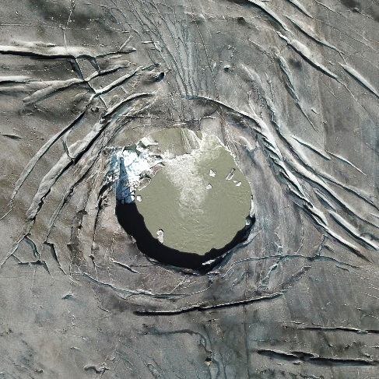
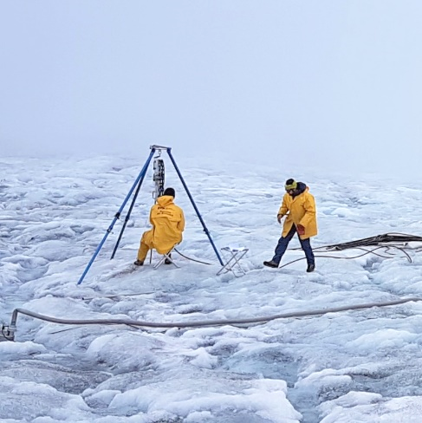
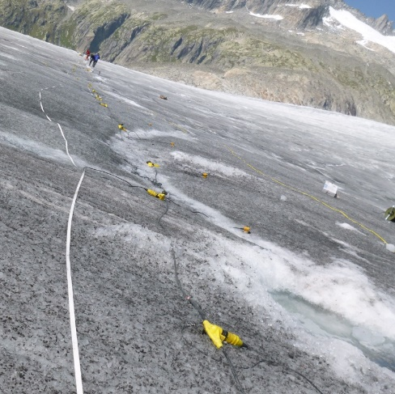
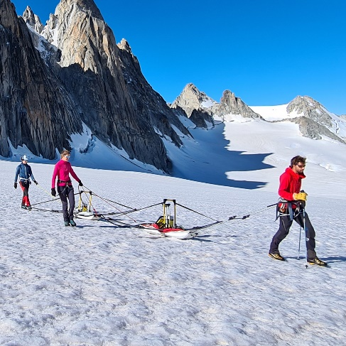
The challenge
Why does water inside glaciers matter?
Remote sensing
Drilling
Ground penetrating radar
Seismics
Photo credits: Raphael Moser, Janosch Beer, Hansruedi Maurer
Visualization: Moritz Müller

Slide 8
The challenge
Remote sensing
Drilling
Ground penetrating radar
Seismics
Photo credits: Raphael Moser, Janosch Beer, Hansruedi Maurer
Visualization: Moritz Müller

Slide 9
The challenge
Remote sensing
Drilling
Ground penetrating radar
Seismics
Photo credits: Raphael Moser, Janosch Beer, Hansruedi Maurer
Visualization: Moritz Müller

Slide 10
The challenge
Remote sensing
Drilling
Ground penetrating radar
Seismics
Photo credits: Raphael Moser, Janosch Beer, Hansruedi Maurer
Visualization: Moritz Müller

Slide 11
The challenge
Remote sensing
Drilling
?
Ground penetrating radar
Seismics
Photo credits: Raphael Moser, Janosch Beer, Hansruedi Maurer
Visualization: Moritz Müller

Slide 12
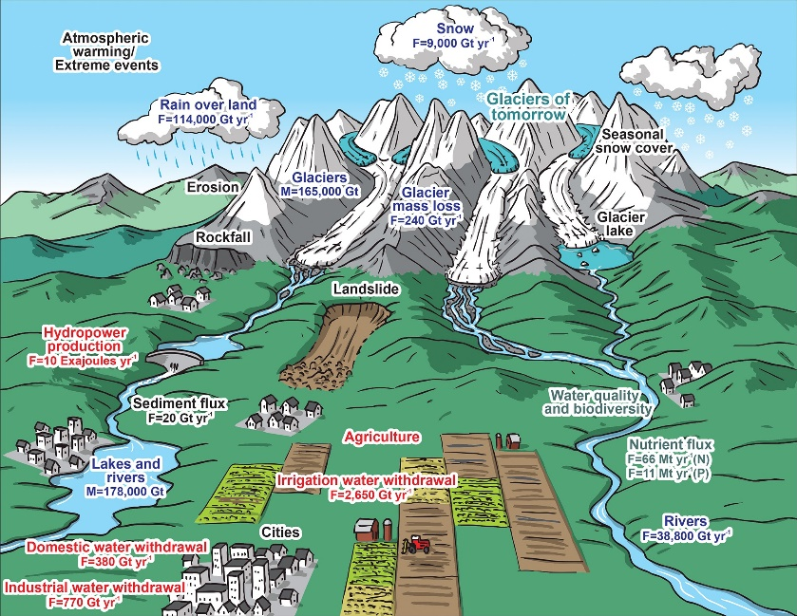
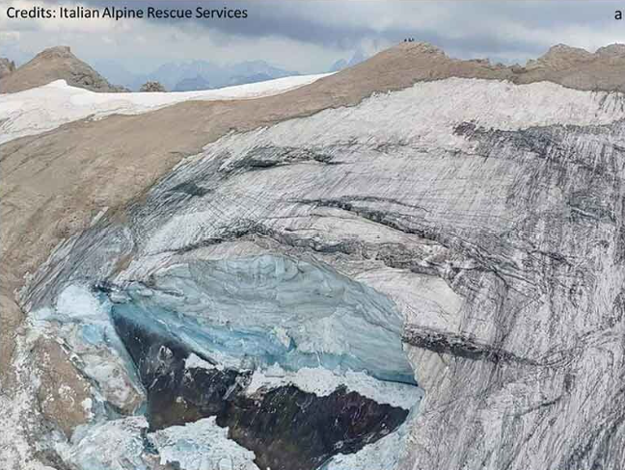
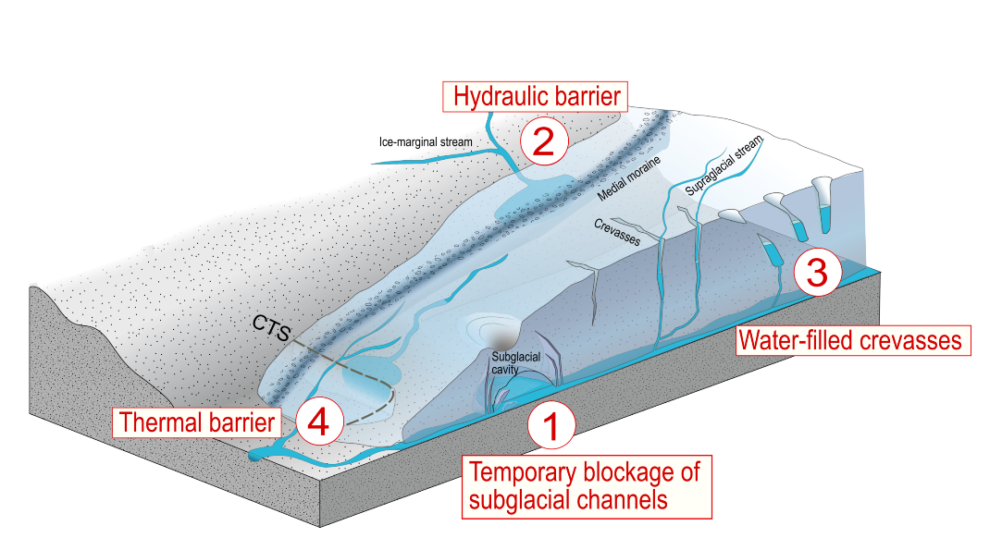
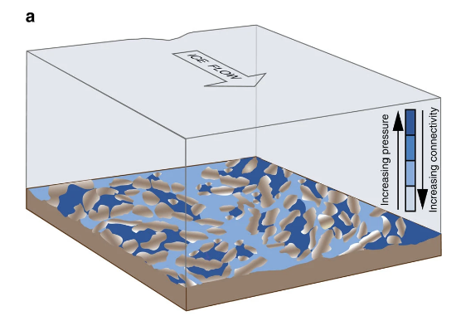
Glacial hydrology
Water supply
Natural hazards
Photo credit: Italian Alpine Rescue Services
M. Huss et al., Toward mountains without permanent snow and ice, 2017
Glacier dynamics
C. Ogier et al., in prep.
Hoffman, et al., Greenland subglacial drainage evolution regulated by weakly connected regions of the bed, 2016

Slide 13
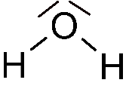
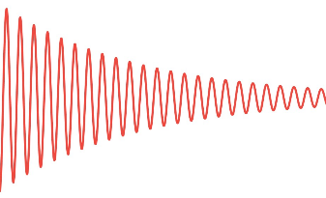
Surface nuclear magnetic resonance
I want to see the instrument!
I love formulas!
Why surface nuclear magnetic resonance (SNMR)?
Non-invasive, direct detection of liquid water
Information in amplitude and exponential decay
Vary field strength to probe different layers
Earth’s magnetic field
Visualization: Moritz Müller

Slide 14
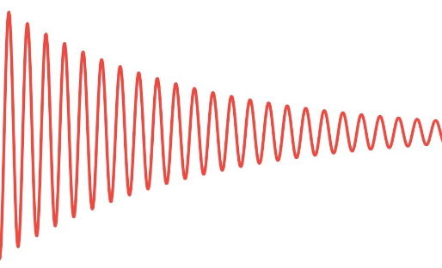
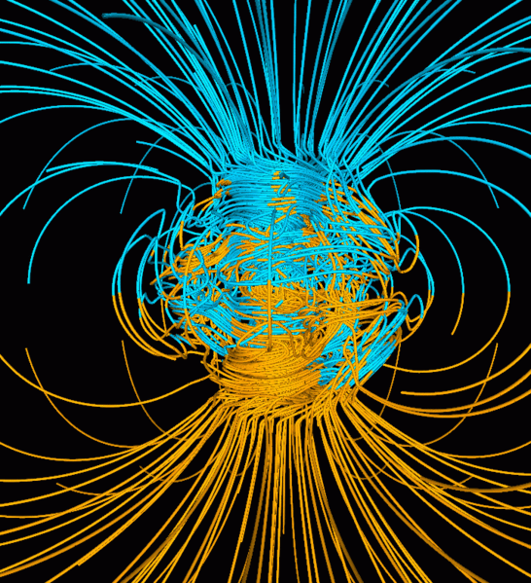
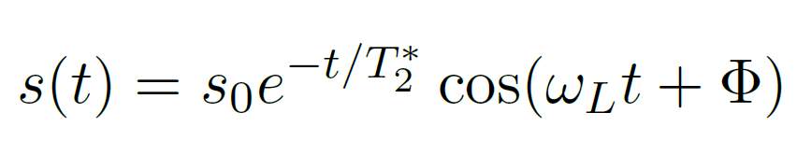
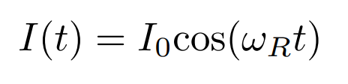



Background on SNMR
Energy
m_{s} = -1/2
$$ΔE=γℏB_{earth}=ℏω_{L}$$
m_{s} = +1/2
B_{earth}
Magnetic field
commons.wikimedia.org/wiki/File:Geodynamo_Between_Reversals.gif
Magnetic moment
Larmor frequency
$$ω_{L}=γB_{earth}$$
$$μ=γm_{s}ℏ$$

Slide 15
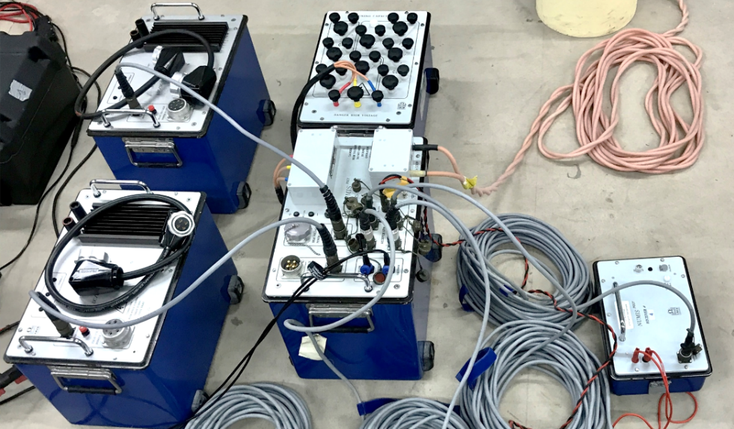
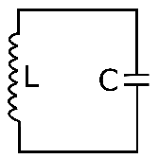
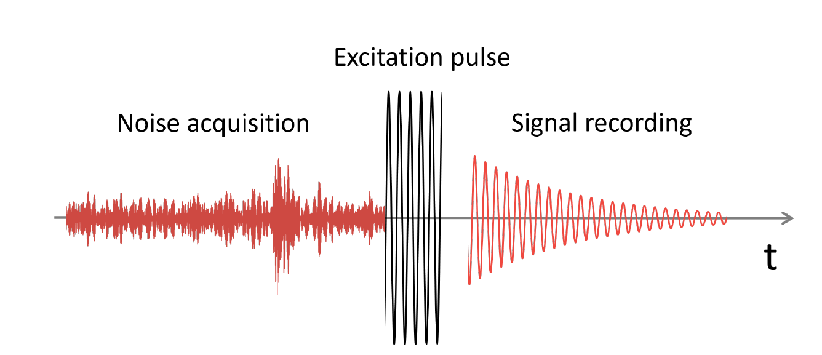
The instrument
12 V supply
DC/DC converter
Capacitor tuning box
Pulse generator
Numis Poly manufactured by Iris instruments
Measurement protocol
Receiver

Slide 16

The survey: Rhonegletscher 2023
Goal: SNMR proof-of-concept study
Perform multiple-day SNMR case study at a site with pre-existing information on englacial channels¹
Combine with GPR measurements
Want to see us in action (nice pictures)?
Want to see the measurement configuration?
Want to learn about the experimental challenges?
Church, G. et al., Ground-penetrating radar imaging reveals glacier’s drainage network in 3D, 2021
Credit DEM: Elias Hodel

Slide 17
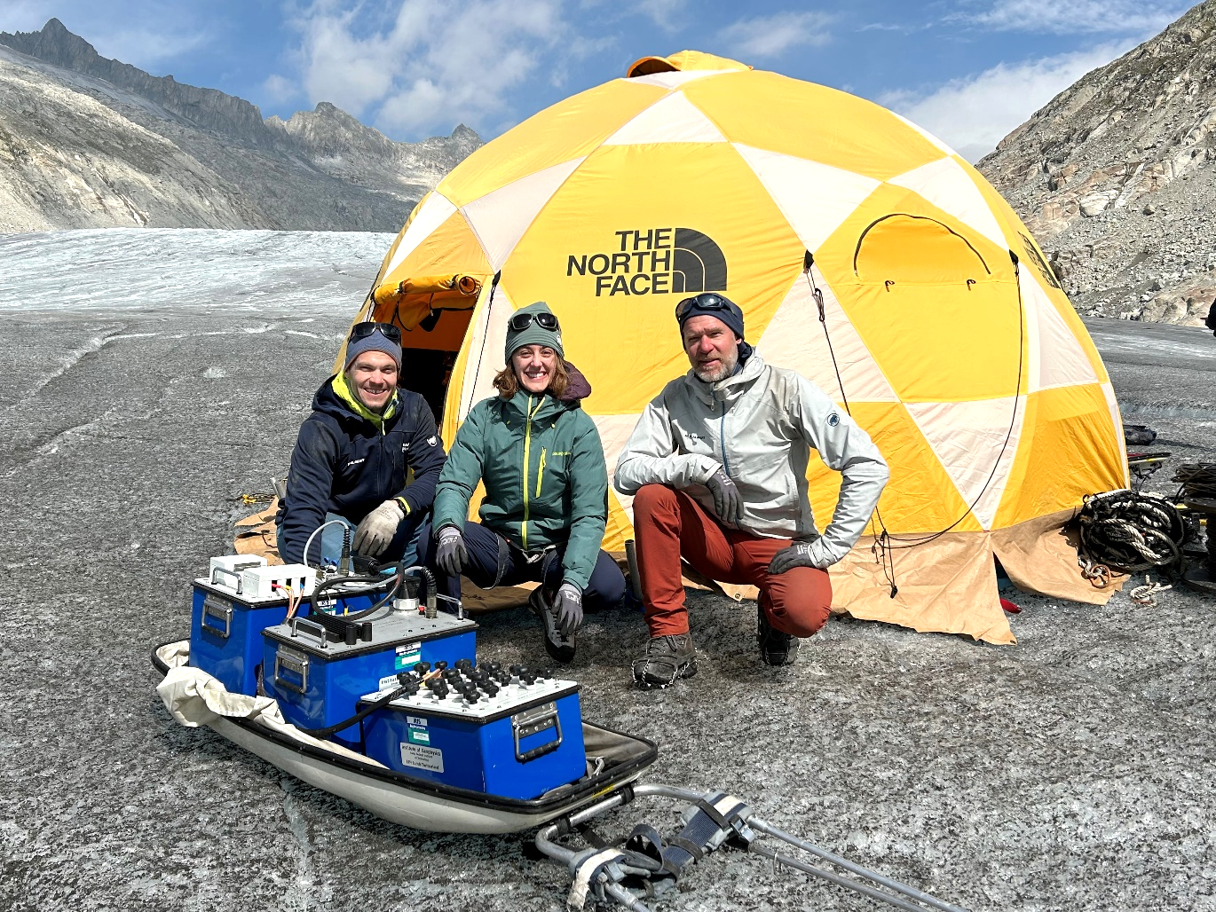
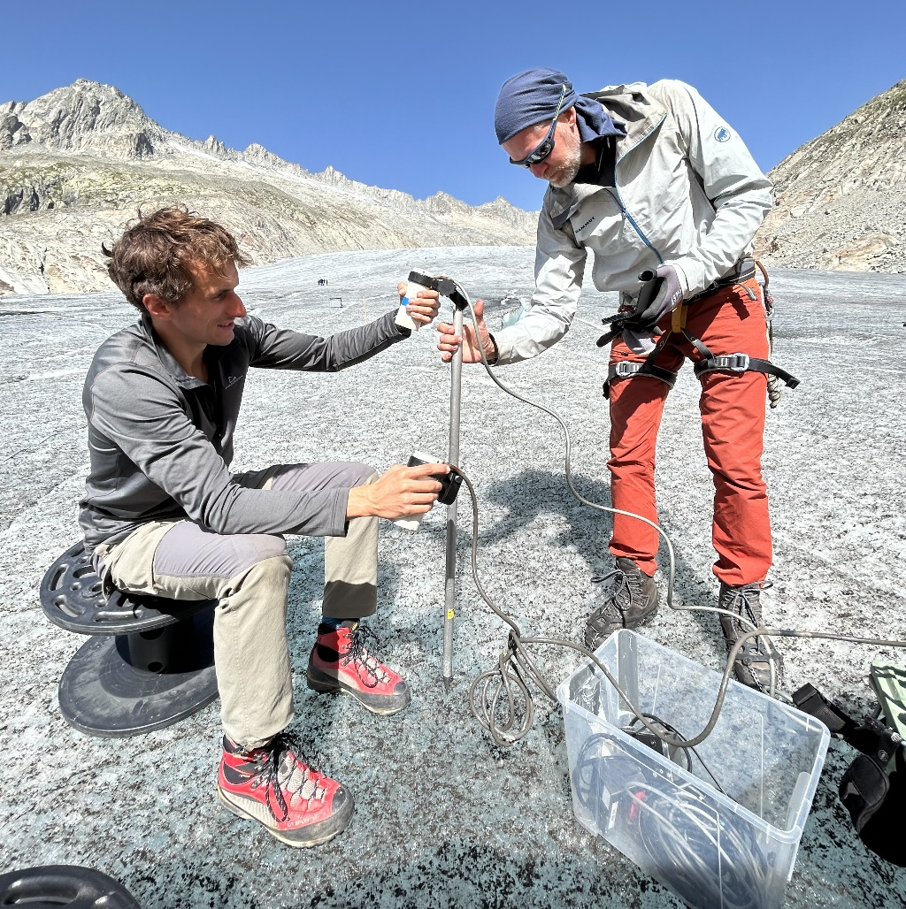
Team in action
Notes:
Connection boxes?

Slide 18
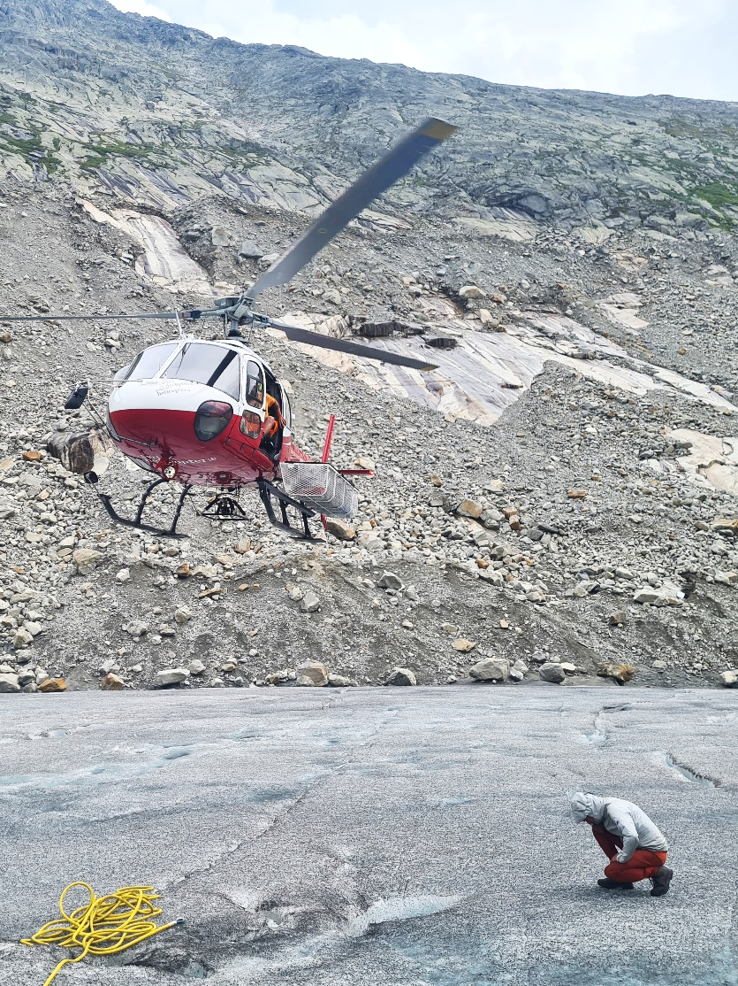
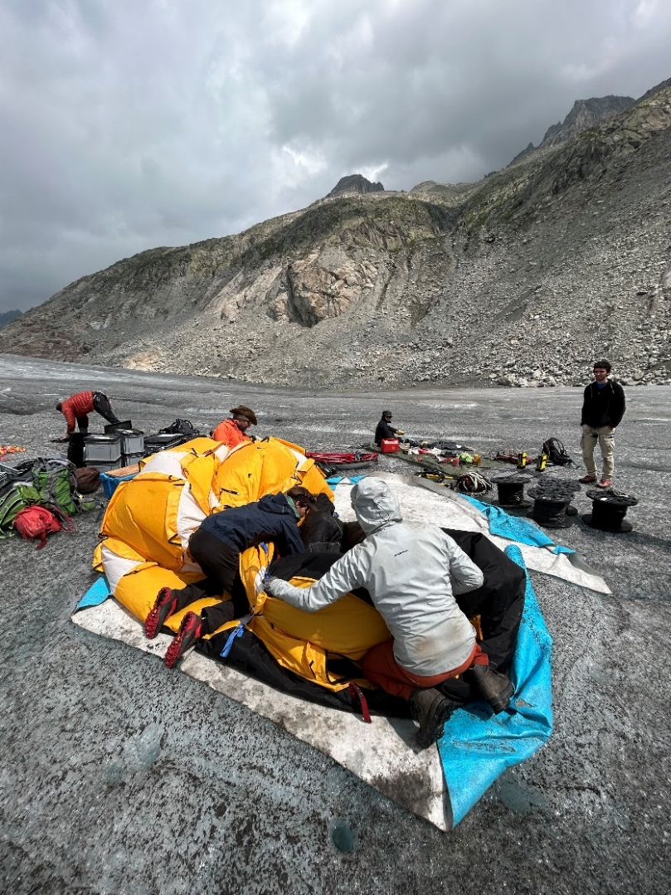
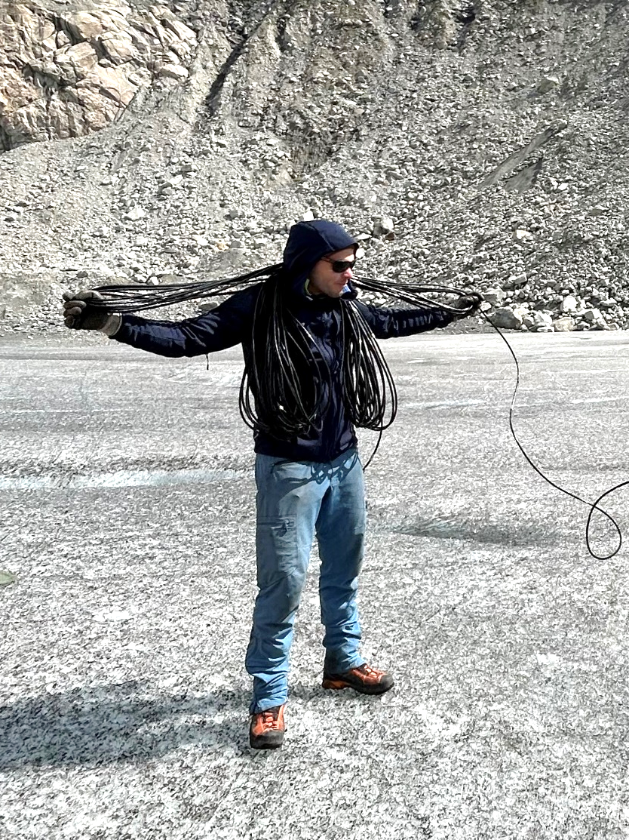
Team in action
Photo by Raphael Moser

Slide 19
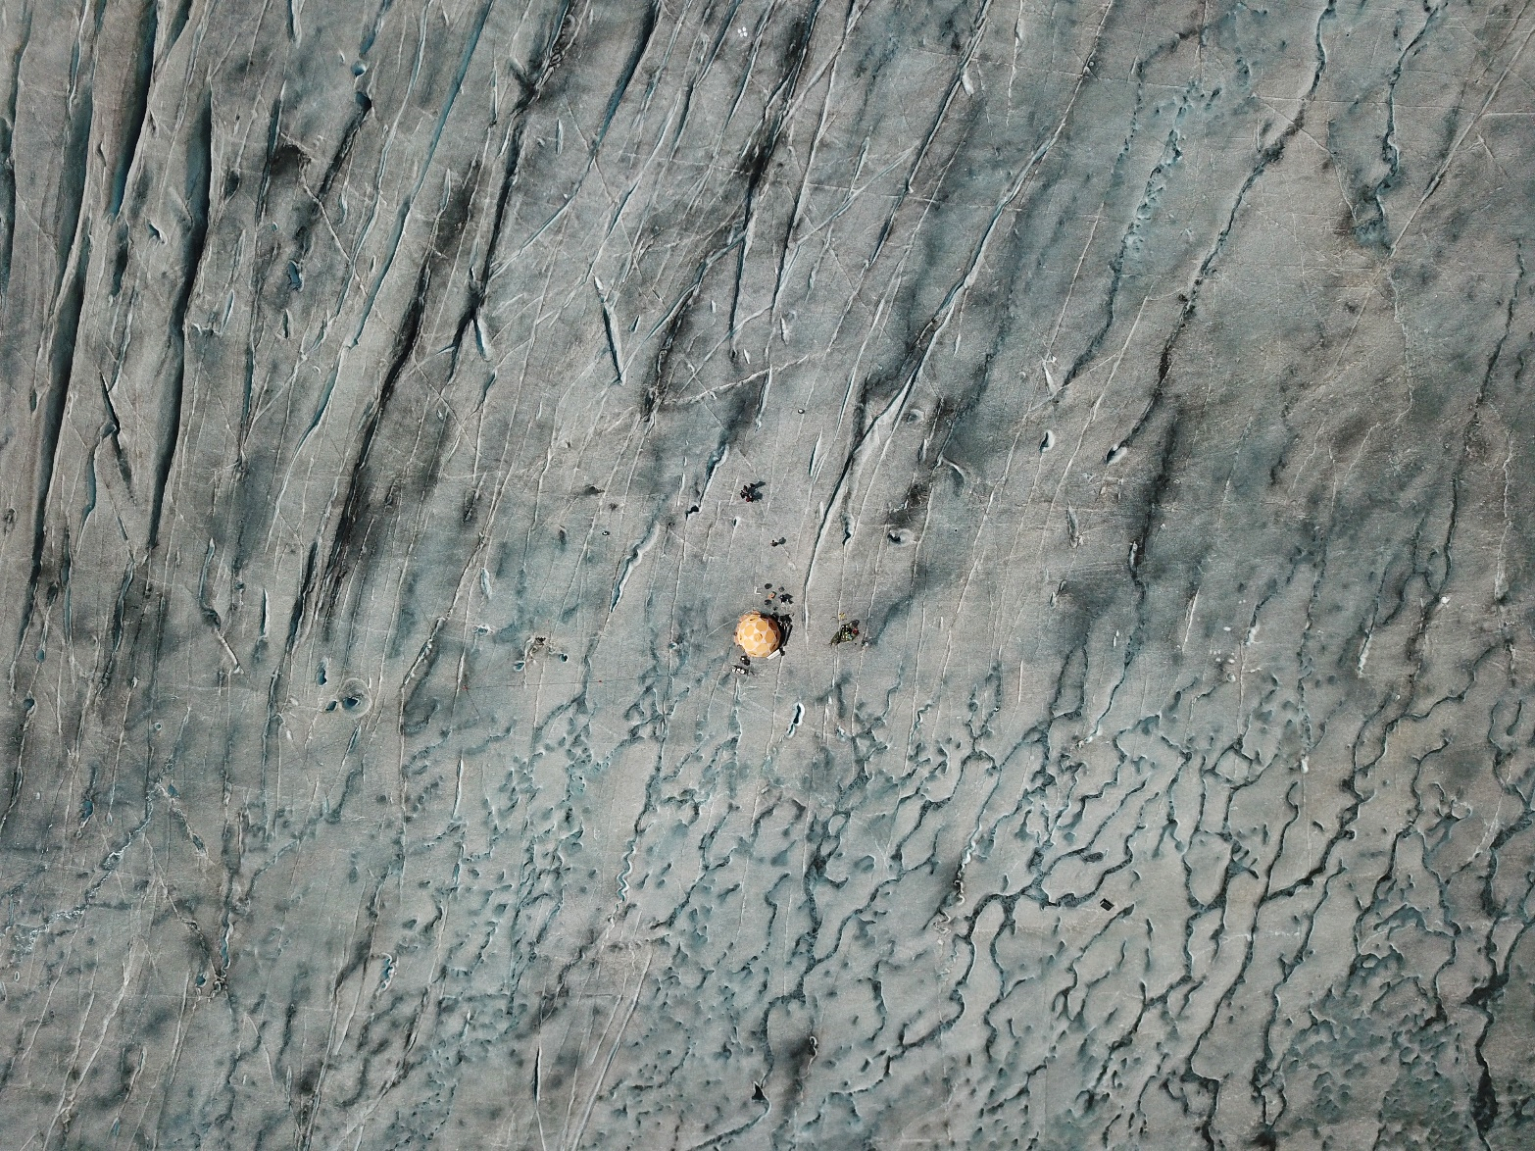
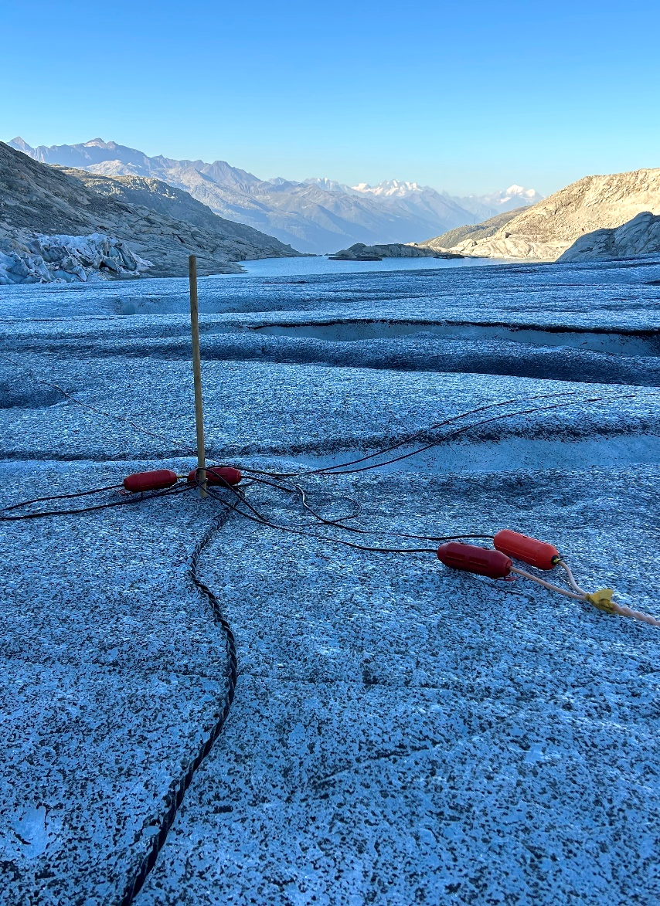
Team in action
~50 m
Photo by Janosch Beer

Slide 20
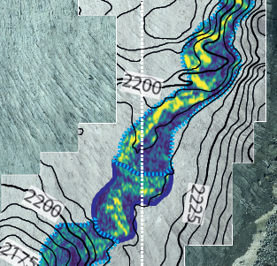
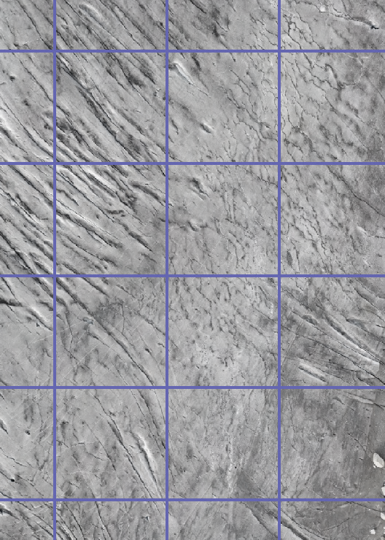
Measurement configuration
Tested multiple configuration including separate transmitter and receiver loops²
Deployed smaller loops for simultaneous noise recording
Applied 16 different field strengths (called pulse moments)
Measured between 16 x 32 and 16 x 96 traces per configuration (duration ~ 2 – 6h)
L23
L11
L12
Church, G. et al., Ground-penetrating radar imaging reveals glacier’s drainage network in 3D, 2021

Slide 21
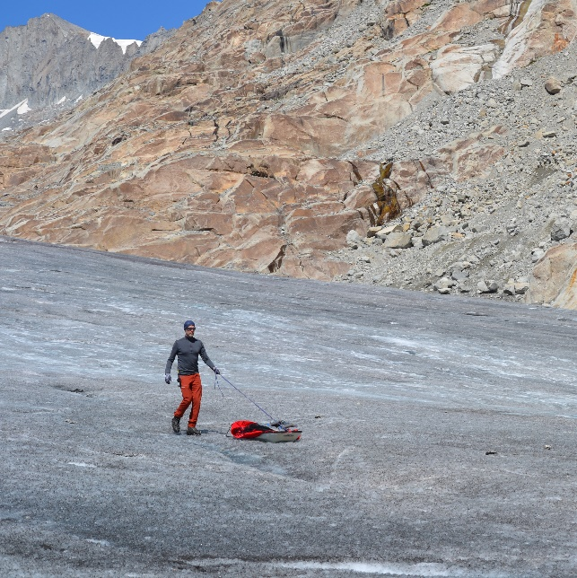
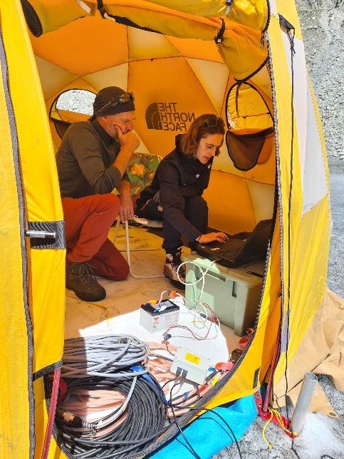









Experimental challenges and limitations
How to improve in the future?
Noise:
Contamination with electromagnetic radiation around 2000 Hz → increases measurement duration and complicates data interpretation
Logistics:
Displacing multiple kilometers of cable in a difficult terrain
Long measurement duration
Ensure safety regarding high voltages and glacier-related hazards
Photo by Raphael Moser

Slide 22

How to improve in the future
Noise:
Assess noise characteristics in advance before performing the full SNMR survey
Ensure selecting the correct excitation frequency by constantly measuring the geomagnetic field
Record a sufficient number of stacks (increases measurement time)
Logistics:
Establish an efficient cable management and installation
Measure multiple channels simultaneously²
Optimize the experimental design to measure only the configurations that further increase the amount of information contained in the SNMR data (based on a priori information of the subsurface)
$$ω_{L}=γB_{earth}$$

Slide 23
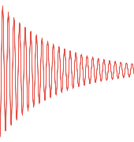
The data
Raw data
Processed data
Estimated parameters
Re[s(t)]/nV
Just noise…?!
1)
2)
Im[s(t)]/nV
Error bars:
Confidence interval
Different field strengths
1) Processing³:
Despiking, harmonic-noise cancellation, reference-loop noise cancellation, stacking, envelope detection, LP filter, resampling
2) Parameter estimation³:
Deterministic approach: Least-squares optimization
Probabilistic approach: Bayesian inference
Want to learn more?
Want to learn more?

Slide 24
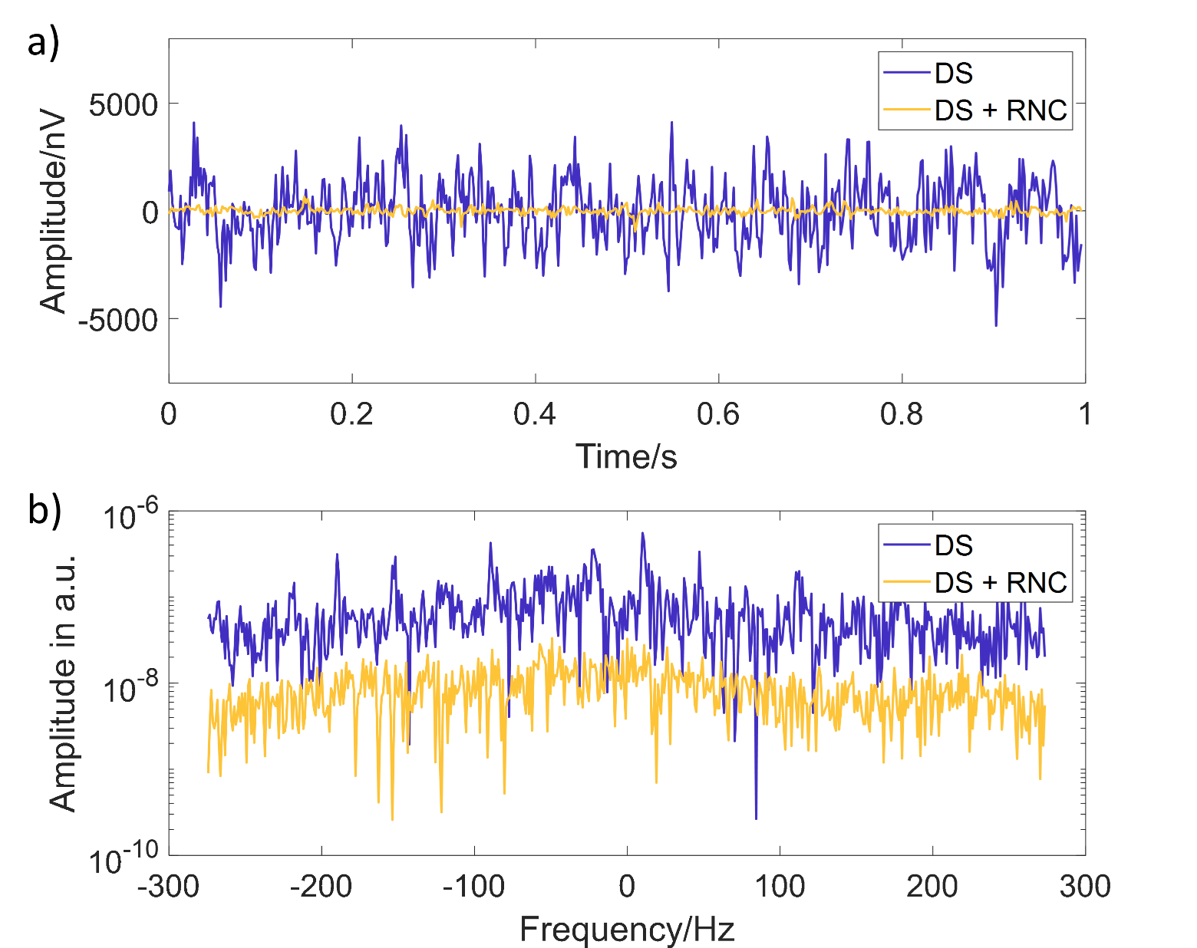
Data Processing: Dealing with noise⁴
Despiking (DS):
Removing spikes, which typically originate from some sort of discharge (e.g. thunderstorms)
Harmonic noise cancellation (HNC)
Removing harmonic noise corresponding higher harmonics of to ~50 Hz (powerlines) and ~16.6 Hz (railway)
Remote reference noise cancellation (RNC)
Removing spatially correlated noise
Processed with MRSmatlab³

Slide 25
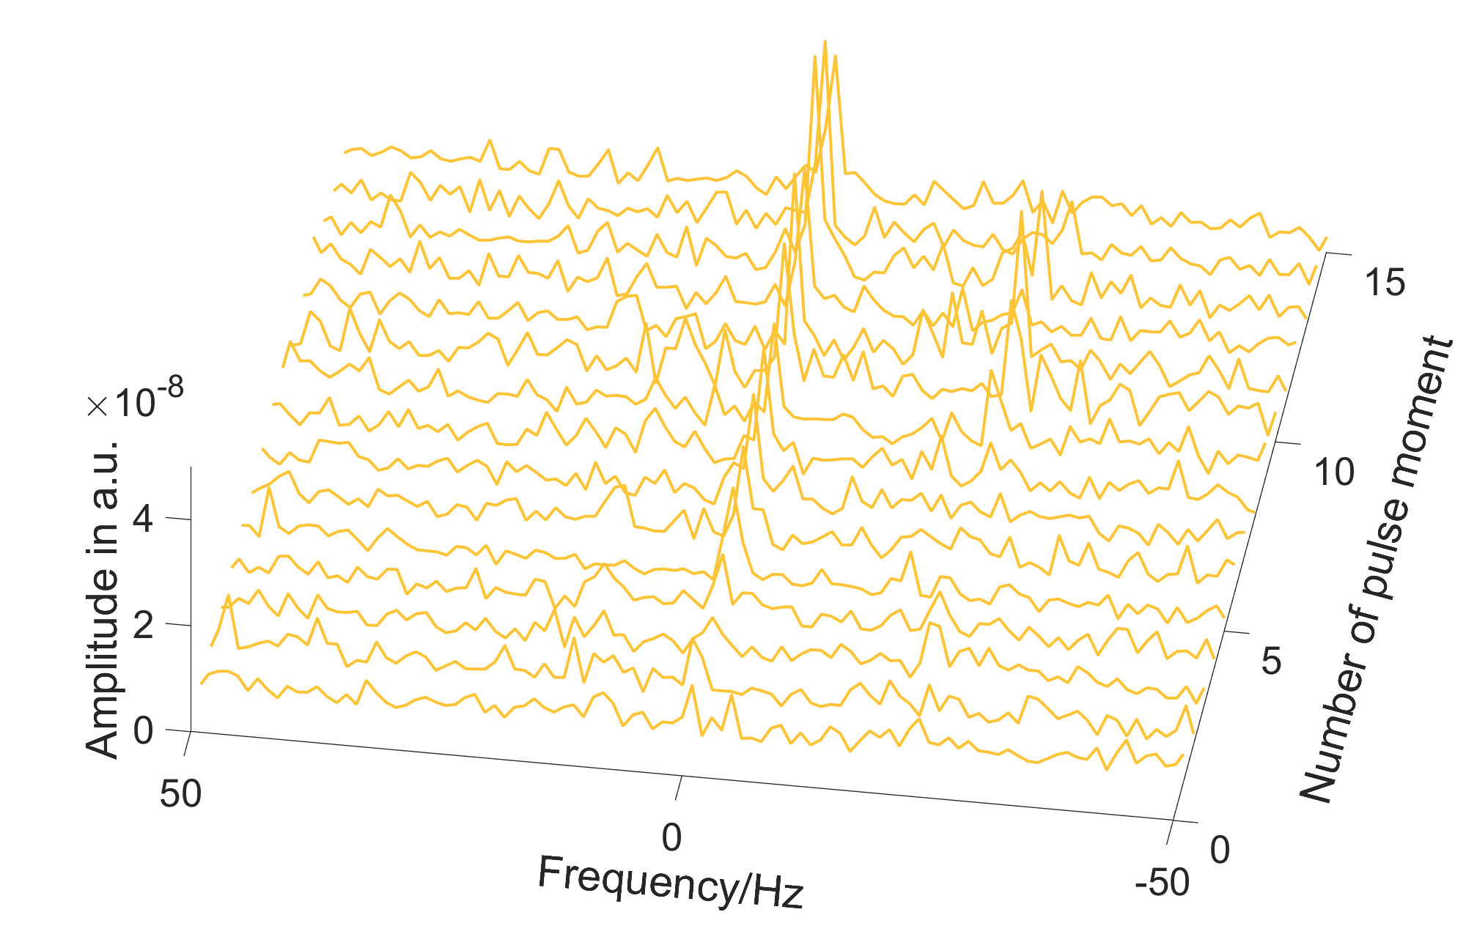
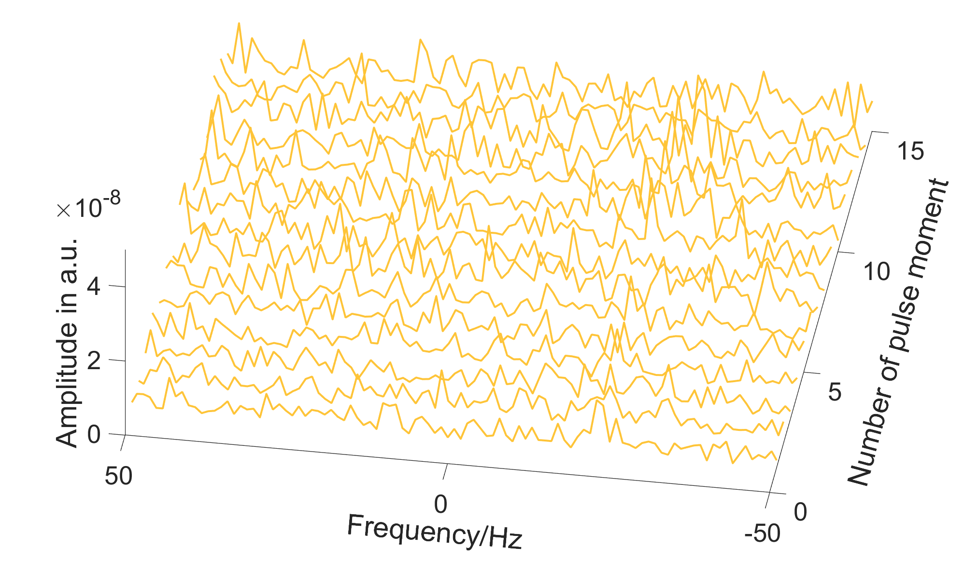
How to recognize an SNMR signal?
Signal + noise
Noise only
Larmor frequency!

Slide 26
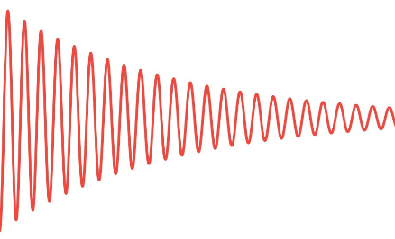
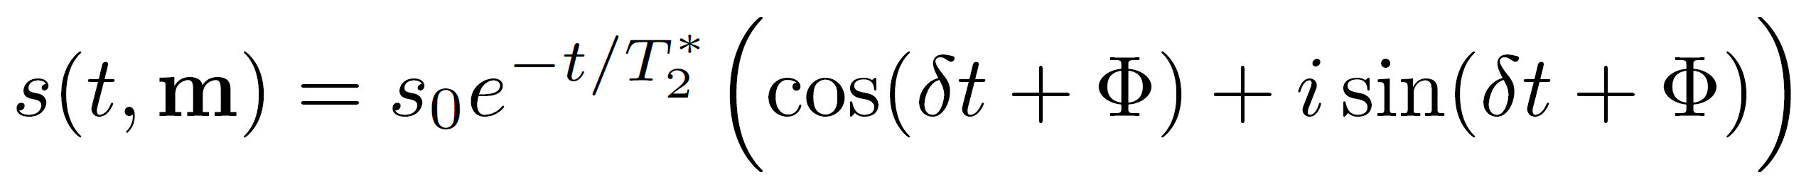
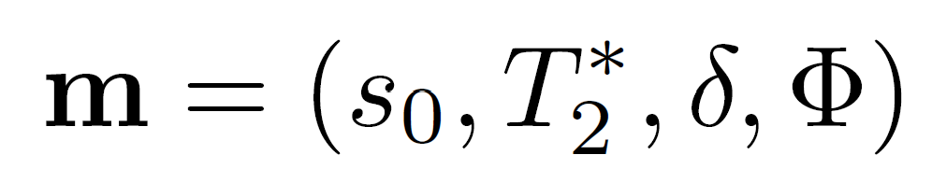
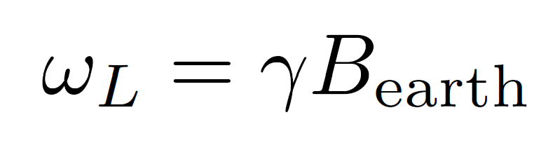

Data Processing: Last steps
+
Stacking of the traces to increase signal-to-noise ratio
Synchronous detection to retrieve the complex envelope
Lowpass filter to decrease noise
Resampling to create independent samples
+
amplitude
frequency
Processed with MRSmatlab³

Slide 27
Parameter estimation
For each pulse moment: Estimate the fitting parameters and their uncertainties from the processed time traces assuming
The complex envelope is a nonlinear function of the four parameters
Re[s(t)]/nV
Im[s(t)]/nV

Slide 28





Parameter estimation: Two approaches
Work in progress
Least-squares approach (deterministic)
Find maximum-likelihood model
Compute posterior covariance in vicinity of maximum-likelihood model
→ First-order approximation of covariance*
Bayesian inference (probabilistic)
Compute posterior probability according to Bayes’ theorem
Assume gaussian data and model priors
→ Investigate posterior in vicinity of the maximum
Linearized forward operator (Jacobian)
Data variance (so far computed from residuals)
$$s_{0}$$
$$T_{2}^{∗}$$
*In reality, there are additional factors further increasing the uncertainty. Currently, we likely underestimate the data uncertainty.⁵

Slide 29



Modelling (solving forward problem)
Work in progress
Sounding curve
Kernel
Water distribution
Hertrich, M., Imaging of groundwater with nuclear magnetic resonance, 2008
Which water models are compatible with the data?

Slide 30

Forward models
Work in progress
Church, G. et al., Ground-penetrating radar imaging reveals glacier’s drainage network in 3D, 2021
Aquifer
1D 100% homogeneous
1D Three layers
3D channel
Notes:
Explain for each model the model space!

Slide 31

1D homogeneous
1D Forward model with 100% temperate ice with various liquid water contents (LWC)
Error bars: 3$σ$

Slide 32

1D homogeneous
1D Forward model with 100% temperate ice with various LWC
Modelled with MRSmatlab³
Error bars: 3$σ$

Slide 33
1D Three layers
1D Forward model with temperate ice + aquifer + temperate ice
Aquifer
Notes:
This is based on prior knowledge on the model (Gregory church’s work) → we only explore a very small part of the model space!!! plus we assume a high uncertainty of the amplitude.
It’s a simplified setting → only three layers + assuming a 1D geometry!

Slide 34

1D three layers
Modelled with MRSmatlab³
Aquifer
Notes:
Focus on approach rather than on numbers!!

Slide 35
1D three layers
Mean LWC:
0.7 – 1.2 %
Aquifer
Notes:
Focus on approach rather than on numbers!!

Slide 36


3D channel – Outlook
Rhonegletscher:
Based on prior information, which 3D channel geometries can explain our data?
Prior information: GPR data, glaciological considerations
3D channel geometries: Parameter space consists of channel thickness and water content
50m
Reflection from the water
Figures by Christophe Ogier

Slide 37

Plans for the future: Research questions
How can we efficiently characterize the en- and subglacial water distribution in mountain glaciers?
What is the potential of SNMR applied on mountain glaciers?
How can we combine GPR and SNMR data to maximize the information obtained through both measurements?
How can we decrease the measurement duration and optimize the field effort?
Forward modelling
Noise studies
Inver-sion
SNMR surveys
Do you have an interesting research question related to the water distribution in glaciers?

Slide 38
Image references
Hansruedi Maurer: ETH Zürich
Daniel Farinotti: ETH Zürich
Raphael Moser: ETH Zürich

Slide 39
References
Church, G., Bauder, A., Grab, M. & Maurer, H. Ground-penetrating radar imaging reveals glacier’s drainage network in 3D. The Cryosphere 15, 3975–3988 (2021). URL https://tc.copernicus.org/articles/15/3975/2021/
Hertrich, M., Green, A. G., Braun, M. & Yaramanci, U. High-resolution surface NMR tomography of shallow aquifers based on multioffset measurements. GEOPHYSICS 74, G47–G59 (2009). URL https://library.seg.org/doi/10.1190/1.3258342
Müller-Petke, M., Braun, M., Hertrich, M., Costabel, S. & Walbrecker, J. MRSmatlab — A software tool for processing, modeling, and inversion of magnetic resonance sounding data. GEOPHYSICS 81, WB9–WB21 (2016). URL https://library.seg.org/doi/10.1190/geo2015-0461.1
T. Kremer, T. Irons, M. Müller-Petke, and J. Juul Larsen, Review of Acquisition and Signal Processing Methods for Electromagnetic Noise Reduction and Retrieval of Surface Nuclear Magnetic Resonance Parameters, Surveys in Geophysics, vol. 43, pp. 999–1053, Aug. 2022, https://link.springer.com/10.1007/s10712-022-09695-3
M Müller-Petke, R Dlugosch and U Yaramanci, Evaluation of surface nuclear magnetic resonance-estimated subsurface water content, New J. Phys. 13 095002 (2011), https://iopscience.iop.org/article/10.1088/1367-2630/13/9/095002

