Slide 1
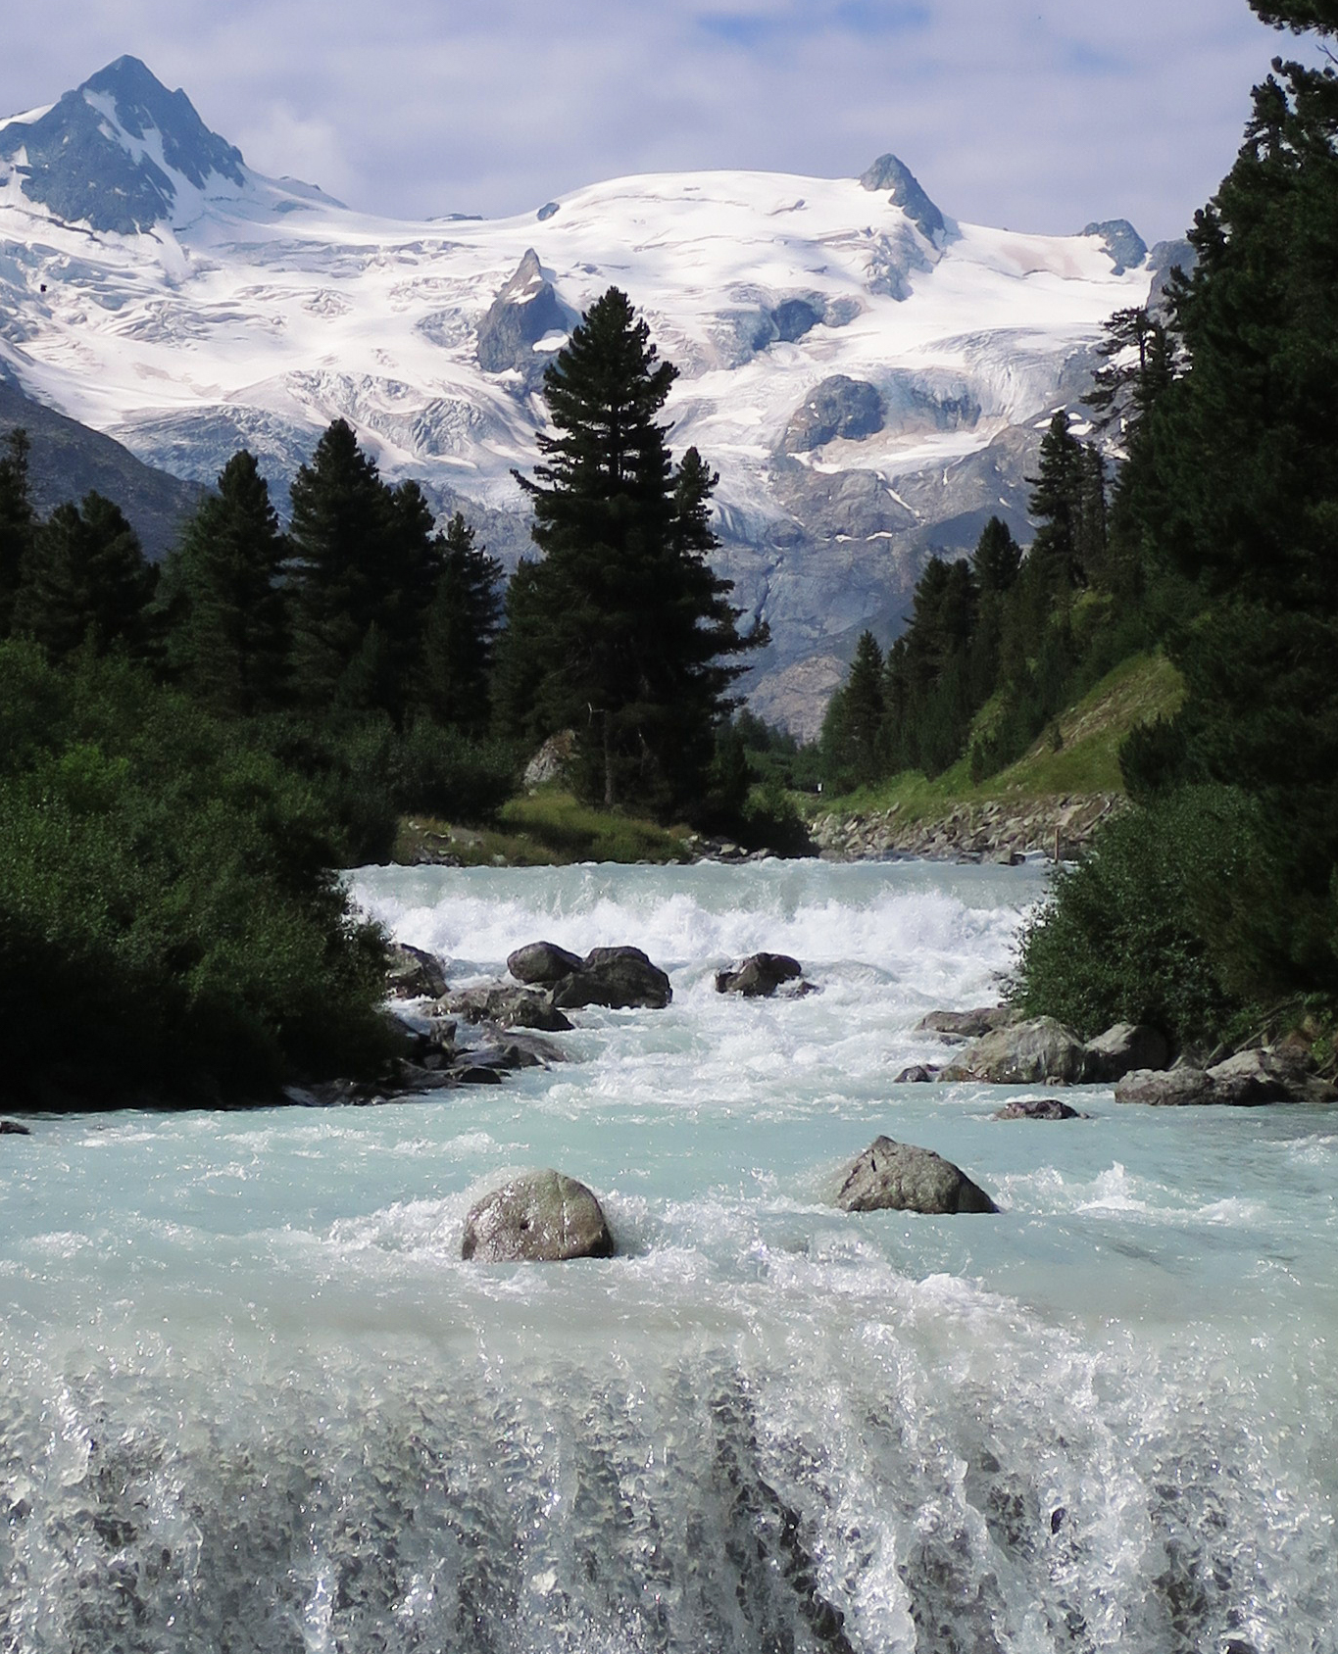


Glaciers – an overlooked water balance component in global hydrological modelling
Sarah Hanus, Lilian Schuster, Peter Burek, Fabien Maussion, Yoshihide Wada, Daniel Viviroli
sarah.hanus@geo.uzh.ch
© Daniel Viviroli

Slide 2
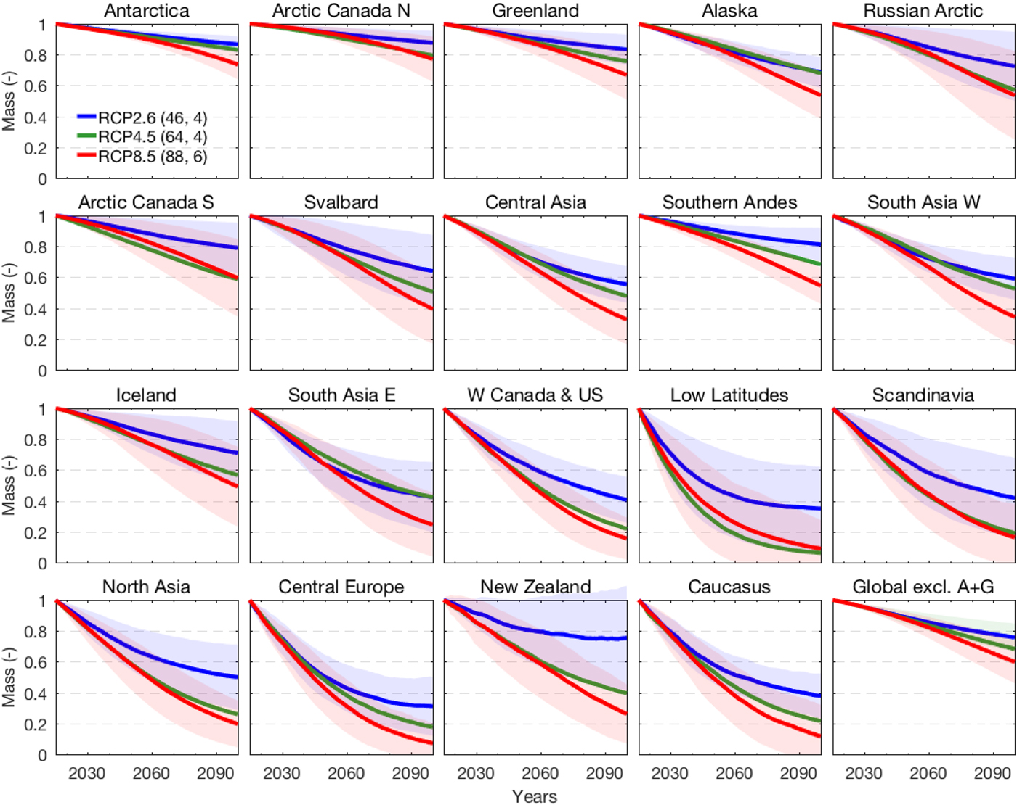

Glaciers
Strong runoff seasonality
Strong volume decreases during this century
Strong glacier runoff changes during this century
(Hock et al., 2019)

Slide 3
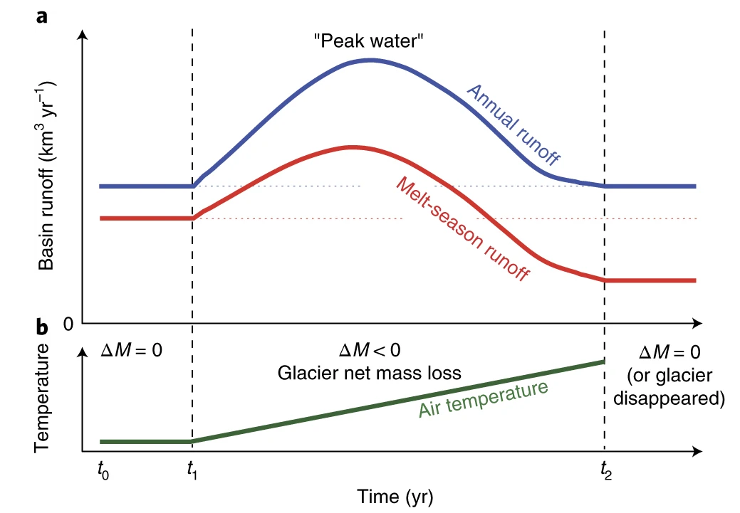
Glaciers
Strong runoff seasonality
Strong volume decreases during this century
Strong glacier runoff changes during this century
(Huss and Hock, 2018)

Slide 4
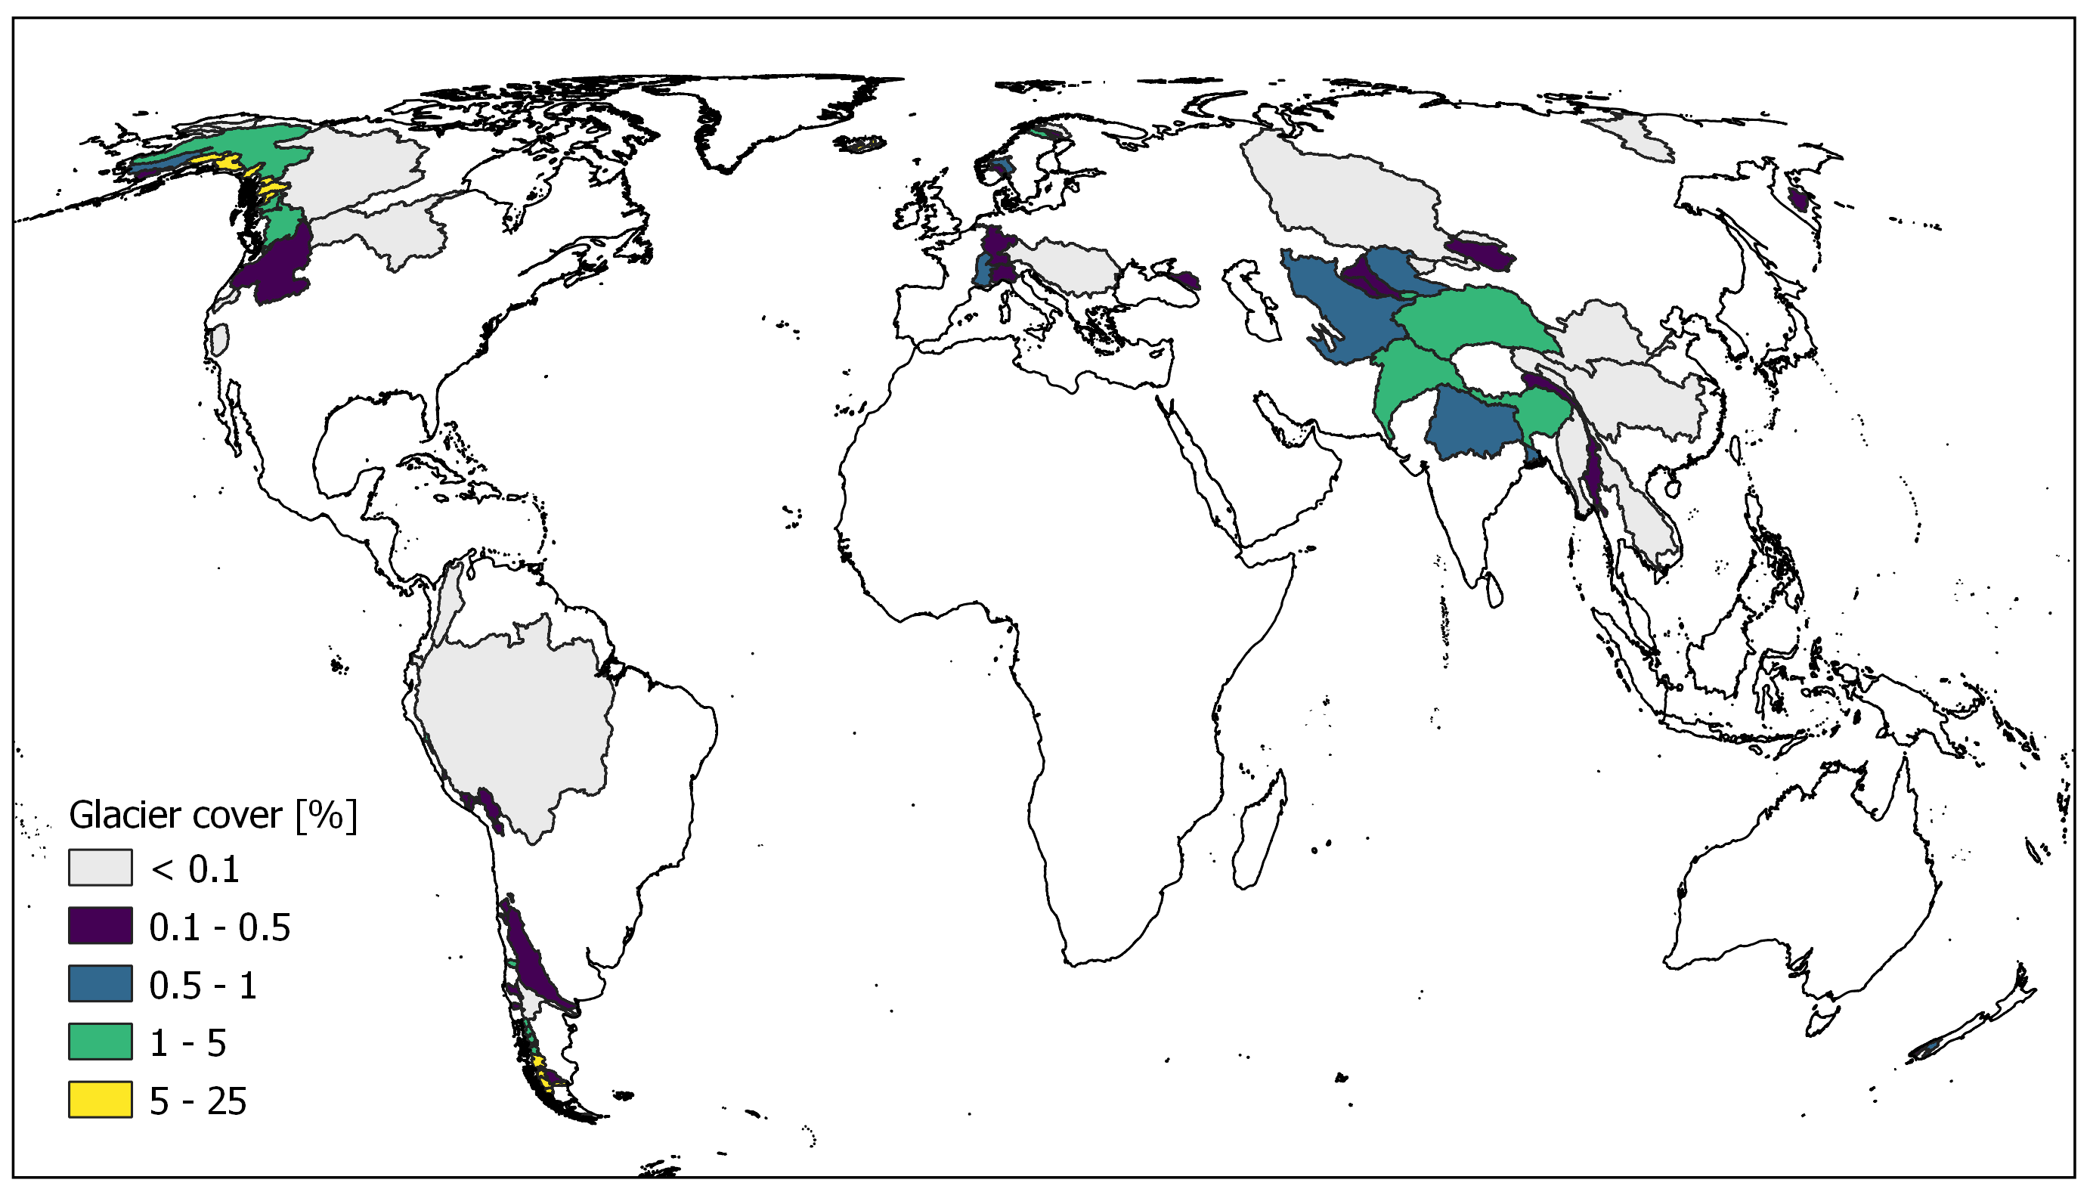
Glaciers in large river basins
Rhine: 0.2% glacier area
  4% ice melt contributions in September at Lobith (Stahl et al. 2016)
  Dry year (2003): 13% ice melt in September (Stahl et al. 2016)
Glaciers not considered in global hydrological models, except in some specific studies (Caceres et al. 2020)
Better model performance in strongly glacierized basins (Wiersma et al. 2022)

Slide 5
Research Aim
Large-scale hydrological modelling framework which explicitly incorporates glacier runoff
Focus on future changes in streamflow
Estimate glacier contributions to streamflow
Assess challenges and limitations
Foster collaboration between the glacier and hydrological modelling communities

Slide 6


Methods
Runoff from glaciers
Changes in glacier area
(Maussion et al., 2019)
CWatM
(Burek et al., 2020)
Challenges
Precipitation correction
Different spatial resolution
…
Evaluation
4 large river basins (5 arcmin)
Global simulations (30 arcmin)

Slide 7
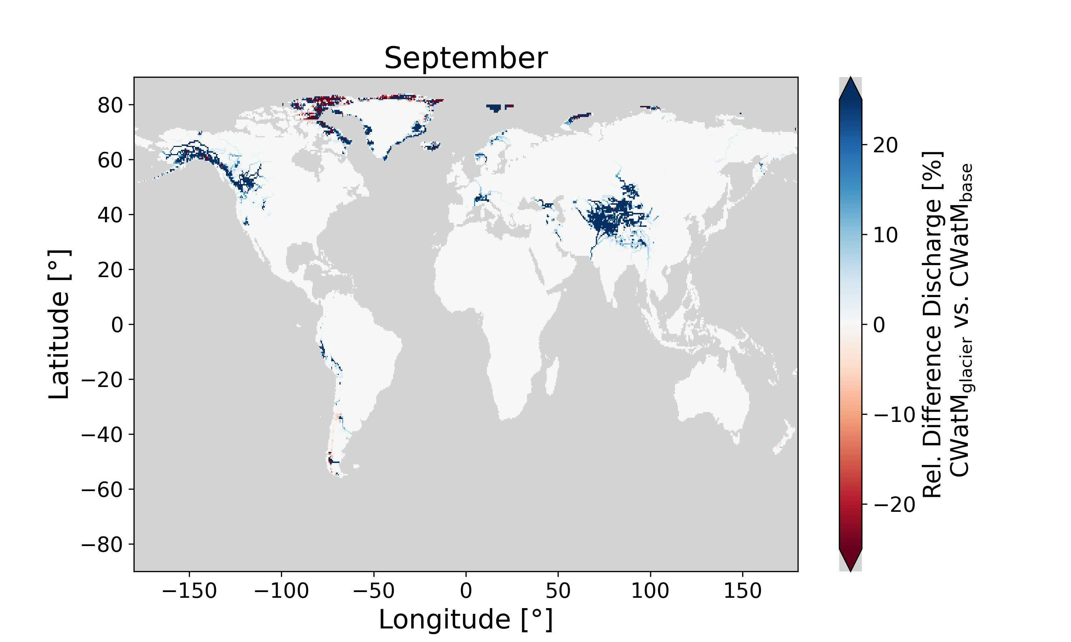
Results – Discharge differences

Slide 8
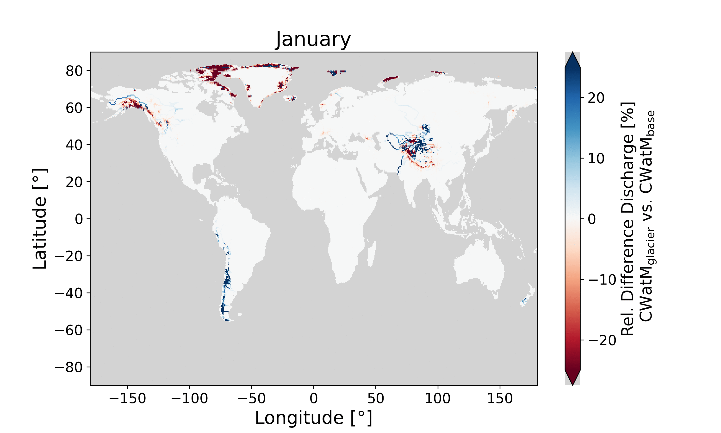
Results – Discharge differences
CWatM_{glacier}
Larger discharge in summer & autumn months
Smaller discharge in winter & spring

Slide 9
Challenges
Model differences
  Spatial resolution
  Snow simulation
Limitations of glacier model
  Calibration limited by data availability
  Choice of precipitation correction highly affects glacier runoff
Limitations of hydrological model
  global scale calibration and evaluation

Slide 10
Is it relevant to represent glaciers?
For future change projections in discharge
Especially with a focus on summer months or extreme years
Otherwise, future discharge changes are likely underestimated in glacierized river basins

Slide 11


More results and discussion at PICO spot A.1!
Find out more in our preprint on EGUsphere
Contact me
sarah.hanus@geo.uzh.ch

Slide 12

Glaciers – an overlooked water balance component in global hydrological modelling
Sarah Hanus, Lilian Schuster, Peter Burek, Fabien Maussion, Yoshihide Wada, Daniel Viviroli
Find out more in the preprint on EGUsphere
Let’s keep in touch!
Teaser
Why glaciers?
Coupling method
Results (Basins)
Results (Global)
Challenges

Slide 13
Why glaciers?
Strong runoff seasonality
Strong volume decreases during this century
Rhine: 0.2% glacier area
  4% ice melt contributions in September at Lobith (Stahl et al. 2016)
  Dry year (2003): 13% ice melt in September (Stahl et al. 2016)
(Hock et al., 2019)
Why glaciers?
Coupling method
Results (Basins)
Results (Global)
Challenges

Slide 14
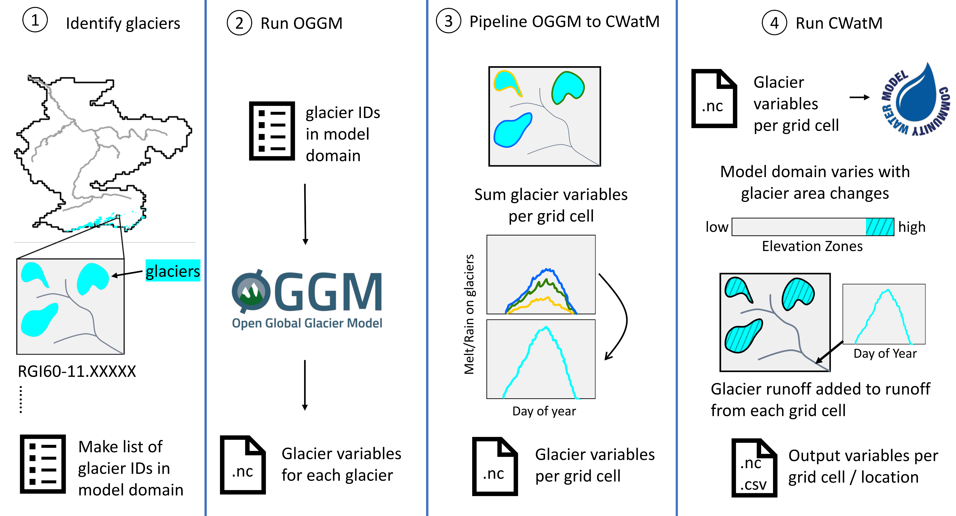
Coupling Method
Sequential Coupling
Global Glacier Model: Open Global Glacier Model (Maussion et al., 2019)
Large-scale hydrological and water resources model: Community Water Model (Burek et al., 2020)
More about global glacier modelling
More about large-scale hydrological modelling
Why glaciers?
Coupling method
Results (Basins)
Results (Global)
Challenges

Slide 15
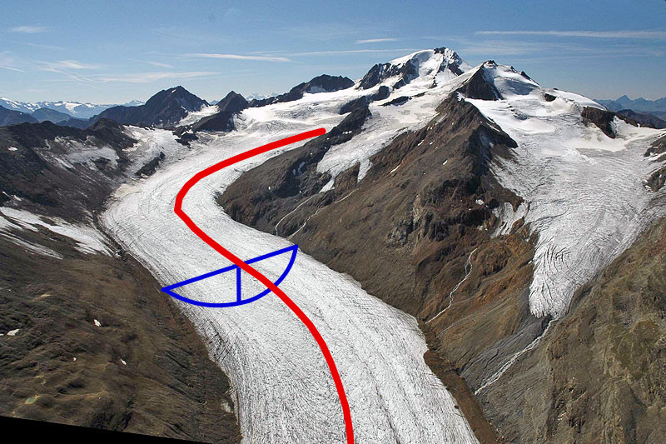
OGGM: Global glacier modelling
community-driven, open-source modelling framework
“glacier-centric”: Simulation of each glacier individually
Glacier outlines from Randolph Glacier Inventory (Pfeffer et al., 2014)
Elevation-band flowlines from DEM (e.g., Huss and Farinotti, 2012; Werder et al., 2020)
1D shallow-ice flowline model
Temperature index mass-balance model
  At each elevation band
Limited possibility of modelling past (earliest 1979)
Can be run on a personal laptop for a few hundred glaciers
Glacier Model Intercomparison Project (Marzeion et al. 2020)
(Maussion et al., 2019)
Figure from https://docs.oggm.org/en/stable/flowlines.html
Check out the extensive documentation: https://docs.oggm.org/
Why glaciers?
Coupling method
Results (Basins)
Results (Global)
Challenges

Slide 16
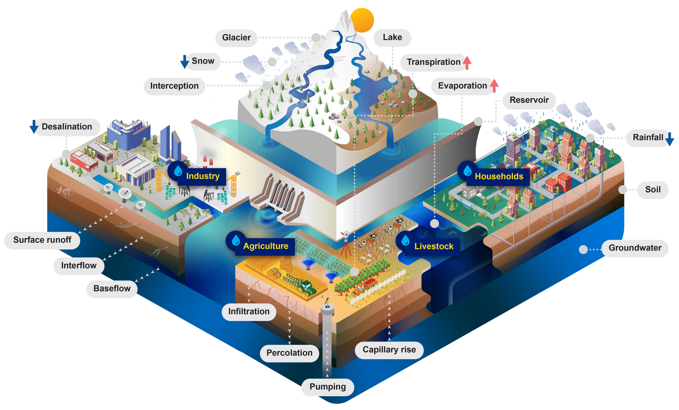
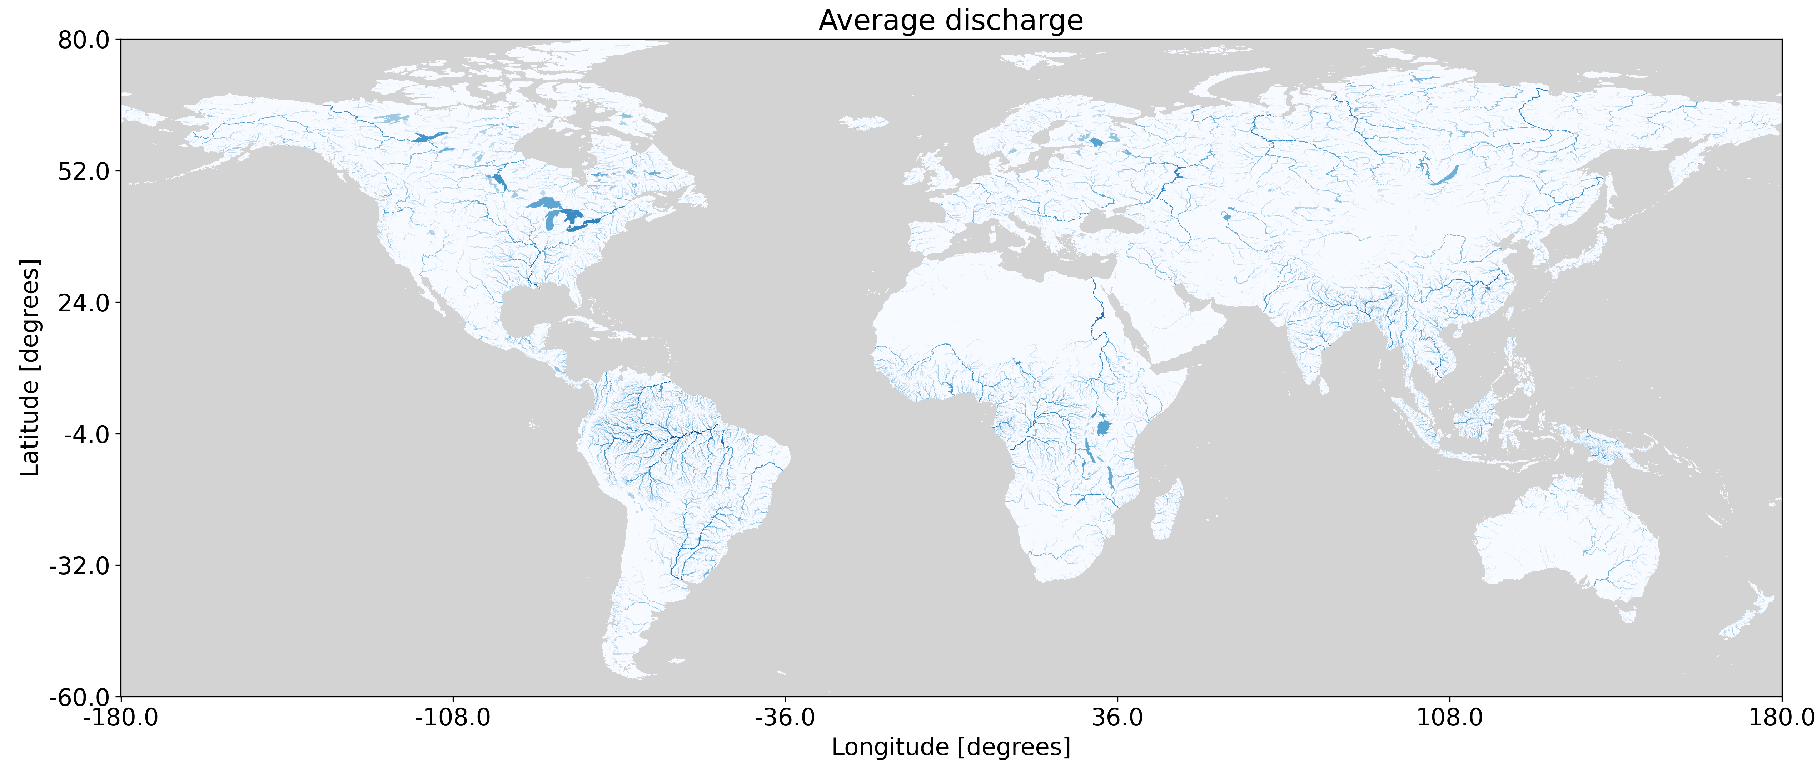
CWatM: Large-scale hydrological modelling
Open-source model
Simulates hydrological storages and processes
Includes human impacts: reservoirs, water use
Grid-based model (30 arcmin, 5 arcmin, 1 arcmin)
Often only simplistic calibration at global scale
Comparison of global hydrological models in the Inter-Sectoral Impact Model Intercomparison Project (ISIMIP)
Why glaciers?
Coupling method
Results (Basins)
Results (Global)
Challenges

Slide 17
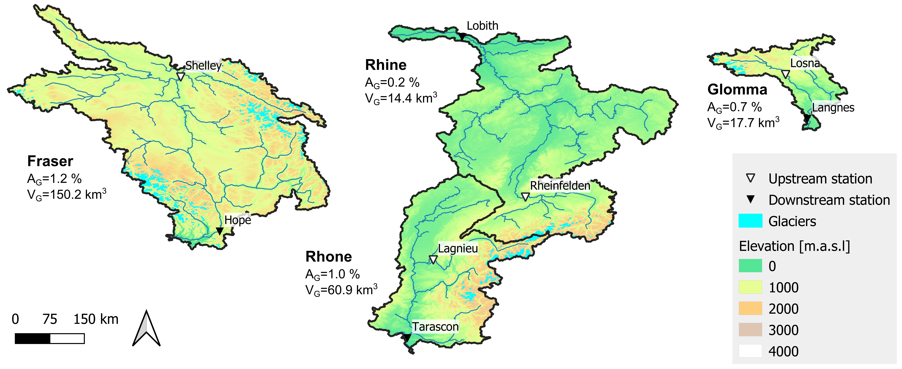
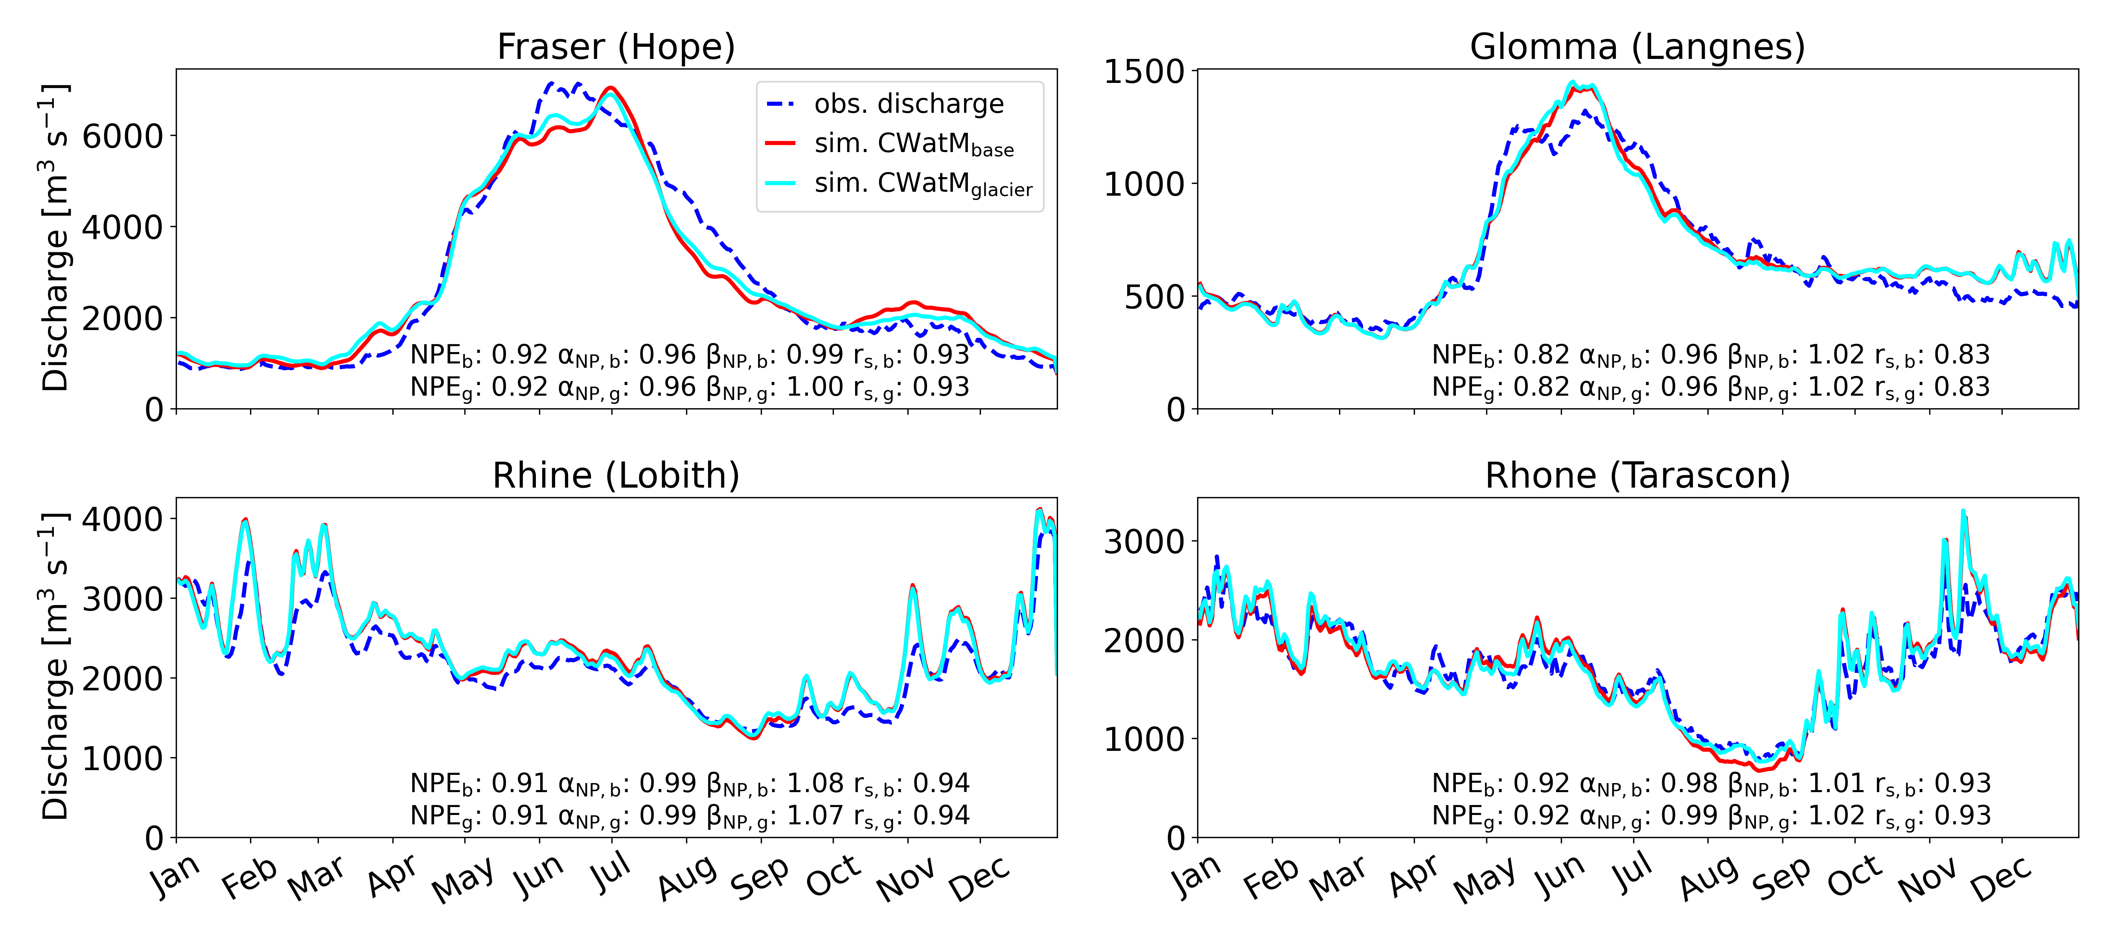
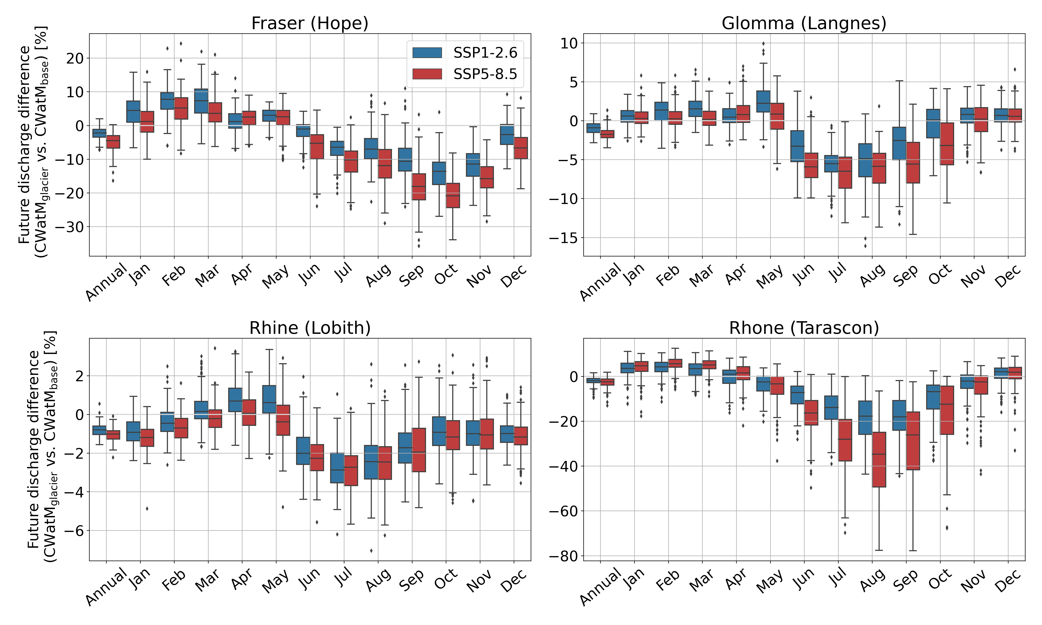
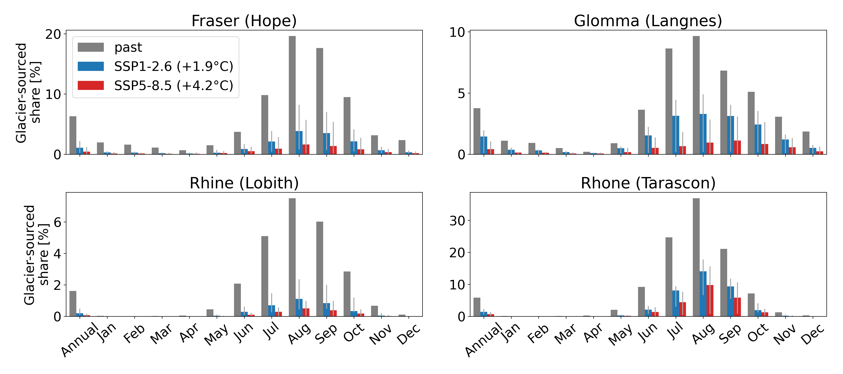
Results (Basins)
①
②
Calibration leads to comparable past model performance for baseline and coupled model
Four study basins
③
Coupled model projects lower future summer discharge
④
Even under a low-emission scenario strong future decrease in glacier-sourced contribution to discharge
Why glaciers?
Coupling method
Results (Basins)
Results (Global)
Challenges

Slide 18
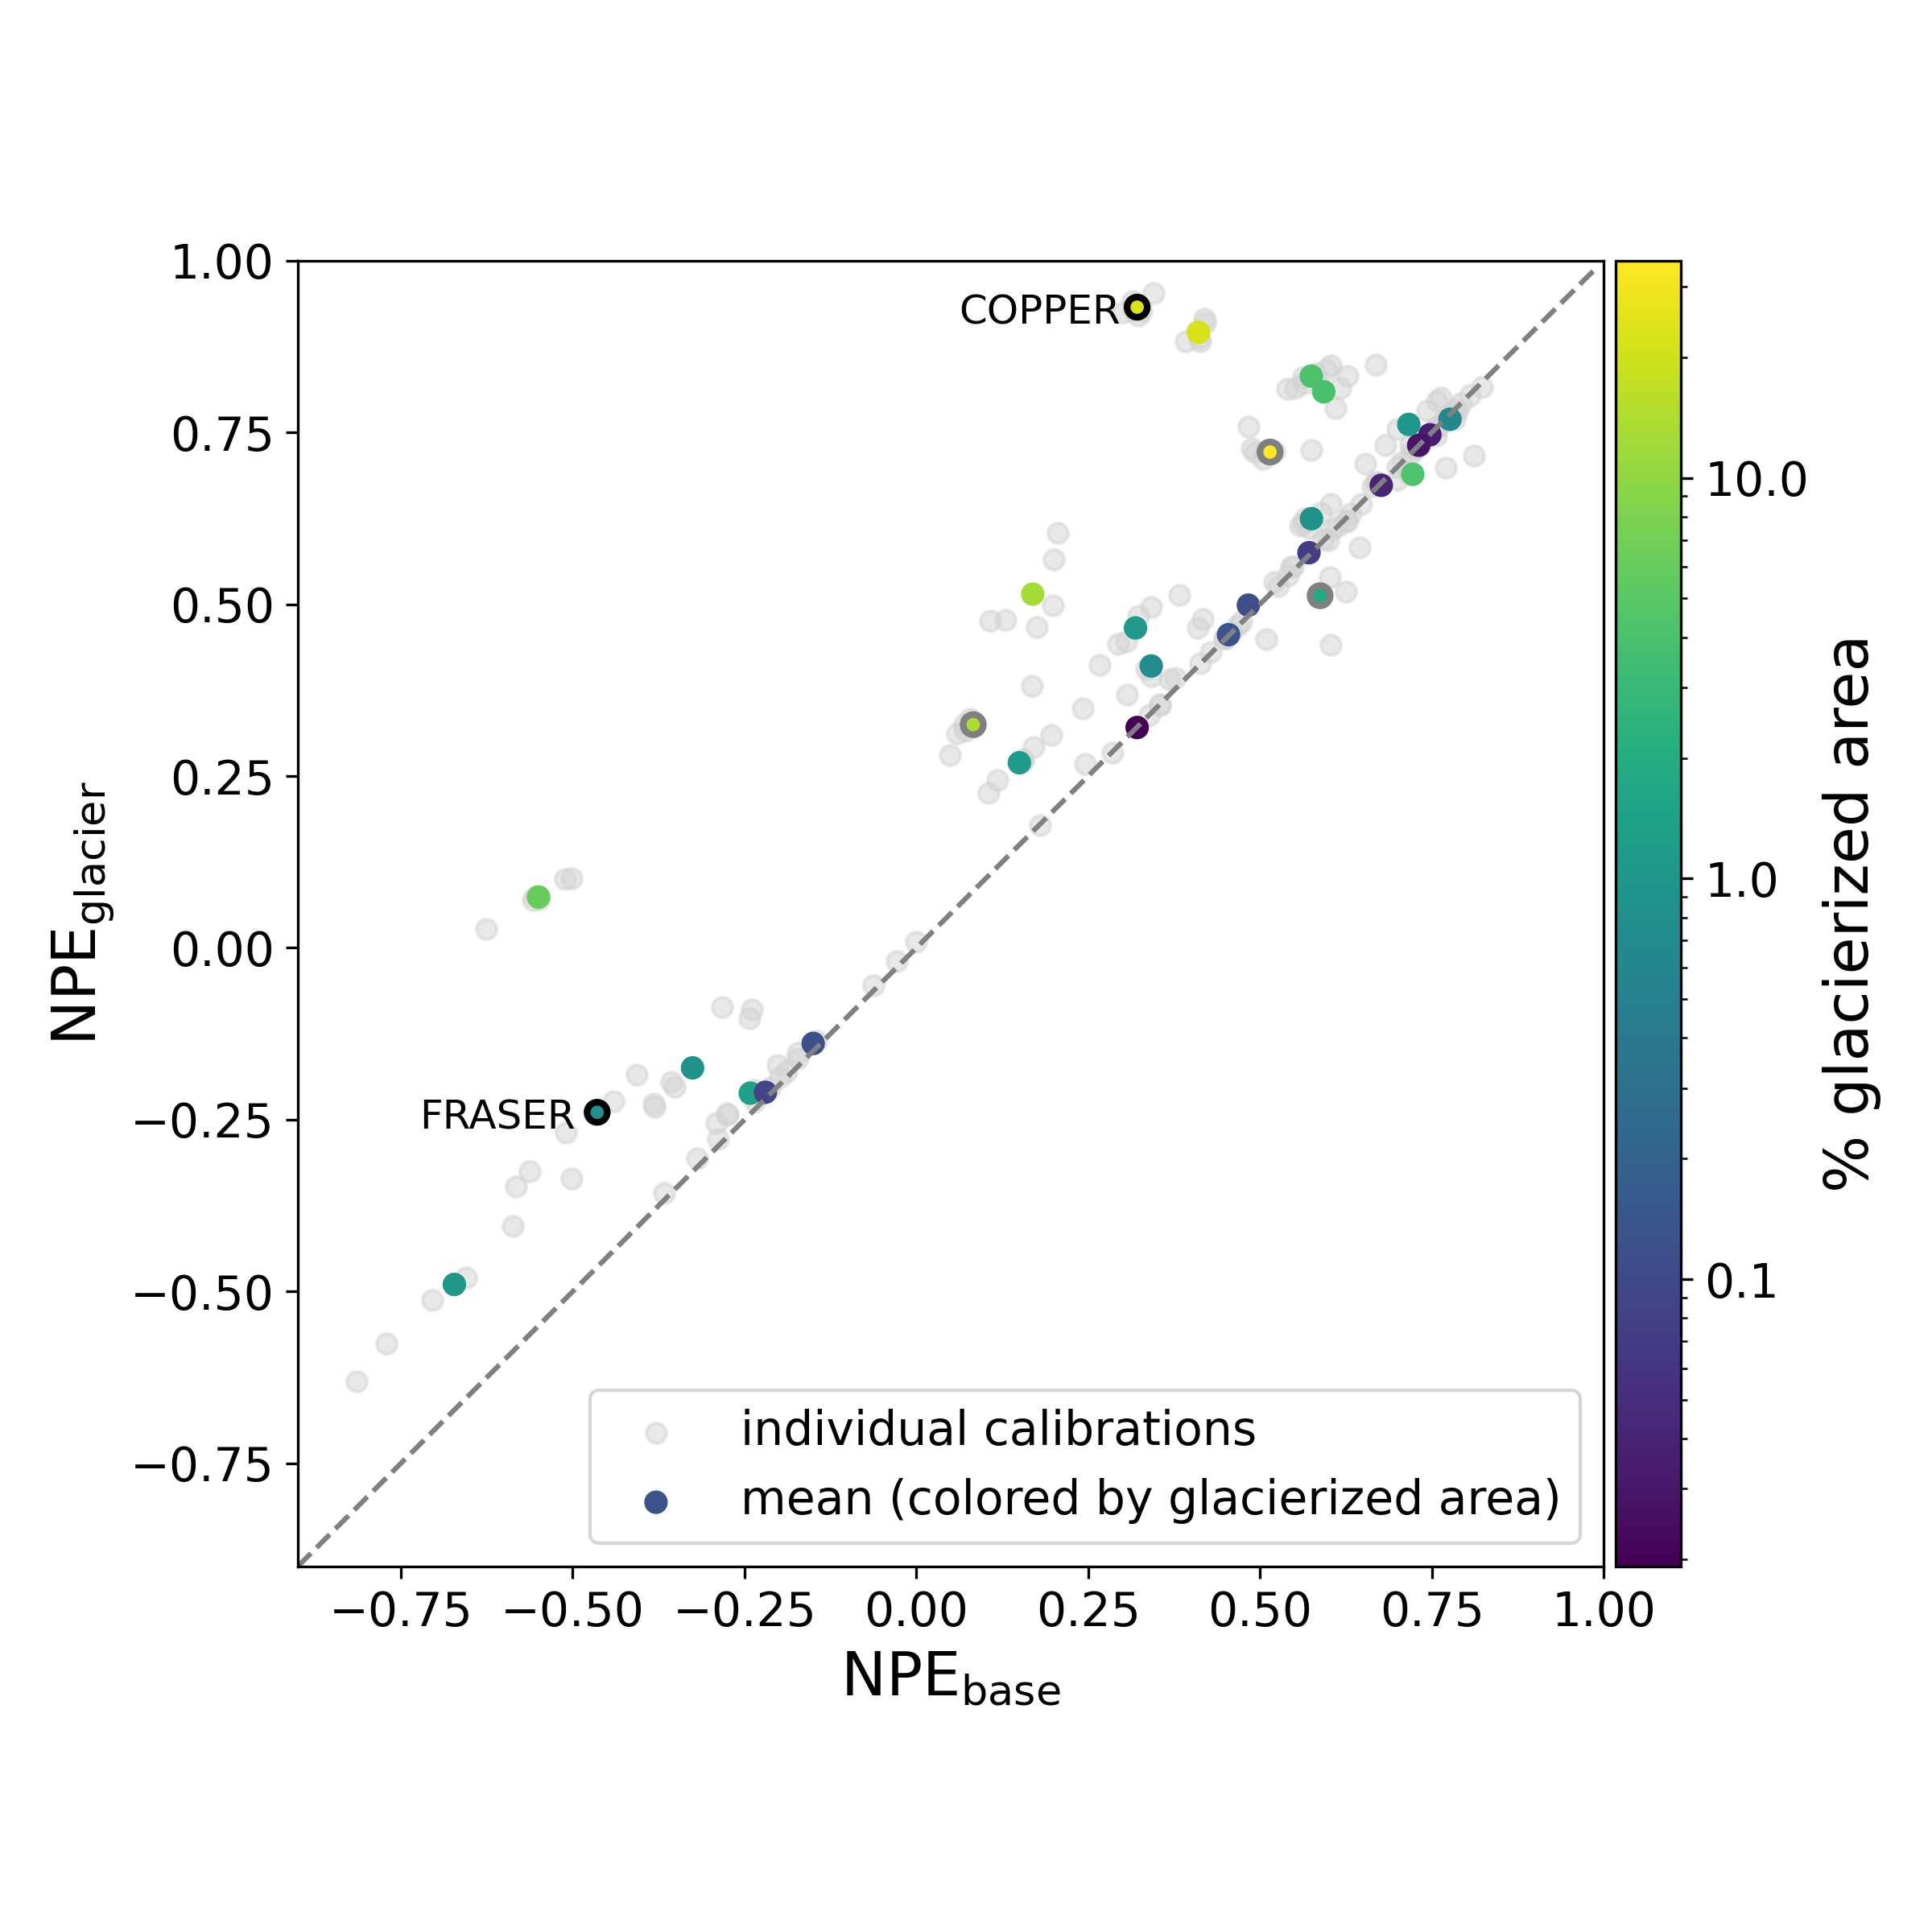
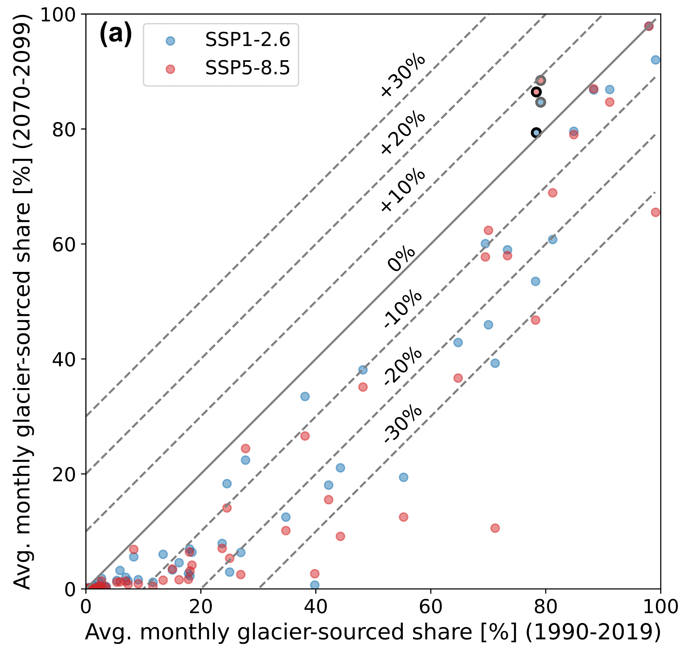
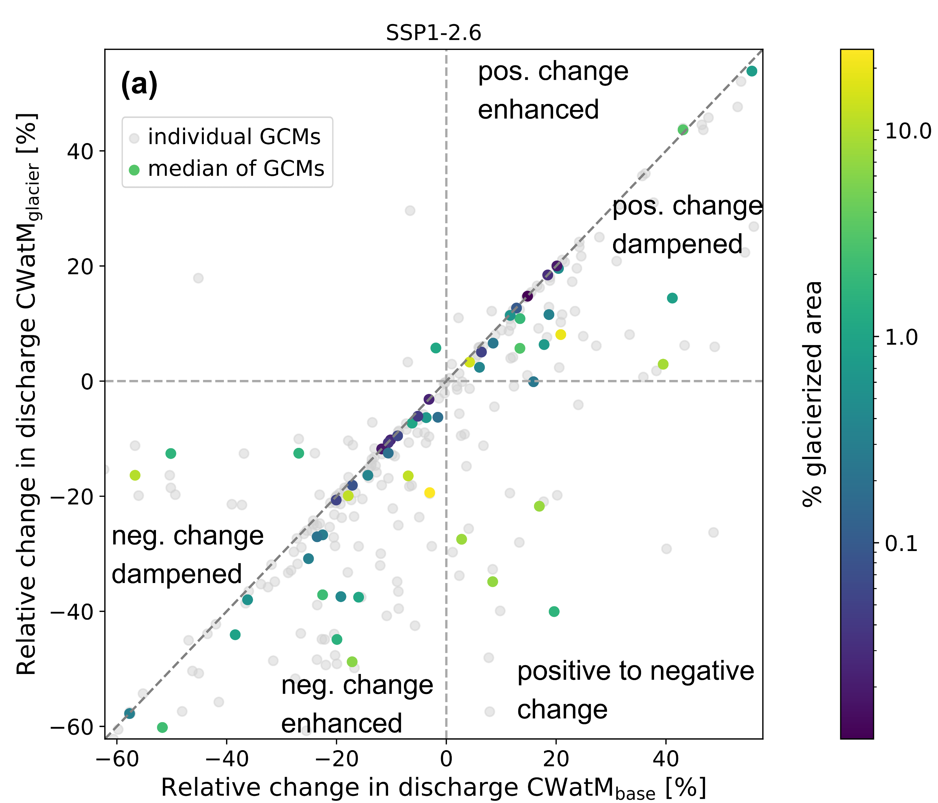
Results (Global)
Performance improves or is similar
for coupled model
Glacier-sourced melt contribution to discharge at river basin outlet decreases in future
Future positive streamflow changes are dampened and negative changes exacerbated when including glaciers
Discharge differences of the coupled model vs. baseline model
Why glaciers?
Coupling method
Results (Basins)
Results (Global)
Challenges

Slide 19
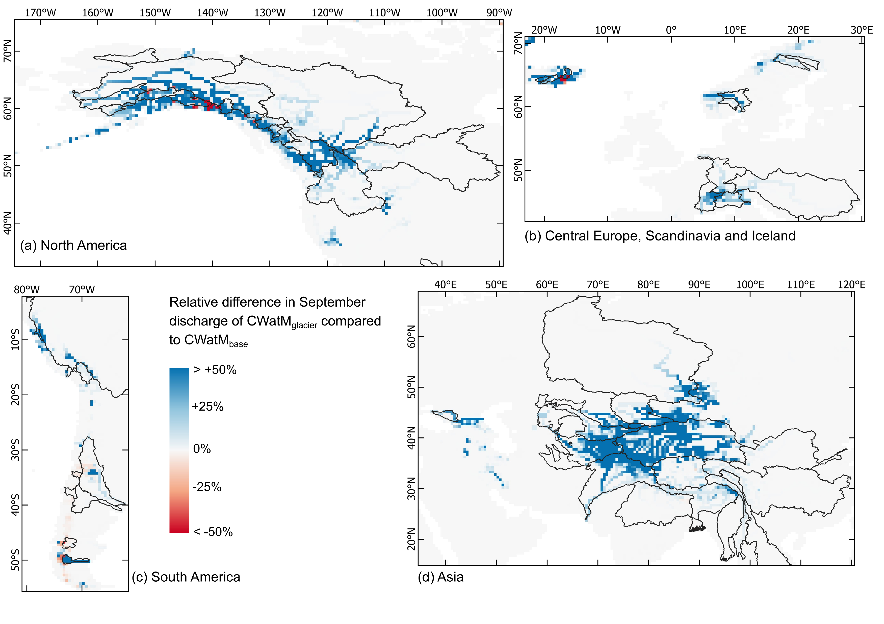
Results (Global) – Discharge differences
CWatM_{glacier}
Larger discharge in summer & autumn months
Smaller discharge in winter & spring
Why glaciers?
Coupling method
Results (Basins)
Results (Global)
Challenges

Slide 20
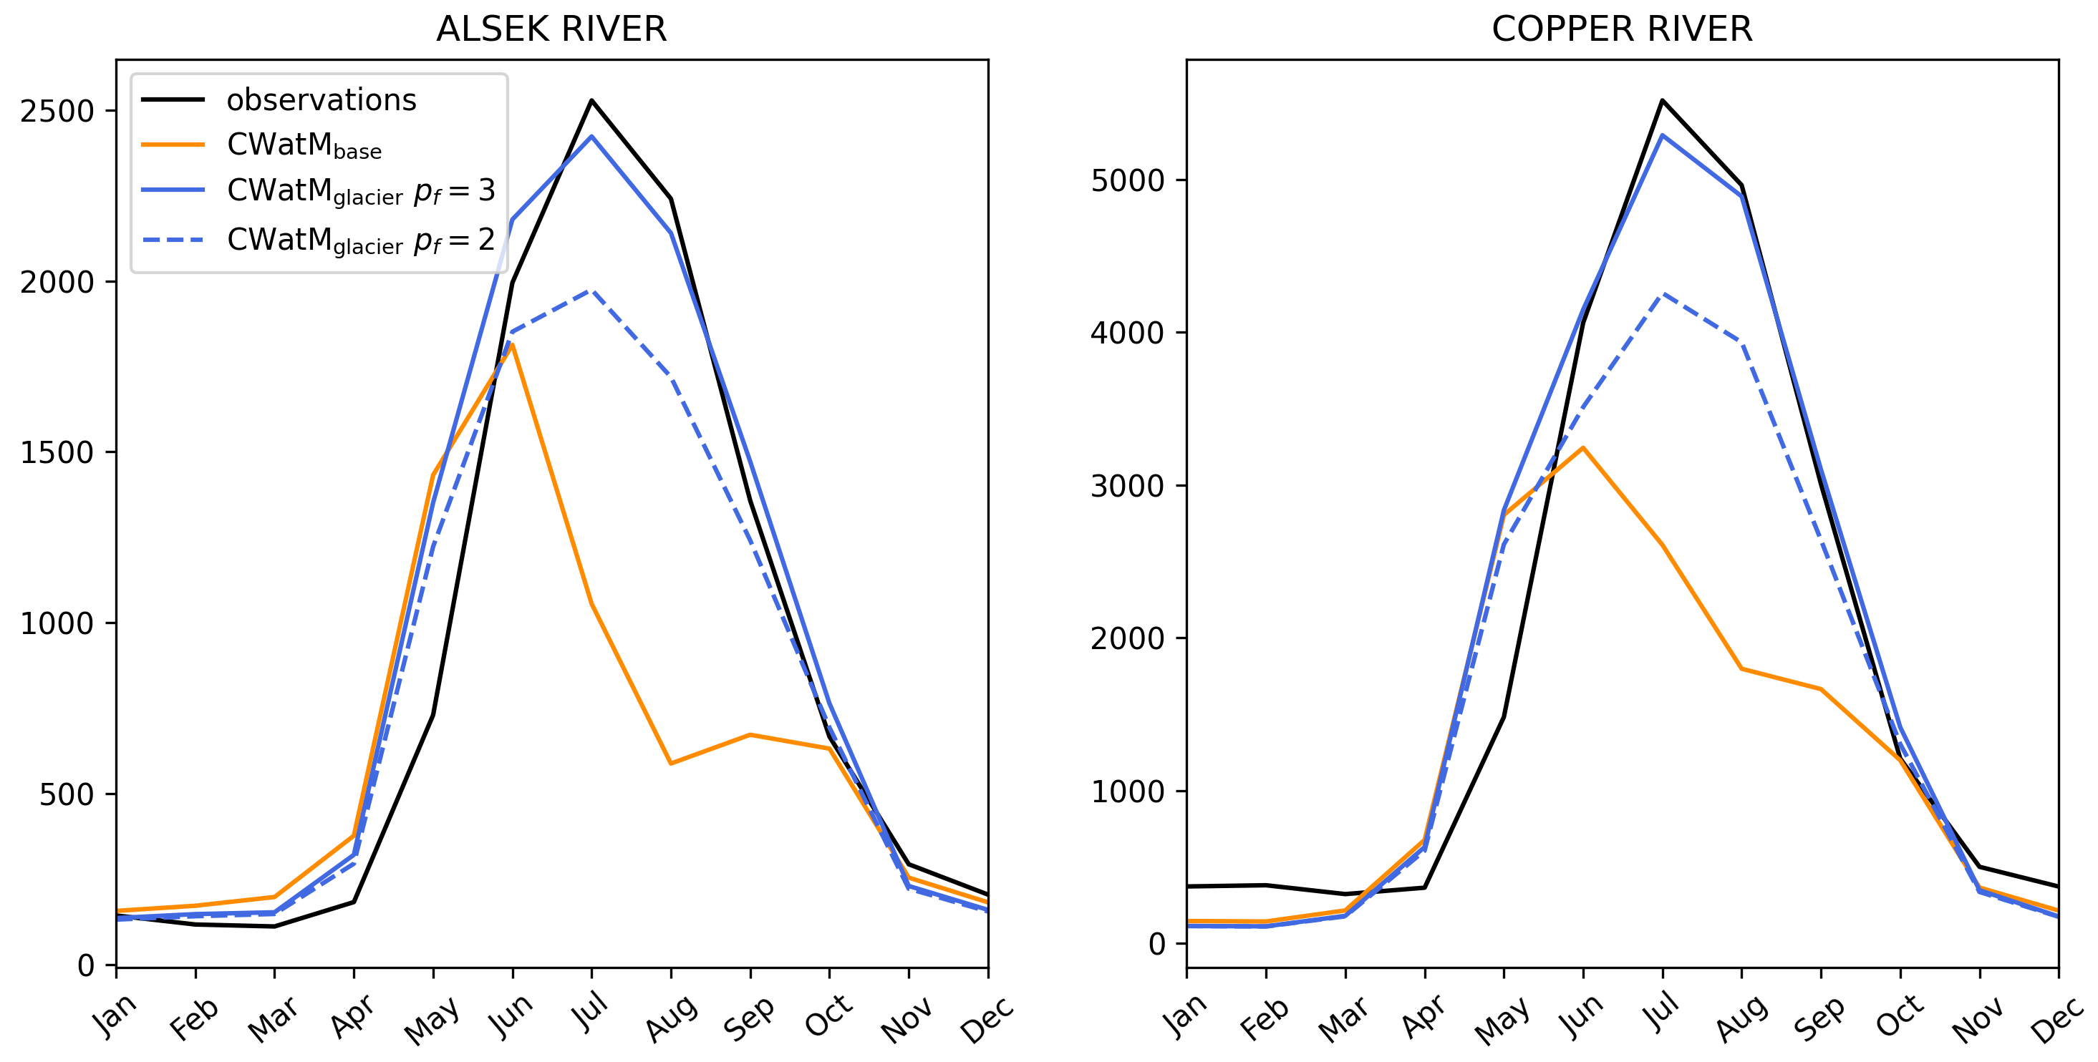
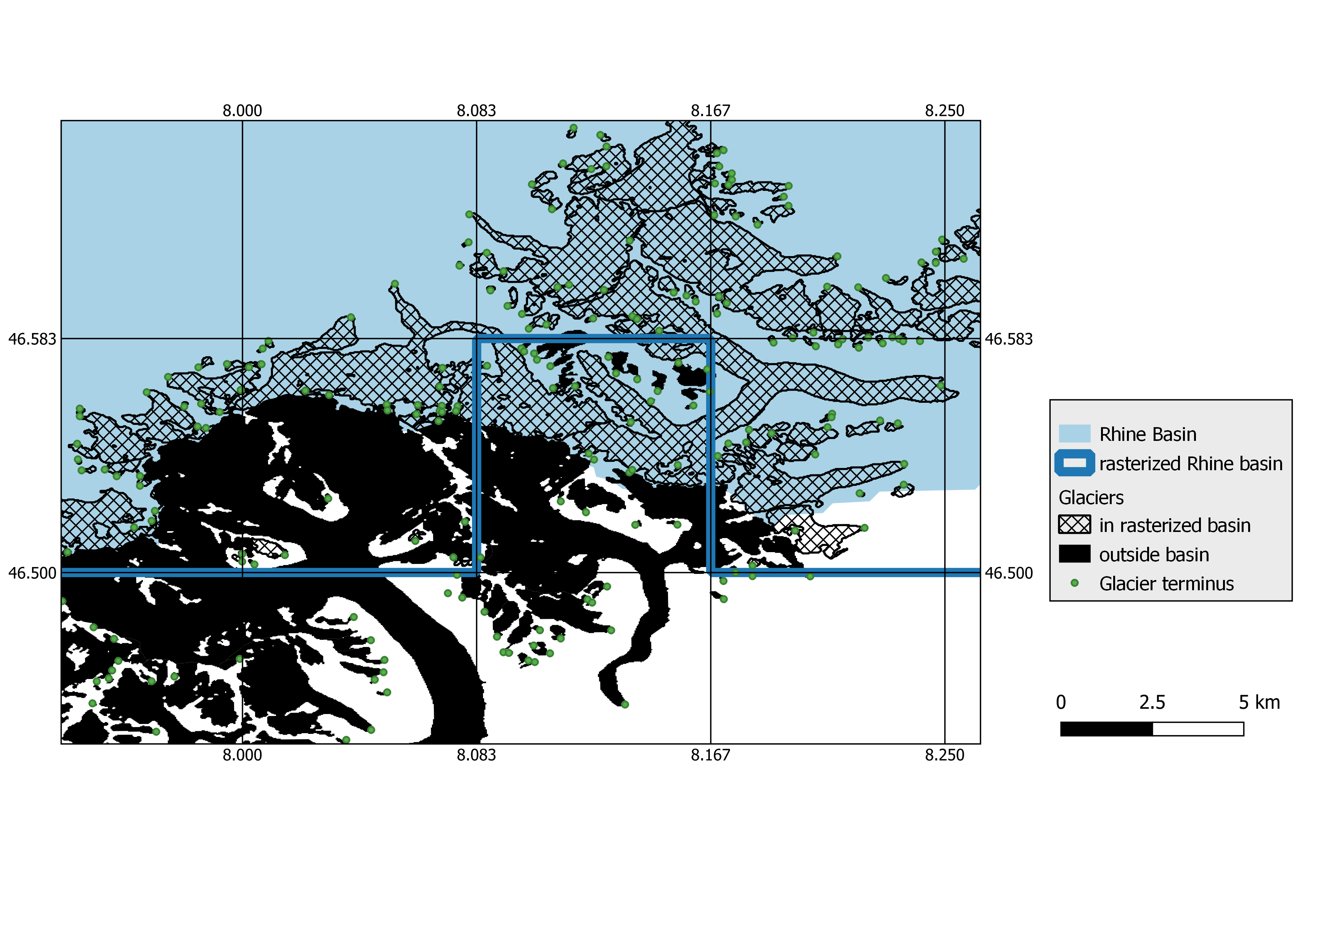


Challenges …
Precipitation correction highly impacts glacier runoff results
Glacier location in modelling grid
Calibration of global hydrological models
Differences in snow melt representation
Glacier melt ≠ Ice melt?
Let’s keep in touch!
Find out more in the preprint
Click here
Find synergies with the glacier modelling community
Continuous collaboration between glacier and hydrological community
… and benefits
Next slide
References
Why glaciers?
Coupling method
Results (Basins)
Results (Global)
Challenges

Slide 21
Benefits
Inclusion of glaciers for future change assessments
  Especially relevant when studies focus on summer months or extreme years
Step towards better understanding the relevance of glaciers for water availability
Opens the possibility to contrast glacier-sourced runoff with other streamflow components
Bridging the gap between assessments of environmental changes and their potential impacts on societies (water use)
Why glaciers?
Coupling method
Results (Basins)
Results (Global)
Challenges

Slide 22

Study Basins
Why glaciers?
Coupling method
Results (Basins)
Results (Global)
Challenges

Slide 23
Performance: Calibrated basins
Downstream discharge stations
Upstream stations
Why glaciers?
Coupling method
Results (Basins)
Results (Global)
Challenges

Slide 24
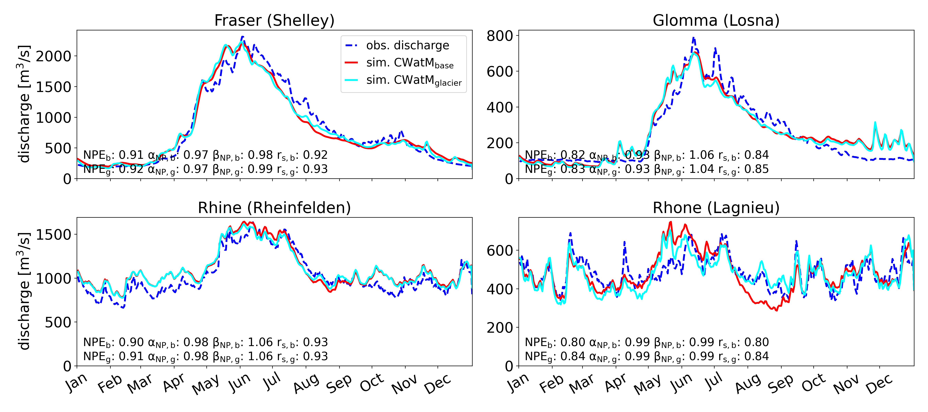
Performance: Calibrated basins
Upstream discharge stations
Why glaciers?
Coupling method
Results (Basins)
Results (Global)
Challenges

Slide 25
Future discharge
2070 – 2099
Change in discharge
Why glaciers?
Coupling method
Results (Basins)
Results (Global)
Challenges

Slide 26
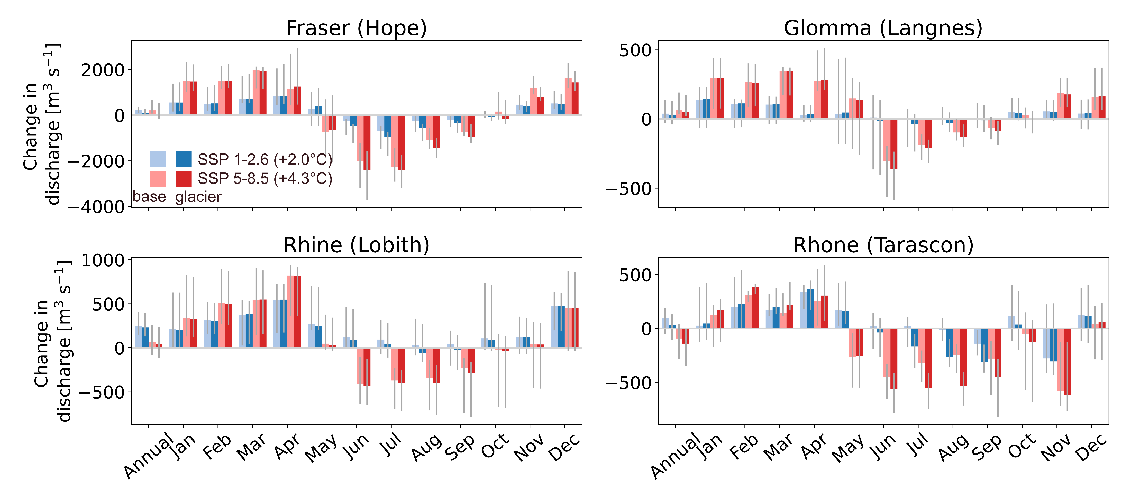
Future change in discharge
2070 – 2099 vs 1990 – 2019
Why glaciers?
Coupling method
Results (Basins)
Results (Global)
Challenges

Slide 27
Glacier-sourced discharge contributions
Future: 2070 – 2099
Why glaciers?
Coupling method
Results (Basins)
Results (Global)
Challenges

Slide 28
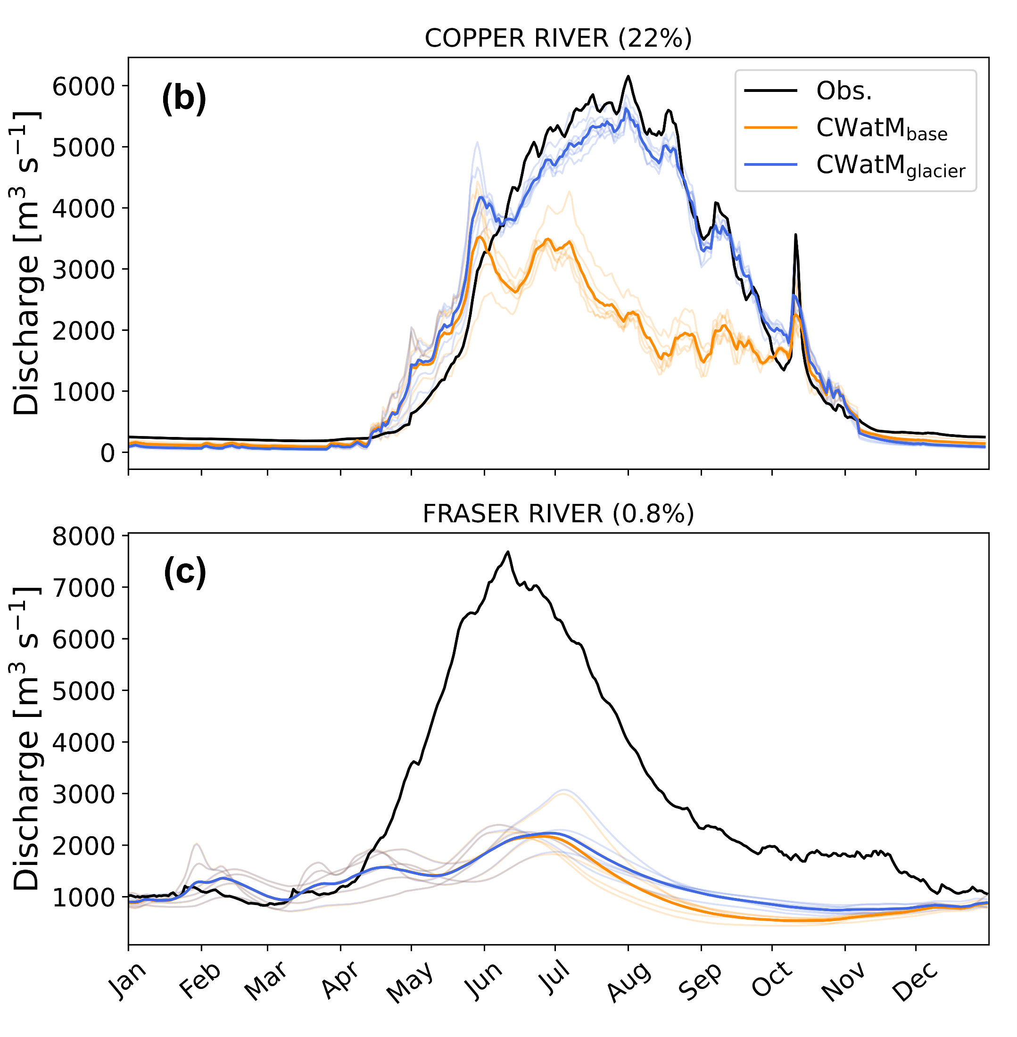
Performance: global simulations
Performance improved for 23 out of 30 basins
Individual calibration of river basins would likely enhance the advantages of glacier inclusion
Why glaciers?
Coupling method
Results (Basins)
Results (Global)
Challenges

Slide 29

Future discharge changes at basin outlets
Month with largest absolute glacier-sourced melt contribution in the past
Positive future change dampened for CWatM_{glacier} vs. CWatM_{base}
Negative future change exacerbated for CWatM_{glacier} vs. CWatM_{base}
Decreased glacier runoff at end of 21st century
Why glaciers?
Coupling method
Results (Basins)
Results (Global)
Challenges

Slide 30

Glacier-sourced melt contributions
Relative glacier-sourced melt contributions are projected to be lower at the end of the century
Uncertainty in relative glacier-sourced melt contributions due to inaccurate representation of observed discharge in simulations
Spatial plot of past glacier-sourced melt contributions to discharge
Future annual glacier-sourced melt volumes
Why glaciers?
Coupling method
Results (Basins)
Results (Global)
Challenges

Slide 31
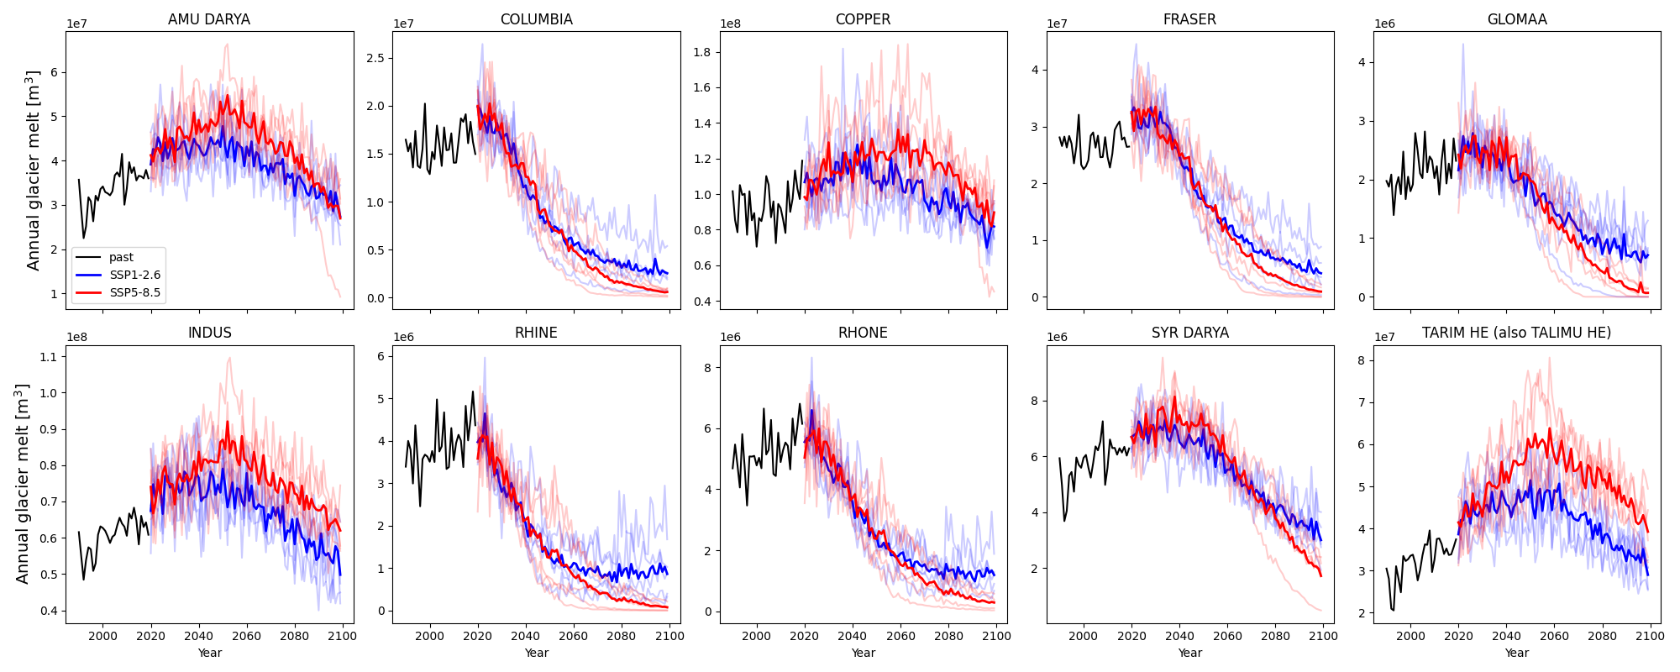
Future annual glacier-sourced melt
Why glaciers?
Coupling method
Results (Basins)
Results (Global)
Challenges

Slide 32
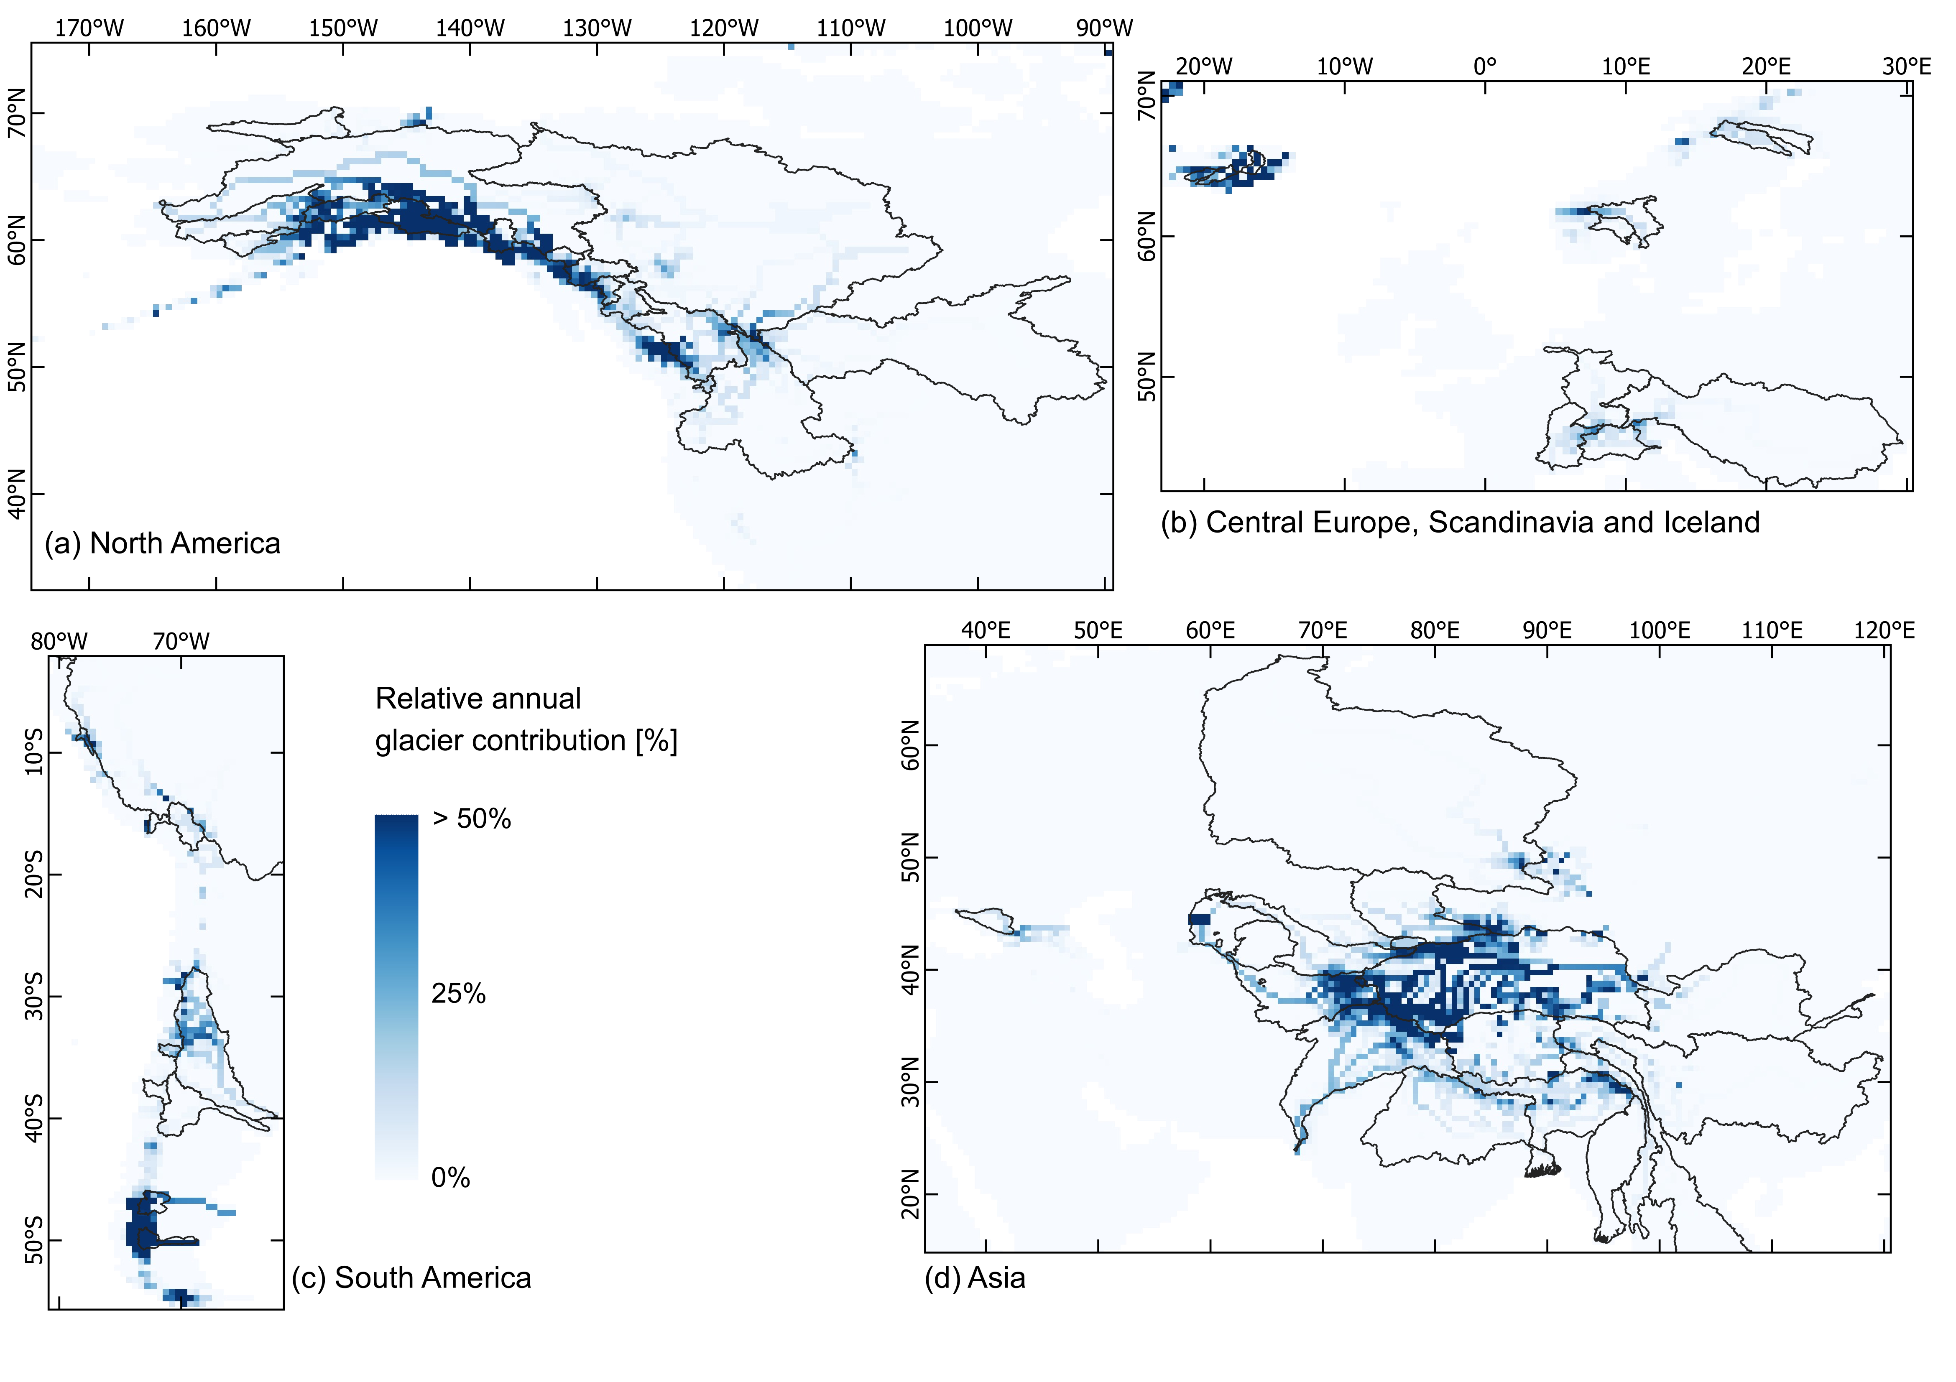
Past annual glacier-sourced melt
Why glaciers?
Coupling method
Results (Basins)
Results (Global)
Challenges

Slide 33
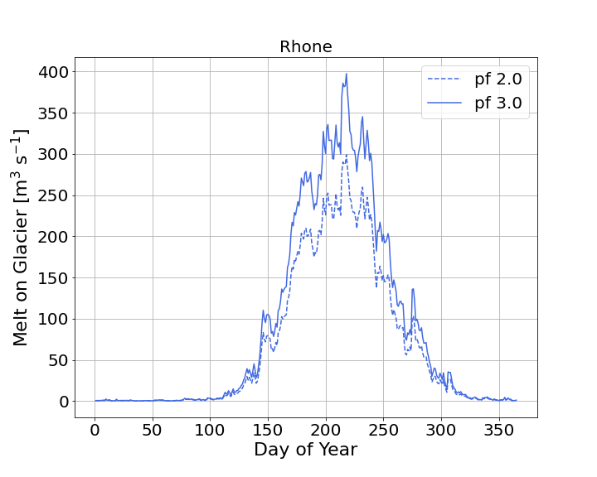
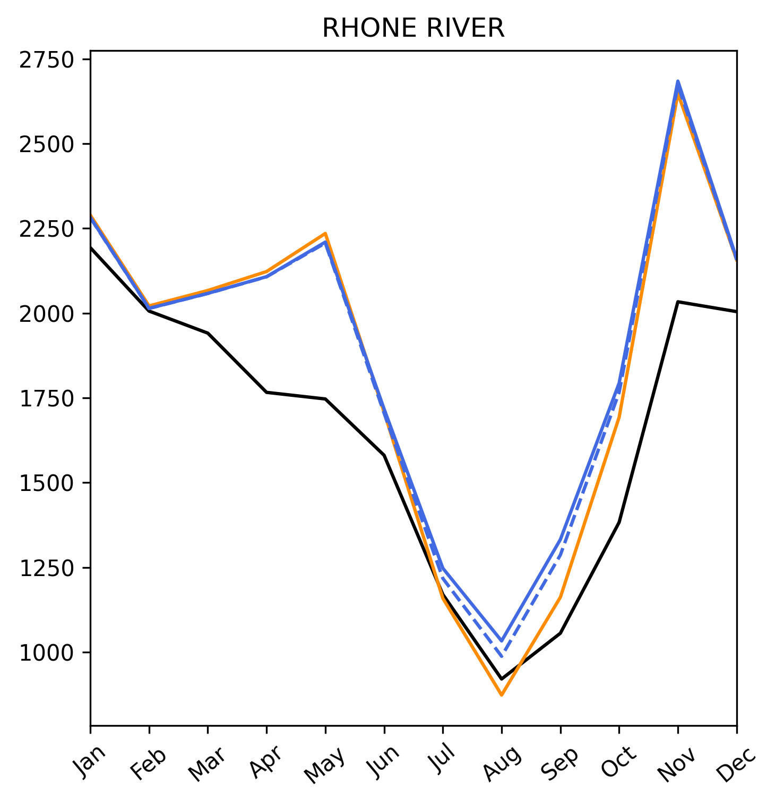
Precipitation correction
Precipitation correction in glacier models to correct for errors in snow input
Different combinations of precipitation correction factor and degree-day factor can represent mass balance of glaciers equally well (Rounce et al, 2020; Schuster et al. 2023)
Using the same precipitation correction in both models resulted in unrealistic calibration and deterioration in model performance
Precipitation correction is higher for the glacier model than for the hydrological model
Why glaciers?
Coupling method
Results (Basins)
Results (Global)
Challenges

Slide 34
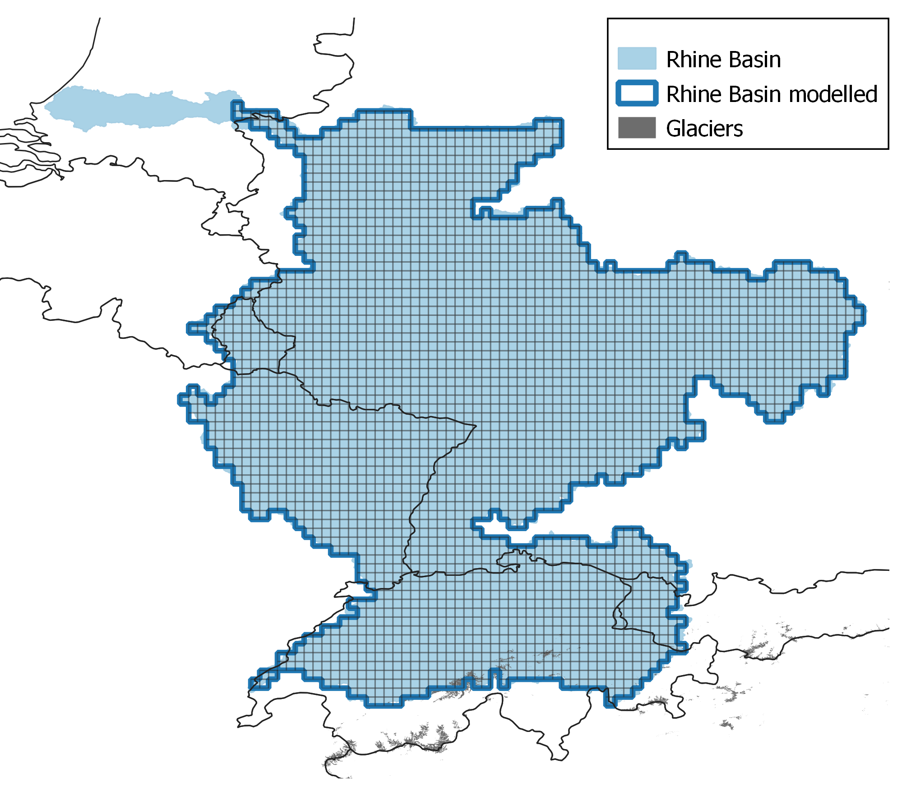
Glacier location in modelling grid
Glacier-sourced melt 13% / 6% lower on 30 / 5 arcmin resolution than for 100 m basin outline for the Rhine
Grid resolution: 5arcmin (6 x 9 km)
Why glaciers?
Coupling method
Results (Basins)
Results (Global)
Challenges

Slide 35
Differences in snow melt representation
OGGM: 30m elevation zones on each glacier
  Degree-day factor as calibration parameter -> calibrated against glacier mass-balance
CWatM: up to 10 equally sized elevation zones per grid cell
  Degree-day factor as calibration parameter -> calibrated against discharge
Snow simulations are not identical
Why glaciers?
Coupling method
Results (Basins)
Results (Global)
Challenges

Slide 36
Glacier melt ≠ Ice melt ?
What is glacier melt?
  Glacier-sourced melt (snow melt + glacier melt)? (e.g. Hanus et al., 2024; Wiersma et al., 2022; Huss and Hock, 2018)
  Ice melt? (e.g. Stahl et al., 2016; Stahl et al., 2022)
Future glacier melt
  Melt from changing glacier-covered area? (e.g. Hanus et al., 2024 ; Stahl et al., 2022)
  Melt from past glacier-covered area? (e.g. Wiersma et al., 2022; Huss and Hock, 2018)
Glacier melt contributions
  Compared to observed discharge? (e.g. Huss and Hock, 2018)
  Comparing different simulations? (e.g. Hanus et al., 2024)
  Effect tracking? (e.g. Stahl et al., 2016; Stahl et al., 2022)
Why glaciers?
Coupling method
Results (Basins)
Results (Global)
Challenges

Slide 37
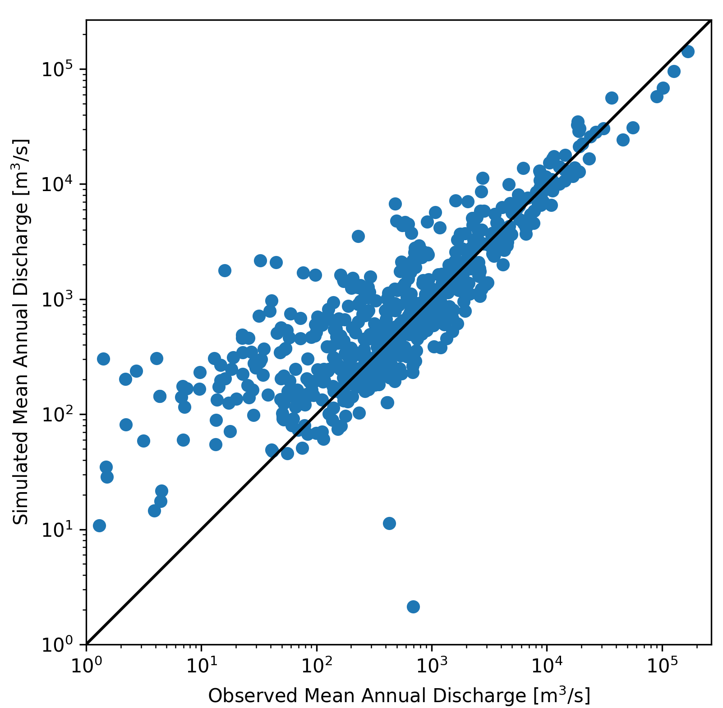
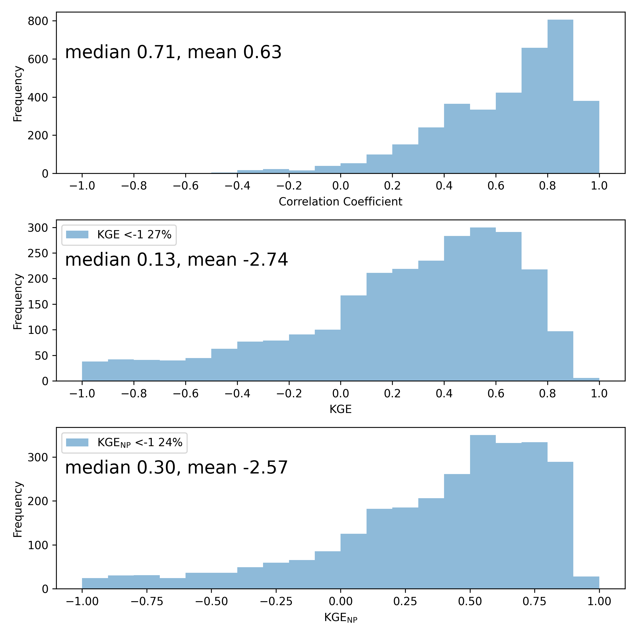
Calibration of global hydrological models
601 GRDC stations
Why glaciers?
Coupling method
Results (Basins)
Results (Global)
Challenges

Slide 38
References
Burek, P., Satoh, Y., Kahil, T., Tang, T., Greve, P., Smilovic, M., . . . Wada, Y. (2020). Development of the community water model (CWatM v1. 04) a high-resolution hydrological model for global and regional assessment of integrated water resources management. Geoscientfiic Model Development, 13 (7), 3267-3298.
Caceres, D., Marzeion, B., Malles, J. H., Gutknecht, B. D., Müller Schmied, H., & Döll, P. (2020). Assessing global water mass transfers from continents to oceans over the period 1948{2016. Hydrology and Earth System Sciences, 24 (10), 4831-4851.
Hock, R., Bliss, A., Marzeion, B., Giesen, R. H., Hirabayashi, Y., Huss, M., Radi´c, V., and Slangen, A. B.: GlacierMIP–A model intercomparison
of global-scale glacier mass-balance models and projections, J. Glaciol., 65, 453–467, 2019.
Hanus, S., Schuster, L., Burek, P., Maussion, F., Wada, Y., & Viviroli, D. (2024). Coupling a large-scale glacier and hydrological model (oggm v1.5.3 and cwatm v1.08) – towards an improved representation of mountain water resources in global assessments. EGUsphere, 2024 , 1–31. Retrieved from https://egusphere.copernicus.org/preprints/2024/egusphere-2023-2562/ doi: 10.5194/egusphere-2023-2562
Huss, M. and Farinotti, D.: Distributed ice thickness and volume of all glaciers around the globe, J. Geophys. Res-Earth, 117, 2012.
Huss, M., & Hock, R. (2018). Global-scale hydrological response to future glacier mass loss. Nature Climate Change, 8 (2), 135-140.
Marzeion, B., Hock, R., Anderson, B., Bliss, A., Champollion, N., Fujita, K., Huss, M., Immerzeel, W. W., Kraaijenbrink, P., Malles, J.-H., et al.: Partitioning the uncertainty of ensemble projections of global glacier mass change, Earth’s Future, 8, e2019EF001 470, 2020.
Maussion, F., Butenko, A., Champollion, N., Dusch, M., Eis, J., Fourteau, K., . . . others (2019). The open global glacier model (oggm) v1. 1. Geoscientific Model Development, 12 (3), 909-931.
Pfeffer, W. T., Arendt, A. A., Bliss, A., Bolch, T., Cogley, J. G., Gardner, A. S., Hagen, J.-O., Hock, R., Kaser, G., Kienholz, C., et al.: The Randolph Glacier Inventory: a globally complete inventory of glaciers, J. Glaciol., 60, 537–552, 2014.
Rounce, D. R., Khurana, T., Short, M. B., Hock, R., Shean, D. E., and Brinkerhoff, D. J.: Quantifying parameter uncertainty in a large-scale glacier evolution model using Bayesian inference: application to High Mountain Asia, J. Glaciol., 66, 175–187, 2020.
Schuster, L., Rounce, D. R., and Maussion, F.: Glacier projections sensitivity to temperature-index model choices and calibration strategies, Ann. Glaciol., p. 1–16, https://doi.org/10.1017/aog.2023.57, 2023.
Stahl, K., Weiler, M., Kohn, I., Freudiger, D., Seibert, J., Vis, M., ... & Bohm, M. (2016). The snow and glacier melt components of streamflow of the river Rhine and its tributaries considering the influence of climate change. Synthesis Report I-25, International Commission for the Hydrology of the Rhine Basin, Lelystad.
Stahl, K., Weiler, M., van Tiel, M., Kohn, I., Hänsler, A., Freudiger, D., ... & Moretti, G. (2022). Impact of climate change on the rain, snow and glacier melt components of streamflow of the river Rhine and its tributaries. CHR report n I-28. International Commission for the Hydrology of the Rhine basin (CHR), Lelystad.
Werder, M. A., Huss, M., Paul, F., Dehecq, A., and Farinotti, D.: A Bayesian ice thickness estimation model for large-scale applications, J. Glaciol., 66, 137–152, 2020.
Wiersma, P., Aerts, J., Zekollari, H., Hrachowitz, M., Drost, N., Huss, M., Sutanudjaja, E. H., and Hut, R.: Coupling a global glacier model to a global hydrological model prevents underestimation of glacier runoff, Hydrol. Earth Syst. Sci., 26, 5971–5986, https://doi.org/10.5194/hess-26-5971-2022, 2022.
Why glaciers?
Coupling method
Results (Basins)
Results (Global)
Challenges

