Slide 1
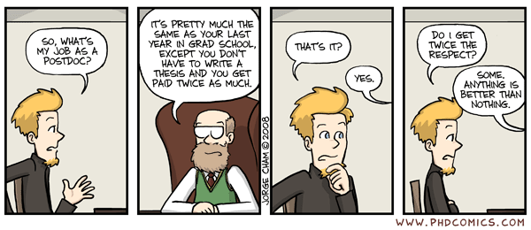
From PhD to Postdoc
…how it works…

Slide 2
From PhD to Postdoc
…if you decide to stay in Academia…
During the PhD:
Publish as many papers as possible
Present your work at conferences/workshops
Build a network of people that is related to your work
Keep contacts
Apply to your preferred Postdoc position(s) 6mnts -1 yr before your defense
How to find/apply for a Postdoc:
Spot the institutions (Universities, labs etc) that focus on what you are doing
Find out if they offer a postdoctoral program
Read carefully the prerequisites and what the program offers
Get in touch with current or past postdocs/employees and ask for their experience.
Apply! (better to apply to more than one)

Slide 3
Personal tips
Know the person you are going to work for
Visit at least once before you apply (visit the lab, get in touch with the personnel)
Find out about the travel budget that the program offer. You will need to go to conferences to present your work
Choose a country/city/place that you like and feels right for you (your life will be there for the next 1-2-3…or more years
…in view of the competition you need to be
knowledgeable and very motivated

Slide 6
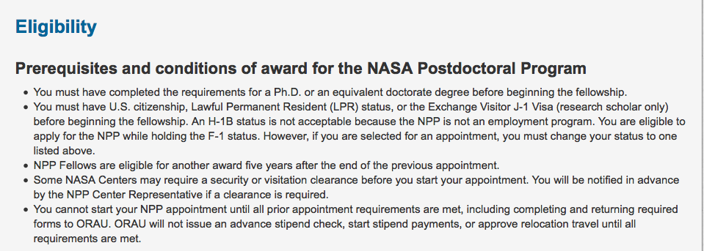

Slide 7
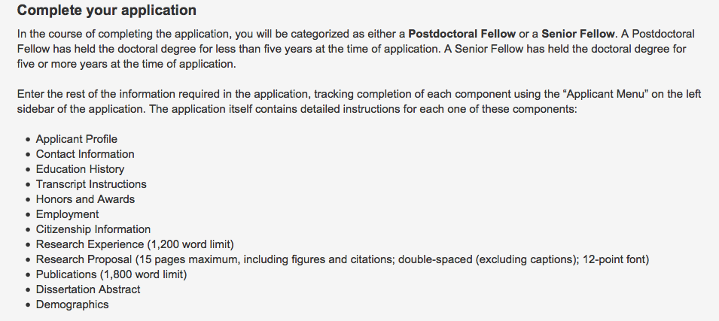

Slide 9
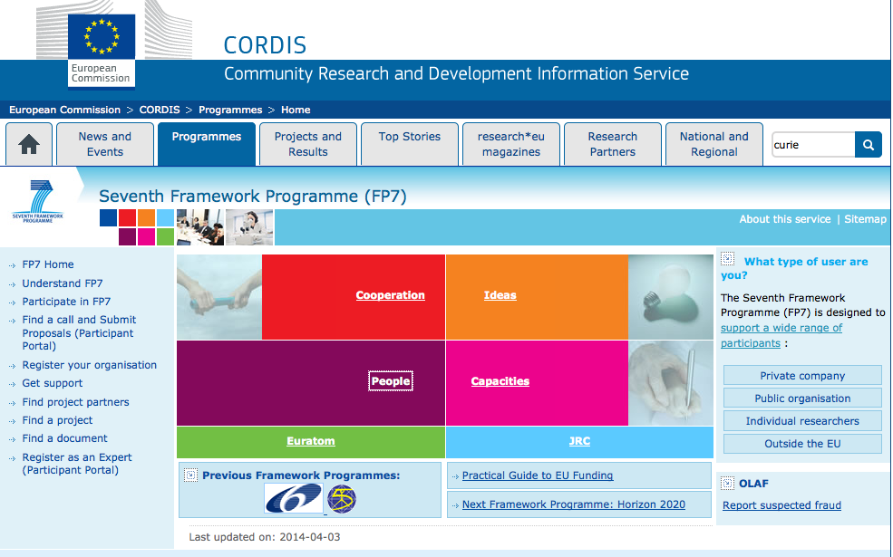
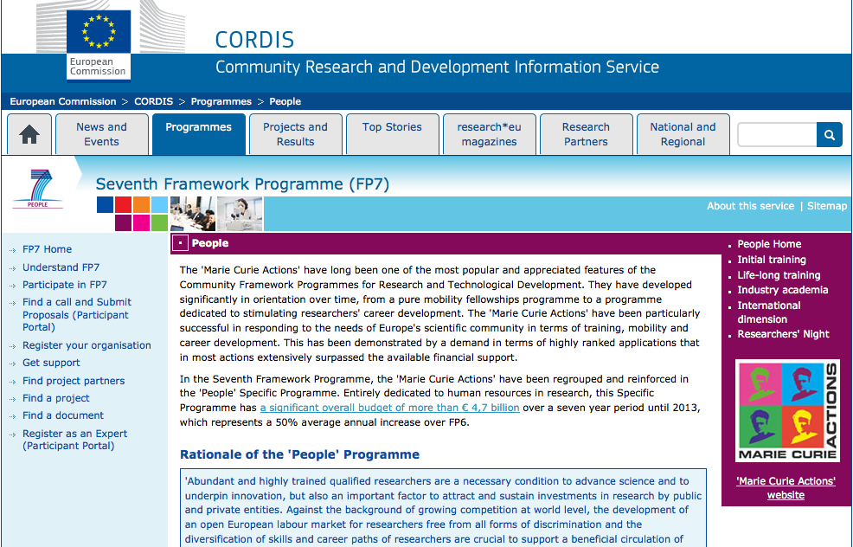
Marie Curie Fellowship

